Slide 1
TITANIC DATA ANALYSIS
Spring 2022 | CS 555 Mohamed Faadil

Slide 2
TABLE OF CONTENTS
1.
3.
2.
4.
INTRODUCTION
LOGISTIC MODEL
Dataset description
Research Scenario
Significant Test using ANCOVA
Model Assessment
PREPROCESSING & EDA
SUMMARY
Data Pre-processing
Exploratory Data Analysis
Conclusion

Slide 3
Introduction
Dataset
This is the Titanic dataset consisting of 891 rows and 10 columns before preprocessing
Attribute Information
survival : 0 = No, 1 = Yes
pclass : the ticket class with values; 1 = 1st, 2 = 2nd, 3 = 3rd
sex: Female or Male
Age: Age in years
sibsp: # of siblings / spouses aboard the Titanic
parch: # of parents / children aboard the Titanic
ticket: Ticket number
fare: Passenger fare
cabin: Cabin number
embarked: Port of Embarkation with values; C = Cherbourg, Q = Queenstown, S = Southampton
Research Scenario
Create a model that predicts which passengers survived the Titanic shipwreck.
Build a predictive model that answers the question: “what sorts of people were more likely to survive?” using passenger data (ie name, age, gender, socio-economic class, etc).
Which of the features seem to have a significant influence (significance level(α) = 0.05) on an individual who survived the sinking?
Do these features still have significant influence, after adjusting for relevant covariants(age, gender…)?
How good is our classification model (i.e., how accurately does our model predict that an individual is going to survive or not)?

Slide 4
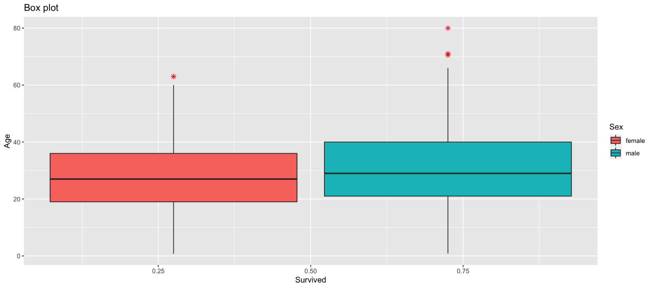
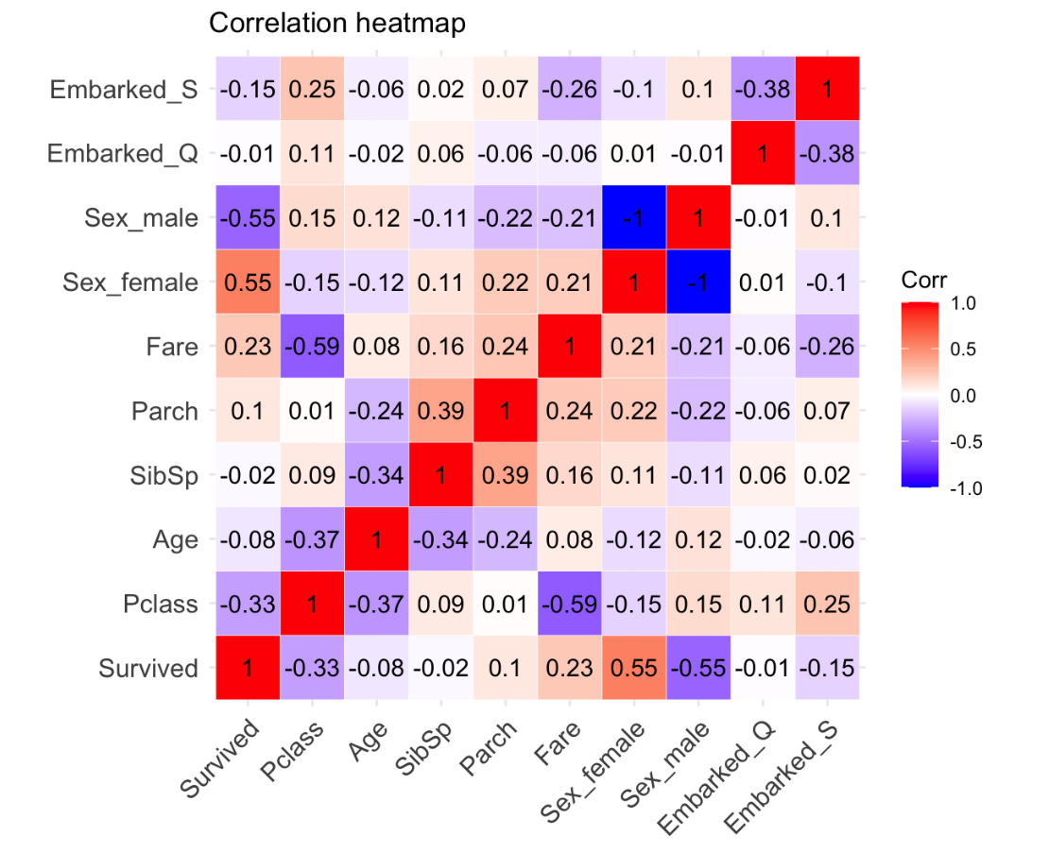
Preprocessing & EDA
Preprocessing
I selected the most suitable attributes and dropped others and NA values. Thus, reducing our dataset to 500 rows while retaining the meaningful properties of the original data necessary for the classification.
Created dummy variables on Sex and Embarked columns
Exploratory Data Analysis

Slide 5
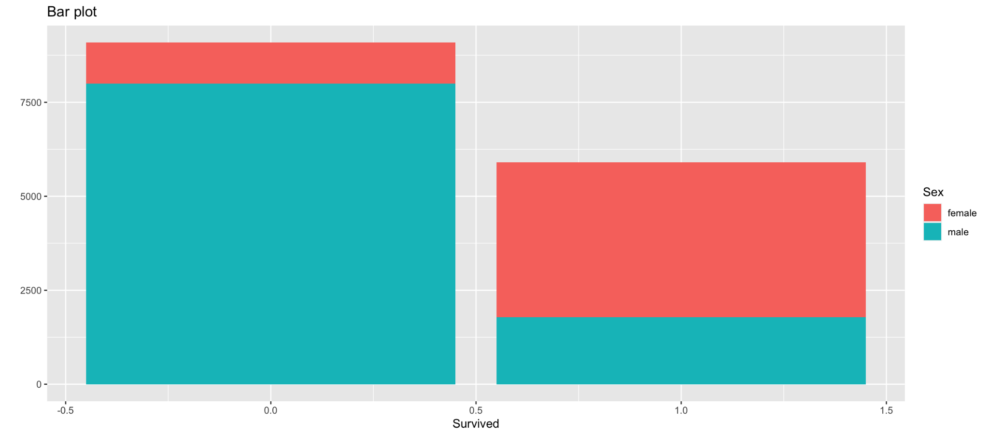
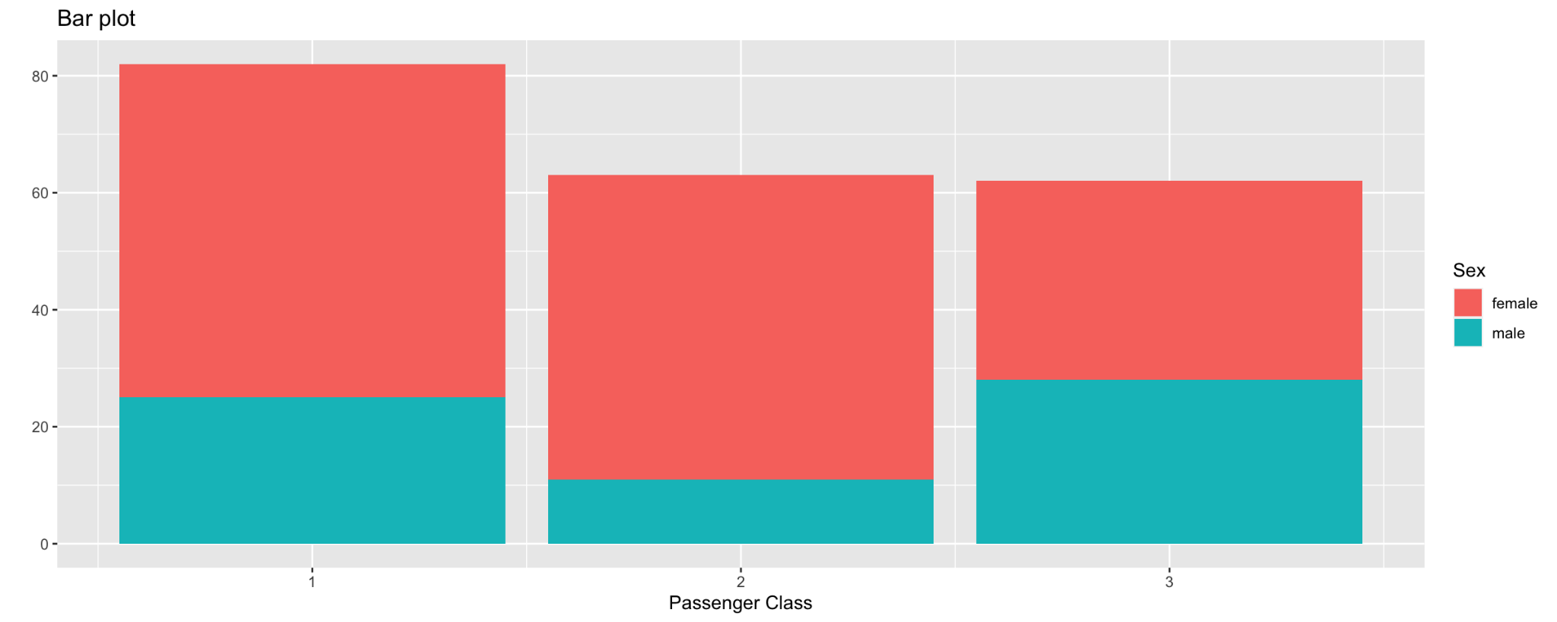
Preprocessing & EDA
Exploratory Data Analysis

Slide 6
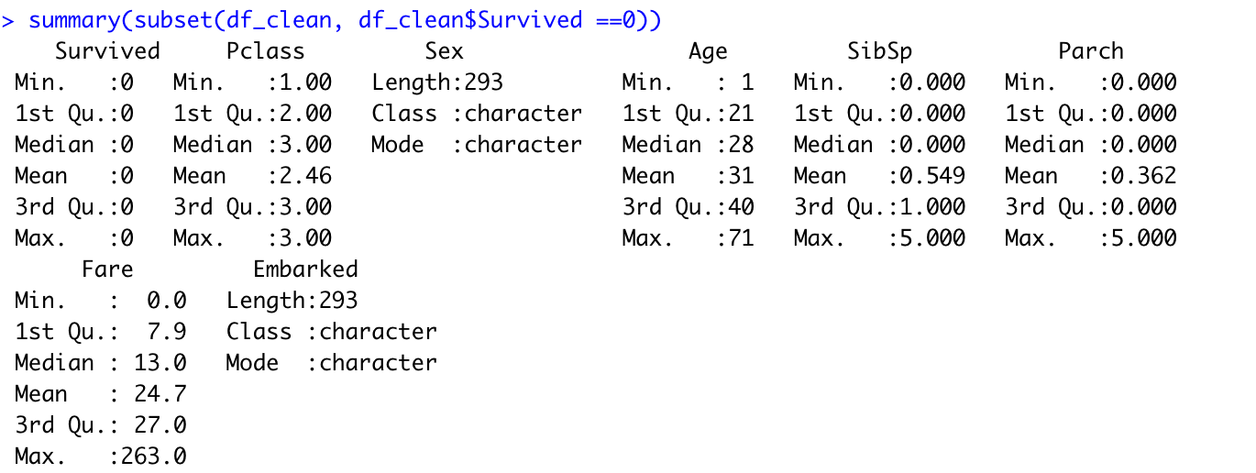
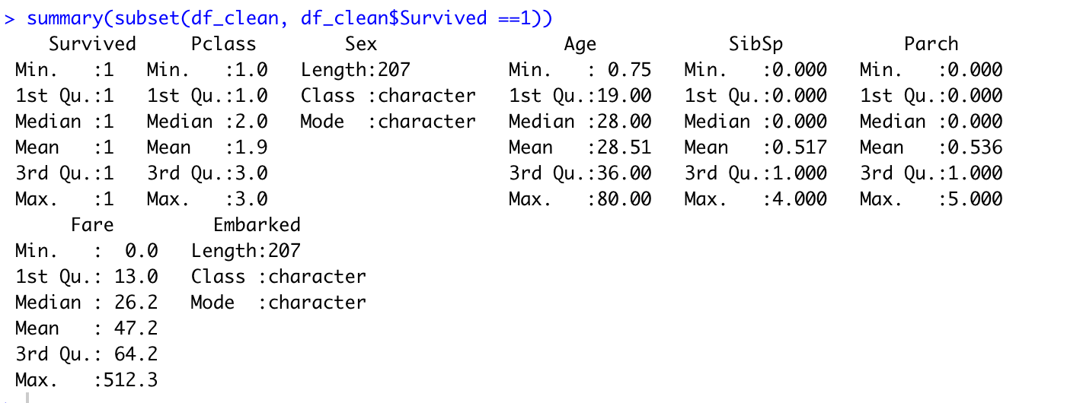
Preprocessing & EDA

Slide 7
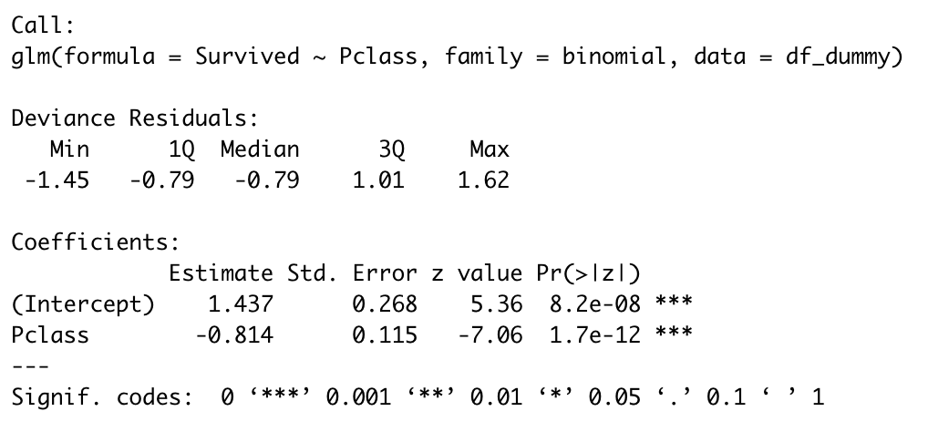
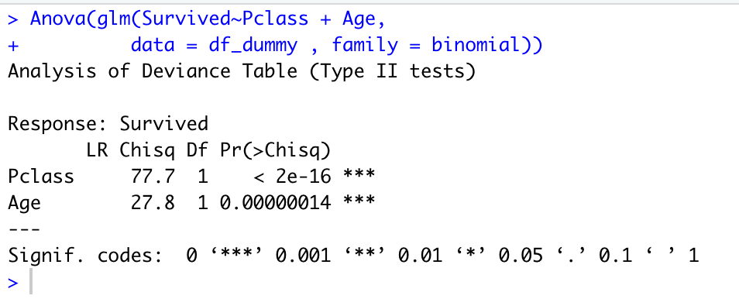
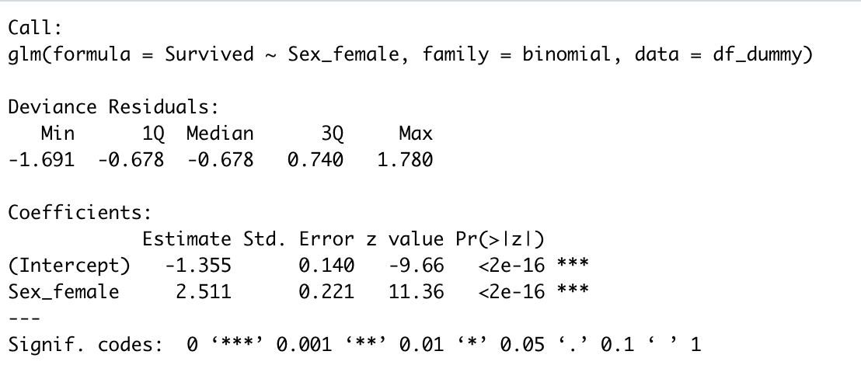
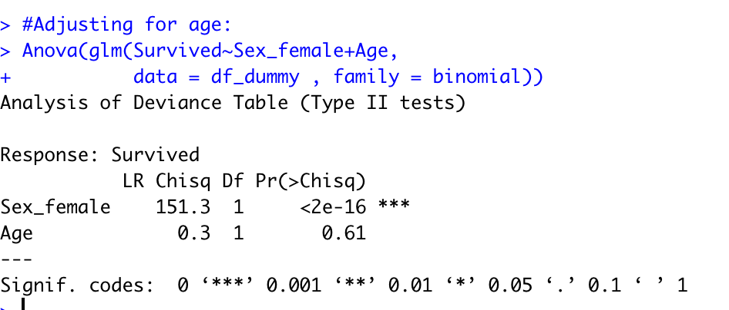
Building logistic regression classification models
Passenger Class
Passenger Class - Adjusting for age
Sex_Female
Sex_Female - Adjusting for age

Slide 8
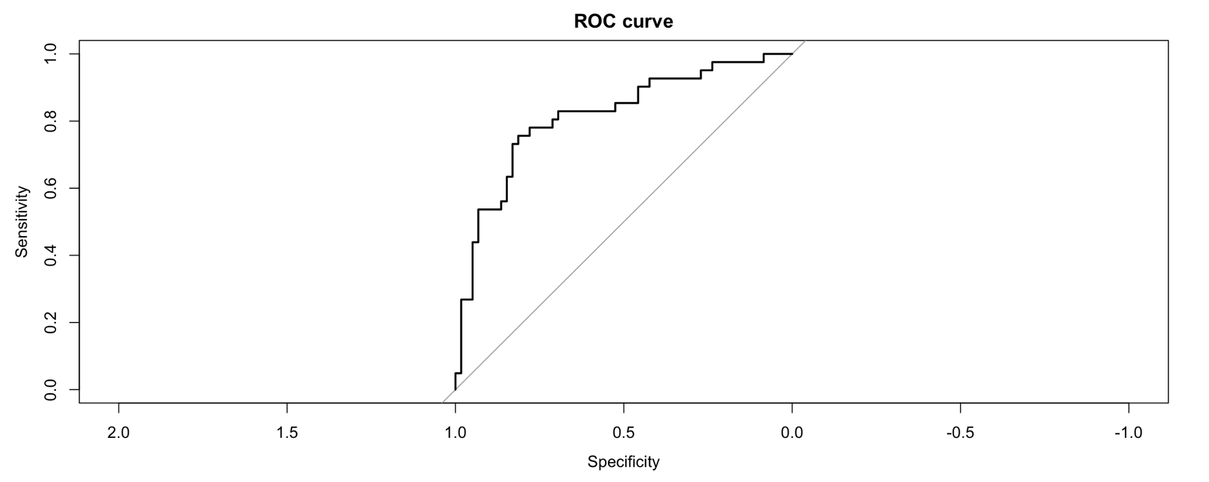
Building logistic regression classification models
Logistic Regression model
79%
ROC curve 0.815
Confusion Matrix
No | Yes | class
48 | 10 | NO
11 | 31 | YES

Slide 9
Conclusion
We conclude that Passenger Class, gender, fare were the significant parameters in survival.
Initially, the female gender parameter showed some sort of correlation with passenger survival.
The age wasn’t a significant predictor if gender is the predictor.
Logistic regression model accuracy of 79%
The area under the ROC curve was 0.815.

