Slide 1

IoT Forensic Gateway
Automated Real Time Forensic Gateway & Predictive Network Intrusion Detection System
Faaiza Mir (2503500)
Dua Masood (2503525)
Sana Rahat (2503539)
Afshan Nawaz (2503544)

Slide 2
Table of Contents
The IoT Forensic Gap
System Architecture Overview
Data Pipeline
Edge Node Configuration
Asynchronous Packet Ingestion
Use Case Diagram
Activity Diagram
Component Diagram
Signature-Based Intrusion Detection
Core Python Libraries
Data Flow Diagram
SQLite Relational Evidence Store
Why SQLite?
Web Dashboard (dashboard.py)
Test Scenarios & Comparative Edge
Future Enhancements & Conclusion

Slide 3
The IoT Forensic Gap
Why Traditional Forensics Fails
The Critical Gap
IoT devices lack persistent storage and traditional file systems, making forensic imaging impossible. Operational data is purely transient when power is lost, evidence is gone permanently.
Tools like Wireshark and Zeek require manual intervention impractical at industrial scale
Stateless UDP protocols mean any missed packet is lost forever
No automated bridge between high-frequency telemetry and court-admissible preservation

Slide 4
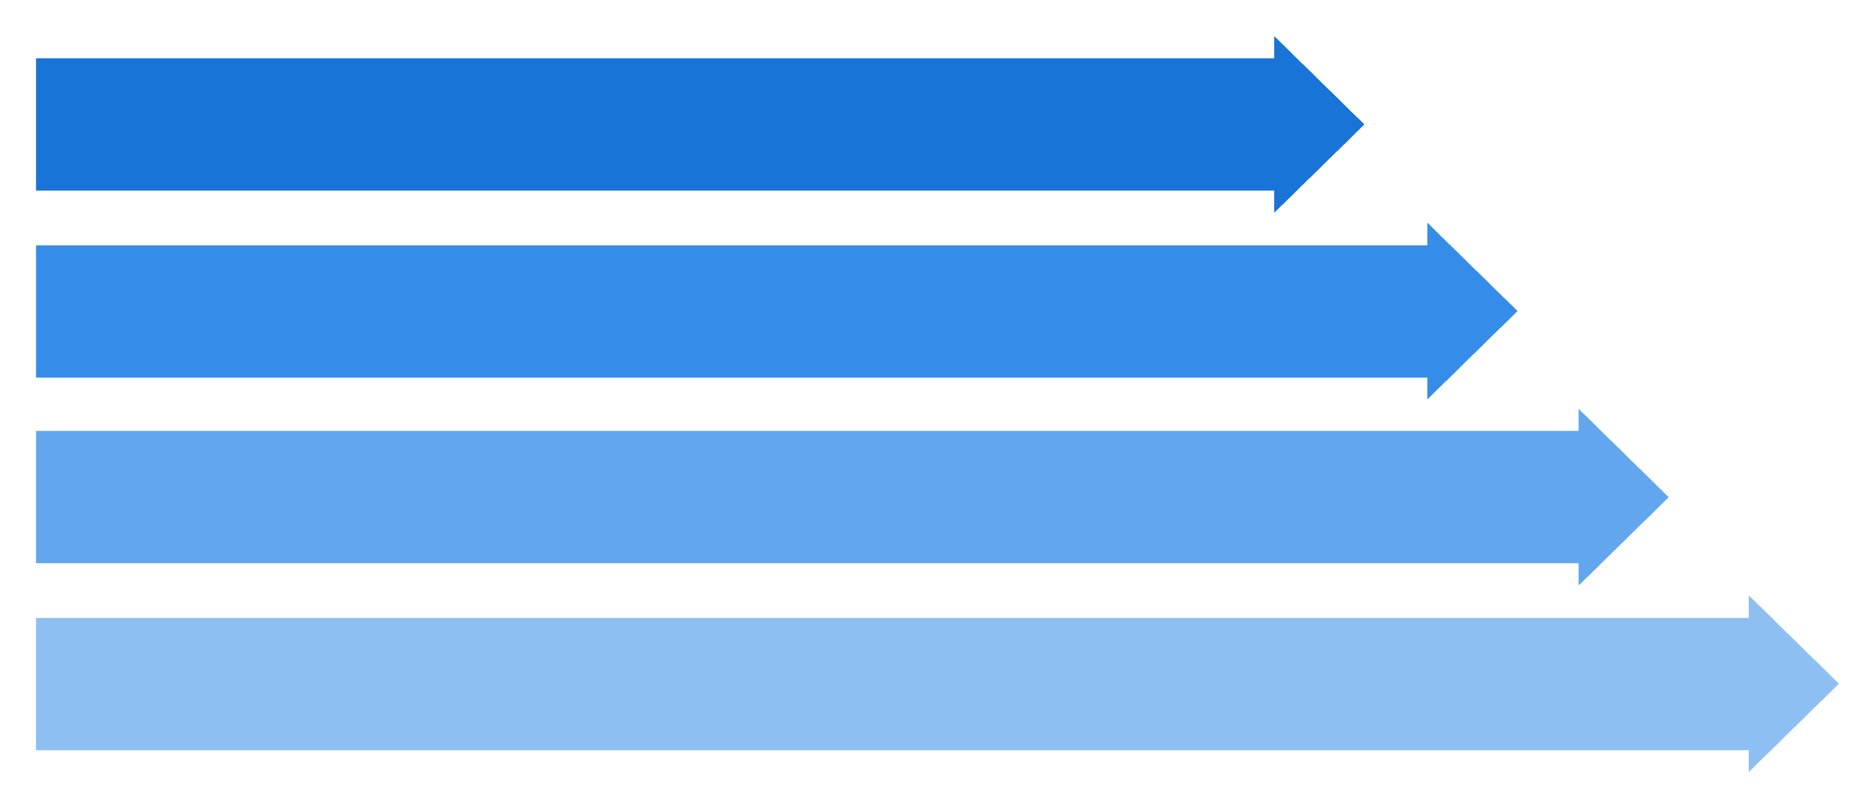
System Architecture Overview
Edge Layer: Lubuntu VMs
Gateway Core: Kali Linux
Persistence Layer: SQLite relational database
Administrative Layer: Web interface

Slide 5

Data Pipeline
UDP Transmission
UTC Timestamping & IP Metadata Mapping
Signature-Based IDS Evaluation
Indexed Review & Audit Readout
Asynchronous Socket Multiplexing
SHA-256 Cryptographic Fingerprinting
Atomic SQLite Database Commit

Slide 6
Edge Node Configuration
HVAC Sensor
Smart Lock
Light Controller
HVAC_Ctrl_01
Port 5000
Temperature and humidity telemetry streams
SmartLock_Zone_02
Port 5001
Access control and status tracking events
LightCtrl_Floor_01
Port 5002
Power load monitoring and consumption data

Slide 7

Asynchronous Packet Ingestion
sniffer.py | Non-Blocking Design
Cryptographic Integrity Sealing
Uses select.select() for socket multiplexing across all three ports simultaneously eliminating thread blocking and synchronization overhead entirely.
Every raw packet payload is immediately hashed using hashlib.sha256() at ingestion before any processing or storage occurs.
Captures raw UDP payloads in real time
Maps source IPs for device identification
Applies UTC timestamps for chain of custody compliance
This creates a mathematically tamper evident link between the stored record and the original intercepted data, satisfying court admissibility requirements.

Slide 8
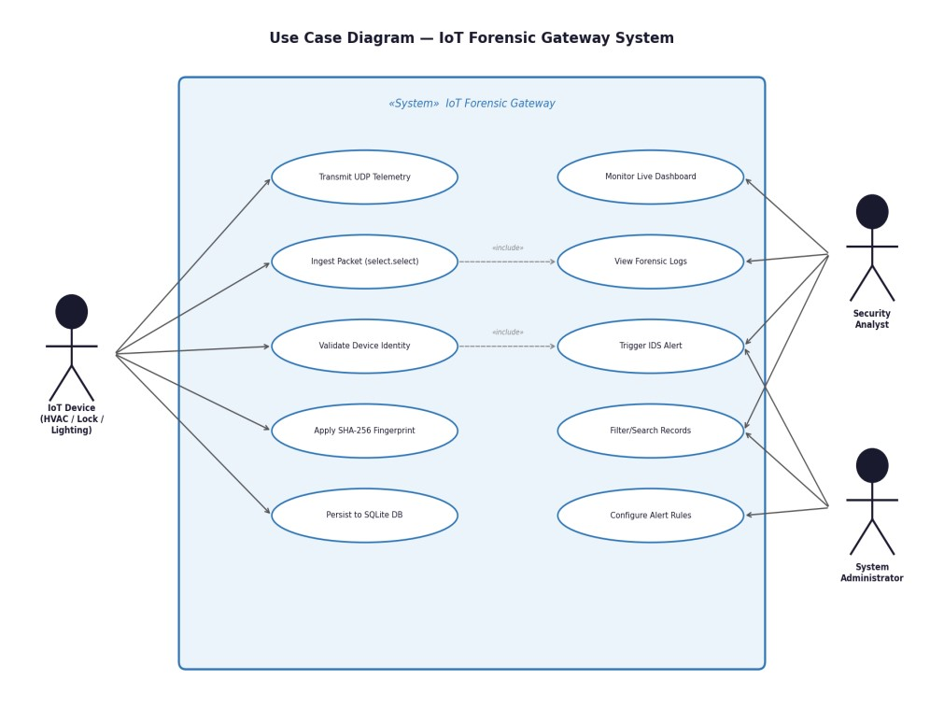
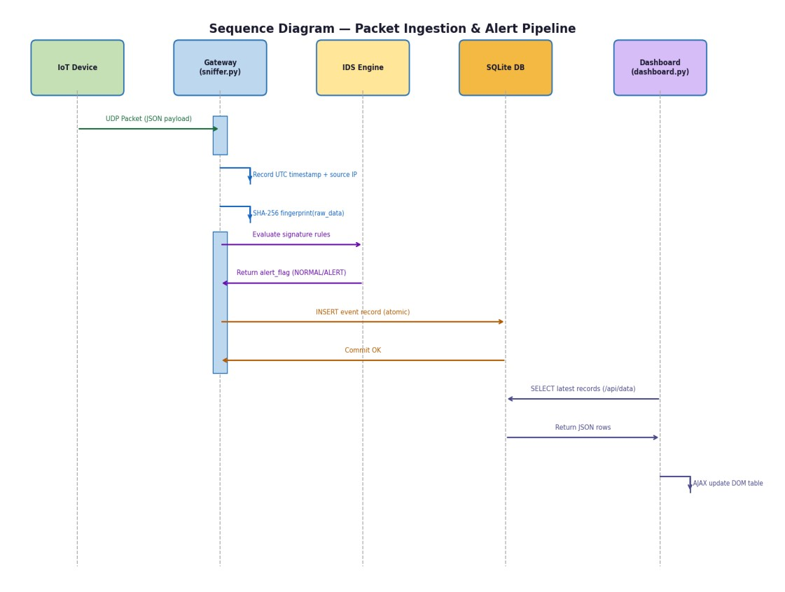
Use Case Diagram
Activity Diagram

Slide 9
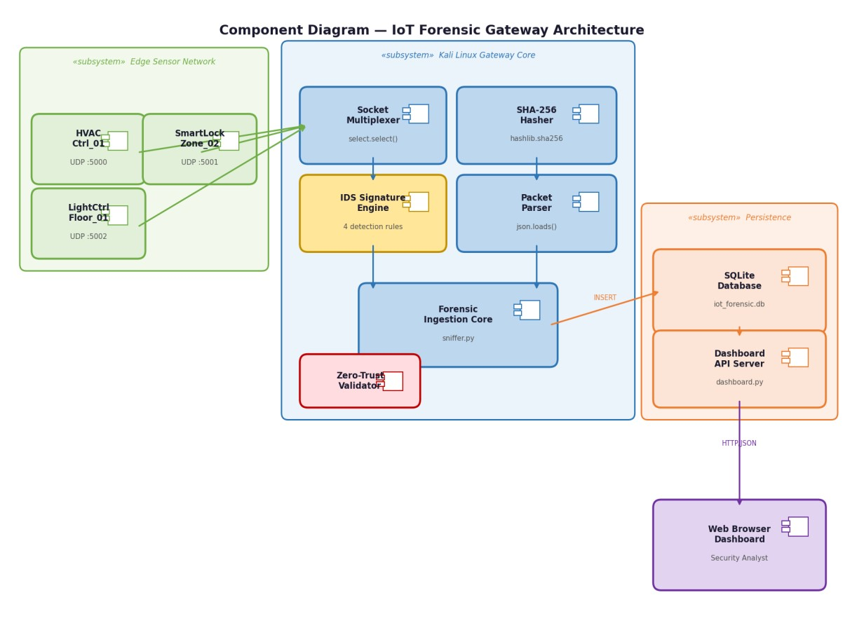
Implementation
Component Diagram

Slide 10
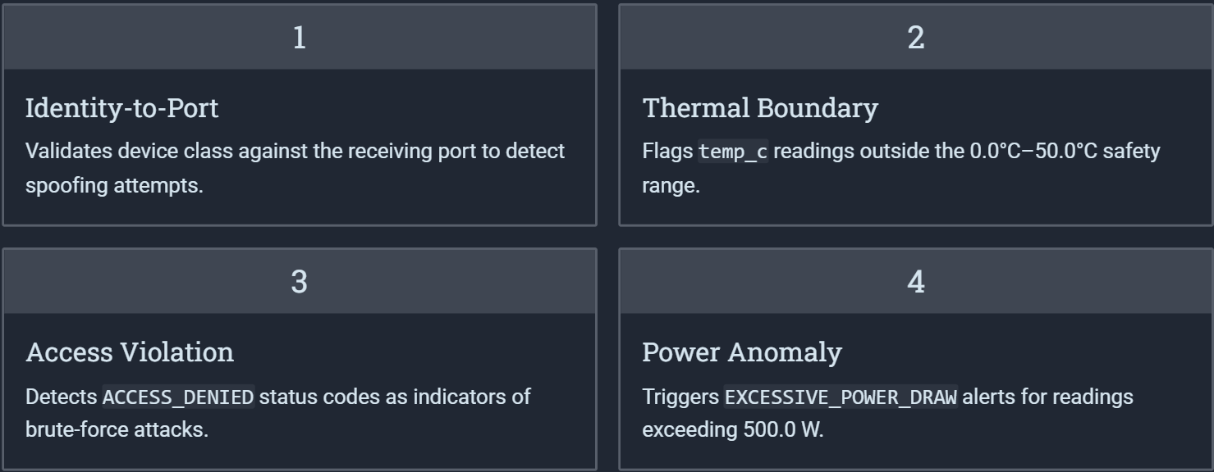
Signature-Based Intrusion Detection
Four deterministic rules evaluate every packet at the gateway core, flagging anomalies before data is persisted.

Slide 11
Core Python Libraries
socket
select
hashlib
Establishes UDP connectivity and port binding for endpoint communication.
Performs non-blocking I/O multiplexing; critical for handling simultaneous sensor streams.
Generates SHA-256 digests to ensure cryptographic integrity of evidence.
sqlite3
json
datetime
Enables ACID-compliant, atomic storage for tamper-evident forensic records.
Serializes and deserializes structured telemetry payloads for analysis.
Provides standardized, high-precision UTC timestamps for forensic timelines.
http.server
logging
struct
Hosts the administrative dashboard for real-time SOC monitoring.
Tracks system status and records real-time forensic alerts.
Facilitates binary data parsing and packet structure handling.

Slide 12
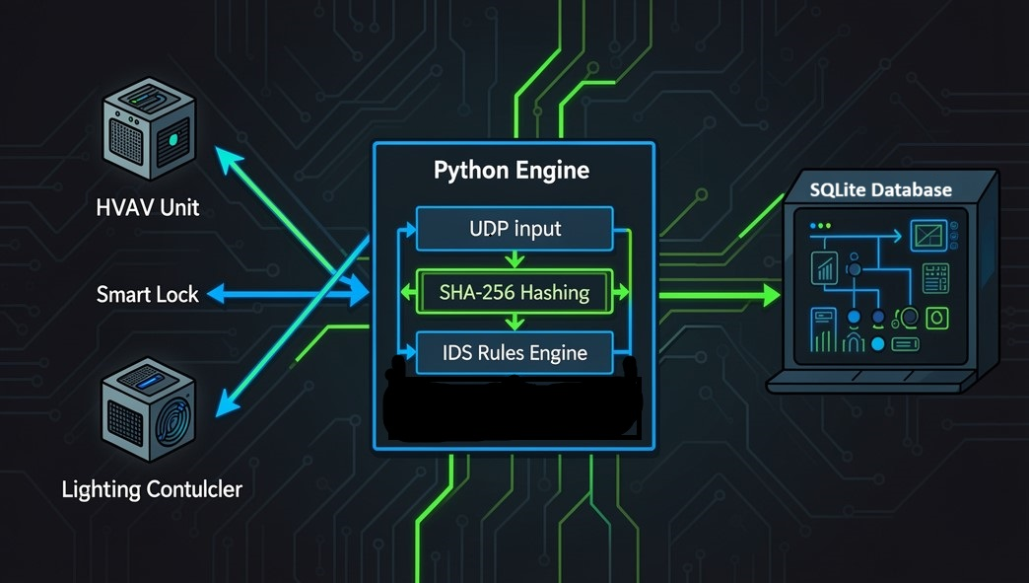
Data Flow Diagram

Slide 13
SQLite Relational Evidence Store
Why SQLite?
Evidence Schema
Field
Purpose
Lightweight & Serverless Architecture
id
Unique record identifier
Atomic Transaction Integrity
timestamp
UTC ingestion time
source_ip
Originating device IP
Zero External Dependencies
device_id
Logical device class
raw_data
Raw UDP payload
Corruption-Resistant Logging
sha256_hash
Integrity seal
Scalable Structured Querying
alert_flag
IDS rule trigger

Slide 14
Dashboard & Zero-Trust Validation
Web Dashboard (dashboard.py)
Zero-Trust Network Philosophy
Server Architecture
Every packet is treated as potentially adversarial until identity checks pass. A known IP sending HVAC data to a Smart Lock port triggers:
CRITICAL: PORT_IDENTITY_MISMATCH
Powered by Python’s http.server for lightweight back-end handling.
Asynchronous Communication
Utilizes JavaScript Fetch API for real time AJAX updates.
Security & Sanitization
Protects the interface against HTML/XSS injection attacks.

Slide 15
Test Scenarios & Comparative Edge
Test Case
Scenario
Outcome
TC-01
Normal telemetry
Stored, no flags
TC-02
Temp anomaly
OUT_OF_BOUNDS_TEMP
TC-03
Identity spoof
PORT_IDENTITY_MISMATCH
TC-04
Brute force
BRUTE_FORCE_SUSPECTED
Comparative Advantage
Performance Highlights
Real-time packet ingestion
Automated SHA-256 sealing
Signature-based IDS
Persistent local structured storage
Non-Blocking Multiplexing (select.select())
Zero Third-Party Dependencies
Resource-Efficient Architecture

Slide 16



Future Enhancements & Conclusion
ML Anomaly Detection
Multi-Gateway Federation
Enterprise SIEM Integration
Transition from signature-based rules to trained models for novel attack signatures.
Distributed gateway nodes for geographically scaled industrial environments.
Format logs for Splunk and IBM QRadar for enterprise security workflows.

Slide 17
THANKYOU
Any Questions ?

