Slide 1
TEAM C / PROJECT OVERVIEW
Supply Chain
Visibility System
with Optimization Analytics
From vessel signals to operational visibility
Faaiz Hamid · Pranav Kadam · Prashant Shukla
Rahul · Varun
POWER BI
GOOGLE COLAB
POWER QUERY + DAX
AIS POSITION TRAIL
1.10M OBSERVATIONS · ~13K VESSELS
Notes:
Source: latest_documentation.pdf, pp. 1–2, 14–15. Suggested speaking time: about 35 seconds.

Slide 2
PROJECT INTRODUCTION
02
Visibility means making vessel activity legible
WHY MONITOR THESE SIGNALS?
SUPPLY-CHAIN VISIBILITY
Where vessels are,
how they are moving,
and what their ETA says.
MOVEMENT
ARRIVAL
Compare moving and stopped observations
Review ETA patterns by time and destination
This project uses AIS observations and weather fields to describe transport activity across vessels and destinations.
ACTIVITY
CONTEXT
See where records concentrate across vessel types and clusters
Explore vessel speed alongside weather fields
Scope: preparation, a Power BI model, KPI measures and eight linked analytical pages.
SUPPLY CHAIN VISIBILITY / TEAM C
02 / 16
Notes:
Source: latest_documentation.pdf, pp. 2, 14–15. Suggested speaking time: about 40 seconds.

Slide 3
PROBLEM STATEMENT & OBJECTIVES
03
Five review questions organize the raw AIS stream
PROBLEM
Point-in-time vessel observations are difficult to compare without a common model, measures and filters.
01
02
03
04
05
Transportation activity
Cargo movement
Delivery performance
Supplier / transport views
Operational efficiency
Records, speed and status
Moving records by destination
ETA by hour, destination and type
Explore carefully labeled proxies
Compare destination patterns
BOUNDARY
The documented work is interactive descriptive analytics; it does not establish a route-optimization algorithm or causal findings.
SUPPLY CHAIN VISIBILITY / TEAM C
03 / 16
Notes:
Source: latest_documentation.pdf, pp. 2, 14, 21, 25–29. Suggested speaking time: about 45 seconds.

Slide 4
DATASET OVERVIEW
04
Each row is one vessel observation at a point in time
1,098,937
~13,000
8
SOURCE DATA
cleaned observations
unique vessels
destination clusters
AIS Data
Complete Weather
Fact_Vessel rows
MMSI identifiers
Clusters 0–7
AIS = Automatic Identification System
Ships transmit identity, time, location, speed, course and other operational information. This dataset combines vessel movement with weather fields.
FIELD GROUPS
IDENTITY
MMSI · vessel name
TIME
BaseDateTime
POSITION
LAT · LON
MOVEMENT
SOG · status
ARRIVAL
ETA · destination cluster
WEATHER
Wind · visibility · temperature
SUPPLY CHAIN VISIBILITY / TEAM C
04 / 16
Notes:
Source: latest_documentation.pdf, pp. 2–4. Suggested speaking time: about 45 seconds. Exact cleaned row count; approximate vessel count.

Slide 5
DATA CLEANING & PREPARATION
05
Preparation makes raw observations consistent for analysis
DATA PREPARATION PIPELINE
1
2
3
4
5
6
AIS + weather
Google Colab
Power Query
Derived fields
Power BI model
DAX + visuals
Source
Clean raw file
Type checks
Status + speed
Fact + dimensions
KPIs + slicers
DERIVED FIELD
Operational_Status
Speed_Category
Moving / Stopped
Stopped · Slow · Moderate · Fast
Numeric columns and timestamp fields were type-checked before loading into the Power BI model.
SUPPLY CHAIN VISIBILITY / TEAM C
05 / 16
Notes:
Source: latest_documentation.pdf, pp. 4–5, 15. Suggested speaking time: about 45 seconds.

Slide 6
DATA MODEL & KPI DEVELOPMENT
06
A star-schema-style model enables reusable filtering and measures
dim_Vessel
Fact_Vessel
dim_Destination
1 → many
1 → many
MMSI · name · type · cargo
Time · location · speed · ETA
weather · status · distance
Cluster · coordinates
DAX MEASURES SUMMARIZE OBSERVATIONS
Total AIS records
Count rows
Unique vessels
Distinct MMSI
Average speed
Mean SOG_kmh
Total distance
Sum dist_km
Average ETA
Mean ETA_hours
Stopped %
Stopped ÷ total
The dimensions filter many observation rows in the central Fact_Vessel table.
SUPPLY CHAIN VISIBILITY / TEAM C
06 / 16
Notes:
Source: latest_documentation.pdf, pp. 6–9, 15. Suggested speaking time: about 50 seconds.

Slide 7
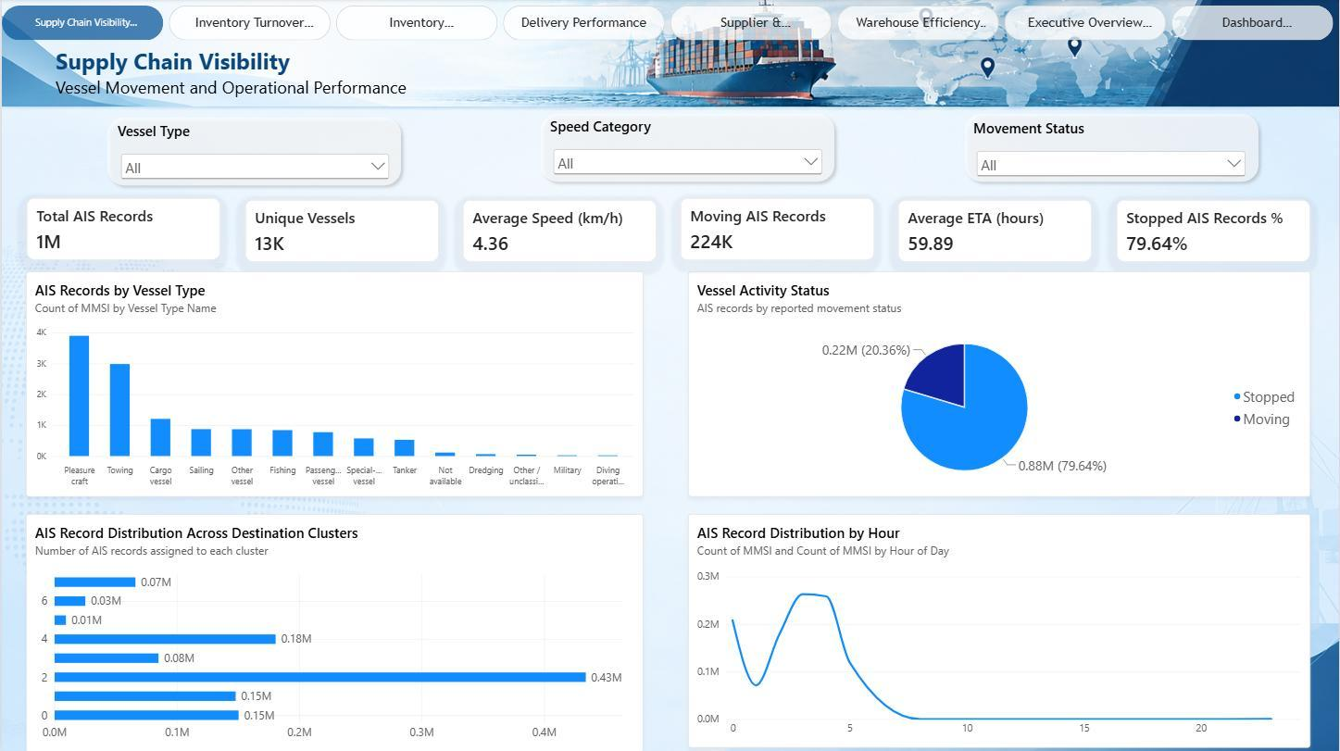
MILESTONE 1 · SUPPLY CHAIN VISIBILITY
07
Milestone 1 sets the vessel-movement baseline
SIX KPI CARDS · FOUR CHARTS · THREE SLICERS
1.1M
4.36 km/h
AIS observations
average speed
~13K unique vessels
Across records
79.64%
59.89 h
stopped
average ETA
~0.88M records
Overall context
Charts: vessel type · movement status · destination cluster · records by hour
Slicers: vessel type · speed category · movement status
HOURLY RECORDS
Peak ~0.26M near hours 3–4 · low ~0.07M near hour 1 · near zero from about hour 8 onward
SUPPLY CHAIN VISIBILITY / TEAM C
07 / 16
Notes:
Source: latest_documentation.pdf, pp. 9–10. Suggested speaking time: about 50 seconds. Screenshot reproduced from the PDF.

Slide 8
MILESTONE 1 · FINDINGS & CARGO MOVEMENT PROXY
08
The cargo “turnover” figure is a movement proxy
WHY NOT ACCOUNTING TURNOVER?
No inventory quantity, average inventory value or COGS is present in the AIS dataset.
224K
~3K
66.04
cargo movement records
active cargo vessels
records per active vessel
Moving AIS observations
Distinct moving vessels
Operational cargo-flow proxy
PROXY BY SPEED CATEGORY
Slow
33
Moderate
44
Fast
46
The denominator uses exact measure counts; approximate 224K and ~3K figures should not be divided to recreate 66.04.
SUPPLY CHAIN VISIBILITY / TEAM C
08 / 16
Notes:
Source: latest_documentation.pdf, pp. 11–14. Suggested speaking time: about 50 seconds. 66.04 is not an accounting inventory turnover ratio.

Slide 9
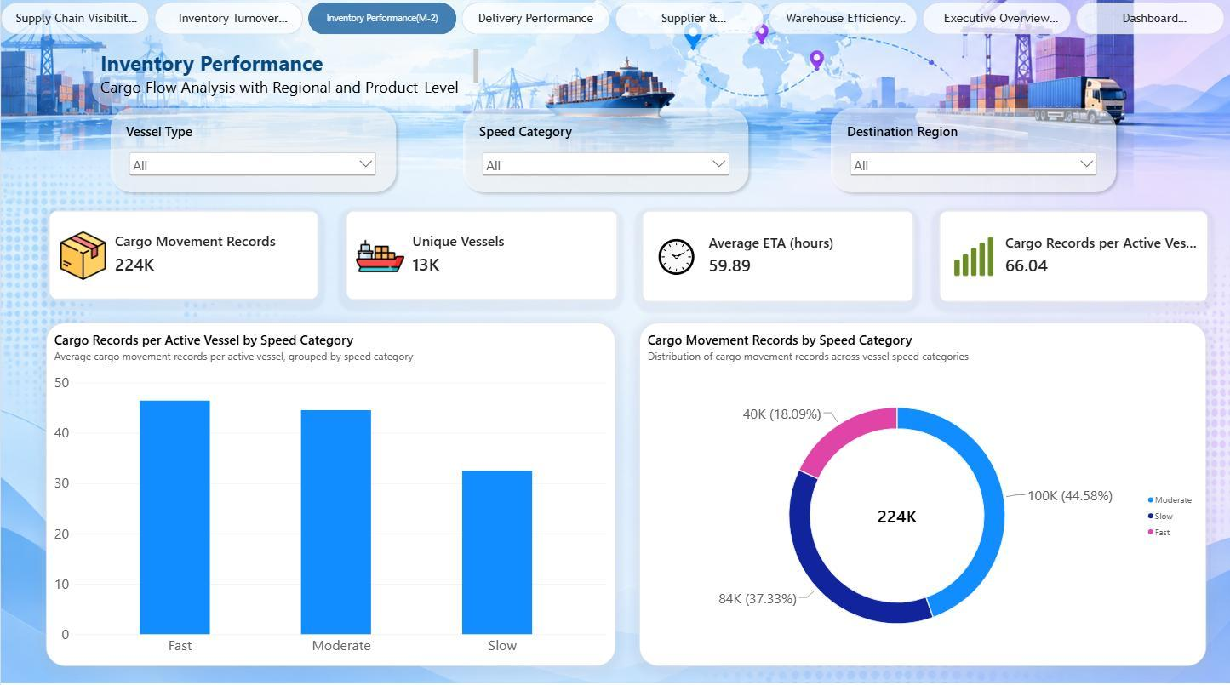
MILESTONE 2 · INVENTORY PERFORMANCE
09
Milestone 2 compares cargo flow across speed and destination
RECORDS BY SPEED CATEGORY
Moderate
100K · 44.58%
Slow
84K · 37.33%
Fast
40K · 18.09%
RECORDS PER ACTIVE VESSEL
224K
Slow
Moderate
Fast
moving cargo records
33
44
46
Destination-cluster proxy range: ~46–96
Not inventory stock turns.
SUPPLY CHAIN VISIBILITY / TEAM C
09 / 16
Notes:
Source: latest_documentation.pdf, pp. 16–17, 19. Suggested speaking time: about 50 seconds. Screenshot reproduced from the PDF.

Slide 10
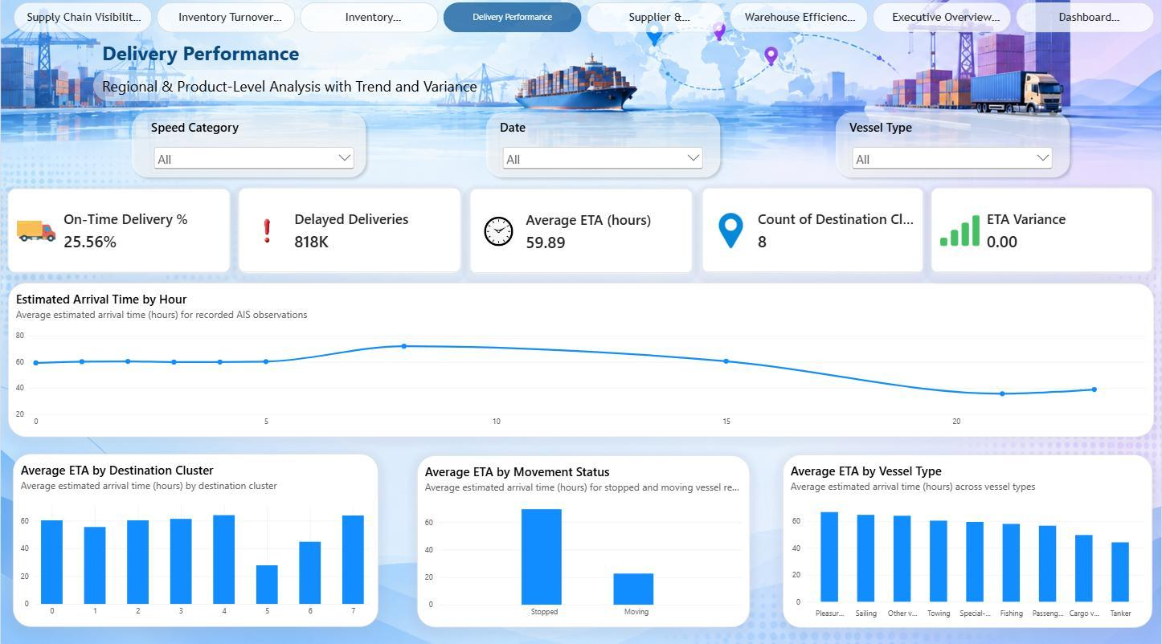
MILESTONE 2 · DELIVERY PERFORMANCE
10
Milestone 2 surfaces ETA variation and an ETA-based on-time indicator
DOCUMENTED ETA COMPARISONS
By destination
By movement status
Cluster 5
~28 h
Stopped ~70 h
Cluster 4
~64 h
Moving ~23 h
BY HOUR
ETA high ~72 h near hour 8
ETA low ~36 h near hour 21
ETA varies across these views; the dataset has no actual arrival timestamps, so these are not verified delivery outcomes.
25.56%
818K
on-time indicator
delayed records
ETA threshold
As documented
No causal explanation is established by these comparisons.
SUPPLY CHAIN VISIBILITY / TEAM C
10 / 16
Notes:
Source: latest_documentation.pdf, pp. 17–20. Suggested speaking time: about 55 seconds. On-time is based on an ETA threshold, not actual delivery timestamps. Screenshot reproduced from the PDF.

Slide 11
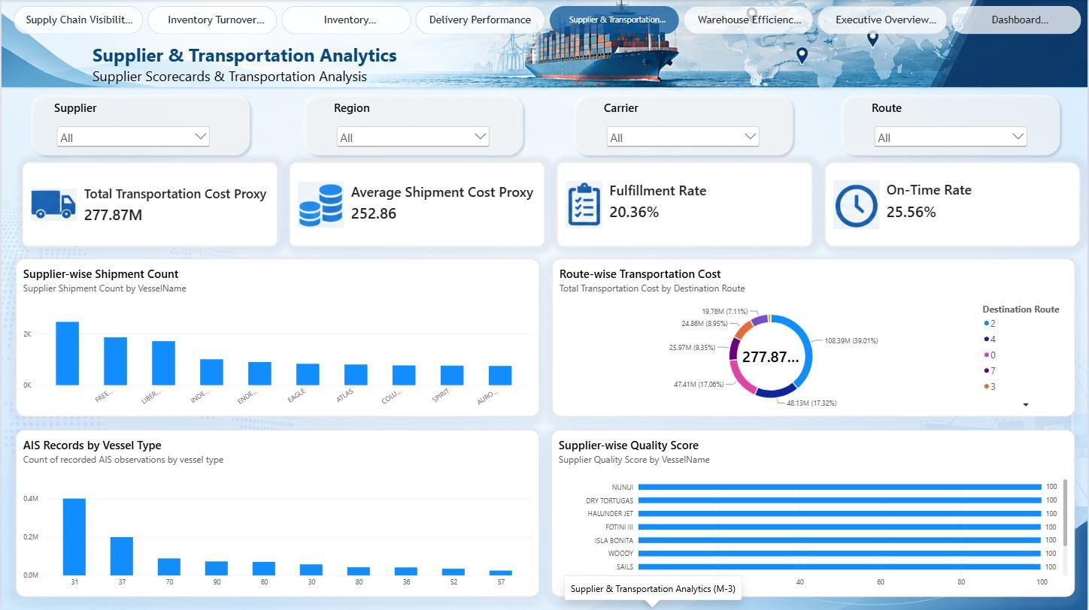
MILESTONE 3 · SUPPLIER & TRANSPORTATION ANALYTICS
11
Milestone 3 combines supplier and transportation proxy views
277.87M
transportation cost proxy
Distance-based; not monetary cost
252.86
average shipment cost proxy
No verified currency unit
20.36%
fulfillment / movement proxy
AIS movement share
PAGE STRUCTURE
25.56%
4 filters: supplier · region · carrier · route
on-time indicator
4 visuals: supplier activity · distance distribution · vessel type · ETA-based quality proxy
ETA threshold
Proxy labels are essential to interpreting this page.
SUPPLY CHAIN VISIBILITY / TEAM C
11 / 16
Notes:
Source: latest_documentation.pdf, pp. 21–24. Suggested speaking time: about 55 seconds. Screenshot reproduced from the PDF.

Slide 12
MILESTONE 3 · PROXY METRICS & INSIGHTS
12
Milestone 3 substitutions are useful for exploration, not business verification
BUSINESS CONCEPT
AIS FIELD USED
INTERPRETATION LIMIT
Supplier
Vessel Name
Vessel activity, not supplier identity
Carrier
Vessel Type
Category, not carrier performance
Region / route
Destination Cluster
No separate route field
Transport cost
Distance
Not monetary spend
Supplier quality
ETA score
Not a supplier quality rating
DOCUMENTED SIGNALS
Cluster 2
Vessel types
Quality score
~108.39M distance proxy (~39% of total)
Type 31 ~0.4M · Type 37 ~0.2M records
All dashboard vessels scored 100
ETA-based normalization can hide differences.
277.87M is a distance proxy; it is not actual shipment cost.
SUPPLY CHAIN VISIBILITY / TEAM C
12 / 16
Notes:
Source: latest_documentation.pdf, pp. 21–24. Suggested speaking time: about 50 seconds.

Slide 13
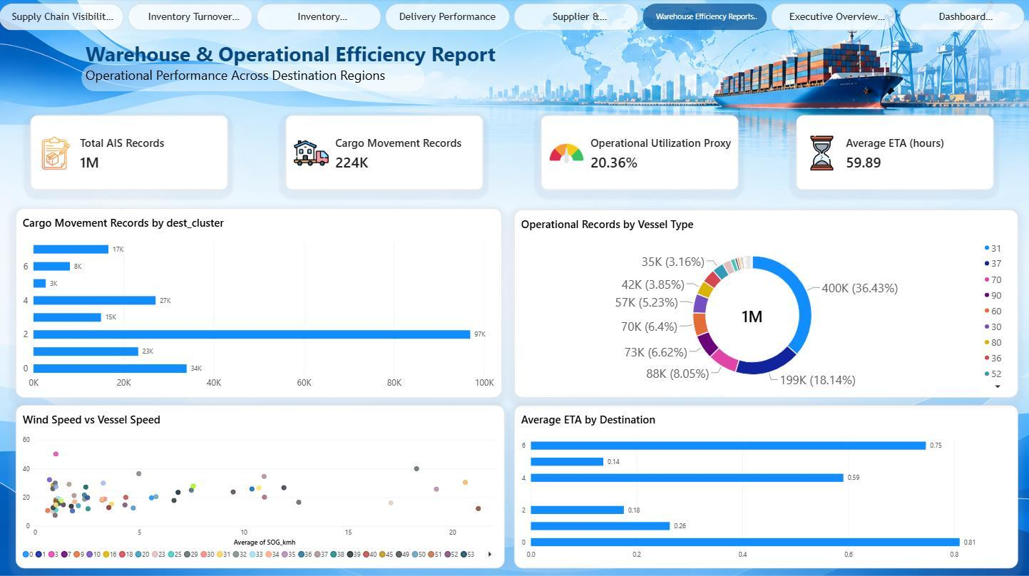
MILESTONE 4 · WAREHOUSE & OPERATIONAL EFFICIENCY
13
Milestone 4 views movement and ETA through an operational-efficiency lens
~1M
224K
AIS records
cargo movement
Rounded in report
Moving records
20.36%
59.89 h
utilization proxy
average ETA
Movement-based
Report-wide
MOVING RECORDS BY DESTINATION
Cluster 2
Cluster 0
Cluster 4
Cluster 5
97K
34K
27K
3K
Wind vs speed is exploratory, not causal. ETA by destination is reported on a scaled 0.14–0.81 scale, not in hours.
SUPPLY CHAIN VISIBILITY / TEAM C
13 / 16
Notes:
Source: latest_documentation.pdf, pp. 25, 29. Suggested speaking time: about 50 seconds. No conventional warehouse stock or capacity measures are present. Screenshot reproduced from the PDF.

Slide 14
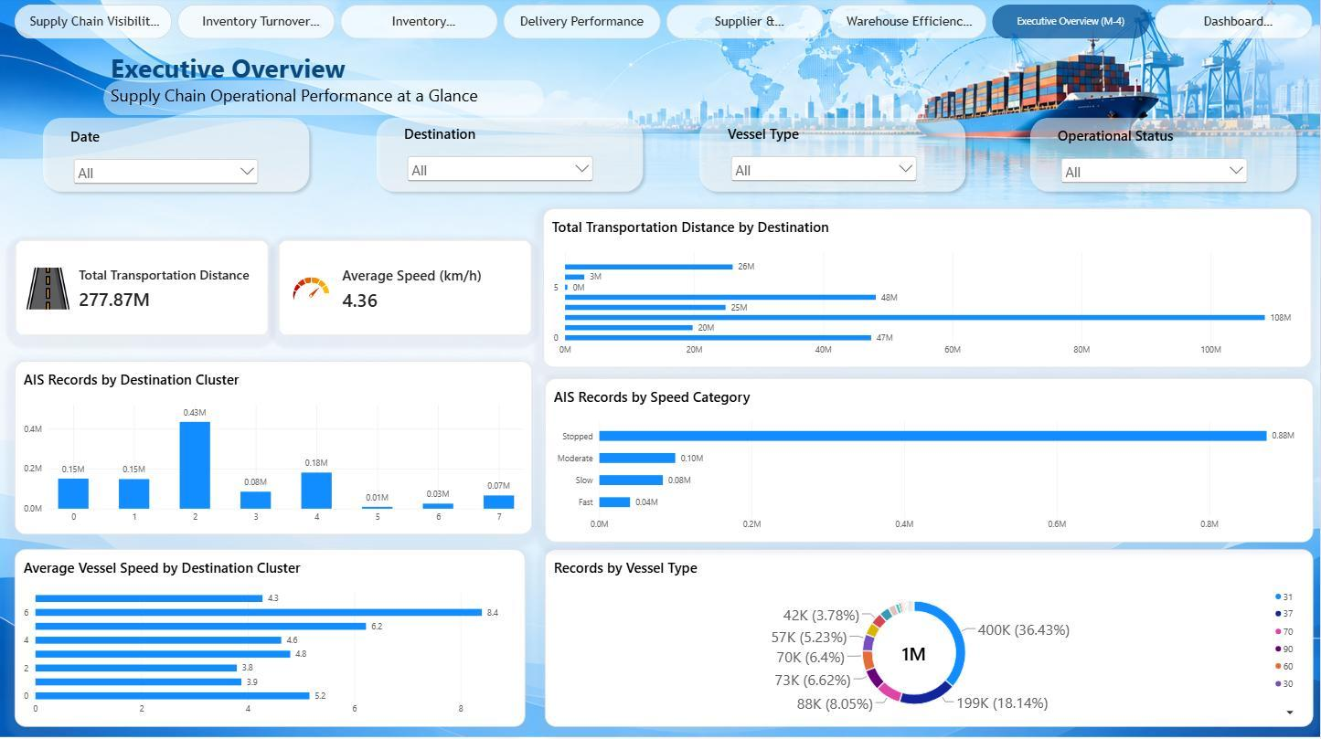
EXECUTIVE OVERVIEW & DESTINATION KPI SUMMARY
14
Executive reporting pairs a summary view with destination diagnostics
DESTINATION
UTIL. %
ON-TIME %
SPEED
ETA h
0
22.60
22.34
5.16
60.27
1
15.71
42.37
3.88
55.46
2
22.33
23.70
3.79
60.25
3
17.66
22.26
4.80
61.31
4
15.01
15.26
4.63
64.00
5
29.37
85.99
6.22
27.84
6
32.10
53.20
8.40
44.81
7
25.16
20.78
4.28
63.76
Total
20.36
25.56
4.36
59.89
108M km
4.36 km/h
“On-time” is ETA-based.
distance proxy · cluster 2
average speed
Largest contribution
Overall
On-time indicator: cluster 5 85.99% · cluster 4 15.26%
Screenshot and table figures are from the final report.
SUPPLY CHAIN VISIBILITY / TEAM C
14 / 16
Notes:
Source: latest_documentation.pdf, pp. 26–28, 30. Suggested speaking time: about 60 seconds. Table transcribed from documentation; on-time remains ETA-based.

Slide 15
OVERALL RESULTS, BUSINESS VALUE & LIMITATIONS
15
Use the report to target questions—not to claim causes
1.10M
20.36%
25.56%
AIS observations
movement / utilization proxy
ETA-based on-time indicator
~13K vessels
Moving AIS share
No actual arrival timestamps
BUSINESS VALUE
Interactive pages help users:
LIMITS THAT SHAPE THE FINDINGS
No inventory quantity or COGS
Compare activity and ETA across destinations
No named supplier or carrier fields
Filter by date, vessel type, speed and status
No shipment cost or actual delivery time
Identify high-volume areas for investigation
No warehouse stock / capacity measures
Movement and ETA comparisons are descriptive
BOUNDARY
The documentation does not demonstrate an optimization algorithm or causal effect.
SUPPLY CHAIN VISIBILITY / TEAM C
15 / 16
Notes:
Source: latest_documentation.pdf, pp. 13–14, 21–28. Suggested speaking time: about 55 seconds.

Slide 16
CONCLUSION & FINAL DELIVERABLES
Four milestones.
One interactive report.
COMPLETED DELIVERABLES
The project moves from AIS preparation to destination-level and executive reporting—showing operational patterns and the limits of the source data.
Eight-page Power BI report
Colab-cleaned AIS data
Fact + dimension model
M1
Visibility model + KPI foundation
Reusable DAX measures
Interactive filters + navigation
M2
Cargo-flow + ETA performance
Testing + performance tuning
Milestone-wise documentation
M3
Supplier / transport proxy views
Published final report
M4
Warehouse + executive reporting
A diagnostic baseline for better operational questions; direct business KPIs need the missing source fields.
TEAM C · Faaiz Hamid · Pranav Kadam · Prashant Shukla · Rahul · Varun
Notes:
Source: latest_documentation.pdf, pp. 27–29. Suggested speaking time: about 45 seconds.

