Slide 1
FIR filter and Distributed Arithmetic
Dr Koushik Maharatna
University of Southampton

Slide 2
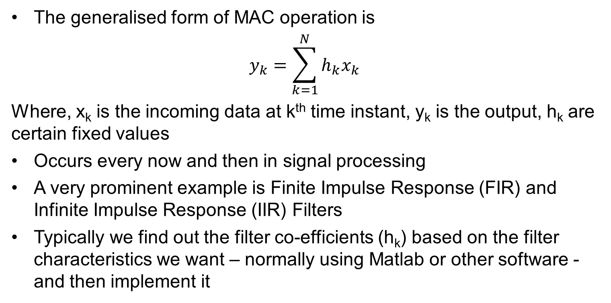
Multiply-Accumulate is a common function
The generalised form of MAC operation is
$$y_{k}=\sum_{k=1}^{N}{h_{k}x_{k}}$$
Where, x_{k} is the incoming data at k^{th} time instant, y_{k} is the output, h_{k} are certain fixed values
Occurs every now and then in signal processing
A very prominent example is Finite Impulse Response (FIR) and Infinite Impulse Response (IIR) Filters
Typically we find out the filter co-efficients (h_{k}) based on the filter characteristics we want – normally using Matlab or other software - and then implement it

Slide 3
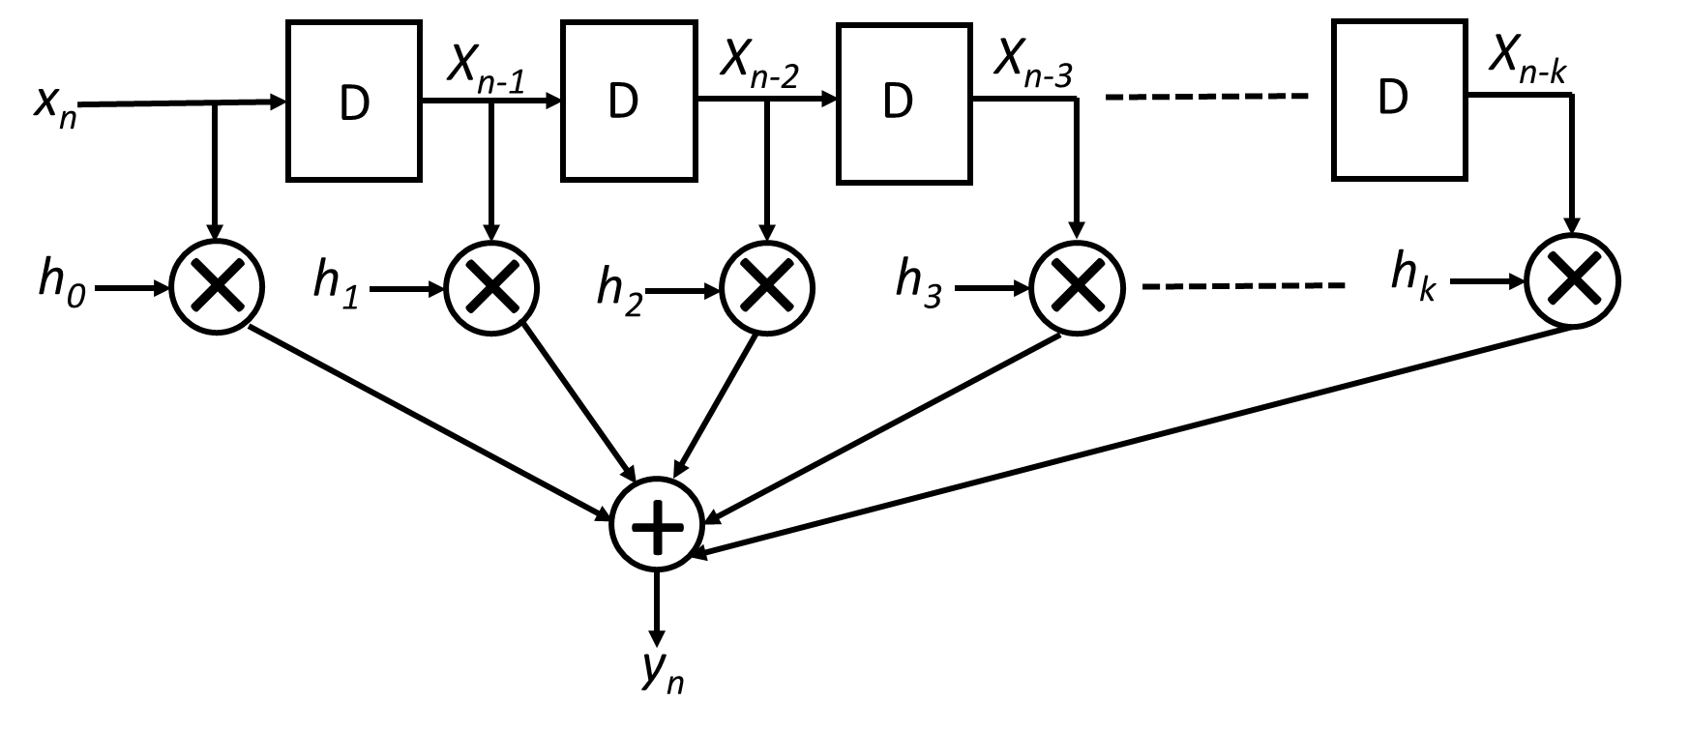
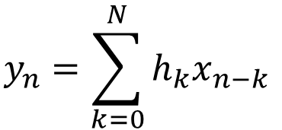
FIR filter
The basic equation of N^{th} order FIR filter is
$$y_{n}=\sum_{k=0}^{N}{h_{k}x_{n−k}}$$
This is the direct form of implementation of an FIR filter
Lots of multiplications and additions are happening here
How to implement such a structure?

Slide 4
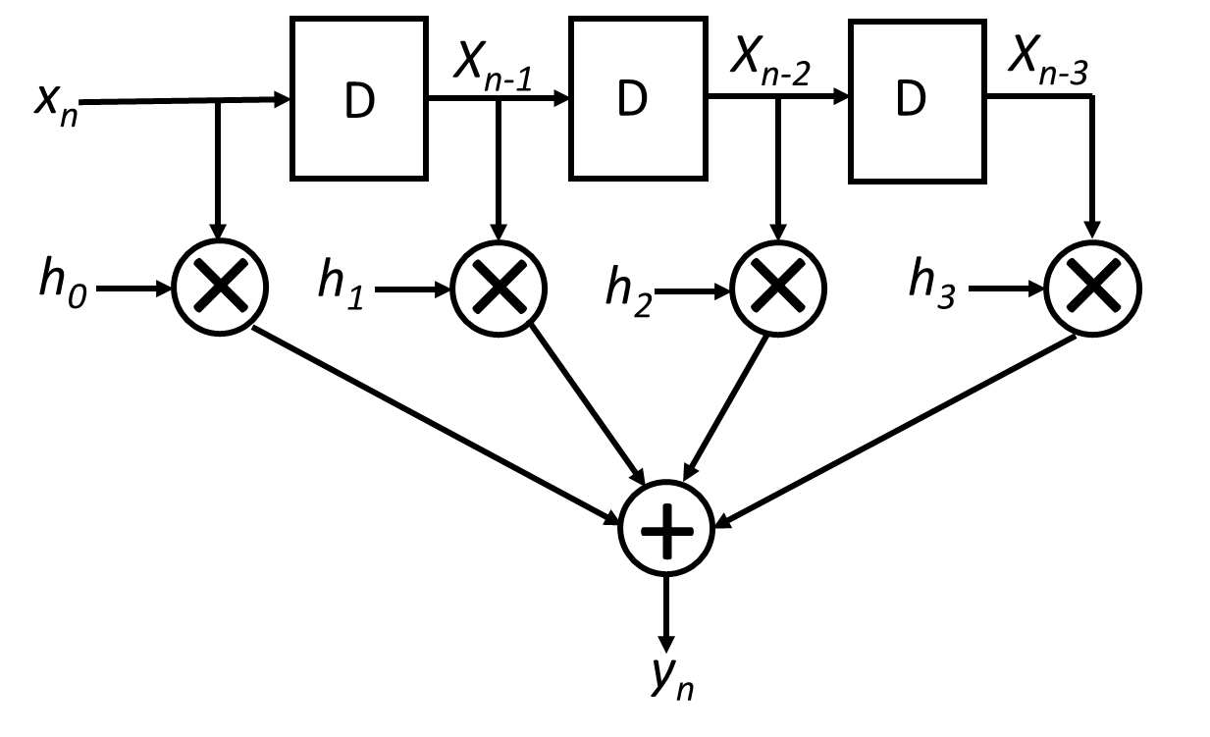
FIR filter
Let’s try to understand it a bit more: let’s say we are dealing with a 3rd order FIR filter
h₀, h₁, h₂, h₃ are 2, 3, 4 and 5 respectively
At t = 0, x₀ = 1; y₀ =(2*1+0+0+0) = 2
At t = 1, x₁ = 2; y₁ = (2*2+3*1+0+0) = 7
At t = 2, x₂ = 3; y₂ = (2*3+3*2+4*1+0) =16
At t = 3, x₃ = 4; y₃ = (2*4+3*3+4*2+5*1) =30
There are different ways to implement such a filter, e.g. consult the multiplier.pptx to see how a multiplier with one fixed multiplier can be realised using shift-and-add techniques
You may also consider Distributed Arithmetic technique we describe here

Slide 5
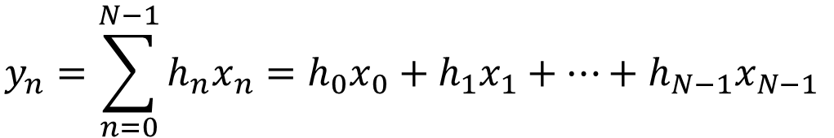
Distributed Arithmetic (DA)
Let’s say x_{n} is the n^{th} data and is a k-bit number. So…..
$$x_{n}=x_{n,k−1}2^{k−1}+x_{n,k−2}2^{k−2}+…+x_{n,1}2^{1}+ x_{n,0}2^{0}$$
REMEMBER x_{n,i} is either 0 or 1
$$y_{n}=\sum_{n=0}^{N−1}{h_{n}x_{n}=h_{0}x_{0}+h_{1}x_{1}+…+h_{N−1}x_{N−1}}$$
Let’s take it term by term
$${h_{0}x}_{0}={h_{0}[x}_{0,k−1}2^{k−1}+x_{0,k−2}2^{k−2}+…+x_{0,1}2^{1}+ x_{0,0}2^{0}]$$
$${h_{1}x}_{1}={h_{1}[x}_{1,k−1}2^{k−1}+x_{1,k−2}2^{k−2}+…+x_{1,1}2^{1}+ x_{1,0}2^{0}]$$
$${h_{N−1}x}_{N−1}={h_{N−1}[x}_{N−1,k−1}2^{k−1}+…+x_{N−1,1}2^{1}+ x_{N−1,0}2^{0}]$$

Slide 6
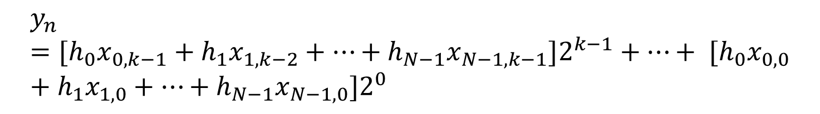
Distributed Arithmetic (DA)
Rearranging we get
$$y_{n}={[h}_{0}x_{0,k−1}+h_{1}x_{1,k−2}+…+h_{N−1}x_{N−1,k−1}{]2}^{k−1}+…+ {{[h}_{0}x}_{0,0}+h_{1}x_{1,0}+…+h_{N−1}x_{N−1,0}]2^{0}$$
Since h_{i}’s are fixed and x_{n,i} are either 0 or 1, each term in the [.] becomes only a combination of h_{i} depending upon the value of x_{n,I} and therefore can be precomputed and stored in a LUT
Once we have the actual x_{n}’s we can use their bit patterns as address to retrieve the correct values from the LUT and send it to sum block
What we achieved here is very fast multiplierless multiplication operation
Let’s explain it with a specific example

Slide 7
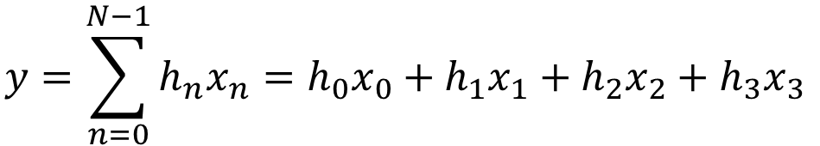
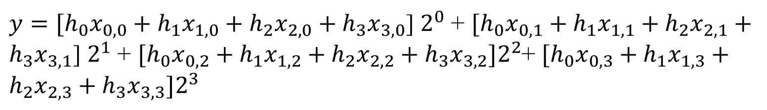
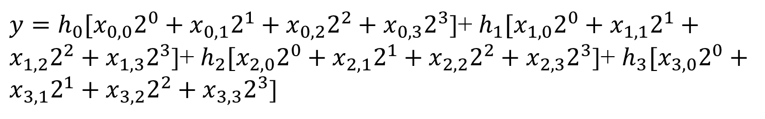
Distributed Arithmetic (DA)
h₀, h₁, h₂, h₃ are 2, 3, 4 and 5 respectively, x_{n} is a 4-bit number and n = 4
$$y=\sum_{n=0}^{N−1}{h_{n}x_{n}=h_{0}x_{0}+h_{1}x_{1}+h_{2}x_{2}+h_{3}x_{3}}$$
$y=h_{0}[x_{0,0}2^{0}+x_{0,1}2^{1}+x_{0,2}2^{2}+x_{0,3}2^{3}$]+ $h_{1}[x_{1,0}2^{0}+x_{1,1}2^{1}+x_{1,2}2^{2}+x_{1,3}2^{3}$]+ $h_{2}[x_{2,0}2^{0}+x_{2,1}2^{1}+x_{2,2}2^{2}+x_{2,3}2^{3}$]+ $h_{3}[x_{3,0}2^{0}+x_{3,1}2^{1}+x_{3,2}2^{2}+x_{3,3}2^{3}$]
Put all 2* terms together
$y={[h}_{0}x_{0,0}+{h_{1}x}_{1,0}+{h_{2}x}_{2,0}+{h_{3}x}_{3,0}$] $2^{0}$+ $[{h_{0}x}_{0,1}+h_{1}x_{1,1}+h_{2}x_{2,1}+{h_{3}x}_{3,1}$] $2^{1}$+ ${[h}_{0}x_{0,2}+{h_{1}x}_{1,2}+h_{2}x_{2,2}+{h_{3}x}_{3,2}{]2}^{2}$+ ${[h}_{0}x_{0,3}+{h_{1}x}_{1,3}+{h_{2}x}_{2,3}+{h_{3}x}_{3,3}{]2}^{3}$

Slide 8
Distributed Arithmetic (DA)
So we get
$y=Sum0∗2^{0}$+ $Sum1∗2^{1}$+ $Sum2$* $2^{2}$+ $Sum3∗2^{3}$
Now we need to make a co-efficient table: basically that will describe all possible bit combination of x_{n} and the corresponding coefficient to calculate Sum*
We will need 2^{n} length coefficient table and therefore in the present case we will need 2⁴ length table
Let’s make it…… you need to keep an eye on the last equation of the last slide

Slide 9
Distributed Arithmetic (DA)
X_{0,k} | X_{1,k} | X_{2,k} | X_{3,k} | Coefficient
0 | 0 | 0 | 0 | 0
0 | 0 | 0 | 1 | h₃ = 5
0 | 0 | 1 | 0 | h₂ = 4
0 | 0 | 1 | 1 | h₂+h₃ = 5+4 = 9
0 | 1 | 0 | 0 | h₁ = 3
0 | 1 | 0 | 1 | h₁+h₃ = 3+5 = 8
0 | 1 | 1 | 0 | h₁+h₂ = 3+4 = 7
0 | 1 | 1 | 1 | h₁+h₂+h₃ = 3+4+5 = 12
1 | 0 | 0 | 0 | h₀ = 2
1 | 0 | 0 | 1 | h₀+h₃ = 2+5 = 7
1 | 0 | 1 | 0 | h₀+h₂ = 2+4 = 6
1 | 0 | 1 | 1 | h₀+h₂+h₃ = 2+4+5 = 11
1 | 1 | 0 | 0 | h₀+h₁ = 2+3 = 5
1 | 1 | 0 | 1 | h₀+h₁+h₃ = 2+3+5=10
1 | 1 | 1 | 0 | h₀+h₁+h₂ = 2+3+4 = 9
1 | 1 | 1 | 1 | h₀+h₁+h₂+h₃ = 2+3+4+5 = 14

Slide 10
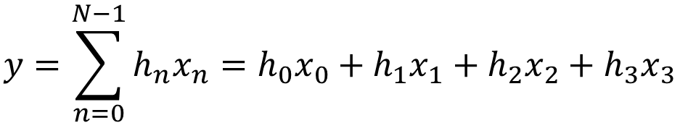
Distributed Arithmetic (DA)
Now let’s see how it works
Let x₀ = 10 = 1010
x₁ = 12 = 1100
x₂ = 15 = 1111
x₃ = 11 = 1011
$$y=\sum_{n=0}^{N−1}{h_{n}x_{n}=h_{0}x_{0}+h_{1}x_{1}+h_{2}x_{2}+h_{3}x_{3}}$$
y = 2*10+3*12+4*15+5*11 = 171
x_{0,0} = 0, x_{1,0} = 0, x_{2,0} = 1, x_{3,0} = 1; Sum0 = 9
x_{0,1} = 1, x_{1,1} = 0, x_{2,1} = 1, x_{3,1} = 1; Sum1 = 11
x_{0,2} = 0, x_{1,2} = 1, x_{2,2} = 1, x_{3,2} = 0; Sum2 = 7
x_{0,3} = 1, x_{1,3} = 0, x_{2,3} = 1, x_{3,3} = 1; Sum3 = 14
y = Sum0*2⁰ + Sum1*2¹ + Sum2*2² + Sum3*2³ = 9 +11*2 +7*4+14*8 = 171

Slide 11
Implementation
Serial implementation: LSB first
x_{0,3}
x_{0,2}
x_{0,1}
x_{0,0}
Coefficient table
x_{1,3}
x_{1,2}
x_{1,1}
x_{1,0}
x_{2,3}
x_{2,2}
x_{2,1}
x_{2,0}
+
Variable shifter
x_{3,3}
x_{3,2}
x_{3,1}
x_{3,0}
Counter
Address bus
Result out
Variable shifters are wire-dominated circuits

Slide 12
Implementation
Serial implementation: MSB first
x_{0,0}
x_{0,1}
x_{0,2}
x_{0,3}
Coefficient table
x_{1,0}
x_{1,1}
x_{1,2}
x_{1,3}
x_{2,0}
x_{2,1}
x_{2,2}
x_{2,3}
+
1-bit shifter
x_{3,0}
x_{3,1}
x_{3,2}
x_{3,3}
Address bus
Result out

Slide 13
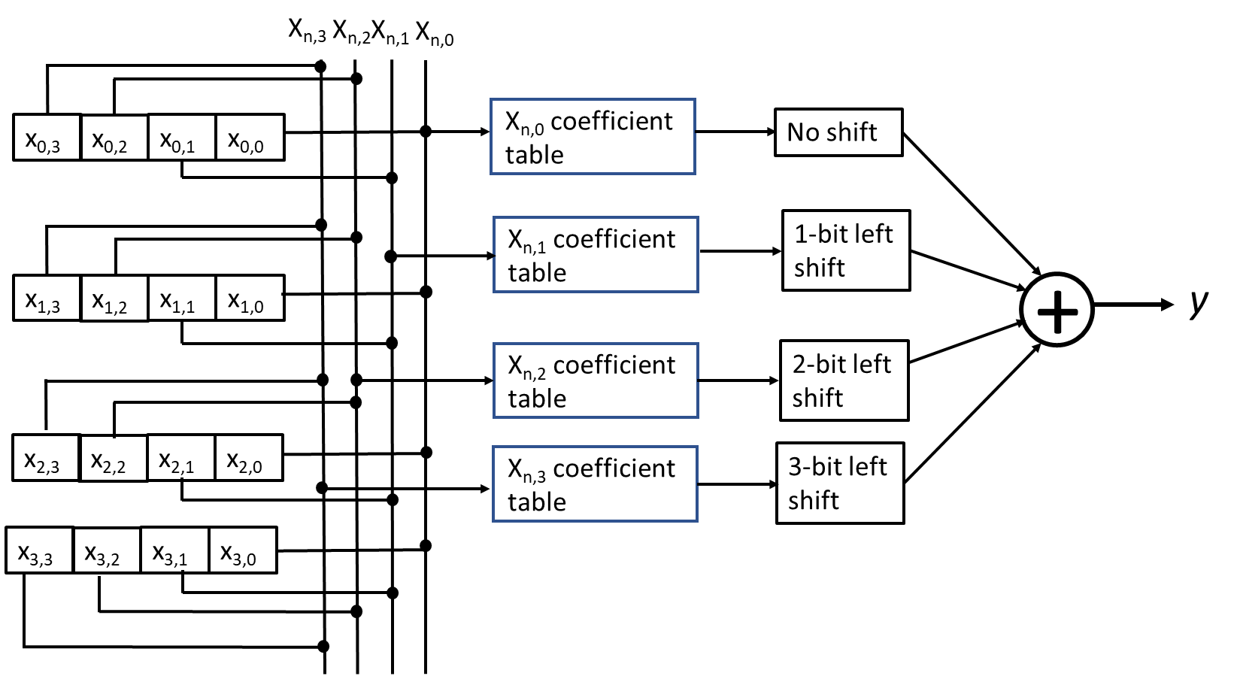
Implementation
Parallel implementation

