Slide 1
Adders
Dr Koushik Maharatna
University of Southampton

Slide 2
Binary adder
C_{in} | A | B | S | C
0 | 0 | 0 | 0 | 0
0 | 0 | 1 | 1 | 0
0 | 1 | 0 | 1 | 0
0 | 1 | 1 | 0 | 1
1 | 0 | 0 | 1 | 0
1 | 0 | 1 | 0 | 1
1 | 1 | 0 | 0 | 1
1 | 1 | 1 | 1 | 1
S = A B C
C = AB + AC_{in} + BC_{in}
A
B
C_{in}
S
C

Slide 3
Binary adder (contd.)
A
Total cost: 2 XOR + 2 AND + 2 OR
S output comes with two gate delay and C with three gate delay
XOR
B
XOR
S
C_{in}
A
AND
B
A
OR
OR
C
B
AND
C_{in}

Slide 4
Binary adder (contd.)
From the truth table if we do not use logic minimisation then C can be expressed as:
C = A/BC_{in} + AB/C_{in} + ABC_{in}/ + ABC_{in}
= (A/B + AB/)C_{in} + AB(C_{in}/ + C_{in})
= (A B) C_{in} + AB
So we can share the term (A B) for the S and C outputs

Slide 5
Binary adder (contd.)
The resulting circuit
Total cost: 2 XOR + 2 AND + 1 OR
S output comes with two gate delay and C with three gate delay
A
XOR
B
XOR
S
C_{in}
AND
OR
C
A
AND
B

Slide 6
Binary adder: looking from a different angle
C_{in} | A | B | A.B (G) | A+B (P) | A B | S | C
0 | 0 | 0 | 0 | 0 | 0 | 0 | 0
0 | 0 | 1 | 0 | 1 | 1 | 1 | 0
0 | 1 | 0 | 0 | 1 | 1 | 1 | 0
0 | 1 | 1 | 1 | 1 | 0 | 0 | 1
1 | 0 | 0 | 0 | 0 | 0 | 1 | 0
1 | 0 | 1 | 0 | 1 | 1 | 0 | 1
1 | 1 | 0 | 0 | 1 | 1 | 0 | 1
1 | 1 | 1 | 1 | 1 | 0 | 1 | 1

Slide 7
Binary adder: looking from a different angle (contd.)
Generate function: The generate signal G occurs when a C output is generated internally within the adder.
G = A . B
Propagate function: When the propagate signal P is true then C_{in} is passed to C when C_{in} is true
P = A + B; but we can also use P = A B since it shows the same behaviour and also can be used to generate the sum term
S = P C_{in}
C = G + P. C_{in}

Slide 8
Multi-bit adder (ripple carry / carry propagate)
A multi-bit adder can be constructed by cascading N number of full adders
A(N-1)
B(N-1)
A1
B1
A0
B0
C_{out}
C(N-2)
C1
C0
C_{in} = 0
S(N-1)
S1
S0
Linear increase of delay with number of bits
T_{d} (worst) = (N-1)T_{carry} + T_{sum}

Slide 9
Carry chain optimisation
Express S in terms of the signal C
S = ABC_{in} + (A + B + C_{in}) C/
Now we first generate the C signal and then use it for the S signal generation
So for each of the full adders the C signal is coming earlier than the sum signal

Slide 10
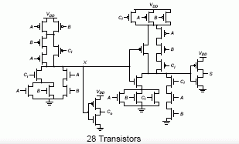
CMOS implementation of adder

Slide 11
Carry chain optimisation: using inversion property
A(i)
B(i)
A(i)
B(i)
C_{in} (i)
C(i)
C_{in} (i)
C(i)
S(i)
S(i)

Slide 12
Carry chain optimisation: using inversion property (contd.)
A(0)
B(0)
A(1)
B(1)
A(2)
B(2)
A(3)
B(3)
C_{in} (0)
C
S(0)
S(2)
S(1)
S(3)
Alternative full adders use the inversion property. This arrangement may result in a significant decrease in carry delay

Slide 13
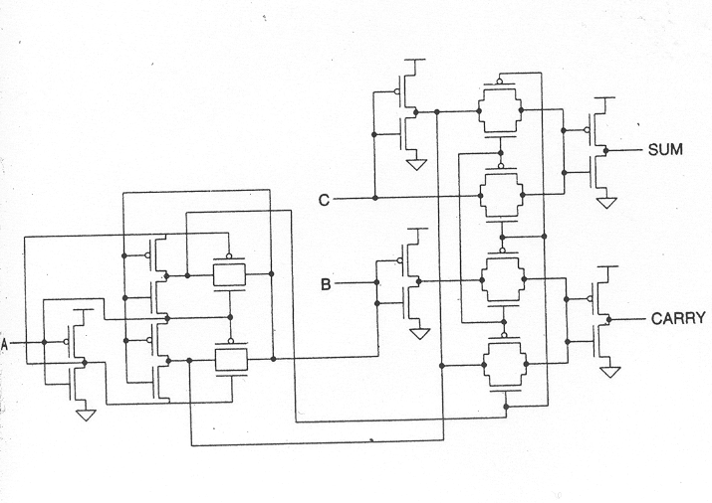
Transmission gate adder

Slide 14
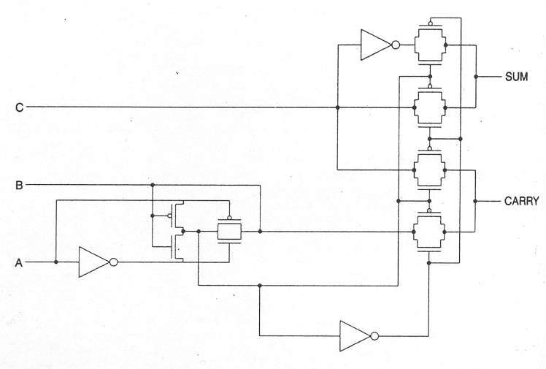
Transmission gate adder (optimised)

Slide 15
Subtractor
Subtractors are similar to the adders in construction
Subtraction operation is normally done following the 2’s complement subtraction rule
  The subtrahend has to be converted to the 2’s complement form
  Add the 2’s complemented subtrahend to the minuend

Slide 16
Subtractor circuit
B0
A0
B1
A1
B2
A2
B3
A3
+
+
+
+
C
V_{DD}
S0
S1
S2
S3

Slide 17
Adder/Subtractor circuit
B0
A0
B1
A1
B2
A2
B3
A3
XOR
XOR
XOR
XOR
+
+
+
+
C
C_{in}
S0
S1
S2
S3
If C_{in} = 0, the circuit will act as adder, If C_{in} = 1, the circuit will act as subtractor

Slide 18
Bit serial adder implementation
C_{out}
REG (1-bit)
data movement
A(i)
data movement
N-bit register
+
result
N-bit register
N bit register
B(i)
data movement
C_{in}
carry movement
clk

Slide 19
Bit serial adder implementation (contd.)
Operates in serial manner
carry(t+1) = A(t+1) B(t+1) + C(t) [A(t+1) + B(t+1)]
sum(t+1) = carry(t+1) [A(t+1) + B(t+1) + C(t+1)] +A(t+1) B(t+1) C(t)
Equal sum and carry delay
N number of cycles required to add two N-bit numbers
Was a good solution for the technology in the range of 2 – 5 µm
Nibble (4-bit) and byte (8-bit) adders are frequently used
Carry-save-addition (CSA)

Slide 20
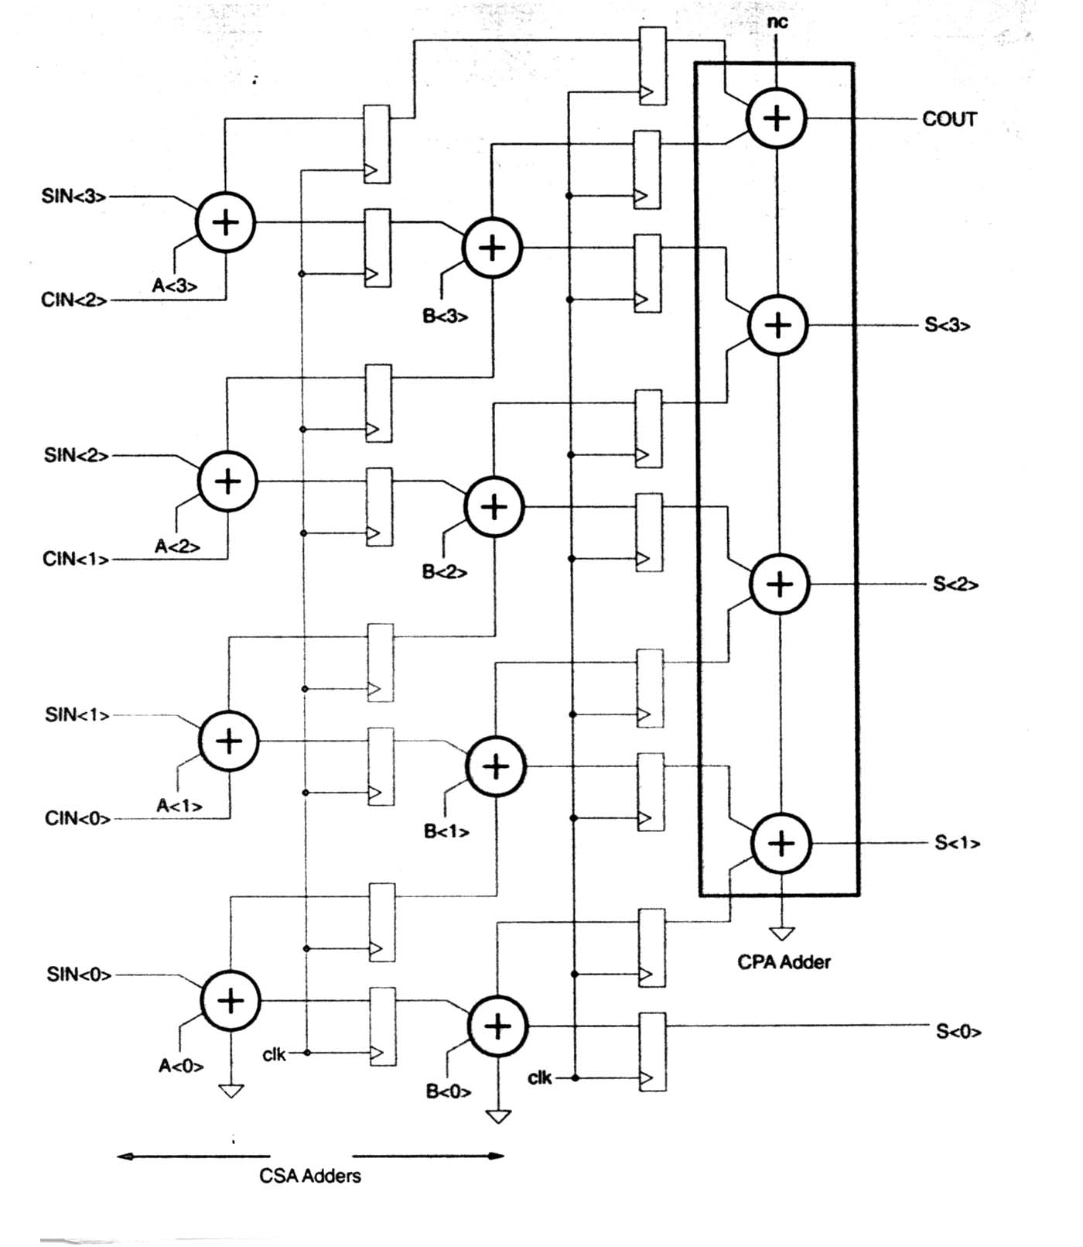
Carry-save adder (CSA)

Slide 21
CSA characteristics
Can add more than two operands
Registers both carries & sums
Shift carries left and add them into next rank
Final stage must be a carry-propagate adder
Reduces critical path to sum of:
  Register clock-to-Q time
  Adder delay
  Register setup time
Pipelining increases the throughput
  Pipelining introduces latency: time required from when the operands are introduced to the data processing element to when outputs are available from the module
  Pipeline the CPA adders at output

Slide 22
Carry-Lookahead Adder (CLA)
Idea
  Try to “predict” C_{k} earlier than T_{c}*k
  Instead of passing through k stages, compute C_{k} separately using 1-stage CMOS logic
  Look at the 0th stage carry and predict all the carry corresponding to the different stages
  Propagate-Generate (PG) formulation can be used efficiently

Slide 23
Carry propagation
What happens to a carry at bit position k ?
A | B | C_{in} | C
0 | 0 | X | 0
0 | 1 | C | C
1 | 0 | C | C
1 | 1 | X | 1
Kill
Kill
0-propagate
Propagate
Propagate
A
B
A
Generate
B
C_{in}
C/
B
p = A+B (or A ⊕ B)
g = A.B
A
A
B
Generate
1-propagate

Slide 24
CLA: formulation of carry propagation equation
If C₄=1, then either:
  g₃ generated at bit pos 3
  g₂.p₃ generated at bit pos 2, propagated 3
  g₁.p₂.p₃ generated at bit pos 1, propagated 2,3
  g₀.p₁.p₂.p₃ generated at bit pos 0, propagated 1,2,3
  C_{in}.p₀.p₁.p₂.p₃ input carry, propagated 0,1,2,3
C₄ = g₃+ g₂.p₃ + g₁.p₂.p₃ + g₀.p₁.p₂.p₃ + C_{in}.p₀.p₁.p₂.p₃
Similarly:
C₃ = g₂ + g₁.p₂ + g₀.p₁.p₂ + C_{in}.p₀.p₁.p₂
C₂ = g₁ + g₀.p₁ + C_{in}.p₀.p₁
C₁ = g₀ + C_{in}.p₀

Slide 25
CLA: static logic implementation
d
o
g₃
e
q
g₂
f
r
g₁
h
s
g₀
j
C_{in}
t
C₄
u
k
p₀
v
l
p₁
p₂
w
m
p₃
x
n

Slide 26
CLA: dynamic logic implementation
  C₄ = g₃+ p₃ . (g₂ + p₂ . (g₁ + p₁ . (g₀ + P₀.C_{in})))
φ is the clk
φ
C₄
p₃
g₃
p₂
g₂
p₁
g₁
p₀
g₀
C_{in}
φ

Slide 27
CLA: dynamic logic implementation (contd.)
Can we reuse logic?
  Can we get C₁, C₂ and C₃ from the same circuit?
φ
C₃/?
C₄
p₃
g₃
C₂/?
No!
C1, C2 and C3
may be floating
(not precharged)
Charge sharing
problem
p₂
g₂
C₁/?
p₁
g₁
p₀
g₀
C_{in}
φ

Slide 28
CLA: dynamic logic implementation (contd.)
φ
φ
C₁/
C₂/
p₀
g₀
p₁
g₁
C_{in}
p₀
g₀
φ
C_{in}
φ
φ
C₄/
p₃
g₃
p₂
g₂
φ
C₃/
p₁
g₁
p₂
g₂
p₀
g₀
p₁
g₁
C_{in}
φ
p₀
g₀
C_{in}
φ

Slide 29
4-bit CLA architecture
A₃
B₃
A₂
B₂
A₁
B₁
A₀
B₀
p,g
p,g
p,g
p,g
p₃
g₃
p₂
g₂
p₁
g₁
p₀
g₀
C₀
C₄
C₁
C₂
C₃
S₃
S₂
S₁
S₀
A 4-bit CLA is practically the limiting size of a CLA

Slide 30
N-bit CLA architecture
…
A₇
B₇
A₆
B₆
A₅
B₅
A₄
B₄
A₃
B₃
A₂
B₂
A₁
B₁
A₀
B₀
…
p,g
p,g
p,g
p,g
p,g
p,g
p,g
p,g
C₀
…
Carry Generator
Carry Generator
C₈
C₄
…
S₇
S₆
S₅
S₄
S₃
S₂
S₁
S₀

Slide 31
Example: 12-bit CLA architecture
A=
1101
1001
1010
B=
0111
0110
1101
A₁₁
A₁₀
A₉
A₈
A₇
A₆
A₅
A₄
A₃
A₂
A₁
A₀
B₁₁
B₁₀
B₉
B₈
B₇
B₆
B₅
B₄
B₃
B₂
B₁
B₀
p,g
p,g
p,g
p,g
p,g
p,g
p,g
p,g
p,g
p,g
p,g
p,g
0
C₀
Carry Generator
Carry Generator
Carry Generator
C₁₂
C₈
C₄
S₁₁
S₁₀
S₉
S₈
S₇
S₆
S₅
S₄
S₃
S₂
S₁
S₀

Slide 32
CLA: Summary
CLA compared to ripple-carry adder:
  Faster (“4 times”?),
  but delay still linear (w.r.t. # of bits)
  Larger area
    P, G signal generation
    Carry generation circuits
    Carry generation ckt for each bit position (no re-use)
Limitation: cannot go beyond 4 bits of look-ahead
  Large p,g fan-out slows down carry generation
Way out: Manchester carry chains
  Tries to reuse logic by pre-charging each carry position

Slide 33
Manchester carry chain
Improvement over CLA:
  Precharge internal nodes to avoid charge-sharing problem
C₁/
C₂/
C₃/
φ
p₀
p₁
p₂
p₃
C4
C_{in}
g₀
g₁
g₂
g₃
φ
Fastest way to do small adders
  6 transistors in critical path

Slide 34
Manchester carry chain: Summary
Compared to CLA:
  Smaller area
    Pre-charge internal nodes
    Reuse logic for intermediate carry signals
  C_{in} close to the output
Carry chain can be any length
  Series propagate is slow (O(n²) delay) ➔
  buffer every 4 bits
Compact adder: good for up to 16 bits
Using carries to compute sum slows down MCC

Slide 35
Carry-bypass adder: idea
The “bypass” idea is general
  Not just for Manchester carry chain
  The local carry chain could be “ripple carry adder”
Bit i to i+k
Structure
  Could be static, dynamic, pass transistor
  Bypass logic determines: “pass” or “kill/generate”?
Setup
Local
Carry
Chain
C_{i+k+1}
C_{i}
Sum
Bypass?

Slide 36
Local carry chain: implementation
Static implementation, using ripple carry adder
Local Carry Chain
FA
FA
FA
FA
Dynamic, Manchester (mux=wire!)
p₀.p₁.p₂.p₃
φ
p₁
p₂
p₃
g₀
g₁
g₂
g₃
C4/
φ
C_{in}/
p₀
p₁
p₂
p₃
φ
φ

Slide 37
Local carry chain : implementation (contd.)
Static transmission gate logic, Manchester
  T₁=(p₀.p₁.p₂)/ .p₃ T₂=p₃/ T₃=p₀.p₁.p₂.p₃
p₀
p₁
p₂
T₁
C₀
C₄
T₁
p₀
p₁
p₂
T₂
g₀
g₁
g₂
g₃
p₀
p₁
p₂
T₂
T₃
T₃

Slide 38
Carry-bypass adder: structure
Timing (Critical path shown in different color):
  1-Setup
  2-Local carry generate/kill, MUX select line ready
  3-C₀-C₁₆ carry propagate (if applicable)
Bit 0-3
Bit 4-7
Bit 8-11
Bit 12-15
Setup
Setup
Setup
Setup
Local
Carry
Chain
Local
Carry
Chain
Local
Carry
Chain
Local
Carry
Chain
C₀
Sum
Sum
Sum
Sum

Slide 39
Carry-bypass adder: timing of a sub-block
For an intermediate stage, after setup:
  If in pass mode
    Local carry vector computes intermediate
    carries (possibly incorrectly)
    At the same time, mux selection set to pass
    When input carry arrives, intermediate carries
    might be recomputed
    Meanwhile, input carry is sent to Cout
Setup
Local
Carry
Chain
Local
Carry
Chain
Sum
  If not pass mode (assume bit 10 generates)
    Local carry vector computes intermediate
    carries (bits 10, 11 correct)
    At the same time, mux selection set to local
    Meanwhile, output carry is sent to Cout correctly
    When input carry arrives, intermediate carries
    C₈and C₉ (S₈,S₉,S₁₀) will be recomputed correctly
Sum
Setup
Local
Carry
Chain
Local
Carry
Chain
Sum
Sum

Slide 40
Carry-bypass adder: timing
Delay =
t_{setup}+
max { t_{select} , 4 x t_{FA}} +
3 x
t_{mux_pass} +
4 x t_{FA}+ t_{sum}
Bit 0-3
Bit 4-7
Bit 8-11
Bit 12-15
Setup
Setup
Setup
Setup
Local
Carry
Chain
Local
Carry
Chain
Local
Carry
Chain
Local
Carry
Chain
C₀
Sum
Sum
Sum
Sum

Slide 41
Carry-bypass adder: pros and cons
Speed:
  Faster than
  ripple adder
  Still linear!
Area overhead:
  Mux (setup?)
  Not worth for
  small adders (N<8)
  10-20% for
  large adders
Ripple Adder
Propagation Delay
Bypass Adder
4..8
Number of bits

Slide 42
Carry-select adder: idea
k bits
Similar to bypass
  Instead of “waiting” for the input carry, ”precompute” the carry output
  Compute C_{i+k} for both cases C_{i}=0 and C_{i}=1
  When C_{i} arrives, select the appropriate result
  Sum computed in one step after the intermediate carry signals are ready
Setup (p,g)
p,g
p,g
0
0-Carry propagation
1
1-Carry propagation
C_{i}
Multiplexers
C_{i+k}
Carry Vector
Sum Generation

Slide 43
Linear carry-select adder: structure
Bits 0-3
Bits 4-7
Bits 8-11
Bits 12-15
Setup
Setup
Setup
Setup
0
0-Carry
0
0-Carry
0
0-Carry
0
0-Carry
1
1-Carry
1
1
1-Carry
1
1-Carry
1
1-Carry
C₀
C₄
C₈
C₁₂
Sum
Sum
Sum
Sum

Slide 44
Linear carry-select adder: timing
Bits 0-3
Bits 4-7
Bits 8-11
Bits 12-15
Setup
Setup
Setup
Setup
0
0-Carry
0
0-Carry
0
0-Carry
0
0-Carry
1
1-Carry
1
1-Carry
1
1-Carry
1
1-Carry
C₀
C₄
C₈
C₁₂
C₁₆
Sum
Sum
Sum
Sum
Delay = 3 + 1 + 1 + 1 + 1 = 7 (16 bits)

Slide 45
Square root carry select adder: idea
Later stages have to wait for the multiplexers in the earlier stages
Why not give them bigger chunks of data to compute?
  Balances the delay paths
  Sub-linear delay (we will see why)

Slide 46
Square root carry select adder: structure
Assuming the following delays:
  Setup=1, carry propagate=1/bit, mux=1
Bits 0-1
Bits 2-4
Bits 5-8
Bits 9-13
Bits 14-19
3
4
5
6
7
C₀
C₂
C₅
C₉
C₁₄
C₁₉
Sum
Delay from all paths = 8 (20 bits)

Slide 47
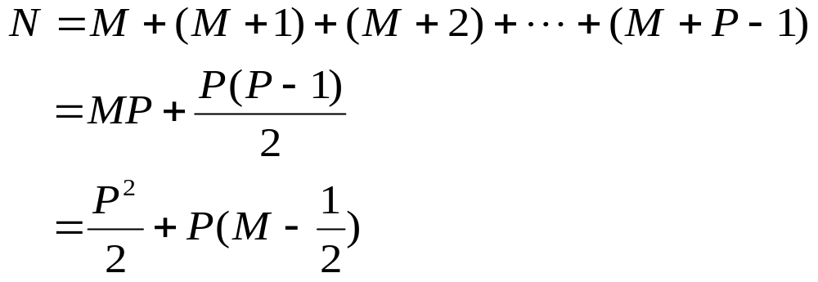
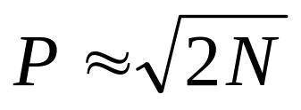
Square root carry select adder: delay
Assume
  N-bit adder
  P stages (delay directly depends on P)
  First stage computes M bits
For M<<N (e.g. N=64, M=2)
  The first term dominates ➔ N ≈ P²/2 ➔

Slide 48
Carry select adder: trade-offs
Area overhead:
  An additional carry path and a multiplexer (not the whole adder)
  About 30% more than a ripple-carry
Delay
  Sub-linear (we can beat that too!)
40.0
ripple adder
30.0
linear select
20.0
10.0
square root select
0.0
0
20
40
60
Number of bits

Slide 49
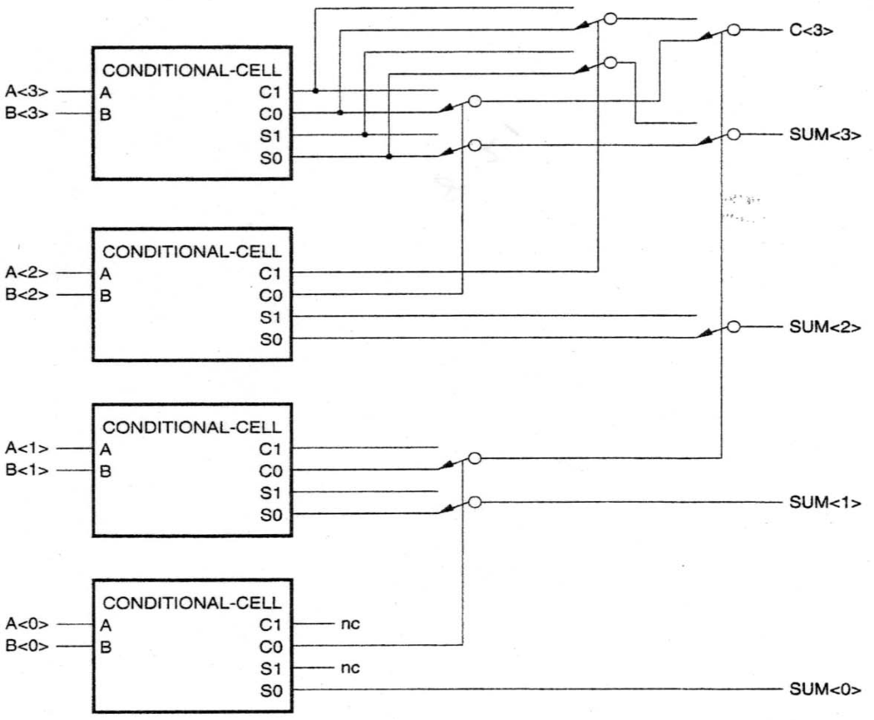
Conditional sum adder

Slide 50
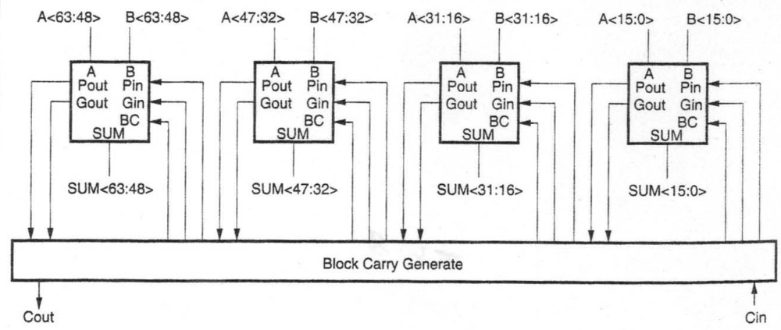
Very wide adder
Use carry-lookahead unit on 4 16-bit block adders to get 64-bit adder
Much faster than fully multiplying out 64 carry equations

Slide 51
Crude adder speedup
  Ripple (Slowest)
  Carry-Lookahead
  Carry-Select
  Manchester
  Transmission Gate (Faster)
  Block Carry-Lookahead
Use block carry lookahead for floating-point ALU’s

