Slide 1
Multiplier
Dr Koushik Maharatna
University of Southampton

Slide 2
Unsigned digital multiplication
Just like decimal long multiplication
  Shift and conditional add product terms
  Example 13 × 5
1101
Multiplicand
×0101
Multiplier
1101
0000
1101
0000
01000001
Product

Slide 3
Unsigned digital multiplication (contd.)
Actually easier than decimal long multiplication
  Because digits are either 1 or 0 – multiplication same as bit by bit logical AND of multiplier and multiplicand
  It is the subsequent addition of partial products that takes effort
If length of the multiplicand is N-bit and length of the multiplier is R-bit then
  length of the product P = N + R
In practice – a running sum of product term is made starting from the LSB
  Rather than shifting the product left, the accumulated product is shifted right

Slide 4
Unsigned digital multiplication (contd.)
In serial multiplication this iterative operation is executed successively in time
  The multiplier is also shifted right on each step
In parallel multiplication, the iterative operation is performed by an array of conditional adders
  Successive right shift of accumulated product implemented by wiring between each stage

Slide 5
Parallel array multiplier
4-bit example
X3 X2 X1 X0
Y3 Y2 Y1 Y0
X3Y0 X2Y0 X1Y0 X0Y0
X3Y1 X2Y1 X1Y1 X0Y1
X3Y2 X2Y2 X1Y2 X0Y2
X3Y3 X2Y3 X1Y3 X0Y3
P7 P6 P5 P4
P3 P2 P1 P0

Slide 6
Array multiplier cell
P
C
P
Y
X
Y
X
Y
Y
+
CO
C
X
PO
CO
X
PO

Slide 7
Array multiplier structure
0
0
0
0
X3
X2
X1
X0
Worst case delay = 2nT
Y0
0
0
Y1
0
Y2
0
Y3
P2
P1
P0
HA
FA
FA
HA
P7
P6
P5
P4
P3

Slide 8
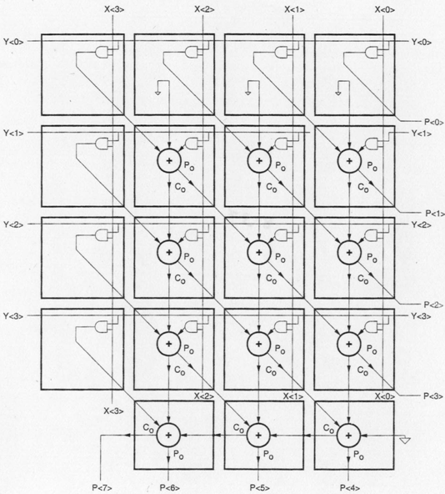
Array multiplier structure: further improvement

Slide 9
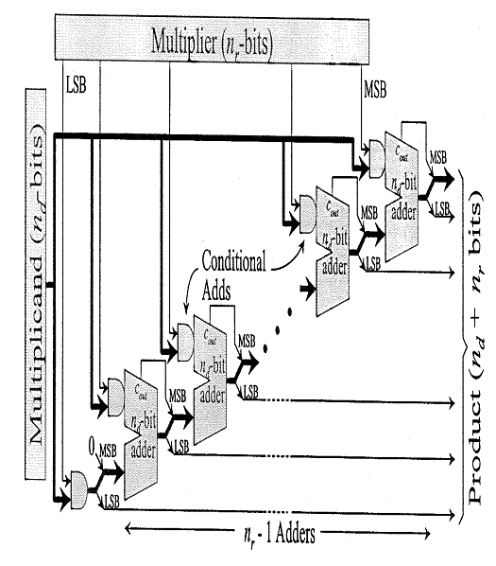
Generalised array multiplier structure

Slide 10
Unsigned digital multiplication: summary
In each stage, LSB drops out to form part of partial product
  The accumulating product is shifted right one place by wiring between each stage
Using CPA settling time of the multiplier is given by the sum of:
1 product AND gate delay
1-input carry propagation delay
N_{d} -1 carry-carry propagation delay
N_{r} -1 input-sum propagation delay
N x N multiplier requires N(N-2) full adders, N half adders and N² AND gates

Slide 11
Signed binary multiplication
Using 2’s complement arithmetic signed multiplication is easy
  Don’t believe this
In order to deal with sign multiplicand: the sign bit of the partial product must be extended – e. g. – 6 X 5
1010
- 6
×0101
5
Sign extension
2’s complement of 6
11111010
0000000
111010
00000
11100010
2’s complement of 30

Slide 12
Signed binary multiplication (contd.)
In order to deal with signed multiplier: final conditional addition is replaced by a conditional subtraction
  Because weight of the MSB of a 2’s complement number is negative
  Example 6 X -5
0110
6
×1011
- 5
00000110
0000110
000000
11010
2’s complement of 6
11100010
2’s complement of 30

Slide 13
Signed multiplication wordlength
N_{d} = P_{d} + F_{d} + 1
SB
P_{d}
F_{d}
Multiplicand
N_{r} = P_{r} + F_{r} + 1
SB
P_{r}
F_{r}
Multiplier
N_{p} = P_{p} + F_{p} + 1 = N_{d} + N_{r}
SB
P_{p} = P_{d} + P_{r} + 1
F_{p} = F_{d} + F_{r}
Multiplicand

Slide 14
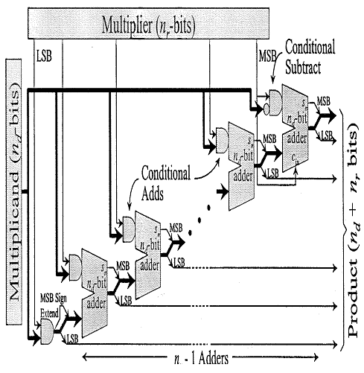
Array multiplier (signed multiplication)

Slide 15
Booth’s algorithm
Alternative way to deal with signed multiplication
Expects the current multiplier bit r_{i} as MSB and so it is treated as negative
If later in the process, when dealing with the next most significant bit r_{i+1} it turns out to be wrong then a correction is made by adding twice the multiplicand

Slide 16
Booth’s algorithm (contd.)
For i^{th} bit of the multiplier the algorithm is
r_{i} | r_{i-1} | Action
0 | 0 | Add zero (do nothing)
1 | 0 | Subtract multiplicand
0 | 1 | Add multiplicand (correction)
1 | 1 | Add zero (do nothing)
Since accumulated product is shifted once to the right, correction addition is twice the previous subtraction

Slide 17
Booth’s algorithm: example
0110
6
×1011
- 5
11111010
2’s complement of 6
0000000
Add zero
000110
Add 6
11010
Subtract 6
11100010
2’s complement of 30
In serial multiplication Booth’s algorithm has a dubious advantage that it is not necessary to know when we come to the MSB and switch to a subtraction

Slide 18
Booth’s algorithm: general comments
For serial multiplication there is no significant difference in cost of implementation
For parallel multiplication Booth’s algorithm is more expensive
Multiplication speed can be improved by processing two bits at a time using the modified Booth’s algorithm

Slide 19
Modified Booth algorithm
Original Booth algorithm looks at one bit (and the previous bit) at a time
A faster multiplier can be realised by looking at two bit (and the previous bit) at a time
Requires addition and subtraction of 1 or 2 times the multiplicand
Two current bits are treated as a 2’s complement number
  If later, it turns out to be wrong, a correction is made

Slide 20
Modified Booth algorithm (contd.)
For i^{th} and (i+1)^{th} bit of multiplier the algorithm is
r_{i+1}, r_{i} | r_{i-1} | Action
00 | 0 | Do nothing
01 | 0 | Add 1 * Multiplicand
10 | 0 | Subtract 2 * Multiplicand
11 | 0 | Subtract 1 * Multiplicand
00 | 1 | Add 1 * Multiplicand
01 | 1 | Add 2 * Multiplicand
10 | 1 | Subtract 1 * Multiplicand
11 | 1 | Do nothing

Slide 21
Modified Booth algorithm (contd.)
Example: 6 × - 5
0 1 1 0
1 0 1 1
0
1 1 1 1 1 0 1 0
2’s complement of 6
1 1 1 0 1 0
Subtract 6
1 1 1 0 0 0 1 0
2’s complement of 30

Slide 22
Modified Booth algorithm: summary
Grouping multiplier bits into pairs
  Reduces number of partial products to half
Use of higher radix reduces number of intermediate addition
  Radix-8 should implement *3, * -3, *4, * -4
  Complicated, trade-off has to be made
Depends on the architecture

Slide 23
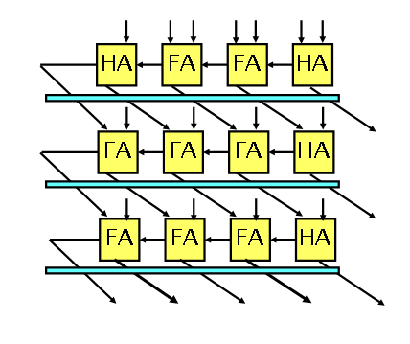
Pipelined multiplier
Insert registers between rows
Insert registers for bits of multiplier: schedule MSB to arrive late

Slide 24
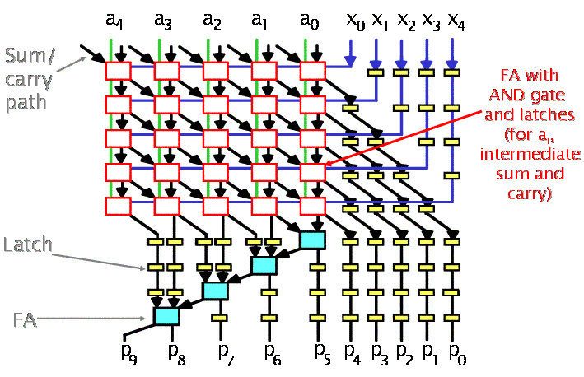
Pipelined multiplier: example

Slide 25
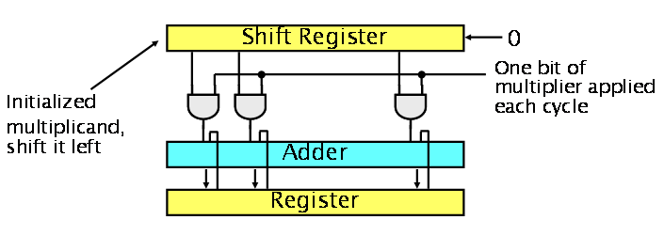
Sequential multiplier
Shift register
  Originally holds the multiplicand
  Shifts it left for each of the partial products
One bit of the multiplier is presented at a time to the AND gates
2N bits

Slide 26
Sequential multiplier: resource requirement
2N-bit adder and 2N-bit register
A better design
  Shift result register to right: use N AND gate and N-bit adder
Register
Adder
Shift Register

Slide 27
Shift and Rotate operation
Used in microprocessor and encryption algorithm
If fixed shift: simply wire the inputs to the correct output position
Variable shift
  One bit shifter
  Barrel shifter
  Logarithmic shifter

Slide 28
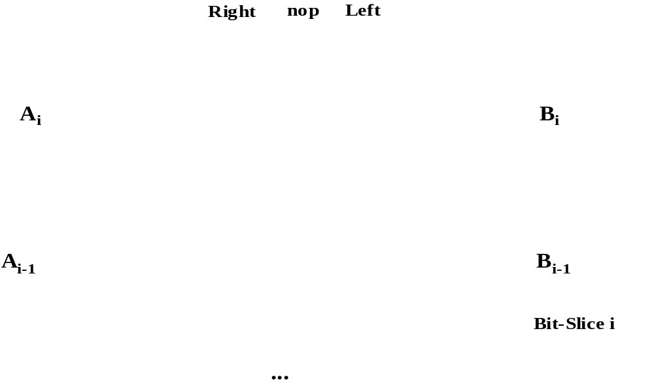
One bit shifter
Right NOP Left
A_{i}
B_{i}
A_{i-1}
B_{i-1}
Bit-slice i

Slide 29
Simple N-bit shifter
Quadratic number of transistor: one transistor switch per path
in1
in2
in3
in4
out1
out2
out3
out4

Slide 30
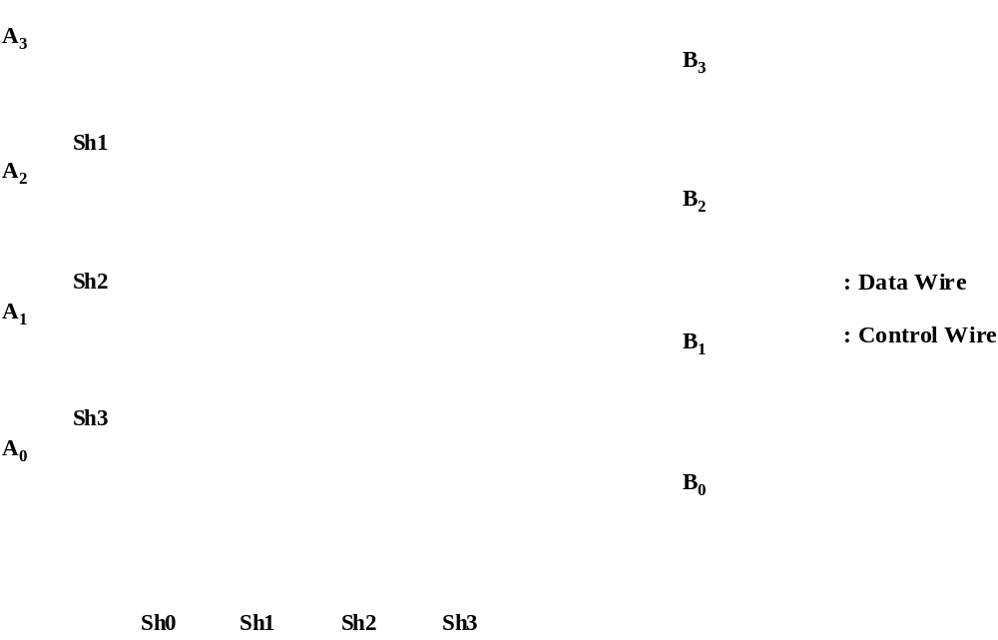
Barrel shifter
Bit 3 wrapped
around, sign extension
Area dominated by
wiring

Slide 31
Logarithmic shifter
S1
S2
o1
i1
S1'
S2'
S1
S2
S1
S2
o2
i2
S1'
S2'
Simplified structure
but more stages
(greater delay)
S1
S2
S1
S2
o3
i3
S1'
S2'
S1
S2
S1
S2
o4
i4
S1'
S2'
S1
S2

Slide 32
Programmable shifter example: 16-bit
I/P
O/P
8 or 0 bit shifter
4 or 0 bit shifter
2 or 0 bit shifter
1 or 0 bit shifter
A
B
C
D
Control lines

Slide 33
Multiplication using shifter
A × 14 = A (1110) = A (2³ + 2² + 2¹)
Fixed shifters, only wires
3-bit left shift
A
2-bit left shift
O/P
+
1-bit left shift

Slide 34
Shifter: summary
Trade-offs between area and delay
  Barrel shifter: fastest O(1), N² transistors
  Logarithmic shifter: O (log N), N log N transistors
  One bit shifter: O (N), N transistors
Barrel shifter: wire dominated circuit

Slide 35
Complex numbers and addition
Complex numbers have real part and imaginary part
  x = a + jb, a = real part, b = imaginary part
  BUT both are just NUMBERS – complex number represents a vector with amplitude √(a²+b²) making a phase angle θ = tan⁻¹(b/a) with the real axis
  So use two separate bus for them – b-bit complex number = b-bit real number and b-bit imaginary number ≡ 2-b bit wordlength
  But keep the convention, i. e., add real part with real part and imaginary part with imaginary part – don’t mix them
  (a + jb) + (c + jd) = (a + c) + j (c + d)
a
b
c
d
The complexity of a b-bit complex adder is 2b full adders
real part
imaginary part

Slide 36
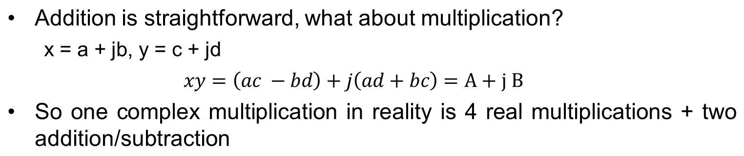
Multiplication of complex numbers
a
c
b
d
a
d
b
c
—
2N-bit adder/subtractor
+
A
B

Slide 37
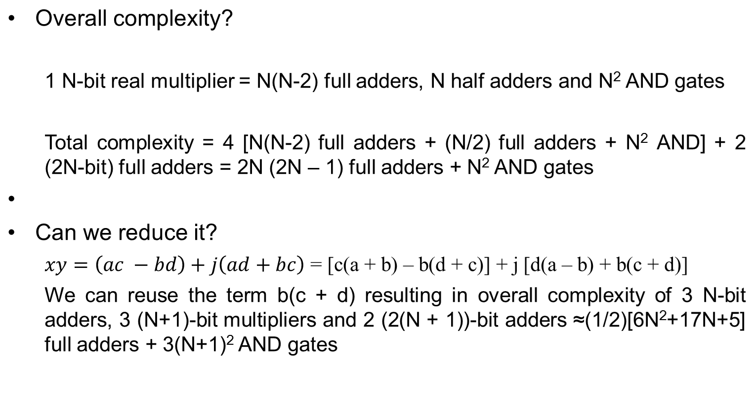
Multiplication of complex numbers

Slide 38
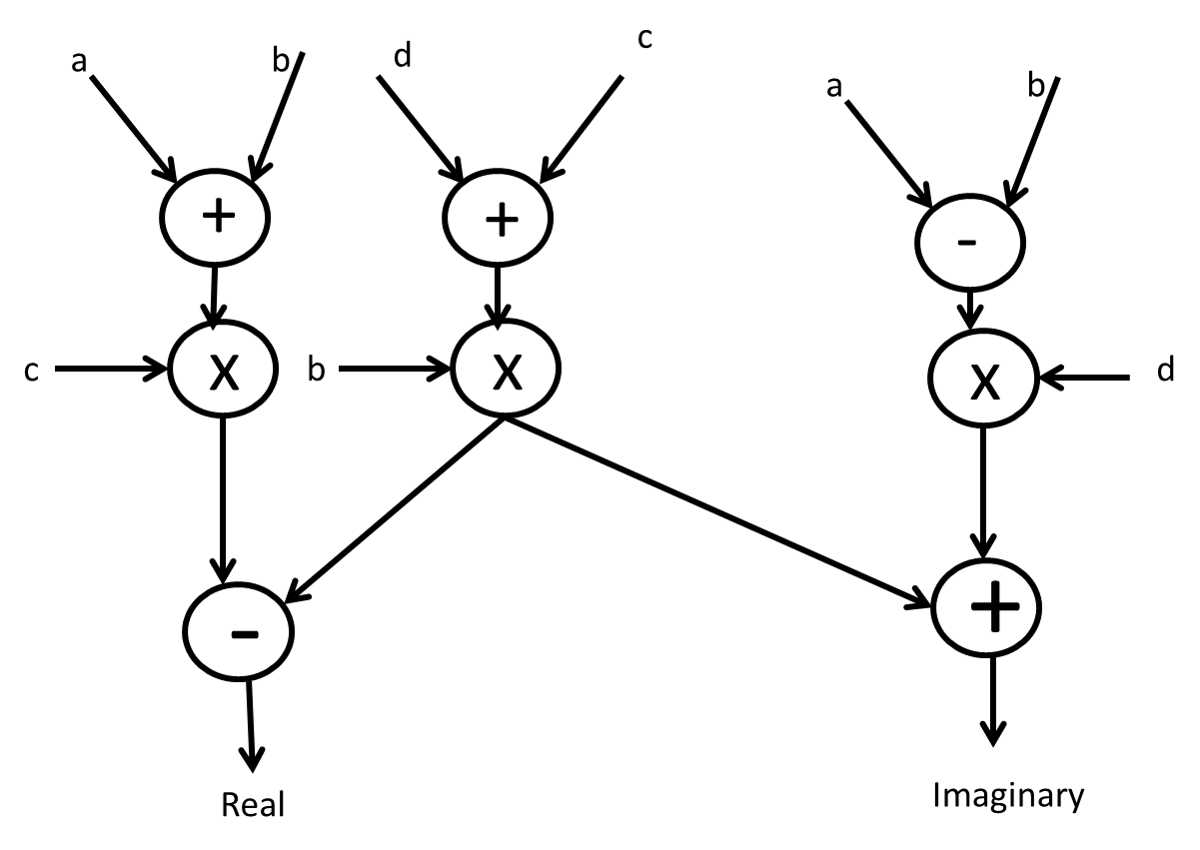
Reduced complex multiplier diagram

Slide 39
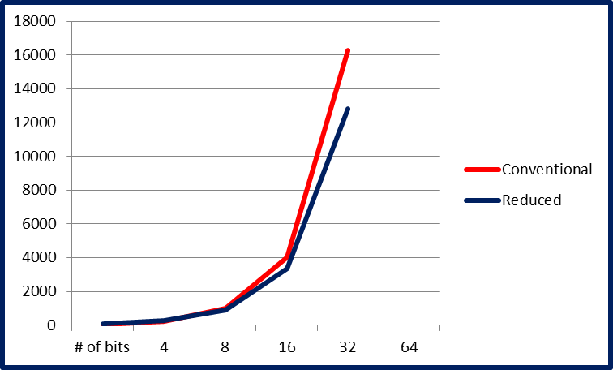
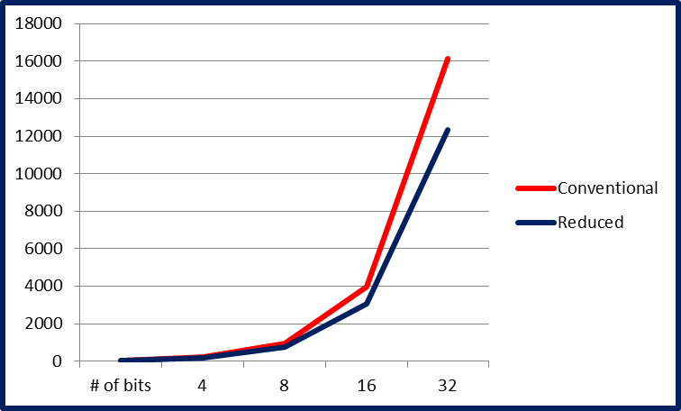
Complexity comparison
Datapath adjusted (adders only)
Uniform datapath (adders only)

