Slide 1

FINAL YEAR PROJECT 2024
Faarha Raza F2020-604
Hamza Azam F2020-705
Fiza Javaid F2020-614

Slide 2
Problem Statement
Problem statement
Pakistani artists face significant challenges in showcasing and selling their artwork due to the reliance on social media platforms, which present issues with payment processing, currency conversion and account creation on international websites.

Slide 3
Solution
Establish a specialized platform exclusively for Pakistani artists
Ensure seamless payment processing with secure methods
Facilitate direct communication between artists and buyers to enhance trust and transparency

Slide 4
Work Done in FYP I
Research
Literature Review
Survey and interviews
Login/Signup
Home screen
Product Listing

Slide 5
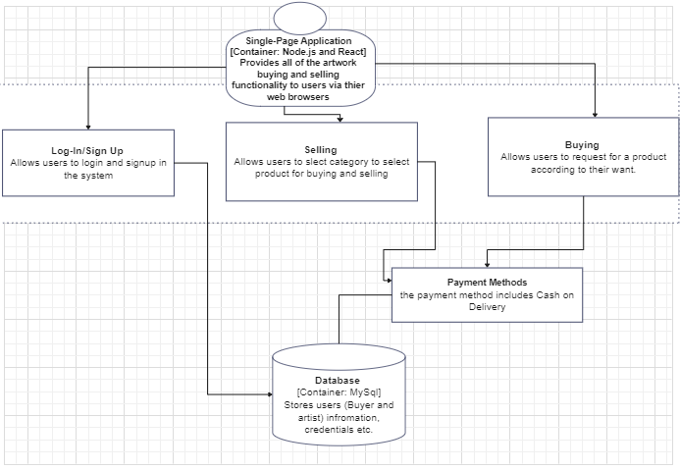
Architecture Diagram

Slide 6
Challenges
Creating an intuitive and user-friendly interface for both artists and buyers.
Designing an effective system for managing commission requests and communication between artists and clients.
Ensuring robust user authentication and data security to protect user information and transactions.
Integrating third-party services for features like email notifications.

Slide 7
In Future
We plan to expand our platform by adding a digital artwork category, allowing artists to sell and showcase digital creations.
We will add JazzCash, EasyPaisa and debit/credit cards to support national and international transactions, making payments easier for users.
Explore the implementation of advanced search filters, AI-based artwork recommendation.
Mobile app version of the platform to improve user accessibility and engagement.

Slide 8
Project Demo

Slide 9
Thanks!

