Slide 1
Capstone
IBM Certified Data Scientist

Slide 2
Predicting Location
Retail Business’s success mostly depends on its location
Locations with foot traffic brings customers
Surrounding features contributes to traffic
Locations with best features wins the contest

Slide 3
Problem Statement
Investment opportunity for an Indian Restaurant
Significant growth of Indian diaspora in NE region
Boston and its metro area is the target location
Identify a location for the new Indian Restaurant

Slide 4
Data Collection
Four Square and Google Maps are primary data sources
Four Square API - collect surrounding features
Google Maps API – Geo-coordinates for locations
Target locations – from investors
Favorite (existing) restaurants – from investors

Slide 5
Data Wrangling/Cleaning
Four Square data is cleaned to keep location data only
Any rows that are not for restaurants are dropped
Data with missing attributes are ignored
Locations fall far from preferred locations are dropped.

Slide 6
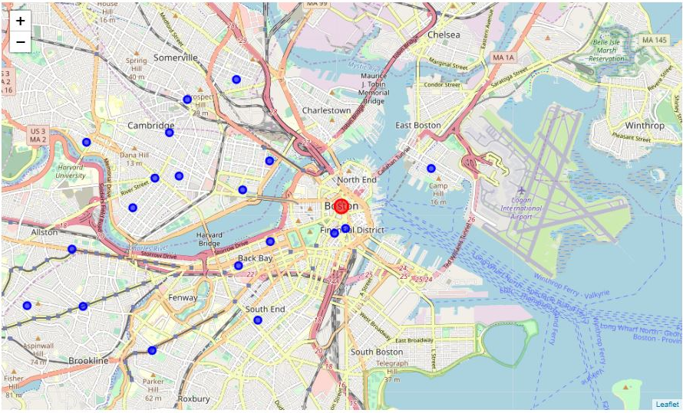
Distribution of Restaurants

Slide 7
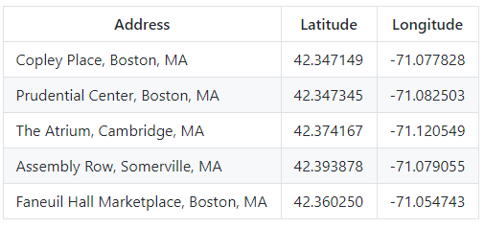
Target Locations

Slide 8
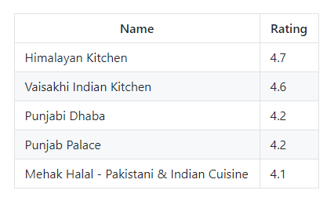
Stake Holders Favorites

Slide 9
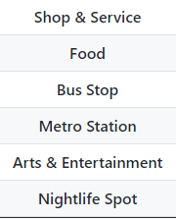
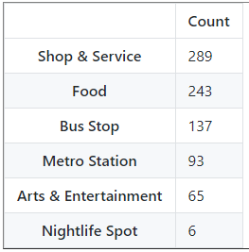
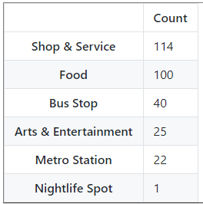
Explored Attractions
Attractions Near All Restaurants
Attractions Near Target Locations

Slide 10
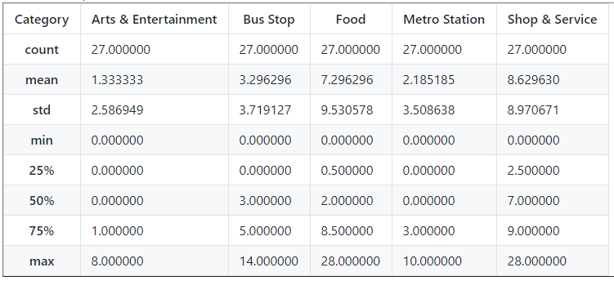
Descriptive Statistics

Slide 11
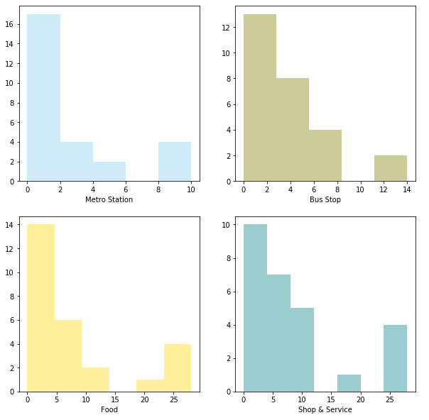
Distribution of Data

Slide 12
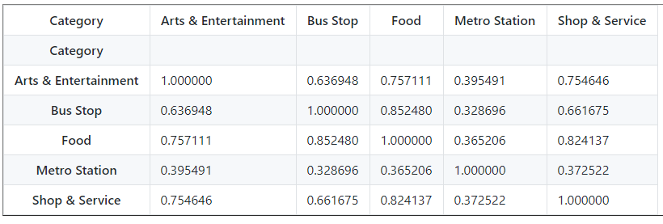
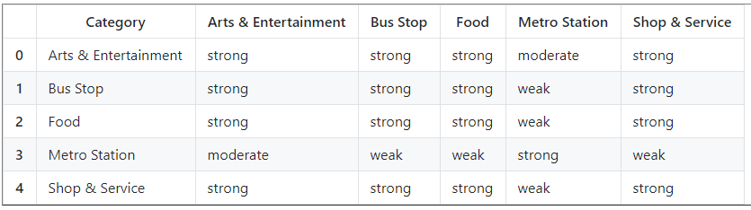
Pearson Correlation

Slide 13
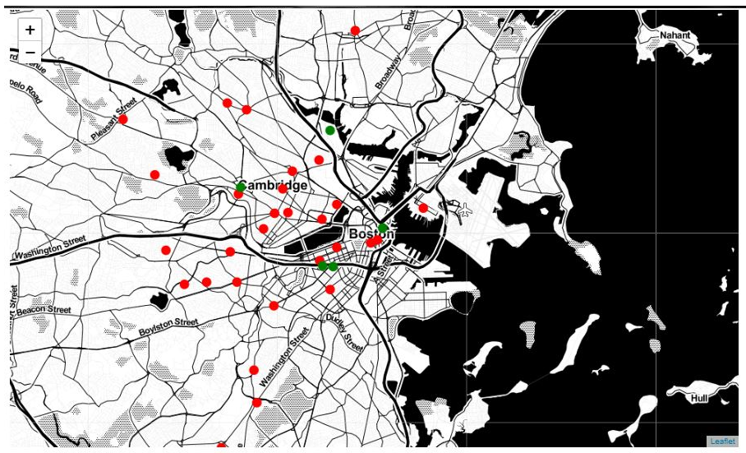
Target & Favorite Locations

Slide 14
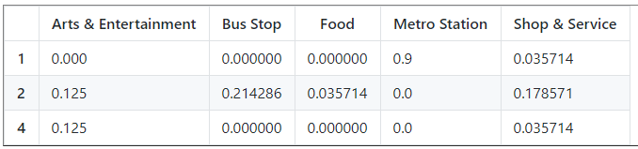
Normalized Target Location Data

Slide 15
Recommended Location
Locations were carefully analyzed
Existing locations were compared to target locations
Surrounding features were key in analysis
Punjabi Dhaba is the recommended location

Slide 16
conclusion
Different methodologies and models were tried
Efficiency and predictabilities were compared
Prediction has more room to improve
Features around the location has be the key for prediction

