Slide 1
Crime Hotspot Analysis
Mapping a safer community
Faatima Aamir_404214
Hijab Zahra_421132
A comprehensive analysis on crimes in Chicago, with Geospatial visualization techniques.

Slide 2
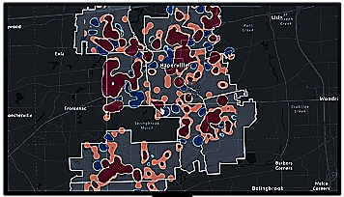
What is Crime Hotspot Analysis?
An analysis technique that assists in mapping criminal activities and to predict them for better planning and safety.

Slide 3

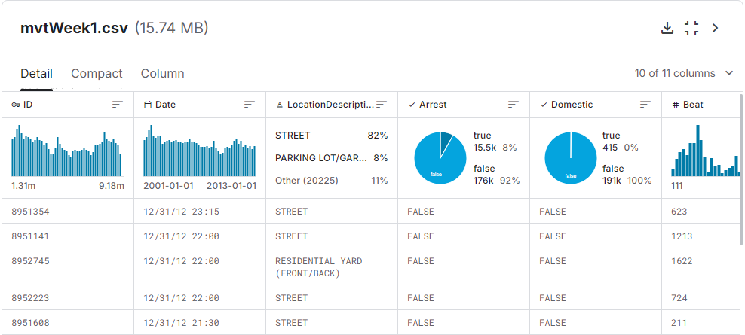
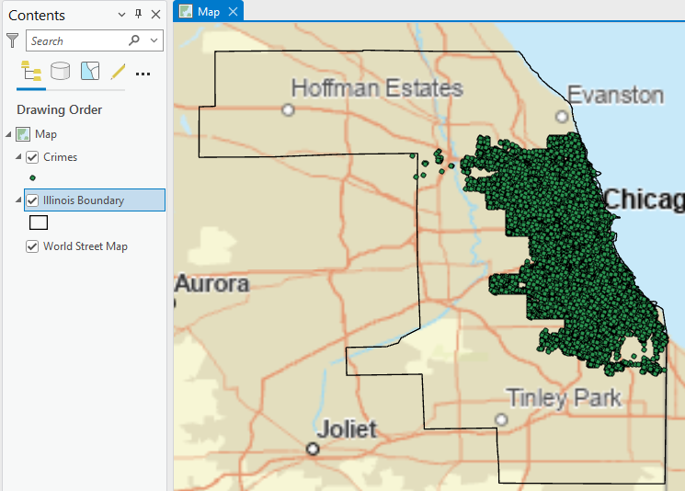
Dataset
Kaggle
Chicago, Illinois Crime Dataset
Link:
https://www.kaggle.com/datasets/econdata/chicago-city-crime-dataset?select=mvtWeek1.csv

Slide 4
1
COLLECT DATA
2
CLEAN DATA
3
TREND VISUALIZATION
The Analysis Process
4
DESCRIPTIVE STATISTICS
5
HOTSPOT ANALYSIS
6
PREDICTIVE MODELLING
7
ACCURACY ASSESSMENT

Slide 5
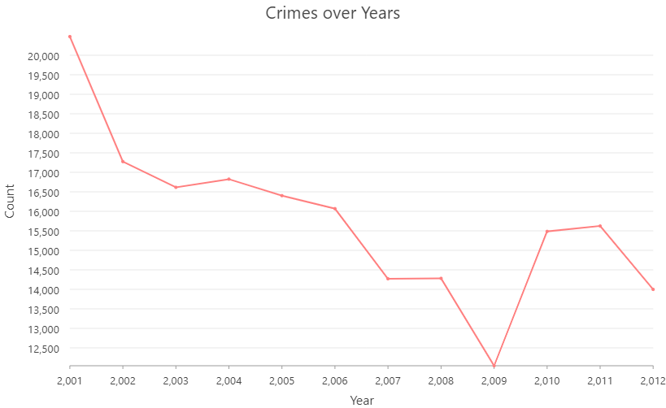
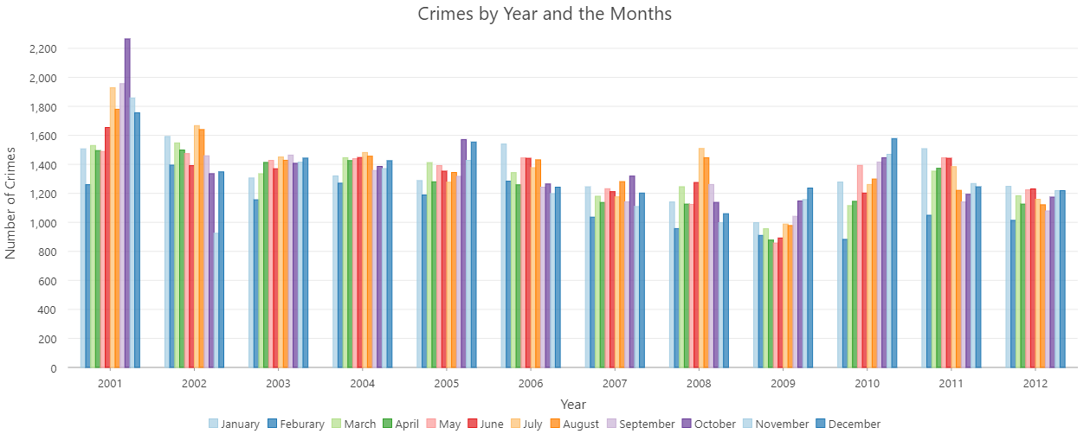
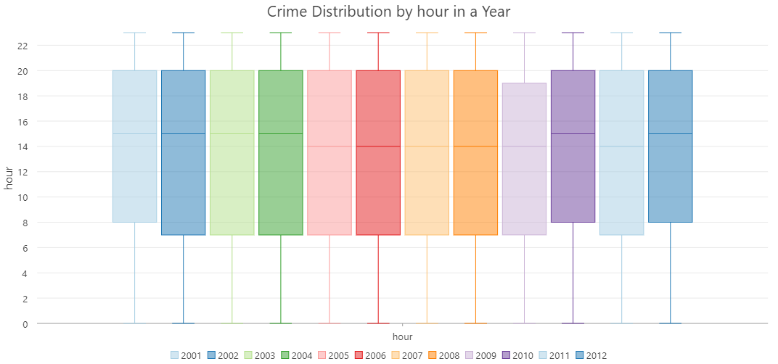
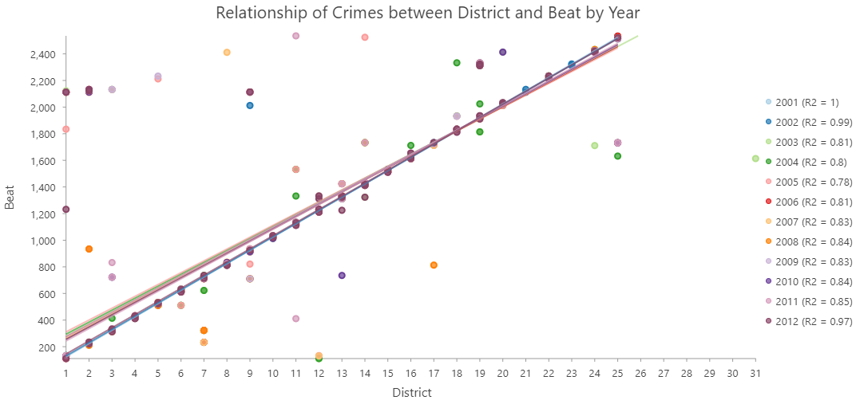
Visualization of Trend Analysis
Line Graph-Trend over the Years
Bar Graph-Distribution of Crimes by Years and Months
Boxplot-Distribution by Hour
Scatterplot-Relationship of Crimes between Districts and Beats

Slide 6
Line Graph-Trend over the Years

Slide 7
Bar Graph-Distribution of Crimes by Years and Months

Slide 8
Boxplot-Distribution by Hour

Slide 9
Scatterplot-Relationship of Crimes between Districts and Beats

Slide 10
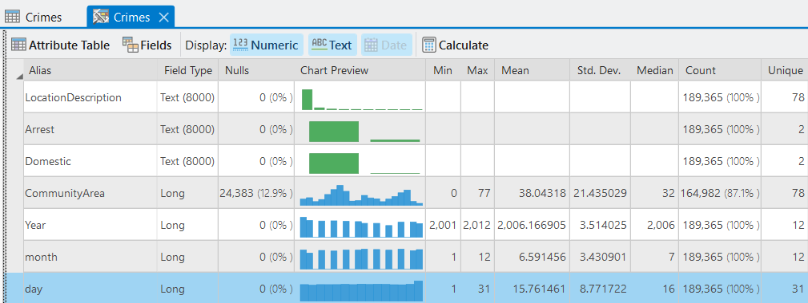
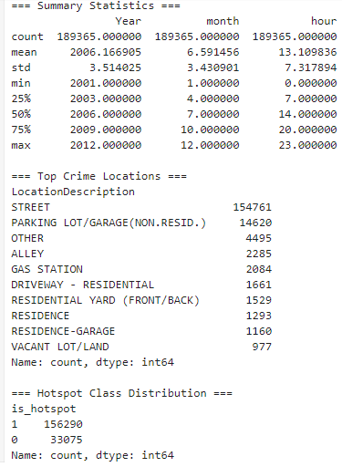
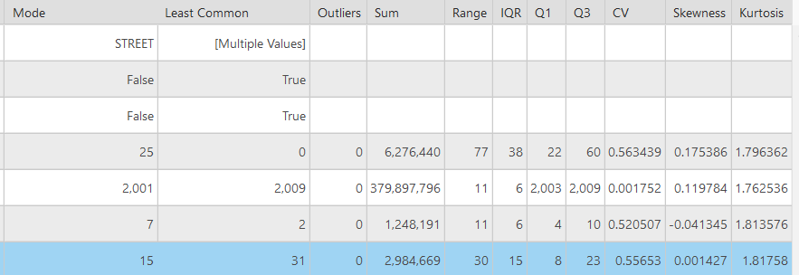
Descriptive Statistics
A thorough summary of the data in a concise manner

Slide 11
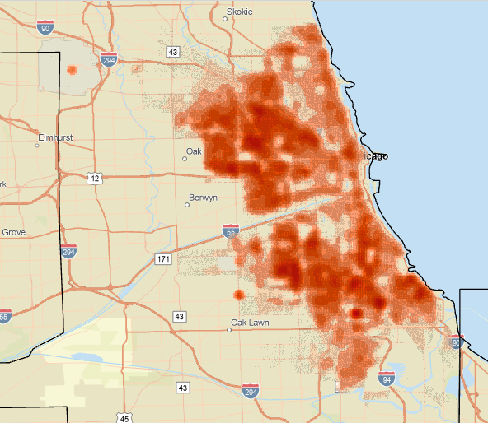
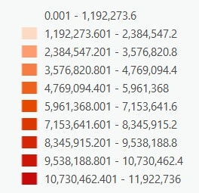
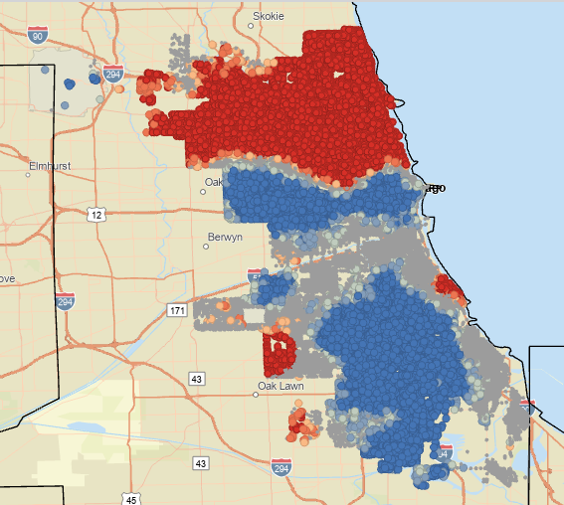
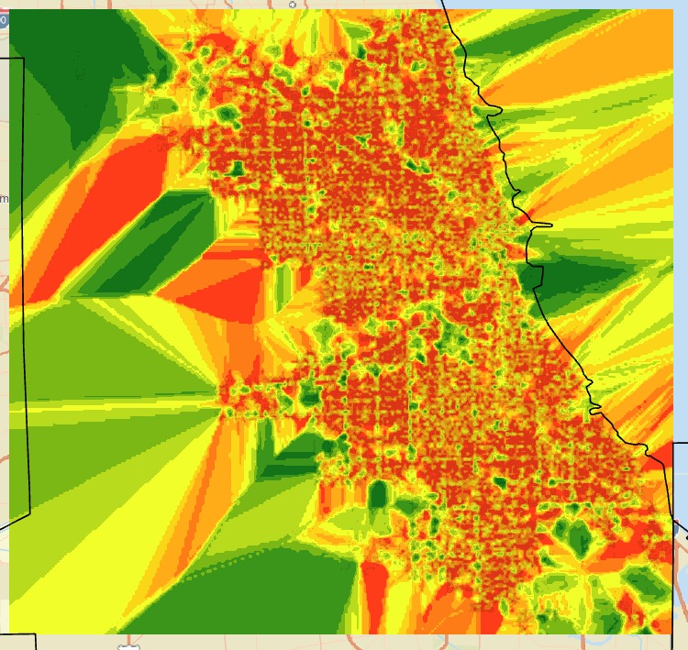
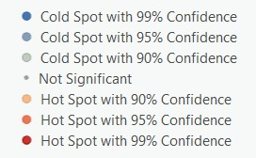
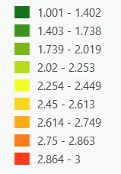
Spatial Statistics
Kernel Density
Generation of Heatmaps, on the bases of density and its weight.
Getis ord
Clustering of points to detect hotspots and coldspots on the basis of z-score and p-score.
Kriging
Raster map generation for the prediction, for a continuous surface, on the basis of interpolation.

Slide 12
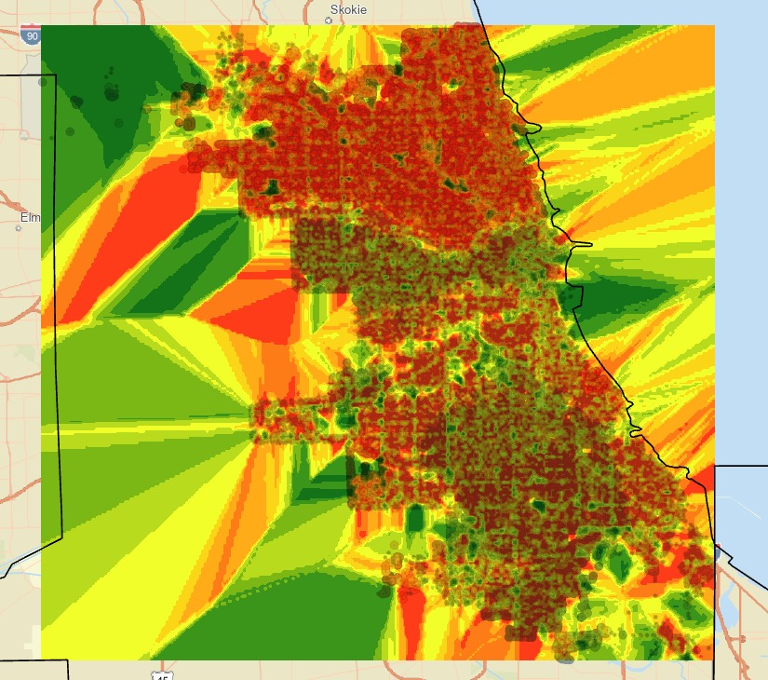
Combined Results
An overlay of the Krigging and Getis-Ord
The overlay shows how accurate the krigging results are.

Slide 13
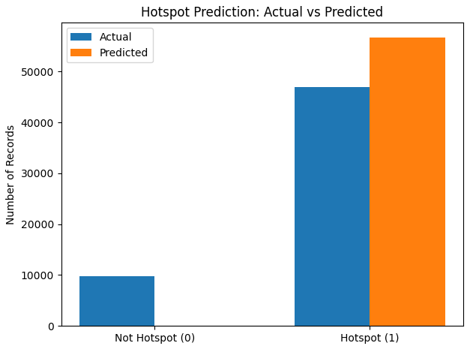
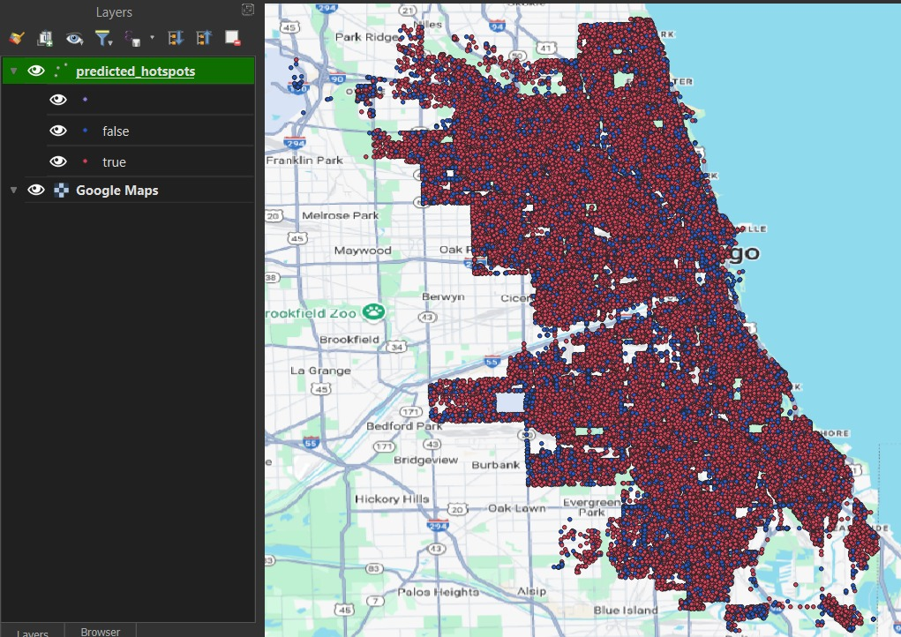
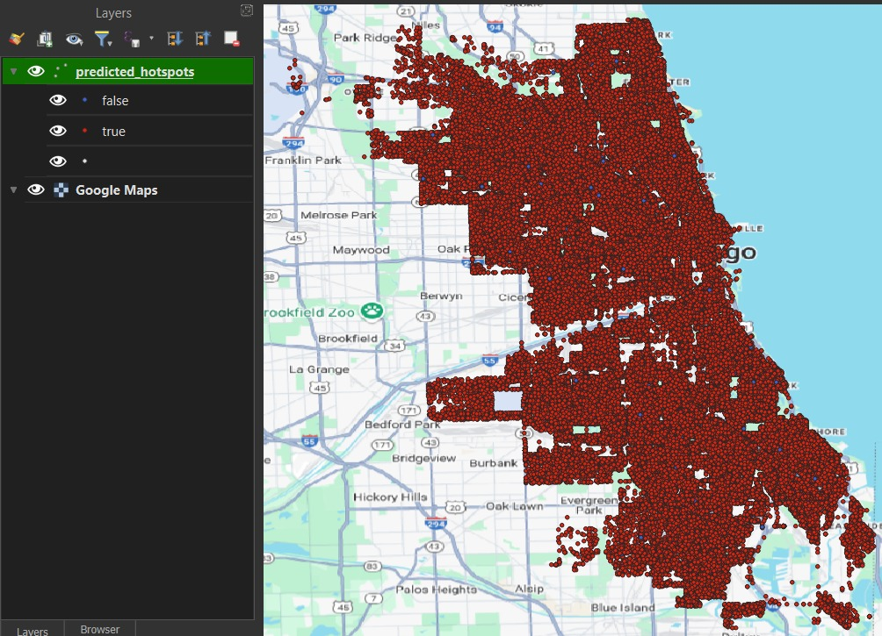
Predictive Modelling
Classification through Random Forest
It can predict Hotspots to maximum extent, but it was was not able to dectect for the non-hotspot areas.
Visualizing in QGIS
Shows the predicted crime hotspots, and the original locatiions for crime hotspot.

Slide 14
Thank You

