Slide 1
Identifying encrypted online video streams using bitrate proﬁles Bachelor’s Thesis Nr. 214b
Florian Moser
Supervised by Prof. Dr. Ankit Singla and Melissa Licciardello
Systems Group
Department of Computer Science
ETH Zurich

Slide 2
Background
Video compression ﬁlesize of videos depends on its content
Netflix Streaming provider from California, USA 131 millions of users
Existing Work Identify video based on segment sizes
DASH video playback adapts to environement video split in segments
2

Slide 3
Variable bitrate encoding
Bitrate: Bits available per time unit higher bitrate means higher quality for the same movie
Variable: Depending on the video because of the way compression works
3

Slide 4
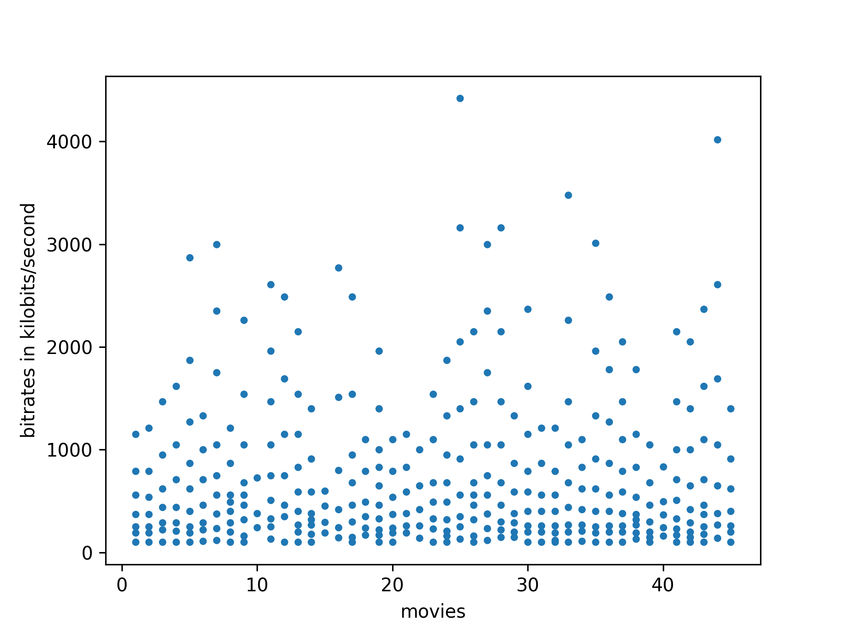
Variable bitrate encoding
Variable bitrate encoding: Netflix
Bitrate: Bits available per time unit higher bitrate means higher quality for the same movie
Bitrate: Bits available per time unit higher bitrate means higher quality for the same movie
Variable: Depending on the video because of the way compression works
Fixed resolution set constrained by end devices
4

Slide 5
Background
Video compression ﬁlesize of videos depends on its content
Netflix Streaming provider from California, USA 131 millions of users
Existing Work Identify video based on segment sizes
DASH video playback adapts to environement video split in segments
Variable bitrate encoding adapt compression to the speciﬁc video
5

Slide 6
Background
Video compression ﬁlesize of videos depends on its content
Netflix Streaming provider from California, USA 131 millions of users
DASH video playback adapts to environement video split in segments
Our Work Identify video based on the bitrates
Solely the measured bandwidth is enough to determine the video!
Variable bitrate encoding adapt compression to the speciﬁc video
6

Slide 7
Motivation
Solely the measured bandwidth is enough to determine the video!
= its easy!
Privacy implications Mass-Surveillance of users ISP-distrimination based on video streaming habits
7

Slide 8
Capture
Modified netflix player able to enforce specific bitrate
Netflix on
Chrome/Selenium
The Internet
Chrome, Selenium, BrowserMob Proxy, HAR files automate netflix traffic capture at different bitrates
BrowserMob Proxy
.har
.har
.har
.har
.har
8

Slide 9
Preparation
Parse HAR files package (=HTTP request size) to Sqlite database
.har
.har
.har
.har
.har
9

Slide 10
Preparation
Parse HAR files extract relevant information to Sqlite database
10

Slide 11
Attacker Model
Attacker
Netflix Browser
The Internet
listens
Controls available bandwidth
Attacker
compares
11

Slide 12
Control Bandwidth
Control Bandwidth: Expectations
Downloaded video size
bitrate
Available bandwidth
12

Slide 13
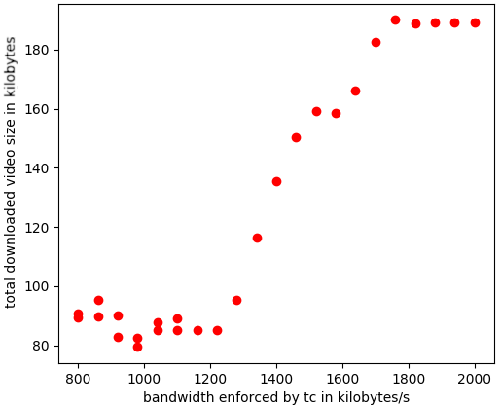
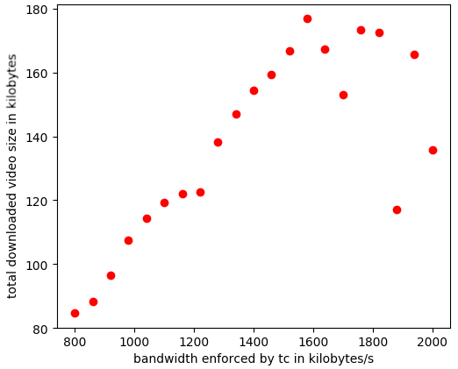
Control Bandwidth
Control Bandwidth: Reality
Imprecise
Time intensive
Difficult to quantify
13

Slide 14
Attacker Model
Attacker
Netflix Browser
The Internet
listens
Controls available bandwidth to measure bitrates of video
Attacker
compares
14

Slide 15
Attack
Simulate Traffic to quantify danger better
listens
Attacker
compares
15

Slide 16
Simulate traffic
Query database get specific package(s) for specific bitrate b of movie m
p1
Distort package(s) with a factor delta
p1
Attacker
Query database with distorted package with a factor delta
p1
p6
p1
16

Slide 17
Our Attackers
Bitrate attacker queries over all different bitrates of a movie
Naive attacker queries over the same bitrate of a movie
p1
p2
p3
p1
p2
p3
p3
p1
p2
p3
p1
p2
p3
p2
p1
p2
p1
p6
p2
p5
p3
p1
p3
p9
p1
p3
p6
p3
p1
p2
p3
p1
p1
p2
p1
p1
p2
p3
p1
p2
p3
p6
p2
p1
17

Slide 18
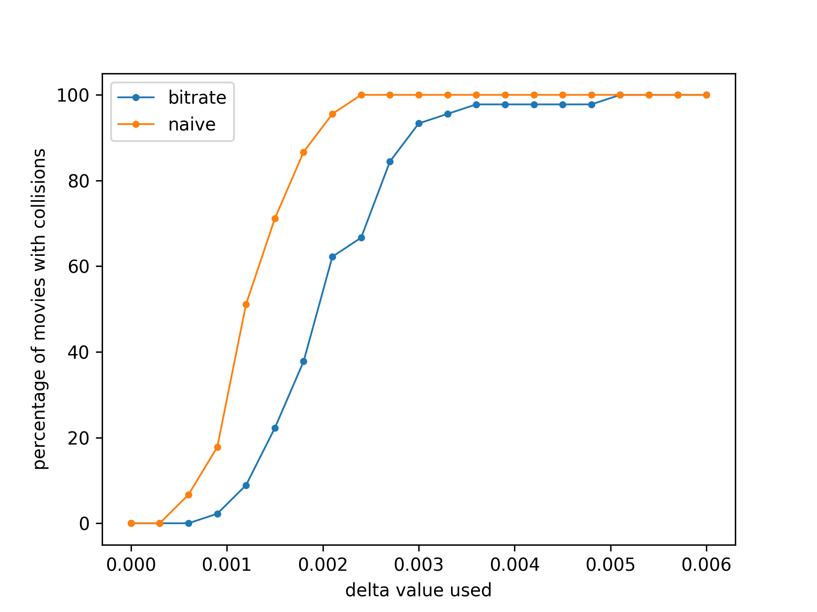
Results: Using 3 video segments per bitrate
x-axis for used delta value y-axis for percentage of movies with collisions
Shown: Variable bitrate encoding makes the identification of videos easier.
Not Shown yet: Identification of videos possible using the measured bandwidth.
18
Notes:
0.3mb average size

Slide 19
How to simulate measured bandwidth
p1
/ capture time
= bandwidth
19

Slide 20
How to simulate measured bandwidth
p1
p2
p3
/ capture time
= bandwidth
20

Slide 21
How to simulate measured bandwidth
3-package
/ capture time
= bandwidth
Simulate bandwidth High aggregation factor Bitrate attacker looks at single aggregated package per bitrate
21

Slide 22
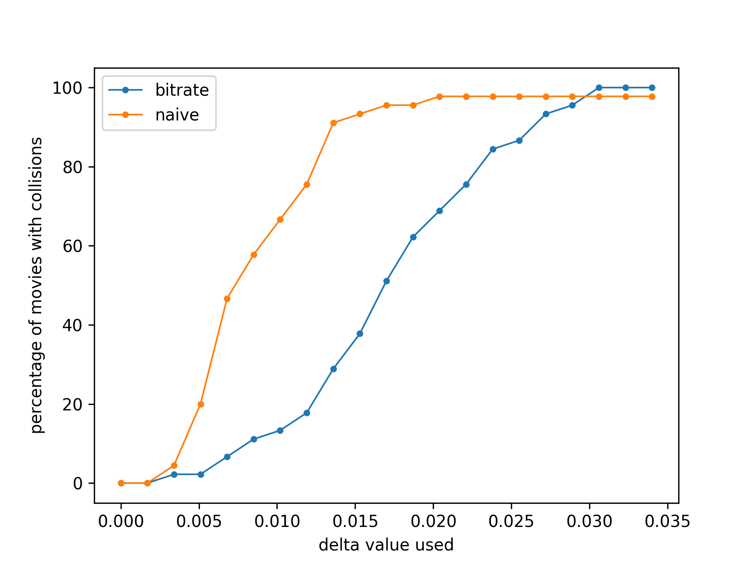
Results: Using 10-packages as bandwidth approximation
x-axis for used delta value y-axis for percentage of movies with collisions
Shown: Variable bitrate encoding allows to identify the videos using only the measured bandwidth
22

Slide 23
Further work
Collect more evidence more movies longer capture higher aggregations
Modify DASH request same-sized packages fix bitrates instead of resolutions
23

Slide 24


Summary
Segment sizes
Bandwidth
24

Slide 25
Appendix
Here starts the appendix
25

Slide 26
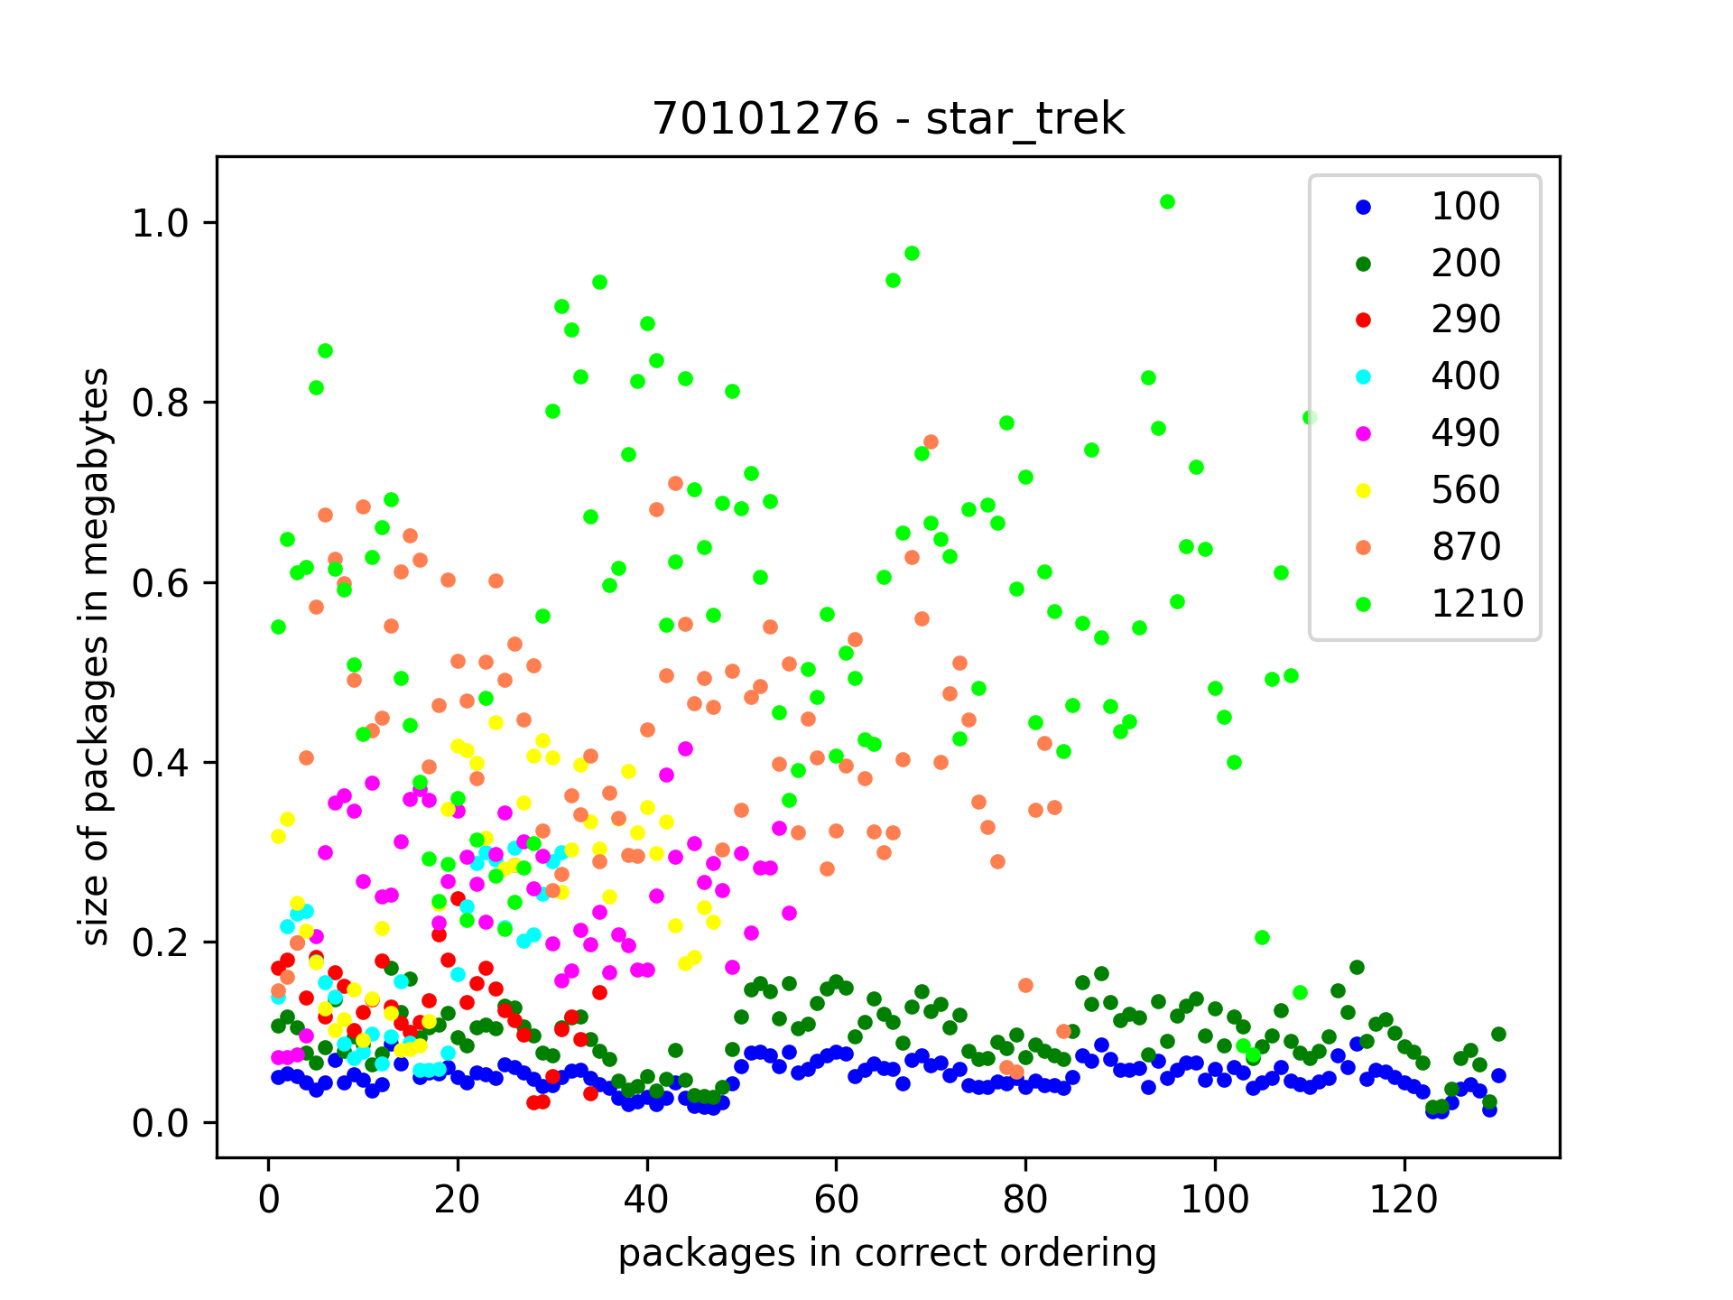
Package sizes are very different
Colors: bitrates
26

Slide 27
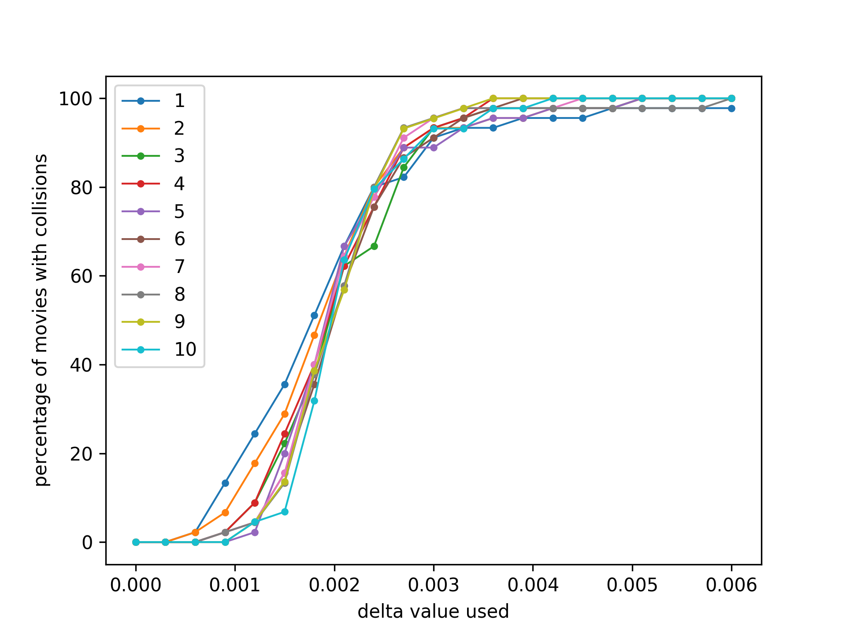
Packages per bitrate of low influence
Colors: #packages per bitrate
27

Slide 28
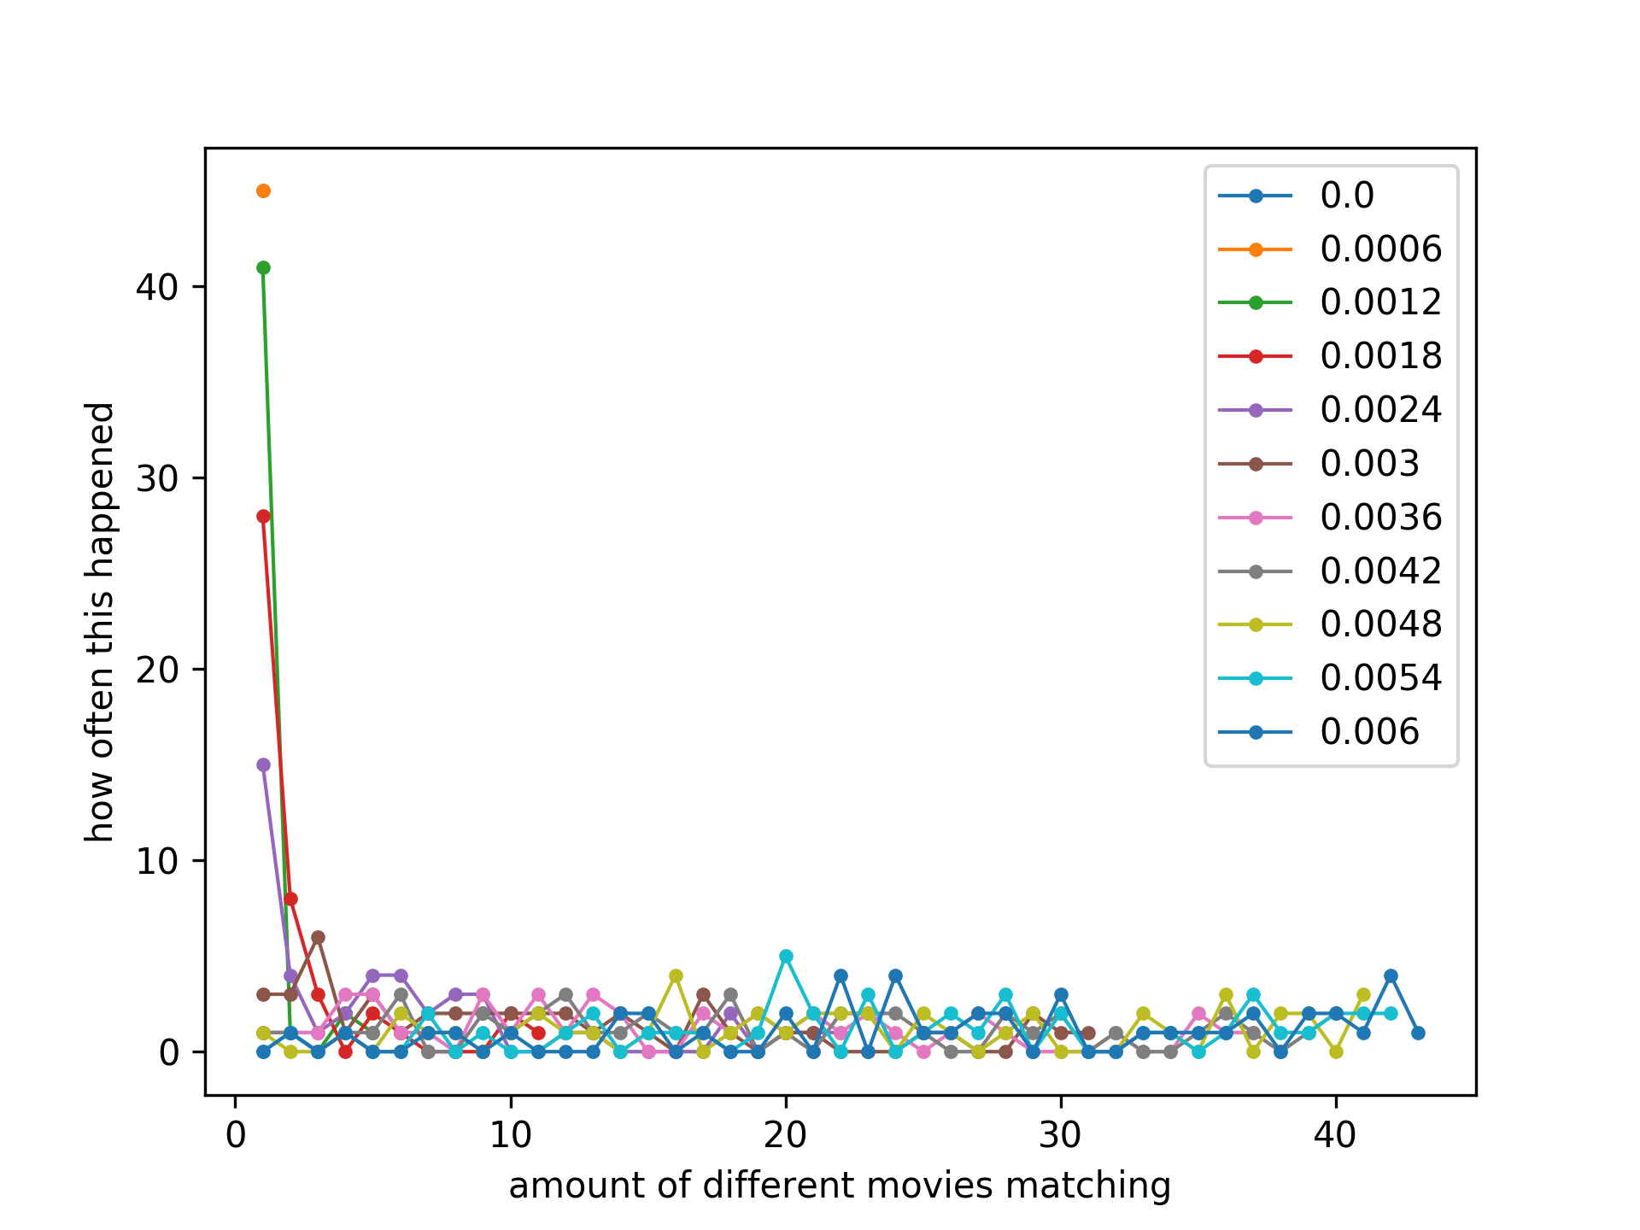
Low collision numbers
Colors: different delta values
28

Slide 29
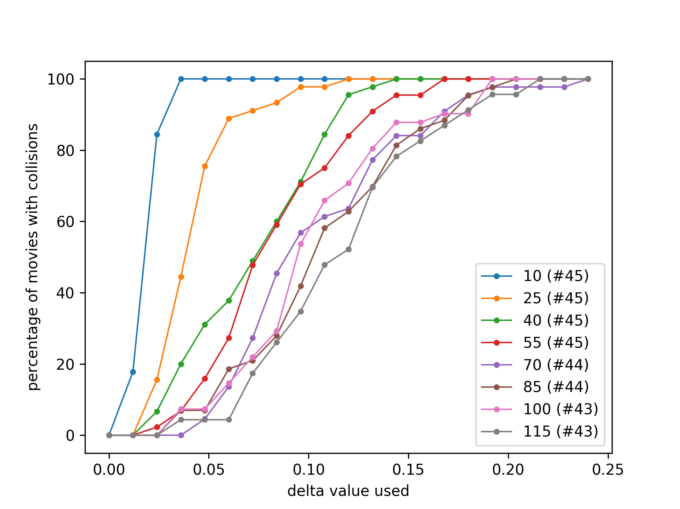
Increasing bandwidth approximation
Colors: different agregation levels
29

Slide 30
Single Bitrate Attack
Query database get n packages for bitrate b of movie m
p1
p2
p3
Distort packages with a factor delta
p1
p2
p3
Attacker
Query database with distorted packages with a factor delta
p2
p1
p1
p3
p6
p3
p1
p1
p2
p9
p1
Determine matching movies unique package for each queried distored package
p1
p2
p3
p6
p2
p1
30

Slide 31
Our Attackers
Bitrate attacker queries over all different bitrates of a movie
Naive attacker queries over the same bitrate of a movie
p1
p2
p3
p1
p2
p3
p3
p1
p2
p3
p1
p2
p3
p2
p1
p2
p1
p6
p2
p5
p3
p1
p3
p9
p1
p3
p6
p3
p1
p2
p3
p1
p1
p2
p1
p1
p2
p3
p1
p2
p3
p6
p2
p1
31

Slide 32
Our Attackers
Bitrate attacker queries over all different bitrates of a movie
Naive attacker queries over the same bitrate of a movie
p1
p2
p3
p1
p2
p3
p3
p1
p2
p3
p1
p2
p3
p2
p1
p2
p1
p6
p2
p5
p3
p1
p3
p9
p1
p3
p6
p3
p1
p2
p3
p1
p1
p2
p1
32

Slide 33
Our Attackers: Using three video segments per bitrate
Bitrate attacker queries over all different bitrates of a movie
Naive attacker queries over the same bitrate of a movie
p1
p2
p3
p3
p1
p2
p1
p1
p2
p2
p3
p3
p1
p2
p3
p3
p1
p2
p3
p3
p2
p3
p2
p2
p1
p1
p2
p3
p3
p1
p1
p2
p3
p3
p1
p2
p3
p2
p3
p1
p2
p2
p1
p1
p1
p1
p1
p5
p3
p1
p2
p1
p2
p1
p2
p6
p2
p3
p9
p3
p9
p3
p9
p3
p1
p6
p2
p5
p3
p6
p3
p6
p3
p6
p3
p1
p1
p3
p1
p1
p1
p6
p2
p2
p5
p3
p3
p1
p1
p2
p1
p1
p2
p1
p1
p2
p1
p1
p2
p3
p3
p1
p1
p2
p3
33
Notes:
Why 3: 12 seconds at each bitrate, so maybe 12*6= about a minute of traffic

Slide 34
Our Attackers: Using three video segments per bitrate
Bitrate attacker queries over all different bitrates of a movie
Naive attacker queries over the same bitrate of a movie
p1
p2
p3
p3
p1
p2
p1
p1
p2
p2
p3
p3
p1
p2
p3
p3
p1
p2
p3
p3
p2
p3
p2
p2
p1
p1
p2
p3
p3
p1
p1
p2
p3
p3
p1
p2
p3
p2
p3
p1
p2
p2
p1
p1
p1
p1
p1
p5
p3
p1
p2
p1
p2
p1
p2
p6
p2
p3
p9
p3
p9
p3
p9
p3
p1
p6
p2
p5
p3
p6
p3
p6
p3
p6
p3
p1
p1
p3
p1
p1
p1
p6
p2
p2
p5
p3
p3
p1
p1
p2
p1
p1
p2
p1
p1
p2
p1
p1
p2
p3
p3
p1
p1
p2
p3
34
Notes:
Why 3: 12 seconds at each bitrate, so maybe 12*6= about a minute of traffic

Slide 35
Our Attackers: Using one 10-package per bitrate
Bitrate attacker queries over all different bitrates of a movie
Naive attacker queries over the same bitrate of a movie
p1
p2
p3
p1
p1
p1
p3
p1
p2
p3
p1
p1
p1
p2
p1
p1
p5
p3
p1
p2
p1
p2
p1
p2
p6
p2
p3
p3
p1
p1
p2
p3
p6
p6
p1
p1
p1
p1
35
Notes:
Why 3: 12 seconds at each bitrate, so maybe 12*6= about a minute of traffic

