Slide 1
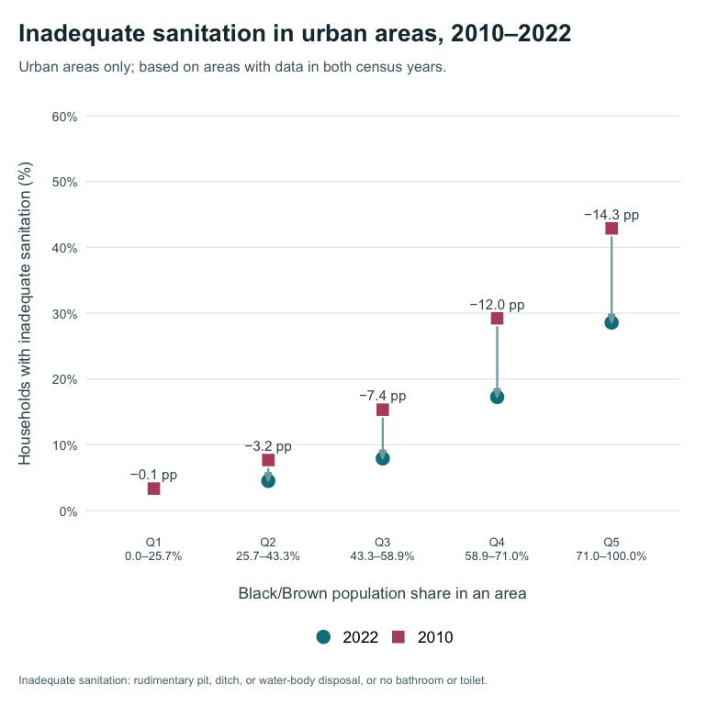
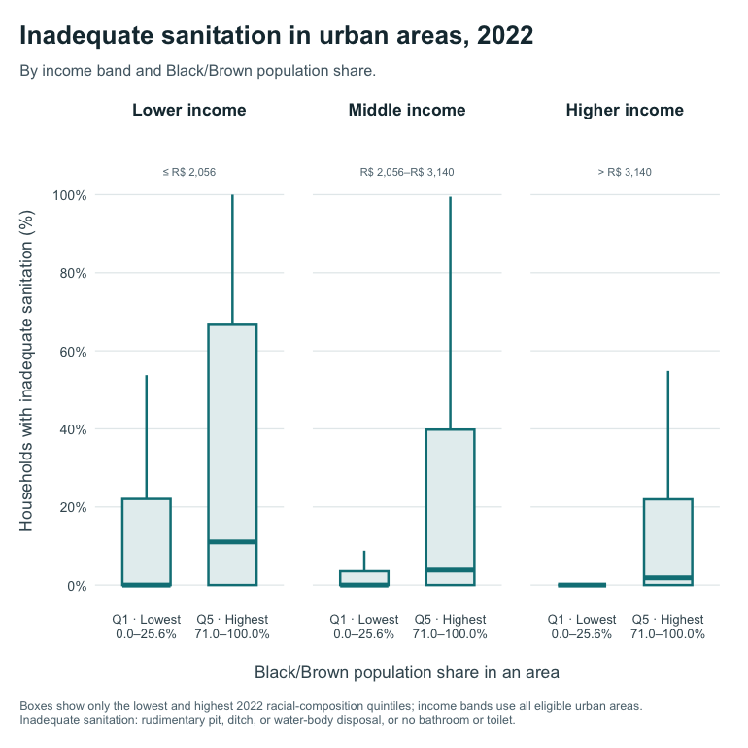
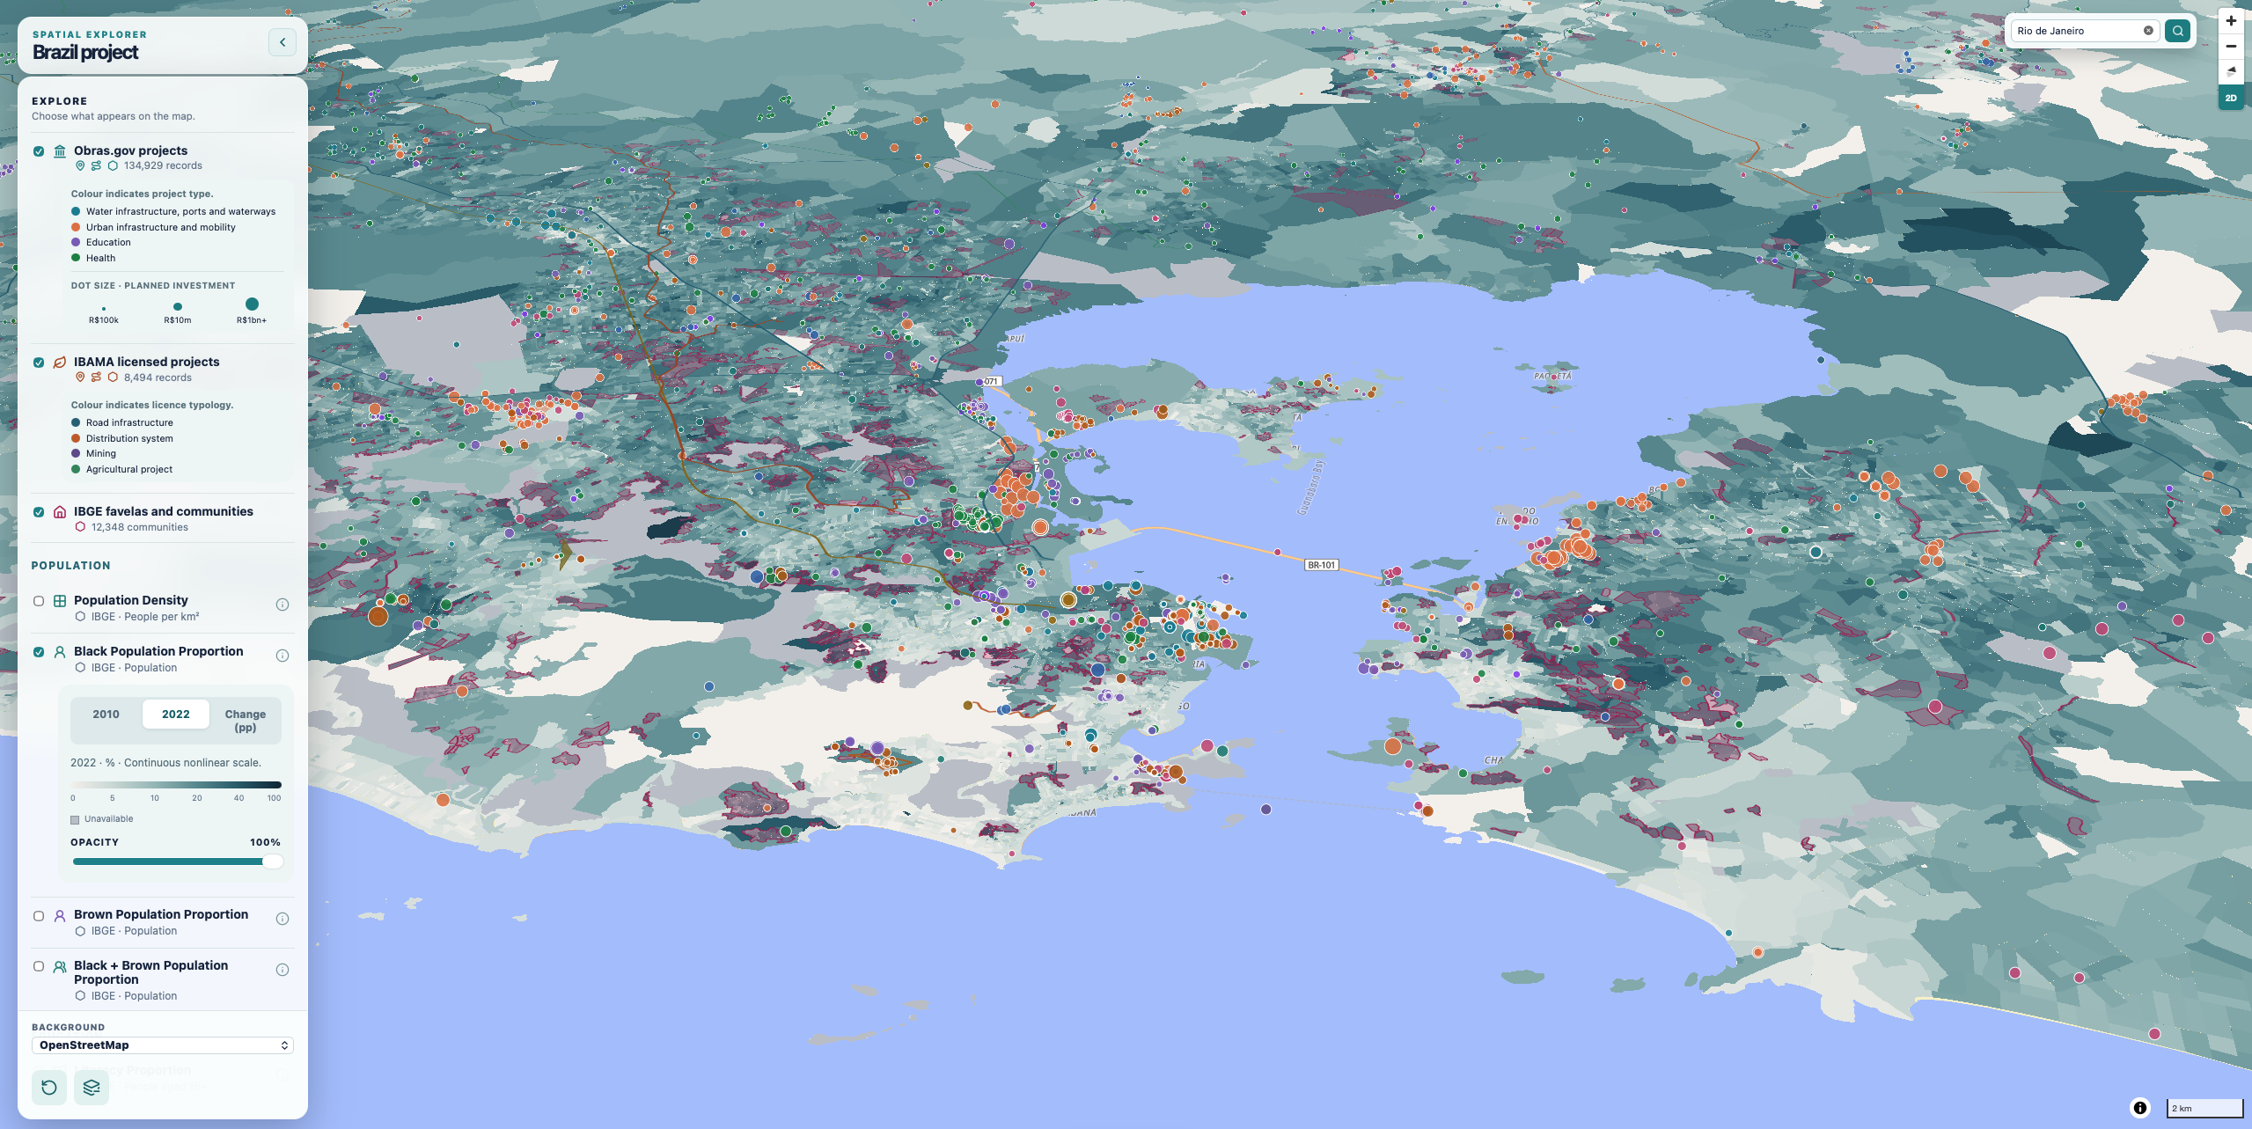



Infrastructure, Race, and Urban Change in Brazil – Who Benefits?
Constructing a National Database of Major Infrastructure Projects
Fabio Schreiber¹, Lorena Melgaço¹, Luana Xavier Pinto Coelho², Philipp Stark¹
¹Lund university, Lund, Sweden; ²University of Brasília, Brasília, Brazil
Motivation
Preliminary Analysis
Large-scale infrastructure investments are frequently promoted as instruments of urban development. However, it remains unclear who benefits from them. While it has been investigated under a class-based framing, systemic racial inequality remains under-researched in this aspect (Dantzler, 2021). Urban planning has historically contributed to the reproduction of racially segregated spaces and unequal access to urban resources, and infrastructure and development interventions have often been implemented through colour-blind approaches that overlook racialised patterns of inequality (Melgaço & Xavier Pinto Coelho, 2022; Xavier Pinto Coelho & Melgaço, 2025).
To be able to analyse how these inequalities are produced and transformed over time, it is therefore necessary to build a comprehensive spatial data infrastructure that brings together census data with geospatial information on public and infrastructure investments, which is currently not available in a systematic form.
In a first analysis we focused only on sanitation as core infrastructure. We looked at the percent of households in an area with no or only rudimentary access to sanitation, which should decrease with infrastructure investment.
Aims
build a georeferenced national database of major public infrastructure investments covering the 2010–2020 intercensal period;
integrate information from multiple sources to create a consistent spatial record of infrastructure investment across the country;
link this database with census data to enable spatial analysis of how infrastructure development intersects with changing patterns of racial and socio-spatial inequality over time
Methods
Inadequate sanitation declined in every racial-composition quintile. The largest reductions occurred in Q4 and Q5. Despite this progress, Q5 remained the most affected group in 2022.
We combine IBGE census data from 2010 and 2022 with Obras.gov investment projects, IBAMA-licensed projects, and IBGE favelas and communities. Census tracts are harmonised into common geographical areas, allowing the same places to be compared between the two census years. We examine population density, racial composition, literacy, household-head income, housing, and access to water, waste collection, sewerage and sanitation services. If data are missing for an area, it is left out of that specific calculation rather than counted as zero. We summarise indicators across common areas and compare patterns by area racial composition and income; results describe area-level patterns, not individual outcomes or causal effects.
A visualization tool
We developed a web application for exploring the interactive map shown here, with additional variables on income, population density, literacy, housing and basic services.
Q5 areas tend to have higher inadequate sanitation than Q1 areas. This pattern appears in lower-, middle-, and higher-income bands. Income differences therefore do not fully account for the spatial inequality.
Lund Social Sciences Methods Centre
Contact and profile
fabio.schreiber@keg.lu.se

