Slide 1
Software Engineering and Design
Task 4 - Requirements document

Slide 2
Functional user requirements
Read patient data
Read diagnosis
Change diagnosis
Read medication
Change medication
Read ICD-10 catalog
Read medication catalog
Read history
Read Orders
Change Orders
Help systemo add text

Slide 3
Non-functional requirements
Tablet
Medication
Data protection

Slide 4
Functional system requirements
Read patient data
Read diagnosis
Change diagnosis
Read medication
Change medication
Read ICD-10 catalog (diagnosis database)
Read medication catalog (medication database)
Read history
Change history
Read Orders
Change Orders
Help system

Slide 5
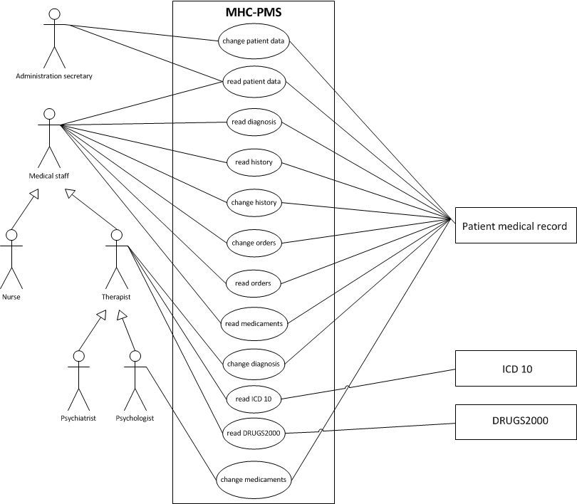
Use cases

Slide 6
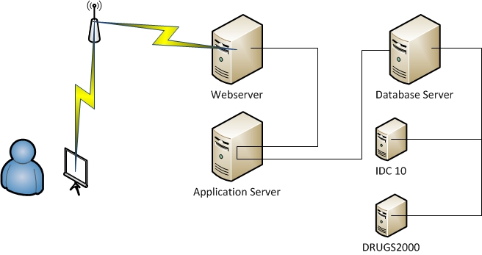
System architecture and system models
Client-server web application with multiple layers.

Slide 7
System evolution
Buffer
Intelligent system architecture

Slide 8
Testing
Dummy database
Simulation
Usability testing
Security testing

