Slide 1
Software Engineering and Design Task 12
State Pattern

Slide 2
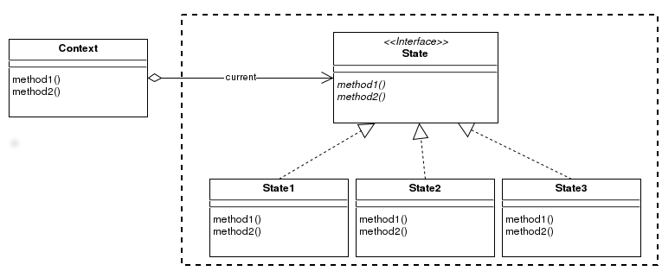
Übersicht

Slide 3
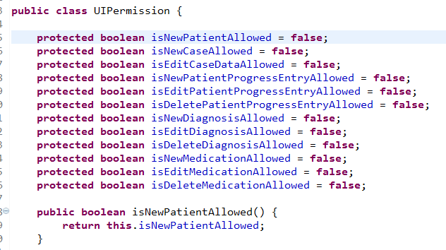
State Base Class

Slide 4
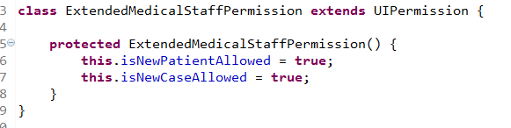
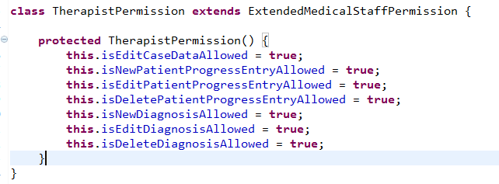
State Subclasses

Slide 5
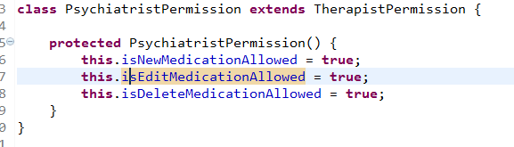
State Subclasses

Slide 6

UI Class

Slide 7
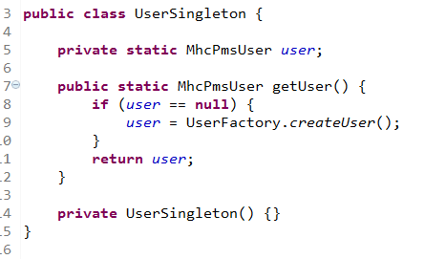
UserSingleton Class

Slide 8
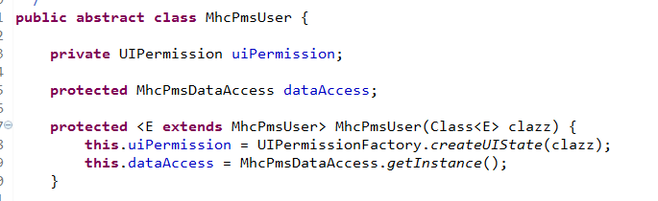
User Base Class

Slide 9
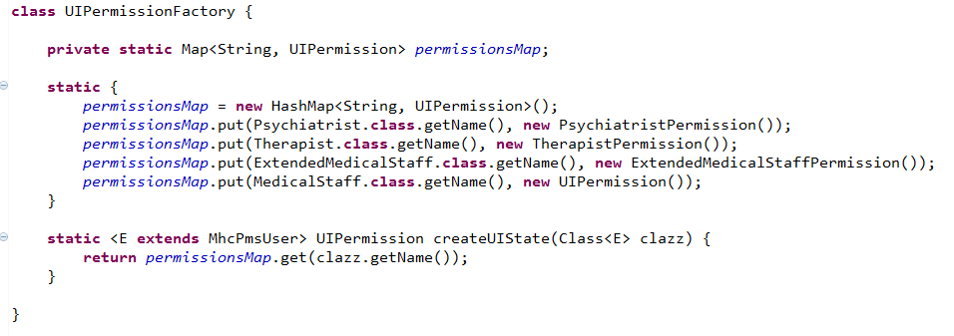
UserPermissionFactory Class

