Slide 1

CONTINENTAL
PAYMENT TECHNOLOGIES
Brand book
Continental Payment Technologies, Inc.
Payment technology across the Americas
VERSION 1.1 | SEPTEMBER 2026
Notes:
[Sources]

Slide 2
BRAND FOUNDATION
02
The brand makes complex commerce feel operationally simple
PURPOSE
BRAND PROMISE
Enable payment and self-service programs to operate confidently across the Americas.
One accountable technology partner - from device choice to fleet visibility.
POSITIONING
A regional payment technology company combining devices, kiosks and multi-brand management.
NORTH AMERICA LATIN AMERICA CARIBBEAN
CONTINENTAL PAYMENT TECHNOLOGIES | BRAND BOOK | VERSION 1.1
Notes:
[Sources]
- https://www.nexgoglobal.com/
- https://www.fecpos.com/

Slide 3
NAMING SYSTEM
03
One consistent company name
LEGAL ENTITY
Continental Payment Technologies, Inc.
PRIMARY DOMAIN
continentalpaytech.com
PUBLIC BRAND
firstname.lastname@continentalpaytech.com
Continental Payment Technologies
Primary company website and email domain.
SECONDARY continentalpay.tech
Approved descriptor
Payment devices, kiosks and lifecycle management
CONTINENTAL PAYMENT TECHNOLOGIES | BRAND BOOK | VERSION 1.1
Notes:
[Sources]
- https://rdap.verisign.com/com/v1/domain/continentalpaytech.com
- https://rdap.radix.host/rdap/domain/continentalpay.tech
- https://www.icann.org/rdap/

Slide 4
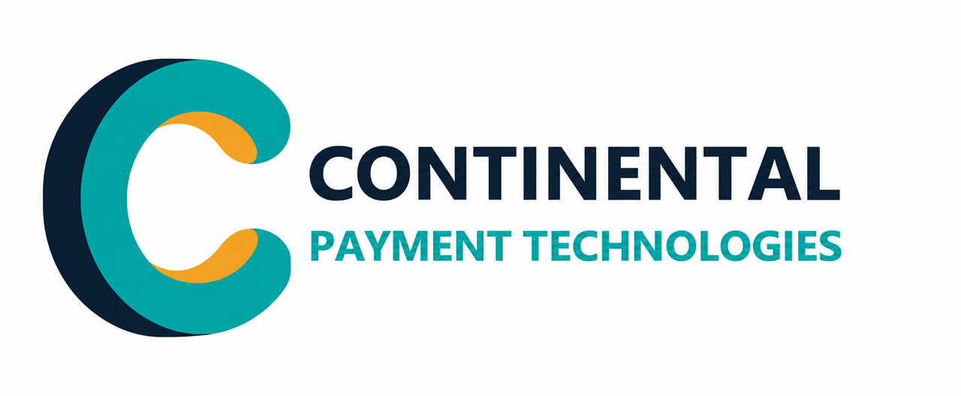
LOGO IDEA
04
The symbol expresses connected continental movement
An interwoven C
A continuous ribbon creates a distinctive C for continental reach, connected operations and long-term partnership.
Navy and teal
Navy provides stability; teal carries visible commerce across devices, kiosks and software.
Amber activation
The small accent marks the moment technology becomes a transaction.
CONTINENTAL PAYMENT TECHNOLOGIES | BRAND BOOK | VERSION 1.1
Notes:
[Sources]
- Final flat master derived from the user-supplied interwoven C concept using the built-in image generation workflow.

Slide 5
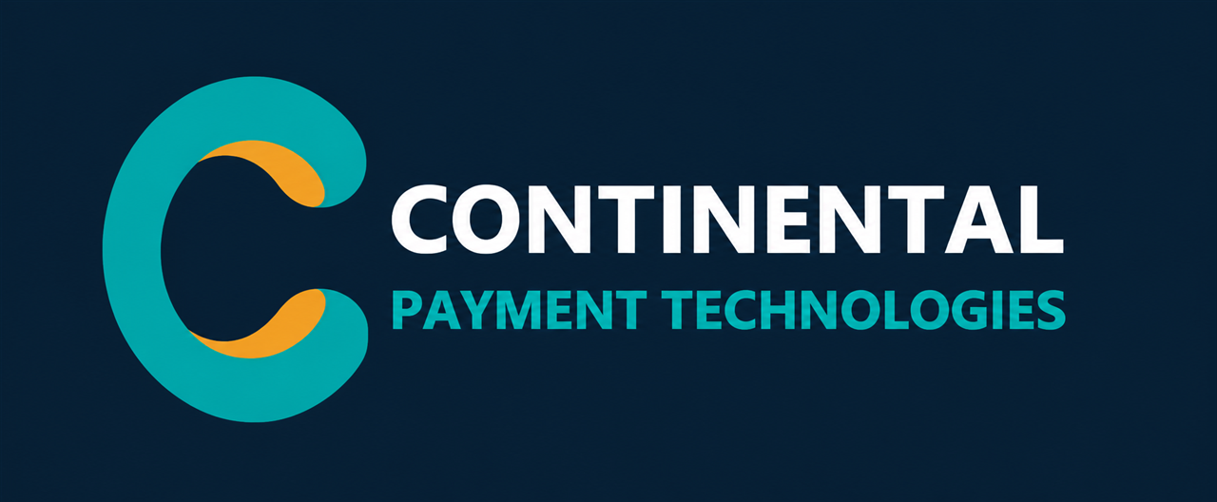
LOGO USE
05
Keep the lockup disciplined, legible and consistent
Clear space
Minimum size
Keep at least one amber-accent height around every side of the lockup.
Full lockup: 140 px digital / 32 mm print
Symbol only: 24 px digital / 8 mm print
Do not stretch, recolor, rotate, add effects or separate the amber accent.
CONTINENTAL PAYMENT TECHNOLOGIES | BRAND BOOK | VERSION 1.1
Notes:
[Sources]

Slide 6
COLOR SYSTEM
06
Color signals trust, movement and human warmth
CONTINENTAL NAVY
COMMERCE TEAL
ACTIVATION AMBER
OPEN WHITE
OPERATIONS SLATE
#0B1F33
#00A7A5
#F5A623
#FFFFFF
#405466
Trust / primary
Movement / digital
Energy / accent
Clarity / space
Body / utility
Recommended balance
55% navy 25% teal 10% amber 10% white
CONTINENTAL PAYMENT TECHNOLOGIES | BRAND BOOK | VERSION 1.1
Notes:
[Sources]

Slide 7
TYPOGRAPHY
07
Typography stays technical without feeling cold
Aptos Display Semibold
Aa
Headlines should be short, decisive and sentence case.
Aptos Regular
0123456789
Use for body copy, proposals, email and product explanations. Favor plain language and generous spacing.
Fallback stack
Arial / Helvetica / sans-serif
Use Courier New only for device IDs, serials and technical code.
CONTINENTAL PAYMENT TECHNOLOGIES | BRAND BOOK | VERSION 1.1
Notes:
[Sources]

Slide 8
VOICE AND MESSAGING
08
A focused voice earns trust in two languages
DIRECT
Lead with the outcome.
CORE LINE
CAPABLE
Explain the operational path.
Payment technology
across the Americas
REGION-AWARE
Respect local markets and language.
CALM
Never overstate security or performance.
SPANISH
Tecnología de pagos
para las Américas
Prefer: connected, reliable, visible, adaptable. Avoid: revolutionary, frictionless, guaranteed, cheapest.
CONTINENTAL PAYMENT TECHNOLOGIES | BRAND BOOK | VERSION 1.1
Notes:
[Sources]

Slide 9
OFFER ARCHITECTURE
09
Organize the offer around customer outcomes
Payment devices
Master brand
PAY
Continental
Payment Technologies
Smart POS / PIN pads / unattended
SERVE
Self-service
Kiosks / POS / peripherals
One commercial relationship.
Four clear solution families.
MANAGE
Global Connect One
Multi-brand TMS / fleet visibility
CARE
Lifecycle services
Deployment / support / renewal
CONTINENTAL PAYMENT TECHNOLOGIES | BRAND BOOK | VERSION 1.1
Notes:
[Sources]
- https://www.nexgoglobal.com/
- https://www.fecpos.com/

Slide 10
PRODUCT BRAND
10
Global Connect One is the signature platform
GLOBAL
CATEGORY
Multi-brand terminal management system
CONNECT ONE
by Continental Payment Technologies
PROMISE
One operational view across diverse device fleets.
Naming rule
First mention: Global Connect One by Continental Payment Technologies
Later mentions: Global Connect One
CONTINENTAL PAYMENT TECHNOLOGIES | BRAND BOOK | VERSION 1.1
Notes:
[Sources]

Slide 11


BRAND IN USE
11
Applications make the identity tangible
Maria Alvarez
Payment technology
across the Americas
Regional Sales Director
Continental Payment Technologies
+1 510 555 0142
maria.alvarez@continentalpaytech.com
continentalpaytech.com
GLOBAL CONNECT ONE
Connecting secure device operations
DEVICE SPLASH
CONTINENTAL PAYMENT TECHNOLOGIES | BRAND BOOK | VERSION 1.1
Notes:
[Sources]

Slide 12
GOVERNANCE
12
Secure the identity before public launch
01
Register
Acquire continentalpaytech.com as primary and continentalpay.tech as a defensive redirect.
02
Clear
Complete California entity, USPTO and international trademark screening.
03
Prepare
Create production SVG and EPS masters, then test accessibility and small-size use.
04
Deploy
Standardize email, proposals, website, device screens and partner materials.
Clearance note
A California company named Continental Payment Solutions appears in Euronet's subsidiary list. Counsel should assess similarity risk before filing or spending on launch.
CONTINENTAL PAYMENT TECHNOLOGIES | BRAND BOOK | VERSION 1.1
Notes:
[Sources]
- https://www.sec.gov/Archives/edgar/data/1029199/000121390025017068/ex211_2.htm

Slide 13
Payment technology across the Americas
continentalpaytech.com
CONTINENTAL PAYMENT TECHNOLOGIES, INC.
Notes:
[Sources]

