Slide 1
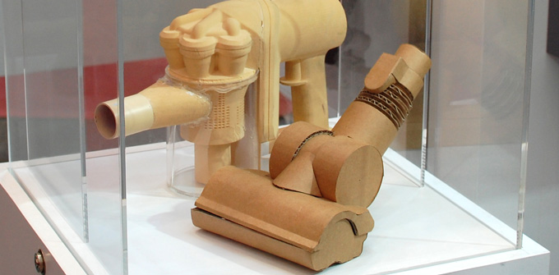

Dyson
Intro to Iteration
Matt Franks Professor, Austin Center for Design

Slide 2
“I haven’t failed, I’ve found 10,000 ways that didn’t work.”
Thomas Edison

Slide 3
Synthesis
Prototyping
Ethnography
Prototyping
Ethnography
Prototyping
Immersion – gaining understanding of a unique situation and empathy with other people
The process of making meaning through inference-based sensemaking
Hypothesis validation through generative form giving and informed trial-and-error

Slide 4
Synthesis
Prototyping
Ethnography
Prototyping
Ethnography
Prototyping
Immersion – gaining understanding of a unique situation and empathy with other people
The process of making meaning through inference-based sensemaking
Hypothesis validation through generative form giving and informed trial-and-error

Slide 5
Synthesis
Prototyping
Ethnography
Prototyping
Ethnography
Prototyping
Immersion – gaining understanding of a unique situation and empathy with other people
The process of making meaning through inference-based sensemaking
Hypothesis validation through generative form giving and informed trial-and-error

Slide 6
Synthesis
Prototyping
Ethnography
Prototyping
Ethnography
Prototyping
Immersion – gaining understanding of a unique situation and empathy with other people
The process of making meaning through inference-based sensemaking
Hypothesis validation through generative form giving and informed trial-and-error

Slide 7
Prototyping is not about creating the right idea

Slide 8
Prototyping is about creating “an idea”

Slide 9
In design, there are no “right” ideas. There are only ideas.

Slide 10
In design, there are no “right” ideas. There are only ideas.
We have no way of evaluating the relative success of an idea until a someone’s had a chance to use it.

Slide 11
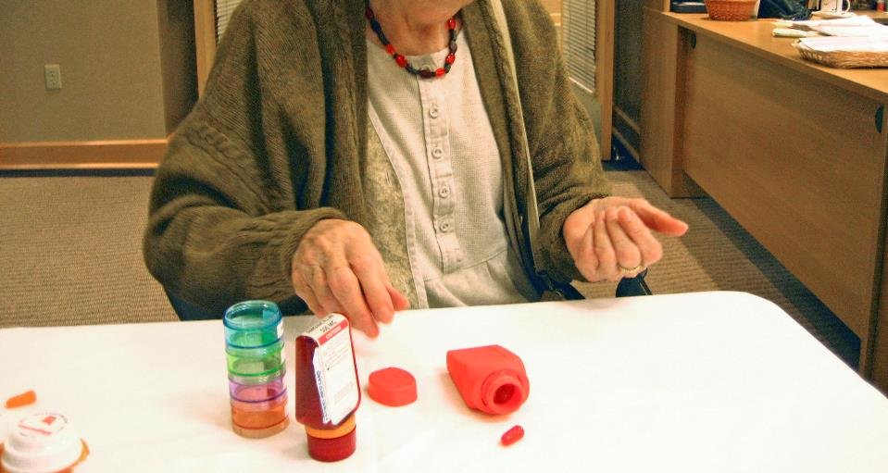

Slide 12
As designers, we use prototyping as a means to learn from and pivot off of an ideas degree of “rightness.”

Slide 13
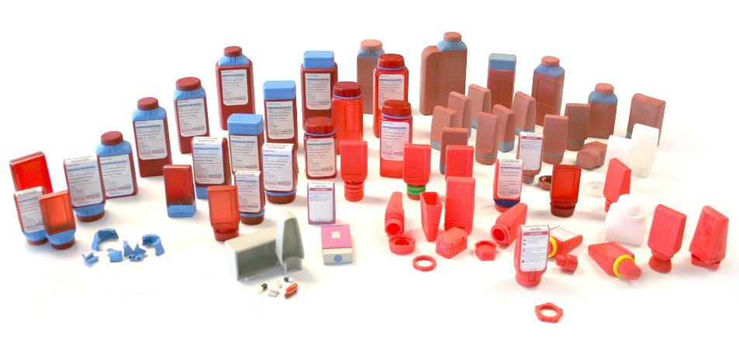

Slide 14
Synthesis
Prototyping
Ethnography
Prototyping
Ethnography
Prototyping
Is a process of Ideation and Iteration.

Slide 15
z
Idea Selection
Ideate
Build
Test
Subjectively narrowing down the pool of ideas to find which ideas are worth further exploration

Slide 16
z
Idea Selection
Ideate
Build
Test
Subjectively narrowing down the pool of ideas to find which ideas are worth further exploration
Exploring a variety of ways in which and idea could be implemented and making assumptions about which implementation is best

Slide 17
z
Idea Selection
Ideate
Build
Test
Subjectively narrowing down the pool of ideas to find which ideas are worth further exploration
Exploring a variety of ways in which and idea could be implemented and making assumptions about which implementation is best
Giving form to an idea. Providing enough detail so our assumptions can be tested

Slide 18
z
Idea Selection
Ideate
Build
Test
Subjectively narrowing down the pool of ideas to find which ideas are worth further exploration
Exploring a variety of ways in which and idea could be implemented and making assumptions about which implementation is best
Giving form to an idea. Providing enough detail so our assumptions can be tested
Testing our assumptions with a user in the context of use

Slide 19
z
Idea Selection
Ideate
Build
Test
Subjectively narrowing down the pool of ideas to find which ideas are worth further exploration
Exploring a variety of ways in which and idea could be implemented and making assumptions about which implementation is best
Giving form to an idea. Providing enough detail so our assumptions can be tested
Testing our assumptions with a user in the context of use
Iteration
Rapidly testing and refining aspects of an idea until it allows users to achieve a goal.

Slide 20
Prototyping is about failure.

Slide 21
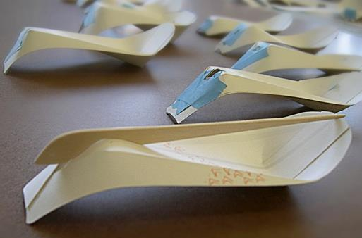
Street Cart Table Wear – Steve Faletti

Slide 22
Prototyping is about failure.
Having the audacity to dream, experiment, and fail - is required.

Slide 23
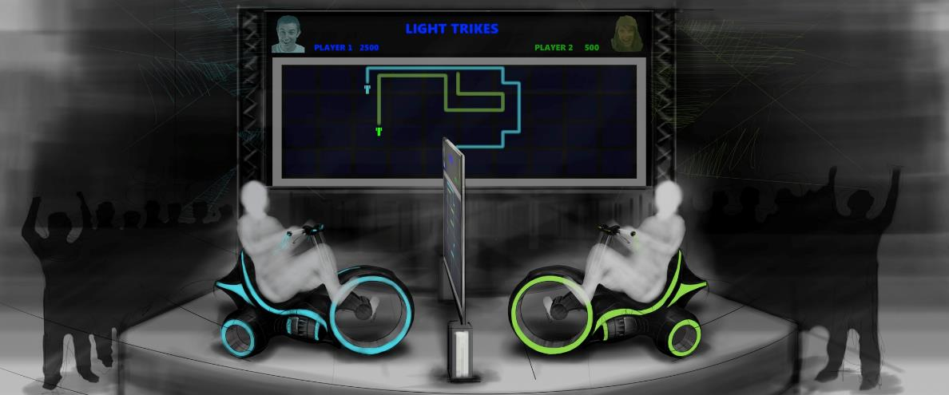

Slide 24
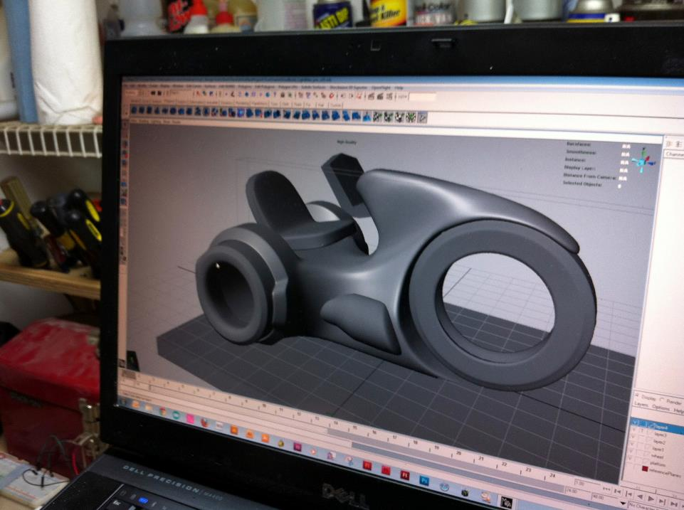

Slide 25
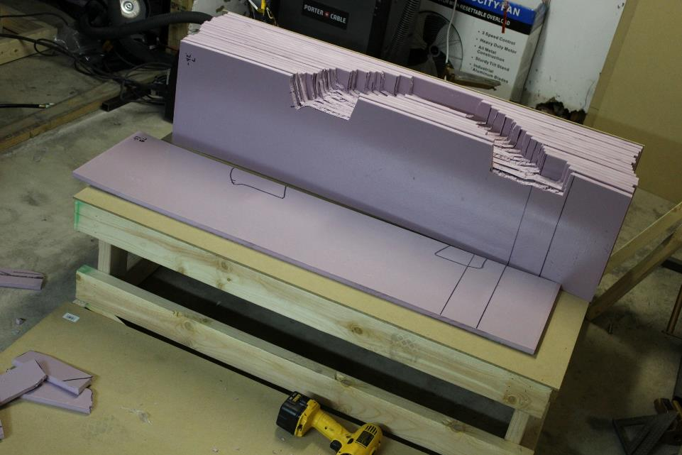

Slide 26
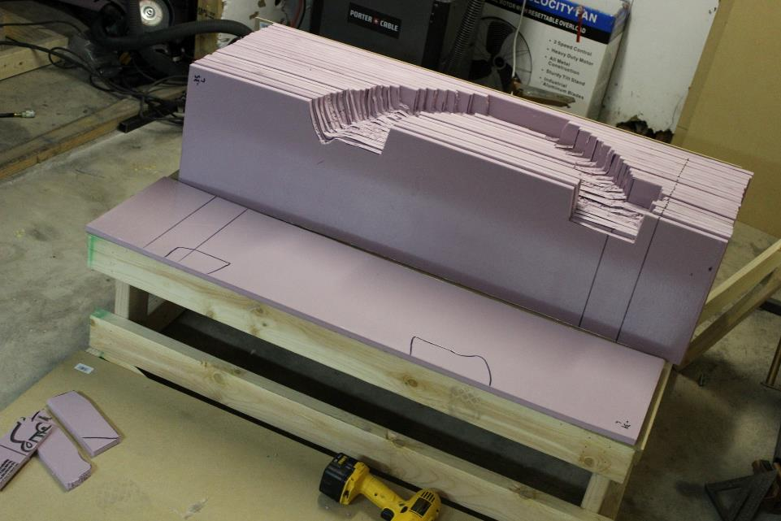

Slide 27
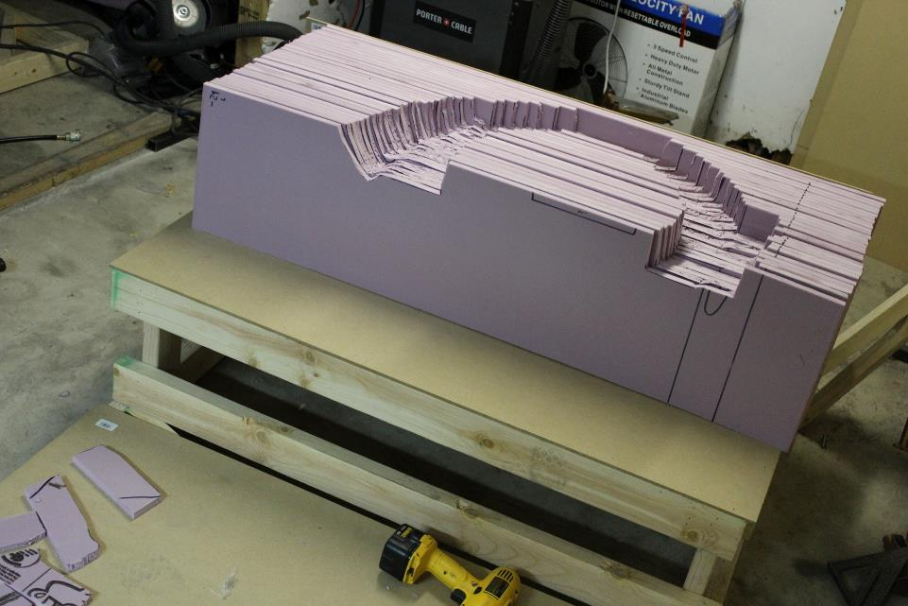

Slide 28
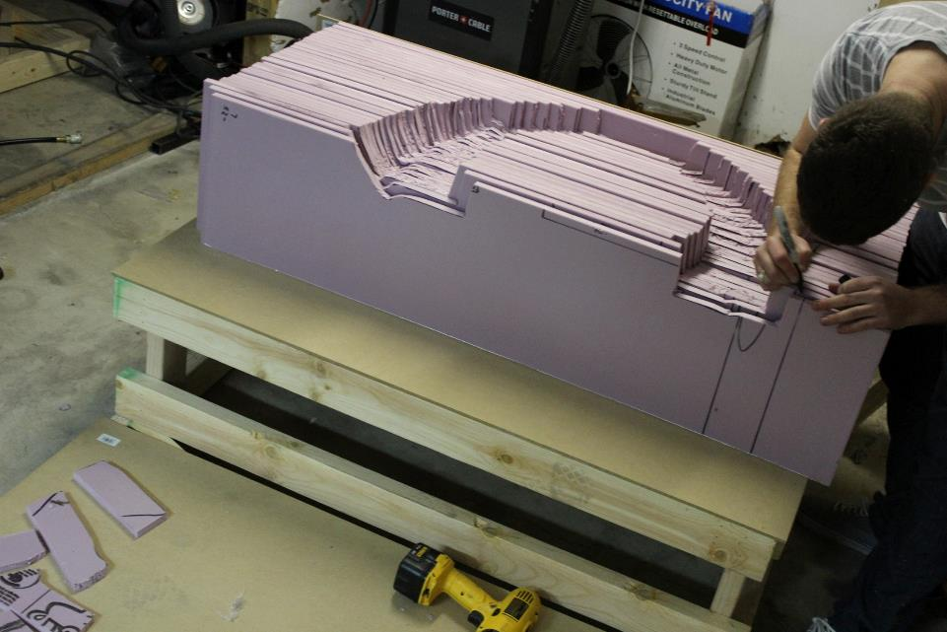

Slide 29
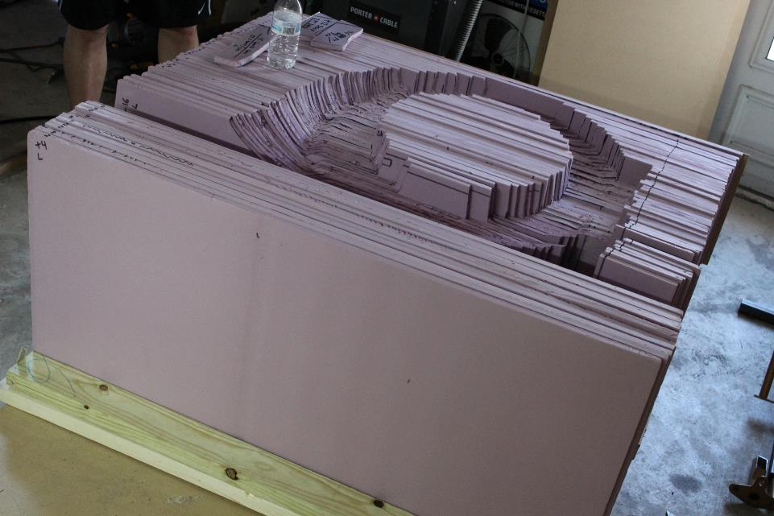

Slide 30
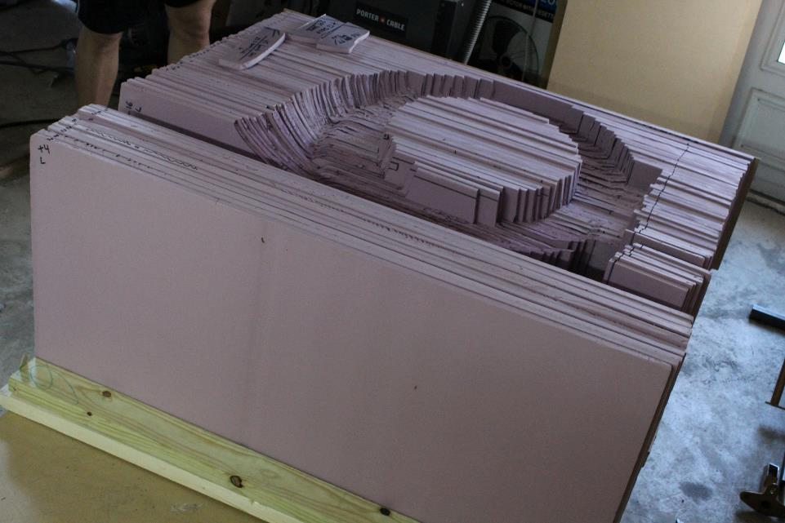

Slide 31
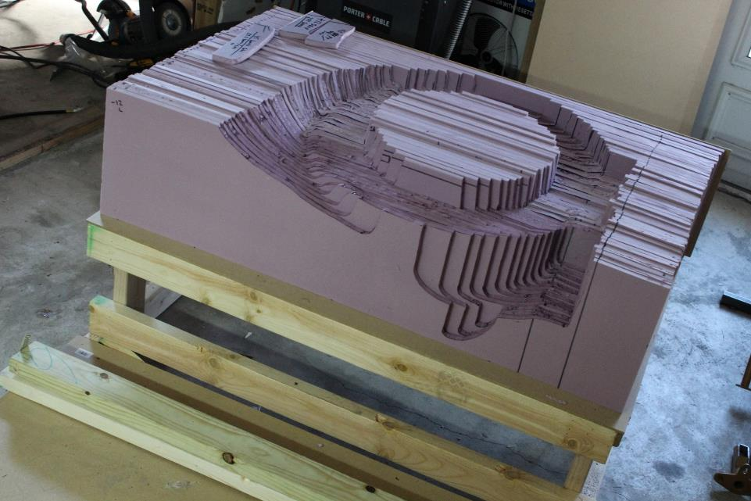

Slide 32
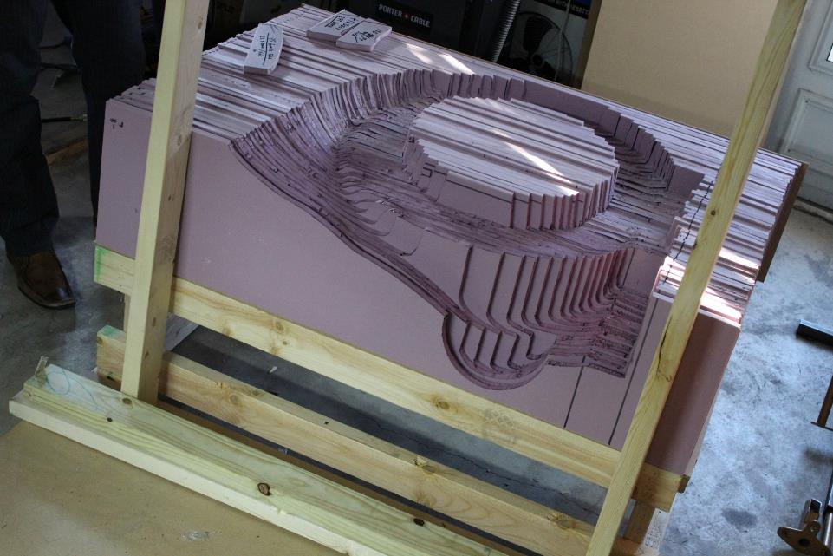

Slide 33
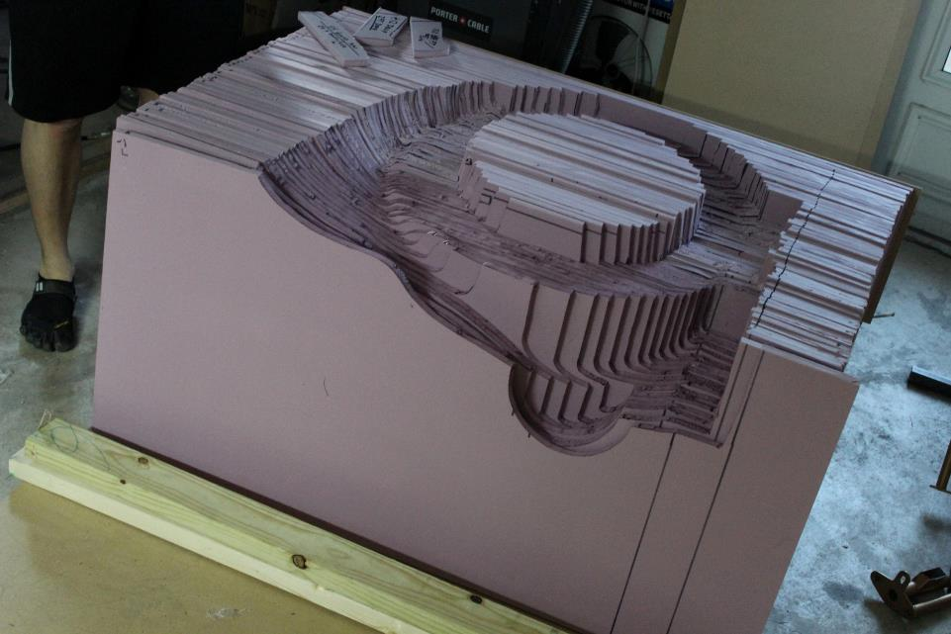

Slide 34
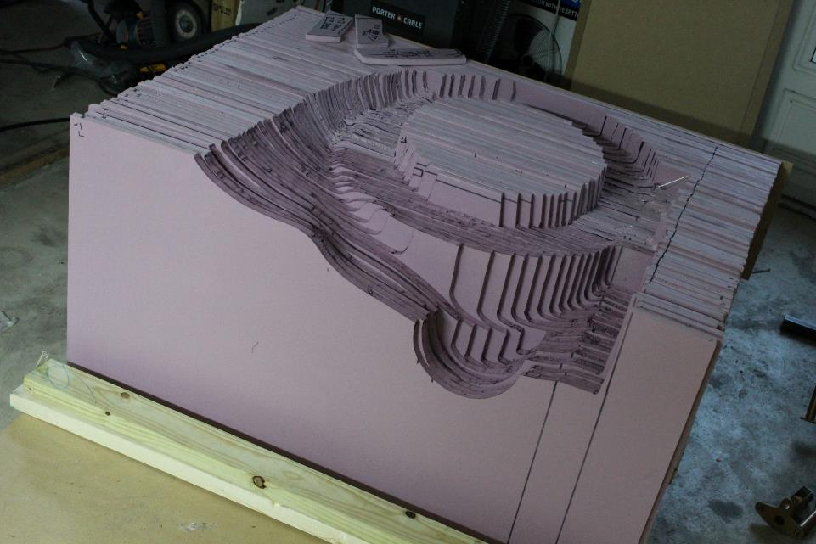

Slide 35
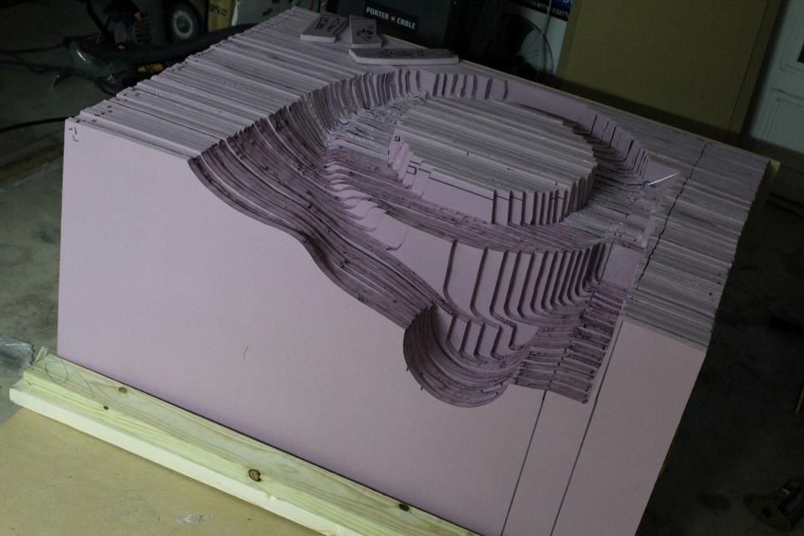

Slide 36
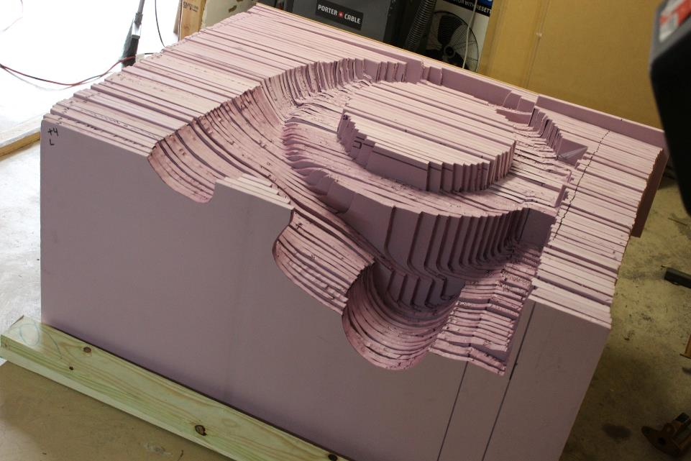

Slide 37
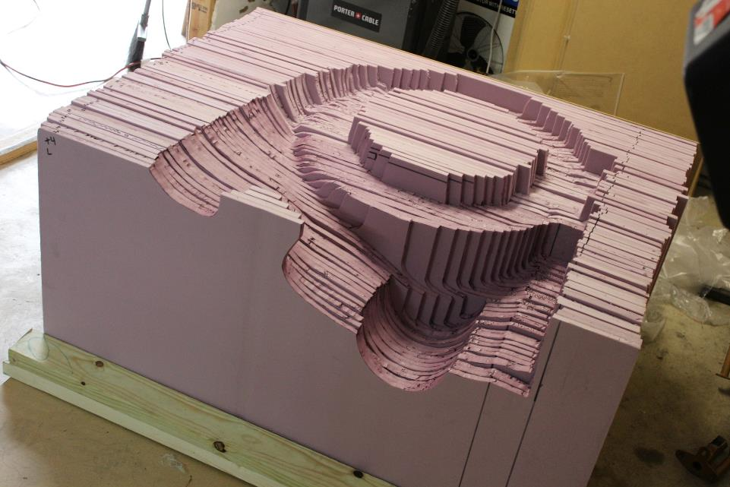

Slide 38
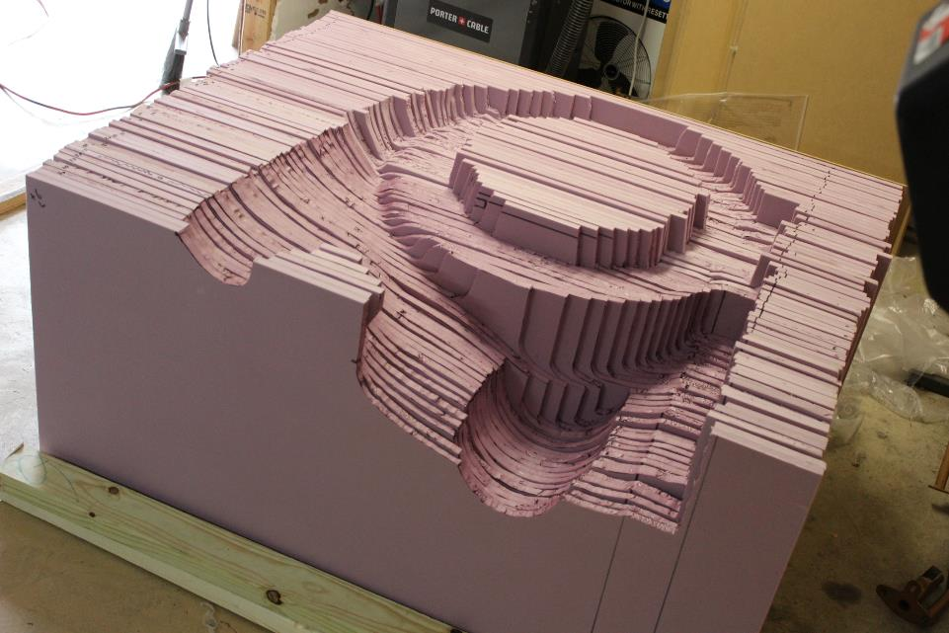

Slide 39
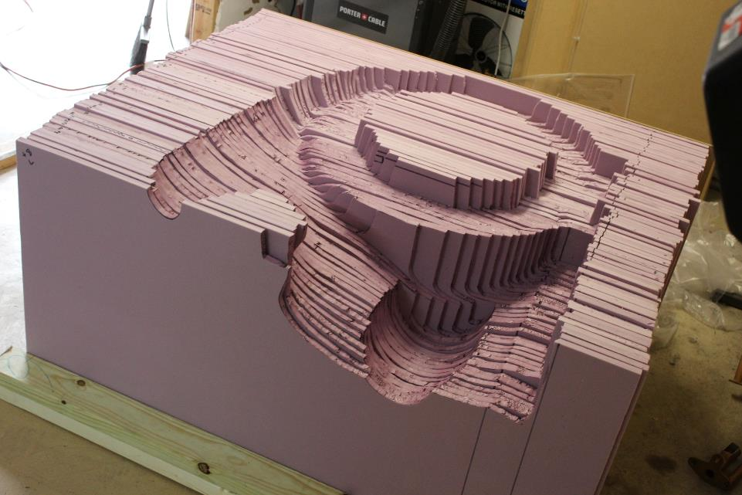

Slide 40
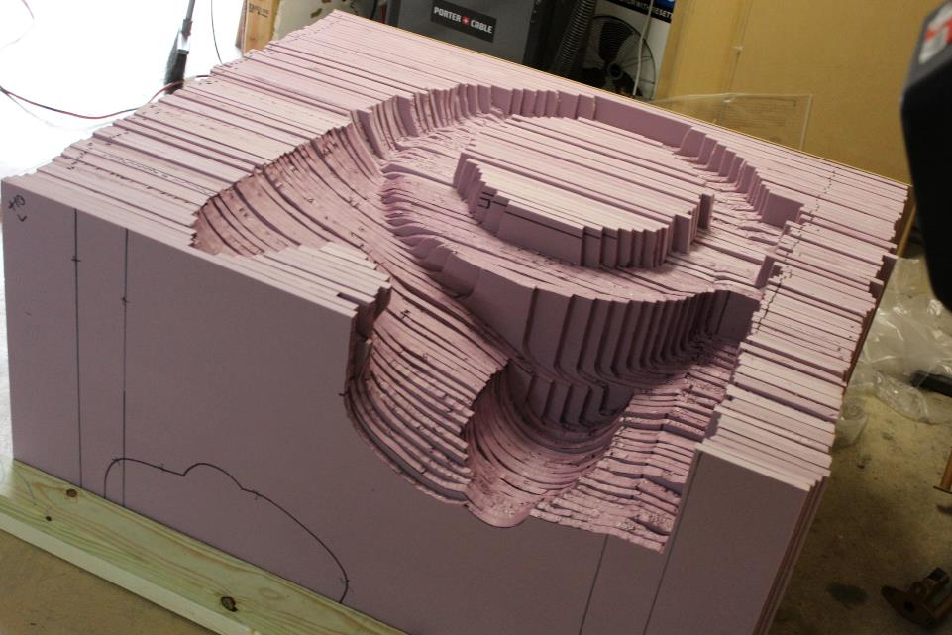

Slide 41
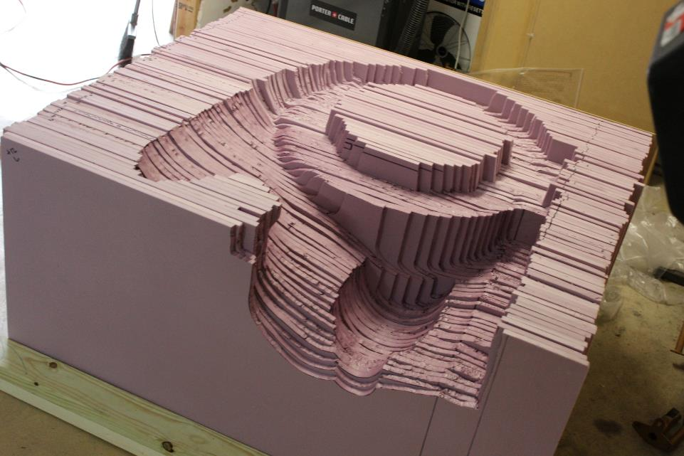

Slide 42
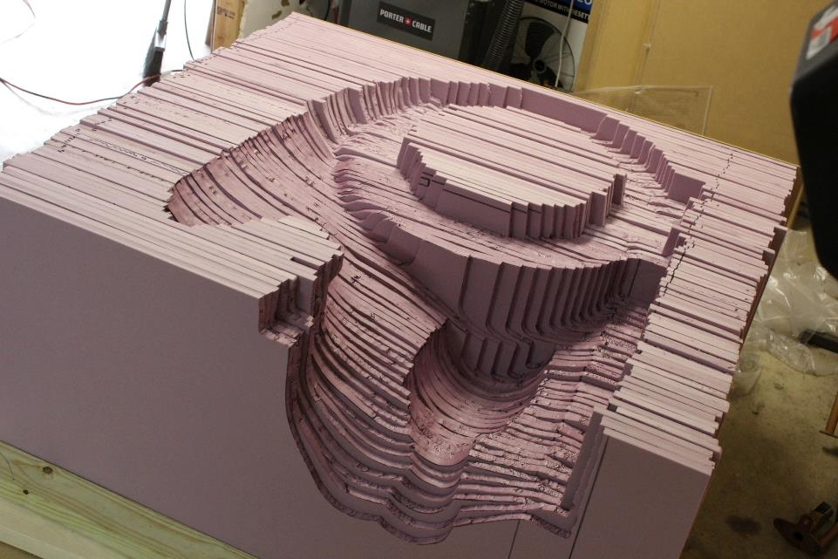

Slide 43
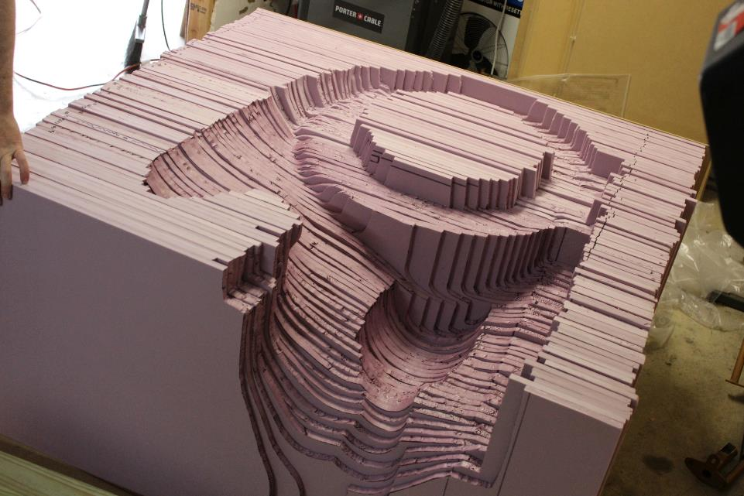

Slide 44
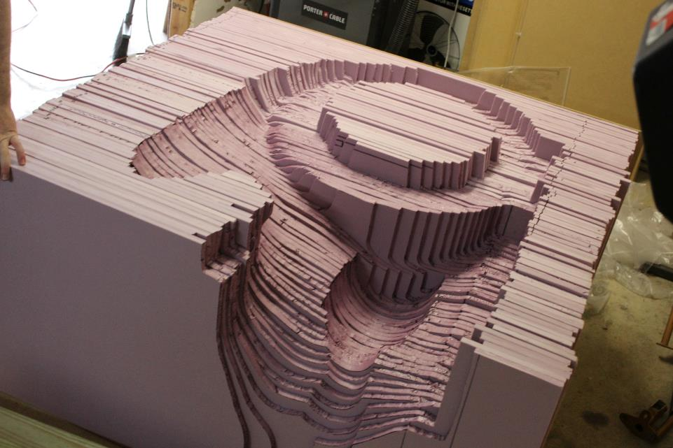

Slide 45
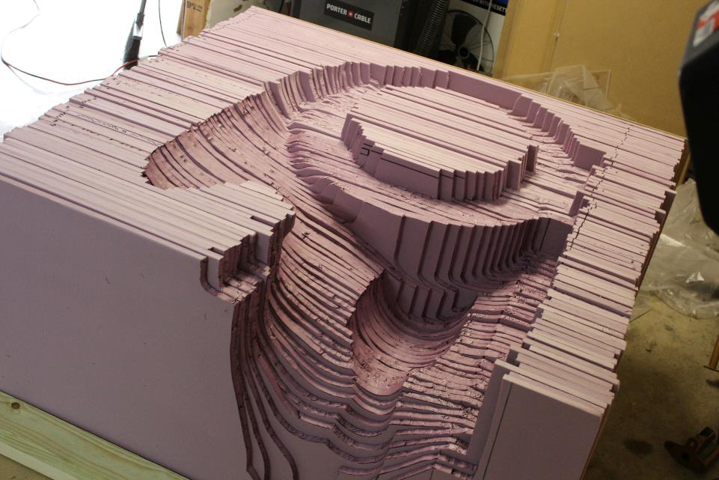

Slide 46
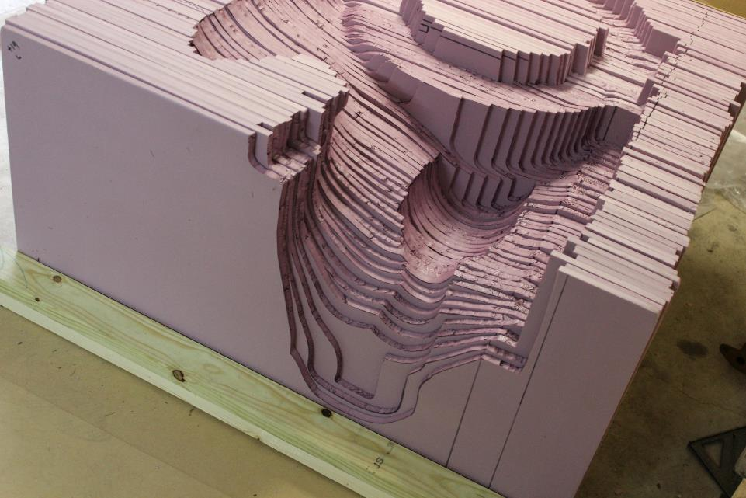

Slide 47
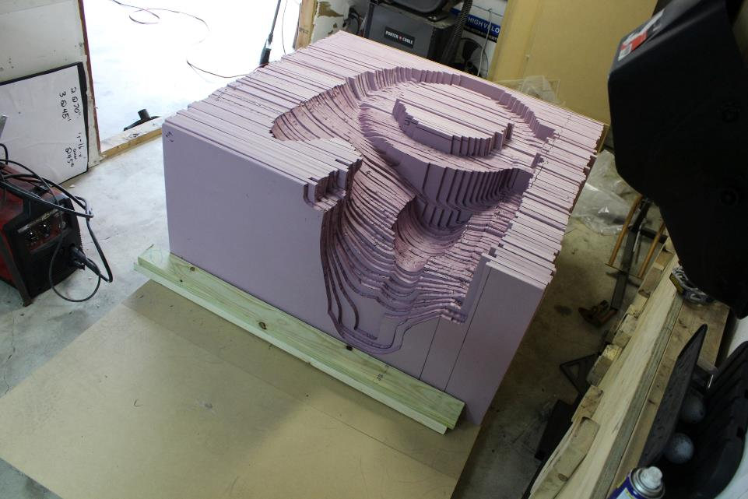

Slide 48
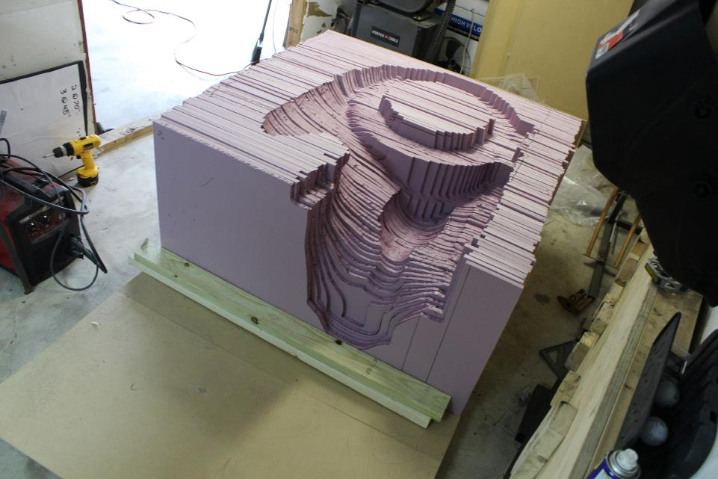

Slide 49
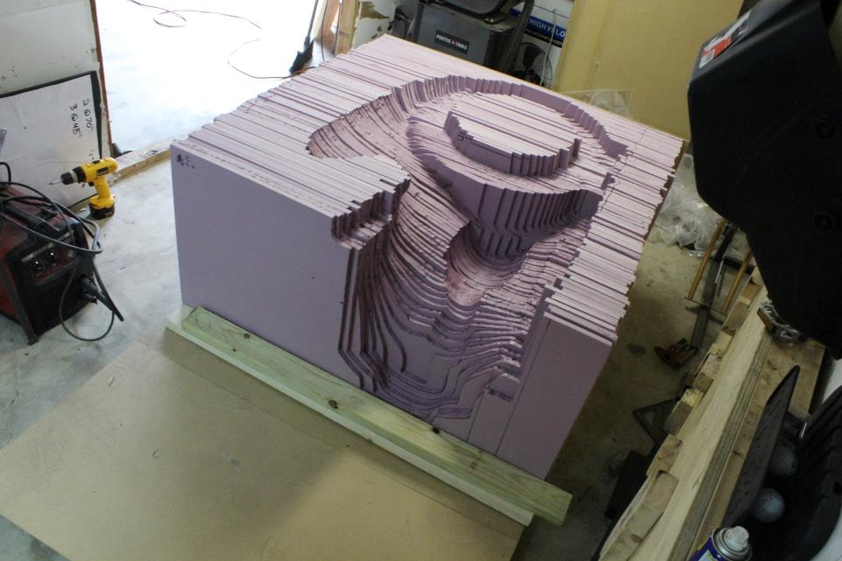

Slide 50
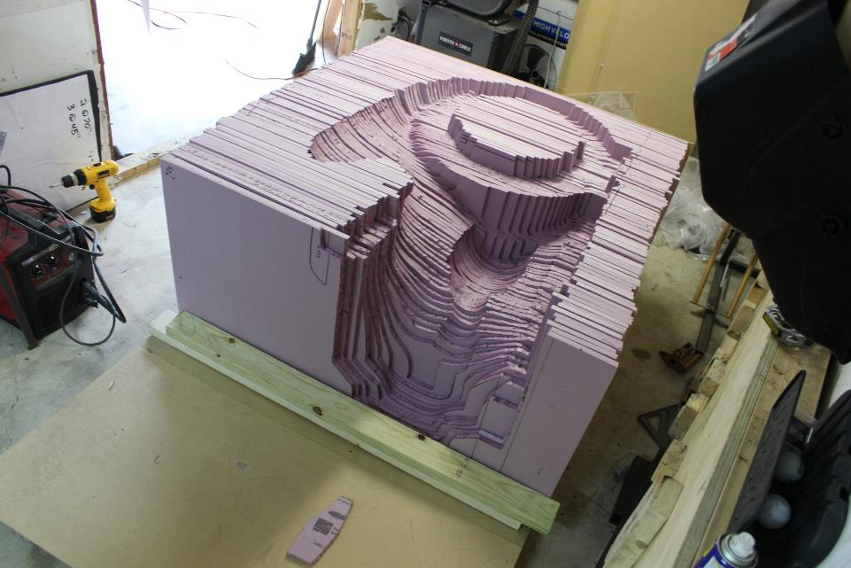

Slide 51
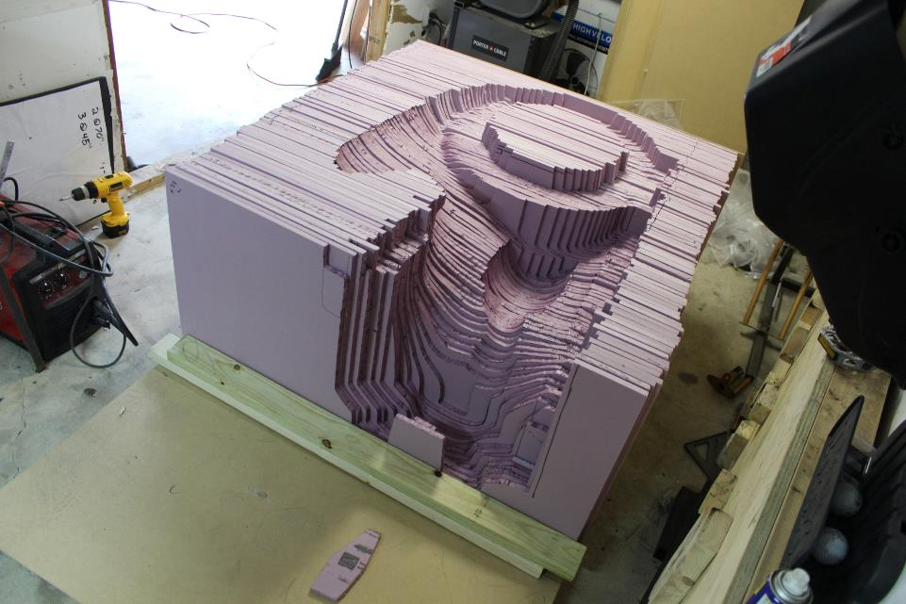

Slide 52
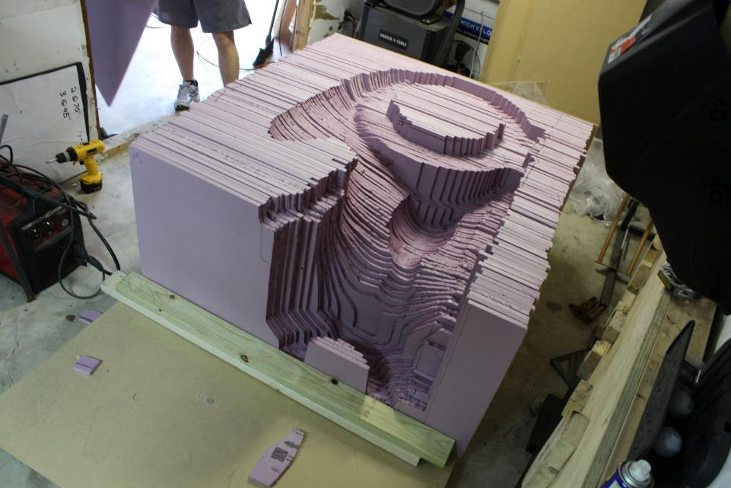

Slide 53
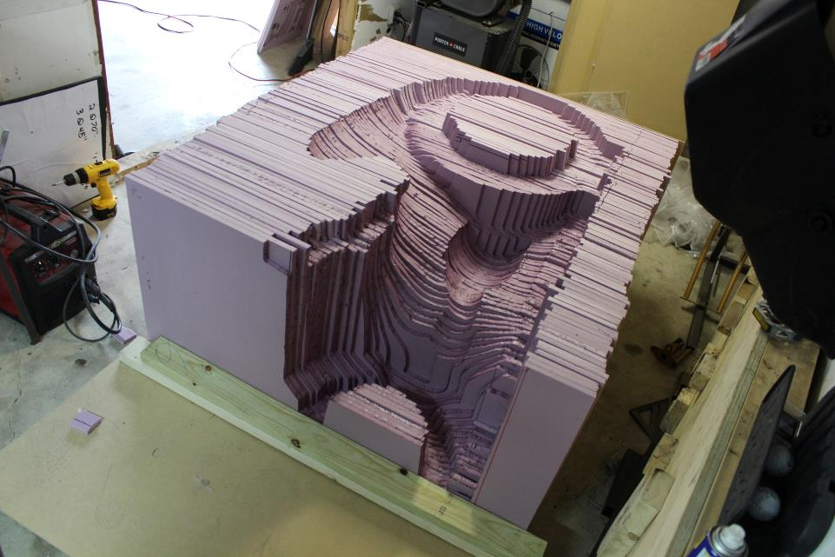

Slide 55
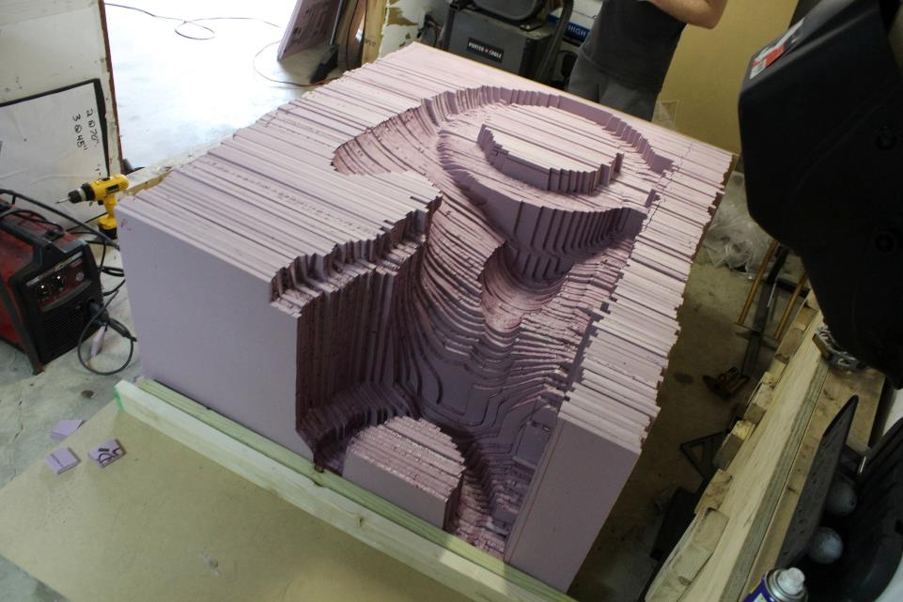

Slide 56
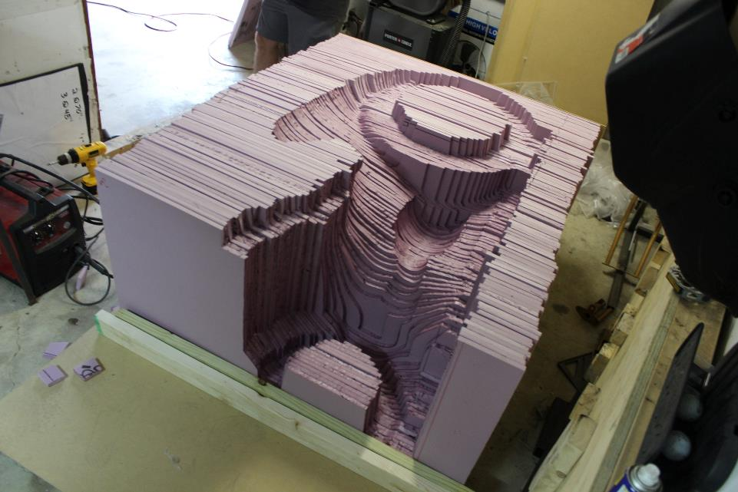

Slide 57
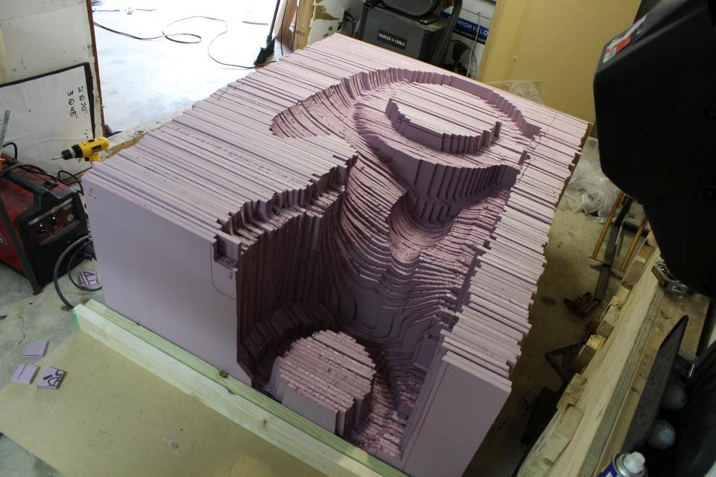

Slide 58
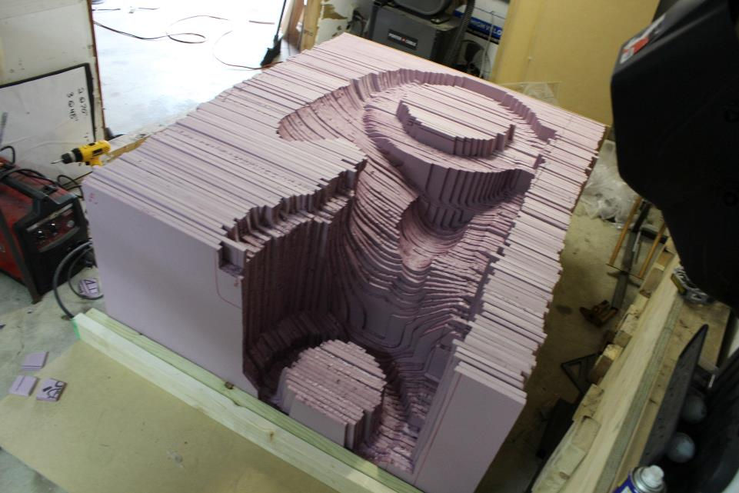

Slide 59
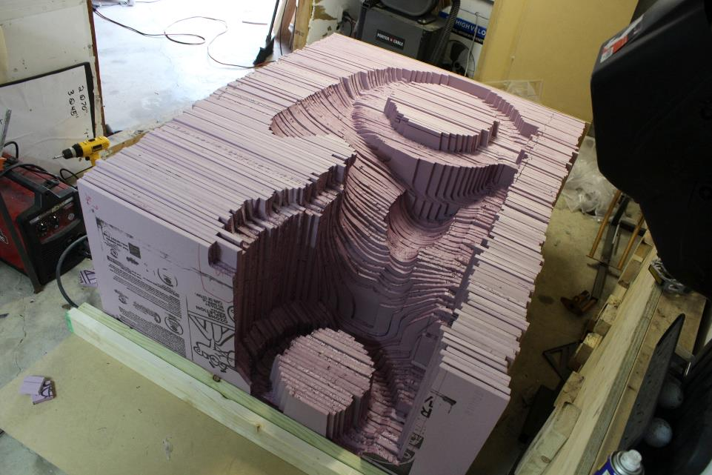

Slide 60
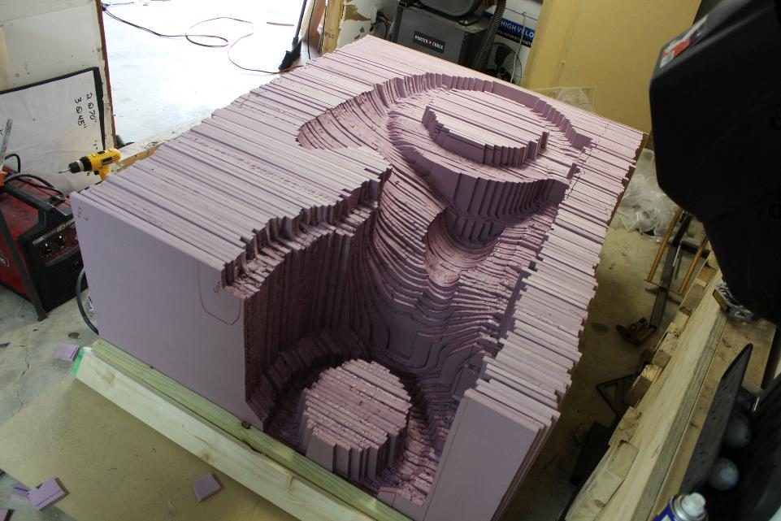

Slide 61
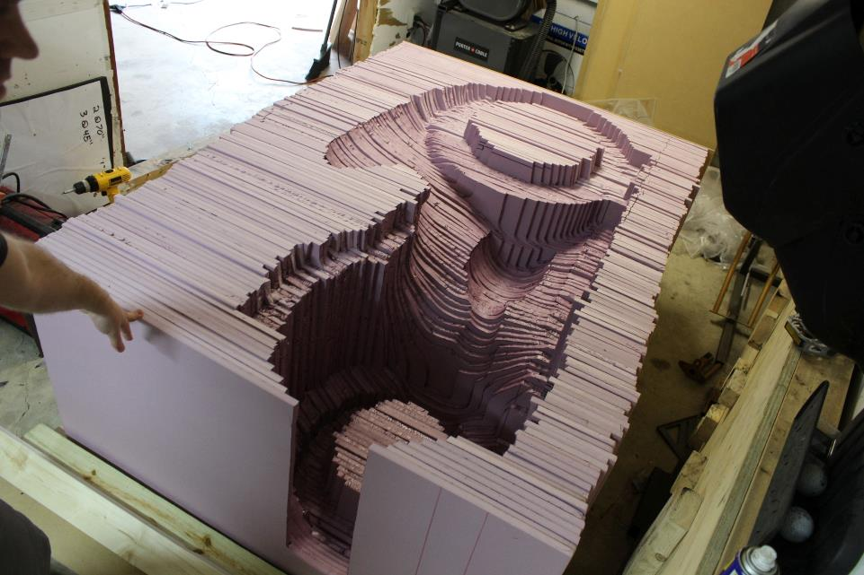

Slide 62
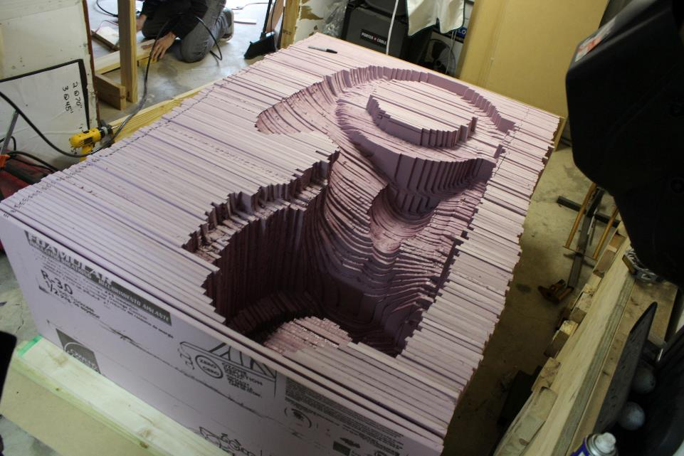

Slide 63
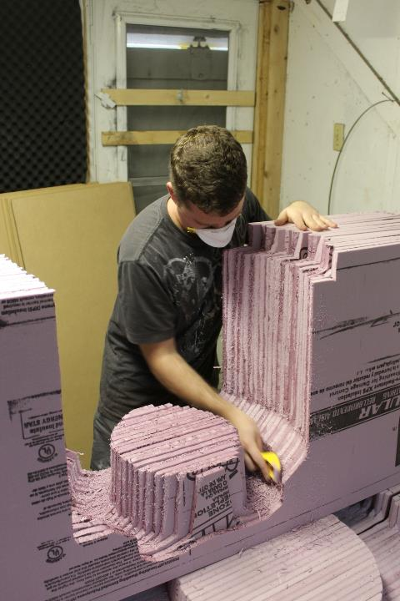

Slide 64
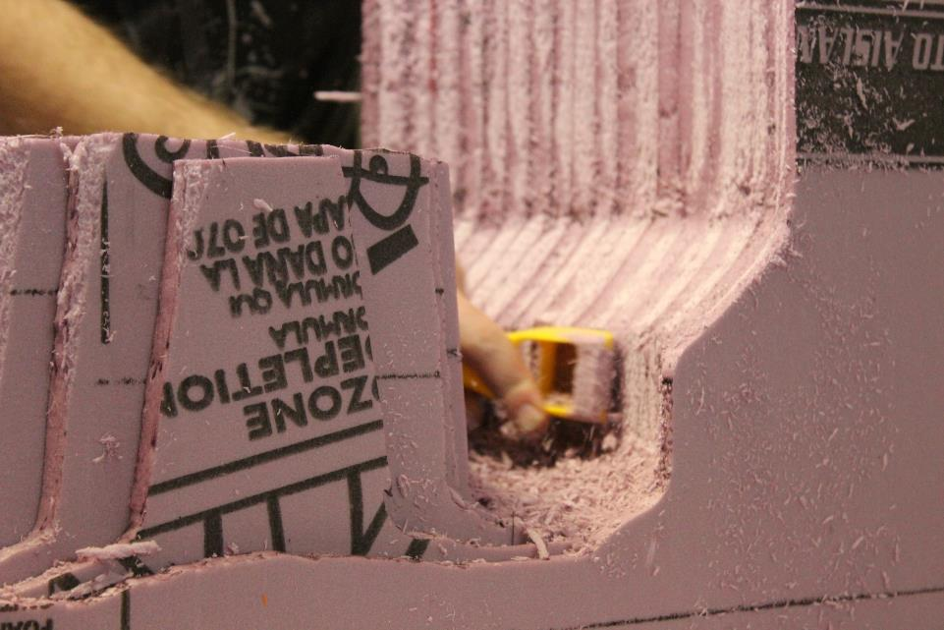

Slide 65
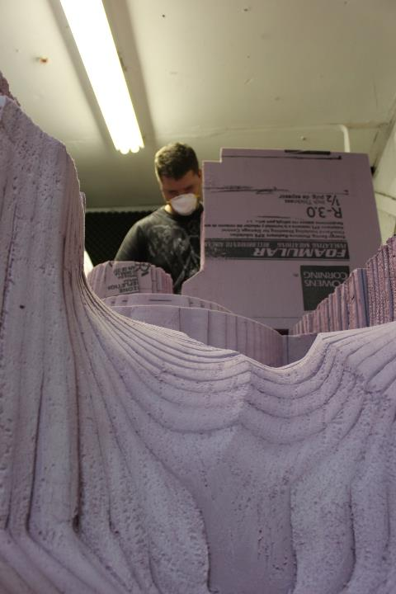

Slide 66
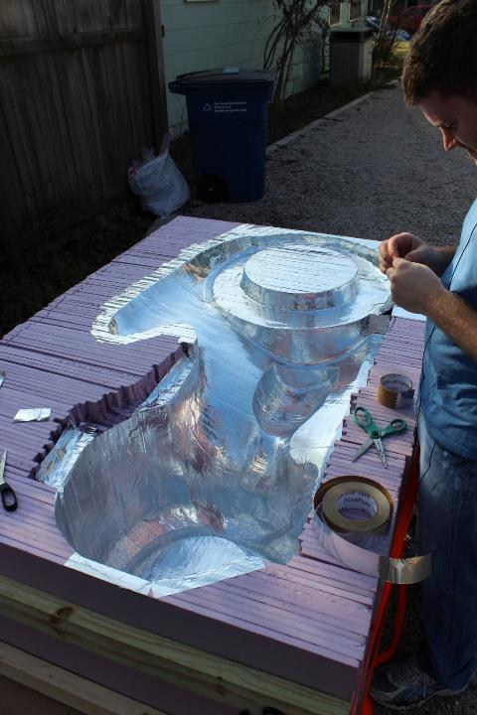

Slide 67


Slide 68
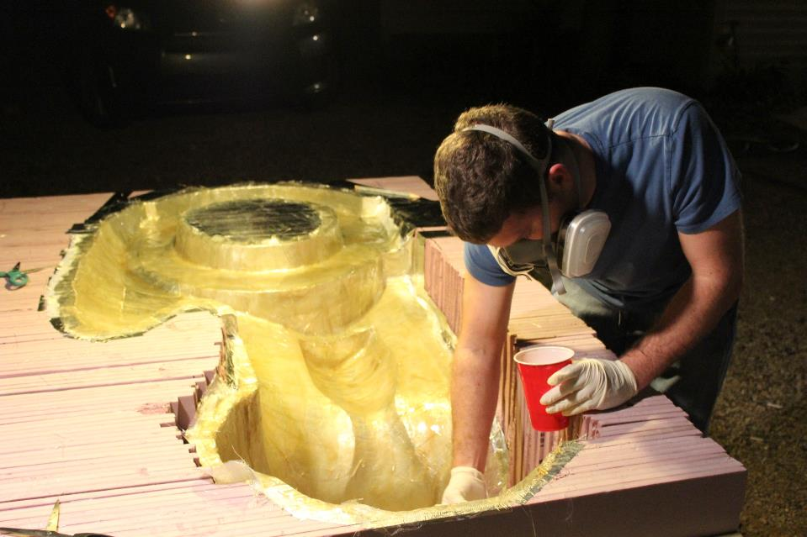

Slide 69
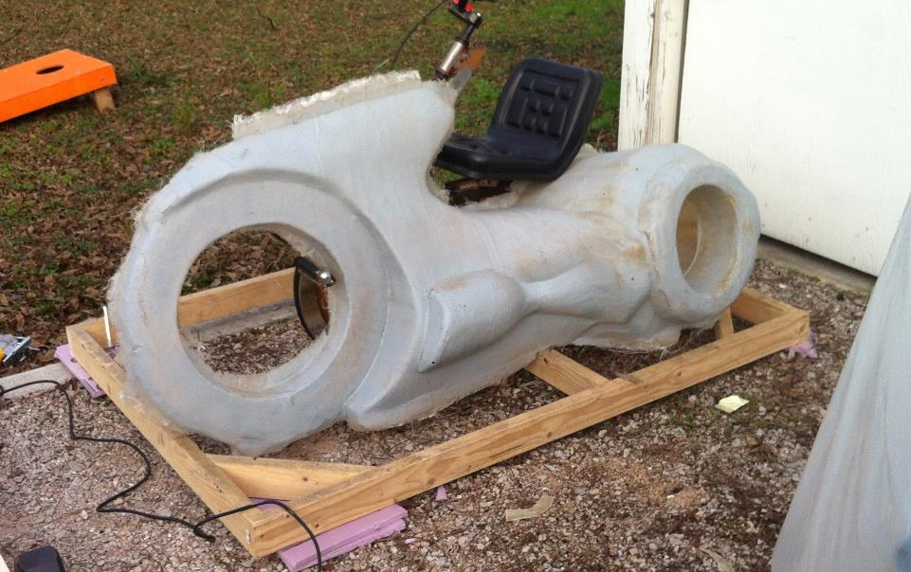

Slide 70
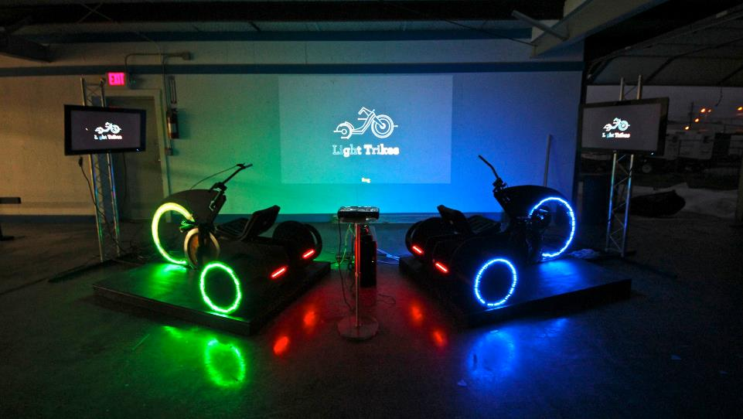

Slide 71
Having a culture that supports these dreamers, experimenters and failures is absolutely critical.

Slide 72
“Early failures are important because they generate systematic learning about where opportunities are (and are not) and how to address them, and they quickly free up people, capital, and ideas for more-promising projects.”
Daniel Isenberg – Harvard Business Review

Slide 73
Give yourself and your team permission to be creative:
Permission to try something new
Permission to avoid cultural rules and established pecking orders
Permission to embarrass yourself
Permission to have and explore crazy ideas

Slide 74
So, fail often and fail early…

