Slide 1
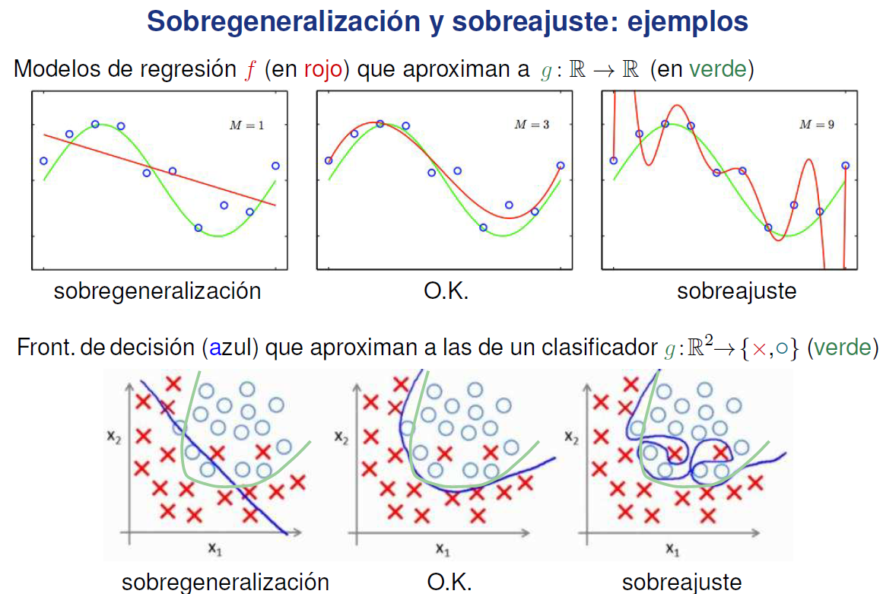

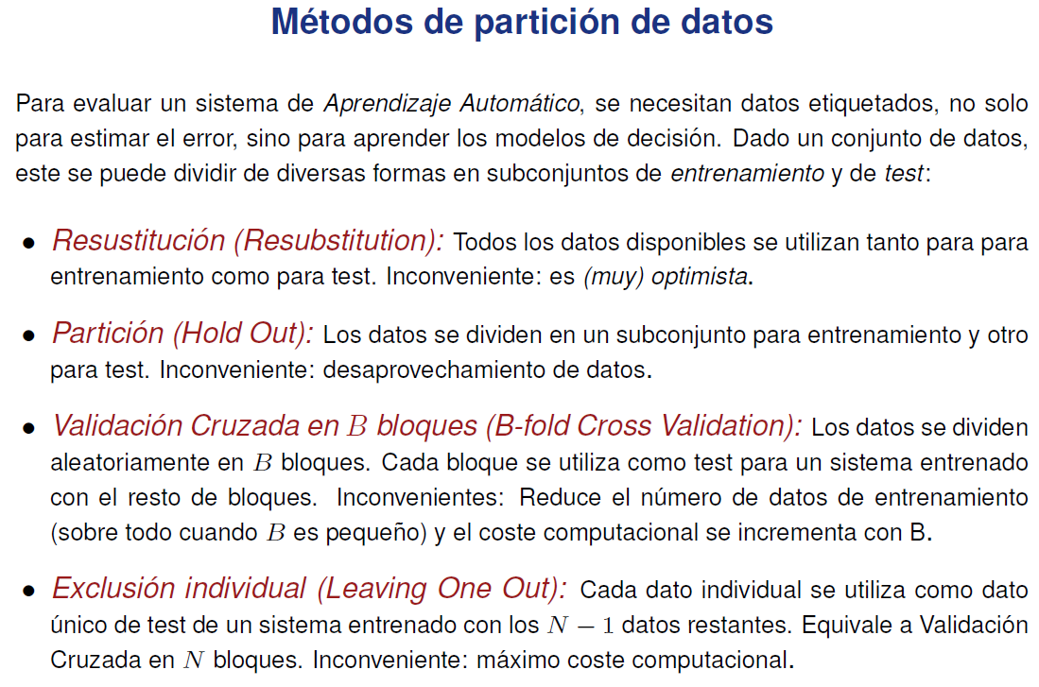
Tema 2-1
P(y=SETO) = 0.3
P(y=VERS) = 0.5
P(y=VIRG) = 0.2
P(y=SETO | x=7) = (0.3*0) / ((0.3*0) + (0.5*0.06) + (0.2*0.12)) = 0
P(y=VERS | x=7) = (0.5*0.06) / 0.054 = 0.56
P(y=VIRG | x=7) = (0.2*0.12) /0.054 = 0.44
Teorema de Bayes: P(x,y) = P(x)*P(y | x) = P(y)*P(x | y)
-> P(y | x) = ( P(y)*P(x|y) ) / P(x)
-> P(y | x) = ( P(y)*P(x|y) ) / sum y' ( P(y')*P(x | y') )
P(x=7) = 0.3*0 + 0.5*0.06 + 0.2*0.12 = 0.054

Slide 2
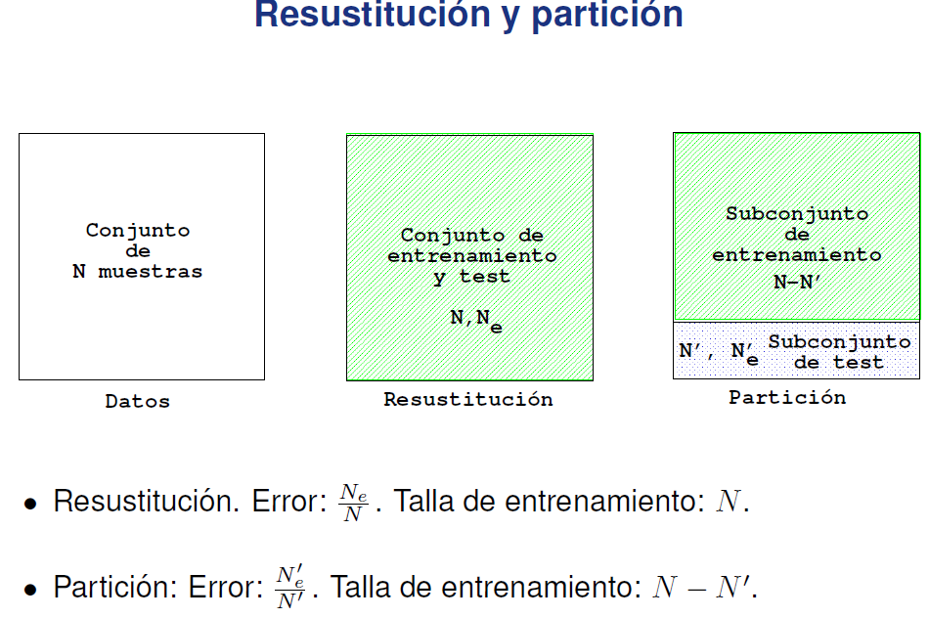
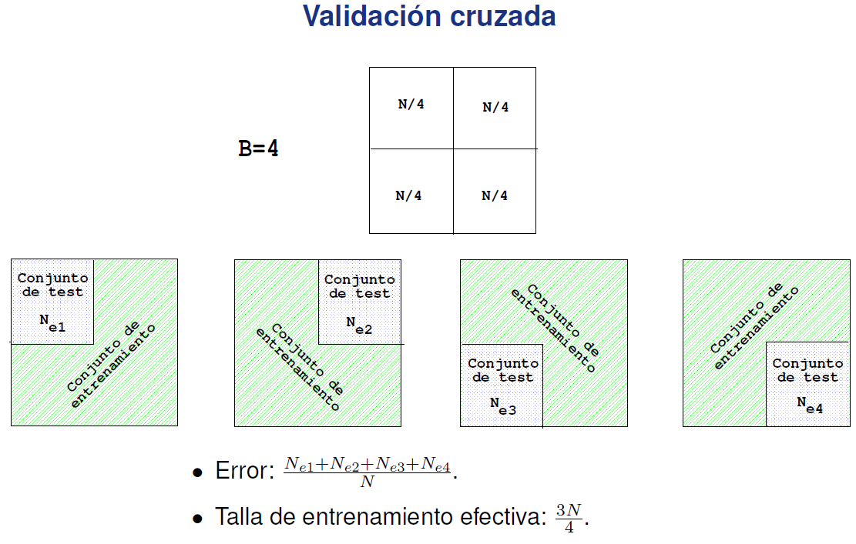
Tema 2-2
-> (B-1)*N / B

Slide 3
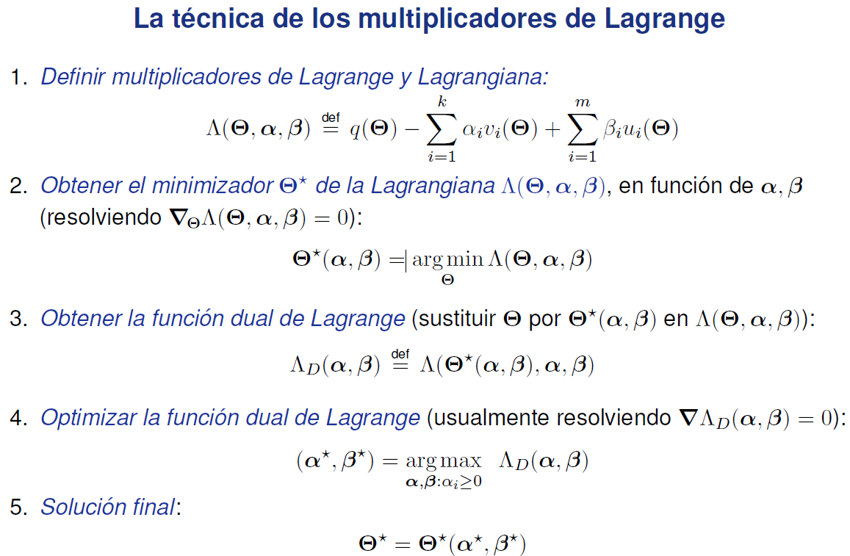
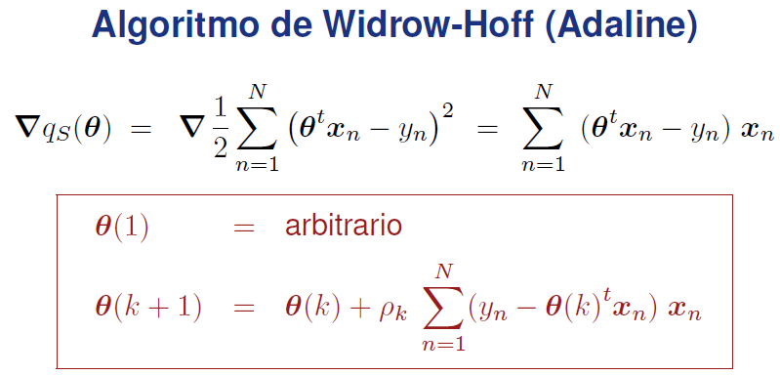


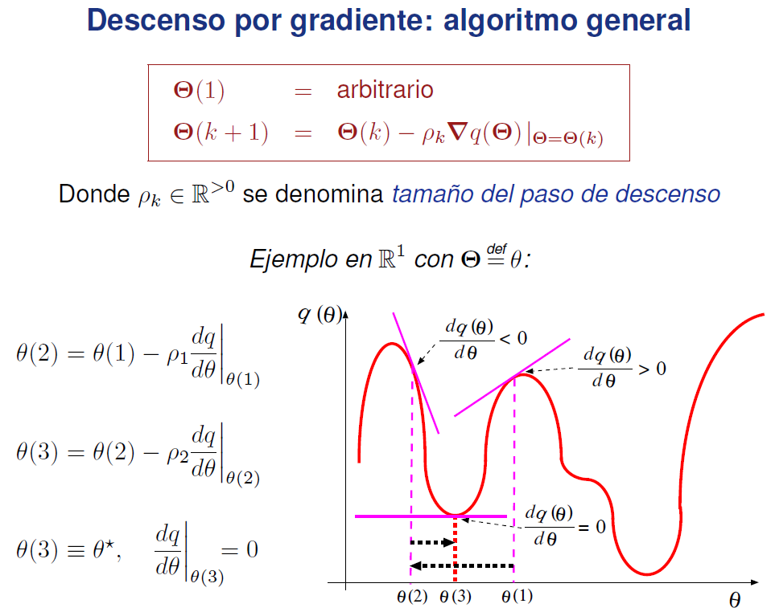
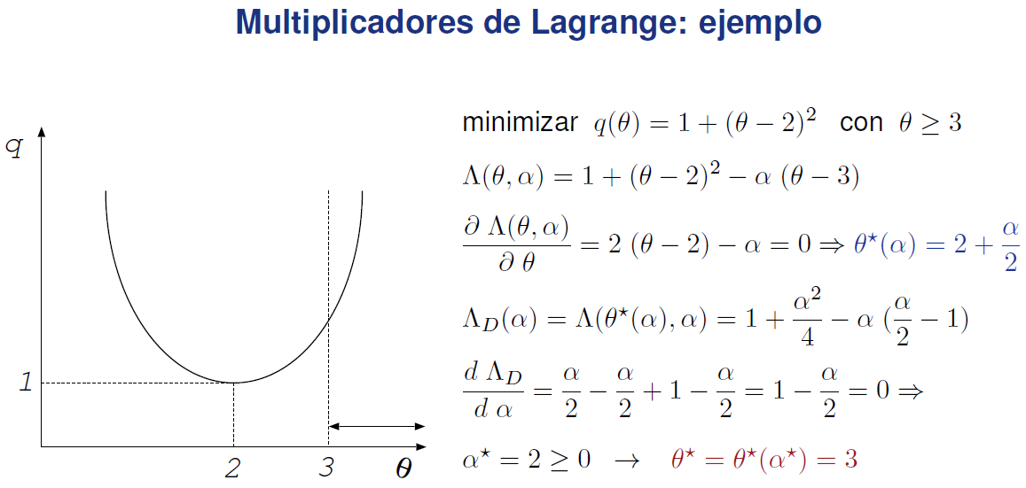
Tema 3

Slide 4
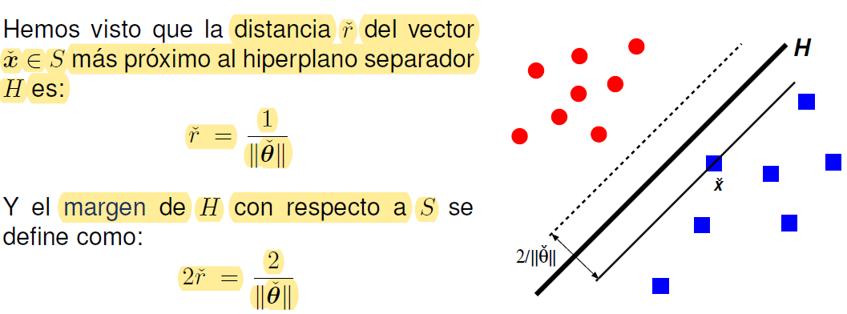



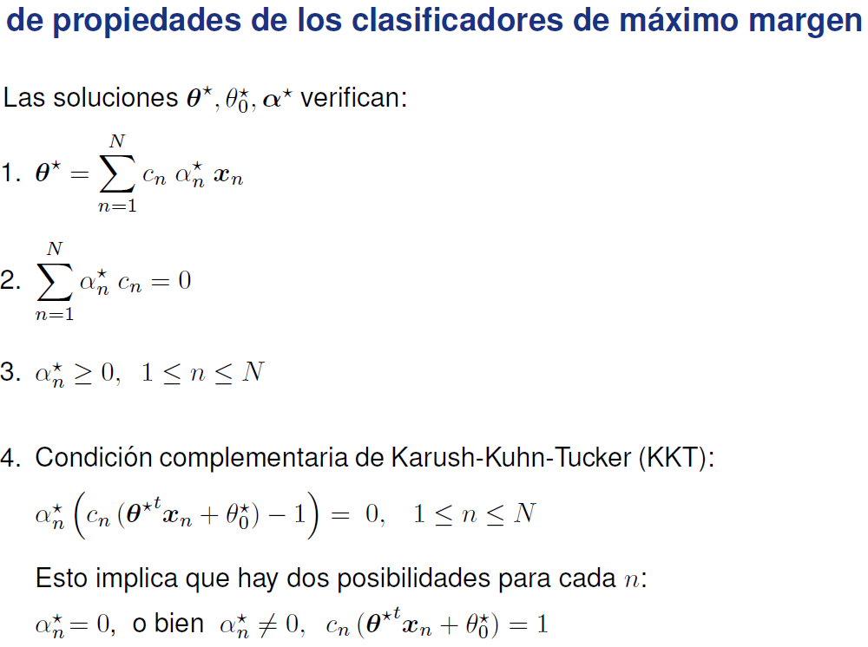
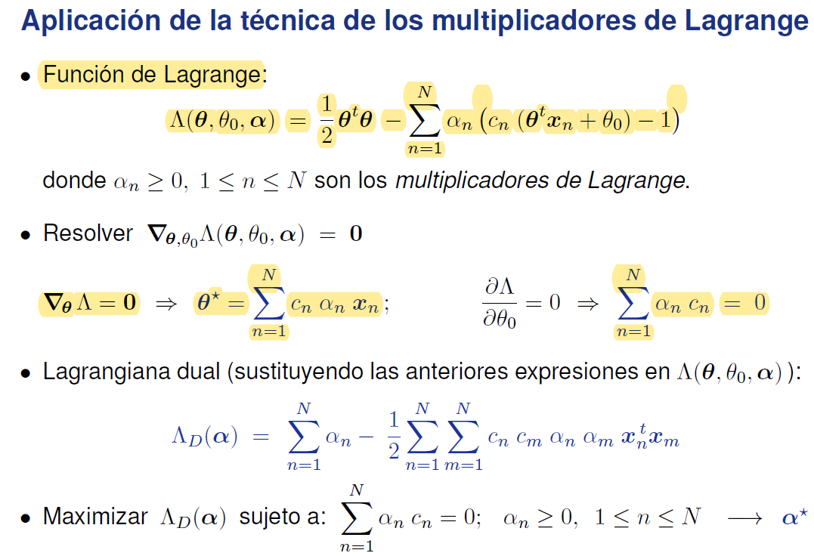
Tema 4-1

Slide 5


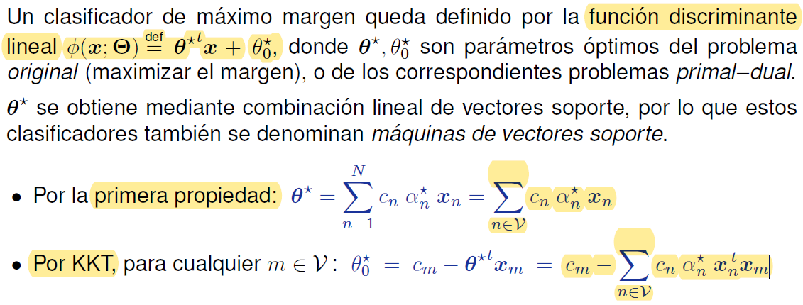


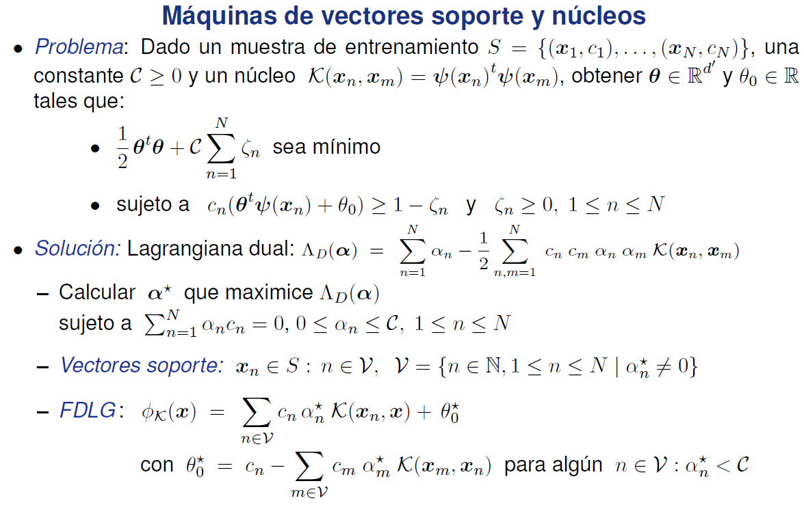
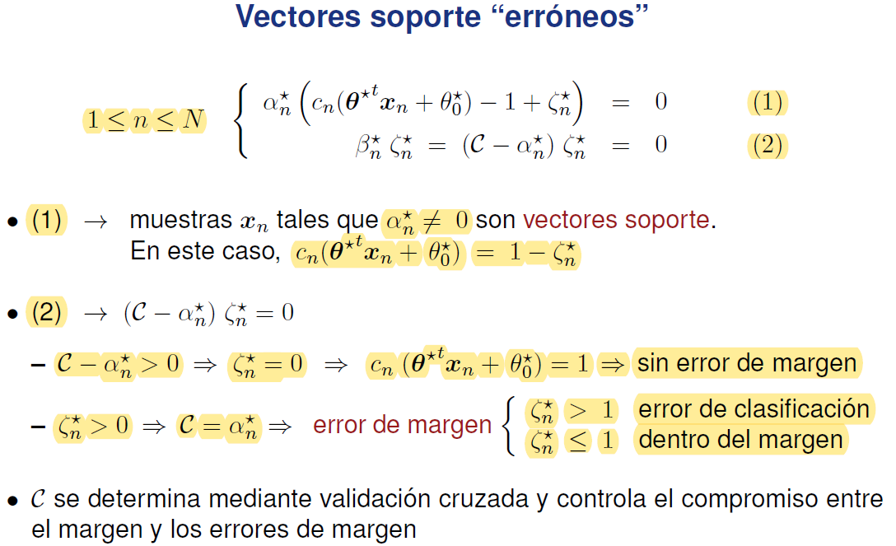
Tema 4-2

Slide 6
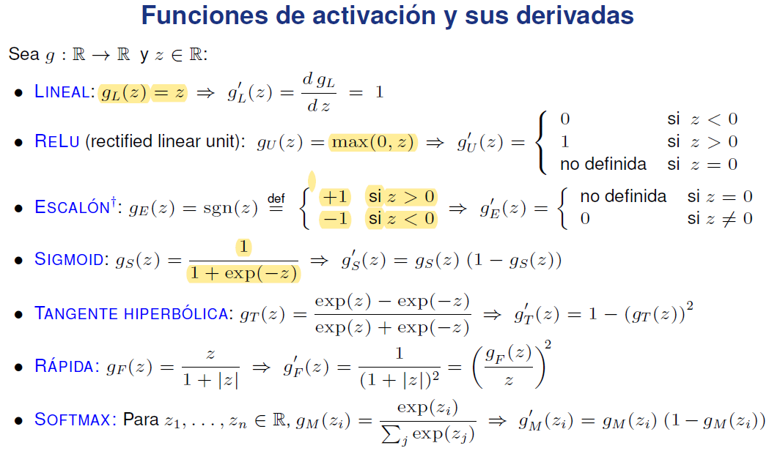
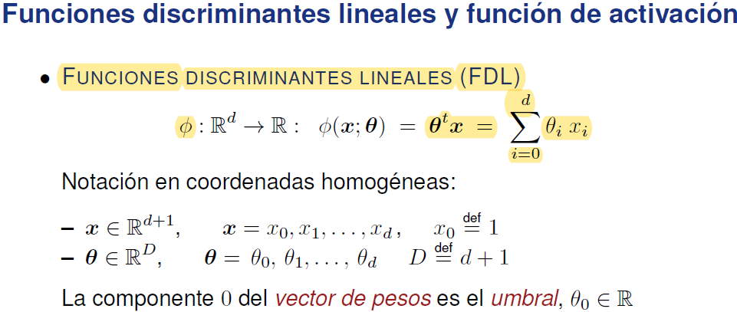
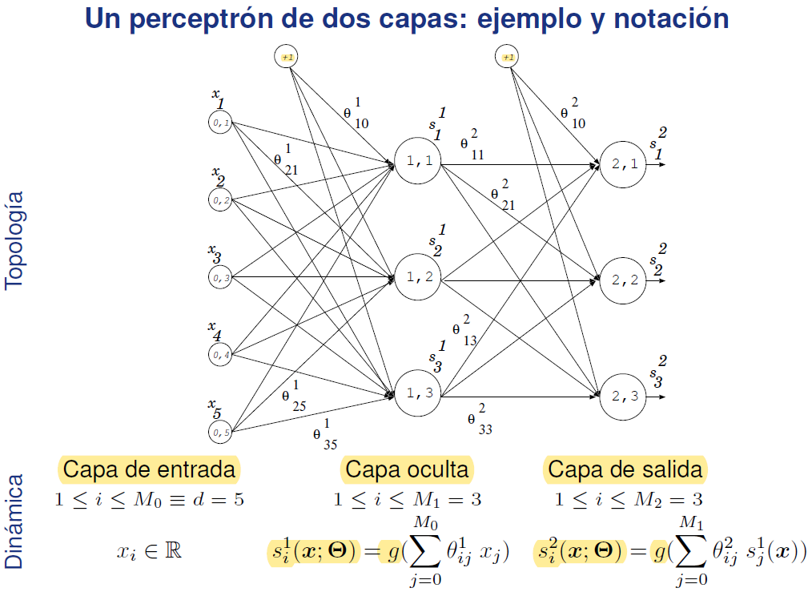
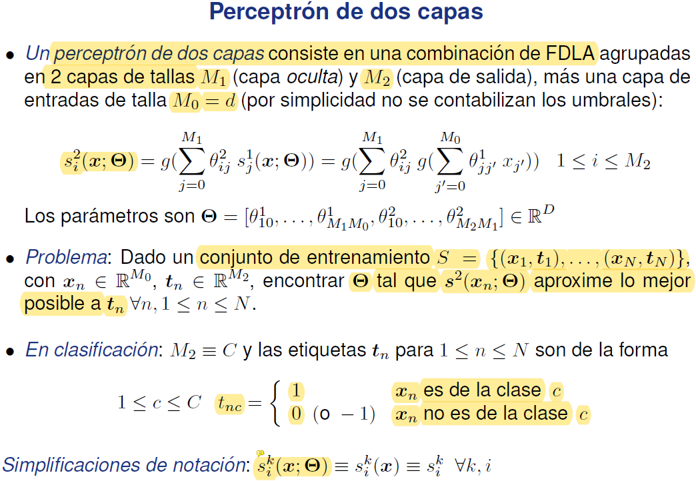
Tema 5-1

Slide 7
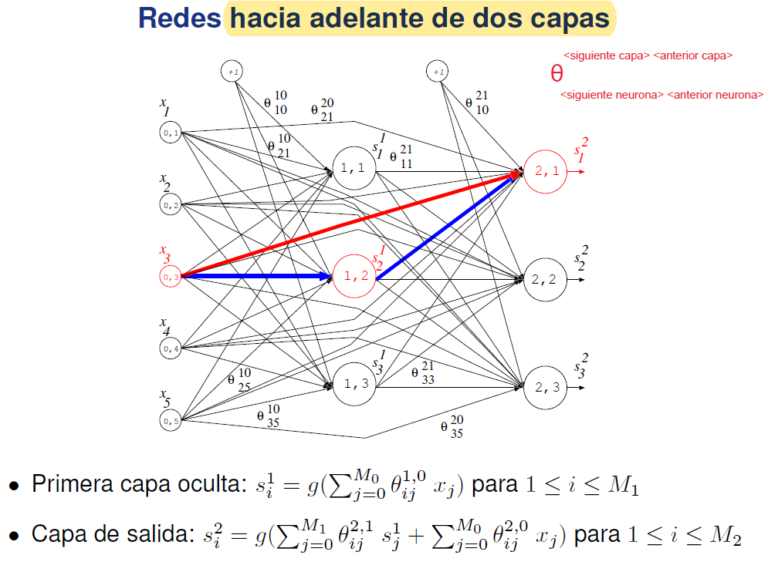
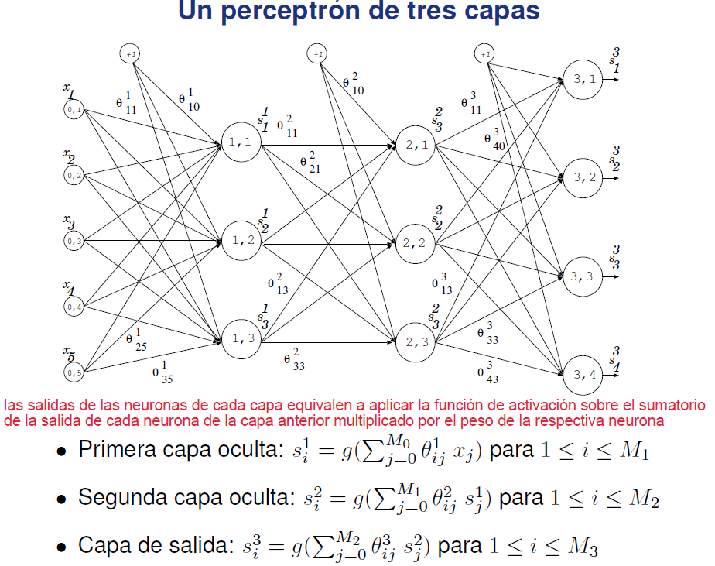
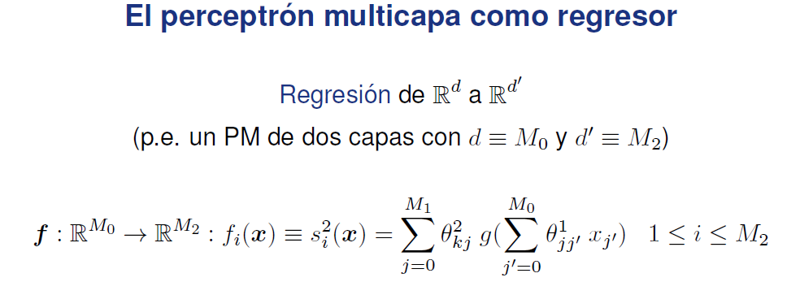

Tema 5-2

Slide 8
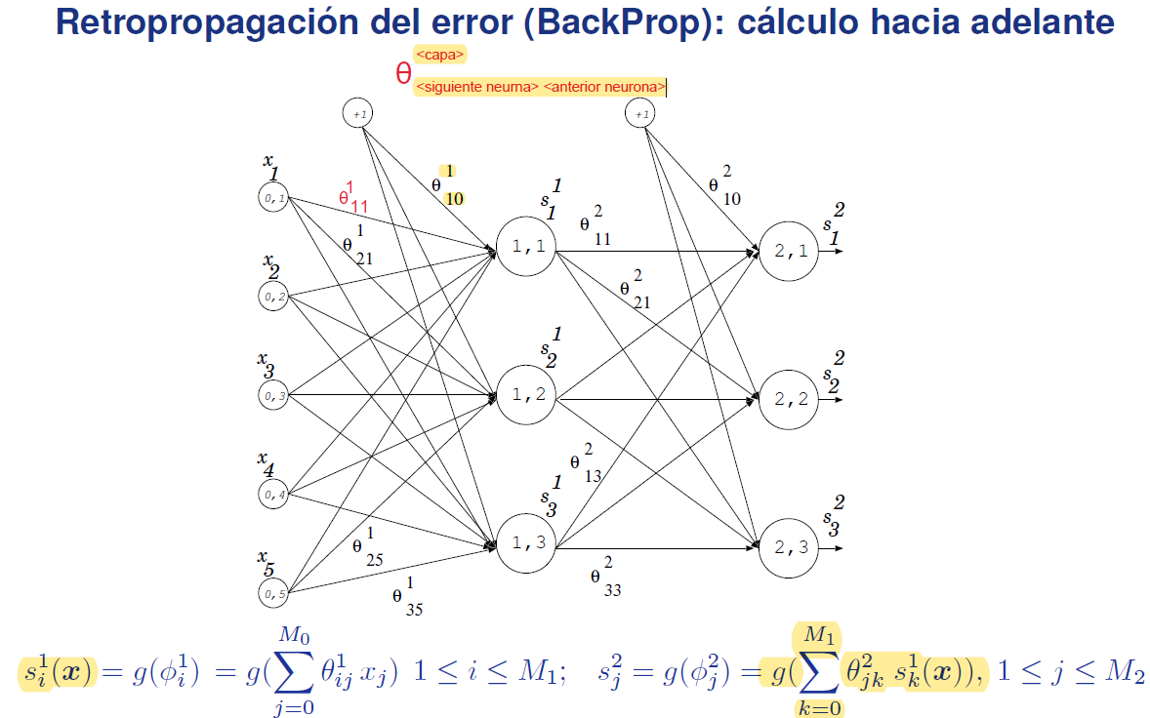
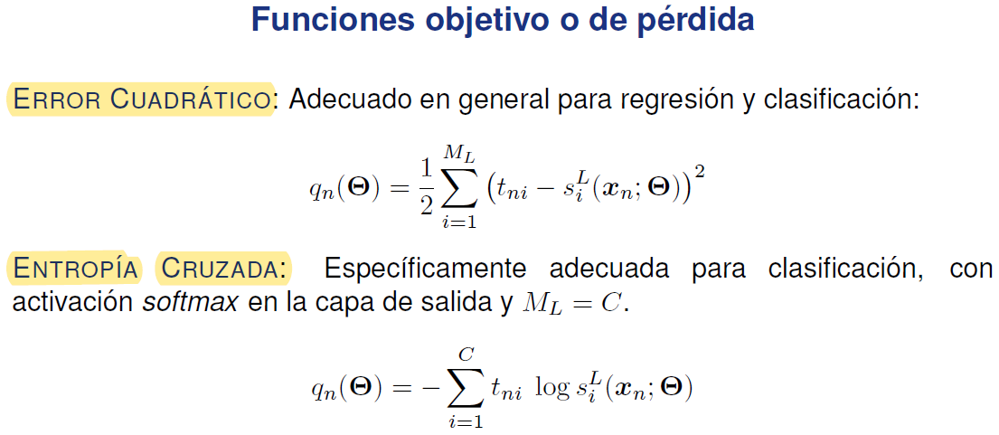


Tema 5-3

Slide 9
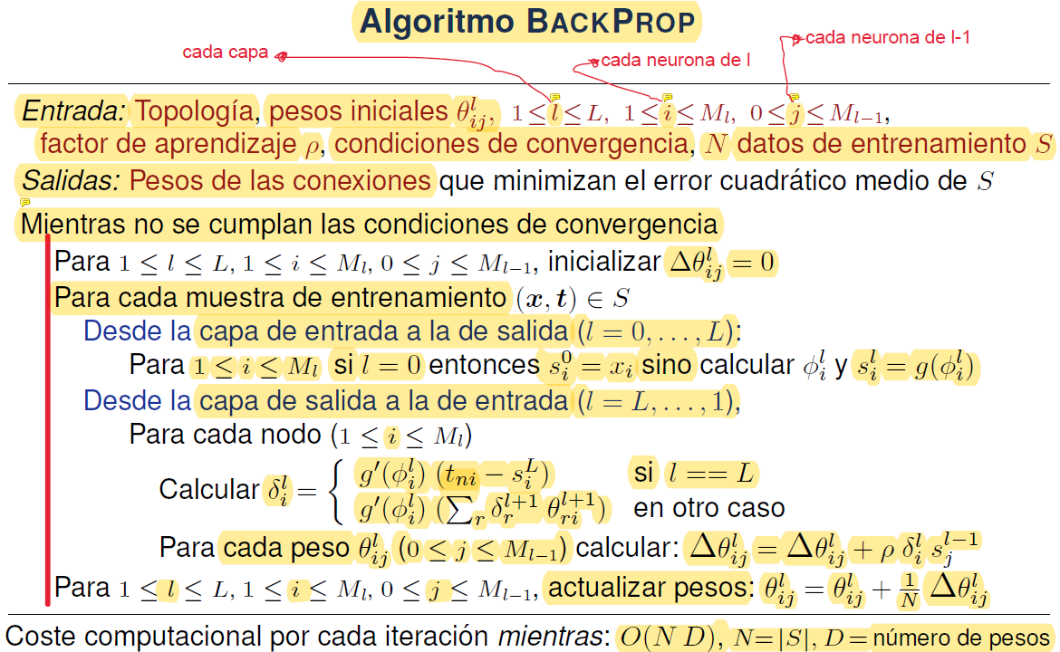
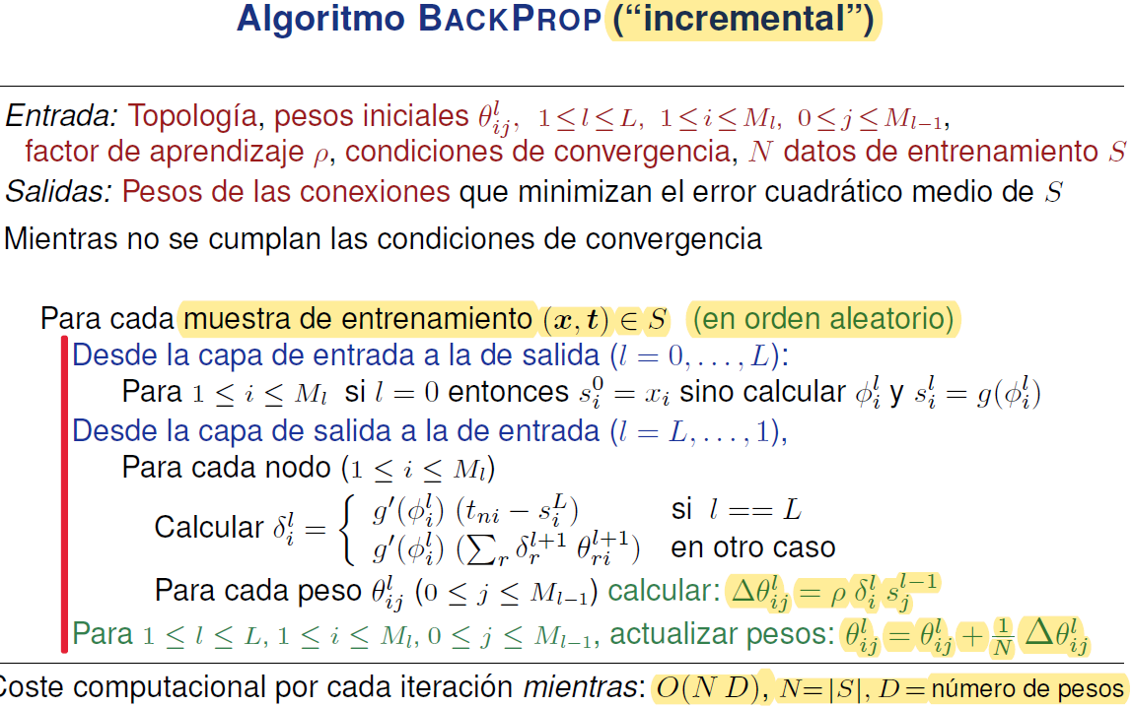
Tema 5-4

Slide 10
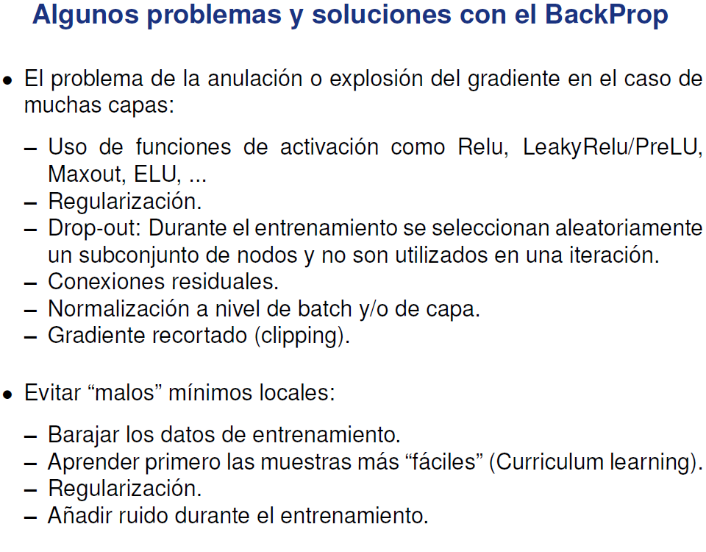
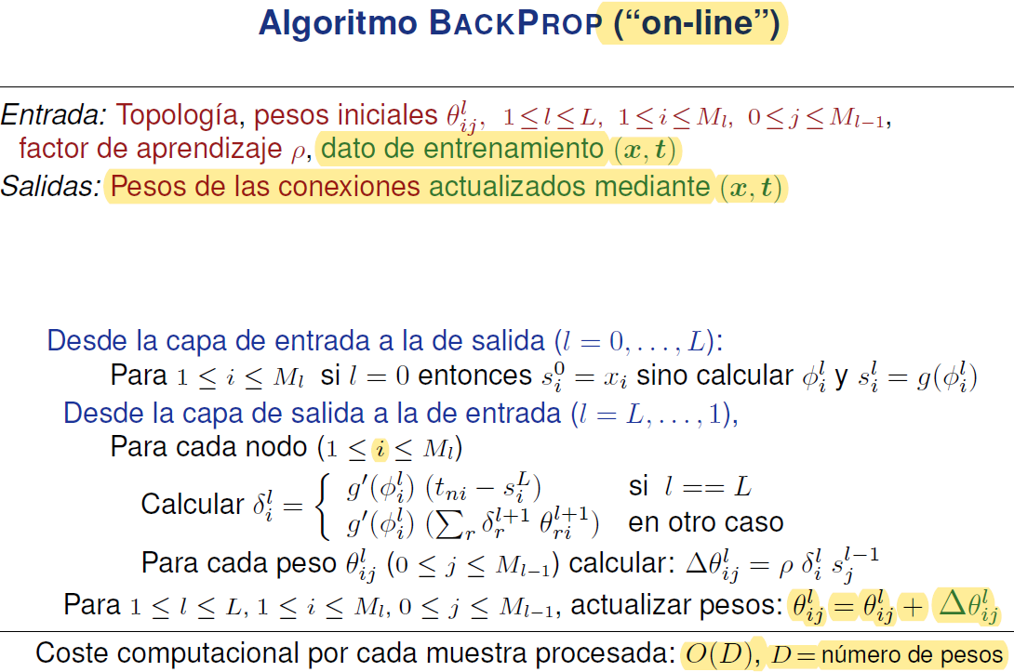
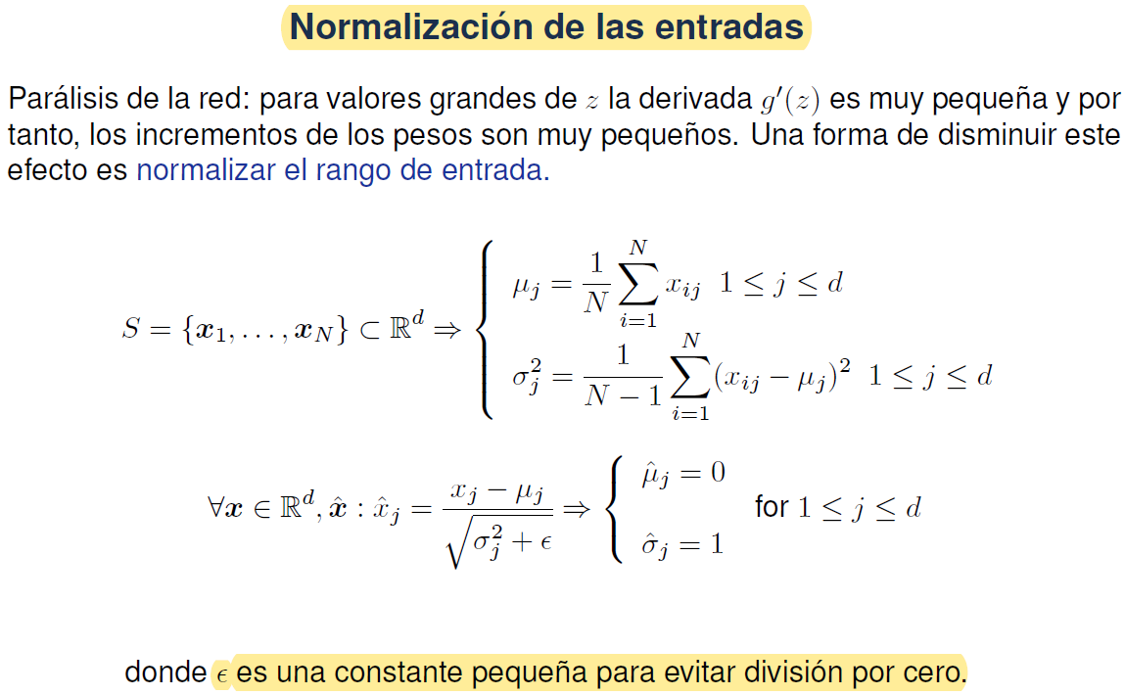
Tema 5-5

Slide 11
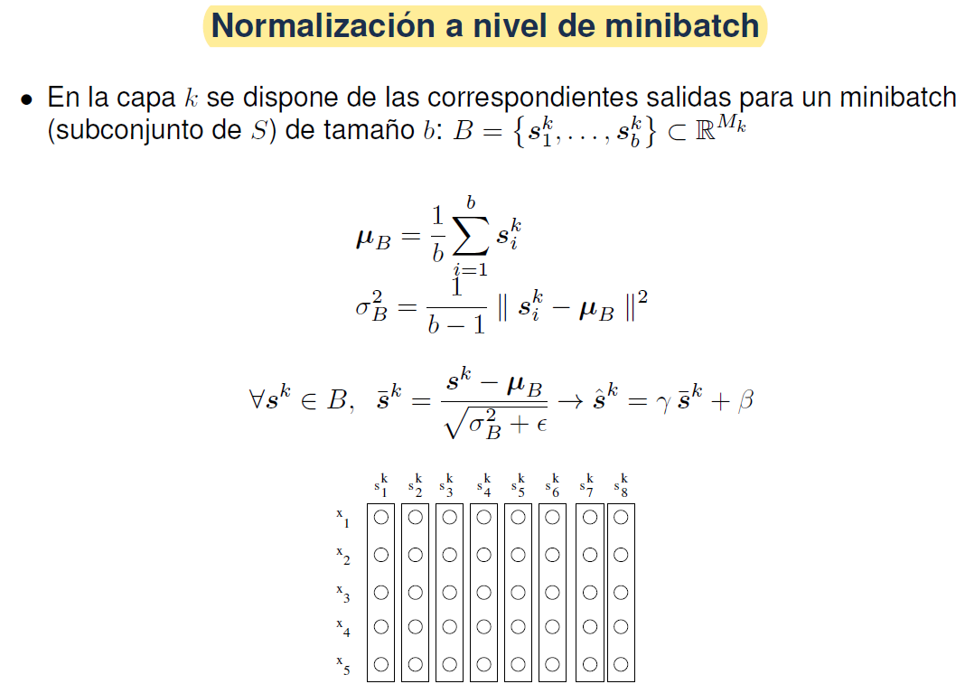
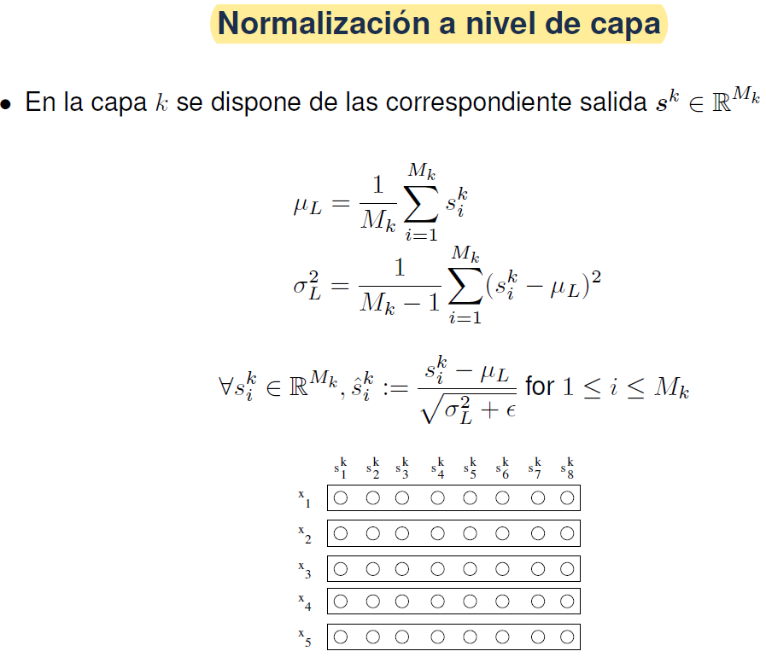
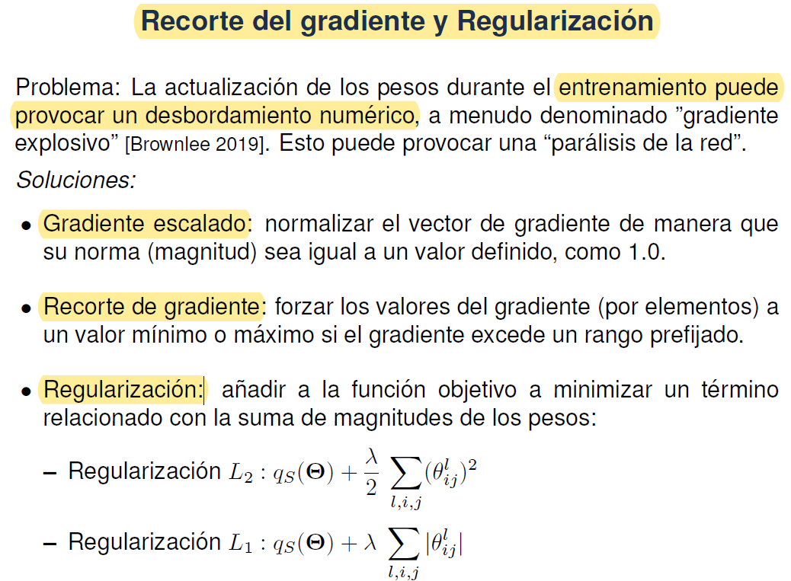
Tema 5-5

Slide 12
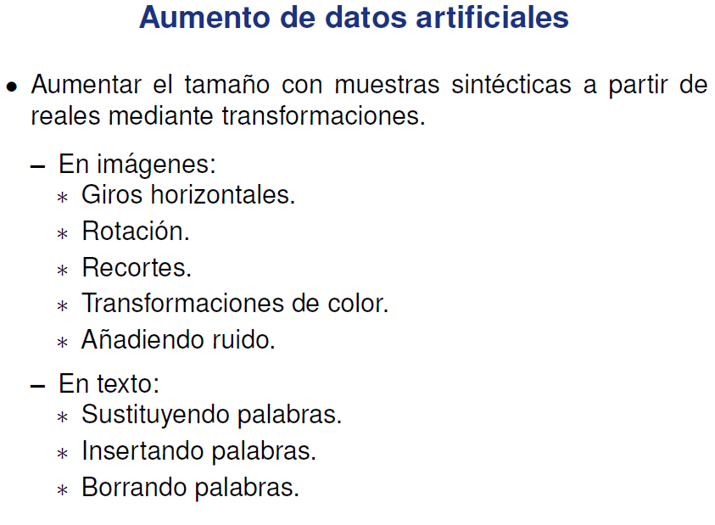
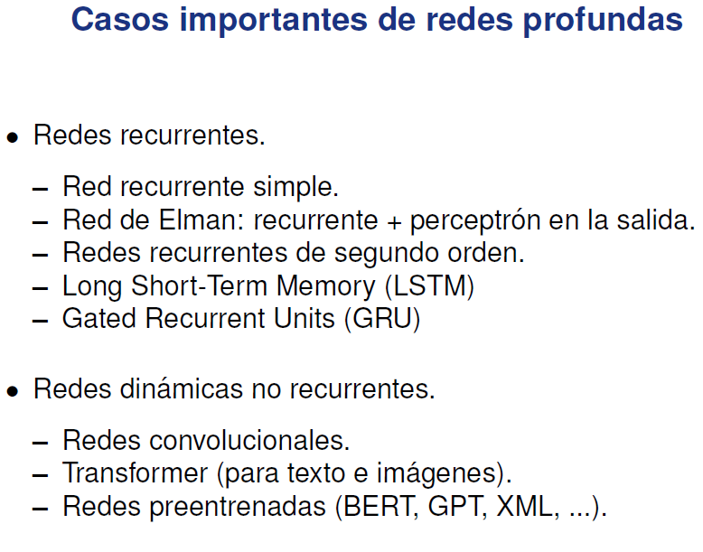
Tema 5-6

