Slide 1
Kinect PPT/PDF Control
Brief guide to use
Niccolò Fabbri
Firenze, 25/11/2016

Slide 2
Kinect PPT/PDF Control
Firenze, 25/11/2016
Goal
This program aims to build a gesture recognition system that uses natural gestures to control a PowerPoint or PDF presentation.
The primary goal of this system is to free the user from restraints and automatically react to the naturally gestures throughout the presentation.

Slide 3
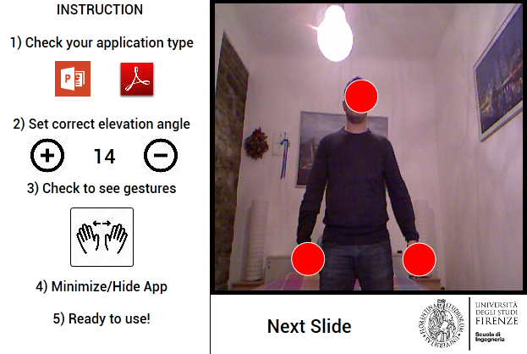
Kinect PPT/PDF Control
Firenze, 25/11/2016
User Interface

Slide 4
Kinect PPT/PDF Control
Firenze, 25/11/2016
Main Features
Application Type: Through these buttons you can change the program to control. The choice is between:
PowerPoint (set default)
Generic PDF Reader
Elevation Angle: Through plus or minus buttons, you can change the elevation angle of device.
This setting is more important if you want to present by sitting.
Gesture Button: Through this button you can see the motion gestures.
Bounding Box: Through this text box you can see the recognized gesture

Slide 5
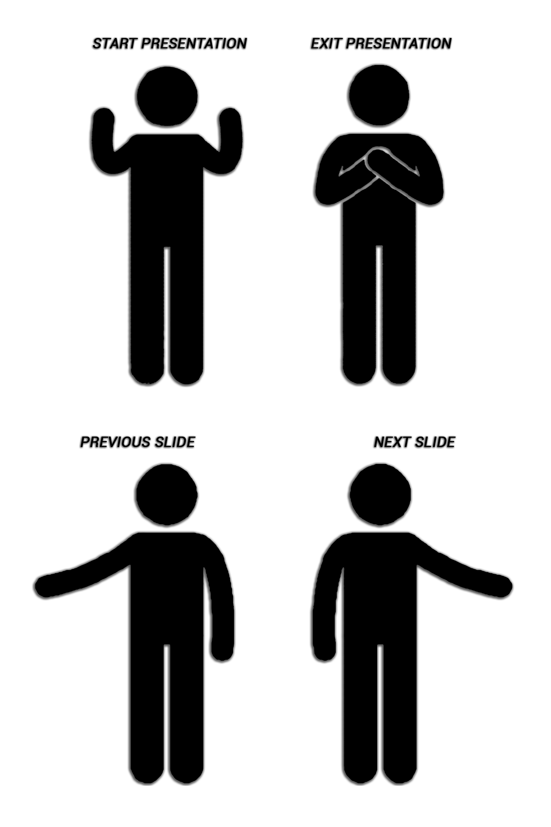
Kinect PPT/PDF Control
Firenze, 25/11/2016
Main Gestures
Start Presentation: Put your hands in line with head.
Exit Presentation: Cross your hands.
Previous Slide: Move your left hand from body to away.
Next Slide: Move your right hand from body to away.

Slide 6
Kinect PPT/PDF Control
Firenze, 25/11/2016
Usage
Point the Kinect device at you and stand at least 1 meter away.
You can see yourself in the application window and the three circles will track your head and hands.
Move, as described in slide 5, your arms to activate the gesture.
These gestures will send an arrow or control key to the foreground application.
Run your PowerPoint or PDF presentation so is the foreground application.
The ellipses grow and change color when your hand exceeds the thresholds. The gestures will only activate once as your hand exceeds the threshold, and only one of the gestures can be active at once. You must bring your hand back closer to your body to activate the gesture a second time.

