Slide 1
KinecTool
A repository of open Kinect projects
Niccolò Fabbri
Florence, 02/12/2016

Slide 2
KinecTool: a repository of open Kinect projects
Florence, 02/12/2016
Introduction (1/2)
The goal of this work is to propose two demos:
Rock Paper Scissors The Game
↓
It focuses on the possibility of to recognize number of fingers present in the hand.
Kinect PPT/PDF Control
↓
It focuses on basic gesture recognition trough skeleton tracking.

Slide 3
KinecTool: a repository of open Kinect projects
Florence, 02/12/2016
Introduction (2/2)
Existing vision – based approaches are limited by the quality of the input image: variations in lighting and background clutters would only worsen the problem
Hand gesture recognition concerns two challenging problems:
Hand detection → depth map obtained by Kinect sensor to detect the hand shapes
Gesture recognition → resolution of Kinect sensor too low; it works well to track a large object (e.g. the human body), while it is difficult to detect a small object (e.g. a human hand)

Slide 4
KinecTool: a repository of open Kinect projects
Florence, 02/12/2016
Related Works
First task was to find a library or an open project providing information on hands and fingers tracking → choice was really small
For RPS The Game all projects use the skeleton tracking engine to follow the hand’s gestures, that means one point or joint in space and no finger tracking.
Robust Hand Gesture Recognition with Kinect Sensor (Nanyang Technological University) I tried to replicate this project, but the results obtained were not up to expectations.
→ Candescent NUI provides full hand recognition with finger points, palm, depth, volume, etc.
For Kinect PPT/PDF Control the choice between libraries is not important because Kinect SDK version 1.8 is enough.
→ I propose a solution that improve use of the controller, extending functionality and introducing a better accuracy

Slide 5
KinecTool: a repository of open Kinect projects
Florence, 02/12/2016
Tools and Techniques Employed
Implementation of these demo have been developed entirely in C# code.
For a correct execution, you need to install some additional packages:
Kinect for Windows SDK v1.8
Microsoft Visual Studio 2012
Candescent NUI library
OpenNI library

Slide 6
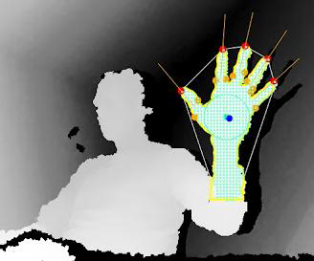
KinecTool: a repository of open Kinect projects
Florence, 02/12/2016
Candescent NUI
Candescent NUI provides lots of useful information for hand and fingers tracking, like the palm position, the number of fingers, each finger’s base position and id.
A convex hull algorithm gives the fingertips position (X, Y, Z), direction, etc;

Slide 7
KinecTool: a repository of open Kinect projects
Florence, 02/12/2016
Candescent NUI
Bases to start with Candescent NUI
To use the Candescent library, the project must add these library’s dll:
CCT.NUI.Core
CCT.NUI.HandTracking
CCT.NUI.KinectSDK
CCT.NUI.Visual

Slide 8
KinecTool: a repository of open Kinect projects
Florence, 02/12/2016
Candescent NUI
Kinect field of view
Kinect for Windows detects objects at 400mm in near mode
Candescent NUI hands have to be at least at 500mm (minimum depth) to be detected correctly; maximum distance is 800mm
The perfect distance for the tracking is around 650mm

Slide 9
KinecTool: a repository of open Kinect projects
Florence, 02/12/2016
Candescent NUI
Fingers Detection
The fingers are numbered from 0 to 4 for each hand
The first finger is always the highest one and then the other fingers are ordered clockwise
So if the hand rotates, the first finger and the others change position → there’s no lock mode on fingers
FingerCount int returns the exact number of fingers at the moment

Slide 10
KinecTool: a repository of open Kinect projects
Florence, 02/12/2016
Kinect SDK
Kinect development kit for Windows 7 allows developers to create their own interfaces and applications for windows → designed to be used with C++ and C#
Kinect SDK offers raw sensor stream to access to low – level streams from the depth sensor, color camera sensor, and four element microphone array
Skeletal tracking: capability to track the skeleton image of one or two people moving within the Kinect field of view for gesture – driven applications

Slide 11
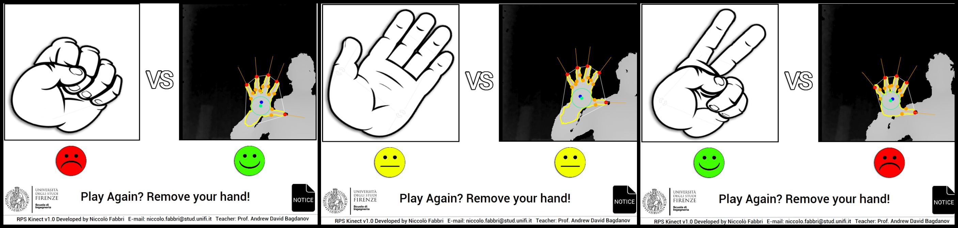
KinecTool: a repository of open Kinect projects
Florence, 02/12/2016
Application
Rock Paper Scissors The Game
Unfortunately Rock Paper Scissors The Game is not always stable and therefore was evaluated as beta game.
Nobody usability test is realized to Rock Paper Scissors The Game.

Slide 12
KinecTool: a repository of open Kinect projects
Florence, 02/12/2016
Application
Kinect PPT/PDF Control (1/2)
This program aims to build a gesture recognition system that uses natural gestures to control a PowerPoint or PDF presentation.
The primary goal of this system is to free the user from these restraints and automatically react to the naturally gestures throughout the presentation → focusing the system’s attention on natural gestures.
The gesture recognition system should not hinder the user, allowing the human – computer interaction to be as seamless and intuitive as possible.

Slide 13
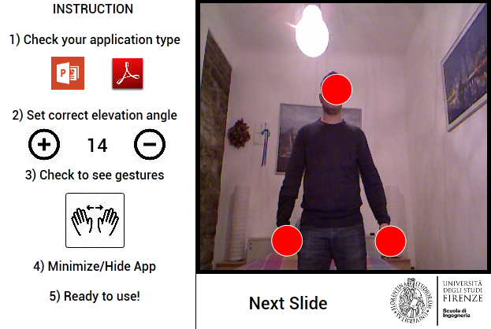
KinecTool: a repository of open Kinect projects
Florence, 02/12/2016
Application
Kinect PPT/PDF Control (2/2)
The Kinect PPT/PDF Control interface improves some important features:
Mode Switch
Set Elevation Angle
Gesture Button
Bounding Box

Slide 14
KinecTool: a repository of open Kinect projects
Florence, 02/12/2016
Usability Test – Kinect PPT/PDF Control
Methodology
The users are asked to complete a series of routine tasks supervised by a moderator with the aim of estimating system:
Before starting the test, the controller is introduced to the user through a presentation of the hands and arms gestures.
Learnability
Easiness of use
Accuracy
Effort and Comfort
Consistency

Slide 15
KinecTool: a repository of open Kinect projects
Florence, 02/12/2016
Usability Test – Kinect PPT/PDF Control
Test Protocol (1/2)
The testing protocol is composed by 3 consecutive task oriented test.
In each test, as the user is asked to complete a series of routine tasks, the supervisor is allowed to help the user. Example of tasks:
Start presentation
Select a specific mode
Go to a precise slide
Come back to a precise slide
Change elevation angle
Switch from one mode to other
Repeat all tasks to sitting
Quit presentation

Slide 16
KinecTool: a repository of open Kinect projects
Florence, 02/12/2016
Usability Test – Kinect PPT/PDF Control
Test Protocol (2/2)
The study involved 17 participants between the ages of 18 and 68.
The location is a room where the user can test the system in privacy and without too many distractions.
The Kinect device is placed on the table in front of user, the user is asked to use the device standing in front, and a second time in a sitting position.
The test requires supposed to require about 5 minutes for each task oriented test, totaling some 15 minutes to user.

Slide 17
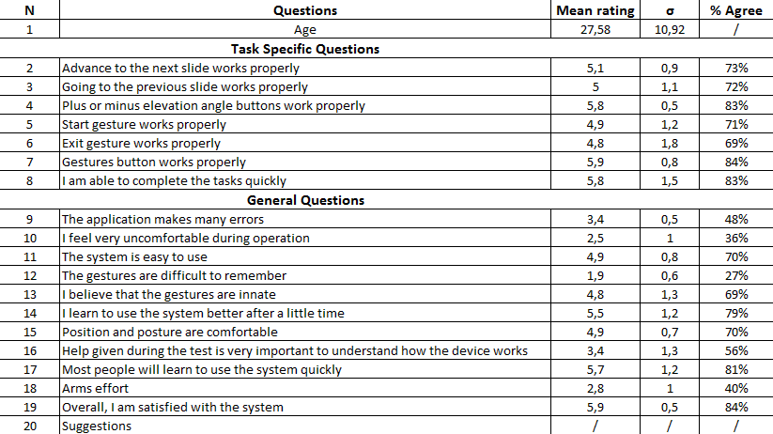
KinecTool: a repository of open Kinect projects
Florence, 02/12/2016
Usability Test – Kinect PPT/PDF Control
Result (1/2)
System usability is evaluated by asking the users 20 SEQ over a 7-point Likert scale

Slide 18
KinecTool: a repository of open Kinect projects
Florence, 02/12/2016
Usability Test – Kinect PPT/PDF Control
Result (2/2)
The essay question Suggestions was very interesting
→ the majority of participants suggested the possibility of to change gestures
In particular the motion gestures, previous and next slides
→ it was suggested to insert new gestures
Closing gesture is not appreciate more
→ not consider suitable to the environment in which he will expose his presentation

Slide 19
KinecTool: a repository of open Kinect projects
Florence, 02/12/2016
Conclusions (1/2)
I tested two different ideas for interaction Human Computer
Rock Paper Scissors The Game
For this demo, Candescent NUI provides accuracy to dynamic hand and fingers detections but results are usually noisy
Kinect PPT/PDF Control
This demo simulates correctly the clicker object that the user can use to control the slides remotely. The results highlights that posture during the operation (both modes: sitting or standing) allows a prolonged usage.

Slide 20
KinecTool: a repository of open Kinect projects
Florence, 02/12/2016
Conclusions (2/2)
In conclusion,
Kinect PPT/PDF Control may be a useful alternative in situations in which using conventional input devices (mouse, touchscreen or clicker object) is difficult, for example if you have a busy hand or other obstacle.

Slide 21
KinecTool: a repository of open Kinect projects
Florence, 02/12/2016
Future Developments
A future development may be to integrate the possibility to control video inside presentation.
For this advancement, I will have suppose to do a simple tracking of the right/left hand joint
Another possible scenario, that requires a little modification, may be the usage during a surgery, to browse some patients’ clinical test, in a sterile operating room, without physically touching a device and so destroying the sterile field.

