Slide 1


Adaptive Text
Extraction and Mining
ECML-2003 Tutorial
Fabio Ciravegna
Department of Computer Science
University of Sheffield
F.Ciravegna@dcs.shef.ac.uk
www.dcs.shef.ac.uk/~fabio
Nicholas Kushmerick
Department of Computer Science
University College Dublin
nick@ucd.ie
www.cs.ucd.ie/staff/nick

Slide 2
What is IE
What can we extract from the Web
and why?
Introduction: (20 minutes)
  what is IE
  What can we extract from the Web
  Why?
Algorithms and methodologies (100 min)
IE in practice (30 min)
Conclusion, Future Work (10 min)
Discussion

Slide 3
The ‘canonical’ IE task
Input:
  Document
    newspaper article, Web page, email message, …
  Pre-defined “information need”
    frame slots, template fillers, database tuples, …
Output
  The specific substrings/fragments of the document or labels that satisfy the stated information need, possibly organised in a template
DARPA’s ‘Message Understanding Conferences/Competitions’ since late1980’s; most recent: MUC-7, 1998.
Recent interest in the machine learning and Web communities.

Slide 4
IE Standard Tasks
Preprocessing
  Tokenization
  Morphological Analysis
  Part of Speech Tagging
Information Identification
  Named Entity Recognition
  Template Filling (from the MUC)
    Template Elements
    Template Relations
    Scenario Template

Slide 5
NE Recognition & Coreference
& Coreference
Organisation
19:16 rates Province of Saskatchewan A3
said it assigned an A3 rating to the Province of Saskatchewan's bond offering that was priced today.
The sale is a reopening of the province's 9.6 percent bonds due February 4, 2022. Proceeds will be used for government purposes, mainly Saskatchewan Power Corp.
Moody’s
Moody's Investors Service Inc
C$115 million
MNY
%
Date
Notes:
15

Slide 6
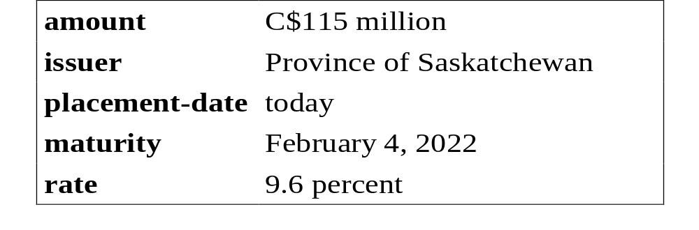
Template Filling
19:16 Moody's rates Province of Saskatchewan A3
Moody's Investors Service Inc said it assigned an A3 rating to the Province of Saskatchewan's C$115 million bond offering that was priced today.
The sale is a reopening of the province's 9.6 percent bonds due February 4, 2022. Proceeds will be used for government purposes, mainly Saskatchewan Power Corp.
Notes:
18

Slide 7
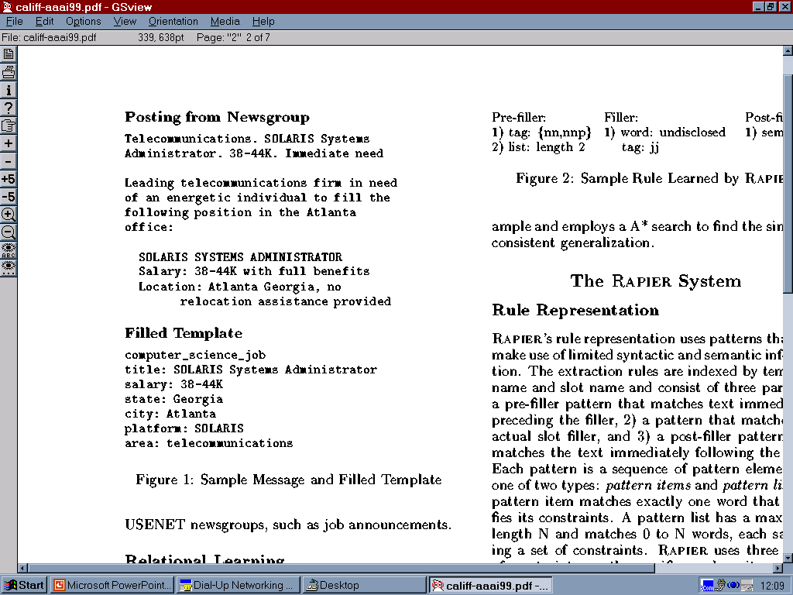
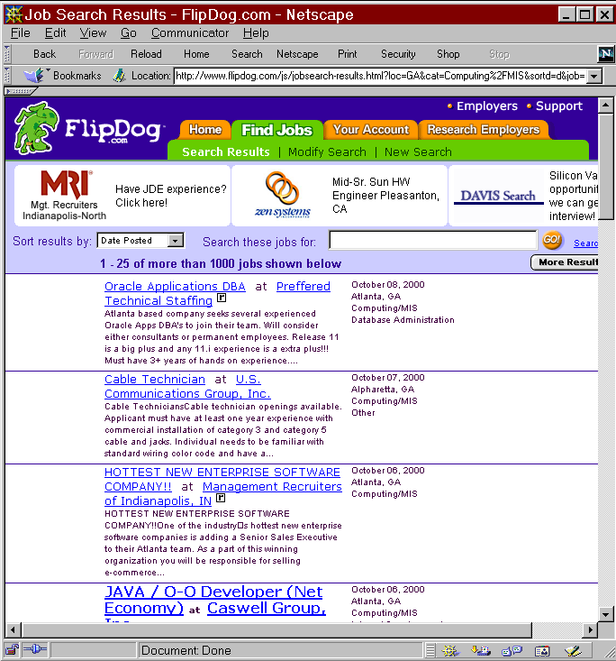
The Big Picture
Intranet
Web
query
processor
ontology
IE
data
base

Slide 8
NYU Architecture: a MUC architecture
Local Text Analysis
Lexical
Analysis
Name
Recognition
Partial
Parsing
Scenario
Pattern Matching
Discourse Analysis
Coreference
Analysis
Inference
Template
Generation

Slide 9
Semantic Web
A brain for Human Kind
From Information-based to Knowledge-Based
Processable Knowledge means:
  Better Retrieval
  Reasoning
Where can IE contribute?

Slide 10
Building the SW
Document annotation
  Manually associate documents (or parts) to ontological descriptions
    Document classification for retrieval
      Where can I buy an Hamster?
      Pet shop web page -> pet shop concept -> hamster
    Knowledge annotation
      Where can I find a hotel in Berlin where single rooms cost less than 400€?
      The Hotel is located in central Berlin and the cost for a single room is 300€
  Editors are currently available for manual annotation of texts

Slide 11
IE for Annotating Documents
Manual annotation is
  Expensive
  Error prone
IE can be used for annotating documents
  Automatically
  Semi-Automatically
    As user support
Advantages
  Speed
  Low cost
  Consistency
  Can provide automatic annotation different from the one provided by the author(!)

Slide 12
SW for Knowledge Management
SW is important for everyday Internet users
SW is necessary for large companies
  Millions of documents where knowledge is interspersed
  Most documents are now
    web-based
    Available over an Intranet
  Companies are valued for their
    Tangible assets (e.g. plants)
    Intangible assets (e.g. knowledge)
  Knowledge is stored in
    mind of employees
    Documentation
  Companies spend 7-10% of revenues for KM

Slide 13
Why Adaptive Systems?
Writing IE systems by hand is difficult and error prone
  Extraction languages can be quite complex
  Tedious write-test-debug-rewrite cycle
Adaptive systems learn from user annotations
  the person tells the learning algorithm what to extract:
  The learner figures out how
Advantages
  Annotating text is simpler & faster than writing rules.
  Domain independent
  Domain experts don’t need to be linguists or programers.
  Learning algorithms ensure full coverage of examples.

Slide 14
Algorithms and Methodologies
A dip into the details of IE for the Web
Introduction: (20 minutes)
Algorithms and methodologies (100 min)
  Wrapper induction
  Boosted wrapper induction
  Hidden Markov models
  Exploiting linguistic constraints
IE in practice (30 min)
Conclusion, Future Work (10 min)
Discussion

Slide 15

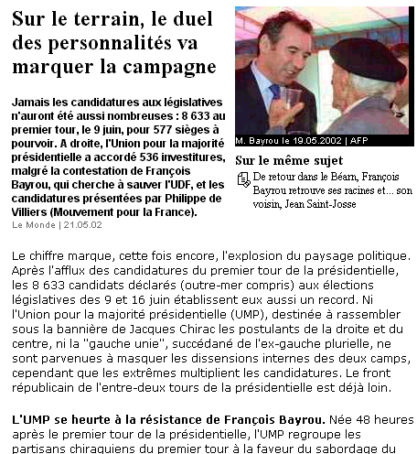
Algorithms: Outline
structured
data
Wrappers
Hand-coded wrappers
Wrapper induction
Learning highly expressive wrappers
Boosted wrapper induction
Hidden Markov models
Exploiting linguistic constraints
natural
text

Slide 16
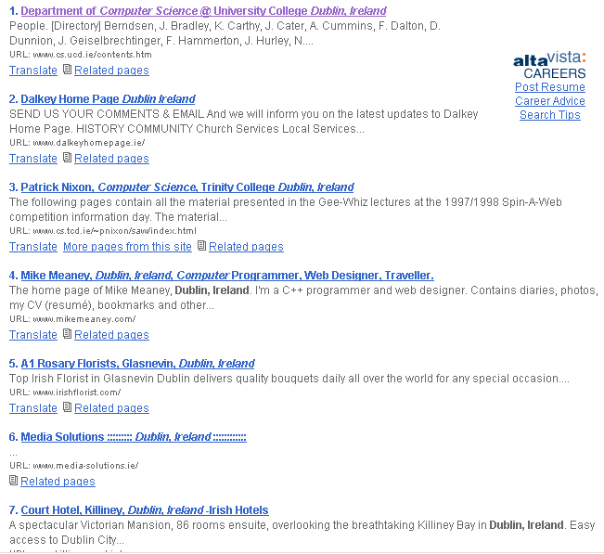
Wrapper induction
Highly regular
source documents
⇓
Relatively simple
extraction patterns
⇓
Efficient
learning algorithms

Slide 17
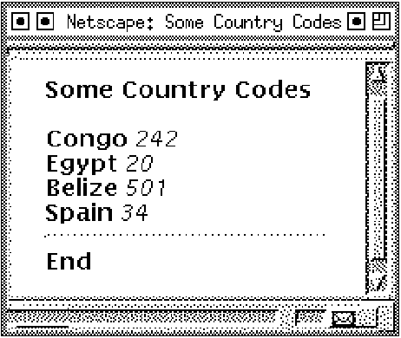
Wrappers: Example and Toolkits
⟨ (Congo, 242)
(Egypt, 20)
(Belize, 501)
(Spain, 34) ⟩
Wrapper toolkits: Specialized programming environments for writing & debugging wrappers by hand
Examples
  World Wide Web Wrapper Factory[ db.cis.upenn.edu/W4F ]
  Java Extraction & Dissemination of Information
  [ www.darmstadt.gmd.de/oasys/projects/jedi ]

Slide 18
Wrappers: Delimiter-based extraction
<HTML><TITLE>Some Country Codes</TITLE>
<B>Congo</B> <I>242</I><BR>
<B>Egypt</B> <I>20</I><BR>
<B>Belize</B> <I>501</I><BR>
<B>Spain</B> <I>34</I><BR>
</BODY></HTML>

Use <B>, </B>, <I>, </I> for extraction

Slide 19
“Left-Right” wrappers
Left-Right wrapper ≡ 2K strings
⟨l₁ , r₁ , …, l_{K} , r_{K}⟩
left delimiters
right delimiters
procedure ExtractCountryCodes
while there are more occurrences of <B>
1. extract Country between <B> and </B>
2. extract Code between <I> and </I>
procedure ExtractAttributes:
while there are more occurrence of l₁
1. extract 1st attribute between l₁ and r₁
. . .
K. extract K^{th} attribute between l_{K} and r_{K}
[Kushmerick et al, IJCAI-97; Kushmerick AIJ-2000]

Slide 20
Wrapper induction
examples

hypothesis
Thai food is spicy.
Vietnamese food is spicy.
German food isn’t spicy.

Asian food
is spicy.
<HTML><HEAD>Some Country Codes</HEAD>
<BODY><B>Some Country Codes</B><P>
<B>Congo</B> <I>242</I><BR>
<B>Egypt</B> <I>20</I><BR>
<B>Belize</B> <I>501</I><BR>
<B>Spain</B> <I>34</I><BR>
<HR><B>End</B></BODY></HTML>
<HTML><HEAD>Some Country Codes</HEAD>
<BODY><B>Some Country Codes</B><P>
<B>Congo</B> <I>242</I><BR>
<B>Egypt</B> <I>20</I><BR>
<B>Belize</B> <I>501</I><BR>
<B>Spain</B> <I>34</I><BR>
<HR><B>End</B></BODY></HTML>
<HTML><HEAD>Some Country Codes</HEAD>
<BODY><B>Some Country Codes</B><P>
<B>Congo</B> <I>242</I><BR>
<B>Egypt</B> <I>20</I><BR>
<B>Belize</B> <I>501</I><BR>
<B>Spain</B> <I>34</I><BR>
<HR><B>End</B></BODY></HTML>

wrapper
<HTML><HEAD>Some Country Codes</HEAD>
<BODY><B>Some Country Codes</B><P>
<B>Congo</B> <I>242</I><BR>
<B>Egypt</B> <I>20</I><BR>
<B>Belize</B> <I>501</I><BR>
<B>Spain</B> <I>34</I><BR>
<HR><B>End</B></BODY></HTML>

Slide 21
Learning LR wrappers
labeled pages
wrapper
<HTML><HEAD>Some Country Codes</HEAD>
<B>Congo</B> <I>242</I><BR>
<B>Egypt</B> <I>20</I><BR>
<B>Belize</B> <I>501</I><BR>
<B>Spain</B> <I>34</I><BR>
</BODY></HTML>
<HTML><HEAD>Some Country Codes</HEAD>
<B>Congo</B> <I>242</I><BR>
<B>Egypt</B> <I>20</I><BR>
<B>Belize</B> <I>501</I><BR>
<B>Spain</B> <I>34</I><BR>
</BODY></HTML>
<HTML><HEAD>Some Country Codes</HEAD>
<B>Congo</B> <I>242</I><BR>
<B>Egypt</B> <I>20</I><BR>
<B>Belize</B> <I>501</I><BR>
<B>Spain</B> <I>34</I><BR>
</BODY></HTML>
<HTML><HEAD>Some Country Codes</HEAD>
<B>Congo</B> <I>242</I><BR>
<B>Egypt</B> <I>20</I><BR>
<B>Belize</B> <I>501</I><BR>
<B>Spain</B> <I>34</I><BR>
</BODY></HTML>
⟨l₁, r₁, …, l_{K}, r_{K}⟩
Example: Find 4 strings
  ⟨<B>, </B>, <I>, </I>⟩
  ⟨ l₁ , r₁ , l₂ , r₂ ⟩

Slide 22
LR: Finding r₁
<HTML><TITLE>Some Country Codes</TITLE>
<B>Congo</B> <I>242</I><BR>
<B>Egypt</B> <I>20</I><BR>
<B>Belize</B> <I>501</I><BR>
<B>Spain</B> <I>34</I><BR>
</BODY></HTML>
r₁ can be any prefix
eg </B>

Slide 23
LR: Finding l₁, l₂ and r₂
<HTML><TITLE>Some Country Codes</TITLE>
<B>Congo</B> <I>242</I><BR>
<B>Egypt</B> <I>20</I><BR>
<B>Belize</B> <I>501</I><BR>
<B>Spain</B> <I>34</I><BR>
</BODY></HTML>
r₂ can be any prefix
eg </I>
l₂ can be any suffix
eg <I>
l₁ can be any suffix
eg <B>

Slide 24
A problem with LR wrappers
Distracting text in head and tail
<HTML><TITLE>Some Country Codes</TITLE>
<BODY><B>Some Country Codes</B><P>
<B>Congo</B> <I>242</I><BR>
<B>Egypt</B> <I>20</I><BR>
<B>Belize</B> <I>501</I><BR>
<B>Spain</B> <I>34</I><BR>
<HR><B>End</B></BODY></HTML>

Slide 25
One (of many) solutions: HLRT
Ignore page’s head and tail
<HTML><TITLE>Some Country Codes</TITLE>
<BODY><B>Some Country Codes</B><P>
<B>Congo</B> <I>242</I><BR>
<B>Egypt</B> <I>20</I><BR>
<B>Belize</B> <I>501</I><BR>
<B>Spain</B> <I>34</I><BR>
<HR><B>End</B></BODY></HTML>
end of head
}
head
}
body
}
tail
start of tail

Head-Left-Right-Tail wrappers

Slide 26
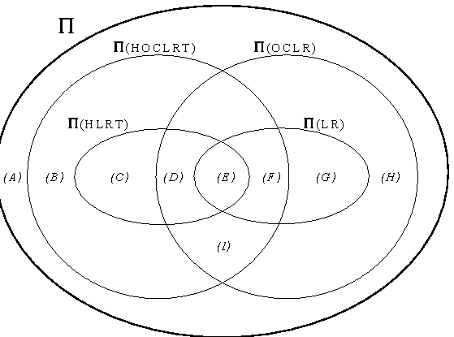
Expressiveness
Theorem:
all sites
Sites
wrappable
by LR
aites
wrappable
by HLRT

Slide 27
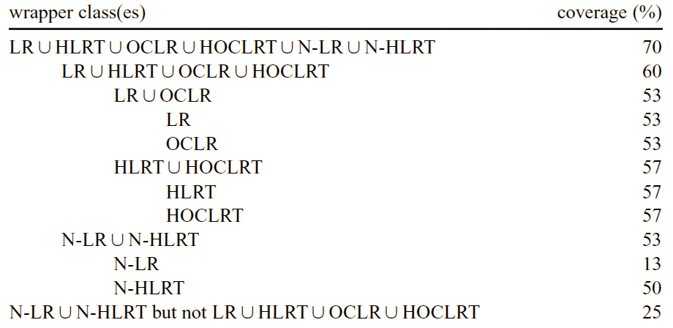
Coverage
Fraction of randomly-selected “data-heavy” Web sites
(search engines, retail, weather, news, finance, …)
for which wrapper in a given class was learned.

Slide 28
Sample complexity
The key problem with machine learning: Training data is expensive and tedious to generate
In practice, active learning and specialized algorithms have reduced training requirements considerably
But this isn’t theoretically satisfying
Computational Learning Theory:
  Time complexity: Time require by an algorithm to terminate, as a function of problem parameters
  Sample complexity: Training data required by a learning algorithm to converge to correct hypothesis, as a function of problem parameters

Slide 29
A Model of Sample Complexity
P[correct wrapper] = f( size of documents,
number of documents,
number of attributes per record )
Analyze wrapper learning
task to derive this function
(Actually, we can compute only a bound on this probability.)
Just like time/space complexity:
time[learn wrapper] = g( size of documents,
number of documents,
number of attributes per record )

Slide 30
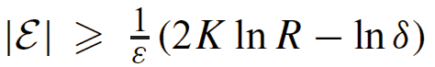
PAC results - LR wrappers
Theorem: Suppose we learn LR wrapper W from training set E, where the longest document has length R and each record contains K attributes. If
then W is probably approximately correct
error(W) < ε
with probability at least 1-δ
|E|

Slide 31
More sophisticated wrappers
LR & HLRT wrappers are extremely simple
(though useful for ~ ²/₃ of real Web sites!)
Recent wrapper induction research has explored…
  more expressive wrapper classes
  [Muslea et al, Agents-98; Hsu et al, JIS-98; Thomas et al, JIS-00, …]
    Disjunctive delimiters
    Sequential/landmark-based delimiters
    Multiple attribute orderings
    Missing attributes
    Multiple-valued attributes
    Hierarchically nested data
  Wrapper verification/maintenance
  [Kushmerick, AAAI-1999; Kushmerick WWWJ-00;
  Cohen, AAAI-1999; Minton et al, AAAI-00]

Slide 32
One of my favorites
Roadrunner
[Valter Crescenzi et al; Univ Roma 3]
Unsupervised wrapper induction
  They research databases, not machine learning, so they didn’t realize training data was needed :-)
Intuition:
  Pose two different queries
  The common bits of the documents come from the template and can be ignored
  The bits that are different are the data that we’re looking for

Slide 33
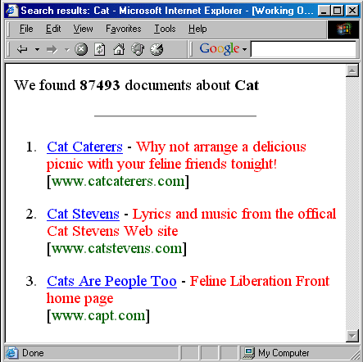
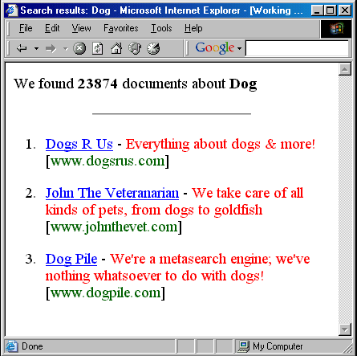
Roadrunner - Example
Common content = Part of template
Varying content = The data!
Complications: Dynamic but unwanted content -- eg advertisements or timestamps

Slide 34
Algorithms: Outline
structured
data
Wrappers
Hand-coded wrappers
Wrapper induction
Learning highly expressive wrappers
Boosted wrapper induction
Hidden Markov models
Exploiting linguistic constraints
natural
text

Slide 35
Boosted wrapper induction
[Freitag & Kushmerick, AAAI-00]
Wrapper induction is suitable only for
rigidly-structured machine-generated HTML…
… or is it?!
Can we use simple patterns to extract from natural language documents?
… Name: Dr. Jeffrey D. Hermes …
… Who: Professor Manfred Paul …
... will be given by Dr. R. J. Pangborn …
… Ms. Scott will be speaking …
… Karen Shriver, Dept. of ...
… Maria Klawe, University of ...

Slide 36
BWI: The basic idea
Learn “wrapper-like” patterns for natural texts
pattern = exact token sequence
Learn many such “weak” patterns
Combine with boosting to build “strong” ensemble pattern
Of course, not all natural text is sufficiently regular!
Demo: www.smi.ucd.ie/bwi

Slide 37
Covering Algorithms
Generalization of Covering Algorithm for learning disjunctive rules
-
+
-
+
-
-
-
-
+
+
-
+
-
-
-
+
-
+
-
-
-

Slide 38
Covering Algorithms
Generalization of Covering Algorithm for learning disjunctive rules
-
+
-
+
-
-
-
-
+
+
-
+
-
-
-
+
-
+
-
-
-
Learned Rule = rule

Slide 39
Covering Algorithms
Generalization of Covering Algorithm for learning disjunctive rules
-
-
-
-
-
-
+
-
+
-
-
-
+
-
+
-
-
-
Learned Rule = rule or rule

Slide 40
Covering Algorithms
Generalization of Covering Algorithm for learning disjunctive rules
-
-
-
-
-
-
+
-
+
-
-
-
-
-
-
-
Learned Rule = rule or rule or rule

Slide 41
Boosting = Generalized Covering
When learn rules on iteration t, give less weight to (but don’t entirely discard) training examples successfully handled in iterations 1, 2, …, t-1
Equivalently: Give more weight to training data that has not yet been covered
-
-
+
-
+
-
-
-
+
+
-
+
-
-
-
-
+
-
-
+
-

Slide 42
Boosting [Schapire & Singer, 1998]
D₁(i) = uniform distribution over
training examples
for t = 1, ..., T
train: use distribution D_{t} to
learn weak hypothesis:
h_{t}: X⇒R
reweight: choose α_{t}, and modify
distribution D_{t} to emphasize
examples missed by h_{t}:
D_{t+1}(i)= D_{t}(i) exp(-α_{t}y_{i}h_{t}(x_{i}))
return:
H(x) = sign(Σ_{t}α_{t}h_{t}(x))
D₀
h₁
D₁
h₂
D₂
.
.
.
h₃

Slide 43
Weak hypotheses: Boundary Detectors
Boundary Detector: [who :][dr . <Capitalized>]
prefix
suffix
matches (e.g.) “… Who: Dr. Richard Nixon …”
Weak Learning Algorithm
Greedy growth from null detector
Pick best prefix/suffix extension at each step
Stop when no further extension improves accuracy
Weighting
α_{t} = ½ ln[(W⁺ + ε) / (W⁻ + ε)]
[Cohen & Singer, 1999]

Slide 44
Boosted Wrapper Induction
Training
Execution
input: labeled documents
Fore = Adaboost fore detectors
Aft = Adaboost aft detectors
Lengths = length histogram
output: Extractor =
<Fore, Aft, Lengths>
input: Document, Extractor, τ
F = {⟨i, c_{i}⟩ | token i matches Fore
with confidence c_{i}}
A = {⟨j, c_{j}⟩| token j matches Aft
with confidence c_{j}}
output:
{⟨i,j⟩ | ⟨i, c_{i} ⟩∈F, ⟨j, c_{j} ⟩∈A,
c_{i}·c_{j}·L(j-i) > τ}

Slide 45
BWI execution example
<0.26.4.95.09.31.03.bg02+@andrew.cmu.edu.0>
Type: cmu.andrew.official.cmu-news
Topic: Chem. Eng. Seminar
Dates: 2-May-95
Time: 10:45 AM
PostedBy: Bruce Gerson on 26-Apr-95 at 09:31 from andrew.cmu.edu
Abstract:
The Chemical Engineering Department will offer a seminar entitled
"Creating Value in the Chemical Industry," at 10:45 a.m., Tuesday, May 2
in Doherty Hall 1112.
The seminar will be given by Dr. R. J. (Bob) Pangborn, Director, Central
Research and Development, The Dow Chemical Company.
[
]
Aft
Length
Fore
0.1
1.3
2.1 [<Cap>][( University]
0.7 [<Alph>][, Director]
[<Alph>][Dr . <Cap>]
[<Alph> by][<Cap>]
0.8
9
10
11
2.1
0.7
0.05
Confidence of "Dr. R. J. (Bob) Pangborn" = 2.1·0.7·0.05 = 0.074

Slide 46
Samples of learned patterns
Speaker: Reid Simmons, School of …
[speaker :][<Alph>]
[speaker <Any>][<FName>]
Presentation Abstract Joe Cascio, IBM
Set Constraints Alex Aiken (IBM, Almaden)
[<Cap>][<FName> <Any> <Punc> ibm]
John C. Akbari is a Masters student at
Michael A. Cusumano is an Associate Professor of
Lawrence C. Stewart is a Consultant Engineer at
[. <Any>][is <ANum> <Cap>]

Slide 47
Evaluation
Wrappers are usually 100% accurate, but perfection is generally impossible with natural text
ML/IE community has a well developed evaluation methodology
  Cross-validation: Repeat many times - randomly select
  2/3 of the data for training, test on remaining 1/3.
  Precision: fraction of extracted items that are correct
  Recall: fraction of actual items extracted
  F₁ = 2 / (1/P + 1/R)
16 IE tasks from 8 document collections
Competitors: SRV, Rapier, HMM
seminar announcements
job listings
Reuters corporate acquisitions
CS department faculty lists
Zagats restaurant reviews
LA Times restaurant reviews
Internet Address Finder
Stock quote server

Slide 48
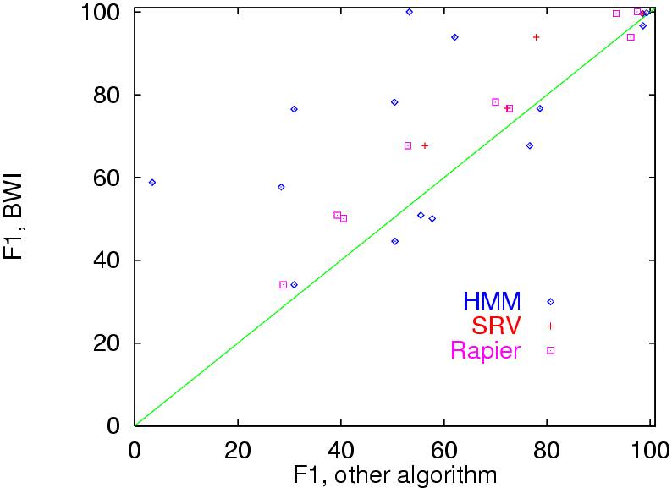
Results: 16 tasks x 4 algorithms
21
cases
7
cases

Slide 49

Boosted Wrapper Induction:
Controversial(?) Conclusion
Is the Great Web -vs- Natural Text Chasm more apparent than real?
IE is possible if the documents contain regularities that can be exploited
But the “reason” (eg, linguistic -vs- markup) for these regularities doesn’t much matter
See also Soderland’s WHISK & Webfoot

Slide 50
Algorithms: Outline
structured
data
Wrappers
Hand-coded wrappers
Wrapper induction
Learning highly expressive wrappers
Boosted wrapper induction
Hidden Markov models
Exploiting linguistic constraints
natural
text

Slide 51
Hidden Markov models
Previous discussion examine systems that use explicit extraction patterns/rules
HMMs are a powerful alternative based on statistical token models rather than explicit extraction patterns.
[Leek, UC San Diego, 1997; Bikel et al, ANLP-97, MLJ 99; Freitag & McCallum, AAAI-99 MLIE Workshop; Seymore, McCallum & Rosenfeld, AAAI-99 MLIE Workshop; Freitag & McCallum, AAAI-2000]

Slide 52
HMM formalism
HMM = states s₁, s₂, …
special start state s₁
special end state s_{n}
token alphabet a₁, a₂, …
state transition probs P(s_{i}|s_{j})
token emission probs P(a_{i}|s_{j})
Widely used in many language processing tasks,
e.g. speech recognition [Lee, 1989], POS tagging
[Kupiec, 1992], topic detection [Yamron et al, 1998].

Slide 53
Applying HMMs to IE
Document ⇒ generated by a stochastic process modelled by an HMM
Token ⇒ word
State ⇒ “reason/explanation” for a given token
  ‘Background’ state emits tokens like ‘the’, ‘said’, …
  ‘Money’ state emits tokens like ‘million’, ‘euro’, …
  ‘Organization’ state emits tokens like ‘university’, ‘company’, …
Extraction: The Viterbi algorithm is a dynamic programming technique for efficiently computing the most likely sequence of states that generated a document.

Slide 54
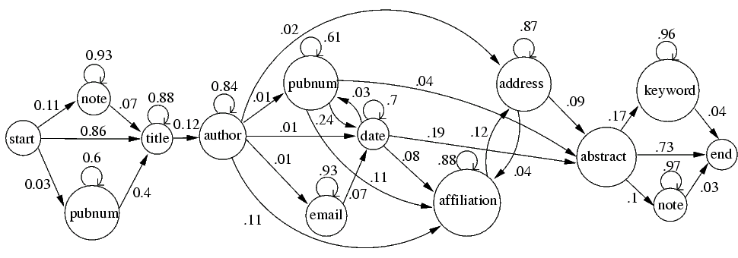
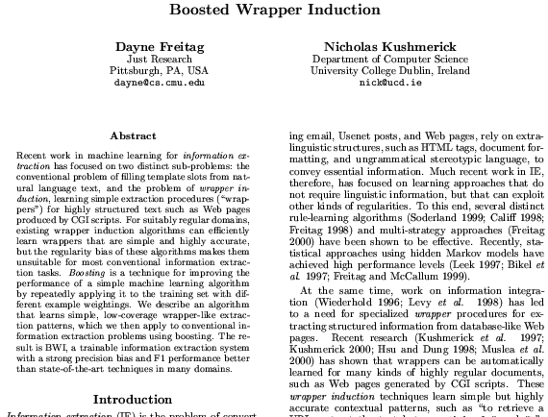
HMM for research papers [Seymore et al, 99]

Slide 55
Learning HMMs
Good news:
  If training data tokens are tagged with their generating states, then simple frequency ratios are a maximum-likelihood estimate of transition/emission probabilities. (Use smoothing to avoid zero probs for emissions/transitions absent in the training data.)
Great news:
  Baum-Welch algorithm trains HMM using unlabelled training data!
Bad news:
  How many states should the HMM contain?
  How are transitions constrained?
  Insufficiently expressive ⇒ Unable to model important distinctions
  Overly-expressive ⇒ sparse training data, overfitting

Slide 56
HMM example
“Seminar announcements” task
<0.15.4.95.15.11.55.rudibear+@CMU.EDU.0>
Type: cmu.andrew.assocs.UEA
Topic: Re: entreprenuership speaker
Dates: 17-Apr-95
Time: 7:00 PM
PostedBy: Colin S Osburn on 15-Apr-95 at 15:11 from CMU.EDU
Abstract:
hello again
to reiterate
there will be a speaker on the law and startup business
this monday evening the 17th
it will be at 7pm in room 261 of GSIA in the new building, ie upstairs.
please attend if you have any interest in starting your own business or
are even curious.
Colin

Slide 57
HMM example, continued
Fixed topology that captures limited context:
4 “prefix” states before & 4 “suffix” after target state
background
5 most-probable tokens
\n . - : unknown
speaker
pre₁
pre₂
pre₃
pre₄
suf₁
suf₂
suf₃
suf₄
\n
seminar
.
robotics
unknown
\n
:
.
-
unknown
\n
who
speaker
:
.
\n
:
.
with
,
unknown
.
dr
professor
michael
\n
,
will
(
-
\n
unknown
.
department
the
\n
of
.
,
unknown
\n
of
unknown
.
:
[Freitag, 99]

Slide 58
Evaluation
21
cases
7
cases
(no learning!)

Slide 59
Learning HMM structure [Seymore et al, 1999]
start with maximally-specific HMM (one state per observed word):
repeat
  (a) merge adjacent identical states
  (b) eliminate redundant fan-out/in
until obtain good tradeoff between HMM accuracy and complexity
…
title
title
auth
abst
start
note
note
note
…
abst
abst
end
auth
auth
title
…
abst
abst
note
auth
auth
title
⇒
note
auth
title
auth
⇒
title
auth
title
auth
auth

Slide 60
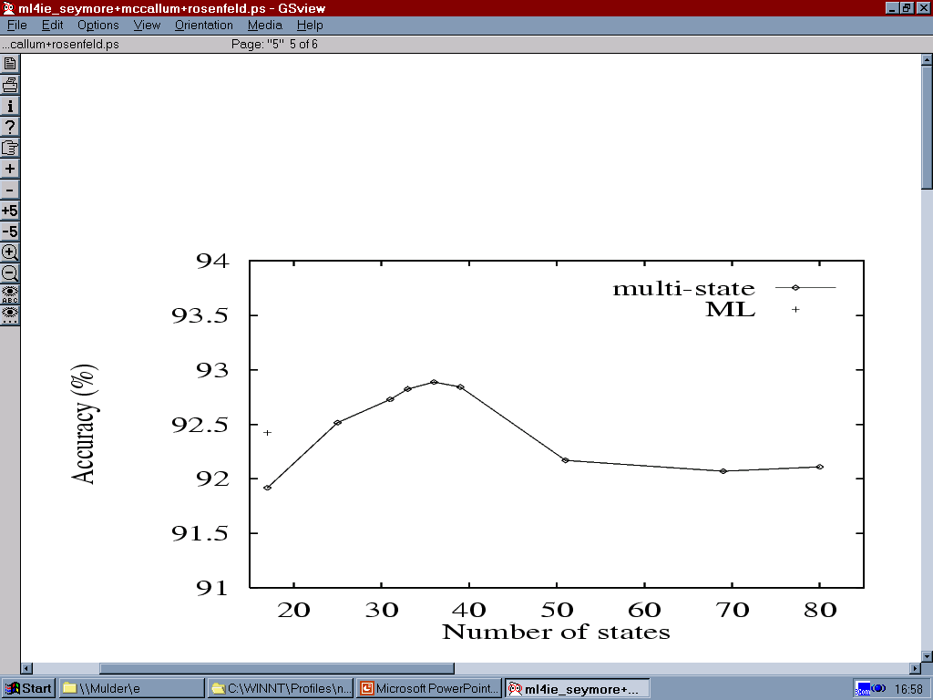
Evaluation
hand-crafted HMM
simple HMM
learned HMM
(155 states)

Slide 61
Algorithms: Outline
structured
data
Wrappers
Hand-coded wrappers
Wrapper induction
Learning highly expressive wrappers
Boosted wrapper induction
Hidden Markov models
Exploiting linguistic constraints
natural
text

Slide 62

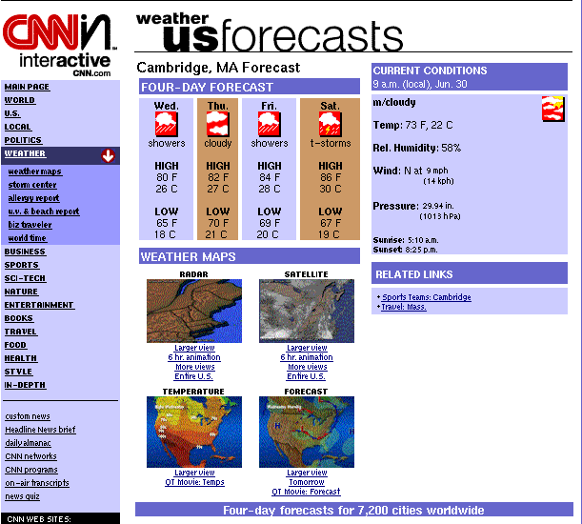
Exploiting linguistic constraints
IE research has its roots in the NLP community
many extraction tasks require non-trivial linguistic processing
Web Documents types can
range from free texts to rigid
HTML documents (e.g. tables)
  Even a mixture of them!
Is NLP robust enough to
cope with such situations?
Showers in the NW by Wednesday
Sakdjlk lksajdlkaj sdlkasdjlkasjd lkjd lakjdlkajsdlk Klkjads lkjds lkajdlkajdlkajdlkasjd jdjdjd slkdjas Dhjjd jfj fjjfkksdl jfjuiekkf fkkf lkjeiikm kjflk lklk Sakdjlk lksajdlkaj sdlkasdjlkasjd lkjd lakjdlkajsdlk klsdf lksjdf lkjf lskdjf lkjsdf lkjf lskdjf lkjfd lksjf lksjf lksjf lksjf l Klkjads lkjds lkajdlkajdlkajdlkasjd jdjdjd slkdjas k,mf sd.,m.jf kdkjsflk fds Dhjjd jfj fjjfkksdl jfjuiekkf fkkf lkjeiikm kjflk lklk m,nfndmsmnsd,mn dsfmn f Sakdjlk lksajdlkaj sdlkasdjlkasjd lkjd lakjdlkajsdlk Klkjads lkjds lkajdlkajdlkajdlkasjd jdjdjd slkdjas Dhjjd jfj fjjfkksdl jfjuiekkf fkkf lkjeiikm kjflk lklk Sakdjlk lksajdlkaj sdlkasdjlkasjd lkjd lakjdlkajsdlk
Klkjads lkjds lkajdlkajdlkajdlkasjd jdjdjd slkdjas Dhjjd jfj fjjfkksdl jfjuiekkf fkkf lkjeiikm kjflk lklk kjdfkl slksjdf lkjsd lkj dslfkjlkjlksj lkjsdlf kjlfkjlkjflskjflksjf
;kl;skf;lskf;slkf;lsdkf ;lk kjijkdsfjkh kjfhsk jfhiwuei ujlkj

Slide 63
Current Approaches
NLP Approaches (MUC-like Approaches)
  Ineffective on most Web-related texts:
    web pages/emails
    stereotypical but ungrammatical texts
  Extra-linguistic structures convey information
    HTML tags, Document formatting, Regular stereotypical language
Wrapper induction systems
  Designed for rigidly structured HTML texts
  Ineffective on unstructured texts
    Approaches avoid generalization over flat word sequence
    Data Sparseness on free texts

Slide 64
Lazy NLP based Algorithm
Learns the best level of language analysis for a specific IE task mixing deep linguistic and shallow strategies
  Initial rules: shallow wrapper-like rules
  Linguistic Information (LI) progressively added to rules
  Addition stopped when LI becomes
    unreliable
    ineffective
Lazy NLP learns best strategy for each information/context separately
  Example:
    Using parsing for recognising the speaker in seminar announcements,
    Using shallow approaches to spot the seminar location

Slide 65
(LP)² [Ciravegna 2001 – IJCAI 01- ATEM01]
Covering algorithm based on LazyNlp
Single tag learning (e.g. </speaker>)
Tagging Rules
  Insert annotation in texts
Correction Rules
  Correct imprecision in information identification by shifting tags to the correct position
TBL-like, with some fundamental differences

Slide 66
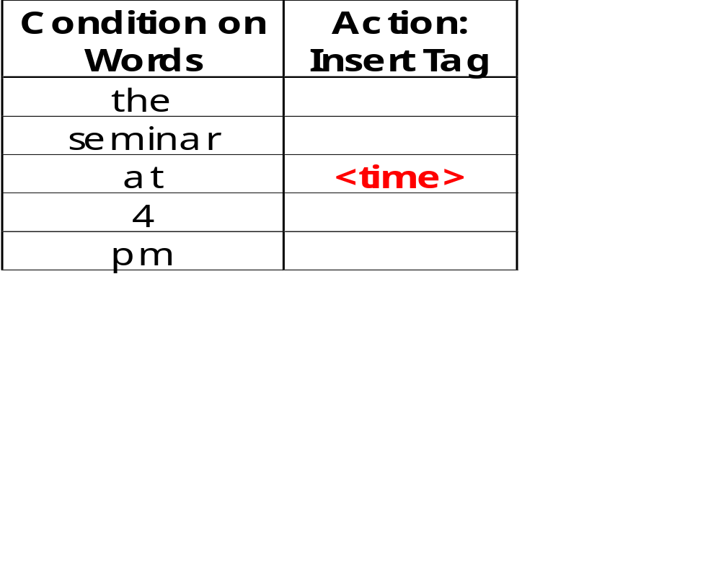
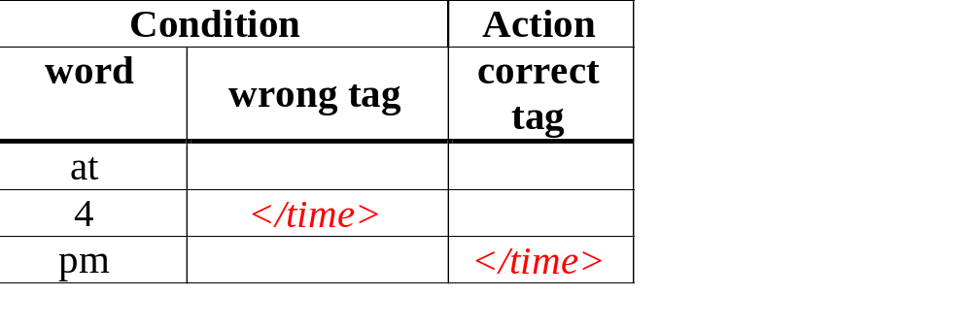
Tagging and Correction Rules: examples
the seminar at <time> 4 pm </time> will
Initial rules= window of
conditions on words
The seminar at 4 </time> PM will be held in Room 201

Slide 67
Rule Generalisation
Each instance is generalised by reducing its pattern in length
Generalizations are tested on training corpus
Best k rules generated from each instance reporting:
  Smallest error rate (wrong/matches)
  Greatest number of matches
  Cover different examples
Conditions on words are replaced by
information from NLP modules
  Capitalisation
  Morphological analysis
    Generalizes over gender/number
  POS tagging
    Generalizes over lexical categories
  User-defined dictionary or gazetteer
  Named Entity Recognizer
Implemented as a general to specific beam search with pruning (AQ-like)

Slide 68
Example of generalization
the seminar at <time> 4 pm will
Condition | Additional Knowledge |  |  |  | Action
Word | Lemma | LexCat | Case | SemCat | Tag
the | the | det | low
seminar | seminar | noun | low
at | at | prep | low
4 |  | digit | low |  | <time>
pm |  | noun | low | timeid
will | will | verb | low
Condition |  |  |  |  | Action
Word | Lemma | LexCat | Case | SemCat | Tag
 | at
 |  | digit |  |  | <time>
 |  |  |  | timeid
Details of the algorithm in [Ciravegna 2001 - ATEM01]

Slide 69
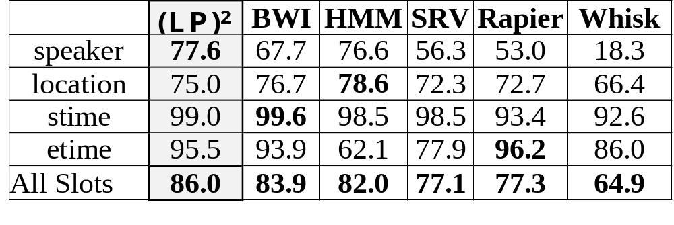
CMU: detailed results
Best overall accuracy
Best result on speaker field
No results below 75%

Slide 70
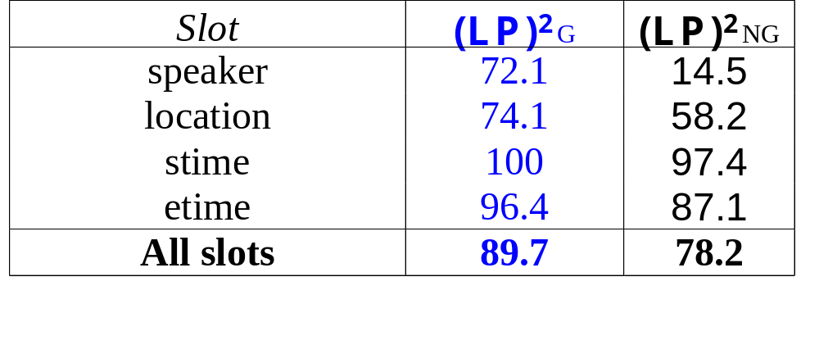
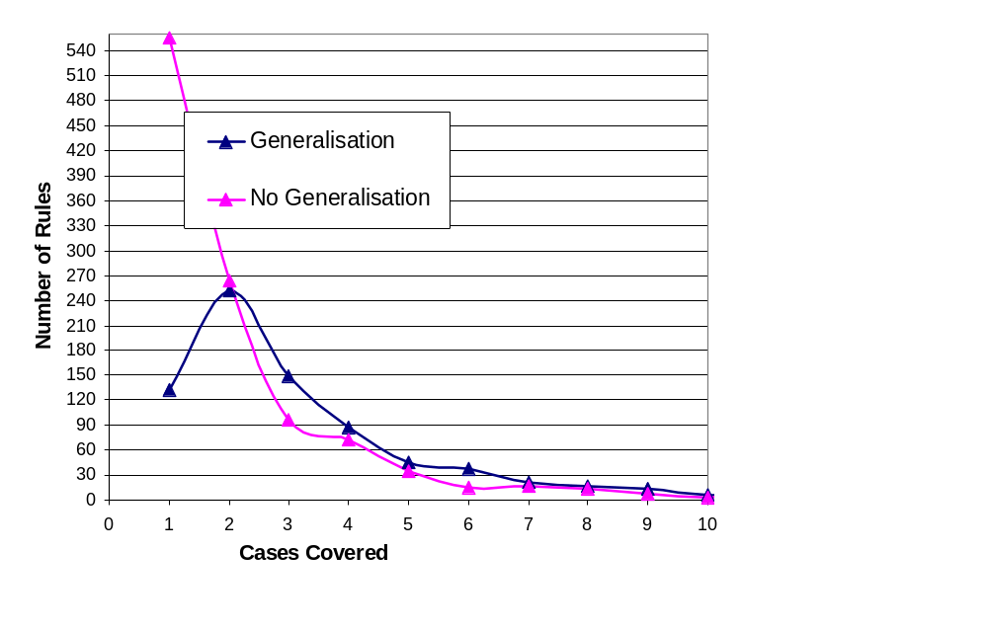
Effect of Generalization(1)
Effectiveness and reduction in data sparseness
}
Most
Interesting
With comparable effectiveness on training corpus!
Non-NLP
  50% rules cover 1 case
  71% cover up to 2 cases
NLP-based generalisation
  14% rules cover 1 case
  42% cover up to 2 cases

Slide 71
Best level of Generalization
ITC seminar announcements
(mixed Italian/English)
  Date, time, location generally in Italian
  Speaker, title and abstract generally in
  English
  English POS also for
  the Italian part
  NLP-based outperforms
  other version
Words
POS
NE
speaker
74.1
75.4
84.3
title
62.8
62.4
62.8
date
90.8
93.4
93.9
time
100
100
100
location
95.0
95.0
95.5

Slide 72
Linguistic constraints: Conclusions
Linguistic phenomena can’t be handled by simple wrapper-like extraction patterns
Even shallow linguistic processing (eg POS tagging) can improve performance dramatically.
  NOTE: linguistic processing must be regular, not necessarily correct!
  Example
  (LexCat:NNP + <BR> + <BR>)<SPEAKER>(NER:<person>)
  none of the covered 32 examples starts actually with an NNP
What about more sophisticated NLP techniques?
  Extension to parsing and corefernce resolution?

Slide 73
Putting IE into Practice
Enabling non-experts to port IE systems
Introduction: (20 minutes)
  what is IE, what can we extract from the Web and why?
Algorithms and methodologies (100 min)
IE in practice (30 min)
  The adaptation problem (20 min)
  WEB + IE: examples of systems (10 min)
Conclusion, Future Work (10 min)
Discussion

Slide 74
Motivation
Impact on the web community will come only if:
  IE systems are portable by non IE experts
  Low cost porting
Non experts
  Need specific easy to use tools to:
    Design application
    Tune application
    Deliver application
  Need support during the whole IE application definition process
In summarising the summary of the summary:
people are a problem.
        Douglas Adams
        The Restaurant at the End of the Universe

Slide 75





Application Development Cycle
User Needs
Scenario
design
Adapting the
IE system
Result
Validation
Application
Delivery

Slide 76
Scenario design
Task: mapping user whishes into templates
Necessity:
  Supporting users in:
    relevant information identification
    scenario organization
Relevant Information Identification:
  Different situations:
    User with developed scenario
      System: no action, but…
    User with preliminary scenario to be refined
      System helps in refining
    User with no scenario
      System helps in
        Identifying relevant information
        Organising it into a scenario

Slide 77
Training
User can select unrepresentative corpora
  Unbalanced wrt genres
    System validates corpus wrt a large corpus
      Comparing formal features
  Unwanted regularities (use of keywords for selection)
    System looks for unusual regularities
  Irrelevant texts (sensitive information)
    No solution to stupidity

Slide 78
Tagging Corpora
Problems:
  Tagging texts can:
    Be difficult and boring
    Take a long time
Effect:
  Mistakes in tagging
  High cost
System:
  reduce/eliminate need for annotated data
    Bootstrapping: from user-defined “seed examples” to system-retrieved similar examples
    Active learning: selection of examples to annotate from unlabeled corpus
Helps in discovering new relations
Helps in focusing on unusual information shape

Slide 79
Result Validation
Try to be more accurate!
OK. Please modify an error threshold
How well does the system perform?
  Solution:
    Facilities for:
      Inspecting tagged corpus
      Showing details on correctness
        Statistics on corpus
        Details on errors (highlight correct/incorrect/missing)
      (e.g. MUC scorer is an excellent tool)
Influencing system behavior
  Solution
    Interface for bridging the user’s qualitative vision and the system’s numerical vision

Slide 80
Application Delivery
Problem:
  Incoming texts deviate from training data
    Training corpus non representative
    Document features change in time
Solution:
  Monitoring application.
    Warn user if incoming texts’ features are statistically different from training corpus:
      Formal features: texts length, distribution of nouns
      Semantic features: distribution of template fillers

Slide 81
Putting IE into Practice (2)
Some examples of Adaptive User-driven IE
for real world applications

Slide 82
Learning Pinocchio
Commercial tool for adaptive IE
  Based on the (LP)² algorithm
  Adaptable to new scenarios/applications by:
    Corpus tagging via SGML
    A user with analyst’s knowledge
Applications
  “Tombstone” data from Resumees (Canadian company) (E)
  IE from financial news (Kataweb) (I)
  IE from classified ads (Kataweb) (I)
  Information highlighting (intelligence)
  (Many others I have lost track of…)
A number of licenses released around the world for application development
[Ciravegna 2001 - IJCAI]
http://tcc.itc.it/research/textec/tools-resources/learningpinocchio/

Slide 83
Application development time
Resumees:
Scenario definition: 10 person hours
Tagging 250 texts: 14 person hours
Rule induction: 72 hours on 450MHz computer
Result validation: 4 hours
Contact:
  Alberto Lavelli
  ITC-Irst
  lavelli@itc.it
  http://tcc.itc.it/research/textec/tools-resources/learningpinocchio/

Slide 84

Amilcare active annotation for the Semantic Web
Tool for adaptive IE from Web-related texts
  Based on (LP)²
  Uses Gate and Annie for preprocessing
  Effective on different text types
    From free texts to rigid docs (XML,HTML, etc.)
  Integrated with
    MnM (Open University) Ontomat (University of Karlsruhe)
    Gate (U Sheffield)
Adapting Amilcare:
  Define a scenario (ontology)
  Define a Corpus of documents
  Annotate texts
    Via MnM, Gate, Ontomat
  Train the system
  Tune the application (*)
  Deliver the application
[Ciravegna 2002 -SIGIR]
www.dcs.shef.ac.uk/~fabio/Amilcare.html

Slide 85
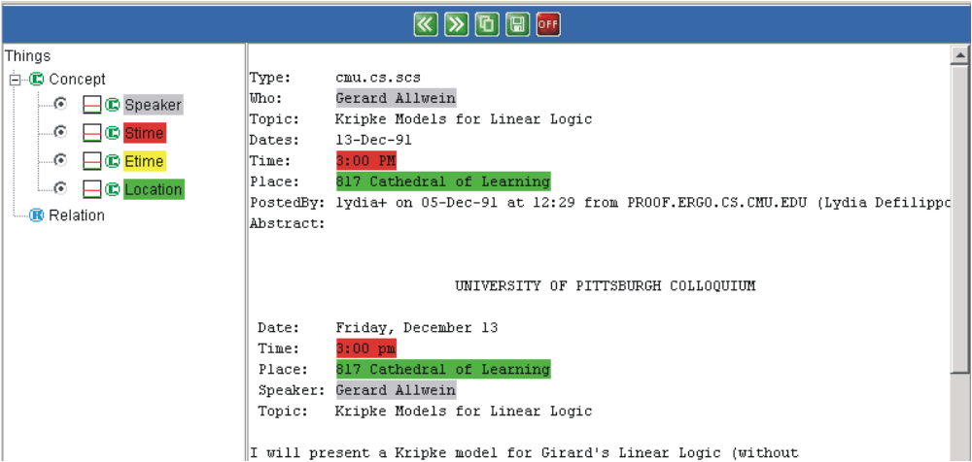
Non-Intrusive Active Learning
Amilcare is specifically designed as companion for text annotation
  It can be inserted in the usual tagging environment
  It works in the background
  At some point it will start helping the user in tagging

Slide 86
Bootstrapping Annotation
Bare text
User
Annotates
Amilcare Learns
In the background
Learning to annotate
User
Annotates
Annotation
comparison
Bare text
Amilcare
Annotates
Use missing cases
and mistakes
to trigger learning

Slide 87
Active Annotation
When Amilcare’s rules reach a user-defined accuracy
WHY active annotation?
  Focuses the slow and expensive user activity on uncovered cases
  Avoids annotating covered cases
  Validating extracted information is
    Simpler & less error prone
    Than annotating bare texts speeding up the process of corpus annotation considerably.
Bare text
Amilcare
Annotates
User
Corrects
Use corrections
to retrain

Slide 88
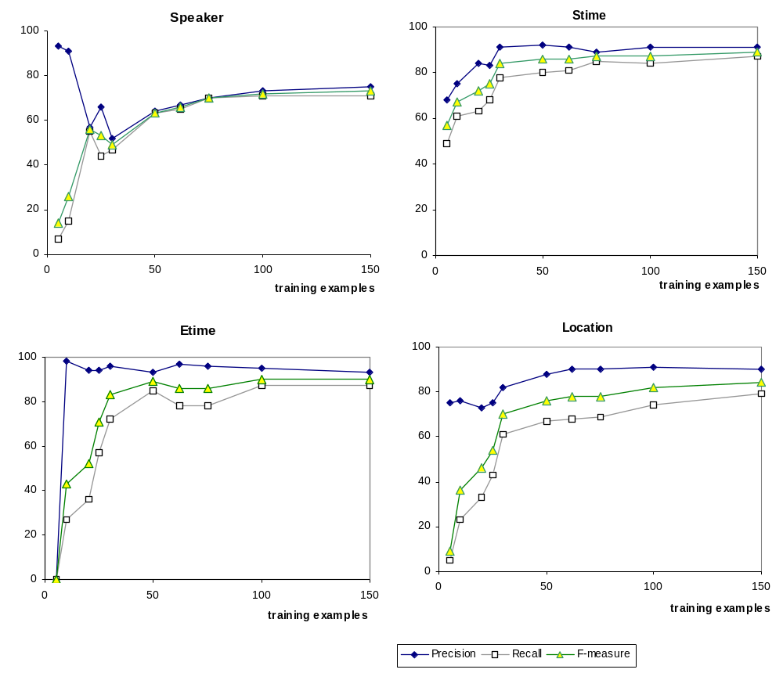
Is IE useful as Help for Tagging?

Slide 89

Conclusions on IE and Tagging
Integration of IE (Amilcare+Gate) and Ontology-based Annotation Tools (MnM and Ontomat)
First step towards a new generation of OEs
Active Learning can provide an interesting interaction modality
  User friendly
  Adaptable

Slide 90
Summary and Conclusions
    The summary of the summary
    Where do we go from now?

Slide 91
Summary
Information extraction:
  core enable technology for variety of next-generation information services
    Data integration agents
    Semantic Web
    Knowledge Management
Scalable IE systems must be adaptive
  automatically learn extraction rules from examples
Dozens of algorithms to choose from
State of the art is 70-100% extraction accuracy (after hand-tuning!) across numerous domains.
  Is this good enough? Depends your application.
Yeah, but does it really work?!
  Several companies sell IE products.
  SW ontology editors start including IE

Slide 92
Open issues, Future directions
Knob-tuning will continue to deliver substantial incremental performance increments
Grand Unified Theory of
text “structuredness”,
to automatically select
optimal IE algorithm for
a given task
natural
spontaneous
restricted
open topic
formal
machine-generated

Slide 93
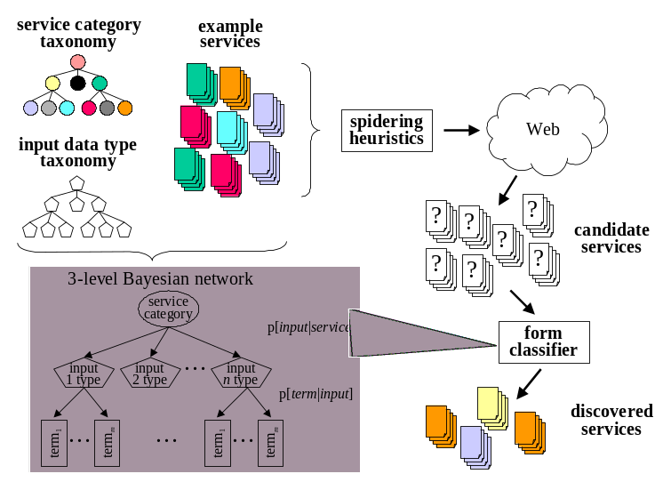
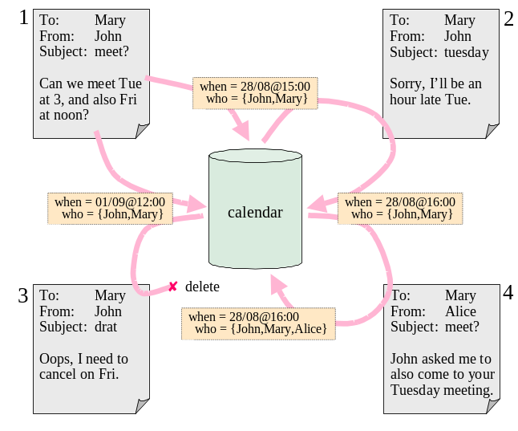
Open Issues, Future directions
Resource Discovery
Cross-Document Extraction

Slide 94
Open issues, Future directions
Adaptive only?
  Mentioned systems are designed for non experts
    E.g. do not require users to revise or contribute rules.
    Is this a limitation? What about experts or even the whole spectrum of skills?
  Future direction: making the best use of user’s knowledge
Expressive enough?
  What about filling templates?
    Coreferences
    (ACME is producing part for YMB Inc. The company will deliver…)
    Reasoning
    (if X retires then X leaves his/her company)

