Slide 1
Where to move in the city of Montreal
The battle of the neighborhood – Coursera Capstone Project

Slide 2
WHY THIS SUBJECT?
Montreal is the second biggest city in Canada
The city of Montreal contains 2 major languages
Some neighborhoods are specialized in different venues

Slide 3
DATA ACQUISITION AND CLEANING
Montreal’s data: The website of Montreal’s city
Venues’ data: Foursquare API
Drop all the NaN values in the dataset
100 venues per neighborhoods
500 meter of radius per neighborhoods

Slide 4
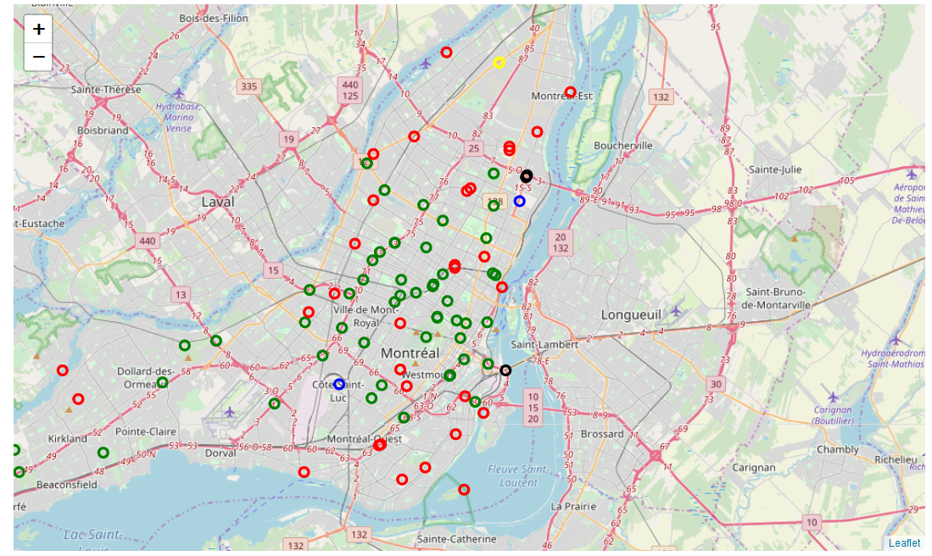
RESULTS OF CLUSTERING (1)

Slide 5
RESULTS OF CLUSTERING (2)
The main venues of each neighborhoods:
Green: Restaurants
Red: Shops
Blue: Gym
Black: Liquor Store
Yellow: Construction & Landscape

Slide 6
CONCLUSION
Impact of the neighborhood in the venues
For a person who wants to live in Montreal, the analysis can help to know the good neighborhood to move in
Future directions: Add crime datas and social/economic data to be more precise in our clustering.

