Slide 1
DEEL / SENIOR DATA ENGINEER ASSESSMENT
From operational CDC
to trusted analytics
A measured Spark Structured Streaming platform
for ACME Delivery Services
Fabricio Dutra
Architecture • methodology • sizing • evidence
Implemented end to end. Tested for correctness, load and recovery.
Sources: README.md | docs/assessment-deliverables.md
01 / 22
Notes:
Open with the operational problem: ACME needs trustworthy order visibility as demand grows. I built and tested the complete source-to-query path. I will explain the consistency contract first, then the measured performance constraints. The main narrative is approximately 18–20 minutes; the appendix supports technical questions. No business ROI or production SLA is claimed.
Evidence: README.md, docs/assessment-deliverables.md

Slide 2
BUSINESS OUTCOME
Four questions drive the platform
01 Open orders
02 Top delivery dates
By delivery date and status
The three dates with most open orders
Support workload planning.
Identify delivery-day concentration.
03 Pending items
04 Top customers
By product: item lines and total units
The three customers with most pending orders
Support picking and storage priorities.
Prioritize operational follow-up.
Definition: PENDING, PROCESSING and REPROCESSING are open; COMPLETED is excluded.
Sources: sql/open-orders.sql | sql/pending-items.sql
02 / 22
Notes:
Tie each output to an operational decision. Order counts must not be multiplied by joining to item rows. Pending items expose line count and total units because the wording can otherwise be ambiguous. The output is an operational current-state view, not a claimed business-impact measurement.
Evidence: sql/open-orders.sql, sql/pending-items.sql

Slide 3
METHODOLOGY
Make the assumptions explicit
Historical contract
Freshness contract
Deployment scope
Initial snapshot + current state
Continuous microbatches.
Reproducible local Docker stack.
accumulated from earlier CDC
30s is a test reference, not a
Production sizing remains a
batches.
requirement supplied by Deel.
measurement-driven strategy.
No pre-snapshot reconstruction.
Measured separately
Correctness, bulk materialization, CDC arrival rate, publication age, recovery and query cold start.
Sources: docs/assessment-deliverables.md | docs/architecture.md
03 / 22
Notes:
State the interpretation before showing results. History is the initial snapshot plus persisted state from earlier batches, not SCD2 or every prior order status. The source fixture is synthetic and continuously updated. The PDF asks for low latency without a numeric SLA; 30 seconds is my experimental reference. Production arrival rates and query-concurrency targets were not supplied.
Evidence: docs/assessment-deliverables.md, docs/architecture.md

Slide 4
ARCHITECTURE
One complete source-to-query path
PostgreSQL + pg_cron
Debezium / Connect
Kafka KRaft
Environment provider
+ connector init
Source + automatic mutations
Snapshot → WAL CDC
Four entity topics
SPARK APPLICATION / 2 shared local slots / single materializer
1 · Bronze
2 · Silver
Gold
Publication
Native Parquet sink
foreachBatch + Delta
Delta facts + dimensions
Delta version manifest
Original key/value bytes
Accumulated current
Historical-state joins
Complete read boundary
state
Persistent observability
Quarantine + Spark UI
Separate Spark SQL CLI
2 checkpoints • progress • event logs
Invalid CDC • optional History Server
Read every table at published versions
Sources: docs/architecture.md | docker-compose.yaml
04 / 22
Notes:
Walk left to right: pg_cron changes PostgreSQL; Debezium snapshots and then tails WAL; Kafka carries four entity topics. Spark has two streams and two persistent checkpoints: Kafka to raw Parquet, then Bronze to foreachBatch. Silver stores ordered current state. Gold joins that historical state and writes facts/dimensions. Only a completed manifest is exposed through the separate Spark SQL CLI. Invalid events block publication and go to quarantine. Both streams share two local slots and one materializer owns the mutable tables. Secrets come from the ignored environment/provider; connector initialization is one-off.
Evidence: docs/architecture.md, docker-compose.yaml

Slide 5
DIMENSIONAL MODEL
Two fact grains prevent double counting
dim_customer
dim_date
dim_product
SCD1 • source customer key
Order / delivery date • key 0
SCD1 • source product key
fact_order
fact_order_item
1 row / order
1 row / order item
Status, dates and customer
Quantity + current parent attributes
Order metrics query fact_order directly. Item metrics count lines and sum quantities.
The source field “quanity” becomes quantity; prices use explicit DECIMAL(20,4) casts.
Sources: app/gold.py | docs/architecture.md
05 / 22
Notes:
The order fact is one row per order and is the source for order-count questions. The item fact is one row per item and carries the current parent status, date and customer for filtering. Dimensions are SCD1 with stable source identifiers, not a surrogate-key service. Dates have an unknown key of zero. Parent changes refresh historical children. Customers/products missing from dimensions do not drop operational order facts.
Evidence: app/gold.py, docs/architecture.md

Slide 6
PROCESSING
Every microbatch earns its publication
1 Preserve
2 Validate
3 Order + apply
Kafka → native Parquet
Decode schema and business rules
Latest LSN / Kafka offset
Checkpoint + sink metadata
Invalid CDC → quarantine + fail
Conditional Silver MERGE
4 Enrich history
5 Refresh Gold
6 Publish
Changed items ↔ stored orders
Affected facts and SCD1
Commit complete table versions
Changed orders ↔ stored items
dimensions
CLI uses versionAsOf
Retain logical delete guards
PySpark DataFrames + Delta MERGE for processing; Spark SQL for the four serving queries.
Sources: app/materialize.py | app/storage.py
06 / 22
Notes:
Bronze retains the exact Kafka key/value bytes and coordinates, including tombstones. The second stream validates before mutating current-state tables, selects the latest event by LSN/offset and conditionally merges Silver. Gold recomputes affected entities by joining the stored state. Only after all writes succeed is a single Delta manifest published. Most transformations use PySpark DataFrames and Delta merge; serving queries are Spark SQL. The pipeline does not collect business datasets to the driver.
Evidence: app/materialize.py, app/storage.py

Slide 7
HISTORY
Historical joins are part of the stream
01
02
03
Snapshot baseline
Later item event
Later parent update
Event → historical lookup
Event → historical lookup
Event → historical lookup
Order O1 is PENDING
New item I1 references O1
Order O1 becomes COMPLETED
Store the order in Silver
Join I1 with stored order O1
Retrieve its stored item I1
Order exists in Gold
Item inherits parent state
Pending item disappears
Illustrative sequence based on tested behavior. “History” means retained state, not SCD2.
Sources: app/gold.py | docs/evidence/historical-join-tests.log
07 / 22
Notes:
Use this illustrative sequence to explain the integration test pattern, not as a captured source record. First an order enters by snapshot. Later a new item arrives with no order event in that batch; its parent status/customer/date come from Silver. Later the order completes with no new item events; stored items are refreshed from the parent change. This is why a watermark-based stream-stream window join would be the wrong contract for long-lived operational orders.
Evidence: app/gold.py, docs/evidence/historical-join-tests.log

Slide 8
ENGINEERING DECISIONS
Choose the simplest components that fit
Decision
Reason
Tradeoff
Parquet Bronze
Preserve original events; native append sink
Keep files, metadata and checkpoint
together
Delta Silver / Gold
Ordered upserts, delete guards, versioned reads
MERGE and retained-target scans have cost
Publication manifest
Expose a completed set of table versions
Supported readers must honor the manifest
On-demand SQL CLI
Deliver the four required queries with few services
Cold start; not a high-QPS query server
Security: environment-based secrets, restricted CDC account, unprivileged Spark, loopback UIs.
TLS, replicated services and shared durable storage are production additions.
Sources: docs/architecture.md | README.md
08 / 22
Notes:
Explain the choices as tradeoffs. Parquet Bronze is append-only raw event preservation; Delta is reserved for mutable current state and dimensional tables. Native checkpoints/metadata must remain intact. The publication manifest provides consistent supported reads but not global source transaction buffering. CLI is an allowed assessment serving option, with a documented cold-start/concurrency cost. Avoid presenting the local plaintext network or a single Kafka broker as production security or availability.
Evidence: docs/architecture.md, README.md

Slide 9
SPARK SIZING
Size for working sets and recovery
2 slots
2 GiB
4
Shared by both streams
JVM heap
Shuffle partitions
local[2] • two-CPU quota
3 GiB total container cap
Starting choice, not proven optimum
Budget / control
Local configuration
Sizing implication
Kafka / Connect /
1 GiB / 1 GiB / 512 MiB
Fit source, CDC and Spark in ~8 GB VM
PostgreSQL
Streaming intake
20k offsets / 10s; 32 files / batch
Bounds intake, not fanout or task memory
Backlog recovery
Required rate ≥ λ + B / R
Arrival λ; backlog B; recovery window R
Scale from measured CPU, GC/spill, task balance, target scans and freshness—not row count alone.
Sources: docs/performance.md | docker-compose.yaml
09 / 22
Notes:
Be precise: local[2] is two task slots sharing one driver JVM, not two executors. Heap is 2 GiB and the container cap is 3 GiB. Four shuffle partitions are a measured starting configuration, not an optimum from an exhaustive A/B study. Both streams compete for these slots. Variables include actual event rate/bytes, historical target size, mutation mix, parent fanout, file layout and desired recovery/freshness. Production must separately size executors and driver on shared durable storage.
Evidence: docs/performance.md, docker-compose.yaml

Slide 10
VALIDATION METHOD
Triangulate correctness and performance
Semantic tests
Independent source oracle
Snapshot + CDC • ordering • deletes
Compare all four business queries against
Historical joins • quarantine • crash / replay
PostgreSQL before / after changes.
Separate workloads
Evidence and accounting
Bulk fixture • intake bursts • stepped CDC
Native task logs + stream progress
Hot parent • query concurrency • outage
Unique Kafka coordinates + publication counts
Synthetic data; short steps; actual rates reported; no production SLA inferred.
Sources: tests/test_pipeline.py | docs/evidence/README.md
10 / 22
Notes:
Separate evidence types. Real Spark/Delta integration tests cover ordering, duplicate events, deletes, late parents, invalid events and crash/replay. PostgreSQL is an independent oracle for all four business metrics. Bulk materialization is measured independently from Kafka/Bronze and full CDC load. Physical checks compare Kafka coordinates and published input counts. There is one execution per stress scenario and approximately two-minute arrival steps, not a statistically certified soak. Captured result files are actual outputs, not fabricated screenshots.
Evidence: tests/test_pipeline.py, docs/evidence/README.md

Slide 11
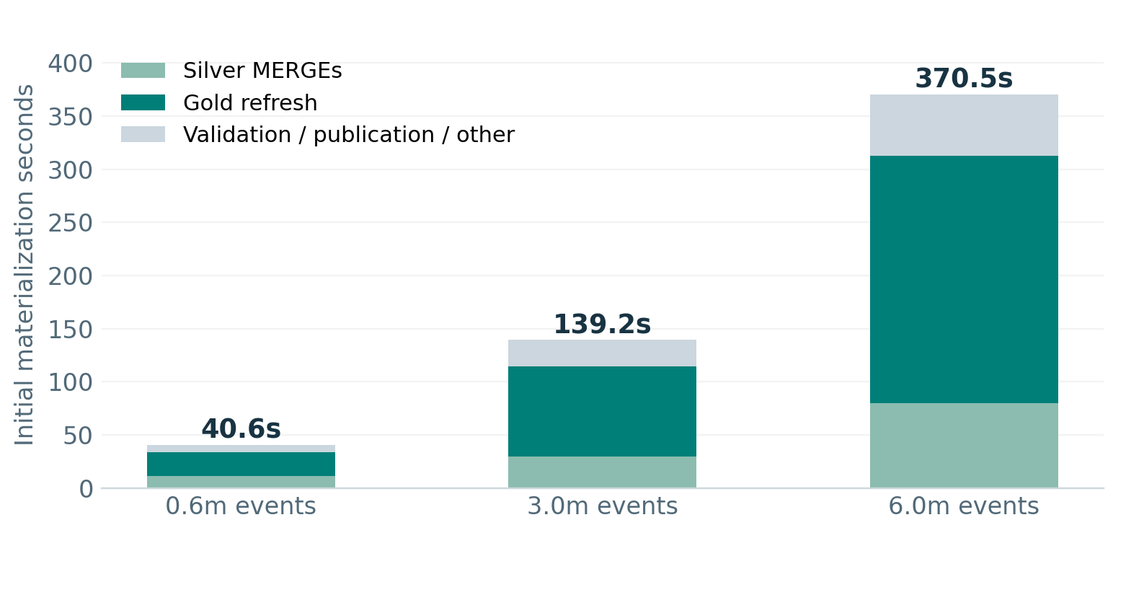
PERFORMANCE / BULK
Gold dominates as retained state grows
370.5s
6,000,200 input events
Initial materialization
63%
Time in Gold refresh
232.5s of 370.5s
846 MB disk spill
Memory pressure near cap
0 failed task attempts
Doubling ~3m → ~6m events increased initial materialization time by 2.66×.
Sources: docs/evidence/stress/materialization.json | docs/evidence/stress/scale-1m-spark-metrics.json
11 / 22
Notes:
The initial materialization grows from 40.6 to 139.2 to 370.5 seconds across roughly 0.6, 3 and 6 million events. Timings exclude Spark initialization, separate Bronze writing and later verification. Gold takes 232.5 seconds, approximately 63% of the largest initial load. Task disk spill is 846 MB across the complete largest application, not just this plotted initial phase. The cgroup probe reaches approximately its cap without OOM. Do not reuse bulk events/s as a streaming capacity promise.
Evidence: docs/evidence/stress/materialization.json, docs/evidence/stress/scale-1m-spark-metrics.json

Slide 12
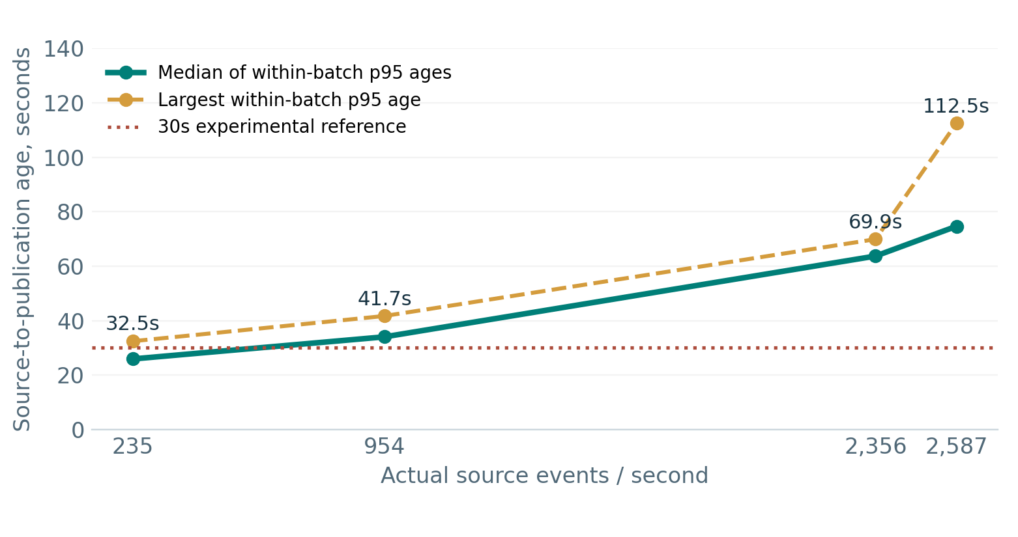
PERFORMANCE / STREAMING
Freshness degrades without container failures
Reference breached
235 events/s: largest batch
p95 = 32.5s
2,587 events/s: 112.5s
Catch-up observed
All four steps drained.
Highest two steps: ~66s and
~70s after load stopped.
Per-batch age summaries—not global event p95. Steps ~2 minutes; nominal 6k/s was not reached.
Sources: docs/evidence/stress/streaming-levels.json | docs/evidence/stress/streaming-batches.json
12 / 22
Notes:
The x-axis uses measured arrival rates: 235, 954, 2356 and 2587 events/s. The nominal 6000 events/s target was not achieved. Each age p95 is computed within a batch from source timestamps, excluding snapshot. The plotted median/maximum of batch p95 values is not a global event p95. Above about 2000 events/s, the original intake cap contributes growing lag. Even the smallest stage has a batch p95 above the chosen 30-second reference. Backlogs drain after load stops, but that is different from preserving freshness while arrivals continue.
Evidence: docs/evidence/stress/streaming-levels.json, docs/evidence/stress/streaming-batches.json

Slide 13
INTEGRITY / RECOVERY
Correctness survives a temporary broker outage
774,001
3 / 3
53.5s
Kafka events = Bronze rows
Metric reconciliations passed
Observed recovery interval
Also unique Kafka coordinates
All four business questions
Stop → restart → catch-up → poll
Mutations exercised
Final source / Gold agreement
12,375 order updates
124,756 orders
6,378 item deletes + tombstones
617,528 active items
6,000 source events while Kafka was down
3,167,520 units
Retained volumes / offsets / checkpoints. This is recovery evidence, not single-broker HA.
Sources: docs/evidence/stress/final-integrity.json | docs/evidence/stress/broker-outage.jsonl
13 / 22
Notes:
Three independent comparisons of all four business metrics passed: after load, after 12375 parent updates and 6378 item deletes, and after broker recovery. Final Kafka offsets, raw Bronze rows/unique coordinates and successfully published raw input counts all agree at 774001. These are event coordinates, not unique business entities. The broker was stopped, 6000 source events committed, and the supervisor restarted Kafka. 53.5 seconds includes stop/wait/start/process/poll; Spark did not need a restart. This proves temporary outage recovery with retained volumes, not HA or disk-loss recovery.
Evidence: docs/evidence/stress/final-integrity.json, docs/evidence/stress/broker-outage.jsonl

Slide 14
NEXT EXPERIMENTS
Scale the measured constraint first
Observed constraint
Candidate action—not yet validated
Acceptance measurement
Gold / target work dominates
Benchmark layout, compaction and
Files scanned + batch time + correctness
affected-row access
Heap / CPU pressure
Compare task input, memory, cores and shuffle
Spill, GC, queued tasks and freshness
count
Backlog and shared slots
Tune intake with downstream capacity; isolate
Stable lag and catch-up within target R
resources
Production durability / serving
Shared lake, replicated Kafka; persistent
Outage tests and latency under concurrency
serving
One parent update refreshed 1m children in 14.1s: event count alone does not size the workload.
Sources: docs/performance-stress.md | docs/performance.md
14 / 22
Notes:
Separate implemented behavior from proposed production changes. First measure retained-target scans and Gold merge/layout costs, including the expensive date-dimension work. Then compare memory, task sizes and partitions under a defined freshness objective. Decouple ingestion/materialization resources when competition is the constraint. Production needs object/shared storage and replicated Kafka with security/monitoring. A single parent updating a million children took 14.1 seconds, illustrating why offsets alone do not size work. No claimed fixed executor count follows from this local run.
Evidence: docs/performance-stress.md, docs/performance.md

Slide 15
HANDOVER / DEMO
Inspect, reproduce and discuss
python3 scripts/setup.py
docker compose up -d --build
docker compose run --rm --no-deps query metrics all
Wait for the first published batch, then inspect the four metrics and publication timestamp.
Working system + measurable limits + a defensible path to production sizing.
Code and all retained analysis: fabdutra/deel-data-engineering-task
Appendix: CDC semantics, failure handling, intake / serving, native metrics and evidence.
Sources: README.md | docs/evidence/README.md
15 / 22
Notes:
Close the core narrative with a clear handover. The repository contains application code, SQL, Docker, tests, measured evidence, documentation and the source for this presentation. The standard source creates and mutates data automatically. During a demo, wait for the published-batch log before querying and point out the manifest timestamp. Distinguish data freshness from a fresh JVM cold start. The optional technical appendix follows. Do not run benchmarks alongside the demo on the small VM.
Evidence: README.md, docs/evidence/README.md

Slide 16
APPENDIX A / CDC
Upserts and deletes preserve ordering
Layer / table
Identity
Mutation behavior
Delete behavior
Silver: 4 entities
Source primary key
Latest LSN / offset; conditional MERGE
Retain _deleted ordering guard
Gold: fact_order
order_id
Refresh changed orders
Logical deletion; CLI filters
Gold: fact_order_item
order_item_id
Changed items + stored children of
Parent/item state drives
changed parents
visibility
Gold: customer /
Stable source key
SCD1 MERGE
Retain delete marker
product
Gold: dim_date
date_key
Merge affected date members;
Members retained
unknown = 0
Topic repartitioning or source-identity changes require a controlled ordering migration.
Sources: app/cdc.py | app/storage.py
16 / 22
Notes:
Silver orders every entity by primary key plus PostgreSQL LSN and Kafka offset. The per-key partition-ordering assumption must be preserved during topic changes. Deletes use logical markers that retain ordering so stale updates cannot resurrect data. Kafka null-value tombstones are preserved in Bronze and do not delete a second time. Customer/product dimensions are SCD1; facts exclude logical deletions in supported queries. Date members are merged by date key and retained. Missing parents are retained in Silver and repaired when the parent arrives.
Evidence: app/cdc.py, app/storage.py

Slide 17
APPENDIX B / FAILURES
Publish a complete read boundary
Failure point
What supported readers see
Recovery action
Before / during Silver merge
Previous complete publication
Retain checkpoint; correct failure; replay
After Silver / partial Gold
Previous published Gold versions
Recompute affected Gold rows; publish last
After manifest commit
New complete version set
Checkpoint replay remains convergent
Invalid CDC contract
Previous publication; batch withheld
Inspect quarantine; fix parser / contract
No global atomic buffering of source transactions across topics. One materializer owns the tables.
Missing Kafka offsets fail visibly. Checkpoints and raw Parquet metadata must stay intact.
Sources: app/materialize.py | app/metrics.py
17 / 22
Notes:
Each Delta transaction is per table. The manifest is the cross-table read contract: capture it once and use versionAsOf for each Gold table. If a batch fails after Silver or some Gold writes, the old manifest remains readable and replay converges from authoritative Silver. After publication, readers can see the new complete versions. Quarantine blocks the batch until parser/validation is corrected; a later source correction does not skip an invalid retained event. Kafka failOnDataLoss is true and source transactions may be split across topic batches.
Evidence: app/materialize.py, app/metrics.py

Slide 18
APPENDIX C / OTHER LOAD TESTS
Intake and serving have different limits
Kafka → Bronze only
Fresh query containers
Payload
20k cap
200k cap
Concurrent processes
Group time
500 B / 250k
127.8s
20.9s
1
24.6s
2
37.9s
5k B / 100k
57.6s
20.4s
4
65.2s
What this demonstrates
What remains open
The original admission cap limits these bursts; larger
Query concurrency at peak write load and an always-on
intake is not a Gold fix.
serving comparison.
Sources: docs/evidence/stress/bronze-load-levels.jsonl | docs/evidence/stress/query-concurrency.jsonl
18 / 22
Notes:
Ingestion uses a separate two-partition synthetic topic and no Gold work. With the same checkpoint/resources, a 250000-record, 500-byte burst drains in 127.8 seconds at 20000 offsets and 20.9 seconds at 200000 offsets. Payloads are synthetic and do not guarantee realistic compression, so this is not broker disk saturation. Query concurrency tests use fresh separate JVMs, a quiet source and a live pipeline; each executes four metrics plus two checks. They show cold-start/contention cost, not peak interactive throughput under maximum writes.
Evidence: docs/evidence/stress/bronze-load-levels.jsonl, docs/evidence/stress/query-concurrency.jsonl

Slide 19
APPENDIX D / SPARK METRICS
Native metrics support the sizing discussion
Fixture
Tasks / fail
CPU sum
GC sum
Disk spill
Task p95
100k orders
642 / 0
47.0s
2.9s
0.0 MB
0.497s
500k orders
689 / 0
196.3s
12.1s
137.7 MB
1.631s
1m orders
680 / 0
482.8s
51.3s
846.0 MB
6.414s
Largest offline fixture
Streaming task extract
~3 GiB cgroup peak; CPU throttling
11,487 attempts / 0 failures
No OOM; measurable memory pressure.
337.4s CPU; 22.7s task GC; no spill.
Sources: docs/evidence/stress/scale-1m-spark-metrics.json | docs/evidence/stress/online-spark-metrics.json
19 / 22
Notes:
Read these as summed task measurements across each complete application. CPU/run time can exceed wall time, and task GC accounting can overlap. Memory spill is an estimated deserialized volume, not extra physical RAM. The table mixes stages, so its global task p95 is not proof of skew. The streaming run had 11487 task attempts with no failures and no task spill; that does not contradict the large offline fixture spilling because its admitted working set is very different. The cgroup sample records 673 memory-limit events and no OOM.
Evidence: docs/evidence/stress/scale-1m-spark-metrics.json, docs/evidence/stress/online-spark-metrics.json

Slide 20
APPENDIX E / ACTUAL OUTPUT
Captured business output is inspectable
Publication batch 39 • 2026-10-20 03:49:33.510811 UTC
Metric
Selected actual group
Result
Open orders
2026-10-20 / PENDING
33 orders
Top delivery date
2026-10-31
4,159 orders
Pending items
Product 1
556,139 lines
2,782,894 units
Top customer
Customer 1 — Awesome Comapany 2.0
112,375 orders
Selected rows only. Full outputs and independent source comparisons are retained as JSON.
Sources: docs/evidence/stress/query-output.json | docs/evidence/stress/reconciliation.jsonl
20 / 22
Notes:
These values are selected from the retained actual query JSON, not a screenshot or a simulated live UI. The publication is batch 39 with pinned Gold versions. Show one row from each of the four metrics; the complete result remains linked. This synthetic load deliberately concentrates new orders on customer 1 and product 1, so the top-customer/product distribution is not representative production demand. All four metrics were compared independently with PostgreSQL.
Evidence: docs/evidence/stress/query-output.json, docs/evidence/stress/reconciliation.jsonl

Slide 21
APPENDIX F / INTERPRETATION
Limits are part of the analytical result
Contract limits
Measurement limits
Current state, not SCD2
One run / scenario; ~2-minute steps
Per-table transactions + manifest reads
Actual peak input ~2.59k/s, not 6k/s
Single materializer; local durable volumes
Batch p95 summaries ≠ global event p95
Replay observed
Production questions still open
Initial 185-row snapshot emitted twice.
Long-duration SLA and workload mix
Bronze retained both coordinate sets.
Distributed executor scaling curve
Final checks used actual offsets; business-state
Broker / CDC / source saturation
reconciliation passed.
Remote storage and peak query writes
Sources: docs/performance-stress.md | docs/assessment-deliverables.md
21 / 22
Notes:
Be ready to explain the gaps without overclaiming. This is a complete assessment implementation, not production certification. Historical semantics, atomicity and single-writer constraints are deliberate. Arrival-rate steps are short and pauses affect actual rates; the nominal 6000 target was not attained. Batch age quantiles are not event-global p95. Snapshot replay emitted the initial 185 records twice; raw coordinates and business reconciliation still matched. A minimum heap, optimum partitions or independently saturated source/broker capacity were not established.
Evidence: docs/performance-stress.md, docs/assessment-deliverables.md

Slide 22
APPENDIX G / DELIVERABLE INDEX
Every claim has a path back to the work
Application + SQL
app/ and sql/
Docker + run instructions
docker-compose.yaml and README
Architecture + historical joins
docs/architecture.md
Sizing + measured limits
docs/performance.md and performance-stress.md
Evidence + experiment code
docs/evidence/ and scripts/stress/
Presentation source + provenance
scripts/presentation/ and docs/presentation/manifest.json
fabdutra/deel-data-engineering-task • private assessment delivery
Sources: docs/assessment-deliverables.md | docs/evidence/README.md
22 / 22
Notes:
Finish technical discussion by pointing to the reviewer index in README. All underlying implementation and retained evidence are in the private repository. This presentation has a reproducible source generator, pinned dependencies, exported outline/English speaker notes and a SHA-256 manifest of inputs/outputs. The private Portuguese study guide is intentionally not part of the submission. Rebuilding the deck uses existing evidence and does not start Docker or rerun the historical performance campaign.
Evidence: docs/assessment-deliverables.md, docs/evidence/README.md

