Slide 1

2006 Pike’s Peek 10k Data Exploration Mission Analytics Data Exercise
Freddie Abel Perez

Slide 2
Questions for Exploration:
1.) What are the Mean, Median, Mode, and Range of the race results for all racers by Gender?
2.) Analyze the difference between gun and net time race results.
3.) How much time separates Chris Doe from the top 10 Percentile of Racers of the same Division?
4.) Compare the Race Results of each Division.

Slide 3
Data Cleansing:
When first looking at the two datasets to get a feel of how to clean/handle them prior to visualizations, I observed the following:
Missing Data:
Hometown: Some entries had missing City, State, or international values entered in the `hometown` column.
Missing state values inferred based on area research
35 missing values left in Males.txt file after filling in.
26 missing values left in Females.txt file after filling in.
Age: Some of the contestants either had missing ages, an age set to 0 or less than 0 randomly scattered throughout.
4 age values were missing within the Males.txt file
4 age values were missing within the Females.txt file.

Slide 4
Data Cleansing:
There were many instances unstructured discrepancies or injected special characters mixed in within features in the data sets.
Net Time, Gun Time: Features have varying datetime structures that needed alignment.
Div/tot: Very unstructured, mismatched information, division number did not correlate with age column.
Featured Engineered new Division Feature based on Age
Text Files: There was an issue with the encoding, ingested using `utf-8` and `latin-1`
Text String Normalization: Applied Regex Pattern matching, removed excess whitespaces.

Slide 5
Data Features Dictionary:
place: The order in which each racer finished relative to racers of the same gender.
age: Age of the racer.
division_new: New Column that parses out the division of the racers based on their age (originally from div/tot & age).
num: Racer’s bib number.
name: Name of racer.
city: Hometown of the racer (originally from hometown column)
state: State of the racer (originally from hometown)
gun_time: Elapsed time from the formal start of the race and when the racer crossed the finish line.
net_time: Elapsed time from when the racer crossed the starting line and when they crossed the finish line.
diff_time: Difference of time between gun_time & net_time (for question 2)
pace: Racer’s average time per mile during the race.

Slide 6
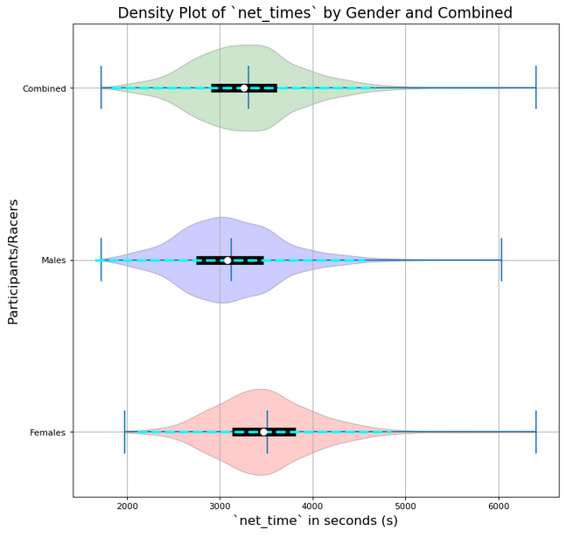
Initial Observations:
Looking at the violin plot with respect to Net Time for each participants, it seems like the Male participants performed better overall in the 10k Race compared to the Female participants.
There is a wide spread of Net Time values among the participants, which may be used to show the spread in level of fitness among them as well.
Overall, a large number of each subpopulation (Male, Female, and the Combined) are densely located about the Mean and Median Values with slight variations in the distributions.

Slide 7
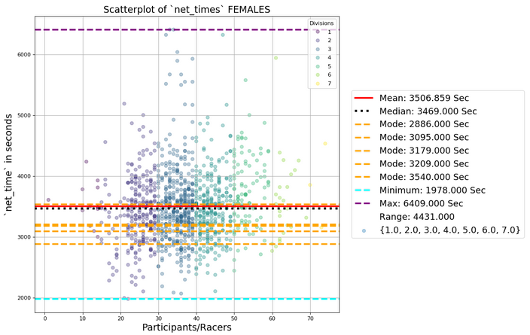
Female Contestants Statistics:
Mean = 58 mins 26.9 sec
Median = 57 mins 49.2 sec
Range = 73 mins 51 sec
Modes =
48 mins 6 sec
52 mins 36.6 sec
52 mins 59.4 sec
53 mins 14.4 sec
59 mins 0 sec

Slide 8
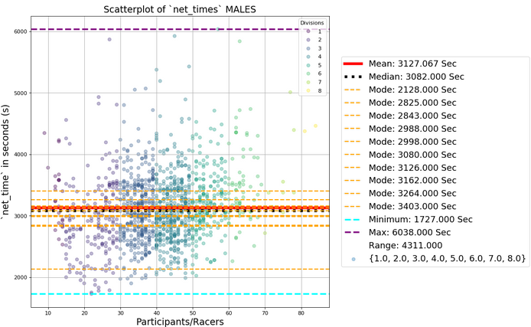
Male Contestants Statistics:
Mean = 52 mins 7.06 sec
Median = 51 mins 22 sec
Range = 71 mins 51 sec
Mode =
35 mins 28 sec
47 mins 5 sec
47 mins 23 sec
49 mins 48 sec
49 mins 58 sec
51 mins 20 sec
52 mins 6 sec
52 mins 42 sec
54 mins 24 sec
56 mins 43 sec

Slide 9
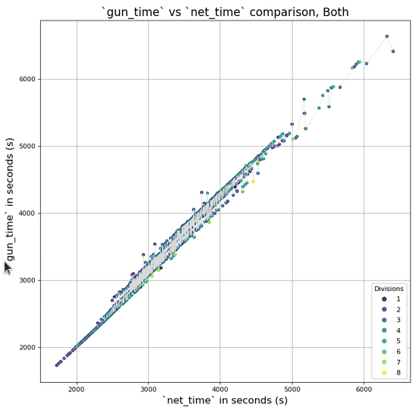
Given the two different time features available `gun_time` and `net_time`, some observations include:
A noticeable difference toward the center/Interquartile range of the whole data set.
The graph shows it widening as the `net_time` gets larger. This could capture more general or casual runners
The points closer to the origin seem to have no difference between their `net_time` and their `gun_time` values.
These racers could be seen more dedicated to the race, or were at a more favorable starting position to allow these two values to align more.
Toward the upper most right corner we can see that population as even more casual runners.
We can see this trend continue when looking at specific genders.
Pearson Correlation Value: 0.9942

Slide 10
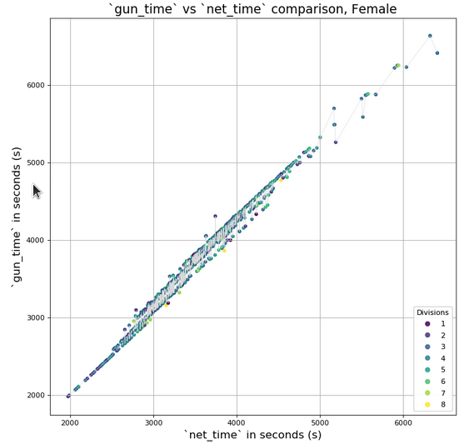
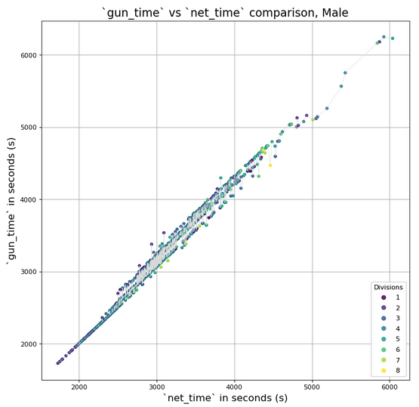
Difference in Gun and Net Time By Gender
Pearson Correlation Value: 0.99486
Pearson Correlation Value: 0.994457

Slide 11
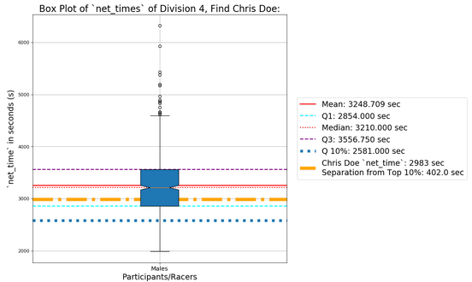
How well does Chris Doe Perform?
Chris Doe’s Net Time performance falls between the Q1 (25th ) and the Median (50th ) percentiles of those participating within his division (4th ).
The Top 10 Percentile completed the race within 43mins 1sec (2581 secs).
Chris Doe comes in at 49 mins, 43 secs (2983 secs), 6mins 21secs (402 secs) longer when compared to the threshold above for the top 10 Percentile.

Slide 12
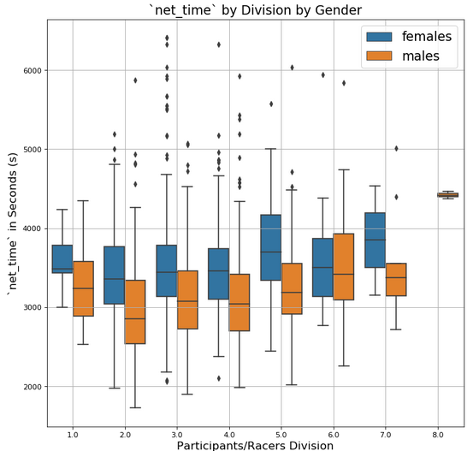
After comparing the racers by division, some insights include:
Divisions 2, 3, & 4were the fastest (looking at the Minimum and the overall Average values) among both Male and Female Participants in the 2006s Pike’s Peak 10k Race.
Most of the runners seem to fall within Divisions 2-5 (ages 15-49) while Divisions 1 (ages 0-14) and Divisions 6-8 (ages 51-79) contained the least

Slide 13
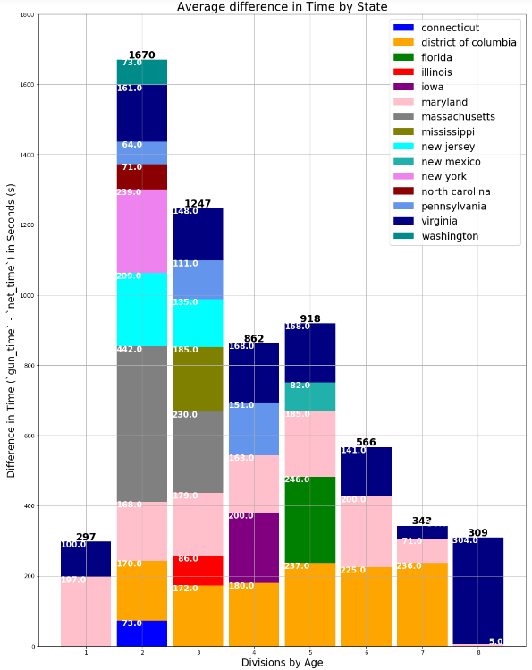
When viewing the divisions by State, we can see that the majority of the racers are from the DMV area.
The Maryland, followed by Virginian and Washington DC Contestants.
Looking at the most represented populations of Marylanders, Virginian, and DC Participants, it seemed like Virginian Racers had the most difference between Gun and Net time, followed by the Marylanders

Slide 14
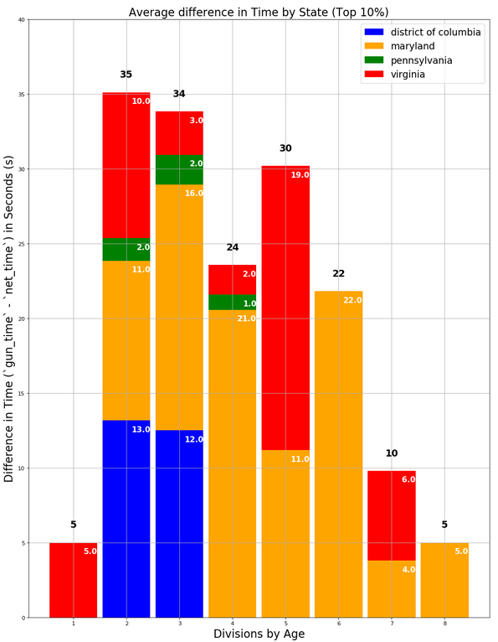
Looking at the T0p 10 percentile in the average difference of Gun and Net time, we can see that a few participants from Pennsylvania (4 Total) had the best overall time.
This is followed by Virginian (32 Total) and Maryland (181 Total) participants.
Within the Top 10 Percentile of participants, DC Participants (12 total) had the least amount of time difference.

Slide 15
Follow on Steps:
A few points that I’d like to follow up would involve:
The large population from Washington State
Further explore the various outliers that can be associated with Division 1 (ages 1-14) and Division 8 (70-79). See if these were outliers or active participants at these ages.
Potentially generate a geographical overlay that utilizes both City and State information to further explore the concentration of all the racers hometowns across the United Continental States and International countries.

Slide 16
Q & A?

Slide 17
Resources:
MA_Exer_PikesPeak_Female.txt
MA_Exer_PikesPeak_Male.txt
FAQ MA Pikes Peak Data Exercise.docx
MA Exercise_20170112-2.pdf

Slide 18
Code Book:

Slide 19
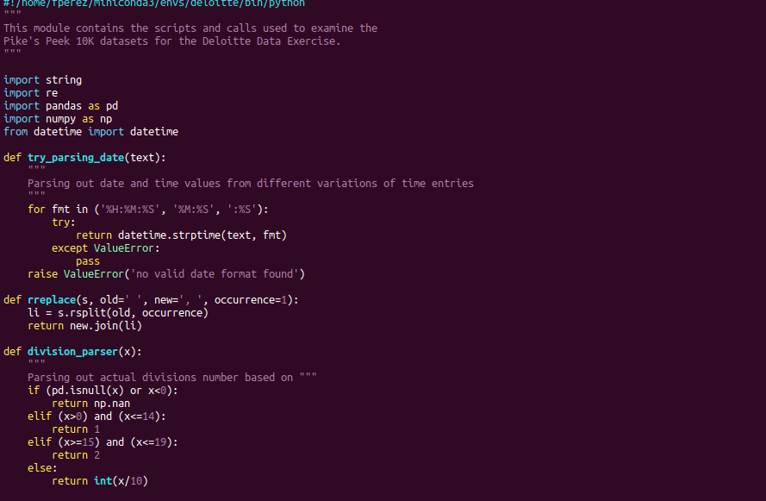
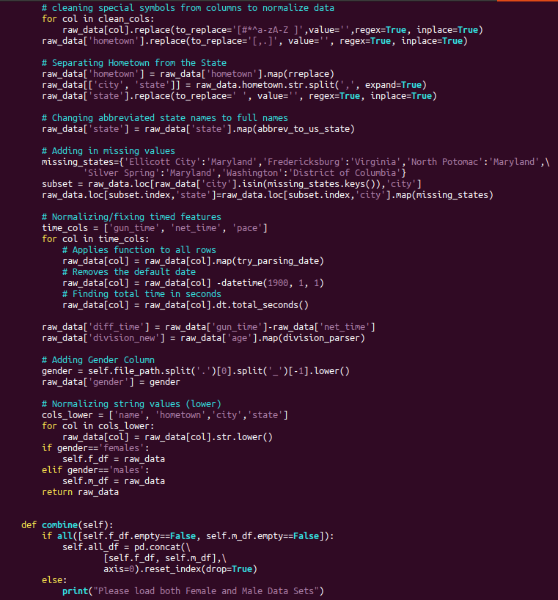
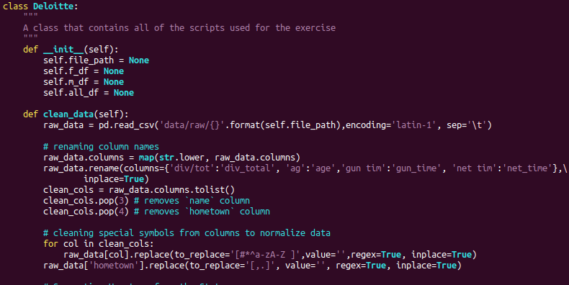
Data Cleansing Code:

Slide 20
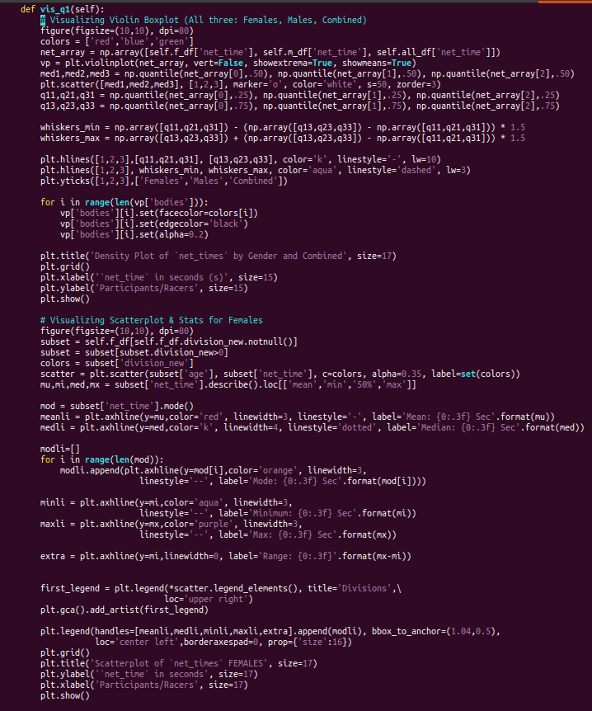
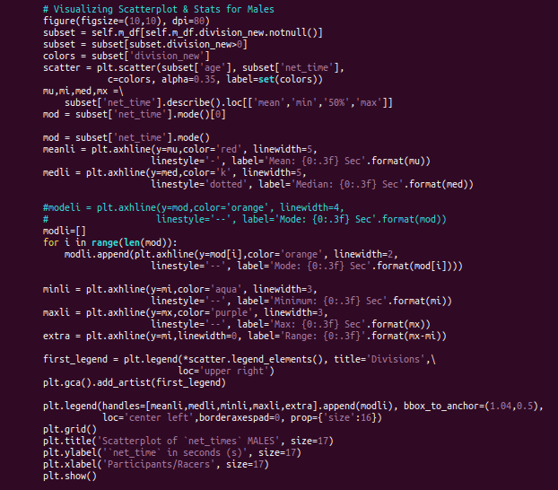

Slide 21
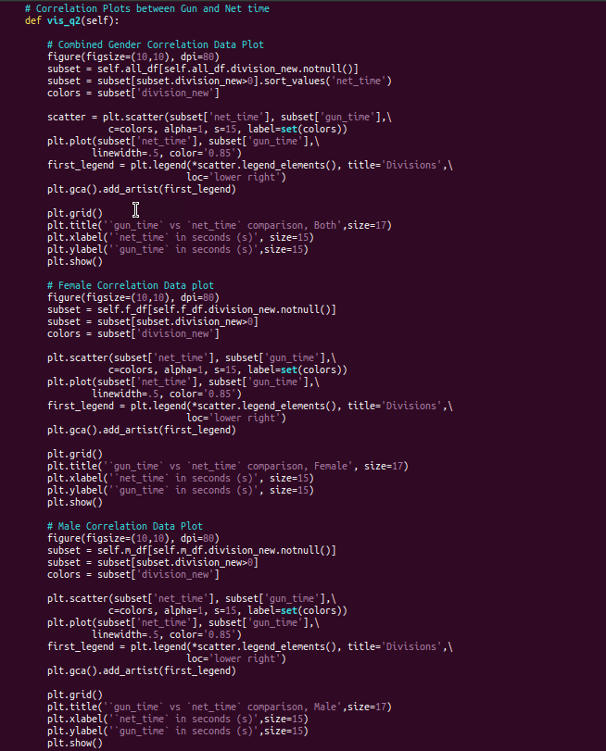
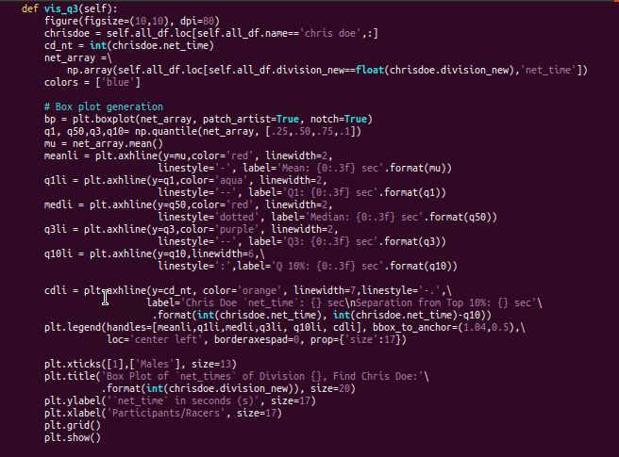

Slide 22
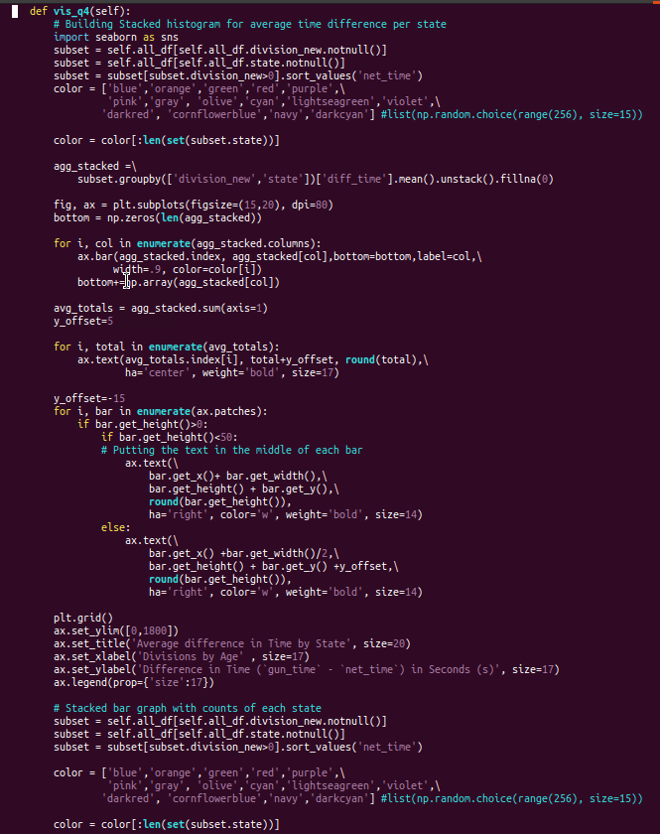
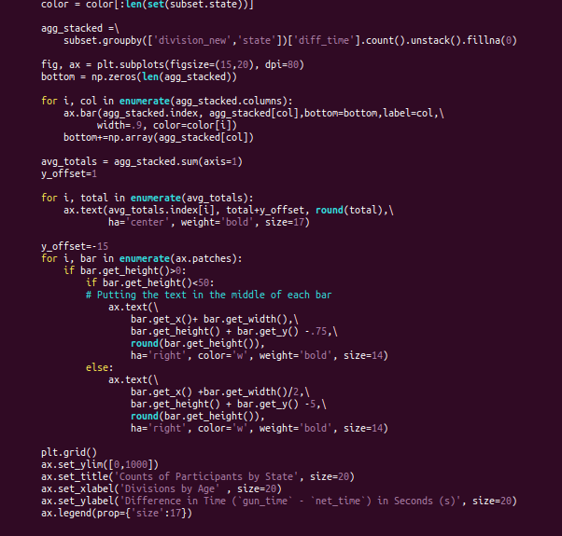

Slide 23
