Slide 1


MEETUP TOPICS
A TEXT MINING AND SEARCH PROJECT
DARIO BERTAZIOLI
FABRIZIO D’INTINOSANTE
MASSIMILIANO PERLETTI

Slide 2







introduction
available in 186 countries
40 millions users
320k active groups
12k daily events
interest in
member of
deals with
DARIO
MILANO DATA SCIENCE #ODSC
TECH
DATA MINING
PYTHON
hosted event
will participate
hosted at
INTRODUZIONE ALLE GAN
MICROSOFT HOUSE, MI
2

Slide 3

goal
Single-Label
Multi-Class
(SLMC)
text classification
topic
3

Slide 4


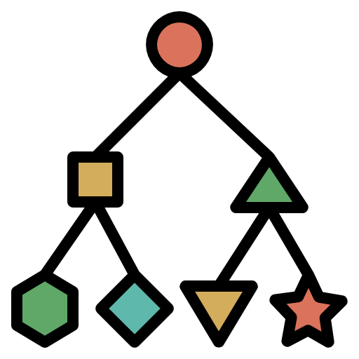



tech
media
business
outodoor
pipeline
from event descriptions predict the event category
socializing
PRE-PROCESSING
TEXT REPRESENTATION
CLASSIFICATION
stemming
BAG-OF-WORDS
lemmatization
1
tf-idf
Random
Forest
tokenization
frequency count
language
detection
2
Neural
Network
WORD EMBEDDING
LDA
clustering
Word2Vec (mean, tf-idf)
Doc2Vec
4

Slide 5
DATASET

Slide 6

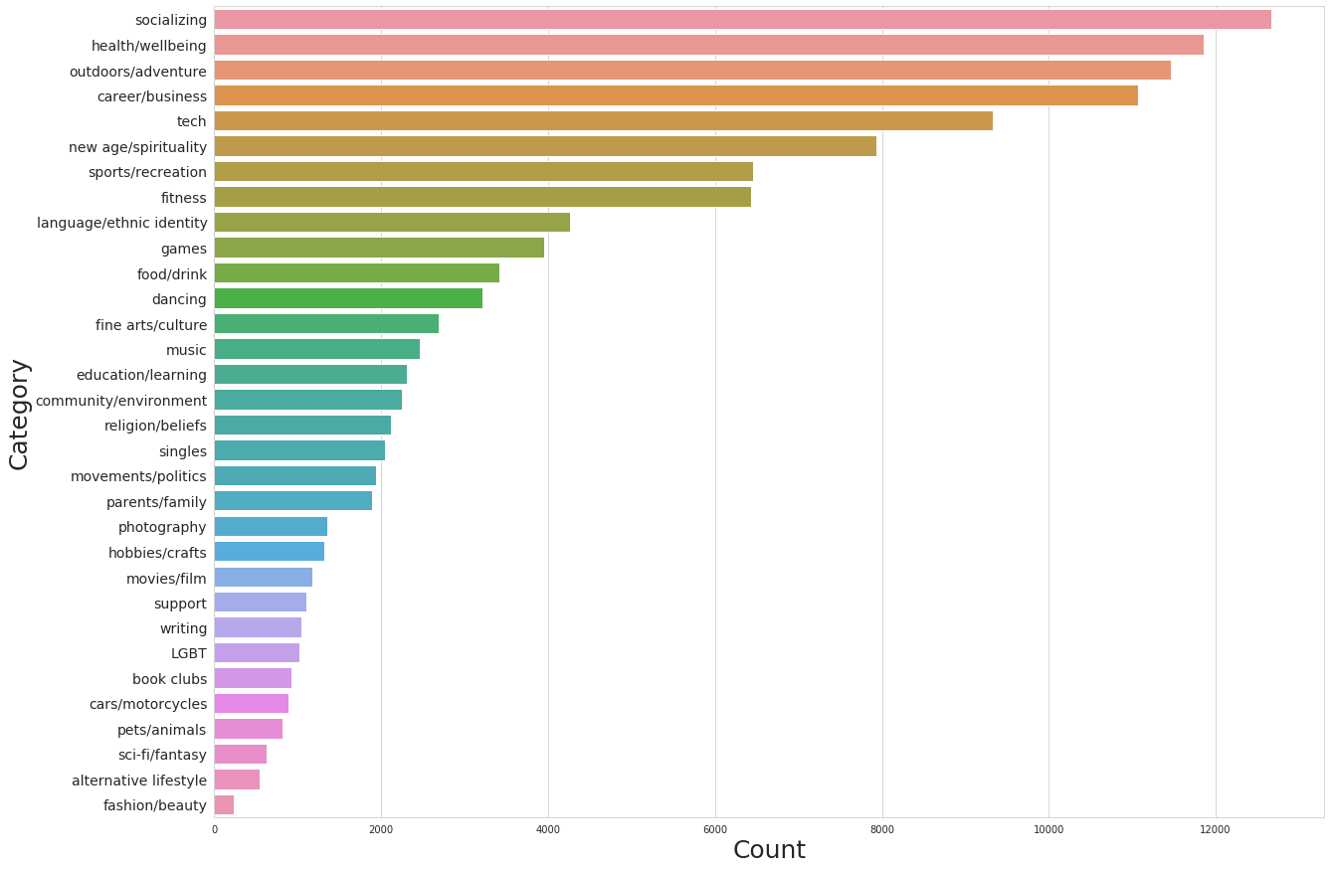
data
variables
remove
134k
description
event_id
event_name
category
record
NA values
duplicates
32
class
6

Slide 7
data
variables
remove
134k
description
event_id
event_name
category
record
NA values
duplicates
32
class
7

Slide 8
data
union
Single-Label
Multi-Class
(SLMC)
unbalanced category
24
similar
topic
class
e.g. singles to socializing
8

Slide 9
PRE-PROCESSING

Slide 10
pre-processing
(garbage in → garbage out)
html & emoji stripping
language detection (minimize api call)
polyglot
language translation
Google-translator API
DeepL API
python-translate API (Microsoft and other providers)
punctuation/special symbols, lowercase
tokenization and stopwords removal
stemming - lemmatization
SnowballStemmer (multilingual)
PorterStemmer (English)
10

Slide 11
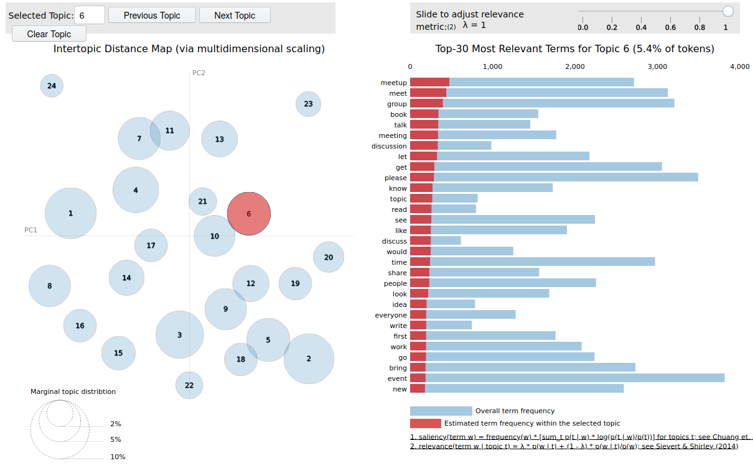

latent dirichlet allocation (LDA)
unsupervised method for topic modeling & topic extraction
generative model (three level bayesian model)
high level idea
assume your texts comes from a latent-topics generated distribution, try to infer the distribution parameters (thus, the latent topics)
(almost) technically
“LDA takes de Finetti theorem seriously”
compute the probability distribution for words in a doc, for a doc in a corpus and for the corpus itself
exploiting the main property of exchangeability of words and docs
use Bayesian inference to obtain the posterior distribution of the latent variables
exploiting variational methods to solve (uncouple) intractable (coupled) equations
interesting note
some Latent topics are well correspondent with our labels while others have no sense but.. that’s a good news!
clusters of “garbage” helps in defining “badwords” to remove in the cleaning process → ~ 1/2% performance gain by only stripping ~50 badwords (the previously introduced “trick”)
11

Slide 12
latent dirichlet allocation (LDA)
unsupervised method for topic modeling & topic extraction
generative model (three level bayesian model)
high level idea
assume your texts comes from a latent-topics generated distribution, try to infer the distribution parameters (thus, the latent topics)
(almost) technically
“LDA takes de Finetti theorem seriously”
compute the probability distribution for words in a doc, for a doc in a corpus and for the corpus itself
exploiting the main property of exchangeability of words and docs
use Bayesian inference to obtain the posterior distribution of the latent variables
exploiting variational methods to solve (uncouple) intractable (coupled) equations
interesting note
some Latent topics are well correspondent with our labels while others have no sense but.. that’s a good news!
clusters of “garbage” helps in defining “badwords” to remove in the cleaning process → ~ 5/7% performance gain by only stripping ~20 badwords (the previously introduced “trick”)
11

Slide 13
TEXT REPRESENTATION

Slide 14



bag-of-words
1
COUNT
TF-IDF
2
Ʃ
tf-idf vectorization
where
13

Slide 15
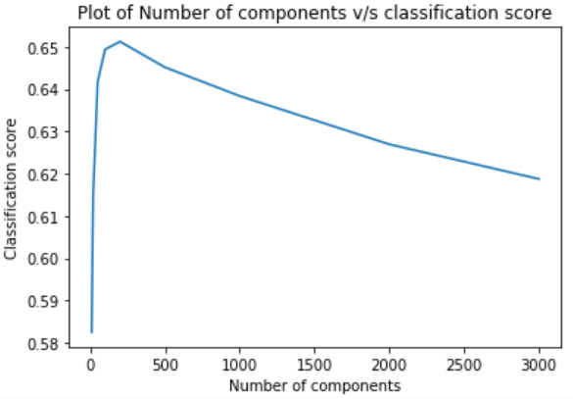
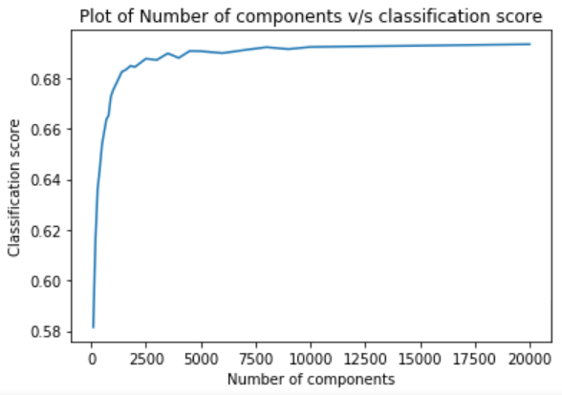
sparsity analysis
B
DIMENSIONALITY REDUCTION (SDV)
CUT-OFF THRESHOLD
A
14

Slide 16
A
CUT-OFF THRESHOLD
sparsity analysis
DIMENSIONALITY REDUCTION (SDV)
B
14

Slide 17
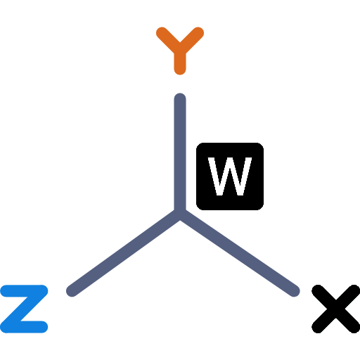
word embedding
1
WORD2VEC
DOC2VEC
2
15

Slide 18
WORD2VEC
1
word embedding
sintetization
strategies
MEAN
TRANSFER LEARNING
TF-IDF
DOC2VEC
2
15

Slide 19

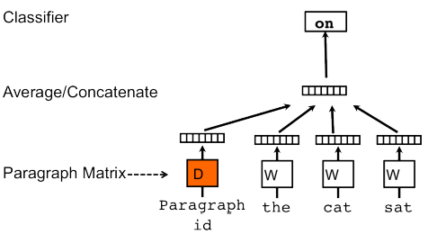
WORD2VEC
1
word embedding
TRANSFER LEARNING
sintetization
strategies
MEAN
CBOW
Window size - 5
Feature dim - 300
Epochs - 10
TF-IDF
DOC2VEC
2
15

Slide 20

1
WORD2VEC
word embedding
PV-DM
PV-DM
conctenate
PV-DBOW
PV-DBOW
DOC2VEC
2
15

Slide 21
1
WORD2VEC
word embedding
PV-DM
PV-DBOW
Feature dim - 300
Epochs - 10
PV-DM
conctenate
PV-DBOW
PV-DBOW
DOC2VEC
2
15

Slide 22
CLASSIFICATION

Slide 23

classifier
RF
NN
default
parameters
(n_estimator – 100)
hyper-parameters
optimization
17

Slide 24

classifier
RF
NN
Random Forest – model surrogate
LCB – activate function
Cross Validation (5-folds)
100 iterations – budget
default
parameters
(n_estimator – 100)
objective function
parameters
1 − average macro f-measure
neurons (layer dense)
rate (dropout layer)
optimizer and learning rate
activation layer (ReLU or LeakyReLU)
17

Slide 25
RESULTS

Slide 26



first evaluation
1
RF
Stemming + Badwords Removal
test each text representation
BOW (tf-idf)
W2V
Stemming
Stemming + Badwords Removal
Lemmatization
Lemmatization + Badwords Removal
Lemmatization + Badwords Removal
processing method
BOW (count)
D2V
19

Slide 27
first evaluation
1
RF
Stemming + Badwords Removal
test each text representation
BOW (tf-idf)
W2V
Stemming
Stemming + Badwords Removal
Lemmatization
Lemmatization + Badwords Removal
Lemmatization + Badwords Removal
processing method
BOW (count)
D2V
19

Slide 28
Stemming + Badwords Removal
BOW (tf-idf)
W2V
Lemmatization + Badwords Removal
BOW (count)
D2V
evaluation model
2
best processing method
best text representation
Lemmatization + Badwords Removal
D2V
NN
RF
NN
20

Slide 29
Stemming + Badwords Removal
BOW (tf-idf)
W2V
Lemmatization + Badwords Removal
BOW (count)
D2V
evaluation model
2
best processing method
best text representation
Lemmatization + Badwords Removal
D2V
NN
RF
NN
79,6%
Macro F-measure
20

Slide 30
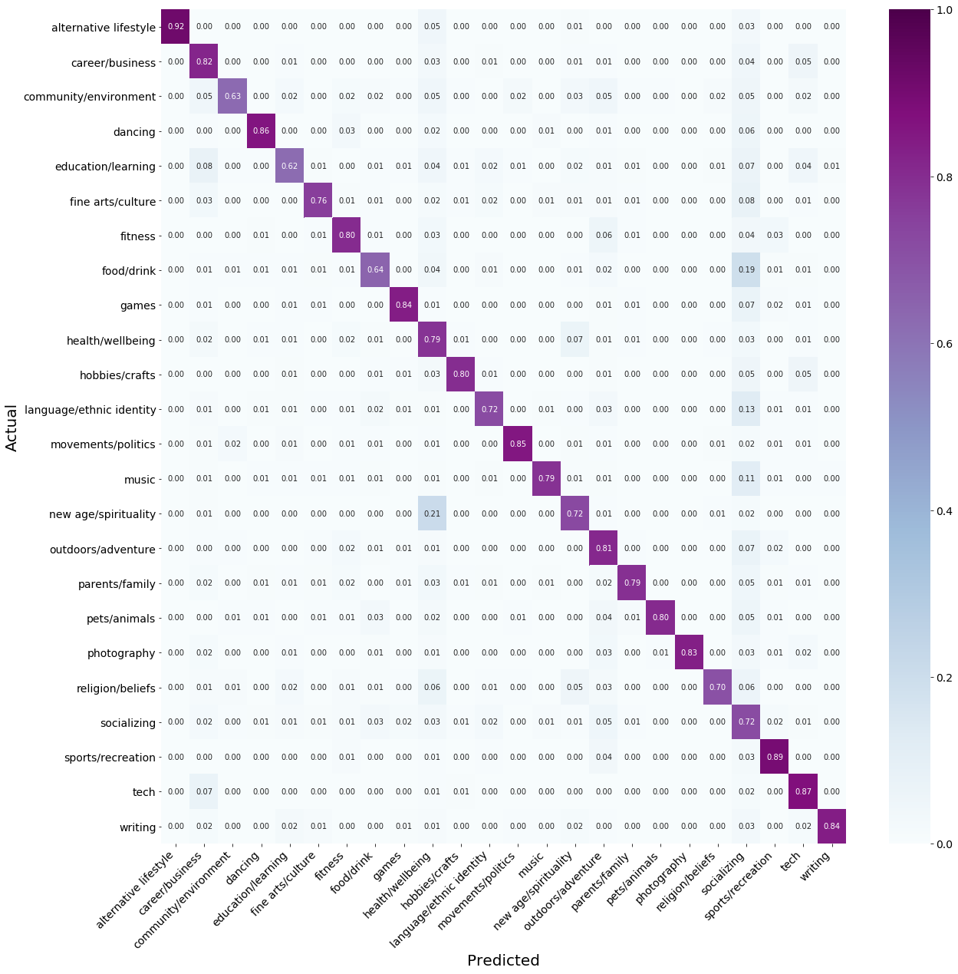


final analysis
21
socializing
most confusing category

Slide 31

final analysis
socializing
most confusing category
new age/spirituality
misclassified
health/wellbeing
21

Slide 32
final analysis
socializing
most confusing category
new age/spirituality
misclassified
health/wellbeing
21

Slide 33
CONCLUSIONS

Slide 34



improvements
final method
more data
(under-represented categories)
lemmatization and badwords removal
doc2vec
NN
more in-depth LDA analysis
(varying number of produced cluster to select better badwords)
78,4%
Top-1 accuracy
test another algorithm to improve embeddings
94,1%
BERT
Top-3 accuracy
23

Slide 35
improvements
final method
more data
(under-represented categories)
lemmatization and badwords removal
doc2vec
NN
more in-depth LDA analysis
(varying number of produced cluster to select better badwords)
78,4%
Top-1 accuracy
test another algorithm to improve embeddings
94,1%
BERT
Top-3 accuracy
23

Slide 36
THANK YOU
MEETUP TOPICS

Slide 37


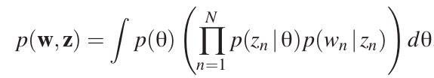
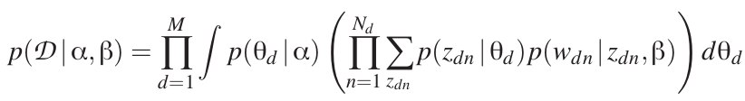



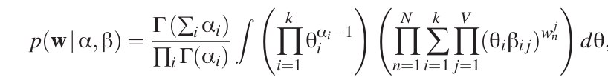
(exchangeability)
By de Finetti’s theorem:
corpus
Dirac-like topic mixture distribution
n-th word for d-th document
distr. parameters
latent topic
joint distribution of a topic mixture θ,
a set of N topics z, and a set of N words w
marginal distribution of a single document
probability of the entire corpus
Inference:
producing the intractable eq (coupled!)
need for variational methods to solve (approx)
-> decoupling

Slide 38
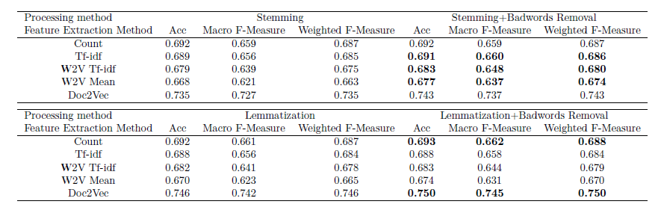

Slide 39
