Slide 1
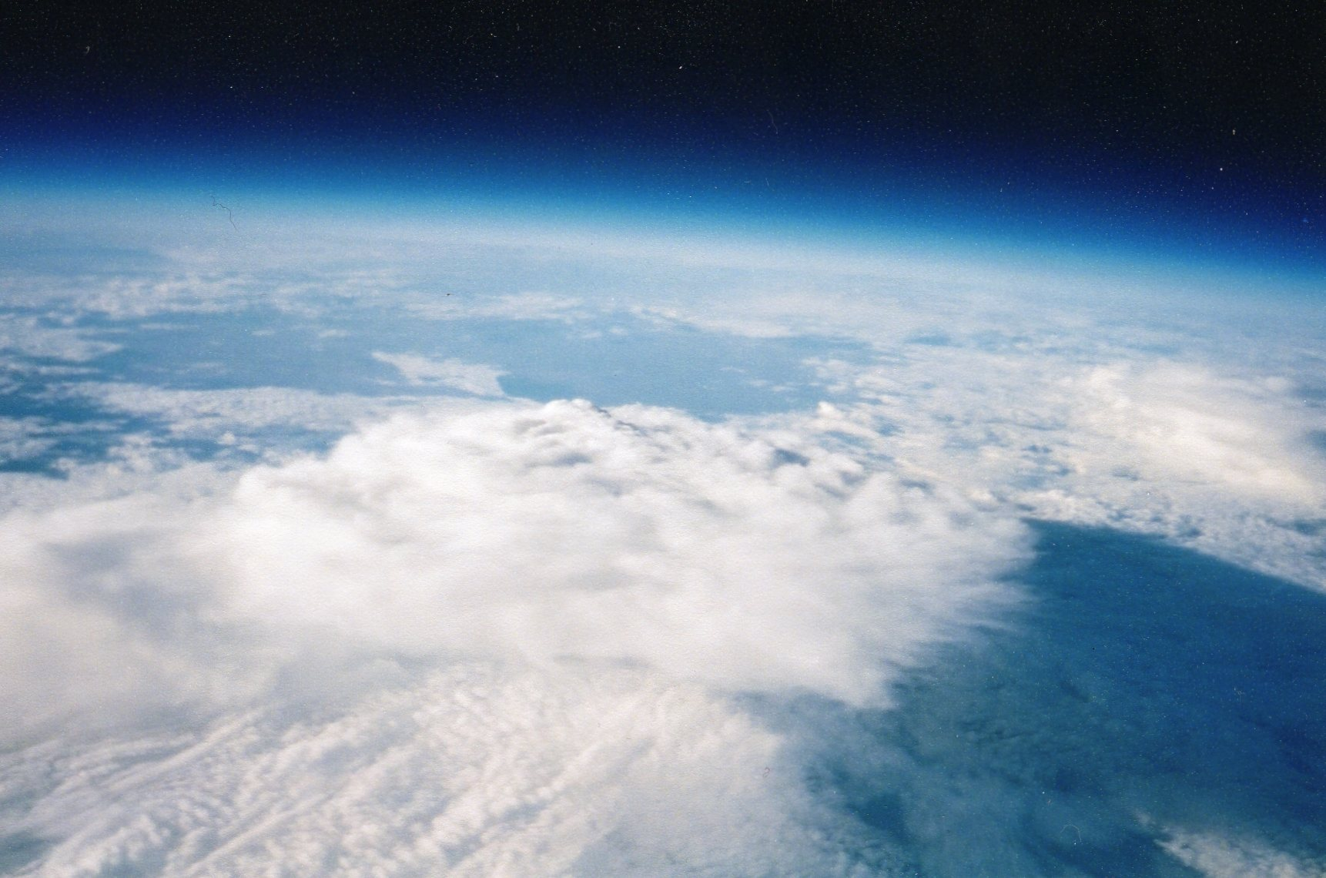
BalloonSats
One tool to teach STEM (science, technology, engineering, and math)
L. Paul Verhage
8 July 2013
Notes:
In this presentation, I want to convince you to help young students develop better math, science, and technology skills. America needs those skills if it’s to retain its strength and competitive advantage in the future. One way you can help is using BalloonSats, a really neat first step to outer space.

Slide 2
Why BalloonSats?
● Near Space Motivates
● Simple to Build
● No Tracking Equipment or Radio License
● Focus on Construction and Data Analysis
Notes:
Near space looks and feels like outer space. So students who make a BalloonSat will feel they’re designing a real satellite. This is motivating for students with a space interest, which is most kids before they enter high school. And as a result, their interest in math, science, and technology is rewarded and perhaps even encouraged as a future college major and career.
The reason to use BalloonSats is that they’re faster, cheaper, and easier to make than a satellite or even complete near spacecraft. That’s because BalloonSats don’t need tracking equipment, it’s already provided for them. Therefore, students don’t need to earn a radio license before building a BalloonSat. Students only need to focus on their energies on designing and building a large but lightweight airframe and on analyzing their data.

Slide 3
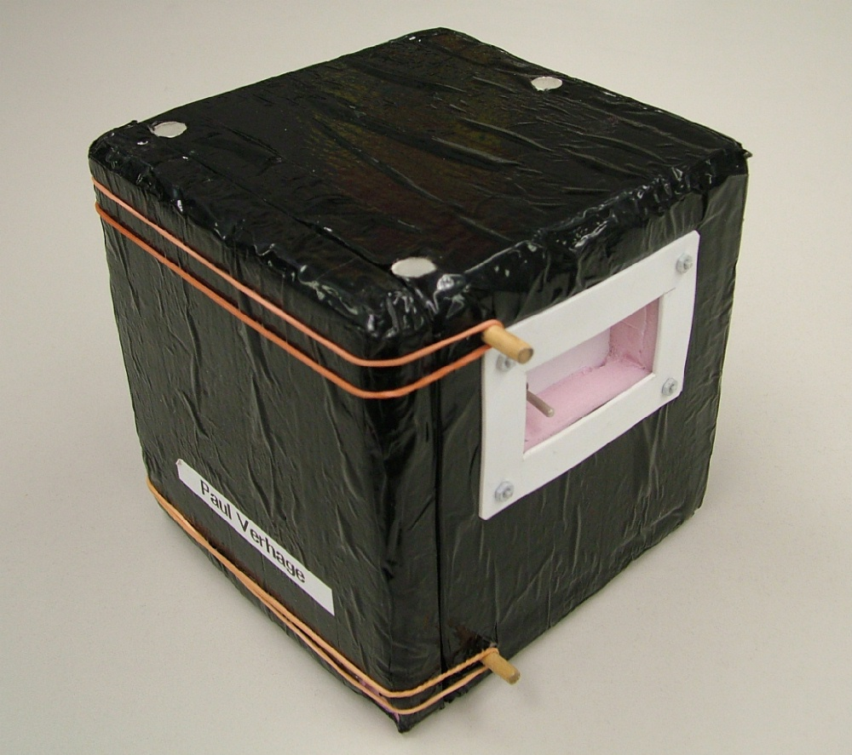
A Typical BalloonSat
Notes:
BalloonSats are easy to build because they’re essentially a Styrofoam box. The sides are glued together with hot glue and the airframe covered in tape. The avionics typically consists of a Hobo datalogger with internal temperature sensor, an external temperature sensor, an APS camera, a 555-based timer that operates the camera every three to four minutes, and some kind of passive experiment.
When they make a BalloonSat, students are learning to use some of the same tools they’ll use to further their education and in their career.

Slide 4
BalloonSat Construction
Workshop
Teams of three or four
Two days/Four hours
Classroom
Teams of three or four
Two weeks/1 class period
Notes:
Making a BalloonSat doesn’t take very long and you don’t need to be there all the time. As a volunteer, you only need to help guide the students in their construction, testing, flight, and data analysis. In the workshop setting, student teams can assemble a BalloonSat in two days, that is, if they have half a day available on each day.
In a classroom setting, BalloonSats combine with other class work and it takes closer to two weeks.
In either setting, teams should be limited to a maximum of four students or you end up with bored team members who are going to look for other things to do. And some of those unwanted activities may involve the hot glue gun or rubber bands.

Slide 5
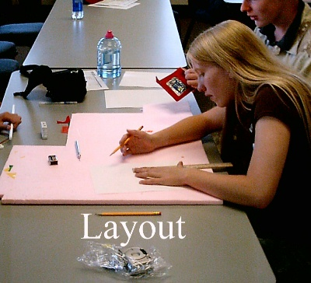
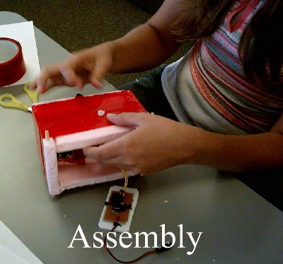
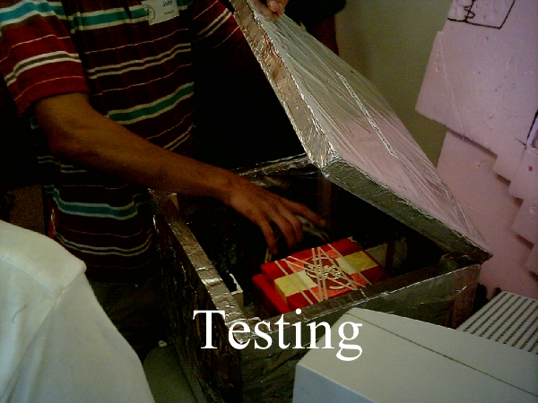
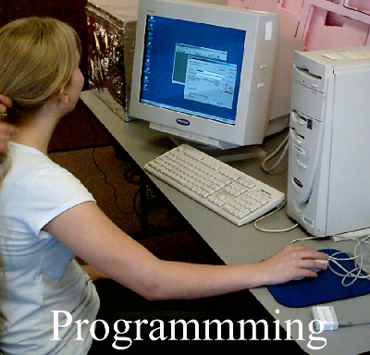
Notes:
Kids can get pretty busy making their BalloonSat. They have to plan a design and lay it out.
Then there’s the actual test fitting and construction. This is frequently followed by modification, since many students have never built a BalloonSat before nor have the patience to carefully design an airframe. Apparently, schools and families don’t teach the measure twice, cut once rule anymore.
After the construction of their BalloonSat, there’s programming the avionics. Here students become familiar with telling the datalogger how often to collect data and from which sensors.
Then there’s the testing, or as I like to call it, the torture of the BalloonSat.
One test is the thermal test to see how cold the interior of the BalloonSat can get and how fast. BalloonSats should retain heat as long as possible unless Frosty the Snowman is a passenger.
Then there’s a drop test to verify that the BalloonSat will remain in one piece during landing.
Some teams perform a shake test that proves the BalloonSat will properly hold its guts together during its mission.
Finally, there’s a function test that does two things. First, it ensures the BalloonSat can quickly be put together at the launch site. After all, you don’t want teens struggling to get their BalloonSat ready for launch after the balloon is filled. The other half of the function test checks that the BalloonSat will work as designed. The most comprehensive test uses a roll of camera film and runs the BalloonSat for three hours. Needless to say, you don’t often see a full up test of the BalloonSat. Still, the function test lets students debug their BalloonSat design.
I have yet to see a BalloonSat fail these tests, except perhaps for thermal testing because I have seen cameras quit working during a flight.

Slide 6
Advanced Students
Notes:
Students who have flown before, or are ready for a more sophisticated challenge, can substitute a simple programmable flight computer in place of the Hobo datalogger. I’ve designed one specifically for BalloonSats that collects data like a Hobo, but operates experiments, unlike a Hobo datalogger.
If an intervalometer operates an onboard camera, then advanced students can assemble a PICAXE based intervalometer and learn to program it.
Finally, experienced students can add a digital camera to their BalloonSat in place of an APS camera. The digital camera allows students to take more pictures during a mission. Be aware however that some digital cameras shut themselves off if they’re not used within 30 or 60 seconds. This is where a flight computer and programmable intervalometer shines, because they have better control the camera than a 555 timer-based intervalometer.

Slide 7
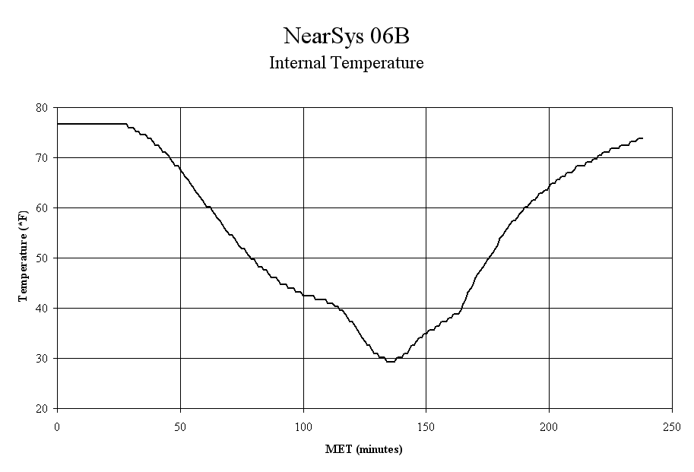
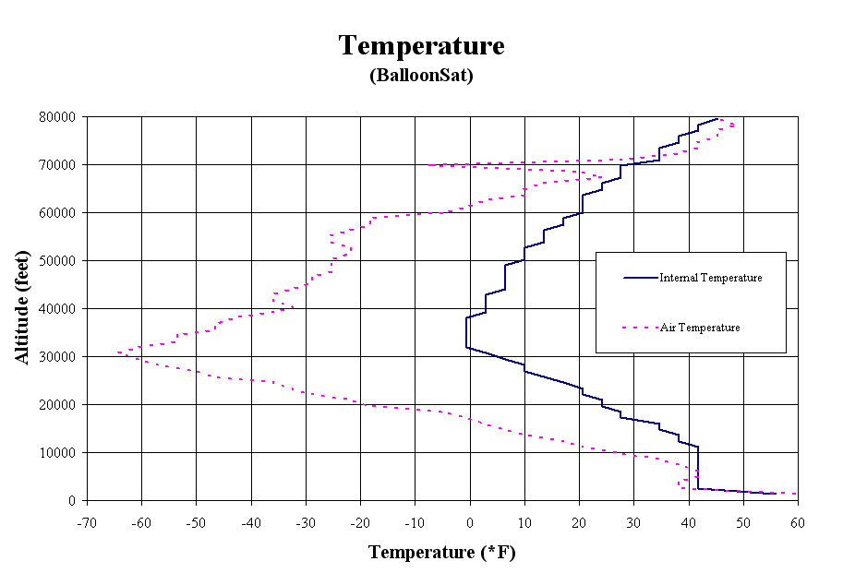
Student Data
Without APRS With APRS
Notes:
After recovery, there’s data to download and analyze. With Hobo data loggers, students will discover how cold their BalloonSats got during its near space mission.
However, if you’ll help students incorporate APRS data into their spreadsheet then they can convert time into altitude and discover where the stratosphere begins or how the relative humidity changes as a function of altitude.
Even having just APRS data is useful. With it, students can determine the wind’s speed as a function of altitude. They can discover the existence of the jet stream.

Slide 8
Potential Problems
Weather
Hot and Sharp Tools
Wrong Audience
Work Schedules
Liability
Notes:
I’d be lying if I told you there were no potential problems you could run into, so I would like to briefly discuss them.
First, there’s the issue of weather. BalloonSat classes are scheduled in advance for particular days and are therefore hostage to the weather. If the weather won’t let a launch occur on the scheduled day, then the students have built a BalloonSat for nothing. So have a backup launch day in case of bad weather.
Hot glue guns can burn and Exacto knives can cut. This is a greater risk with younger students. While schools and unions can protect most teachers from simple accidents during class time, you may not be protected when helping a class as a volunteer. So check with the host organization, make them aware of the risk, see that the kids are using safety equipment, and watch everyone like a hawk.
Regrettably, there will be some students who are simply not interested. In the classroom, there is often an appropriate activity for these students. That way they’re out of trouble and not leading other students off-task. It’s a bit easier for workshops since students shouldn’t be there if they’re not interested in BalloonSats. However, you can still find students who were signed up by their parents without student involvement.
A BalloonSats launch needs a launch and chase crew. Since many classes take place during work days, it can be difficult to line up working adults for the chase and recovery crews when the launch is taking place on a Wednesday morning. Therefore, it’s a good idea to have your own amateur radio license and tracking equipment. And don’t forget that you’ll increase your odds of success if there’s more than one mobile tracker. So let any potential help know about the launch weeks in advance and don’t forget to involve retirees.
A second liability issue is when students go on chase. If a driver is not a bus driver, then accidents are probably not covered by the school. Irate parents can unfairly shut down a program if their child becomes injured during a chase.
But don’t let these risks prevent you from participating in a BalloonSat class. The benefits far outweigh the risks and the risks can be mitigated. Just be aware that there are risks and that you need to stay on top of them.

Slide 9
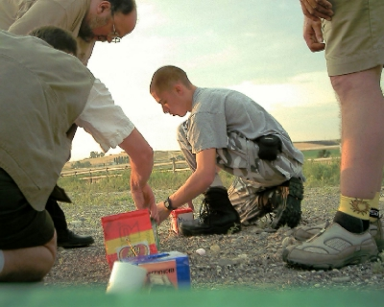
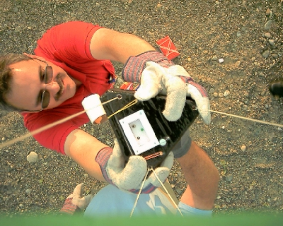
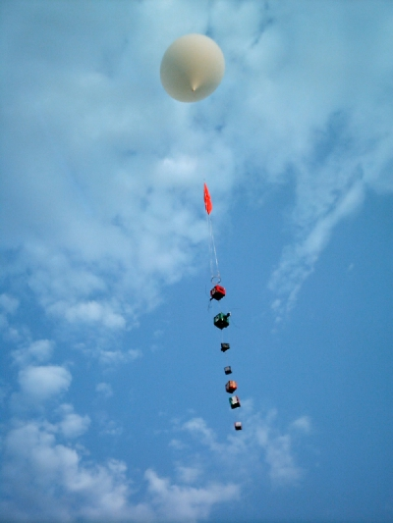
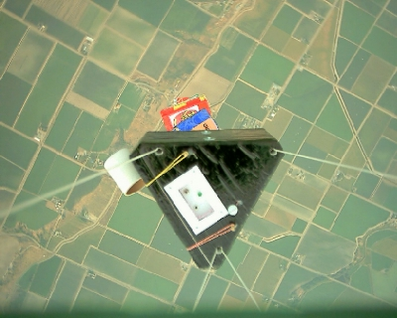
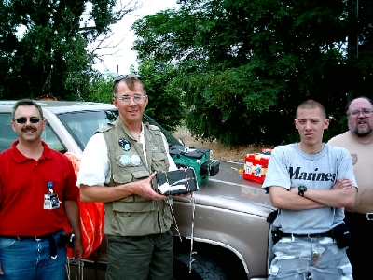
Notes:
There’s a lot of exciting stuff on launch day. So try to involve the students with prep, launch, chase, and recovery. If they can’t, then have them track the flight over Findu.com. There they can act as mission control and with the help of a licensed ham, even communicate with the chase crew.

Slide 10

Umm, I wonder….
NearSys@gmail.com
Notes:
If you have experience launching near spacecraft, then I encourage you to get help out at a BalloonSat class, or even start one yourself. Your participation could turn a kid from drifting with the current to actively pursuing a math, science, and technology career and education.
Feel free to contact me for or with ideas. You’ll find some of my thoughts in Nuts and Volts, ATV Quarterly, and Citizen Scientist.

