Slide 1
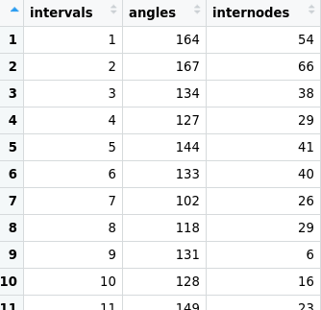
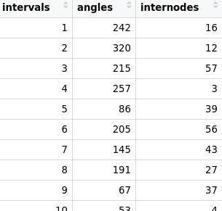
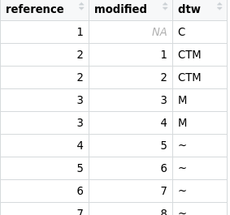
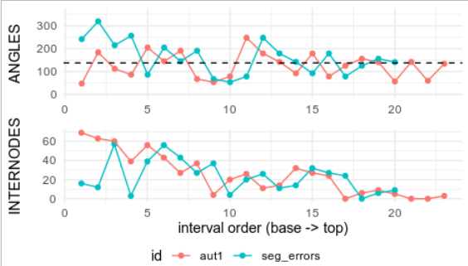
Testing DTW by simulating phyllotaxis sequences and segmentation errors
1. initial sequences
2. measures_type1
Real biological values
e.g. manual measures
DTW
alignment1
DTW
alignment2
2’. measures_type2
e.g. automated measures
2’’. segmentation_errors
...
e.g. organs gained / lost
Eval DTW prediction quality
Eval DTW sensitivity to measure precision
$values
$interval_alignement
$plotting

