Slide 1
Elastic collisions of balls

Slide 2
v₁
θ₁
Φ
v₂
θ₂
Φ= phi
θ1= theta1
θ2= theta2
Φ

Slide 3
y
y'
Φ
v
θ
x
Φ= phi
θ=theta
x'=v*cos(θ - Φ)
y'=v*sin(θ - Φ)
Φ
x'

Slide 4
new Cartesian coordinate system
v₁y
v'₁y
v₁
Changing
Cartesian
coordinate system
v₁
v₁x
v'₂x
v'₁x
v₂
v₂y
v₂
v₂x
v'₂y

Slide 5
Before collision
After collision
v'₁y
u'₁y
u'₁x
v'₁x
v'₂x
v'₂y
u'₂x
u'₂y

Slide 6
After collision
u'₁
u₁
u_{1y}
u'₁=u₁
u'₂=u₂
u'_{1y}
Changing back
Cartesian
coordinate system
u'_{1x}
u_{1x}
u_{2x}
u'_{2y}
u'_{2x}
u_{2y}
Φ
u'₂
u₂

Slide 7
u’1
u’1y
u’1x
Φ
Φ
π/2−Φ
u’2x
u’2y
u’2

Slide 8
u’1
u’1y
u’1x
π/2+Φ
Φ
u’1x* cosΦ
u’1y* cos(π/2+Φ)
u1x=u’1x* cos(Φ)+u’1y* cos(π/2+Φ)

Slide 9
u’1
u’1y
u’1x
u’1y* sin(π/2+Φ)
π/2+Φ
u’1x* sin(Φ)
Φ
u1y=u’1x * sin(Φ) + u’1y * sin(π/2+Φ)

Slide 10
u’2y* cos(π/2+Φ)
u’2x* cos(Φ)
Φ
u’2y
Φ+π/2
u’2x
u’2
u2x=u’2x * cos(Φ) + u’2y * cos(π/2+Φ)

Slide 11
u'_{2y}* sin(π/2+Φ)
Φ
u'_{2x}* sin(Φ)
Φ+π/2
u’_{2y}
u'_{2x}
u’₂
u_{2y}=u’_{2x} * sin (Φ) + u’_{2y} * sin(π/2+Φ)

Slide 12
u1
u1y
u’1y
u’1x
Φ
π/2−Φ
u1x
u2x
u’2y
u’2x
u2y
u2

Slide 13
click-on StartButton (event)
Remove RenderFrame() callback from the
Render event
CleanBalls()
Resize the array balls[]
StartDraw()
Add RenderFrame() callback to the
Render event

Slide 14
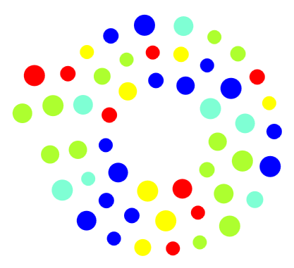
x
θ
R0
y

Slide 15
k=0,1,2,…. TotNumCircles
balls[k].p = balls[k].p + balls[k].v;
Check balls[k].p vs canvas boundaries
(check on canvas width & canvas height)
colliding()
RenderFrame()
NO
Check collision
Render event
(invoked at any
frame redrawing)
YES
resolveCollision()
end of cycle on k

Slide 16
Canvas.Width
balls[k].v.Y
balls[k].v.Y
balls[k].v.X
balls[k].v.Y
balls[k]
balls[k].v.X
balls[k]
Canvas.Height
balls[k].v.X=-1*balls[k].v.X;
balls[k].v.Y = -1 * balls[k].v.Y;

