Slide 1

elasticsearch
Fabian Kopf
18. May 2026

Slide 2
Agenda
1
What is ElasticSearch
2
Architecture
3
Key features
4
How does it work
5
Query Language & API
6
Usecases
7
Advantages & Disadvantages
8
Project

Slide 3
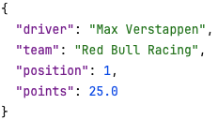
What is Elasticsearch?
NoSQL document store and search engine
Open-source
Build on Apache Lucene
Apache Lucene is an open-source Java library
Provides the core indexing and full-text search engine
Stores data in JSON format
Notes:
Elasticsearch stores data in JSON format and making it easy to index and search structured and unstructured data.

Slide 4
What is Elasticsearch?
Handle large volumes of data
In real-time
Structured and unstructured data
Elastic Stack
Elasticsearch
Kibana
Beats
Logstash
Developed by Elastic NV
Notes:
Beats for data shipping, and Logstash for data processing.
Stuctured Data: is data that follows fixed format an can be organized into rows
Unstructured data: has no fixed format or schema like email text, log files, documents ,. …

Slide 5
Architecture
Cluster
One ore more nodes working together
Document
JSON object
Shard
A subset of an index stored on a node, enable parallel processing
Node
Single Elasticsearch instance
Replica
Copy of a shard
Index
A collection of documents
Notes:
Elasticsearch stores data in JSON format and making it easy to index and search structured and unstructured data.

Slide 6
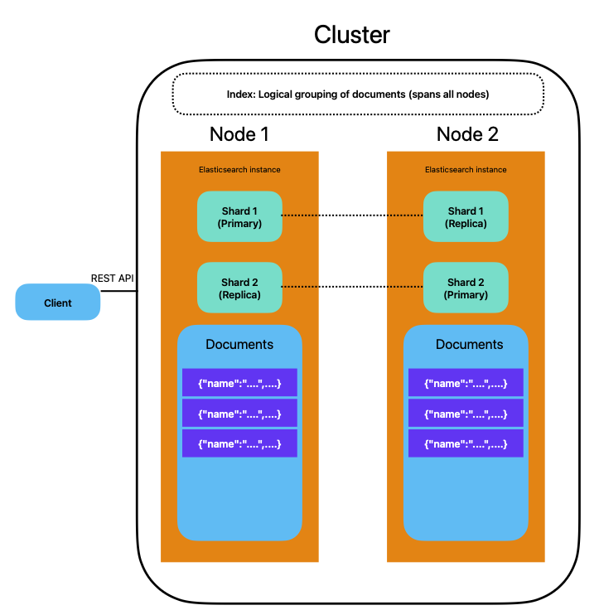
Notes:
Documents are indexed across one ore more shards. Each shard is itself a fully functional index

Slide 7
Key features
Distributed and Scaleable
Real-Time Data Analysis
Full-Text Search
RESTful API
Schemaless
Notes:
Elasticsearch is because of its architecture distributed by nature. This allows it to scale horizontally across multible nodes to handle large datasets and high query volumes
It provides powerful full-text-search capabilities, enabling users to search for documents based on their content and relevance
Support real time indexing and quering, making it suitable for use cases that require up-to-date insights from continuously changing data
Offers a RESTful API, making it easy to interact with the system using simple http requests
Is schemaless, meaning we can index and search data without having to define a rigit schema already

Slide 8
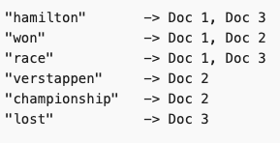


How does it work
Indexing
Data is analysed → tokenized → stored in inverted index
Instant lookups without scanning every record
Notes:
Data is ingested into Elasticsearch through the indexing process
Analyse then tokenize and thte inverted index
Tonkenized are some steps more – that what you can see here ande then all is lowercased and the the is never stored because it would be useless for searching

Slide 9
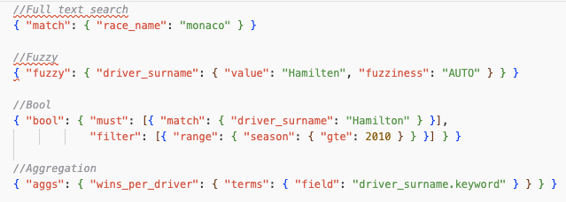
How does it work
Querying
Client send JSON-based Query DSL request via REST API
Full-text match, fuzzy, bool, range, geo and aggregation queries
Notes:
Match - full-text search, finds "Monaco Grand Prix" by typing "monaco”
Fuzzy - tolerates typos, "Hamilten" still finds "Hamilton”
Bool - combines conditions, like SQL WHERE with AND/OR
Aggregation - group and count, like SQL GROUP BY

Slide 10
How does it work
Sharding and Replication
An Index split into shards distributed across nodes
Replicas of shard as backup
Distributed Search
ES communicates with all nodes in the cluster to fetch all relevant data
Node requests are parrallel and the results are merged together
Notes:
It employs distributed search and aggregation strategies to parallelize computation and merge results from multiple shards.

Slide 11
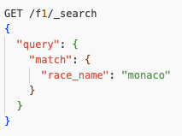
Query Language & API
RESTful API
Operation carried out via HTTP Request (GET, POST, PUT, DELETE)
Query DSL
JSON domain-specific language for building queries
Types: match (full-text), term (exact), bool ( compound), range (numeric, date), fuzzy and aggs (aggreagation)
Notes:
GET -> HTTP Methode +index name + endpoint
Query -> QueryDSL Body
Match-> Query type: full-text search
field: search value Query gets all documents of driver results where the race_name is monaco
Match - full-text search, finds "Monaco Grand Prix" by typing "monaco”
Fuzzy - tolerates typos, "Hamilten" still finds "Hamilton”
Bool - combines conditions, like SQL WHERE with AND/OR
Aggregation - group and count, like SQL GROUP BY

Slide 12
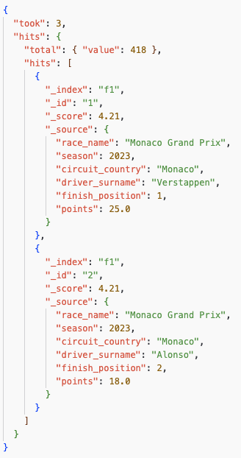
Query Language & API
Notes:
The key fields worth pointing out on your slide:
took — how many milliseconds the query took (3ms!)
total.value — total number of matching documents (418 — remember, one per driver result)
_score — the relevance score, higher = better match
_source — the actual document data you indexed

Slide 13
Usecases
Application with search functionality
Blog posts, Product catalogs, log files, …
Log and Event Data Analysis
Real-time analysis
Detect anomalies
Business Analytics
Geospatial Search
Notes:
Aggregations over sales figures, user behavior or financial records generate dashboards and reports without requiring a separate BI platform. Aggregationen von Verkaufszahlen, Nutzerverhalten oder Finanzdaten ermöglichen die Erstellung von Dashboards und Berichten, ohne dass eine separate BI-Plattform erforderlich ist.
geo_point fields allow proximity quer ies, radius filters and map-based visualizations — used in booking platforms, logistics and asset tracking
Geospatial Search GEODATEN SUCHE ermöglicht die Suche und Filterung von Daten anhand geografischer Koordinaten, wie zum Beispiel das Anzeigen aller F1-Strecken auf einer Weltkarte.

Slide 14
Advantages & Disadvantages
Horizontal scalability
Real-time search and analytics
Different Methods to query data (with Query DSL)
Ecosystem (Kibana)
Complex Setup
Resource intensive
No ACID transactions
Notes:
Horizontal scalability — new nodes can be added to a cluster at any time to absorb growing data volumes and query loads.
Near real-time search and analytics — the inverted index delivers results across terabytes of data in milliseconds.
Flexible Query DSL — supports full-text, fuzzy, geo, bool, range and aggregation queries all in one system.
Rich ecosystem — Kibana, Logstash and Beats cover visualization, ingestion and data shipping out of the box.
Complex setup — cluster sizing, JVM tuning, shard allocation and security configuration demand significant expertise.
Resource intensive — even moderate deployments require substantial CPU, memory and disk; under-provisioning causes instability.
No ACID transactions — only eventual consistency, making it unsuitable for use cases that require strict data integrity.

Slide 15

Project
Dataset of the F1 World Championship 1950 – 2024 used
https://www.kaggle.com/datasets/jtrotman/formula-1-race-data
Load data into Elasticsearch and query with an Python script
Visual data with Kibana
Elasticsearch & Kibana running in a Docker-Container
ES: http://localhost:9200
Kibana: http://localhost:5601

Slide 16
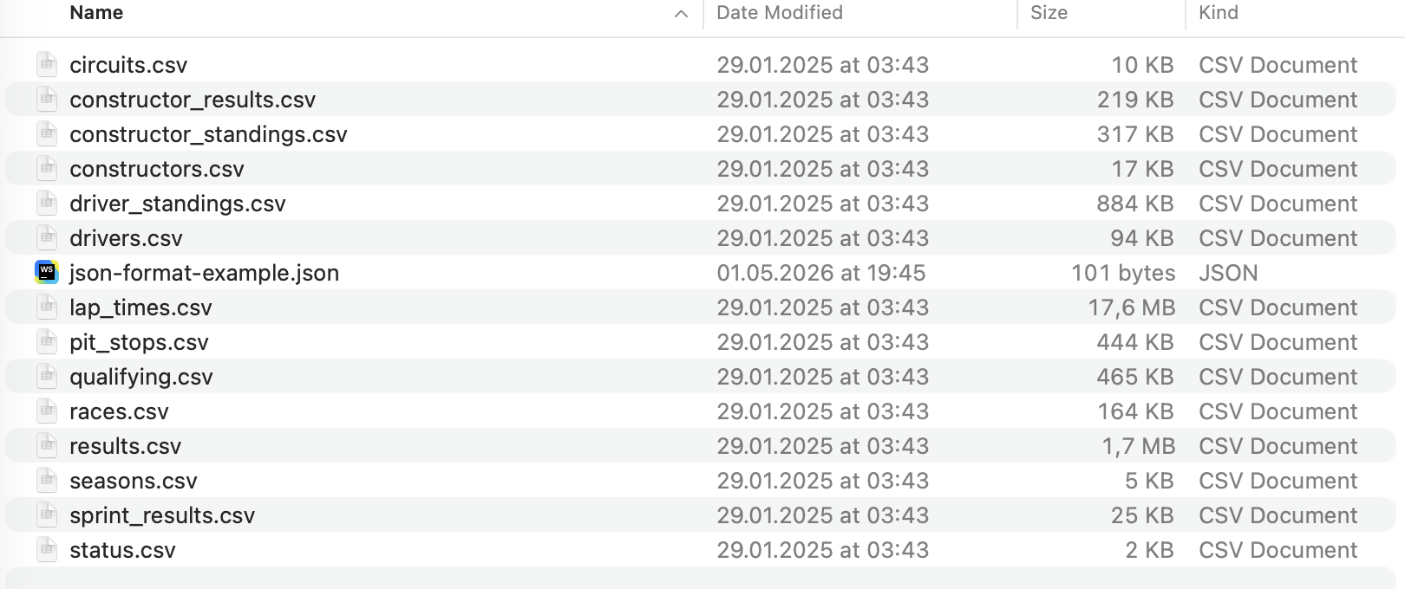
Project - Procedure
Inserter
Connect to Elasticsearch
Load relevant CSV files
Merge all 6 dataframes into one flat struture
Creates one document for each race result row
Create fresh index with mapping
Send all documents in batches of 500
Notes:
Load CSV : Read 6 CSV files into pandas dataframes
The mapping defines the data types of every field before any data is inserted – comparable to CREATE TABLE in sql
The relevant CSV files are loaded into pandas dataframes. The program then merges all dataframes into a single flat table, because Elasticsearch works best with flat documents rather than relational structures. This merged table is then iterated row by row, and for each race result row one document is created containing all additional information like points, circuit, constructor and so on. These documents are then bulk inserted into Elasticsearch.

Slide 17
Project - Procedure
Queries
Run queries with the Python script
search_race_by_name()
search_driver_fuzzy()
filter_races_by_country()
...
Notes:
Load CSV : Read 6 CSV files into pandas dataframes
The mapping defines the data types of every field before any data is inserted – comparable to CREATE TABLE in sql

Slide 18
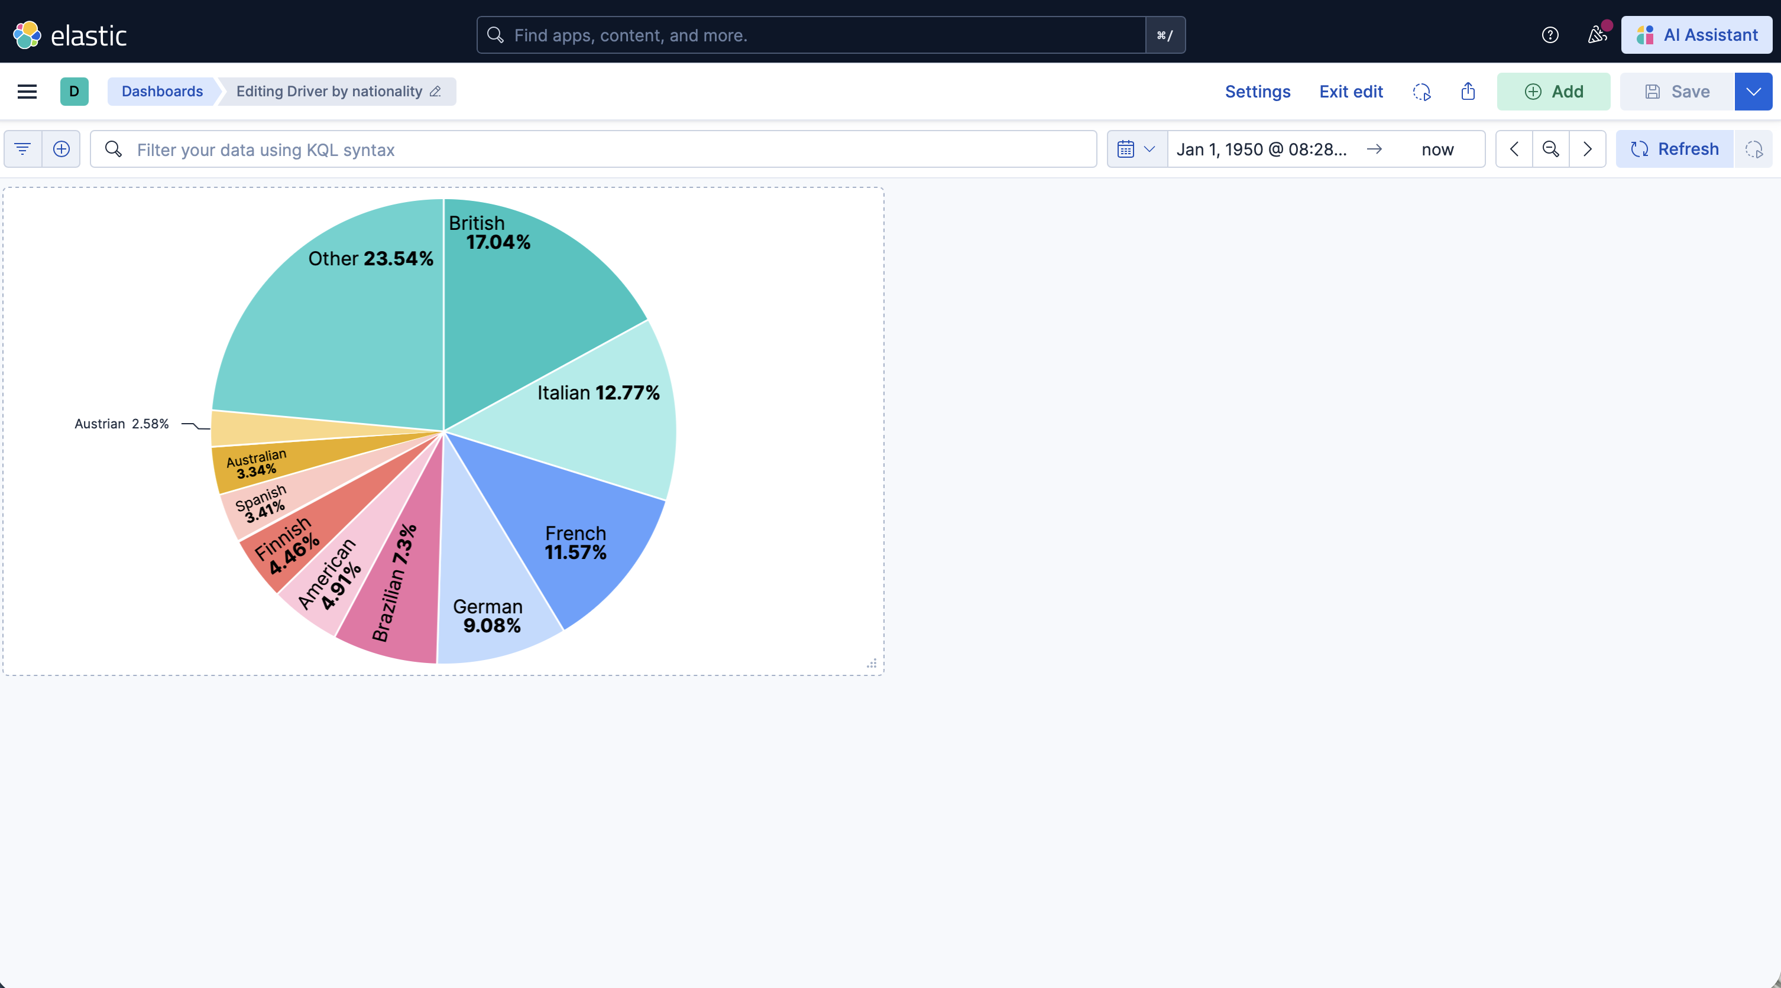
Project - Visualization
Kibana
Dashboard for visualization
Notes:
Load CSV : Read 6 CSV files into pandas dataframes
The mapping defines the data types of every field before any data is inserted – comparable to CREATE TABLE in sql

Slide 19
Thanks for your attention
Any questions?

Slide 20
Sources
https://www.purestorage.com/knowledge/elasticsearch-architecture.html
https://www.geeksforgeeks.org/elasticsearch/elasticsearch-architecture/
https://www.geeksforgeeks.org/elasticsearch/what-is-elastic-search-and-why-is-it-used/
https://www.elastic.co/elasticsearch/features
https://www.elastic.co/kibana

