Slide 1

Mobile Application

Slide 2

Table of Contents
Introduction
Context
Design
Landing Page
Audience Page
Presentation Page
Create Presentation Dialog

Slide 3

Introduction
Unser Ziel:
Problem: Herausforderungen bei traditionellen Präsentationsmethoden
Lösung: Eine nahtlose Plattform für Präsentatoren und Zuhörer
Wichtigkeit effektiver Kommunikation und Wissensteilung
Unsere App:
Vereinfacht Präsentationsinitiierung und -navigation für Präsentatoren
Bietet bequemes und interaktives Zuhören für das Publikum
Förderung von Engagement, Zusammenarbeit und Wissensteilung
Notes:
This Project describes the user interface design of the application, which is designed to be simple, intuitive, and user-friendly. It provides an overview of the main pages and their components, along with wireframes and next steps for further improvement.

Slide 4
Context
Target Audience: Presenters and audience members.
Every user can be a presenter or part of the audience.
Presenters initiate presentations, and other users can follow.
The app displays a searchable list of ongoing presentations with thumbnails and titles.

Slide 5

Design
The application follows the principles of Material Design and aims to provide a consistent and visually appealing user experience. It consists of the following main pages:
Landing Page
Audience Page
Presentation Page
Create Presentation Dialog

Slide 6
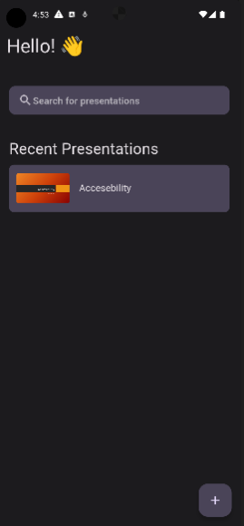
Landing Page
The initial page that users see upon opening the app.
It shows a searchable list of ongoing presentations.
Each presentation card includes a thumbnail, title, and can be clicked to start watching.
The "FAB" (Floating Action Button) in the bottom right corner allows users to upload a new presentation.
Notes:
The Landing Page is the initial screen that users see when they open the application. It displays a greeting message and allows users to search for presentations or create a new presentation.

Slide 7
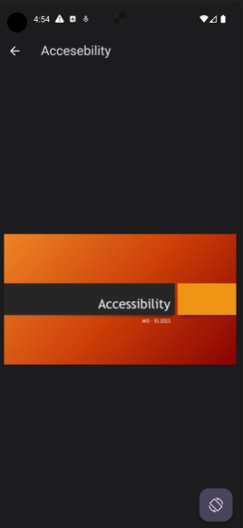
Audience Page
The page where audience members view the active slide of the presentation.
Supports both landscape and portrait modes.
Manual switching between modes using a button at the bottom of the navigation bar.
This page also includes a button to leave the presentation and return to the landing page.
Notes:
The Audience Page is displayed when a user selects a presentation from the list on the Landing Page. It shows the active slide of the presentation and allows users to navigate through the slides. Users can also change the orientation of the presentation between vertical and horizontal modes.

Slide 8
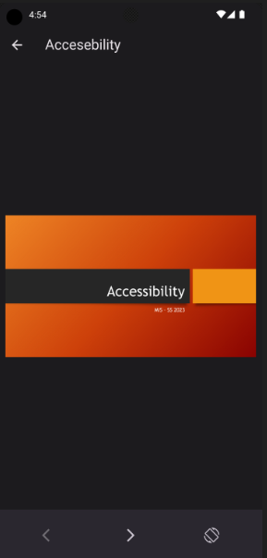
Presentation Page
The page visible to the presenter during the presentation.
Supports both landscape and portrait modes.
Allows presenters to navigate between uploaded slides, edit the title, and end the presentation.
Confirmation is required to leave the presentation, preventing accidental closure.
Notes:
The Presentation Page is displayed when a user creates a new presentation. It shows the presentation document and enables users to navigate through the slides. Similar to the Audience Page, users can switch between vertical and horizontal orientations.

Slide 9
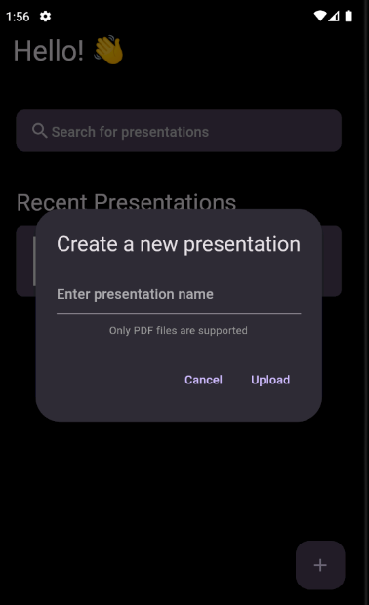
Create Presentation Dialog
Clicking the plus button on the landing page opens a pop-up to start a new presentation.
The pop-up provides information on supported file formats and includes a button to upload a file from the user's device.
Notes:
The Create Presentation Dialog appears when a user taps the floating action button (FAB) on the Landing Page. It allows users to create a new presentation by entering a presentation name and uploading a PDF file.

Slide 10
Color Scheme
The app incorporates the standard "Material 3" dark mode color palette.
The color scheme is designed to be easy on the eyes and does not distract the audience from the current slide.
It blends in with the bezels of the screen, ensuring a seamless viewing experience.

Slide 11

Thank you !
Any question ?

