Slide 1

Mobile Application
By Alex Djomo and Fabian Kirchhoff

Slide 2

Table of Contents
Introduction
Design
Landing Page
Create Presentation Dialog
Presentation Page
Audience Page
Demo
Next Steps

Slide 3
Introduction
Target Audience: Presenters and audience members.
Every user can be a presenter or part of the audience.
Presenters initiate presentations, and other users can follow.
The app displays a searchable list of ongoing presentations with thumbnails and titles.

Slide 4

Design
The application follows the principles of Material Design and aims to provide a consistent and visually appealing user experience. It consists of the following main pages:
Landing Page
Create Presentation Dialog
Presentation Page
Audience Page
Notes:
The app incorporates the standard "Material 3" dark mode color palette.
The color scheme is designed to be easy on the eyes and does not distract the audience from the current slide.
It blends in with the bezels of the screen, ensuring a seamless viewing experience.

Slide 5
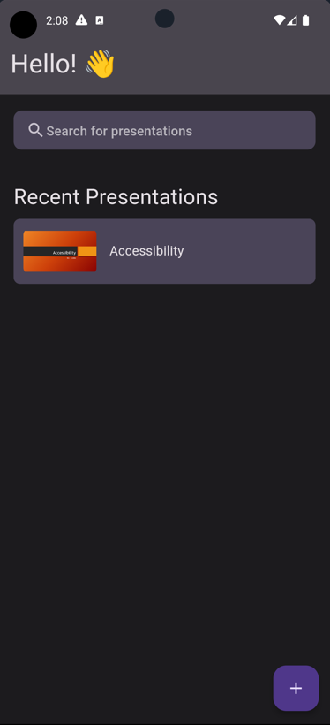
Landing Page
The initial page that users see upon opening the app.
It shows a searchable list of ongoing presentations.
Each presentation card includes a thumbnail, title, and can be clicked to start watching.
The "FAB" (Floating Action Button) in the bottom right corner allows users to upload a new presentation.
Notes:
The Landing Page is the initial screen that users see when they open the application. It displays a greeting message and allows users to search for presentations or create a new presentation.

Slide 6
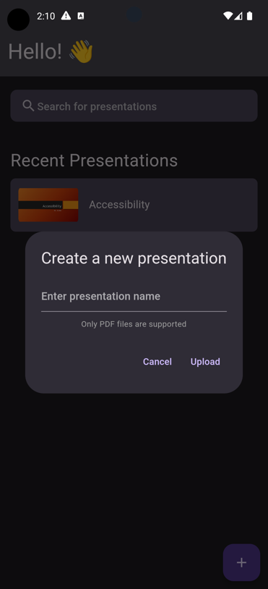
Create Presentation Dialog
Clicking the plus button on the landing page opens a pop-up to start a new presentation.
The pop-up provides information on supported file formats and includes a button to upload a file from the user's device.
Notes:
The Create Presentation Dialog appears when a user taps the floating action button (FAB) on the Landing Page. It allows users to create a new presentation by entering a presentation name and uploading a PDF file.

Slide 7
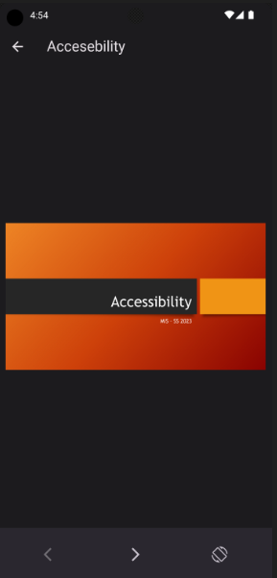
Presentation Page
The page visible to the presenter during the presentation.
Supports both landscape and portrait modes.
Allows presenters to navigate between uploaded slides, edit the title, and end the presentation.
Confirmation is required to leave the presentation, preventing accidental closure.
Notes:
The Presentation Page is displayed when a user creates a new presentation. It shows the presentation document and enables users to navigate through the slides. Similar to the Audience Page, users can switch between vertical and horizontal orientations.

Slide 8
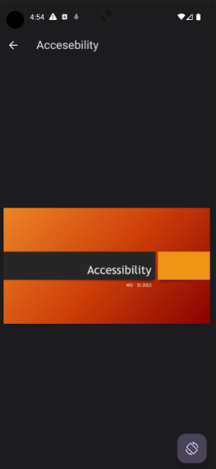
Audience Page
The page where audience members view the active slide of the presentation.
Supports both landscape and portrait modes.
Manual switching between modes using a button at the bottom of the navigation bar.
This page also includes a button to leave the presentation and return to the landing page.
Notes:
The Audience Page is displayed when a user selects a presentation from the list on the Landing Page. It shows the active slide of the presentation and allows users to navigate through the slides. Users can also change the orientation of the presentation between vertical and horizontal modes.

Slide 9
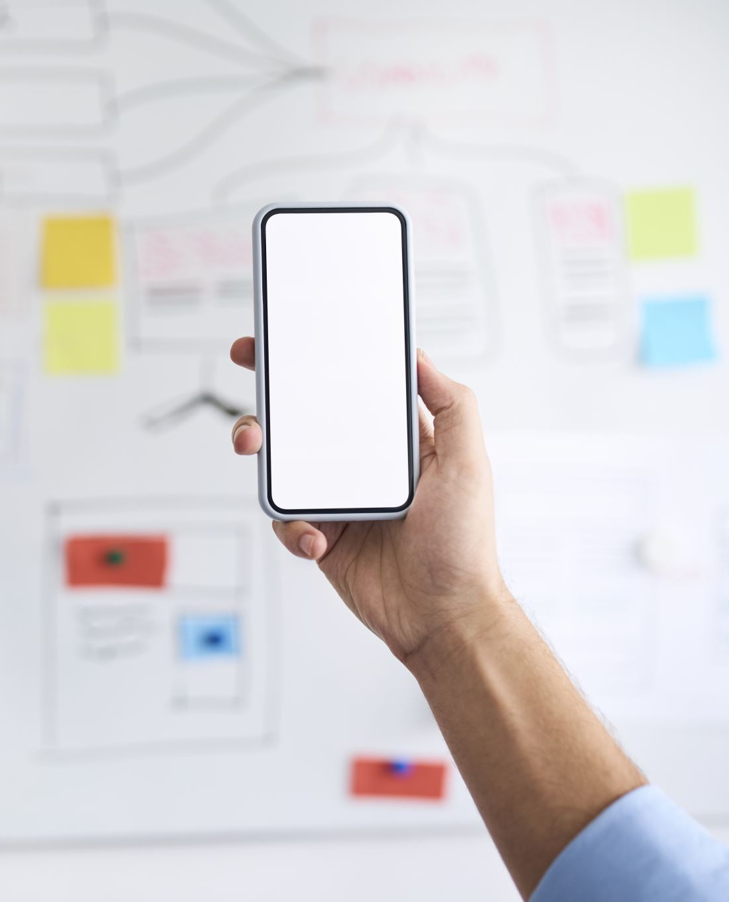
Demo
Now, let's proceed with a short demo of the application. I will showcase the app by running it on two emulators simultaneously.

Slide 10

Next Steps
While the current design meets the basic requirements of the application, there are several areas for future improvement. Some of the next steps include:
Making the presentation title unique: Implement a mechanism to ensure that presentation titles are unique, especially when multiple users are using the application.
Adding authentication: Introduce user authentication to allow users to have their own presentations and restrict access to specific users. Firebase Authentication could be utilized for this purpose.
Supporting multiple file types: Expand the application's file support beyond PDF files, such as adding compatibility for PowerPoint, Word, Excel, and other commonly used file formats.
Adding animations: Enhance the user experience by incorporating animations to make the application more interactive and visually engaging.
Improving error handling: Strengthen the error handling system, particularly for scenarios like failed file uploads. Provide informative error messages to users in case of errors or unexpected issues.
iOS support: Extend the application's compatibility to iOS devices, enabling a broader range of users to access and utilize the app.

Slide 11

Thank you !
Any question ?

