Slide 1
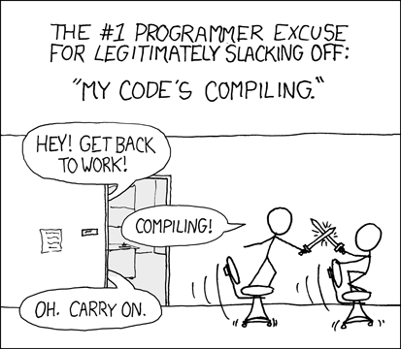

No Build
Making Javascript (and TypeScript) Fun Again
Fabian Paus
12+ years of C++ experience (backend services, robotics)
~3 years of web development
Currently working on customer IAM
https://xkcd.com/303/

Slide 2




Building Websites has Become Complex
Type checking and compiling TypeScript to JavaScript
Bundling multiple files into a single file, e.g. webpack
Minification and tree shaking, e.g. esbuild
Building CSS, e.g. tailwind
Polyfills, …

Slide 3
What is No Build?
Type checking and compiling TypeScript to JavaScript
Bundling multiple files into a single file, e.g. webpack
Minification and tree shaking, e.g. esbuild
Building CSS, e.g. tailwind
Polyfills, …

Slide 4
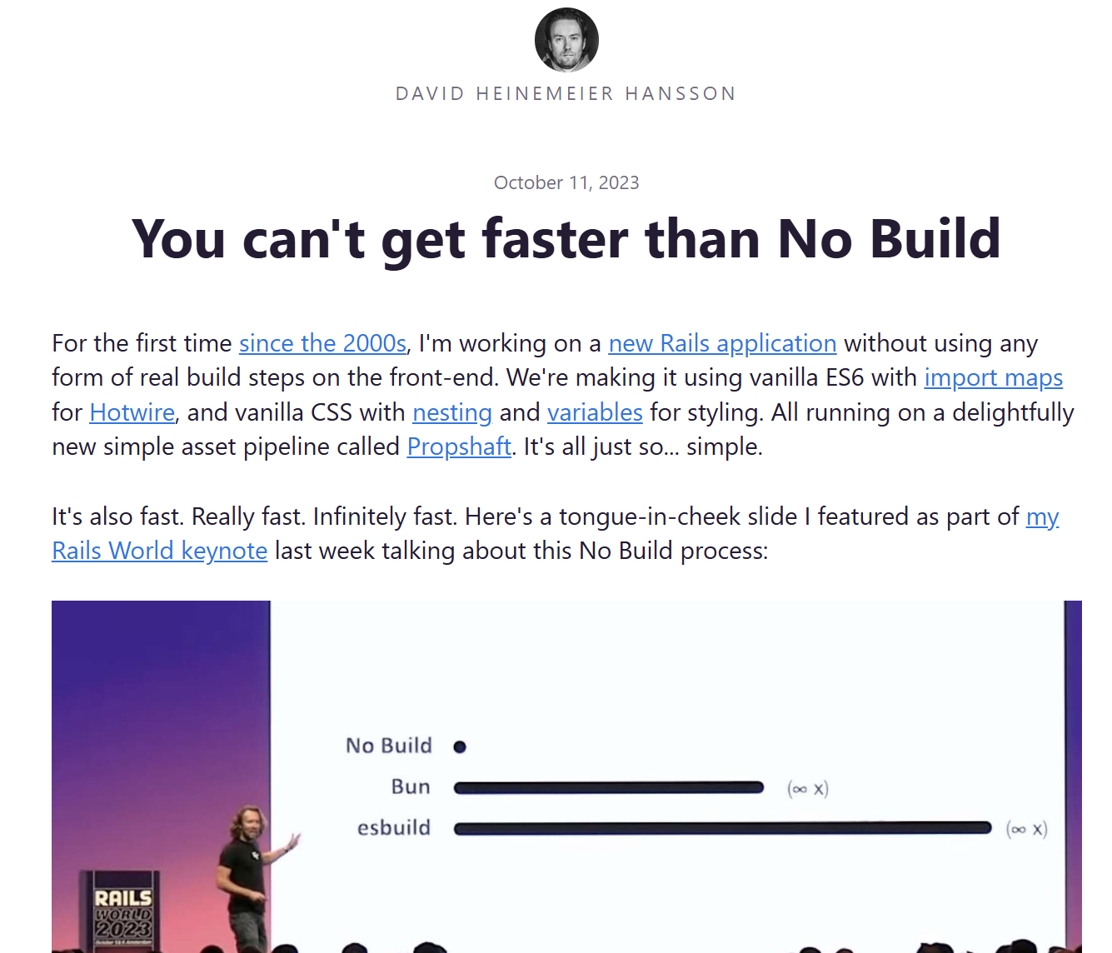
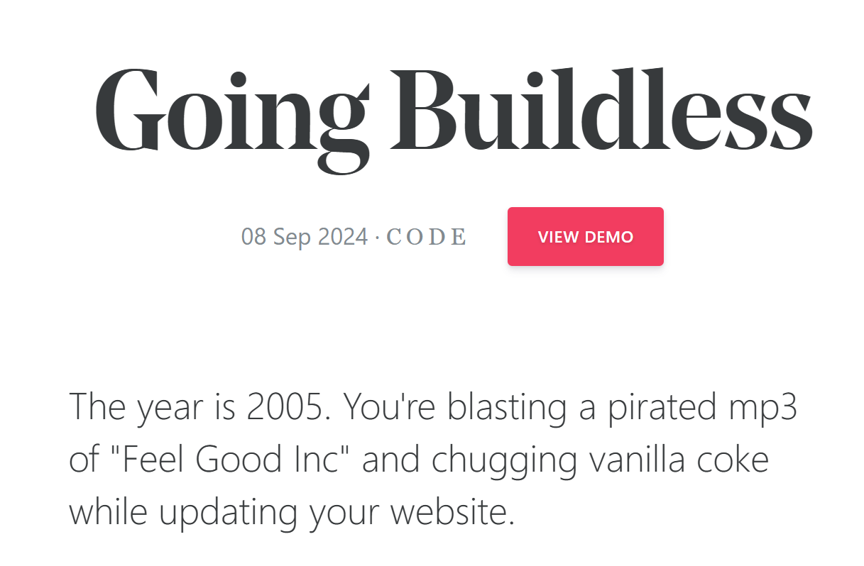
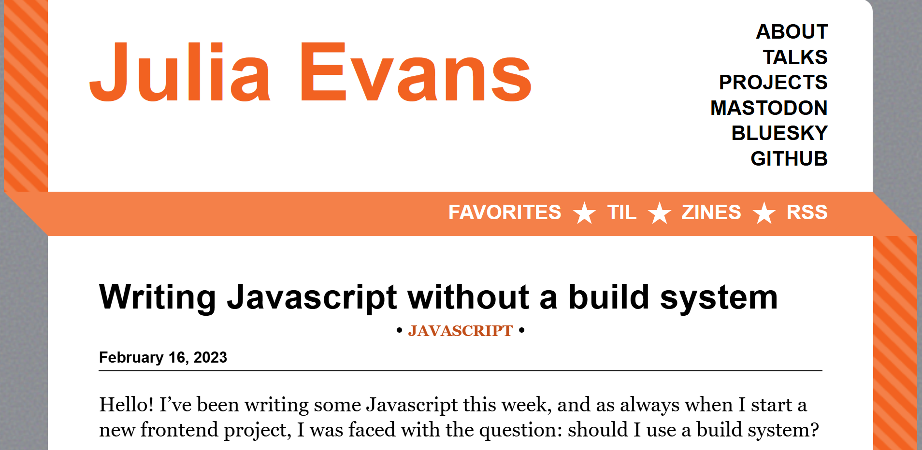

What is No Build?
🔨
A trend to build web applications without a build system
https://mxb.dev/blog/buildless/
https://jvns.ca/blog/2023/02/16/writing-javascript-without-a-build-system/
https://world.hey.com/dhh/you-can-t-get-faster-than-no-build-7a44131c

Slide 5
What is No Build?
🔨
A trend to build web applications without a build system
Plan for today:
How to type check without compiling
Why bundling is not as important as you think
Why you might consider not to minify

Slide 6
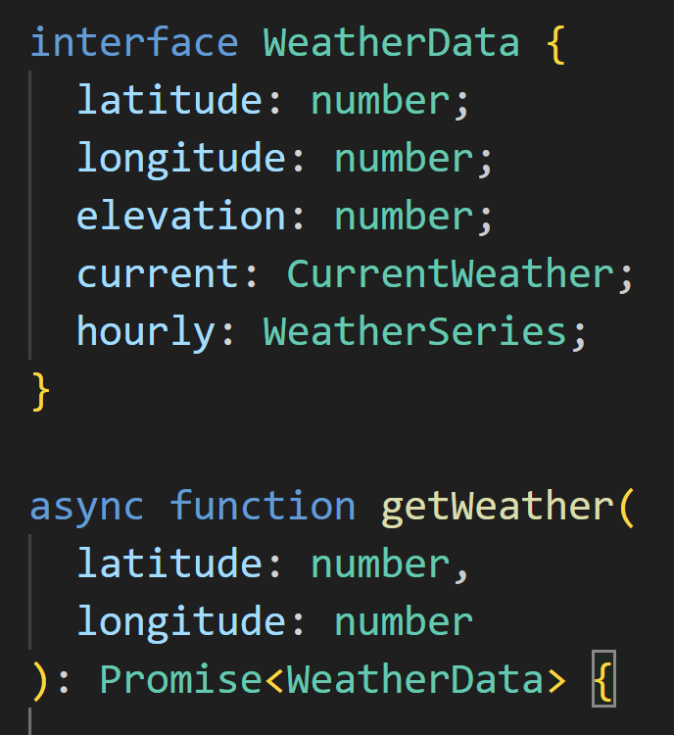
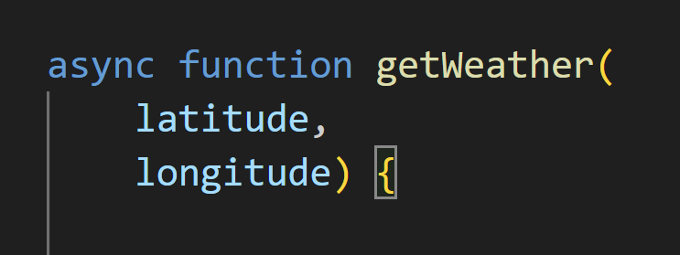
TypeScript: Type Checking for Javascript
TypeScript:
Define types
Annotate the code with types
➔ Catch errors at compile time
Javascript:

Slide 7




TypeScript: Compilation
TypeScript:
Javascript:
tsc
execute
TypeScript Compiler (tsc)
Checks for type errors
Removes all type annotations
Translates TypeScript specific constructs (enums, namespaces)
Javascript Runtime
Executes Javascript code
Provided by browsers, Node.js
Examples: V8, SpiderMonkey

Slide 8
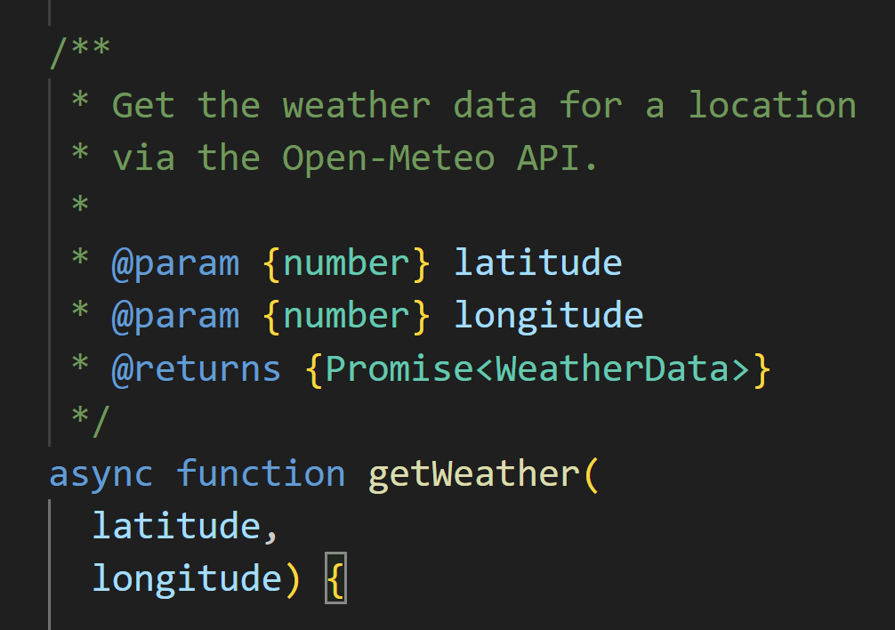
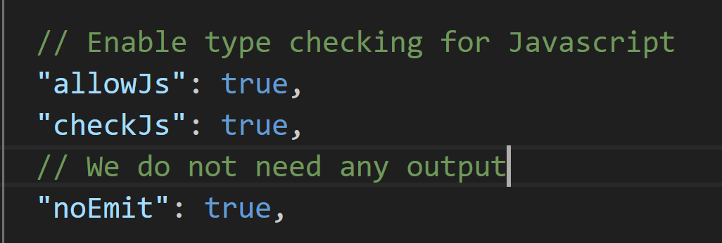
JSDoc: Annotate Types in Javascript
TypeScript:
Javascript with JSDOC:
execute
JSDoc
API documentation generator for Javascript
Plain Javascript with comments ➔ no translation
tsc and IDEs can type check your code
Almost as powerful as TypeScript (no enums, namespaces)
tsconfig.json

Slide 9
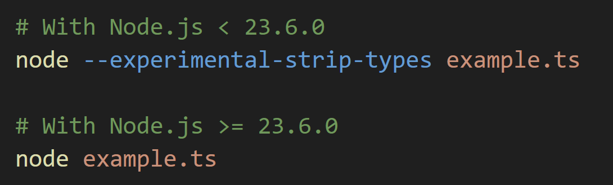
Node.js: Strip Types
TypeScript:
execute
--experimental-strip-types
Let’s you execute TypeScript directly
Replaces annotations with whitespace
No type checking
Default starting with Node.js 23.6

Slide 10
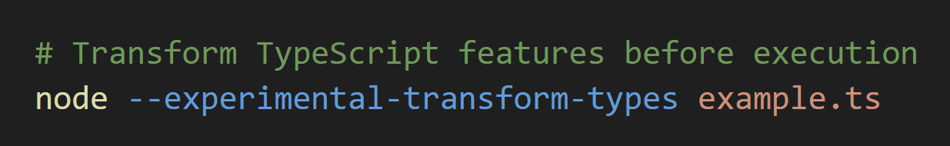
Node.js: Transform TypeScript
TypeScript:
execute
--experimental-transform-types
Let’s you execute TypeScript directly
Transforms TypeScript features (enums, namespaces)
Requires source maps for debugging

Slide 11

Demo: Type Checking without Build Step
Simple script to get the current temperature
Query the Open-Meteo API
Parse the results (JSON)
Output the current temperature
TypeScript with and without build step
Javascript with JSDoc

Slide 12
What is No Build?
🔨
A trend to build web applications without a build system
Plan for today:
How to type check without compiling
Why bundling is not as important as you think
Why you might consider not to minify

Slide 13


What is Bundling?
ui.js
bundle
deploy
serve
weather.js
bundled.js
blog.js
Server
Bundle all your Javacript files into a single file
This bundle is deployed to your server
Browsers only need to download one Javascript file
Reduce round trips between browser and server
Resolve dependencies at bundle time (import, require)

Slide 14

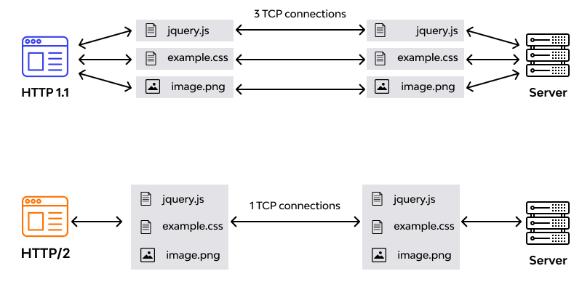
Performance Improvements?
Bundling: Only one file needs to be downloaded ➔ One HTTP GET request, one network connection
HTTP 2.0: Only one TCP connection
Caching for bundled code:
A change in a single source file invalidates the complete bundle
Browser needs to download the complete bundle
Caching for non-bundled code:
Only the changed files are invalidated
Download size can be much smaller
Notes:
Have you actually measured that bundling makes your website load faster? Even after small updates?

Slide 15
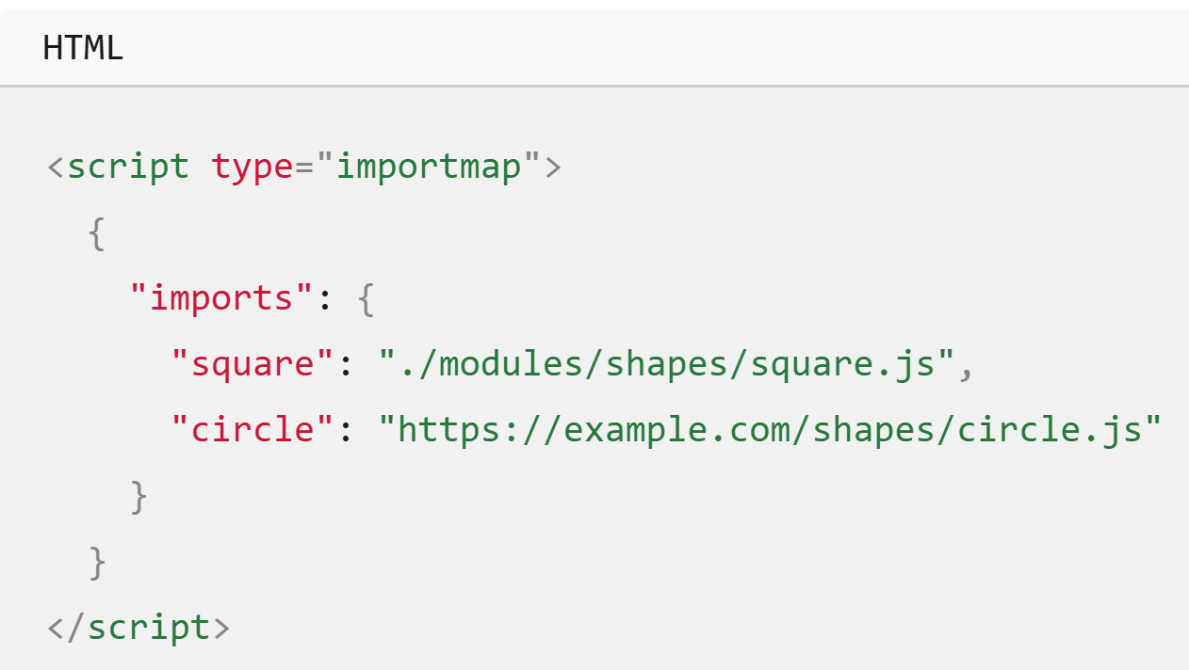
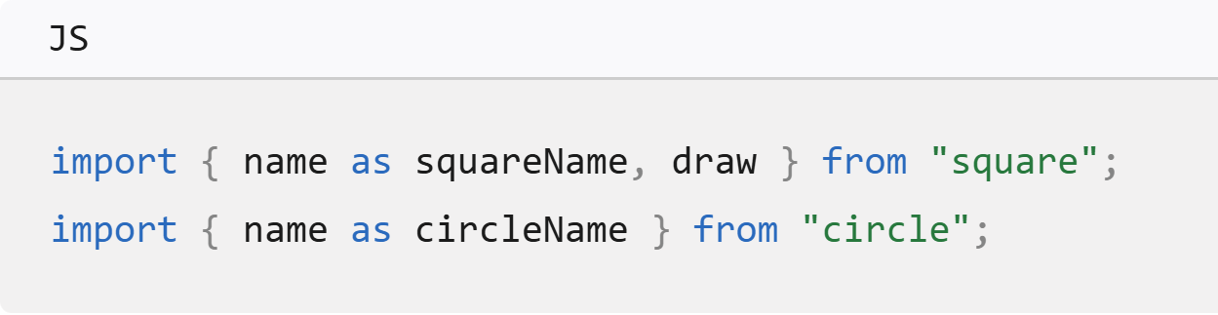
Import Maps for Dependency Resolution
Resolving dependencies via import maps
Use modern ESM syntax to declare dependencies (import)
Define file locations in HTML

Slide 16
What is No Build?
🔨
A trend to build web applications without a build system
Plan for today:
How to type check without compiling
Why bundling is not as important as you think
Why you might consider not to minify

Slide 17
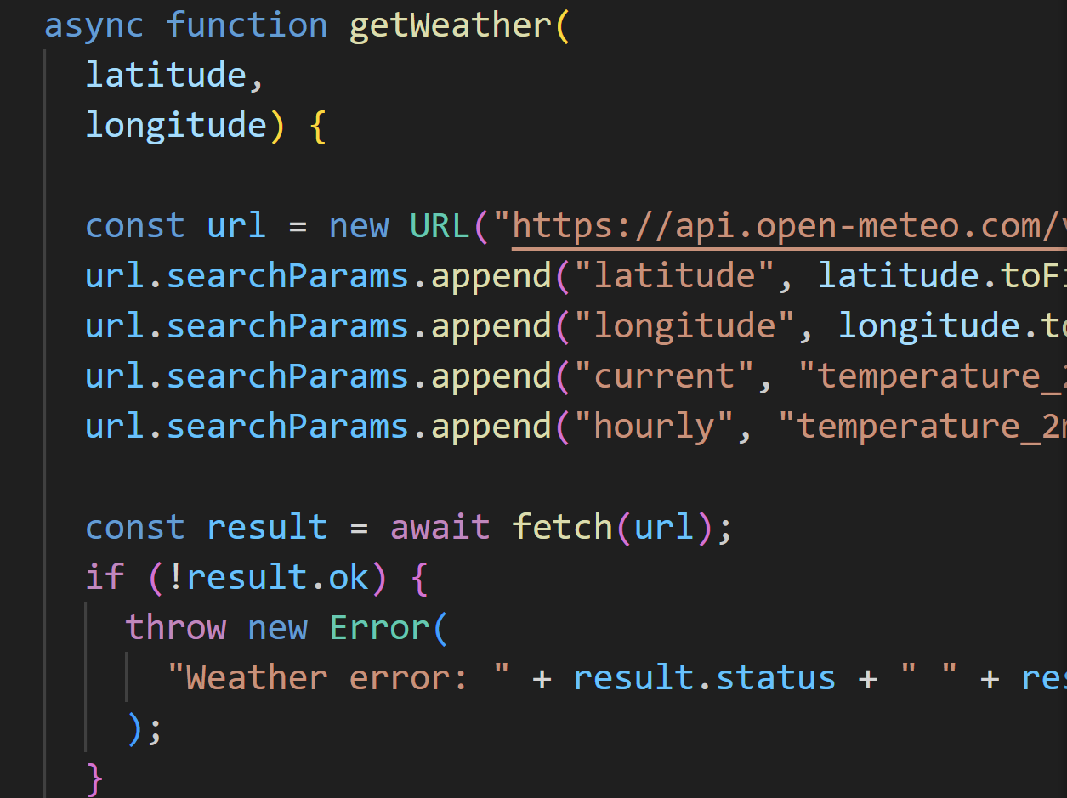
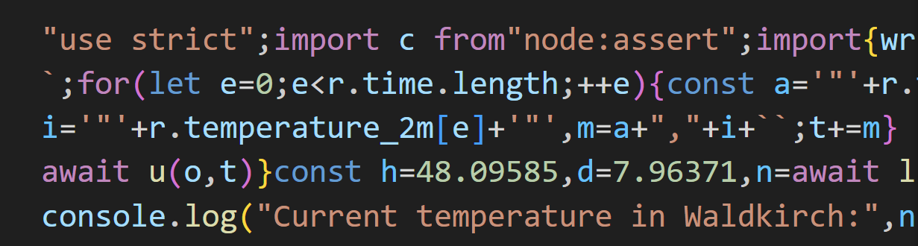
What is Minification?
minify
execute
Reduce code size by:
Removing comments and whitespace
Shorten variable and function names
➔ Does not affect how the browser executes the code

Slide 18

Why not to Minify?
It becomes difficult to learn and discover:
New developers see an awesome websites
They want to know how they work → View Source
They see this gibberish
For our and the web’s future, it’s the morally right thing to do!
Notes:
For our and the web’s future it is moral to not minify

Slide 19
What is No Build?
🔨
A trend to build web applications without a build system
Plan for today:
How to type check without compiling
Why bundling is not as important as you think
Why you might consider not to minify

Slide 20



Thanks for your Attention!
Example project on GitHub:
https://github.com/fabian-paus/no-build-introduction
Blog posts:
https://world.hey.com/dhh/you-can-t-get-faster-than-no-build-7a44131c
https://jvns.ca/blog/2023/02/16/writing-javascript-without-a-build-system/
https://mxb.dev/blog/buildless/
Videos:
Interview with DHH: https://www.youtube.com/watch?v=mTa2d3OLXhg&t=3000s
Ruby on Rails 2023: https://youtu.be/iqXjGiQ_D-A?t=1663

