Slide 1
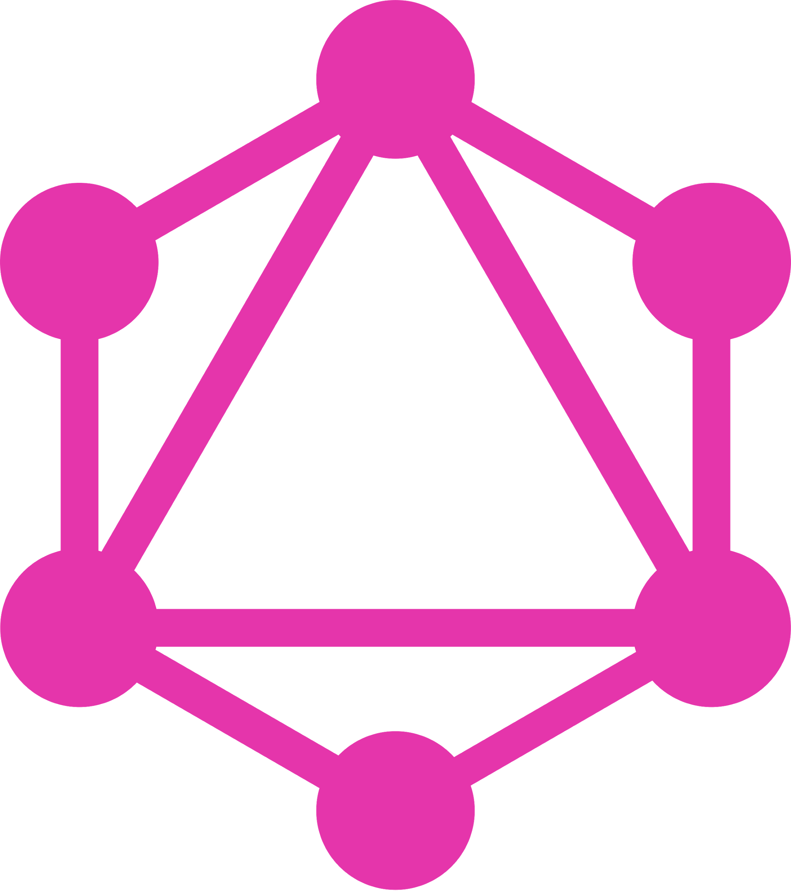
GraphQL
What is it and why should we care?

Slide 2
Agenda
How are we doing things at the moment?
How does GraphQL work?
GraphQL and Apollo
Show me the code

Slide 3
Rest
Each endpoint is defined by a URL, within this endpoint you define exactly what you will get back from this endpoint
Every action of the same domain (e.g. books) has a different endpoint
/books -> gets all books
/books/:id/comments -> gets all book comments
With this we end up
Over and under fetching data because endpoints return fixed data structures
Over creating endpoints
Slow product iteration because of time spent creating new endpoints

Slide 4
Rest - Example
Frontend -> I need to display a list of all users with their information
/users -> returns a list of all users
Frontend -> I need to display only the first and lastname of users in a list
/users -> get all users?
/users/fullnam -> create a new endpoint to only deliver what we need?

Slide 5
Here comes GraphQL
Has strong type system
Query based data fetching, you get what you request (also in the same format
Can be fetched like a normal http request with params
Rapid product iteration
No endpoint versioning
Powerful tooling like docs, dev tools etc.

Slide 6
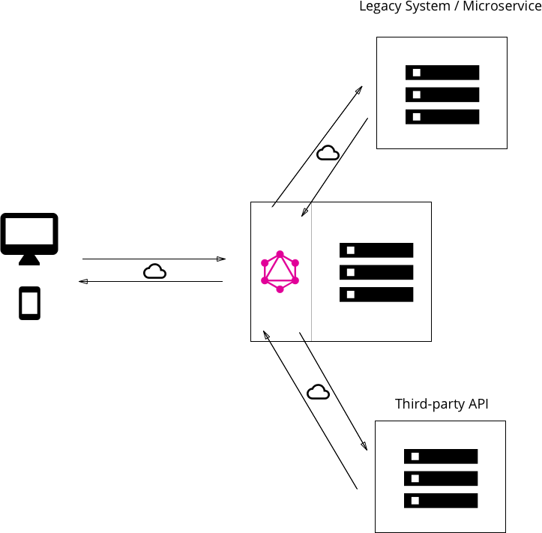
GraphQL architecture

Slide 7
How to GraphQL
Types
Queries
Mutation
Resolver
Schema

Slide 8
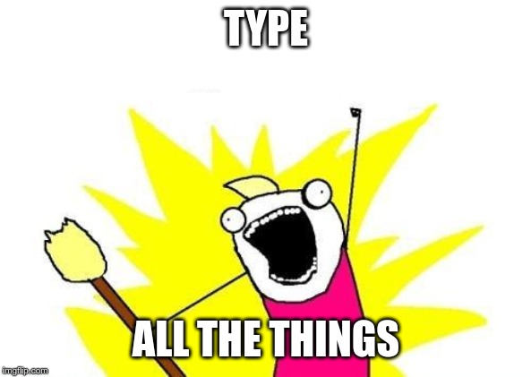
GraphQL - types
type Booking {
id: String
status: String
}
type Query {
bookings: [Booking]!
}
type Mutation {
addBooking(booking: Booking): Booking
}

Slide 9
GraphQL - Queries
const Query = {
bookings: async () => {
const bookings = await database.findBookings(); // Basically anything here
return bookings;
}
};

Slide 10
GraphQL - mutation
const Mutation = {
addBooking: (booking: Booking) => {
database.addBooking(booking); // Again, anything possible here
return booking;
}
};

Slide 11
GraphQL - resolvers
import BookingQuery from "./booking.query";
import BookingMutation from "./booking.mutations";
const resolver = {
Mutation: BookingMutation,
Query: BookingQuery
}

Slide 12
GraphQL - schema
import resolvers from "./booking.resolver";
import typeDefs from "./booking.types";
const executableSchema = makeExecutableSchema({
Resolvers,
typeDefs
});

Slide 13
GraphQL & Apollo
Apollo...
… is build on top of GraphQL
… is a GraphQL toolkit
… offers a GraphQL client, server and engine
… comes with out-of-the-box websockets

