Slide 1
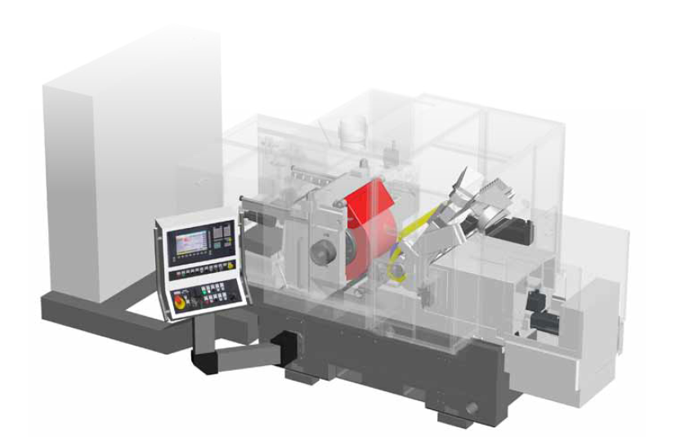
Kronos M Grinding Machine by Mikrosa
Grinding Wheel
Dressing Unit
Control System
Regulating Wheel

Slide 2
3 Positions: J2, J3, J4
At each position:
Body Mass Acceleration Sensor
Mechanical Vibration Sensor
Microphone

Slide 3
Highest Accuracies with Time, Frequency and Time Frequency Features – Random Forest Algorithm
Highest Achieved Accuracies for each Process
and Corresponding Sensor Positions
Highest Achieved Accuracies - Position J2
Highest Achieved Accuracies - Position J4

Slide 4
Results for Different Algorithms and Sensor Data – Position J2
Riemenspannung
Spektrum
Luftschleifen
Abrichten

Slide 5
Results Using a Small Number of Time Features for Computing Efficiency - Riemenspannung, Spektrum
Riemenspannung J2 - Time Features Random Forest - KS
Set (No. Features) | Features
S1 (1) | Variance
S2 (1) | Kurtosis
S3 (2) | Variance Kurtosis
S4 (2) | Kurtosis Max.
S5 (3) | Variance Kurtosis Min.
Spektrum J2 - Time Features, Random Forest - BMA+KS
Set (No. Features) | Features
S1 (1) | KS - Zero Crossing Rate
S2 (1) | BMA - x Mean
S3 (2) | KS - Zero Crossing Rate BMA - x Mean
S4 (2) | KS - Mean BMA - x Mean
S5 (2) | KS - Kurtosis KS - Zero Crossing Rate
S5 (3) | BMA - x Mean KS - Zero Crossing Rate KS - Kurtosis
S6 (3) | KS - Kurtosis KS - Mean KS - Skew
S7 (3) | BMA - Lin. Corr. Coeff. xz KS - Zero Crossing Rate BMA - x Mean

Slide 6
Results Using a Small Number of Time Features for Computing Efficiency - Luftschleifen
Luftschleifen J2 - Time Features, Random Forest - BMA
Set (No. Features) | Features
S1 (1) | x Mean
S2 (2) | x Mean Lin. Corr. Coeff. yz
S3 (2) | x Mean z Zero Crossing Rate
S4 (3) | x Mean Lin. Corr. Coeff. xz z Min.
S5 (3) | x Mean z Zero Crossing Rate z Min.
S6 (4) | x Mean z Zero Crossing Rate z Min. z Variance
S7 (4) | x Mean z Min. Lin. Corr. Coeff. zx z Zero Crossing Rate

Slide 7
Results Using a Small Number of Time Features for Computing Efficiency - Abrichten
Abrichten J2 - Time Features, Random Forest - BMA+KS
Set (No. Features) | Features
S1 (1) | KS - Mean
S2 (2) | BMA - z Variance
S3 (2) | BMA - z Variance KS - Zero Crossing Rate
S4 (2) | BMA - z Variance BMA - y Variance
S5 (3) | KS - Zero Crossing Rate BMA - y Variance BMA - Lin. Corr. Coeff. yx
S6 (3) | BMA - z Variance BMA - y Variance KS - Mean
S7 (3) | KS - Zero Crossing Rate KS - Mean BMA - z Variance
S8 (4) | KS - Mean BMA - y Variance BMA - z Variance KS - Zero Crossing Rate

Slide 8
Results using Amplitude Independent Features for Working Material Independent Classification
Spektrum – Position J2
Luftschleifen – Position J2

Slide 9
Results with Noisy Data
Mixed Features Time Features
Riemenspannung
Spektrum
Mixed Features Time Features

Slide 10
Mixed Features Time Features
Luftschleifen
Mixed Features Time Features
Abrichten

