Slide 1
Image and Video Analysis Exam OpenPose to Robotics
University of Florence, Italy
15 July 2019
Fabian Greavu
Lorenzo Pisaneschi

Slide 2
What is OPtoROBO?
OPtoROBO is an entertainment system that makes you able to drive an RC car.
It works simply with a webcam that detects gestures used to control the car.
When you start OPtoROBO a simple User Interface helps you in driving experience.
There is also an «On Board Cam» that shows you where the car is going.

Slide 3
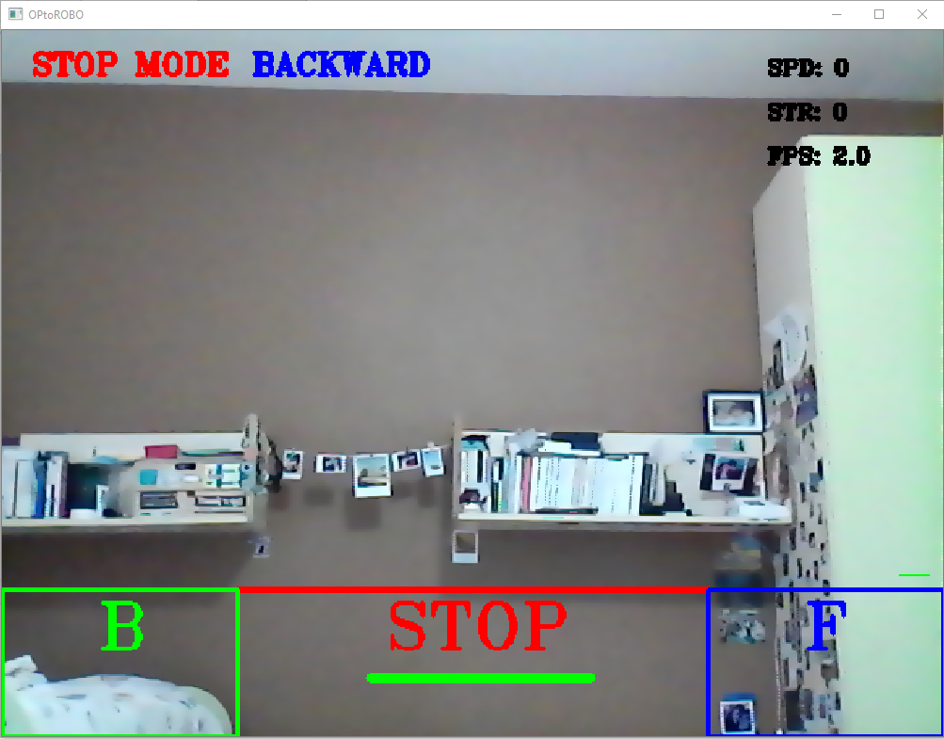
User Interface
1. Mode selected
2. Direction selected
3. Speed, steering angle and FPS processed info
4. Backward zone
5. Stop zone
6. Steering wheel
7. Forward zone
8. Speedometer
9. Drive zone
1
2
3
9
8
5
6
7
4

Slide 4
Gestures List
OPtoROBO car driving version works with the left and right wrist detection. All is made with these coordinates points.
STOP: both left and right wrist in «Stop Zone»
SELECT DIRECTION : Left wrist in B (Backward) or right wrist in F (Forward)
ACCELERATION: Aligned left and right wrist in drive zone
STEERING: «Steering wheel gestures» in drive zone for steering left/right
QUIT APPLICATION: Left wrist in B and right wrist in F for 4 sec

Slide 5
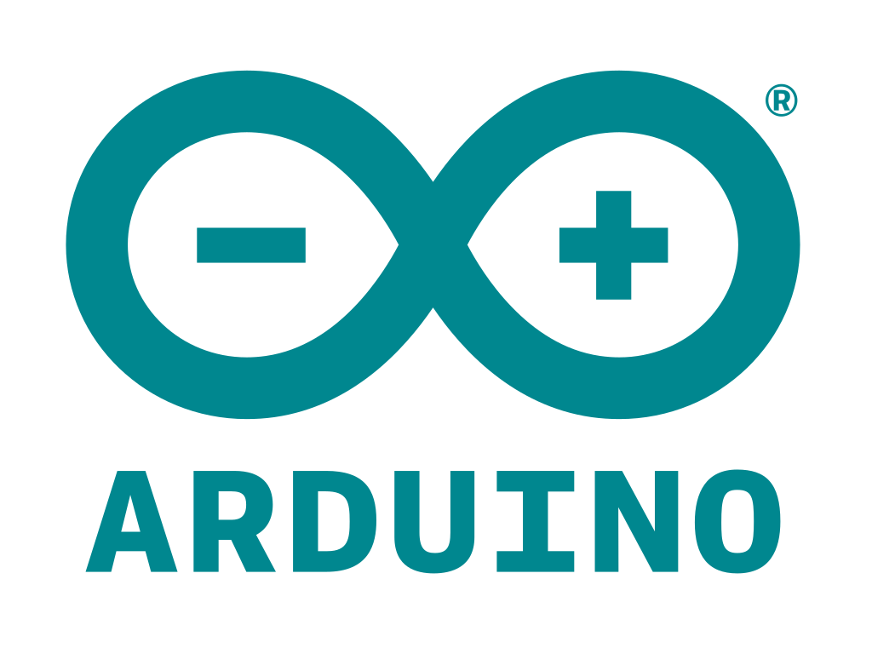

Technologies Hardware
Arduino components which are car controllers
Bluethoot module that allows sending signals from PC to Arduino’s car components

Slide 6
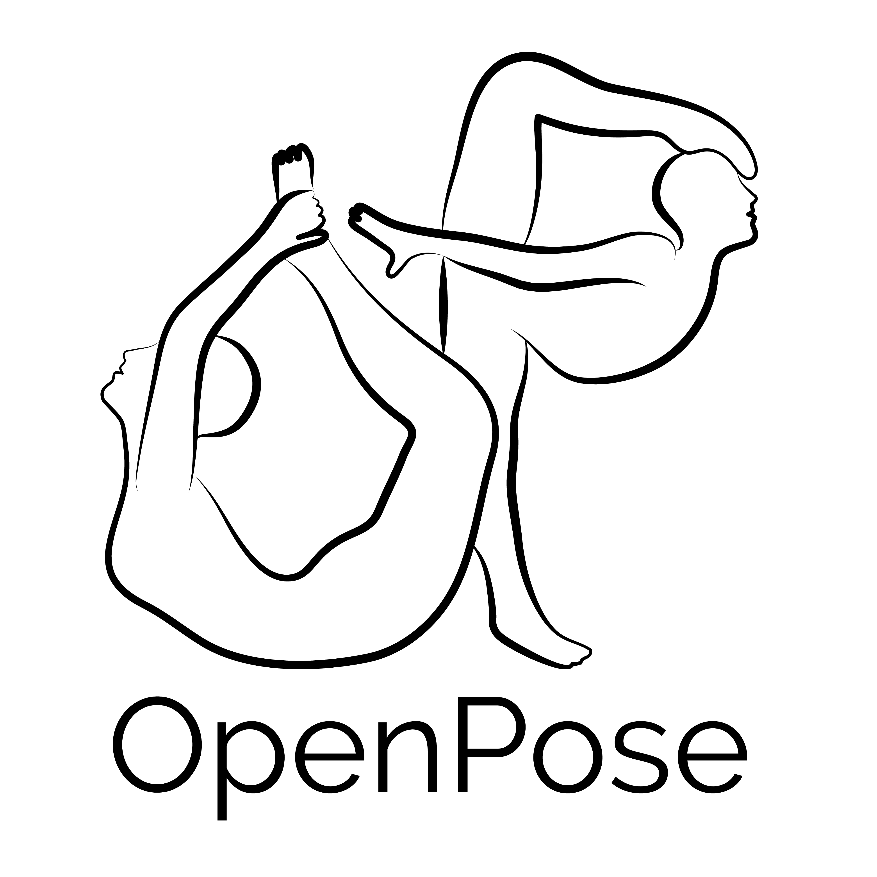


Technologies Software
The code is all implemented in Python (using libraries that interfaces the Arduino controllers with Python itself).
Openpose library is used or the real-time people detection and pose estimation in OPtoROBO application
OpenCV library is used for frame processing

Slide 7
Implementations
All the gestures are mapped from frames captured by webcam
The wrist coordinates detected by OP are saved in arrays and used to compute speed, steering angle, select drive directions or quitting OPtoROBO application.
A steering wheel line shows the user gestures
The gestures are computed processing frames; then they are mapped in signals for Arduino controller

Slide 8
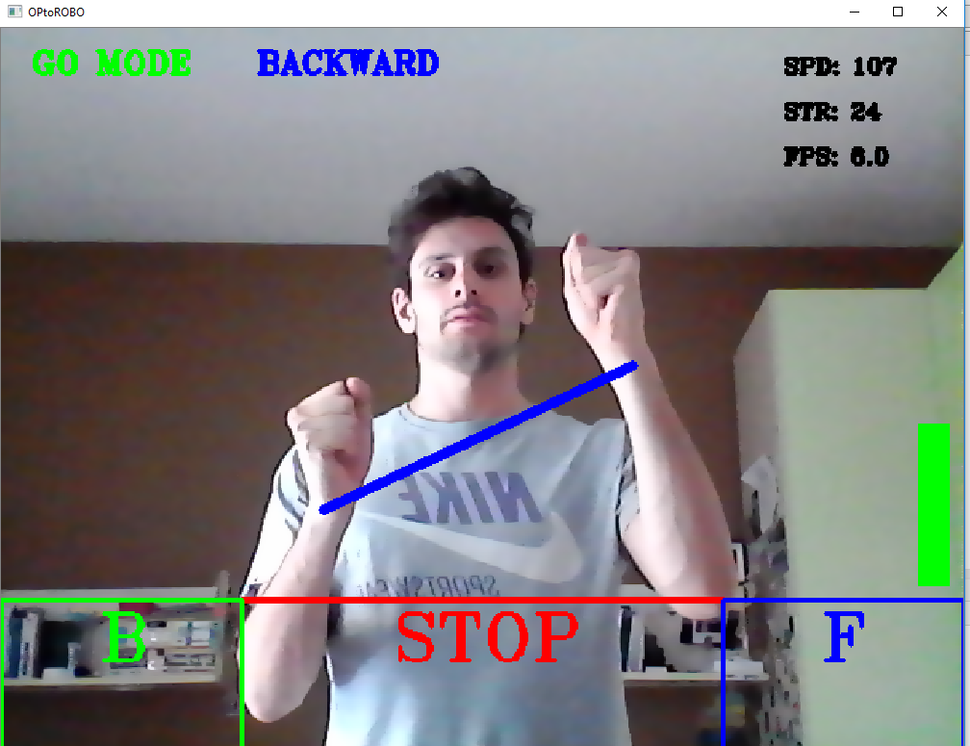
Driver Interface

Slide 9
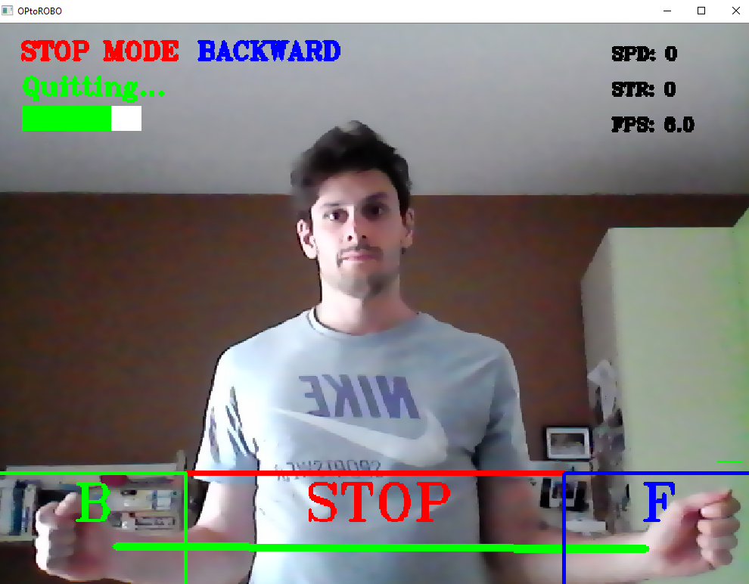
Quit OPtoROBO gesture

Slide 10
Optimization on Real-Time wirst positions
OPtoROBO provides error detection on wrist points positions individuated by OP
This error detection allows the correction on speed and steering angle computation
If the speed variation is too big, it’s maintained the last one. The same procedure is done with steering angle variation.

Slide 11
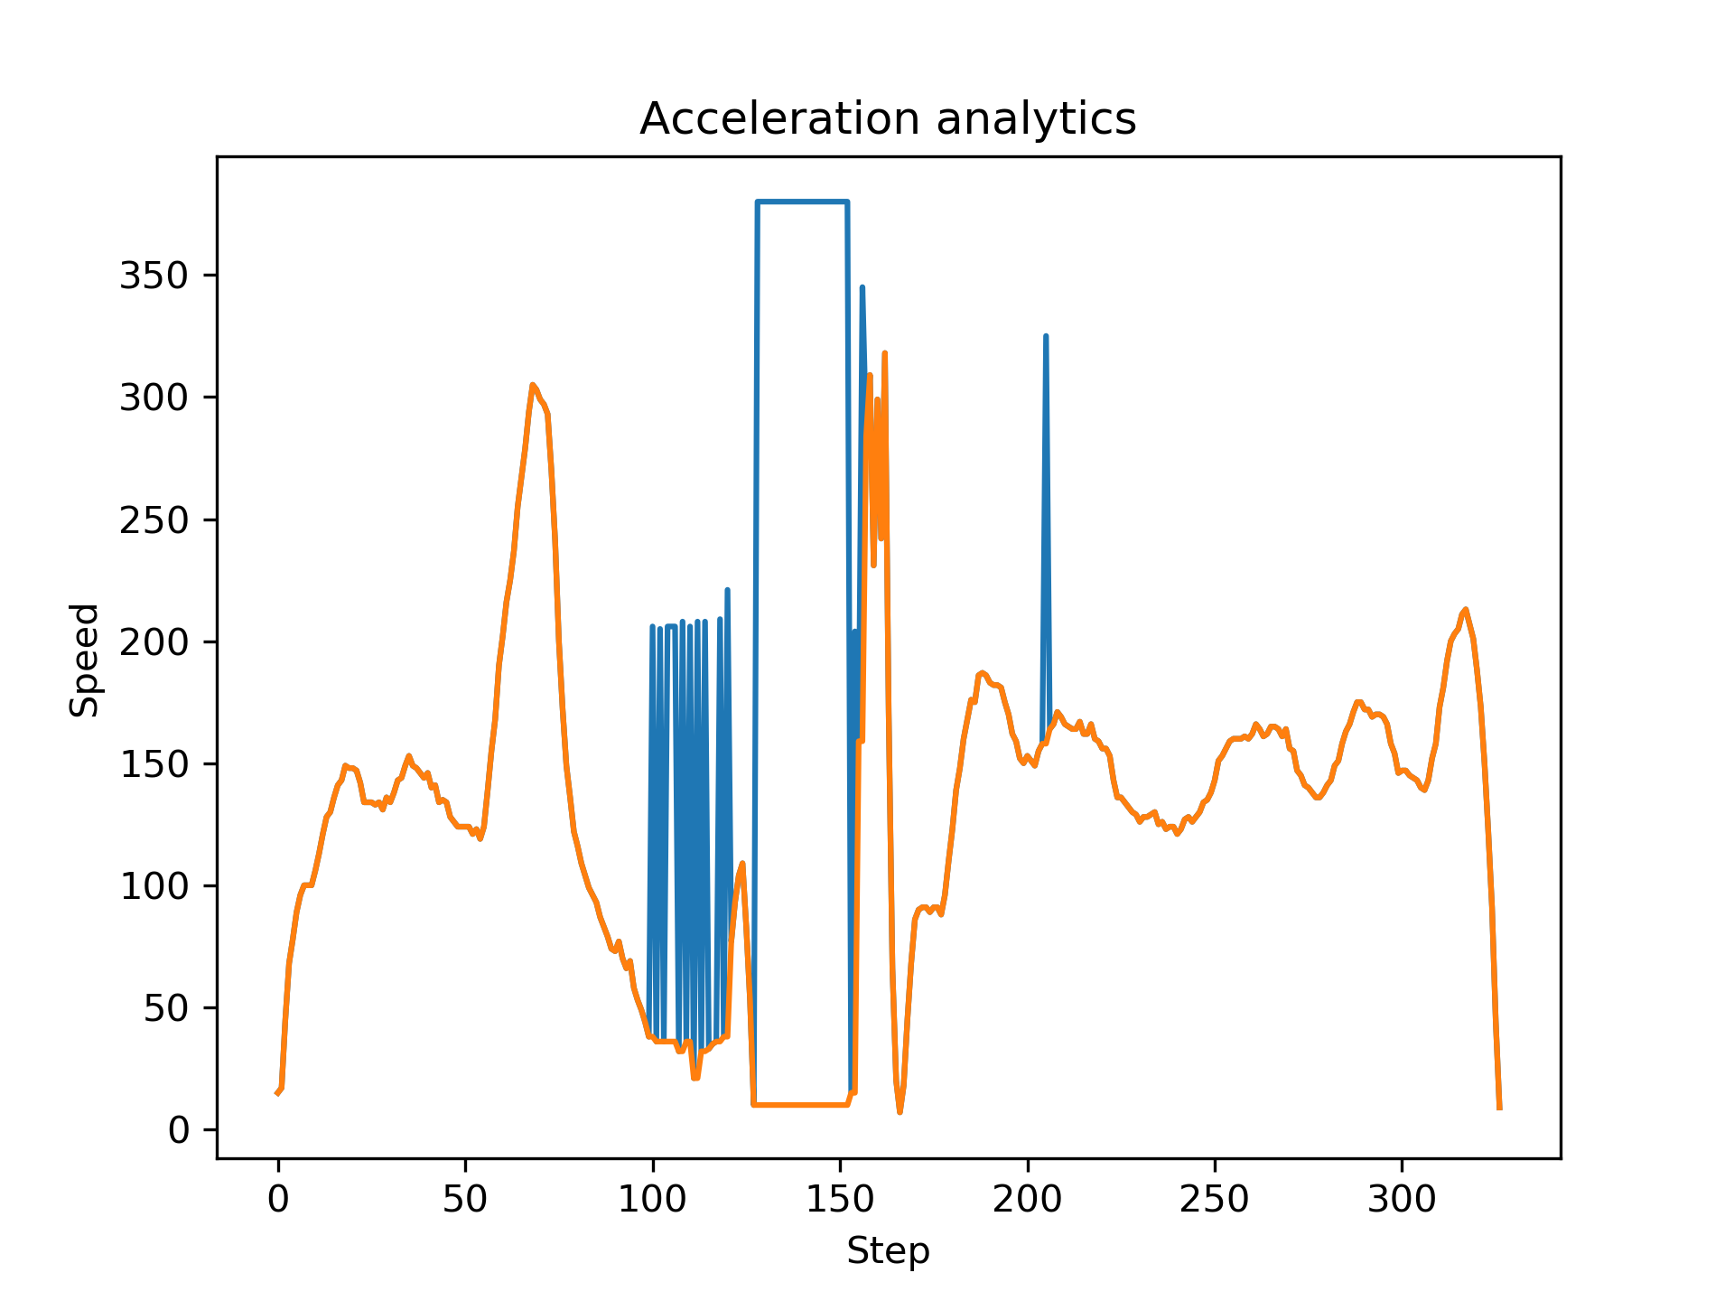
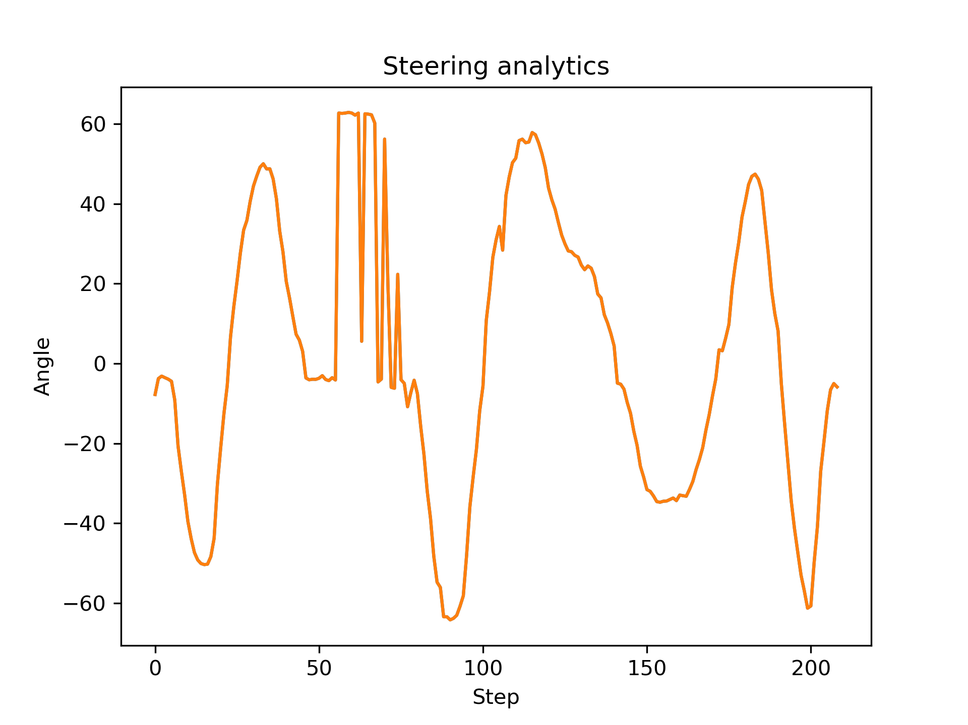
Speed and Steering Angles correction

Slide 12
Operations on frames
A BILATERAL FILTER is used to reduce noise in computed frames
img = cv2.bilateralFilter(img, 9, 40, 75)
MOVING AVERAGE FILTER can be added at user’s discretion. The effect is a smoother image with sharp features removed, reducing errors in detection process.
cv2.accumulateWeighted(img, avg, alpha)
res = cv2.convertScaleAbs(avg)
return res

Slide 13
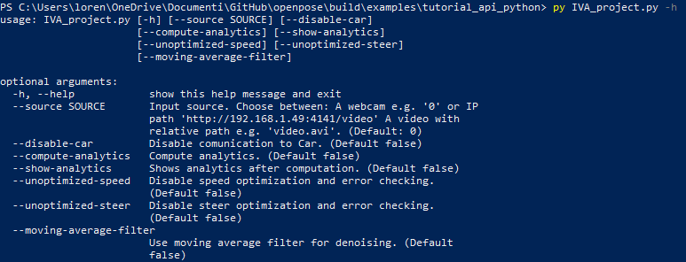
OPtoROBO from CMD
It’s possible to use OPtoROBO directly from Command Shell

Slide 14
Prerequisites & Installation
Before doing anything, clone and install OpenPose and follow the instructions.
Clone OPtoROBO repo in {OpenPoseClonedRepo}/build/examples/tutorial_api_python
Install all the necessary Python modules
It’s important that you have a good GPU. We have done test with GTX 1050 (7 FPS) and GTX 1660ti (20 FPS).
Python 3.7

Slide 15
Future developments
OPtoROBO is an open project. We want to:
Use radio signal instead Bluetooth for further remote control
Read clerear data and pass them with a better errors detection and correction
Improve optimization
Use strongest filteering for a better frame information extraction
Create a multi-platform system for different veichles drive experience

Slide 16
References
Openpose: https://github.com/CMU-Perceptual-Computing-Lab/openpose
Openpose paper: https://arxiv.org/pdf/1611.08050.pdf
OpenCV: https://opencv.org/
Python: https://www.python.org/downloads/
Arduino: https://www.arduino.cc/
OPtoROBO repo: https://github.com/fabian57fabian/OpenPose-to-robotics

Slide 17
THANKS FOR YOUR ATTENTION!!!

