Slide 1

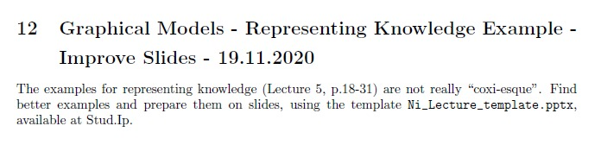
Neuroinformatics Lecture (L5)
Improve Slides
Group 30:
Fabian Imkenberg,
Jacqueline Näther,
Christoph Werries
Prof. Dr. Gordon Pipa
Institute of Cognitive Science, University of Osnabrück
Notes:
Hallo and thank you for the introduction.
I will present a non-parametric significance test for estimating the statistical significance of Joint-Spike events.

Slide 2
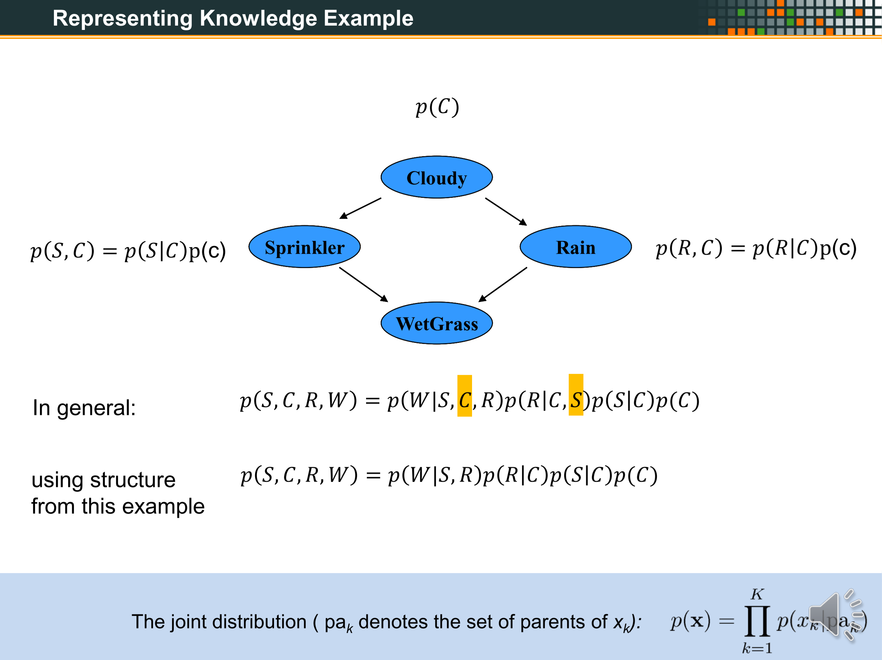
XXX
XXX
OLD

Slide 3
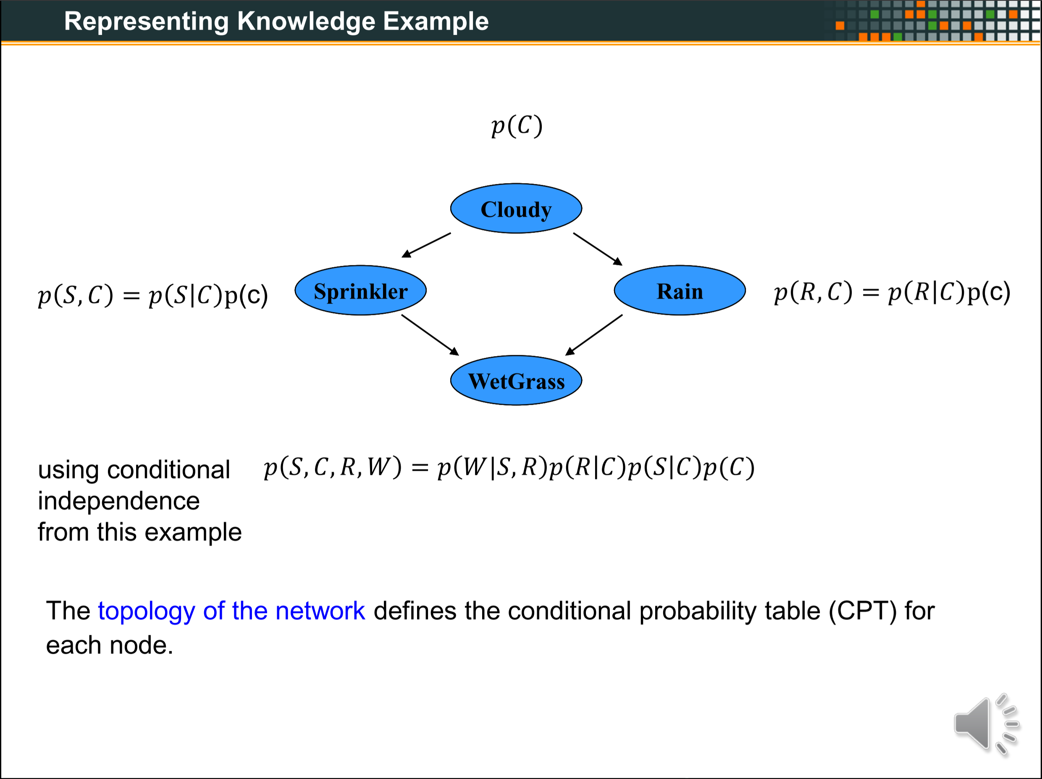
XXX
XXX
OLD

Slide 4

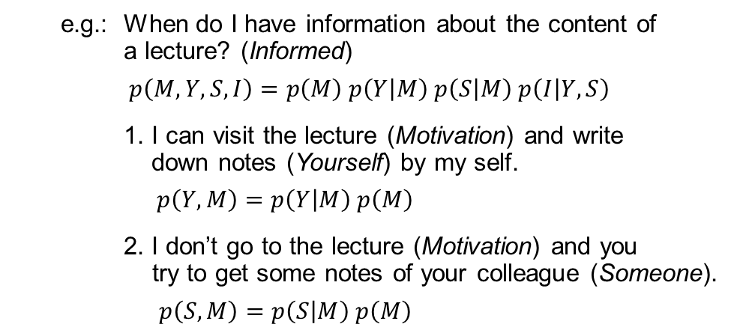



Representing knowledge example
How to use graphical models for real world problems?
The model can help us to understand how a special state is dependent on its conditions.
e.g.: When do I have information about the content of
a lecture? (Informed)
$p\left(M, Y, S, I\right)=p\left(M\right) p\left(Y | M\right) p\left(S | M\right) p\left(I | Y,S\right)$
1. I can visit the lecture (Motivation) and write
down notes (Yourself) by my self.
$p\left(Y,M\right)=p\left(Y | M\right) p\left(M\right)$
2. I don’t go to the lecture (Motivation) and you
try to get some notes of your colleague (Someone).
$p\left(S,M\right)=p\left(S | M\right) p\left(M\right)$
$$p(M)$$
Motivation
$$p(Y, M)$$
$$p(S, M)$$
Yourself
Someone
Informed
$$p(M, Y, S,I)$$
With knowing the probabilities, there is a way to easily represent the topology of the network, using concrete numbers of the probabilities.
➔ using Conditional Probability Tables (CPT)

Slide 5
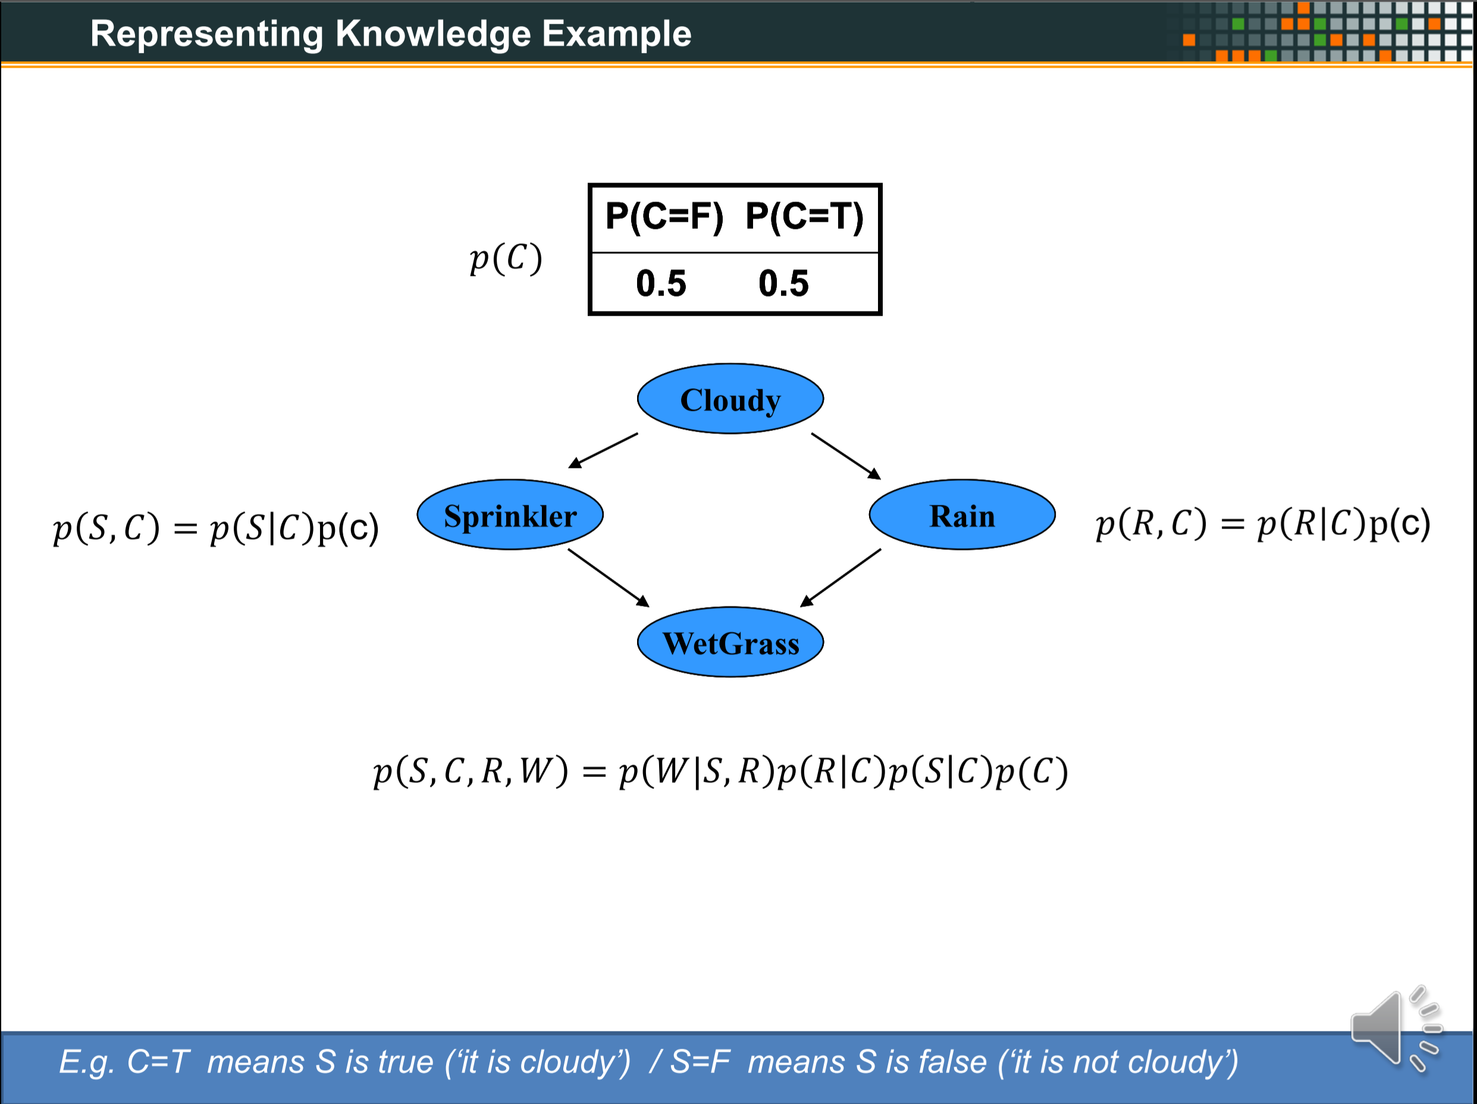
XXX
XXX
OLD

Slide 6
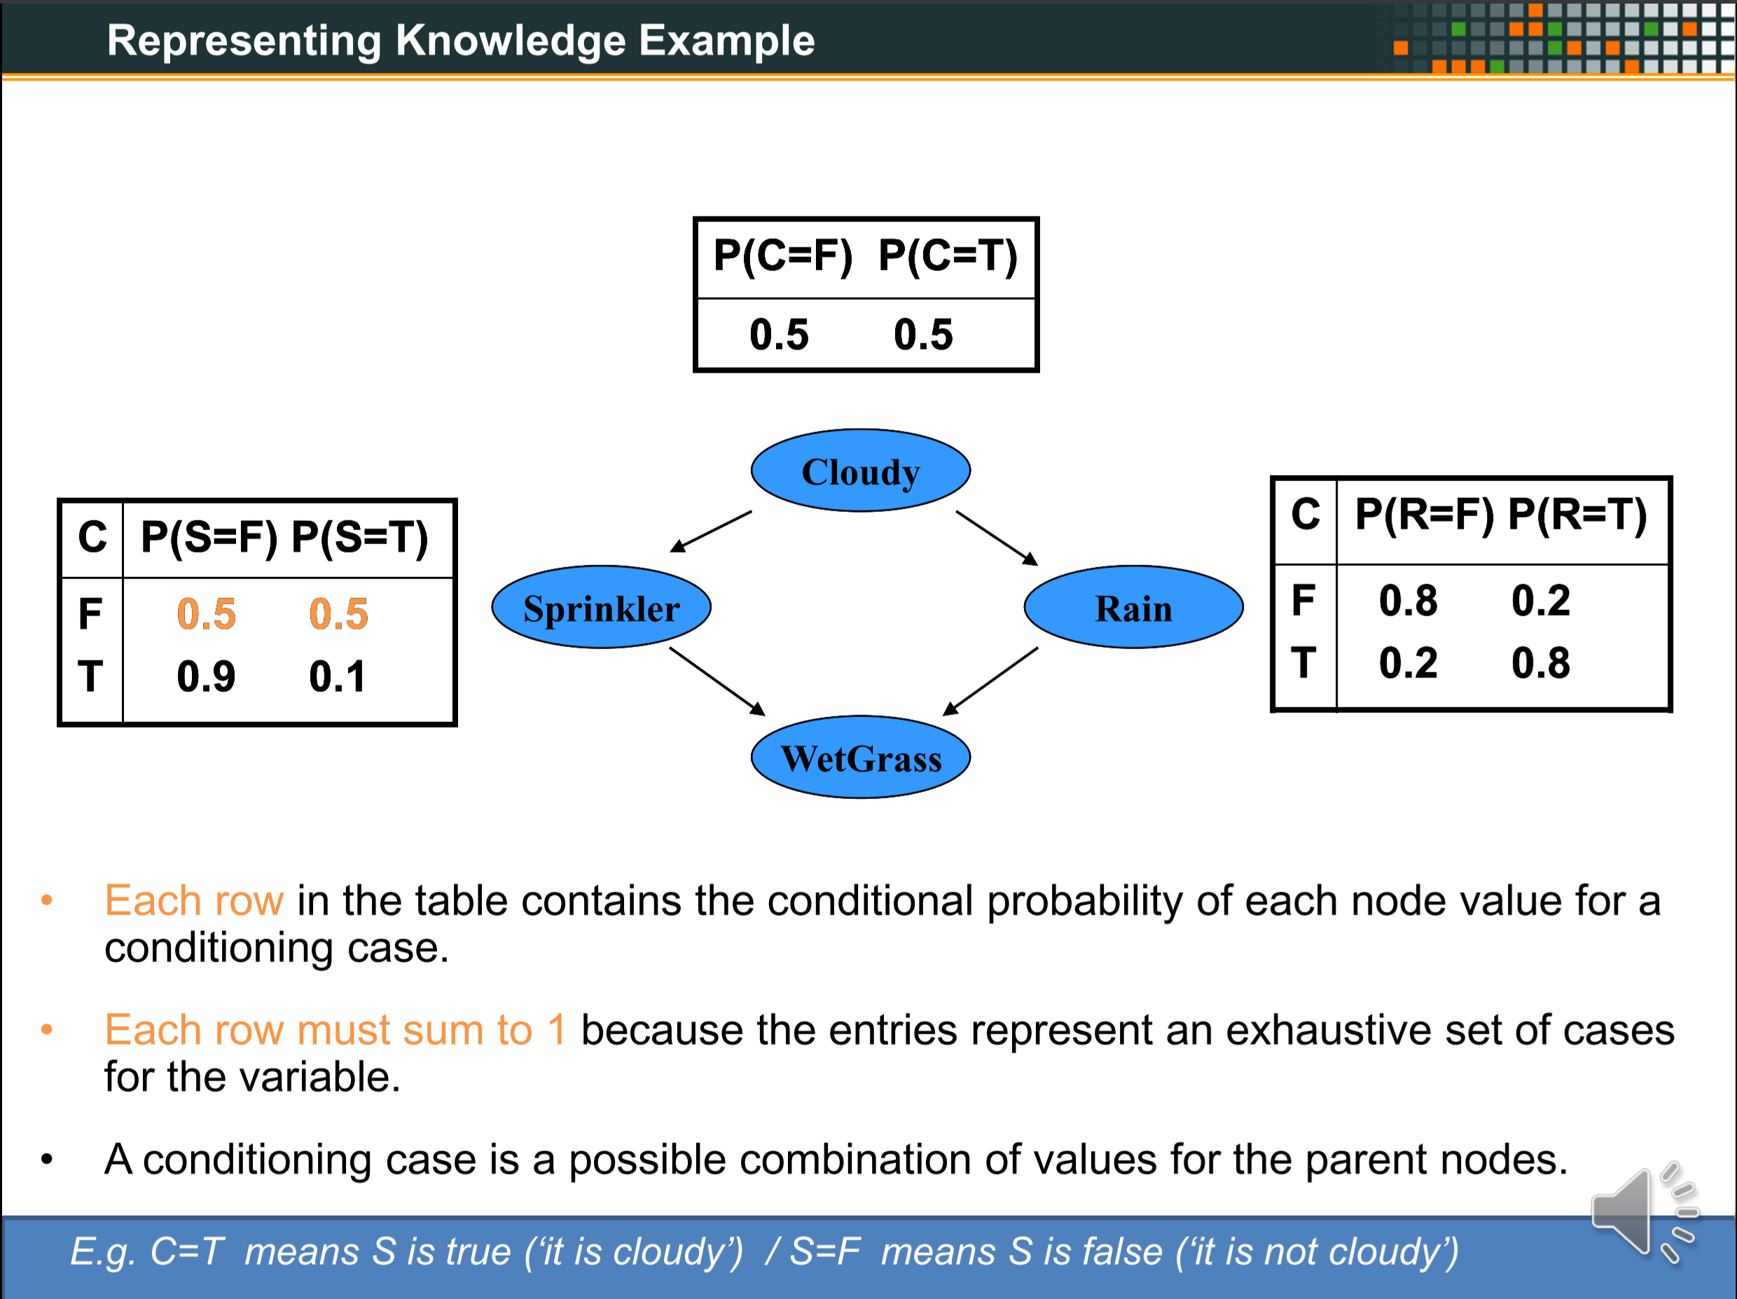
XXX
XXX
OLD

Slide 7
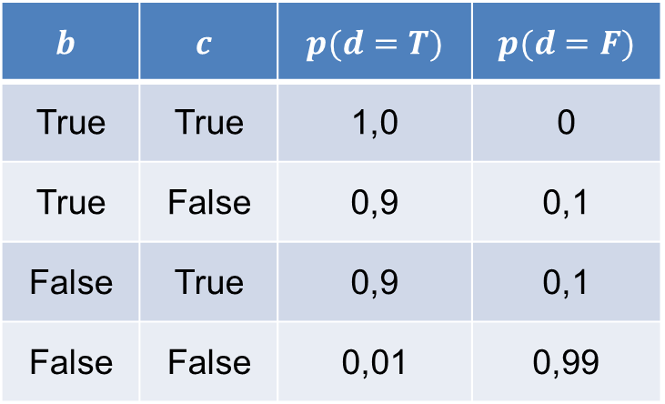




Representing knowledge example
How does it work with CPTs?
$$p(a)$$
a
$$p(a,b)$$
$$p(a,c)$$
Conditions of the parent nodes of the node you are looking at.
b
c
Probabilities of each case from the node you are looking at.
d
$$p(a,b,c,d)$$
$$b$$ | $$c$$ | $$p(d=T)$$ | $$p(d=F)$$
True | True | 1,0 | 0
True | False | 0,9 | 0,1
False | True | 0,9 | 0,1
False | False | 0,01 | 0,99
Area which is represented by the table.
Probabilities of the node you are looking on (here d).
These one are given.
! The sum of the probabilities of condition cases must be 1.
Condition cases of the conditions from the parent nodes of the node you are looking at.

Slide 8
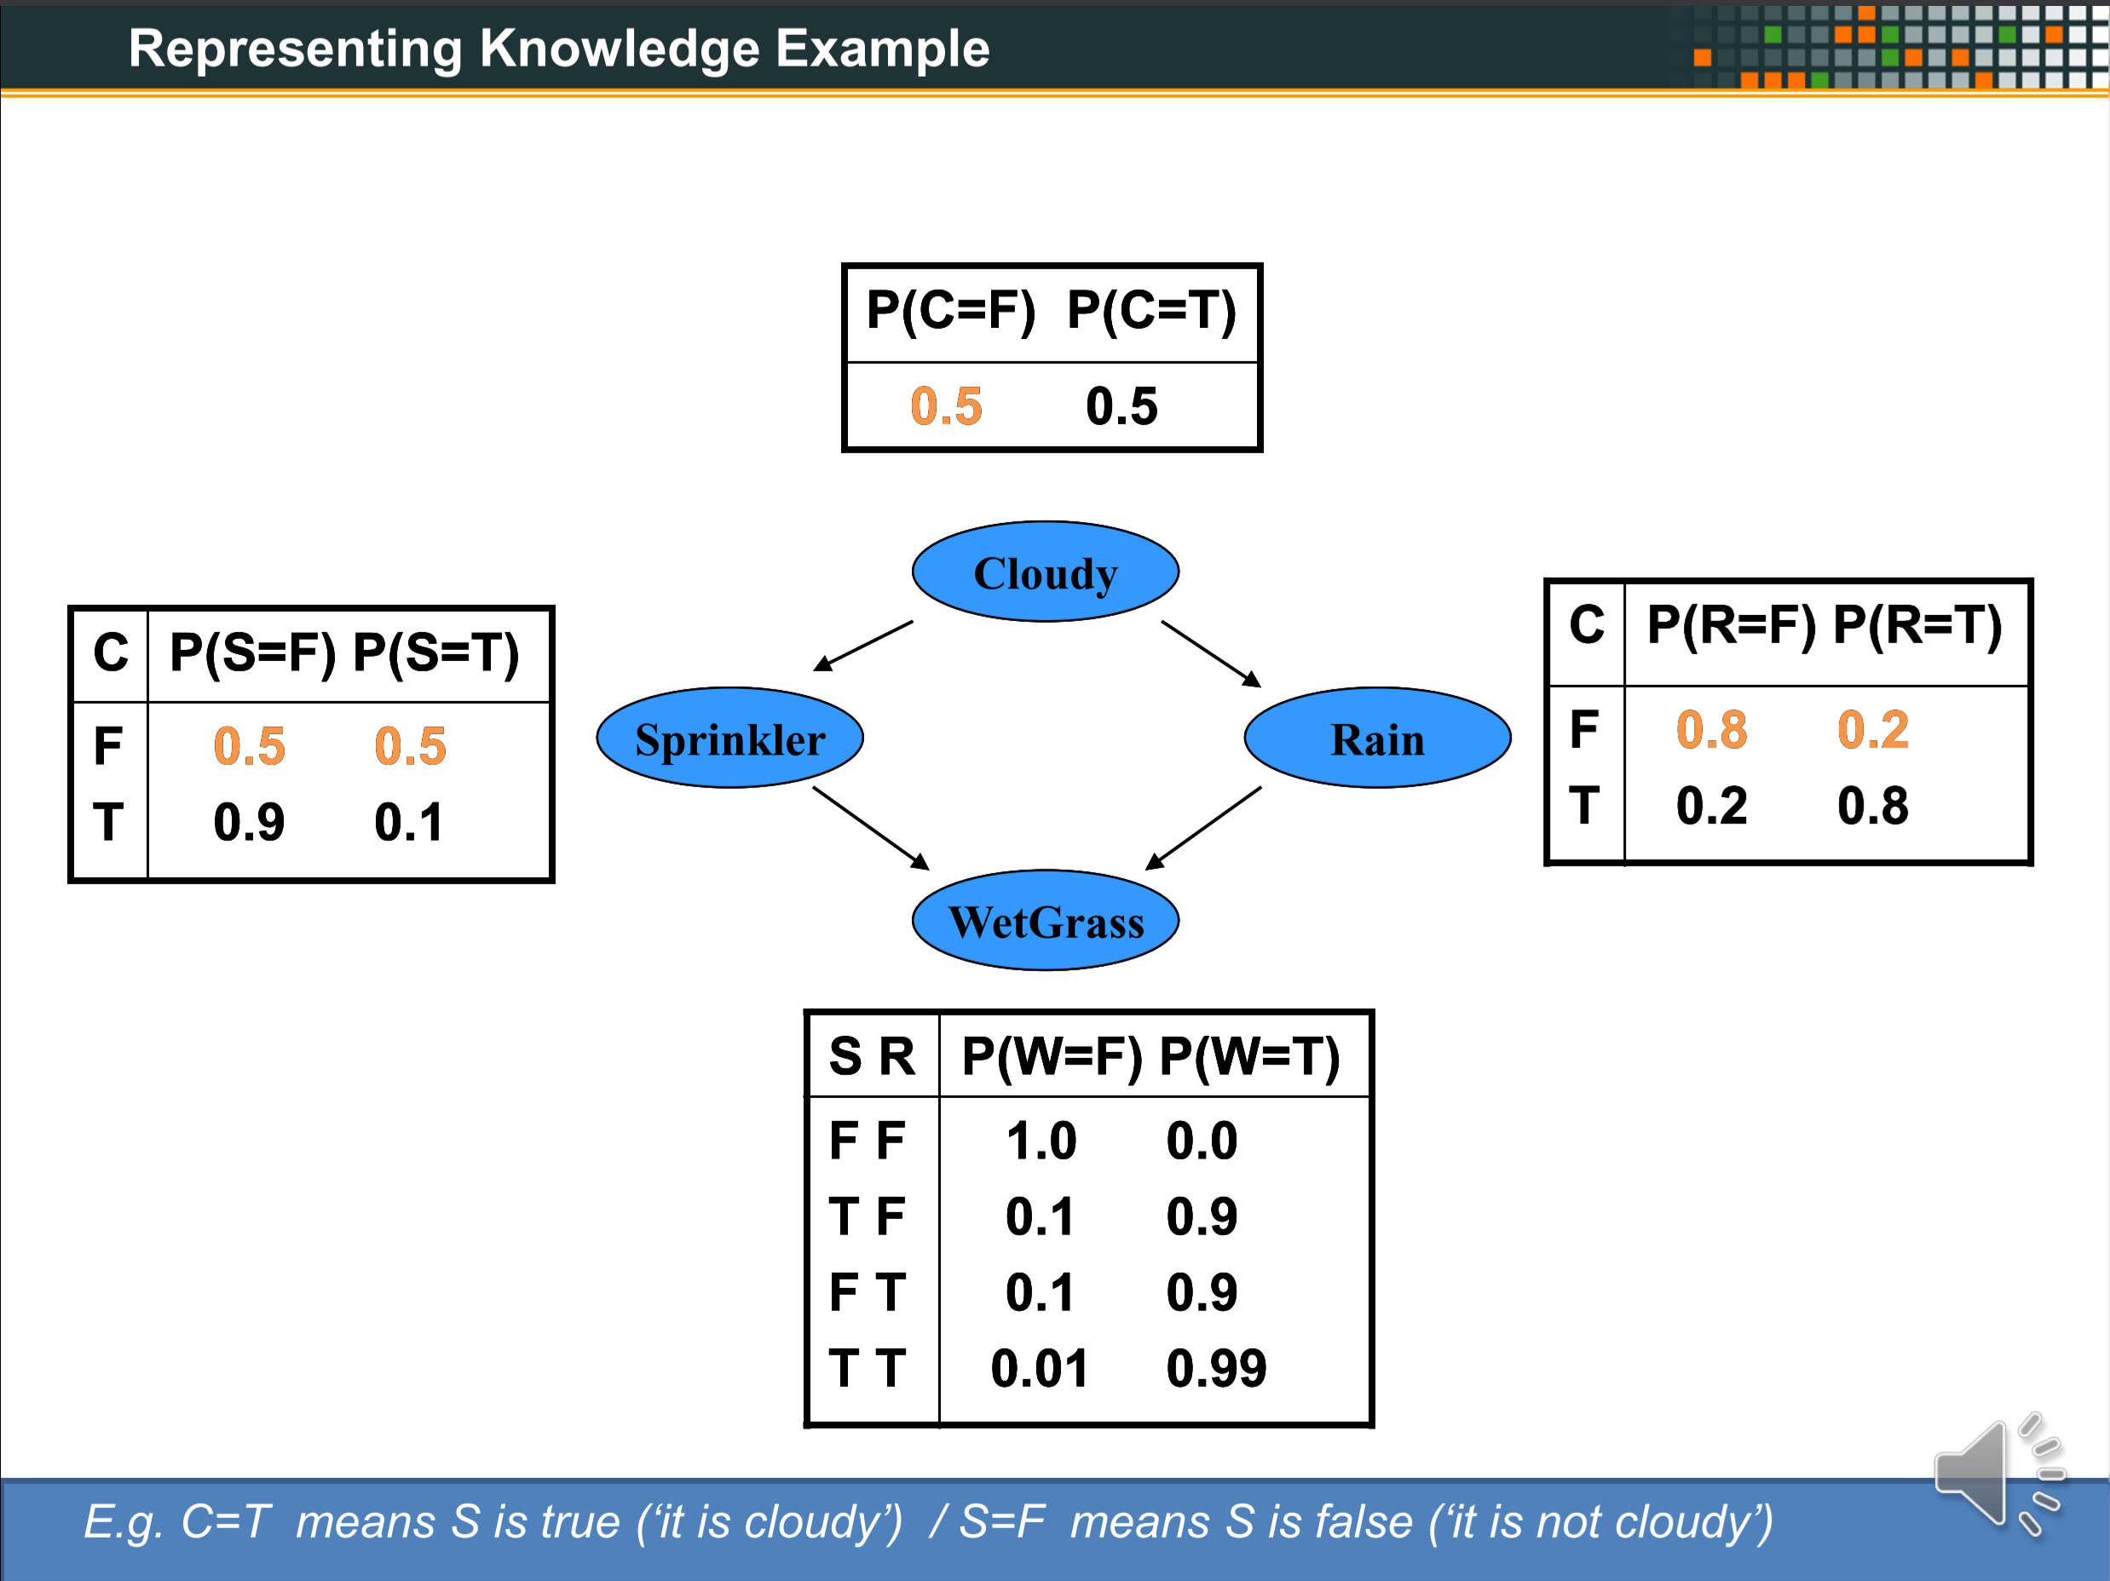
XXX
XXX
OLD

Slide 9
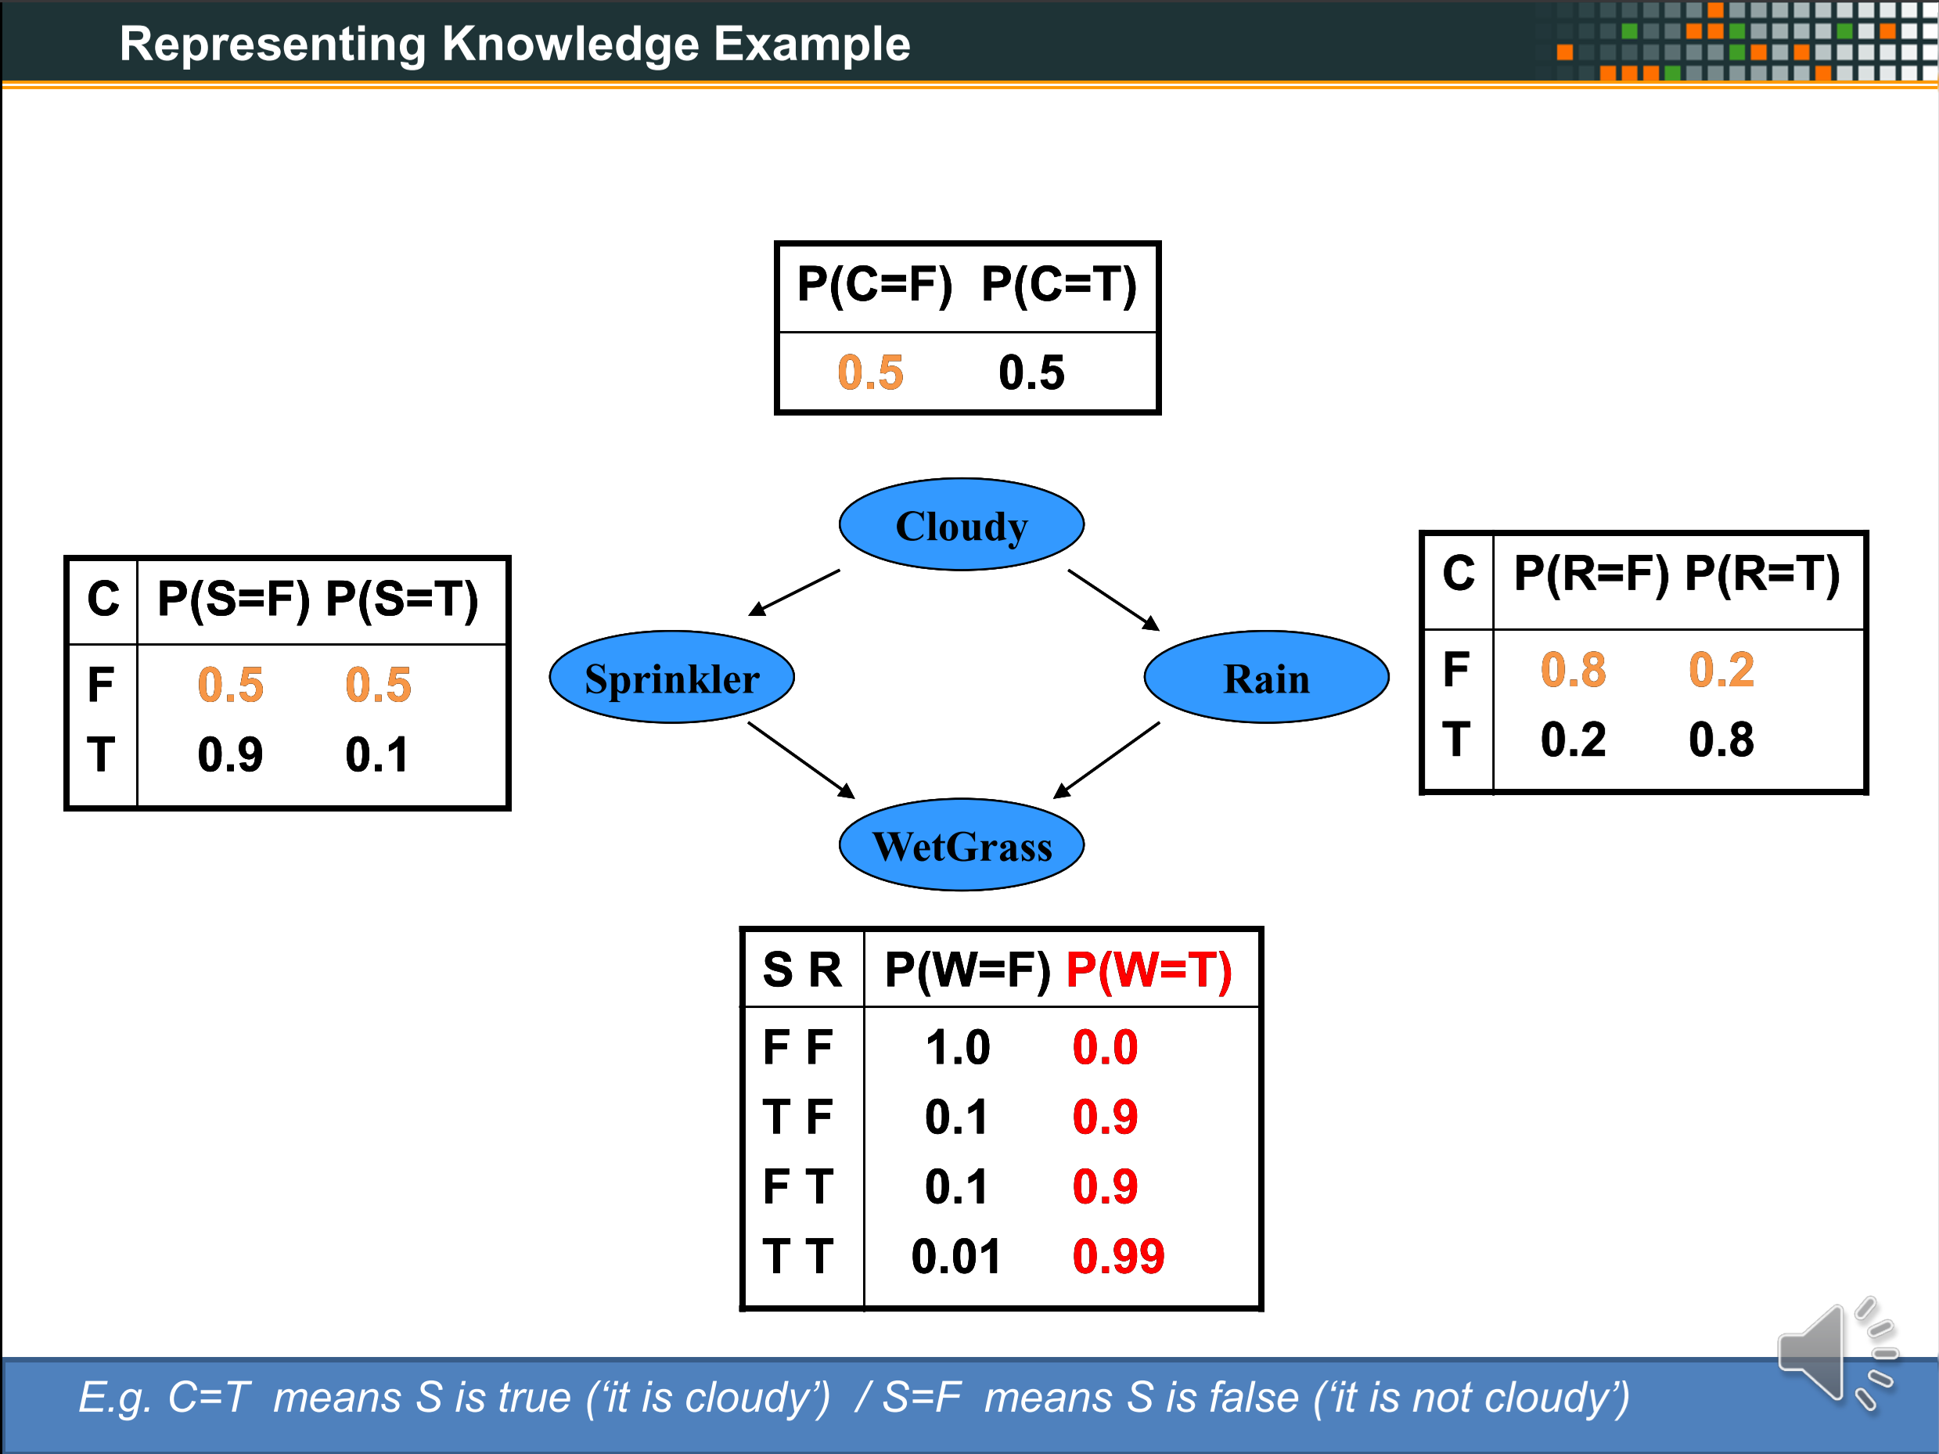
XXX
XXX
OLD

Slide 10
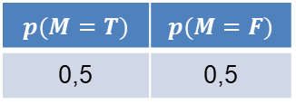
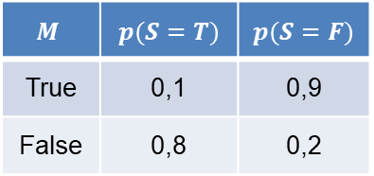



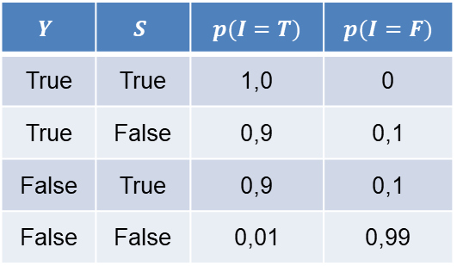

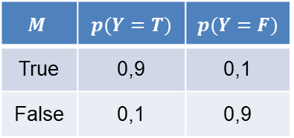
Representing knowledge example
Example: CPTs using for real world problems.
$$p(M=T)$$ | $$p(M=F)$$
0,5 | 0,5
$$p(M)$$
Motivation
$$M$$ | $$p(Y=T)$$ | $$p(Y=F)$$
True | 0,9 | 0,1
False | 0,1 | 0,9
$$p(Y,M)$$
$$p(S, M)$$
$$M$$ | $$p(S=T)$$ | $$p(S=F)$$
True | 0,1 | 0,9
False | 0,8 | 0,2
Yourself
Someone
Informed
$$p(M,Y,S,I)$$
$$Y$$ | $$S$$ | $$p(I=T)$$ | $$p(I=F)$$
True | True | 1,0 | 0
True | False | 0,9 | 0,1
False | True | 0,9 | 0,1
False | False | 0,01 | 0,99

Slide 11
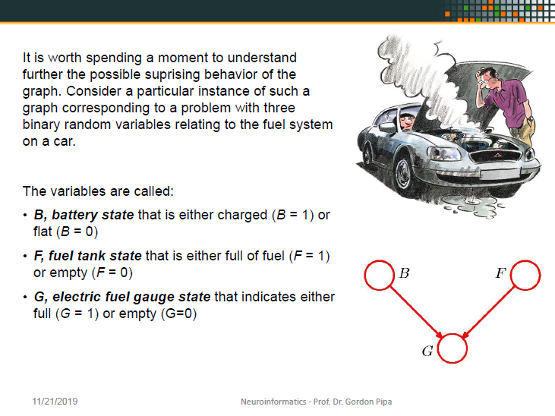
OLD

Slide 12

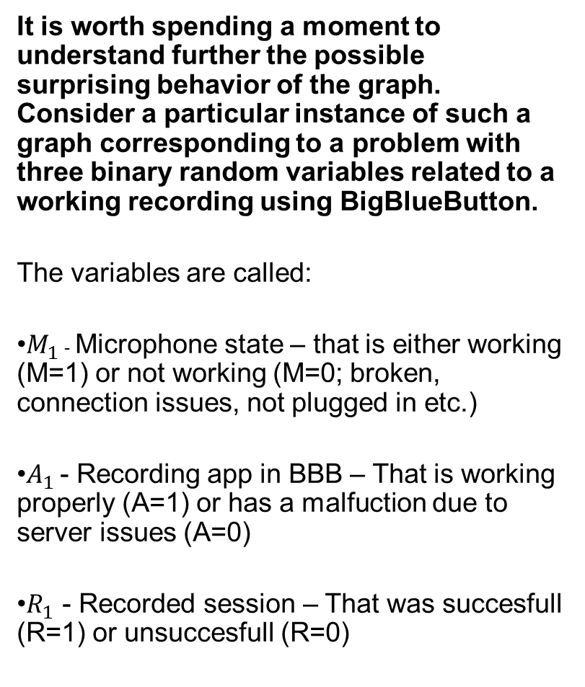
Representing knowledge: BBB example
It is worth spending a moment to understand further the possible surprising behavior of the graph. Consider a particular instance of such a graph corresponding to a problem with three binary random variables related to a working recording using BigBlueButton.
The variables are called:
$M_{1}$ - Microphone state – that is either working (M=1) or not working (M=0; broken, connection issues, not plugged in etc.)
$A_{1}$ - Recording app in BBB – That is working properly (A=1) or has a malfuction due to server issues (A=0)
$R_{1}$ - Recorded session – That was succesfull (R=1) or unsuccesfull (R=0)
M
A
R

Slide 13
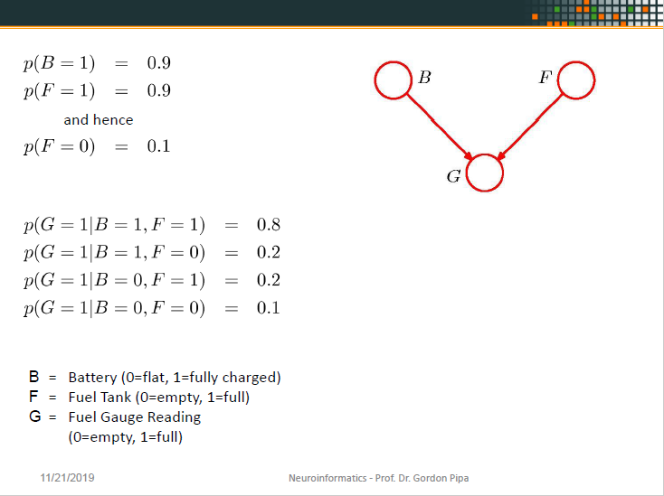
OLD

Slide 14
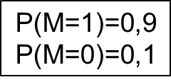
Representing knowledge: BBB example
$$\text{P}\text{(}\text{M}\text{=1)=0,9}$$
$$\text{P}\text{(}\text{M}\text{=0)=0,1}$$
P(A=1)=0,9
P(A=0)=0,1
M
A
P(A=1) | P(A=0)
0,9 | 0,1
P(M=1) | P(M=0)
0,9 | 0,1
R
M | A | P(R=1) | P(R=0)
0 | 0 | 0,1 | 0,9
1 | 0 | 0,2 | 0,8
0 | 1 | 0,2 | 0,8
1 | 1 | 0,8 | 0,2
P(R=1|M=1,A=1)=0,8
P(R=1|M=1,A=0)=0,2
P(R=1|M=0,A=1)=0,2
P(R=1|M=0,A=0)=0,1
P(R=0|M=1,A=1)=0,2
P(R=0|M=1,A=0)=0,8
P(R=0|M=0,A=1)=0,8
P(R=0|M=0,A=0)=0,9

Slide 15
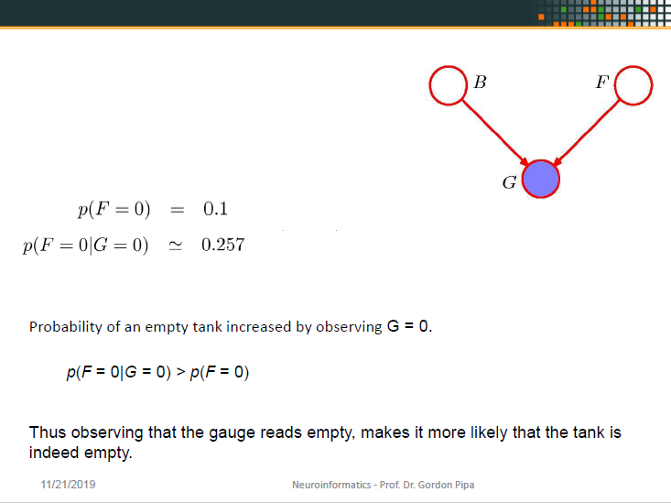
OLD

Slide 16
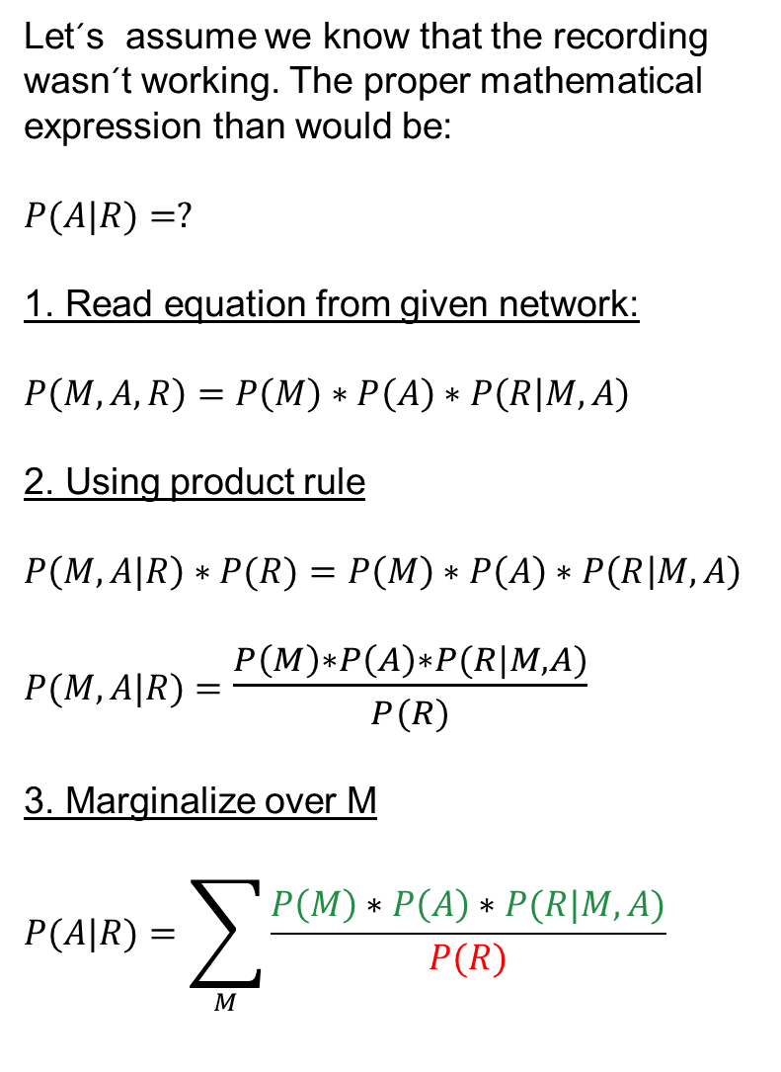
Representing knowledge: Calculation approach
Let´s assume we know that the recording wasn´t working. The proper mathematical expression than would be:
$$P(A|R)=?$$
1. Read equation from given network:
$$P\left(M,A,R\right)=P\left(M\right)∗P\left(A\right)∗P\left(R | M,A\right)$$
2. Using product rule
$$P\left(M,A|R\right)∗P(R)=P\left(M\right)∗P\left(A\right)∗P\left(R | M,A\right)$$
$P(M,A|R)$ $=$ $\frac{P\left(M\right)∗P\left(A\right)∗P(R|M,A)}{P(R)}$
3. Marginalize over M
$$P(A|R)=\sum_{M}{\frac{P\left(M\right)∗P\left(A\right)∗P(R|M,A)}{P(R)}}$$
M
A
=
R
As we see on the tables a slide ago, there is no P(R) that we could directly plug in, as it is not directly given (dependend on p(M) and p(A)).
So we have to calculate it somehow out of the given information.

Slide 17
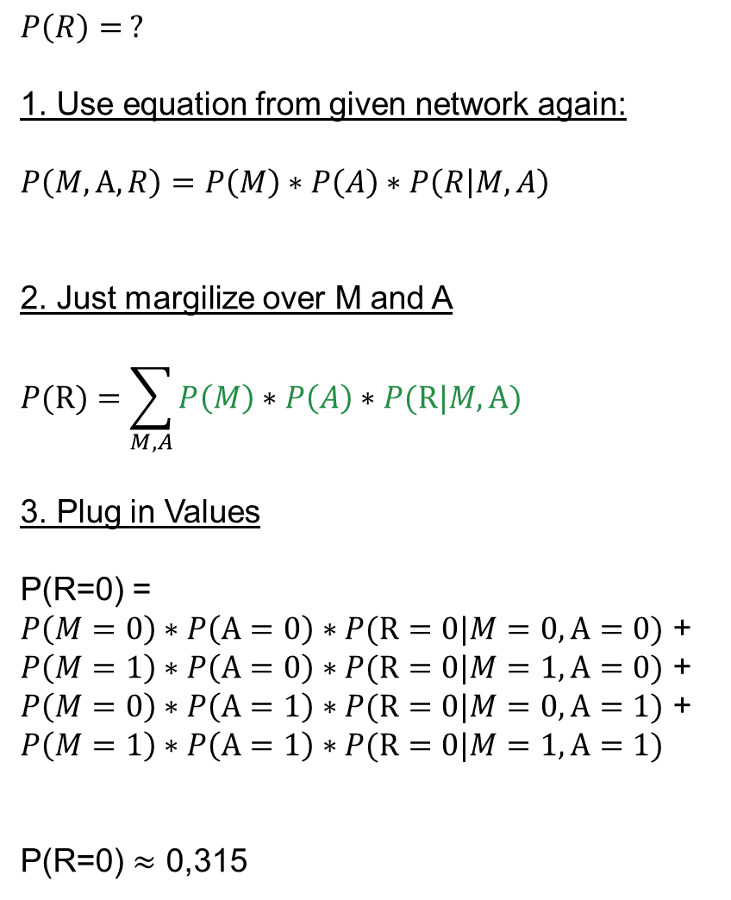
Representing knowledge: Calculation approach
$$P\left(R\right)= ?$$
1. Use equation from given network again:
$$P\left(M,A,R\right)=P\left(M\right)∗P\left(A\right)∗P\left(R | M,A\right)$$
2. Just margilize over M and A
$$P(R)=\sum_{M,A}{P\left(M\right)∗P\left(A\right)∗P(R|M,A)}$$
3. Plug in Values
P(R=0) = $P\left(M=0\right)∗P\left(A=0\right)∗P(R=0|M=0,A=0)$ + $P\left(M=1\right)∗P\left(A=0\right)∗P(R=0|M=1,A=0)$ + $P\left(M=0\right)∗P\left(A=1\right)∗P(R=0|M=0,A=1)$ + $$P\left(M=1\right)∗P\left(A=1\right)∗P(R=0|M=1,A=1)$$
P(R=0) $≈$ 0,315
M
A
=
R
Now that we calculated our P(R=0) we can return to our original task.
As side nodes: You don´t need to calculate P(R=0) already. You simply can plug the formula in later.
Additionaly we just calculated the probability of an unsuccesfull recording without knowing anything about the recording functionality or the state of the microphone given the probabilities on the table.

Slide 18
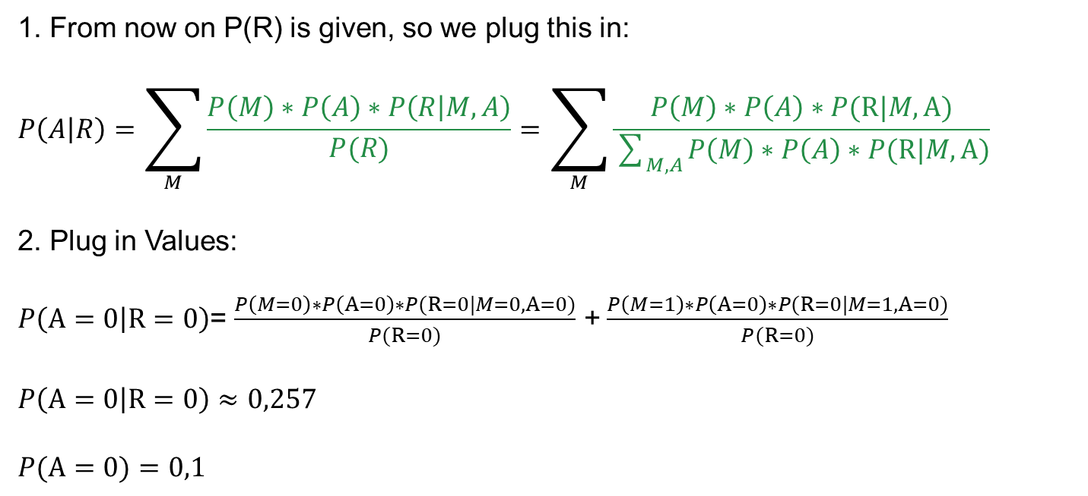
Representing knowledge: Calculation approach
1. From now on P(R) is given, so we plug this in:
$$P\left(A | R\right)=\sum_{M}{\frac{P\left(M\right)∗P\left(A\right)∗P\left(R | M,A\right)}{P(R)}}=\sum_{M}{\frac{P\left(M\right)∗P\left(A\right)∗P(R|M,A)}{\sum_{M,A}{P\left(M\right)∗P\left(A\right)∗P(R|M,A)}}}$$
2. Plug in Values:
$P\left(A=0 | R=0\right)$= $\frac{P\left(M=0\right)∗P\left(A=0\right)∗P(R=0|M=0,A=0)}{P(R=0)}$ +$\frac{P\left(M=1\right)∗P\left(A=0\right)∗P(R=0|M=1,A=0)}{P(R=0)}$
$P\left(A=0 | R=0\right)$ $≈$ $0,257$
$$P(A=0)=0,1$$
Probability of problems with the recording app (A) increased by observing R = 0
p(A = 0|R = 0) > p(A = 0)
Thus knowing that the recording wasn´t successful, makes it more likely that the recording functionality wasn´t working properly. -> Simply common sense displayed in a mathematical manner.

Slide 19
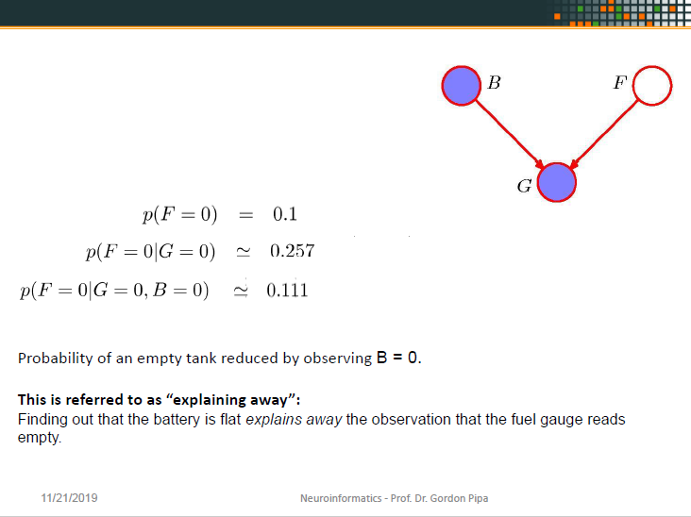
OLD

Slide 20
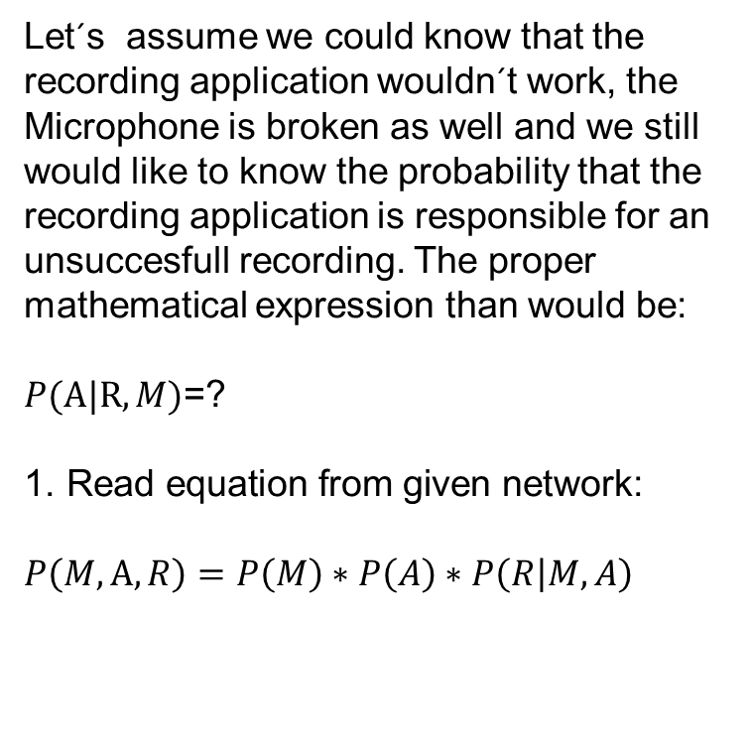
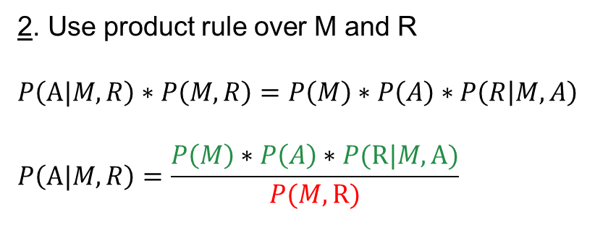
Representing knowledge: Calculation approach
Let´s assume we could know that the recording application wouldn´t work, the Microphone is broken as well and we still would like to know the probability that the recording application is responsible for an unsuccesfull recording. The proper mathematical expression than would be:
$P(A|R,M)$=?
$$\text{1. }\text{Read} \text{equation} \text{from} \text{given} \text{network}\text{:}$$
$$P\left(M,A,R\right)=P\left(M\right)∗P\left(A\right)∗P\left(R | M,A\right)$$
M
A
R
=
As we see on the tables a slide ago, there is no P(M,R) that we could directly plug in, as it is not directly given (dependend on p(M) and p(A)).
So we have to calculate it somehow out of the given information again.
2. Use product rule over M and R
$$P\left(A|M,R\right)∗P\left(M,R\right)=P\left(M\right)∗P\left(A\right)∗P\left(R | M,A\right)$$
$$P\left(A|M,R\right)=\frac{P\left(M\right)∗P\left(A\right)∗P(R|M,A)}{P(M,R)}$$

Slide 21
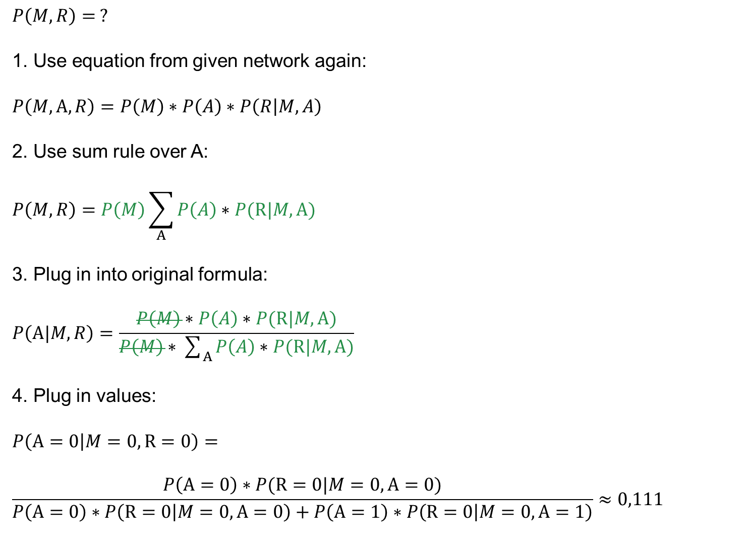
Representing knowledge: Calculation approach
$$P\left(M,R\right)= ?$$
1. Use equation from given network again:
$$P\left(M,A,R\right)=P\left(M\right)∗P\left(A\right)∗P\left(R | M,A\right)$$
2. Use sum rule over A:
$$P\left(M,R\right)=P\left(M\right)\sum_{A}{P\left(A\right)∗P(R|M,A)}$$
3. Plug in into original formula:
$$P\left(A|M,R\right)=\frac{P\left(M\right)∗P\left(A\right)∗P(R|M,A)}{P\left(M\right)∗\sum_{A}{P\left(A\right)∗P(R|M,A)}}$$
4. Plug in values:
$$P\left(A=0 | M=0,R=0\right)=$$
$$\frac{P\left(A=0\right)∗P(R=0|M=0,A=0)}{P\left(A=0\right)∗P\left(R=0 | M=0,A=0\right)+P\left(A=1\right)∗P\left(R=0 | M=0,A=1\right)}≈0,111$$
M
A
=
R
The Probability of an malfunction in BBB (A=0) is reduced due to observing the malfunction of the micro (M=0) knowing that a recording was not successful (R=0).
This is referred to as “explaining away”:
Finding out that the micro actually isn´t working properly explains that the recording wasn´t successful and thus explains away a malfunction in BBB.

Slide 22
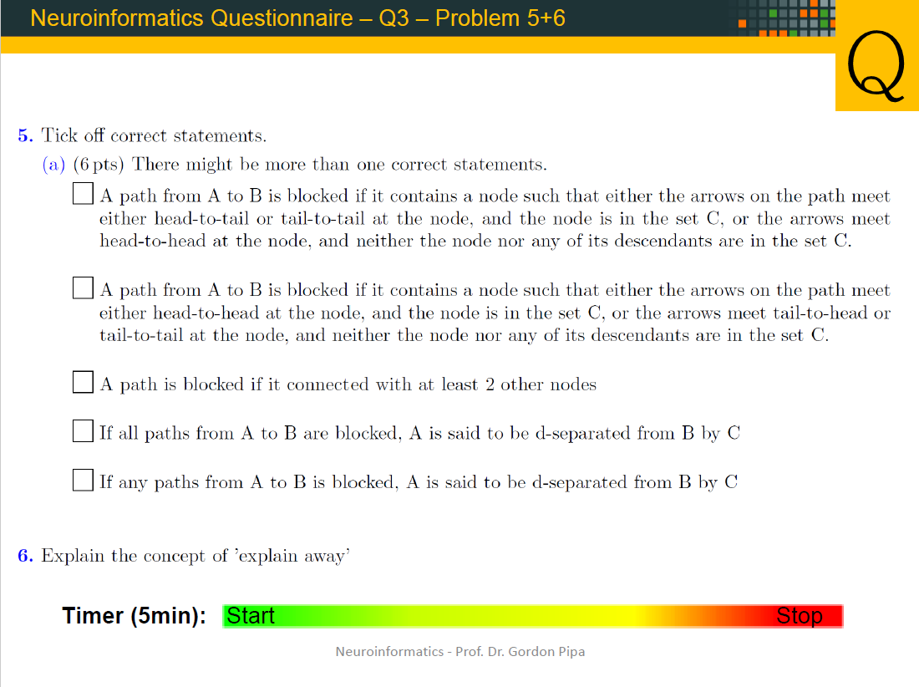
OLD

Slide 23
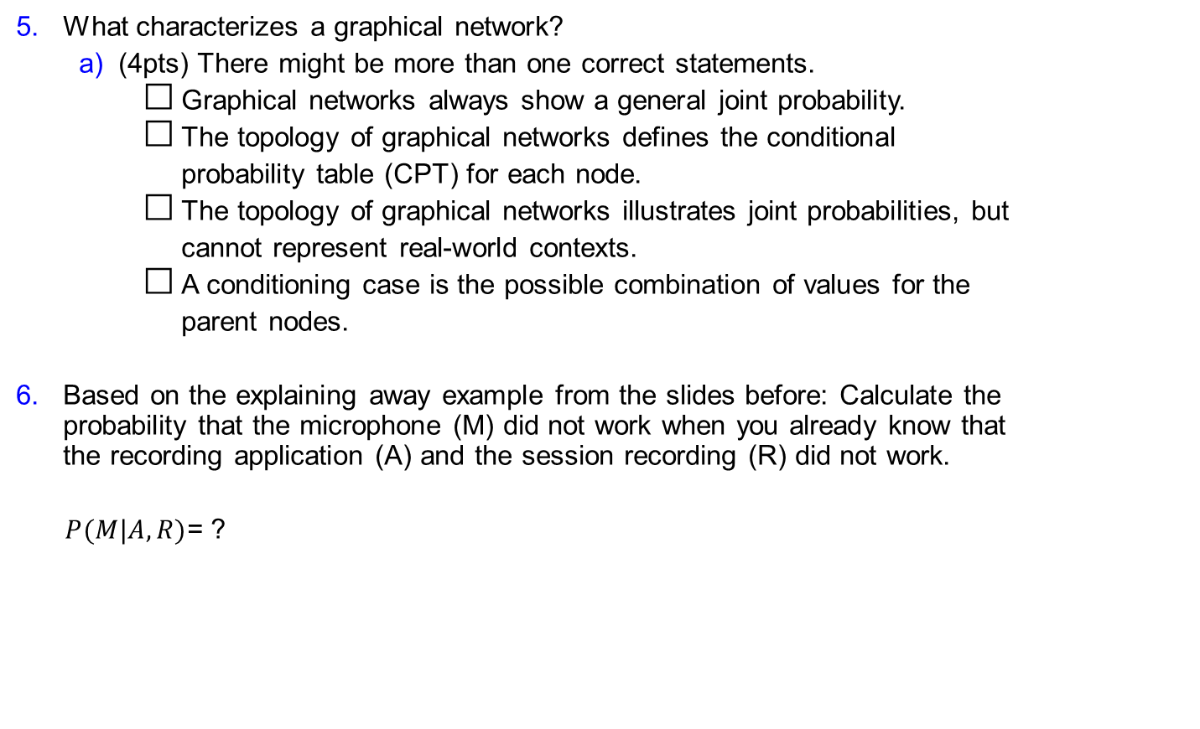
Questionnaire – Q3 – Problem 5+6
Q
What characterizes a graphical network?
(4pts) There might be more than one correct statements.
Graphical networks always show a general joint probability.
The topology of graphical networks defines the conditional
probability table (CPT) for each node.
The topology of graphical networks illustrates joint probabilities, but
cannot represent real-world contexts.
A conditioning case is the possible combination of values for the
parent nodes.
Based on the explaining away example from the slides before: Calculate the probability that the microphone (M) did not work when you already know that the recording application (A) and the session recording (R) did not work.
$P(M|A,R)$= ?
Start
Timer
M
A
R
Stop

Slide 24
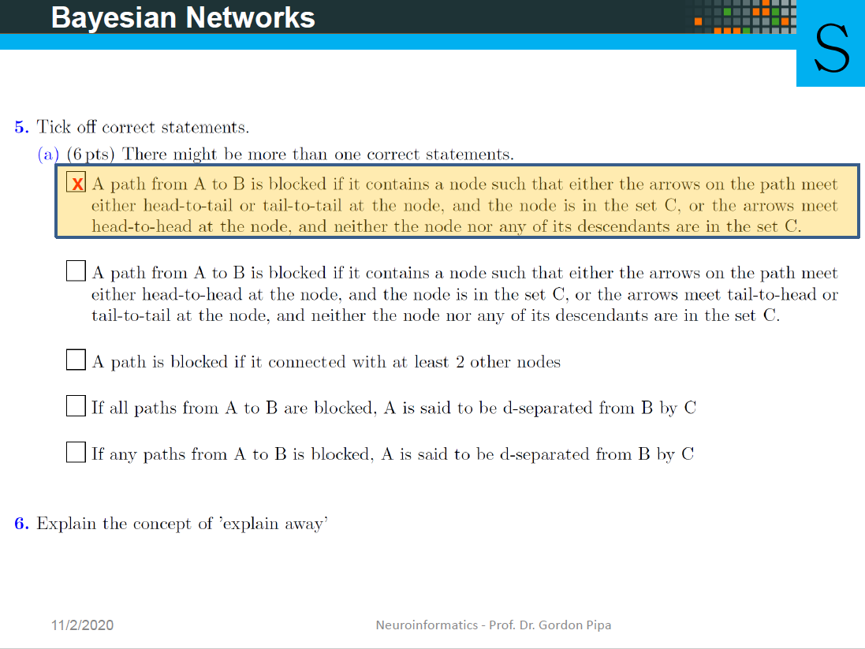
OLD

Slide 25
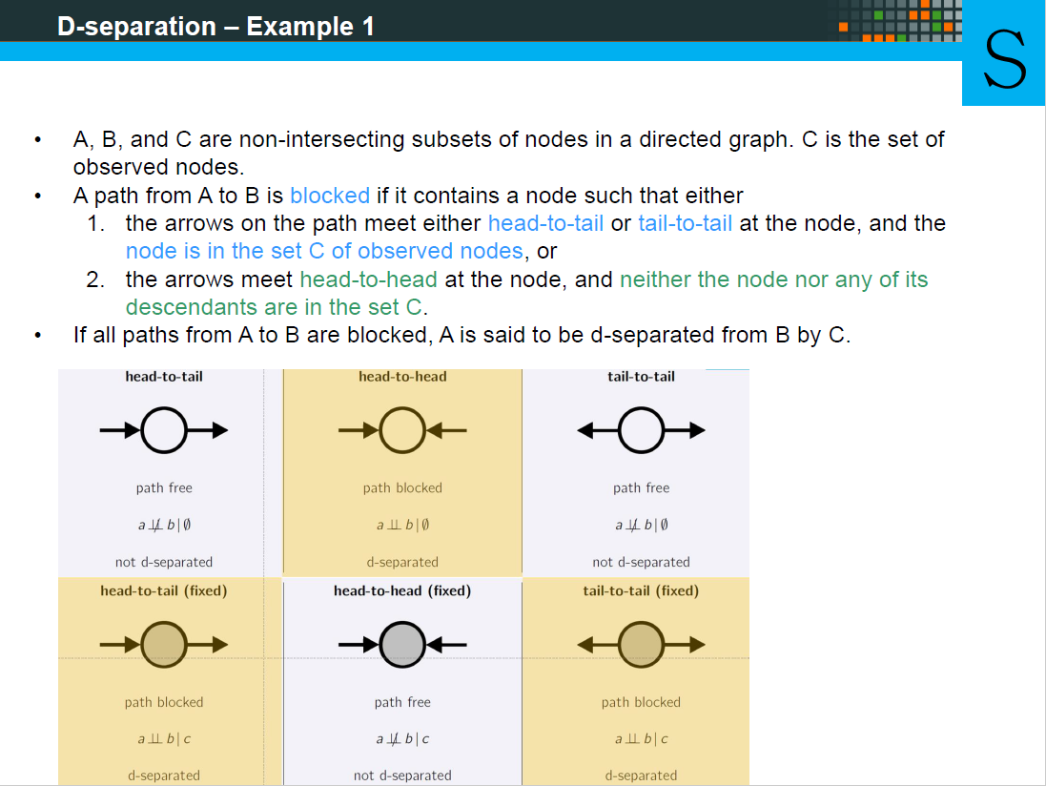
OLD

Slide 26
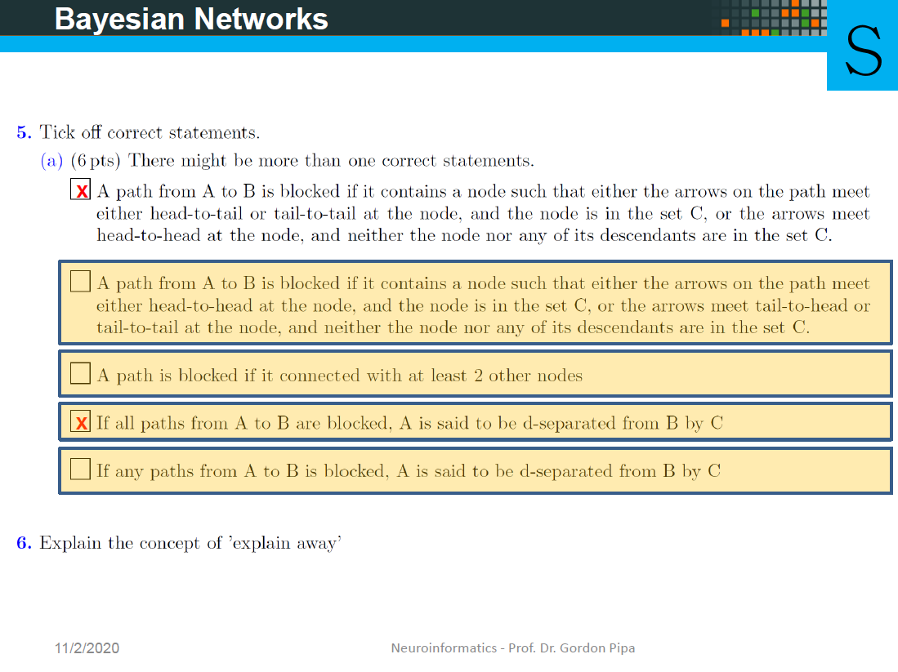
OLD

Slide 27
Questionnaire – Q3 – Problem 5+6
S
What characterizes a graphical network?
(4pts) There might be more than one correct statements.
Graphical networks always show a general joint probability.
The topology of graphical networks defines the conditional
probability table (CPT) for each node.
The topology of graphical networks illustrates joint probabilities, but
cannot represent real-world contexts.
A conditioning case is the possible combination of values for the
parent nodes.

Slide 28
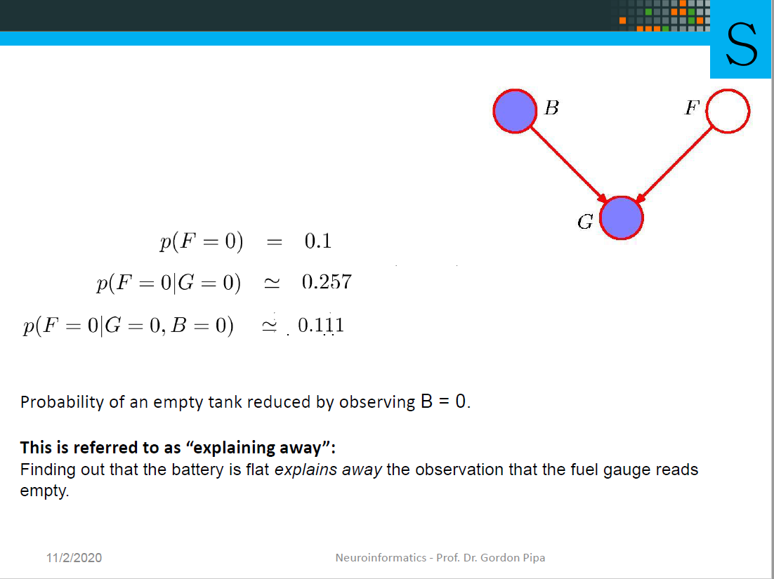
OLD

Slide 29
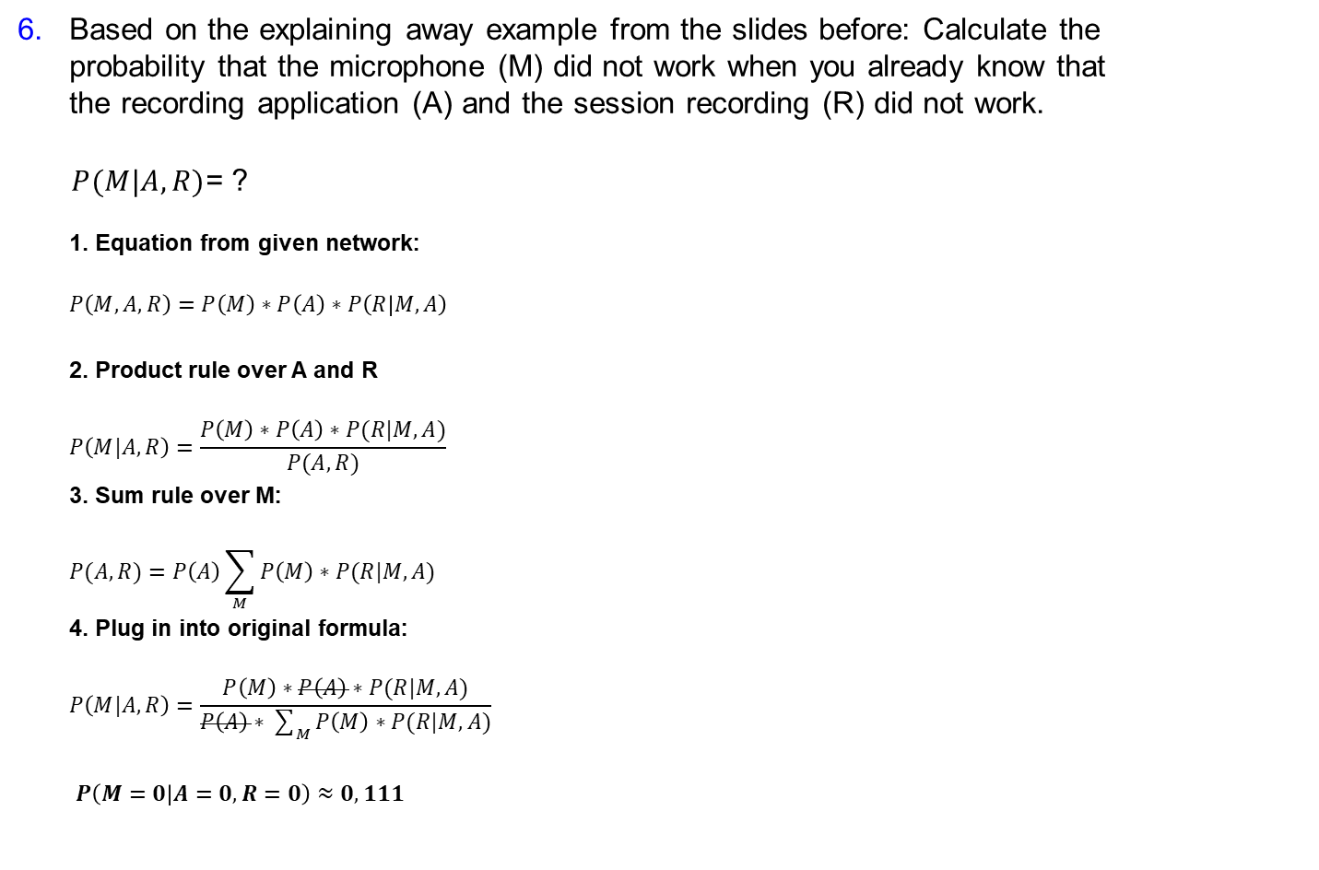
Questionnaire – Q3 – Problem 5+6
S
Based on the explaining away example from the slides before: Calculate the probability that the microphone (M) did not work when you already know that the recording application (A) and the session recording (R) did not work.
$P(M|A,R)$= ?
$$\text{1}\text{. }\text{Equation} \text{from} \text{given} \text{network}\text{:}$$
$$P\left(M,A,R\right)=P\left(M\right)∗P\left(A\right)∗P\left(R | M,A\right)$$
2. Product rule over A and R
$$P\left(M|A,R\right)=\frac{P\left(M\right)∗P\left(A\right)∗P(R|M,A)}{P(A,R)}$$
3. Sum rule over M:
$$P(A,R)=P\left(A\right)\sum_{M}{P\left(M\right)∗P(R|M,A)}$$
4. Plug in into original formula:
$$P\left(M|A,R\right)=\frac{P\left(M\right)∗P\left(A\right)∗P(R|M,A)}{P\left(A\right)∗\sum_{M}{P\left(M\right)∗P(R|M,A)}}$$
$P\left(M=0 | A=0,R=0\right)$ $≈0,111$
A
R

Slide 30
MIT License
Copyright (c) [2020] [Fabian Imkenberg, Jacqueline Näther, Christoph Werries]
Permission is hereby granted, free of charge, to any person obtaining a copy
of this software and associated documentation files (the "Software"), to deal
in the Software without restriction, including without limitation the rights
to use, copy, modify, merge, publish, distribute, sublicense, and/or sell
copies of the Software, and to permit persons to whom the Software is
furnished to do so, subject to the following conditions:
The above copyright notice and this permission notice shall be included in all
copies or substantial portions of the Software.
THE SOFTWARE IS PROVIDED "AS IS", WITHOUT WARRANTY OF ANY KIND, EXPRESS OR
IMPLIED, INCLUDING BUT NOT LIMITED TO THE WARRANTIES OF MERCHANTABILITY,
FITNESS FOR A PARTICULAR PURPOSE AND NONINFRINGEMENT. IN NO EVENT SHALL THE
AUTHORS OR COPYRIGHT HOLDERS BE LIABLE FOR ANY CLAIM, DAMAGES OR OTHER
LIABILITY, WHETHER IN AN ACTION OF CONTRACT, TORT OR OTHERWISE, ARISING FROM,
OUT OF OR IN CONNECTION WITH THE SOFTWARE OR THE USE OR OTHER DEALINGS IN THE
SOFTWARE.

