Slide 1
Actris: Session-Type Based Reasoning in Separation Logic
Jonas Kastberg Hinrichsen
Jesper Bengtson
Robbert Krebbers
Notes:
Already seen session types and separation logic, paper builds on top of that
Actris is about verification of programs that make use of message passing

Slide 2
Use Cases
MOTIVATION
Message Passing in Applications
«From network protocols over the Internet to server-client systems in local area networks to distributed applications in the world wide web to interaction between mobile robots to a global banking system, [...]»
BACKGROUND
WHAT’S NEW
CASE STUDY
Honda et al. [1998]
Notes:
Where is message passing used?
Network protocols
Server-client systems
Distributed applications
Interaction between mobile robots
Global banking system
[...]: the execution of complex, reciprocal communication among multiple processes becomes an important element in the achievement of the goals of applications

Slide 3
Use Cases
MOTIVATION
Web Frameworks
www.techempower.com/benchmarks
BACKGROUND
WHAT’S NEW
CASE STUDY
Notes:
Message passing has many use cases
Web frameworks
Actix Web is based on Actix framework, uses message passing
Second fastest web framework in benchmark
Actix not to be confused with actris

Slide 4
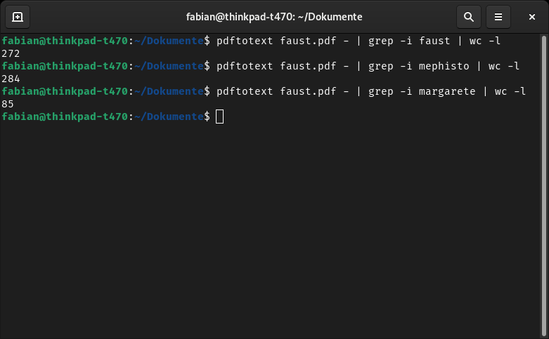
Use Cases
MOTIVATION
Interprocess Communication
BACKGROUND
WHAT’S NEW
CASE STUDY
Notes:
Interprocess communication (Unix pipes are message passing between different programs)
Ever used pipes?
- Later: Case Study Map Reduce (Distributed algorithm, communication via message passing)

Slide 5
Problem: Mixed Concurrency Models
type Users = Arc<RwLock<HashMap<usize, mpsc::UnboundedSender<Result<Message, warp::Error>>>>>;
async fn user_connected(ws: WebSocket, users: Users) {
let my_id = NEXT_USER_ID.fetch_add(1, Ordering::Relaxed);
let (tx, mut rx) = ws.split();
users.write().await.insert(my_id, tx);
// ...
}
async fn user_message(my_id: usize, msg: Message, users: &Users) {
for (&uid, tx) in users.read().await.iter() {
if my_id != uid {
if let Err(_disconnected) = tx.send(Ok(Message::text(msg.unwrap().clone()))) {}
}
}
}
async fn user_disconnected(my_id: usize, users: &Users) {
users.write().await.remove(&my_id);
}
MOTIVATION
Example: Websocket Chat
BACKGROUND
WHAT’S NEW
CASE STUDY
github.com/seanmonstar/warp/blob/master/examples/websockets_chat.rs
Notes:
Highlights mixed concurrency in real world applications
Example taken from some github program

Slide 6
Problem: Mixed Concurrency Models
type Users = Arc<RwLock<HashMap<usize, mpsc::UnboundedSender<Result<Message, warp::Error>>>>>;
async fn user_connected(ws: WebSocket, users: Users) {
let my_id = NEXT_USER_ID.fetch_add(1, Ordering::Relaxed);
let (tx, mut rx) = ws.split();
users.write().await.insert(my_id, tx);
// ...
}
async fn user_message(my_id: usize, msg: Message, users: &Users) {
for (&uid, tx) in users.read().await.iter() {
if my_id != uid {
if let Err(_disconnected) = tx.send(Ok(Message::text(msg.unwrap().clone()))) {}
}
}
}
async fn user_disconnected(my_id: usize, users: &Users) {
users.write().await.remove(&my_id);
}
MOTIVATION
Example: Websocket Chat
■ Message Passing
BACKGROUND
WHAT’S NEW
CASE STUDY
github.com/seanmonstar/warp/blob/master/examples/websockets_chat.rs

Slide 7
Problem: Mixed Concurrency Models
type Users = Arc<RwLock<HashMap<usize, mpsc::UnboundedSender<Result<Message, warp::Error>>>>>;
async fn user_connected(ws: WebSocket, users: Users) {
let my_id = NEXT_USER_ID.fetch_add(1, Ordering::Relaxed);
let (tx, mut rx) = ws.split();
users.write().await.insert(my_id, tx);
// ...
}
async fn user_message(my_id: usize, msg: Message, users: &Users) {
for (&uid, tx) in users.read().await.iter() {
if my_id != uid {
if let Err(_disconnected) = tx.send(Ok(Message::text(msg.unwrap().clone()))) {}
}
}
}
async fn user_disconnected(my_id: usize, users: &Users) {
users.write().await.remove(&my_id);
}
MOTIVATION
Example: Websocket Chat
■ Message Passing
■ Readers-Writer Lock
BACKGROUND
WHAT’S NEW
CASE STUDY
github.com/seanmonstar/warp/blob/master/examples/websockets_chat.rs

Slide 8
Problem: Mixed Concurrency Models
type Users = Arc<RwLock<HashMap<usize, mpsc::UnboundedSender<Result<Message, warp::Error>>>>>;
async fn user_connected(ws: WebSocket, users: Users) {
let my_id = NEXT_USER_ID.fetch_add(1, Ordering::Relaxed);
let (tx, mut rx) = ws.split();
users.write().await.insert(my_id, tx);
// ...
}
async fn user_message(my_id: usize, msg: Message, users: &Users) {
for (&uid, tx) in users.read().await.iter() {
if my_id != uid {
if let Err(_disconnected) = tx.send(Ok(Message::text(msg.unwrap().clone()))) {}
}
}
}
async fn user_disconnected(my_id: usize, users: &Users) {
users.write().await.remove(&my_id);
}
MOTIVATION
Example: Websocket Chat
■ Message Passing
■ Readers-Writer Lock
■ Atomic Types
BACKGROUND
WHAT’S NEW
CASE STUDY
github.com/seanmonstar/warp/blob/master/examples/websockets_chat.rs

Slide 9
Problem: Mixed Concurrency Models
type Users = Arc<RwLock<HashMap<usize, mpsc::UnboundedSender<Result<Message, warp::Error>>>>>;
async fn user_connected(ws: WebSocket, users: Users) {
let my_id = NEXT_USER_ID.fetch_add(1, Ordering::Relaxed);
let (tx, mut rx) = ws.split();
users.write().await.insert(my_id, tx);
// ...
}
async fn user_message(my_id: usize, msg: Message, users: &Users) {
for (&uid, tx) in users.read().await.iter() {
if my_id != uid {
if let Err(_disconnected) = tx.send(Ok(Message::text(msg.unwrap().clone()))) {}
}
}
}
async fn user_disconnected(my_id: usize, users: &Users) {
users.write().await.remove(&my_id);
}
MOTIVATION
Example: Websocket Chat
■ Message Passing
■ Readers-Writer Lock
■ Atomic Types
Difficult to prove functional correctness of programs using mixed concurrency protocols
BACKGROUND
WHAT’S NEW
CASE STUDY
github.com/seanmonstar/warp/blob/master/examples/websockets_chat.rs
Notes:
Highlights mixed concurrency in real world applications
Difficult to prove functional correctness of programs using mixed concurrency protocols

Slide 10
Goals
MOTIVATION
Create a logic for proving functional correctness of programs that use a combination of message passing and other concurrency paradigms
BACKGROUND
WHAT’S NEW
CASE STUDY

Slide 11
Hoare Logic
MOTIVATION
Reason about the correctness of programs
Describe how the state of a program changes
BACKGROUND
WHAT’S NEW
CASE STUDY
Notes:
- We know hoare logic from formal methods

Slide 12
Hoare Logic
MOTIVATION
Separation
Reason about the correctness of programs
Describe how the state of a program changes
BACKGROUND
+ Ownership of resources
WHAT’S NEW
CASE STUDY
Notes:
Use separation logic to talk about concurrent ownership of resources
Hoare logic not expressive enout to talk about concurrent programs

Slide 13












Hoare Logic
MOTIVATION
Separation
$$l↦v$$
$$P∗Q$$
Unique ownership of location $l$ in store that points to value $v$ in heap
Heap can be split into disjoint parts where $P$ and $Q$ hold respectively
BACKGROUND
$$P$$
$$l$$
$$v$$
WHAT’S NEW
$$l$$
$$v$$
$$l′$$
$$v’$$
$$Q$$
CASE STUDY
Notes:
- For P * Q: l and l’ do not alias/l differs from l’, otherwise, heap could not be separated

Slide 14
Previous Work
let (c, c’) = new_chan () in
fork {
let l = recv c’ in
l <- !l + 2;
send c’ ()
}
let l = ref 40 in
send c l;
recv c;
!l
$$\{True\}$$
MOTIVATION
Let’s try to verify this program using previous state of the art.
BACKGROUND
WHAT’S NEW
$$\{42.\}$$
CASE STUDY
Notes:
- Value before dot denotes return value

Slide 15
Previous Work
let (c, c’) = new_chan () in
fork {
let l = recv c’ in
l <- !l + 2;
send c’ ()
}
let l = ref 40 in
send c l;
recv c;
!l
$$\{True\}$$
MOTIVATION
Previous work (Bocchi et al. [2010]) cannot verify this because it does not support mutable state.
BACKGROUND
WHAT’S NEW
$$\{42.\}$$
CASE STUDY

Slide 16
Previous Work
let (c, c’) = new_chan () in
fork {
let l = recv c’ in
l <- !l + 2;
send c’ ()
}
let l = ref 40 in
send c l;
recv c;
!l
$$\{True\}$$
MOTIVATION
Previous work (Craciun et al. [2015]) cannot verify this because it does not support dependent protocols.
BACKGROUND
WHAT’S NEW
$$\{42.\}$$
CASE STUDY
Notes:
Picking location l is delayed to just before the send operation
This makes it impossible to verify this
Would be possible if reference was created before channel creation

Slide 17
Previous Work
let (c, c’) = new_chan () in
fork {
let l = recv c’ in
l <- !l + 2;
send c’ ()
}
let l = ref 40 in
send c l;
recv c;
!l
$$\{True\}$$
MOTIVATION
But with Actris, verification is possible, as we will see later!
BACKGROUND
WHAT’S NEW
$$\{42.\}$$
CASE STUDY
Notes:
- first introduce some new concepts

Slide 18
Actris
MOTIVATION
Extension of Iris separation logic to support message passing
  Introduces dependent separation protocols
BACKGROUND
WHAT’S NEW
CASE STUDY

Slide 19
Actris
MOTIVATION
Extension of Iris separation logic to support message passing
  Introduces dependent separation protocols
... but without some shortcomings of earlier work
  Allows verification of multiple concurrency models
    Programs using locks
  Applicable on a wider range of programs
    Recursion
    Sending functions/channels over channels
    Mutable/Shared state
BACKGROUND
WHAT’S NEW
CASE STUDY

Slide 20
Ecosystem
MOTIVATION
Actris
Iris
Coq
Support for verification of message passing programs
Proof assistant
Support for separation logic proofs
Contribution of this paper!
BACKGROUND
WHAT’S NEW
CASE STUDY
Notes:
Coq: assists with development of formal proofs
Make use of all the advantages of Iris

Slide 21

Dependent Separation Protocols
MOTIVATION
$$c↣!\vec{x}:\vec{τ}\left\langle v\right\rangle \left\{P\right\}.prot$$
value being sent or received
send (!) or receive (?)
BACKGROUND
dependent separation protocol tail
WHAT’S NEW
unique ownership of endpoint c, and c follows this protocol
separation logic proposition possibly using v
binds x into v, P and prot
CASE STUDY
Notes:
- Tail to continue the protocol

Slide 22

Dependent Separation Protocols
MOTIVATION
Send Type
$$c↣!(a:ℕ)⟨a⟩$$
«send integer value»
BACKGROUND
WHAT’S NEW
CASE STUDY
Notes:
Extension of separation logic
Angle brackets: value being sent/received
Round brackets: binds a to the protocol

Slide 23
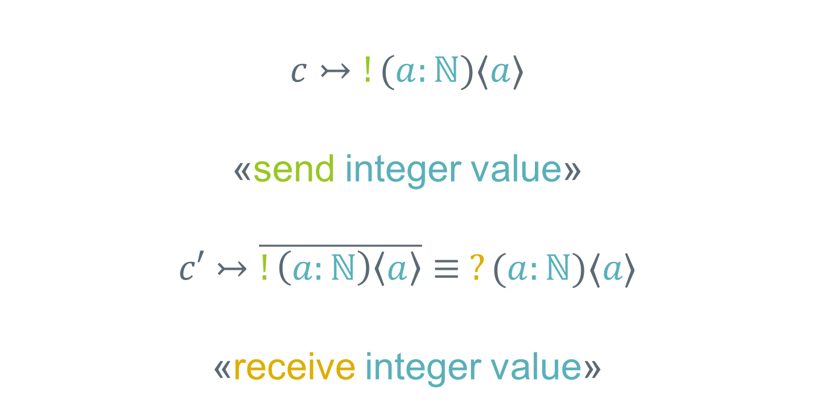
Dependent Separation Protocols
MOTIVATION
Duals
$$c↣!(a:ℕ)⟨a⟩$$
«send integer value»
$$c′↣\overline{!\left(a:ℕ\right)\left\langle a\right\rangle }≡ ?(a:ℕ)⟨a⟩$$
«receive integer value»
BACKGROUND
WHAT’S NEW
CASE STUDY
Notes:
- Taking the dual of a protocol
c, c’ are dependent
Sends to receives, and receives to sends («?» to «!», «!» to «?»)
Taking the dual twice results in the original protocol
Everthing we send is received

Slide 24
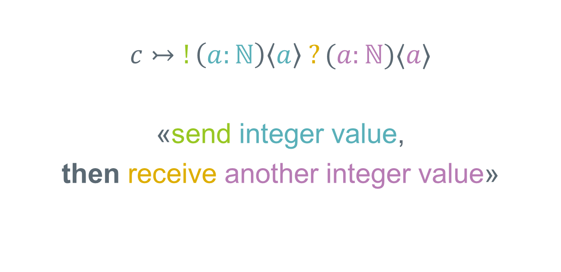
Dependent Separation Protocols
MOTIVATION
Composition
$$c↣!\left(a:ℕ\right)\left\langle a\right\rangle ?(a:ℕ)⟨a⟩$$
«send integer value,
then receive another integer value»
BACKGROUND
WHAT’S NEW
CASE STUDY
Notes:
- Composing protocols

Slide 25

Dependent Separation Protocols
MOTIVATION
Propositions
$$c↣!\left(a:ℕ\right)\left\langle a\right\rangle \{a>10\}$$
«send integer value greater than 10»
BACKGROUND
WHAT’S NEW
CASE STUDY
Notes:
- Curly brackets: Separation logic proposition

Slide 26

Dependent Separation Protocols
MOTIVATION
References
$$c↣!(l:\text{Loc})(b:ℕ)⟨l⟩\{l↦b\}$$
«send reference to integer value»
BACKGROUND
WHAT’S NEW
CASE STUDY
Notes:
Proposition communicates the ownership of l
b is never actually sent, only l

Slide 27
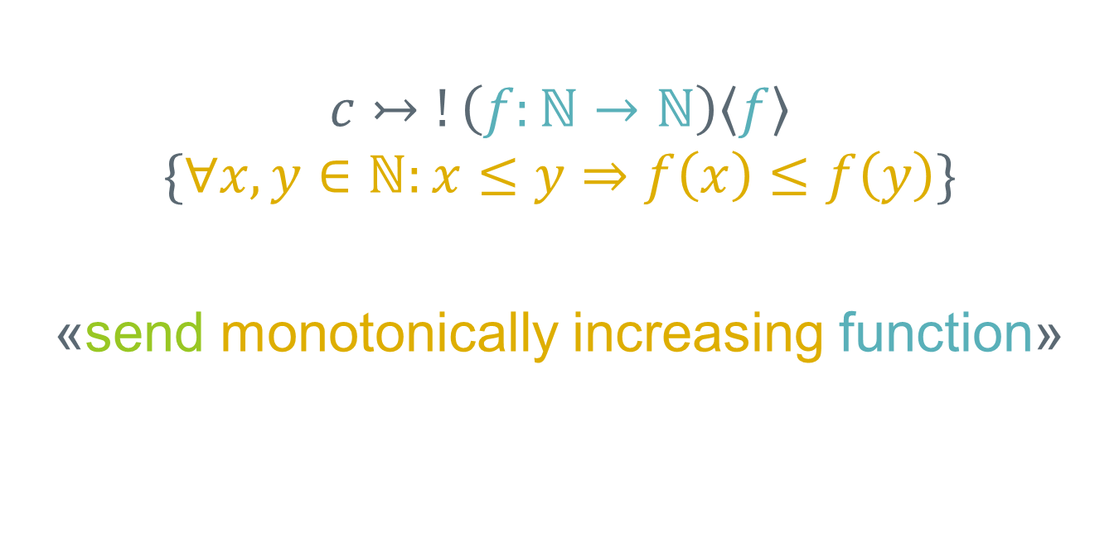
Dependent Separation Protocols
MOTIVATION
Functions
$$c↣!\left(f:ℕ→ℕ\right)\left\langle f\right\rangle$$
$$\{∀x,y∈ℕ:x≤y⇒f\left(x\right)≤f\left(y\right)\}$$
«send monotonically increasing function»
BACKGROUND
WHAT’S NEW
CASE STUDY

Slide 28
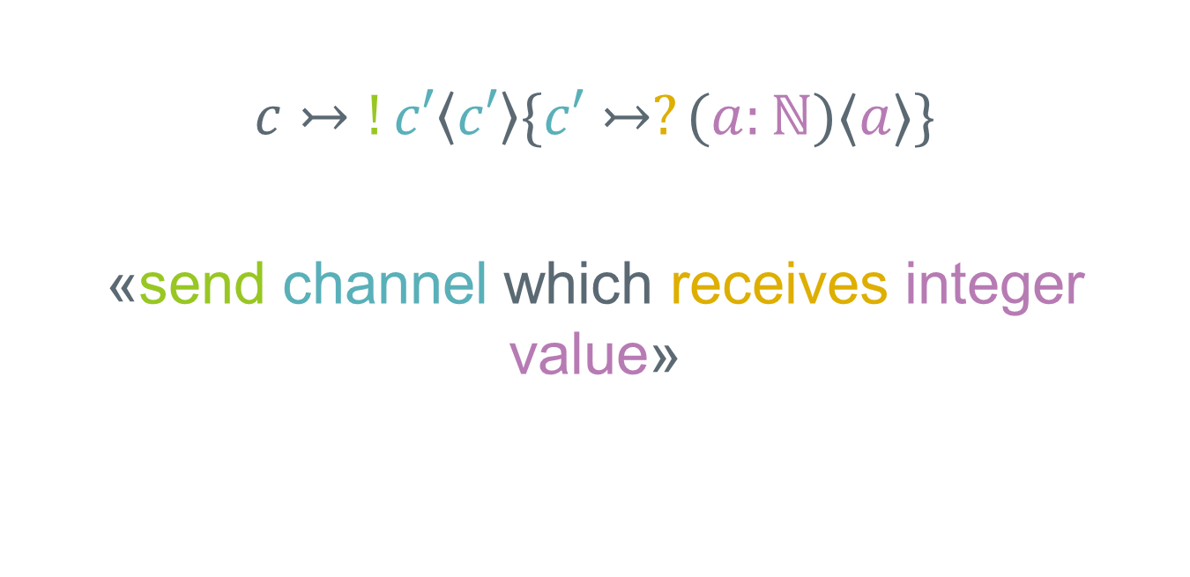
Dependent Separation Protocols
MOTIVATION
Delegation
$$c↣!c′\left\langle c′\right\rangle \{c′↣?(a:ℕ)⟨a⟩\}$$
«send channel which receives integer value»
BACKGROUND
WHAT’S NEW
CASE STUDY
Notes:
Delegation (sending channel endpoints over channels)

Slide 29
Message Passing Rules
MOTIVATION
Duality guarantees that any receive is matched with a send, and the other way around
c and c’ can be separated
BACKGROUND
WHAT’S NEW
CASE STUDY
Notes:
Tuple before dot denotes return value of new_chan function
Any send is matched with a receive which is needed to establish safety

Slide 30
Message Passing Rules
MOTIVATION
Duality guarantees that any receive is matched with a send, and the other way around
c and c’ can be separated
BACKGROUND
Requires send (!) type
P holds in precondition, but doesn’t hold in postcondition
Give up ownership of resources in P
WHAT’S NEW
CASE STUDY

Slide 31
Message Passing Rules
MOTIVATION
Duality guarantees that any receive is matched with a send, and the other way around
c and c’ can be separated
BACKGROUND
Requires send (!) type
P holds in precondition, but doesn’t hold in postcondition
Give up ownership of resources in P
WHAT’S NEW
Requires receive (?) type
P doesn’t hold in precondition, but holds in postcondition
Acqires the resources P
CASE STUDY
Notes:
- P in a sense is moved from sender to receiver, with it ownership over the resources

Slide 32
Dependent Separation Protocols
$$\{True\}$$
let (c, c’) = new_chan () in
fork {
let l = recv c’ in
l <- !l + 2;
send c’ ()
}
let l = ref 40 in
send c l;
recv c;
!l
MOTIVATION
Let’s try to verify this program!
BACKGROUND
WHAT’S NEW
CASE STUDY
$$\{42.\}$$
Notes:
- Previous work wasn’t able to verify this

Slide 33
Dependent Separation Protocols
$$\{True\}$$
let (c, c’) = new_chan () in
fork {
let l = recv c’ in
l <- !l + 2;
send c’ ()
}
let l = ref 40 in
send c l;
recv c;
!l
MOTIVATION
$$\{c↣prot∗c′↣\overline{prot}\}$$
BACKGROUND
WHAT’S NEW
CASE STUDY
$$\{42.\}$$
Notes:
Apply new_chan rule
Note c and c’ are duals (every receive matches a send and the other way around)

Slide 34
Dependent Separation Protocols
$$\{True\}$$
let (c, c’) = new_chan () in
fork {
let l = recv c’ in
l <- !l + 2;
send c’ ()
}
let l = ref 40 in
send c l;
recv c;
!l
MOTIVATION
$$\{c↣prot∗c′↣\overline{prot}\}$$
$$\left\{c^{′}↣\overline{prot}\right\}$$
BACKGROUND
$$\{c↣prot\}$$
WHAT’S NEW
CASE STUDY
$$\{42.\}$$
Notes:
- Can separate c, c’ because star operator

Slide 35
Dependent Separation Protocols
$$\{True\}$$
let (c, c’) = new_chan () in
fork {
let l = recv c’ in
l <- !l + 2;
send c’ ()
}
let l = ref 40 in
send c l;
recv c;
!l
MOTIVATION
$$\{c↣prot∗c′↣\overline{prot}\}$$
$$\left\{c^{′}↣\overline{prot}\right\}$$
BACKGROUND
$$\{c↣prot\}$$
WHAT’S NEW
$$\left\{c↣prot∗l↦x∗x=40\right\}$$
CASE STUDY
$$\{42.\}$$
Notes:
Indroduce new variable x which is equal to 40
l points to x

Slide 36
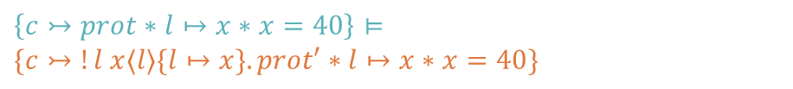

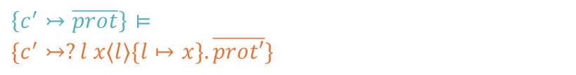
Dependent Separation Protocols
$$\{True\}$$
let (c, c’) = new_chan () in
fork {
let l = recv c’ in
l <- !l + 2;
send c’ ()
}
let l = ref 40 in
send c l;
recv c;
!l
MOTIVATION
$$\{c↣prot∗c′↣\overline{prot}\}$$
$$\left\{c^{′}↣\overline{prot}\right\}⊨$$
$$\{c^{′}↣?l x⟨l⟩\{l↦x\}.\overline{prot′}\}$$
$$prot=!l x\left\langle l\right\rangle \left\{l↦x\right\}.prot^{′}$$
BACKGROUND
$$\{c↣prot\}$$
WHAT’S NEW
$$\left\{c↣prot∗l↦x∗x=40\right\}⊨$$
$$\{c↣!l x⟨l⟩\{l↦x\}.prot′∗l↦x∗x=40\}$$
CASE STUDY
$$\{42.\}$$
Notes:
rewrite prot
bind l, x to prot
only send l, but l points to x
dual receives l instead

Slide 37


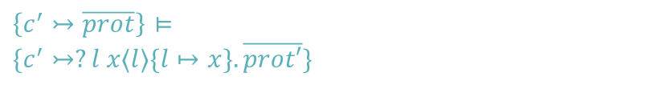
Dependent Separation Protocols
$$\{True\}$$
let (c, c’) = new_chan () in
fork {
let l = recv c’ in
l <- !l + 2;
send c’ ()
}
let l = ref 40 in
send c l;
recv c;
!l
MOTIVATION
$$\{c↣prot∗c′↣\overline{prot}\}$$
$$\left\{c^{′}↣\overline{prot}\right\}⊨$$
$$\{c^{′}↣?l x⟨l⟩\{l↦x\}.\overline{prot′}\}$$
$$prot=!l x\left\langle l\right\rangle \left\{l↦x\right\}.prot^{′}$$
BACKGROUND
$$\{c↣prot\}$$
WHAT’S NEW
$$\left\{c↣prot∗l↦x∗x=40\right\}⊨$$
$$\{c↣!l x⟨l⟩\{l↦x\}.prot′∗l↦x∗x=40\}$$
$$\left\{c↣prot^{′}∗x=40\right\}$$
CASE STUDY
$$\{42.\}$$
Notes:
Apply send rule
Main process no longer owns l
only prot’ is left

Slide 38
Dependent Separation Protocols
$$\{True\}$$
let (c, c’) = new_chan () in
fork {
let l = recv c’ in
l <- !l + 2;
send c’ ()
}
let l = ref 40 in
send c l;
recv c;
!l
MOTIVATION
$$\{c↣prot∗c′↣\overline{prot}\}$$
$$\left\{c^{′}↣\overline{prot}\right\}⊨$$
$$\{c^{′}↣?l x⟨l⟩\{l↦x\}.\overline{prot′}\}$$
$$prot=!l x\left\langle l\right\rangle \left\{l↦x\right\}.prot^{′}$$
$$\{c′↣ \overline{prot′}∗l↦x\}$$
BACKGROUND
$$\{c↣prot\}$$
WHAT’S NEW
$$\left\{c↣prot∗l↦x∗x=40\right\}⊨$$
$$\{c↣!l x⟨l⟩\{l↦x\}.prot′∗l↦x∗x=40\}$$
$$\left\{c↣prot^{′}∗x=40\right\}$$
CASE STUDY
$$\{42.\}$$
Notes:
l is now owned by forked process
only dual of prot’ left

Slide 39


Dependent Separation Protocols
$$\{True\}$$
let (c, c’) = new_chan () in
fork {
let l = recv c’ in
l <- !l + 2;
send c’ ()
}
let l = ref 40 in
send c l;
recv c;
!l
MOTIVATION
$$\{c↣prot∗c′↣\overline{prot}\}$$
$$\left\{c^{′}↣\overline{prot}\right\}⊨$$
$$\{c^{′}↣?l x⟨l⟩\{l↦x\}.\overline{prot′}\}$$
$$prot=!l x\left\langle l\right\rangle \left\{l↦x\right\}.prot^{′}$$
$$\{c′↣ \overline{prot′}∗l↦x\}$$
BACKGROUND
$$\left\{c^{′}↣ \overline{prot^{′}}∗l↦x+2\right\}$$
$$\{c↣prot\}$$
WHAT’S NEW
$$\left\{c↣prot∗l↦x∗x=40\right\}⊨$$
$$\{c↣!l x⟨l⟩\{l↦x\}.prot′∗l↦x∗x=40\}$$
$$\left\{c↣prot^{′}∗x=40\right\}$$
CASE STUDY
$$\{42.\}$$
Notes:
- l points to x + 2

Slide 40

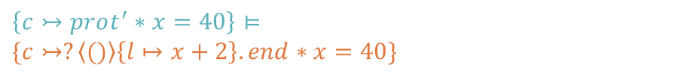

Dependent Separation Protocols
$$\{True\}$$
let (c, c’) = new_chan () in
fork {
let l = recv c’ in
l <- !l + 2;
send c’ ()
}
let l = ref 40 in
send c l;
recv c;
!l
MOTIVATION
$$\{c↣prot∗c′↣\overline{prot}\}$$
$$\left\{c^{′}↣\overline{prot}\right\}⊨$$
$$\{c^{′}↣?l x⟨l⟩\{l↦x\}.\overline{prot′}\}$$
$$prot=!l x\left\langle l\right\rangle \left\{l↦x\right\}.prot^{′}$$
$$prot^{′}= ?\left\langle ()\right\rangle \left\{l↦x+2\right\}.end$$
$$\{c′↣ \overline{prot′}∗l↦x\}$$
BACKGROUND
$$\left\{c^{′}↣ \overline{prot^{′}}∗l↦x+2\right\}⊨$$
$$\{c^{′}↣!\left\langle ()\right\rangle \left\{l↦x+2\right\}.end∗l↦x+2\}$$
$$\{c↣prot\}$$
WHAT’S NEW
$$\left\{c↣prot∗l↦x∗x=40\right\}⊨$$
$$\{c↣!l x⟨l⟩\{l↦x\}.prot′∗l↦x∗x=40\}$$
$$\left\{c↣prot^{′}∗x=40\right\}⊨$$
$$\{c↣?\left\langle ()\right\rangle \left\{l↦x+2\right\}.end∗x=40\}$$
CASE STUDY
$$\{42.\}$$
Notes:
Rewrite prot’
Send unit type, but ownership is still transferred
c receives unit type because it is dual of c’

Slide 41

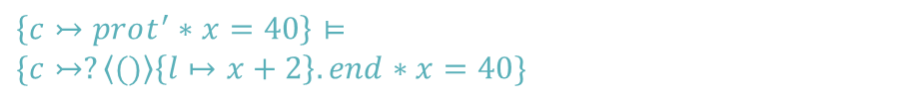

Dependent Separation Protocols
$$\{True\}$$
let (c, c’) = new_chan () in
fork {
let l = recv c’ in
l <- !l + 2;
send c’ ()
}
let l = ref 40 in
send c l;
recv c;
!l
MOTIVATION
$$\{c↣prot∗c′↣\overline{prot}\}$$
$$\left\{c^{′}↣\overline{prot}\right\}⊨$$
$$\{c^{′}↣?l x⟨l⟩\{l↦x\}.\overline{prot′}\}$$
$$prot=!l x\left\langle l\right\rangle \left\{l↦x\right\}.prot^{′}$$
$$prot^{′}= ?\left\langle ()\right\rangle \left\{l↦x+2\right\}.end$$
$$\{c′↣ \overline{prot′}∗l↦x\}$$
BACKGROUND
$$\left\{c^{′}↣ \overline{prot^{′}}∗l↦x+2\right\}⊨$$
$$\{c^{′}↣!\left\langle ()\right\rangle \left\{l↦x+2\right\}.end∗l↦x+2\}$$
$$\{c′↣end\}$$
$$\{c↣prot\}$$
WHAT’S NEW
$$\left\{c↣prot∗l↦x∗x=40\right\}⊨$$
$$\{c↣!l x⟨l⟩\{l↦x\}.prot′∗l↦x∗x=40\}$$
$$\left\{c↣prot^{′}∗x=40\right\}⊨$$
$$\{c↣?\left\langle ()\right\rangle \left\{l↦x+2\right\}.end∗x=40\}$$
CASE STUDY
$$\{42.\}$$
Notes:
After send, forked process no longer owns l
c’ is end

Slide 42
Dependent Separation Protocols
$$\{True\}$$
let (c, c’) = new_chan () in
fork {
let l = recv c’ in
l <- !l + 2;
send c’ ()
}
let l = ref 40 in
send c l;
recv c;
!l
MOTIVATION
$$\{c↣prot∗c′↣\overline{prot}\}$$
$$\left\{c^{′}↣\overline{prot}\right\}⊨$$
$$\{c^{′}↣?l x⟨l⟩\{l↦x\}.\overline{prot′}\}$$
$$prot=!l x\left\langle l\right\rangle \left\{l↦x\right\}.prot^{′}$$
$$prot^{′}= ?\left\langle ()\right\rangle \left\{l↦x+2\right\}.end$$
$$\{c′↣ \overline{prot′}∗l↦x\}$$
BACKGROUND
$$\left\{c^{′}↣ \overline{prot^{′}}∗l↦x+2\right\}⊨$$
$$\{c^{′}↣!\left\langle ()\right\rangle \left\{l↦x+2\right\}.end∗l↦x+2\}$$
$$\{c′↣end\}$$
$$\{c↣prot\}$$
WHAT’S NEW
$$\left\{c↣prot∗l↦x∗x=40\right\}⊨$$
$$\{c↣!l x⟨l⟩\{l↦x\}.prot′∗l↦x∗x=40\}$$
$$\left\{c↣prot^{′}∗x=40\right\}⊨$$
$$\{c↣?\left\langle ()\right\rangle \left\{l↦x+2\right\}.end∗x=40\}$$
$$\{c↣end∗l↦x+2∗x=40\}$$
CASE STUDY
$$\{42.\}$$
Notes:
c is end
main process aquires ownership of l again
now l points to x + 2, and x = 40

Slide 43
Dependent Separation Protocols
$$\{True\}$$
let (c, c’) = new_chan () in
fork {
let l = recv c’ in
l <- !l + 2;
send c’ ()
}
let l = ref 40 in
send c l;
recv c;
!l
MOTIVATION
$$\{c↣prot∗c′↣\overline{prot}\}$$
$$\left\{c^{′}↣\overline{prot}\right\}⊨$$
$$\{c^{′}↣?l x⟨l⟩\{l↦x\}.\overline{prot′}\}$$
$$prot=!l x\left\langle l\right\rangle \left\{l↦x\right\}.prot^{′}$$
$$prot^{′}= ?\left\langle ()\right\rangle \left\{l↦x+2\right\}.end$$
$$\{c′↣ \overline{prot′}∗l↦x\}$$
BACKGROUND
$$\left\{c^{′}↣ \overline{prot^{′}}∗l↦x+2\right\}⊨$$
$$\{c^{′}↣!\left\langle ()\right\rangle \left\{l↦x+2\right\}.end∗l↦x+2\}$$
$$\{c′↣end\}$$
$$\{c↣prot\}$$
WHAT’S NEW
$$\left\{c↣prot∗l↦x∗x=40\right\}⊨$$
$$\{c↣!l x⟨l⟩\{l↦x\}.prot′∗l↦x∗x=40\}$$
$$\left\{c↣prot^{′}∗x=40\right\}⊨$$
$$\{c↣?\left\langle ()\right\rangle \left\{l↦x+2\right\}.end∗x=40\}$$
$$\{c↣end∗l↦x+2∗x=40\}$$
CASE STUDY
$$\{x+2. c↣end∗l↦x+2∗x=40\}⊨$$
$$\{42.\}$$
Notes:
return x+2
but x = 40, output is 42

Slide 44
Dependent Separation Protocols
$$\{True\}$$
let (c, c’) = new_chan () in
fork {
let l = recv c’ in
l <- !l + 2;
send c’ ()
}
let l = ref 40 in
send c l;
recv c;
!l
MOTIVATION
$$\{c↣prot∗c′↣\overline{prot}\}$$
$$\left\{c^{′}↣\overline{prot}\right\}⊨$$
$$\{c^{′}↣?l x⟨l⟩\{l↦x\}.\overline{prot′}\}$$
$$prot=!l x\left\langle l\right\rangle \left\{l↦x\right\}.prot^{′}$$
$$prot^{′}= ?\left\langle ()\right\rangle \left\{l↦x+2\right\}.end$$
$$\{c′↣ \overline{prot′}∗l↦x\}$$
BACKGROUND
Safety: The program will not get stuck
Postcondition validity: If the program terminates, the postcondition holds
$$\left\{c^{′}↣ \overline{prot^{′}}∗l↦x+2\right\}⊨$$
$$\{c^{′}↣!\left\langle ()\right\rangle \left\{l↦x+2\right\}.end∗l↦x+2\}$$
$$\{c′↣end\}$$
$$\{c↣prot\}$$
WHAT’S NEW
$$\left\{c↣prot∗l↦x∗x=40\right\}⊨$$
$$\{c↣!l x⟨l⟩\{l↦x\}.prot′∗l↦x∗x=40\}$$
$$\left\{c↣prot^{′}∗x=40\right\}⊨$$
$$\{c↣?\left\langle ()\right\rangle \left\{l↦x+2\right\}.end∗x=40\}$$
$$\{c↣end∗l↦x+2∗x=40\}$$
CASE STUDY
$$\{x+2. c↣end∗l↦x+2∗x=40\}⊨$$
$$\{42.\}$$
Notes:
Previous work wasn’t able to verify this
We have now proven safety and postcondition validity

Slide 45
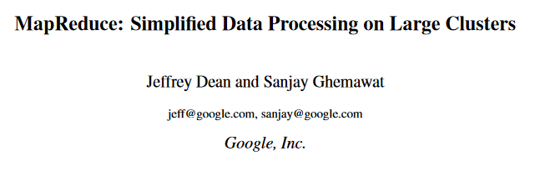
Map-Reduce
MOTIVATION
«Hundreds of MapReduce programs have been implemented and upwards of one thousand MapReduce jobs are executed on Google's clusters everyday.»
BACKGROUND
Dean and Ghemawat [2004]
WHAT’S NEW
CASE STUDY
Notes:
Paper used this new logic to verifiy map-reduce algorithm as a case study
Distributed algorithm to process big datasets
read quote
BUT: Verified their own implementation, not actually Google’s version

Slide 46

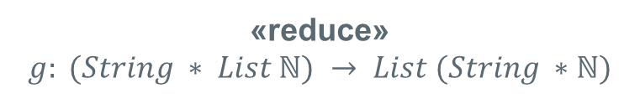
Map-Reduce
MOTIVATION
[Mephisto, Mephisto, Faust]
flatMap f
[Gretchen, Faust ,Faust]
(Mephisto, 2)
group
(Gretchen, 1)
(Faust, 1)
(Faust, 2)
(Mephisto, [2])
flatMap g
(Faust, [1, 2])
(Gretchen, [1])
(Mephisto, 2)
end
(Faust, 3)
(Gretchen, 1)
BACKGROUND
WHAT’S NEW
«map»
$$f: String→List (String ∗ℕ)$$
«reduce»
$$g: (String ∗ List ℕ) → List (String ∗ℕ)$$
CASE STUDY
Notes:
Example: Counting words
We want to compute the mappings f and g in parallel
Use message passing to communicate

Slide 47
Map-Reduce
MOTIVATION
Distributed Load-Balancing Mapper
Worker 1
Worker 2
Worker 3
...
Worker n
Load-balancing mapper sends some work to be mapped
BACKGROUND
WHAT’S NEW
CASE STUDY
Notes:
- How do we distribute the work

Slide 48
Map-Reduce
MOTIVATION
Distributed Load-Balancing Mapper
Worker 1
Worker 2
Worker 3
...
Worker n
Load-balancing mapper sends some work to be mapped
Same channel endpoint used by all the workers («manifest sharing»)
BACKGROUND
WHAT’S NEW
CASE STUDY
Notes:
- Sharing of a channel endpoint using locks is called manifest sharing

Slide 49

Map-Reduce
MOTIVATION
Distributed Load-Balancing Mapper
Worker 1
Worker 2
Worker 3
...
Worker n
Load-balancing mapper sends some work to be mapped
Same channel endpoint used by all the workers («manifest sharing»)
Some worker acquires the lock on the channel endpoint, receives the work and releases the lock
BACKGROUND
WHAT’S NEW
CASE STUDY

Slide 50
Map-Reduce
MOTIVATION
Distributed Load-Balancing Mapper
Worker 1
Worker 2
Worker 3
...
Worker n
Load-balancing mapper sends some work to be mapped
Same channel endpoint used by all the workers («manifest sharing»)
Some worker acquires the lock on the channel endpoint, receives the work and releases the lock
Support for multiple concurrency protocols needed
BACKGROUND
WHAT’S NEW
CASE STUDY
Notes:
- Support for locks needed
- Actris can verify map reduce because it inherits support for locks from Iris

Slide 51
Map-Reduce
MOTIVATION
Previous work was able to verify this too, but only for specific mappers and reducers
With Actris, verification is possible for general mappers and reducers
Actris is expressive enough to talk about complex mixed concurrency models, e.g. endpoint sharing using locks
 | Lines of Code
Implementation | 165
Proof | 627
BACKGROUND
WHAT’S NEW
CASE STUDY
Notes:
Proof of map-reduce is provided by the paper
About 4 times as many lines of proof as there are lines of implementation

Slide 52
Summary
MOTIVATION
Support for programs that use a combination of concurrency paradigms
Use dependent separation protocols
  Uses separation logic
  Inspired by session types
Prove functional correctness of Map-Reduce
Future Work
  Multy-party dependent separation protocols
  Proofs of deadlock-freedom
BACKGROUND
WHAT’S NEW
CASE STUDY

Slide 53
Summary
MOTIVATION
Support for programs that use a combination of concurrency paradigms
Use dependent separation protocols
  Uses separation logic
  Inspired by session types
Prove functional correctness of Map-Reduce
Future Work
  Multy-party dependent separation protocols
  Proofs of deadlock-freedom
BACKGROUND
WHAT’S NEW
CASE STUDY

Slide 54
Summary
MOTIVATION
Support for programs that use a combination of concurrency paradigms
Use dependent separation protocols
  Uses separation logic
  Inspired by session types
Prove functional correctness of Map-Reduce
Future Work
  Multy-party dependent separation protocols
  Proofs of deadlock-freedom
BACKGROUND
WHAT’S NEW
CASE STUDY

Slide 55
Limitations and Future Work
Limitations
Future Work
Channel endpoints can only be shared using Locks
«Only» proves safety and postcondition validity
Not clear how to verify «real» programs
Multy-party dependent separation protocols
Proofs of deadlock-freedom
Notes:
Locking needed for enpoint sharing
But endpoint sharing is used often => Support for multy party dependent separation protocols
What about deadlock freedom, resoucre-leak freedom?
Build Actris on top of another framework to support other guarantees
Proves only programs written in Coq proof assistant, still need 4 lines of proof for every line of implementation

