Slide 1
Jupyter notebooks
(.ipynb)
Scrips for notebooks
(*_for_nb.py)
Basic scrips
(*.py)
preprocessing.ipynb
segmentation_sa.ipynb
find_reference.ipynb
segmentation_quality.ipynb
morphology.ipynb
relaxometry_EPG.ipynb
relaxometry_fitting.ipynb
preprocessing_for_nb.py
segmentation_sa_for_nb.py
find_reference_for_nb.py
segmentation_quality_for_nb.py
morphology_for_nb.py
relaxometry_for_nb.py
elastix_transformix.py
find_reference_functions.py
find_reference_random_gen.py
morphology_functions.py
relaxometry_functions.py
sitk_functions.py
pykneer_io.py
codeScheme.png

Slide 2

preprocessing
segmentation
analysis
preprocessing.ipynb
atlas-based (single atlas)
morphology
segmentation_sa.ipynb
find_reference.ipynb
segmentation_quality.ipynb
morphology.ipynb
relaxometry_fitting.ipynb
relaxometry_EPG.ipynb
validation
relaxometry
moduleNotebooks.png
preprocessing
segmentation
analysis
preprocessing.ipynb
atlas-based (single atlas)
morphology
segmentation_sa_ns.ipynb
segmentation_sa_mm.ipynb
find_reference.ipynb
segmentation_quality.ipynb
morphology.ipynb
relaxometry_fitting.ipynb
relaxometry_EPG.ipynb
validation
relaxometry
demoNotebooks.png

Slide 3
preprocessing
segmentation
analysis
prep_dicom_folders.ipynb
preprocessing.ipynb
atlas-based (single atlas)
morphology
segmentation_sa.ipynb
find_reference_sa.ipynb
segmentation_quality.ipynb
morphology.ipynb
relaxometry_fitting.ipynb
relaxometry_EPG.ipynb
validation
relaxometry
moduleNotebooks.png
preprocessing
segmentation
analysis
prep_dicom_folders.ipynb
preprocessing.ipynb
atlas-based (single atlas)
morphology
segmentation_sa_ns.ipynb
segmentation_sa_mm.ipynb
find_reference_sa.ipynb
segmentation_quality.ipynb
morphology.ipynb
relaxometry_fitting.ipynb
relaxometry_EPG.ipynb
validation
relaxometry
demoNotebooks.png

Slide 4
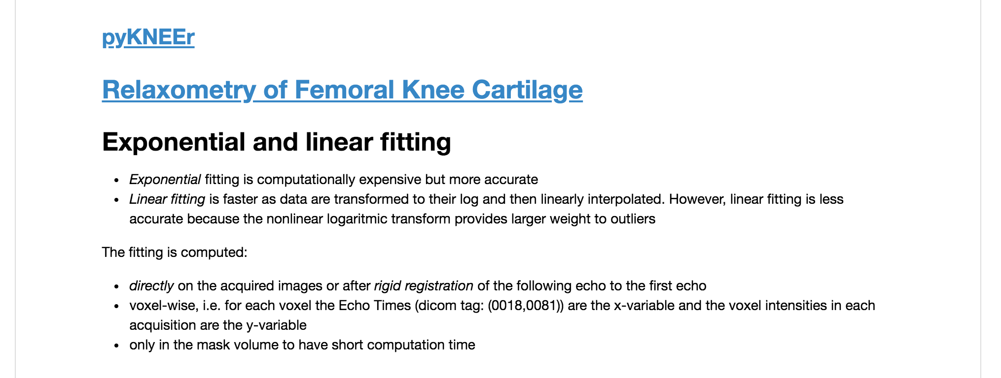
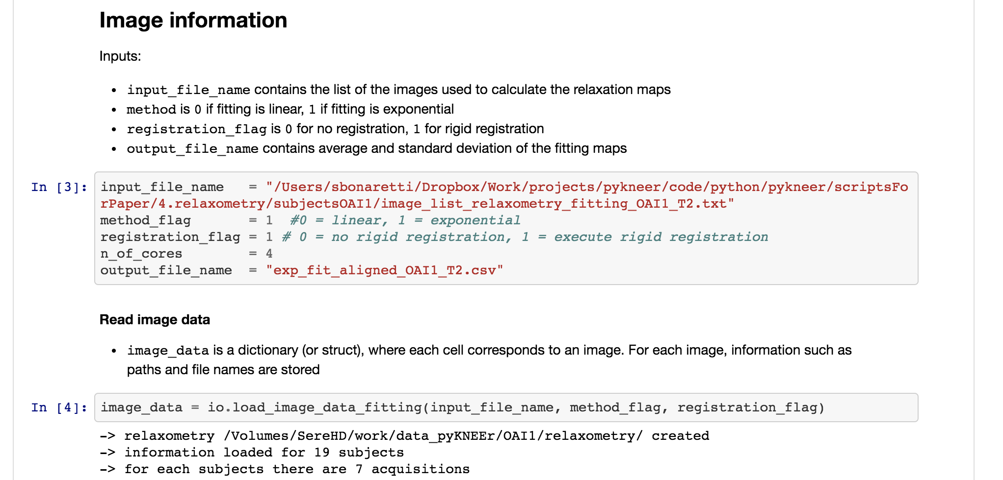
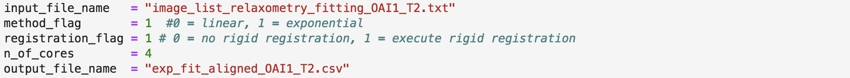
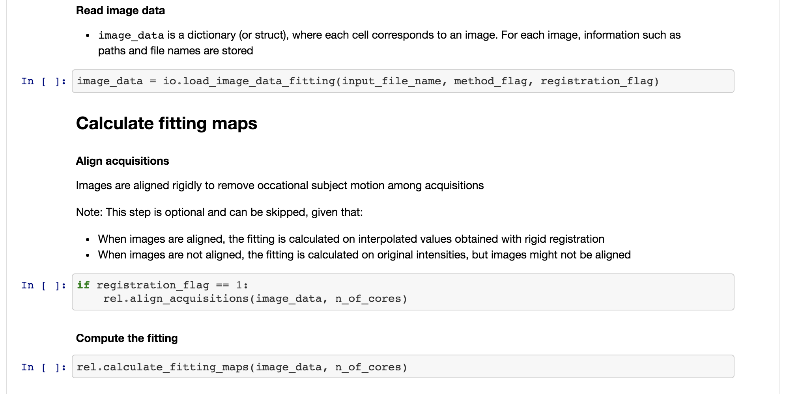

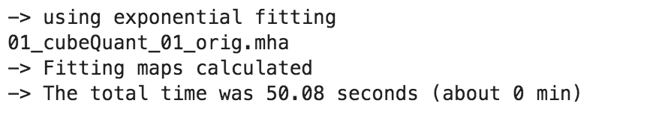
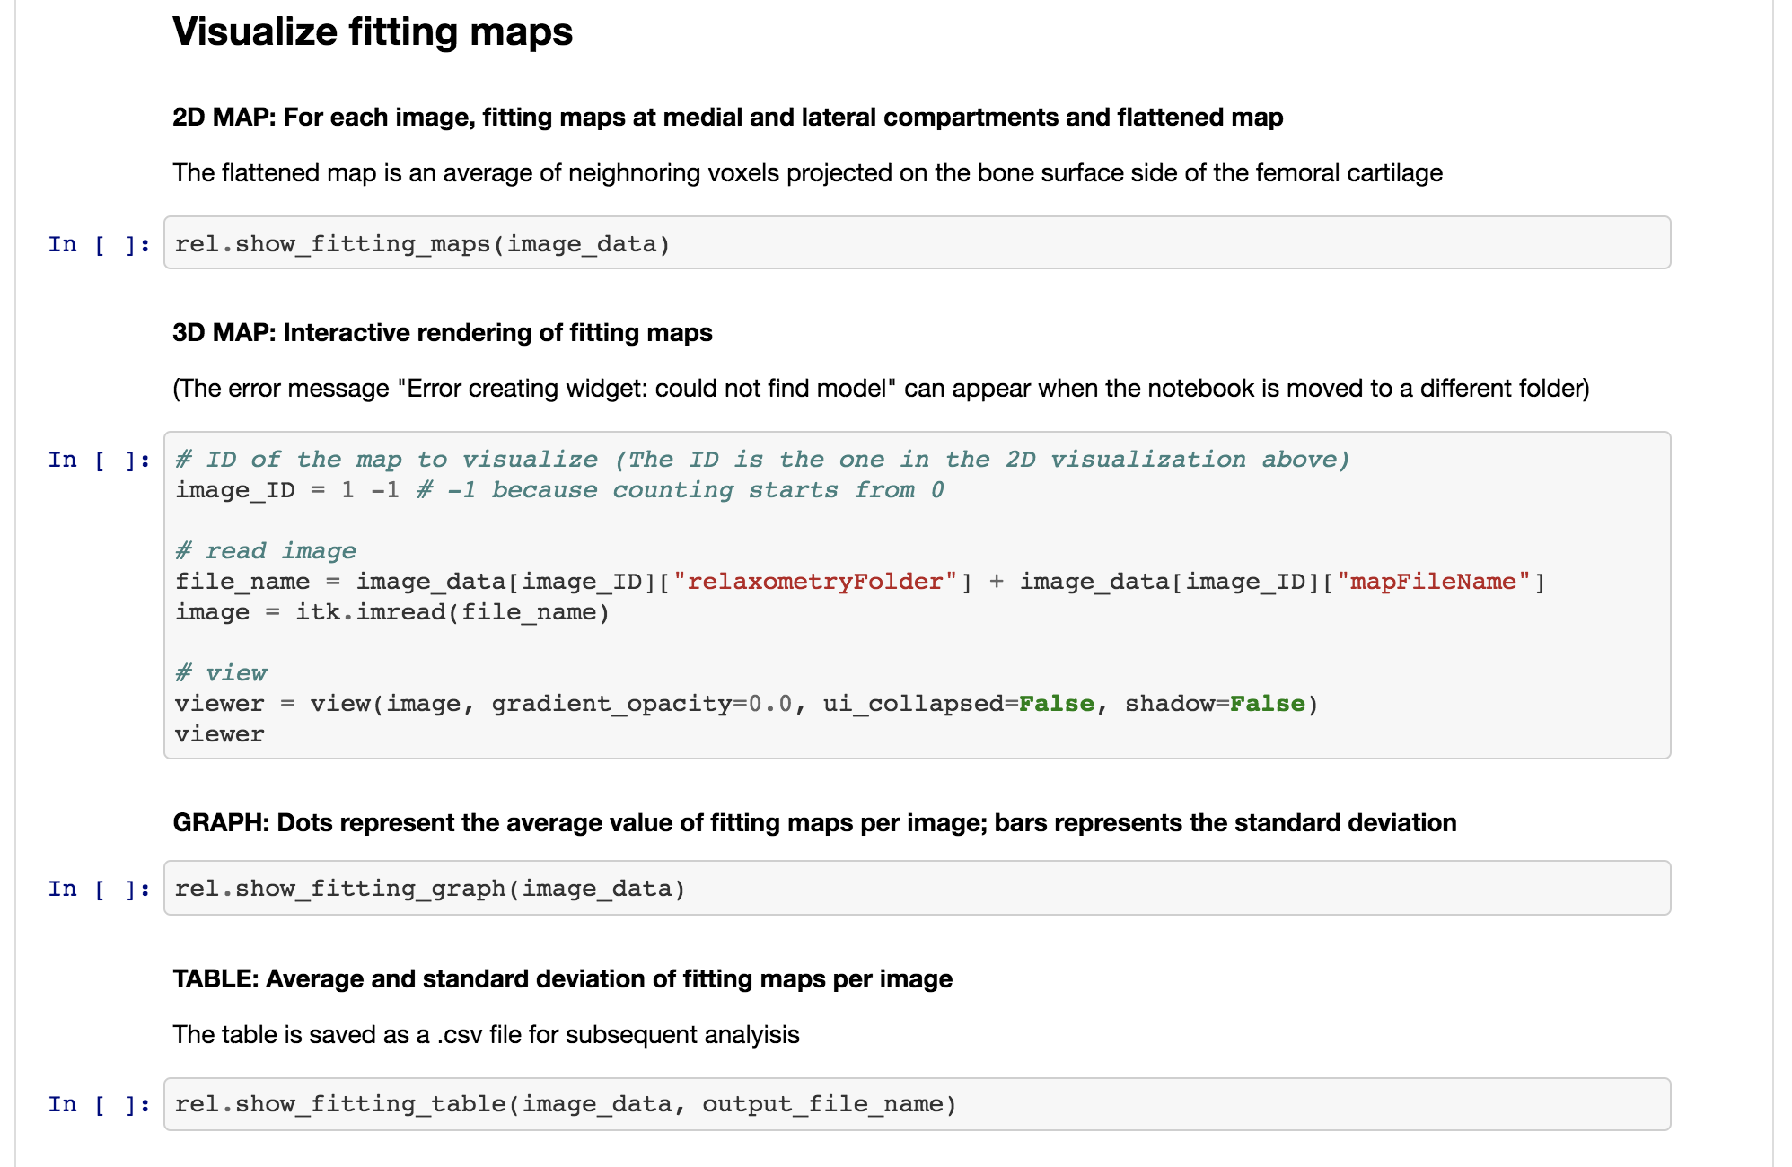
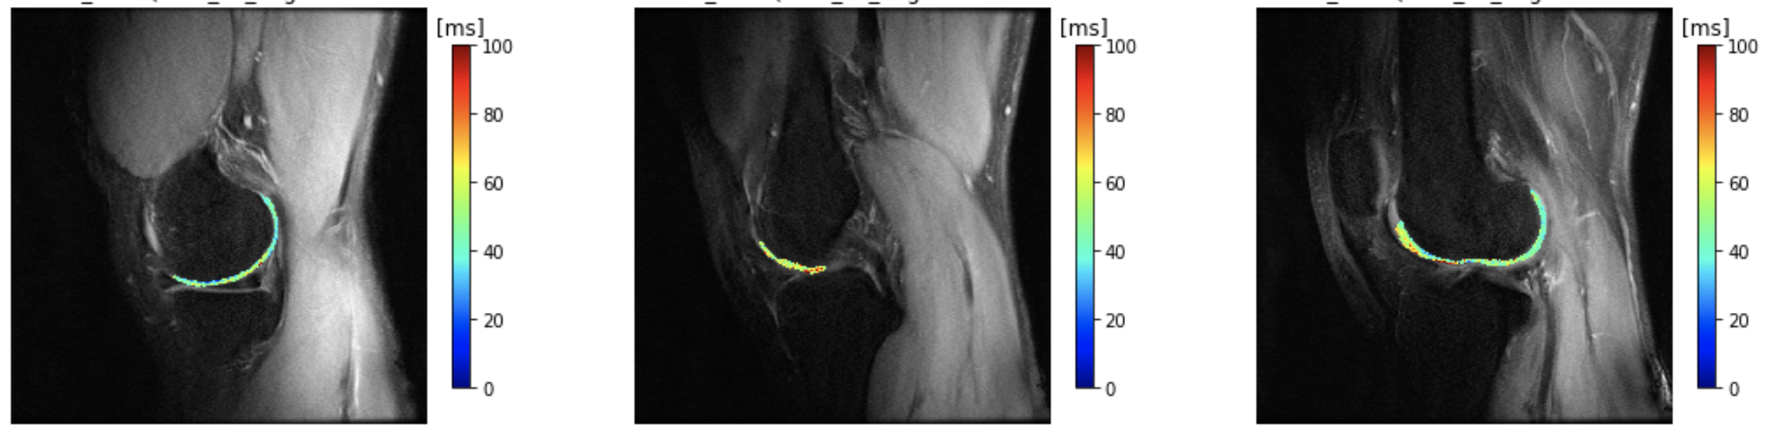
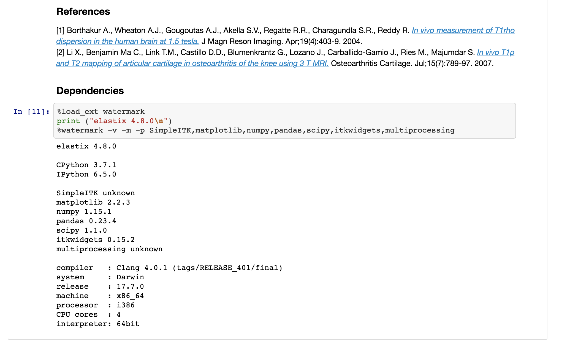
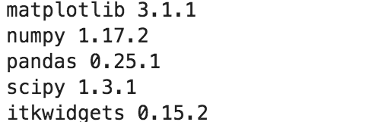
link to GitHub repository
link to documentation
introduction
user inputs
commands with narrative
visualization of outputs
references
dependencies
notebookStructure.png

Slide 5
notebookStructure.png

Slide 6
1. Link to GitHub repository
2. Link to documentation
3. Introduction
4. User inputs
5. Commands with narrative
6. Visualization of outputs
7. References
8. Dependencies
link to GitHub repository
link to documentation
introduction
user inputs
commands with narrative
visualization of outputs
references
dependencies

Slide 7
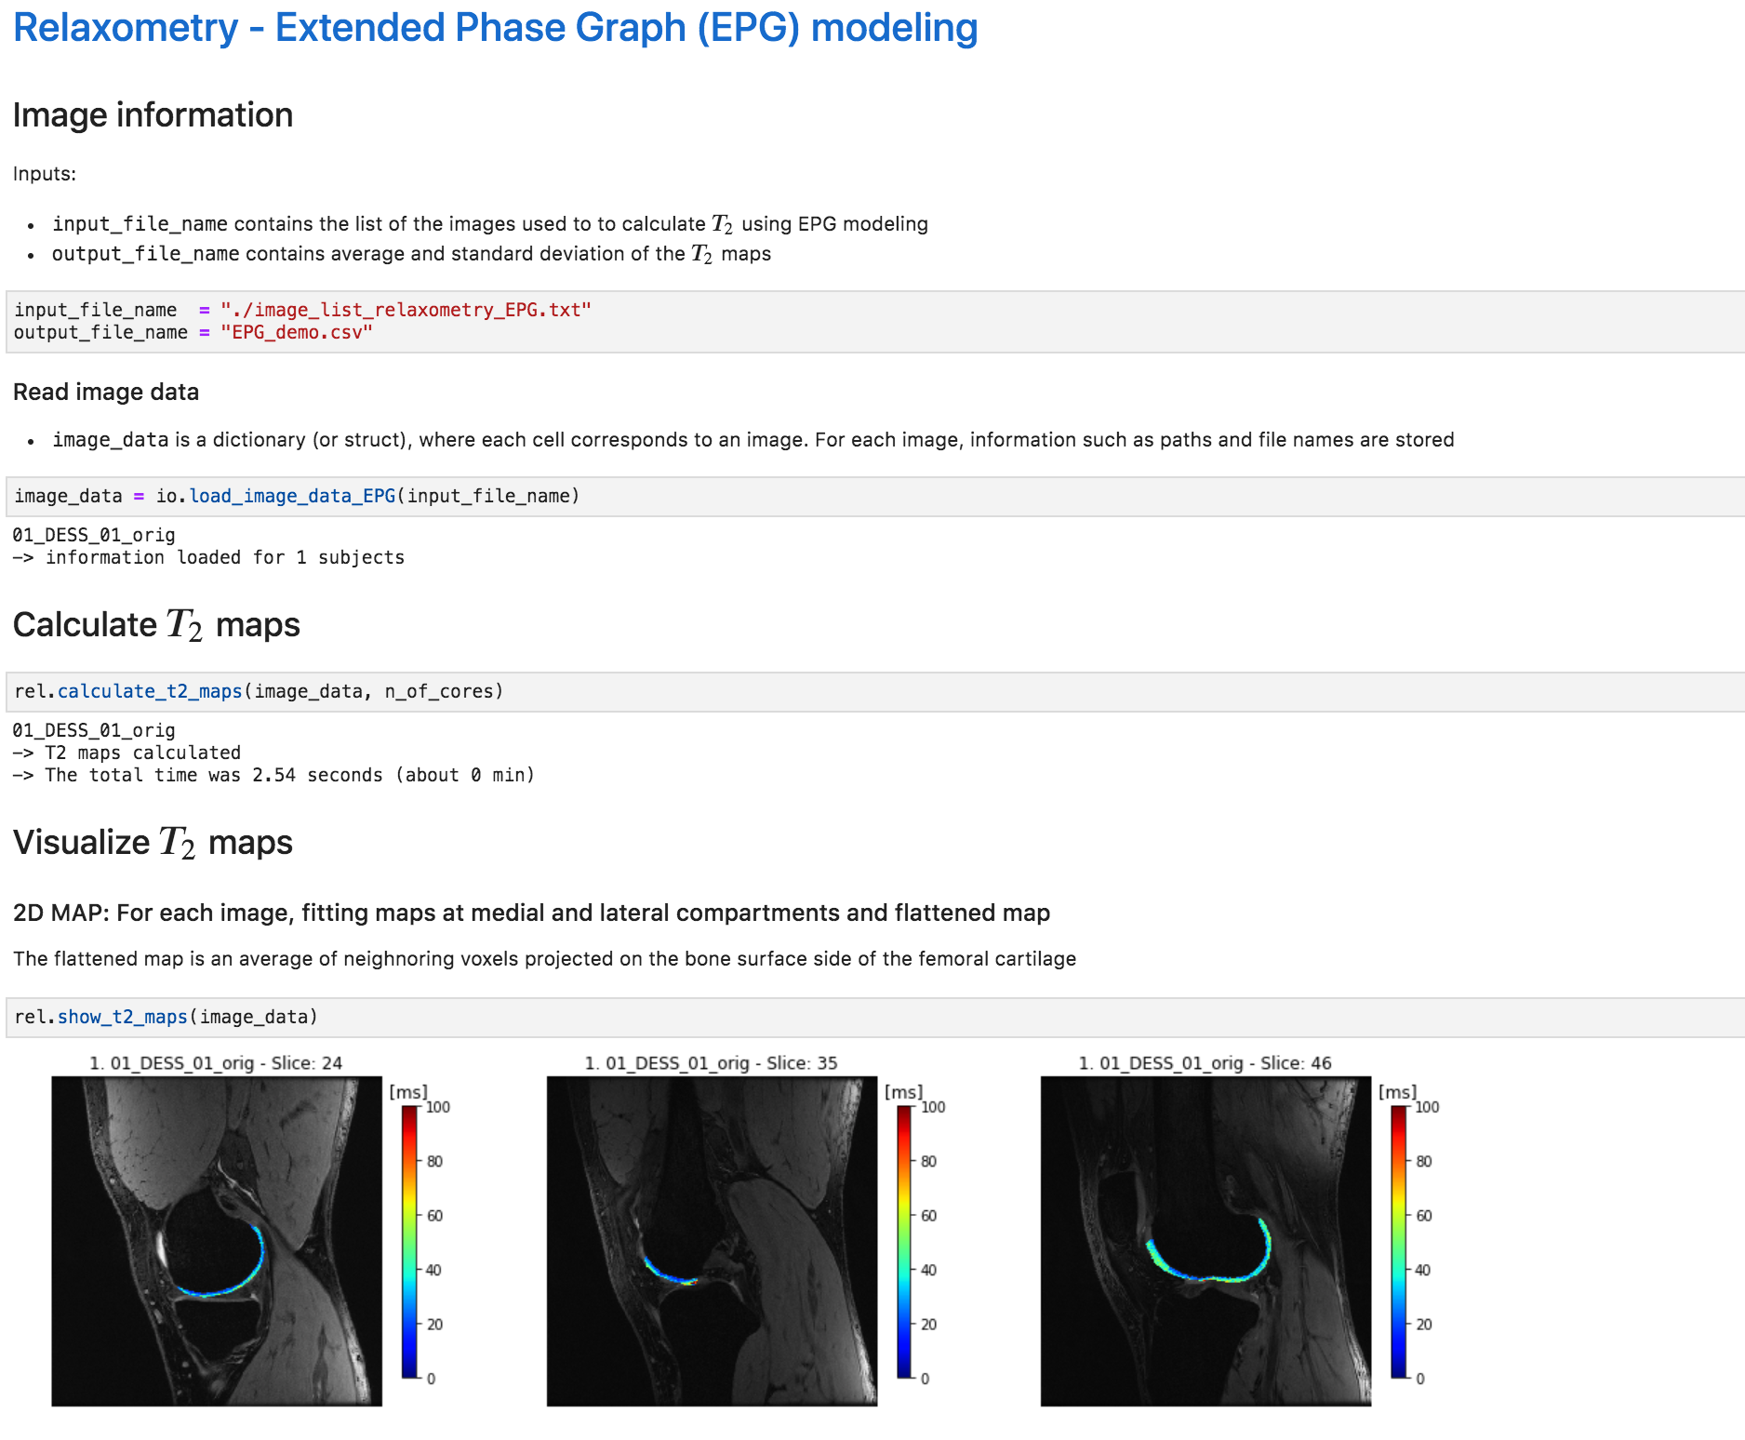
1. Link to GitHub repository
1. Link to documentation
3. Introduction
4. User inputs
5. Commands with narrative
6. Visualization of outputs
7. References
8. Dependencies

