Slide 1

Streamlining Urban CFD Simulations: An Automated Workflow for SOD2D pre-processing
Fabián Hernández¹, Ivette Rodríguez¹, Oriol Lehmkuhl²
¹ TUAREG - Turbulence and Aerodynamics Research Group, Universitat Politècnica de Catalunya
² LS-CFD – Large-Scale Computational Fluid Dynamics,
Barcelona Supercomputing Center

Slide 2




outline
BACKGROUND
Expansion for Digital Twins
EXPLORATION
City4CFD
Open source datasets
METHODOLOGY
City4CFD
ANSA scripting
SIMULATION
CEDVAL case
Monterrey case
Terrassa case
FUTURE WORK
FLIC

Slide 3
outline
BACKGROUND
Expansion for Digital Twins
EXPLORATION
City4CFD
Open source datasets
METHODOLOGY
City4CFD
ANSA scripting
SIMULATION
CEDVAL case
Monterrey case
Terrassa case
FUTURE WORK
FLIC

Slide 4



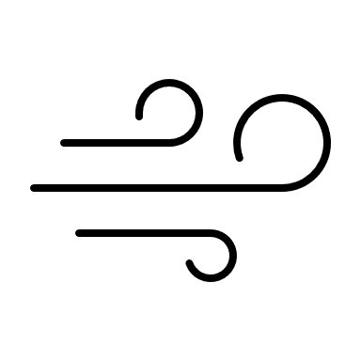
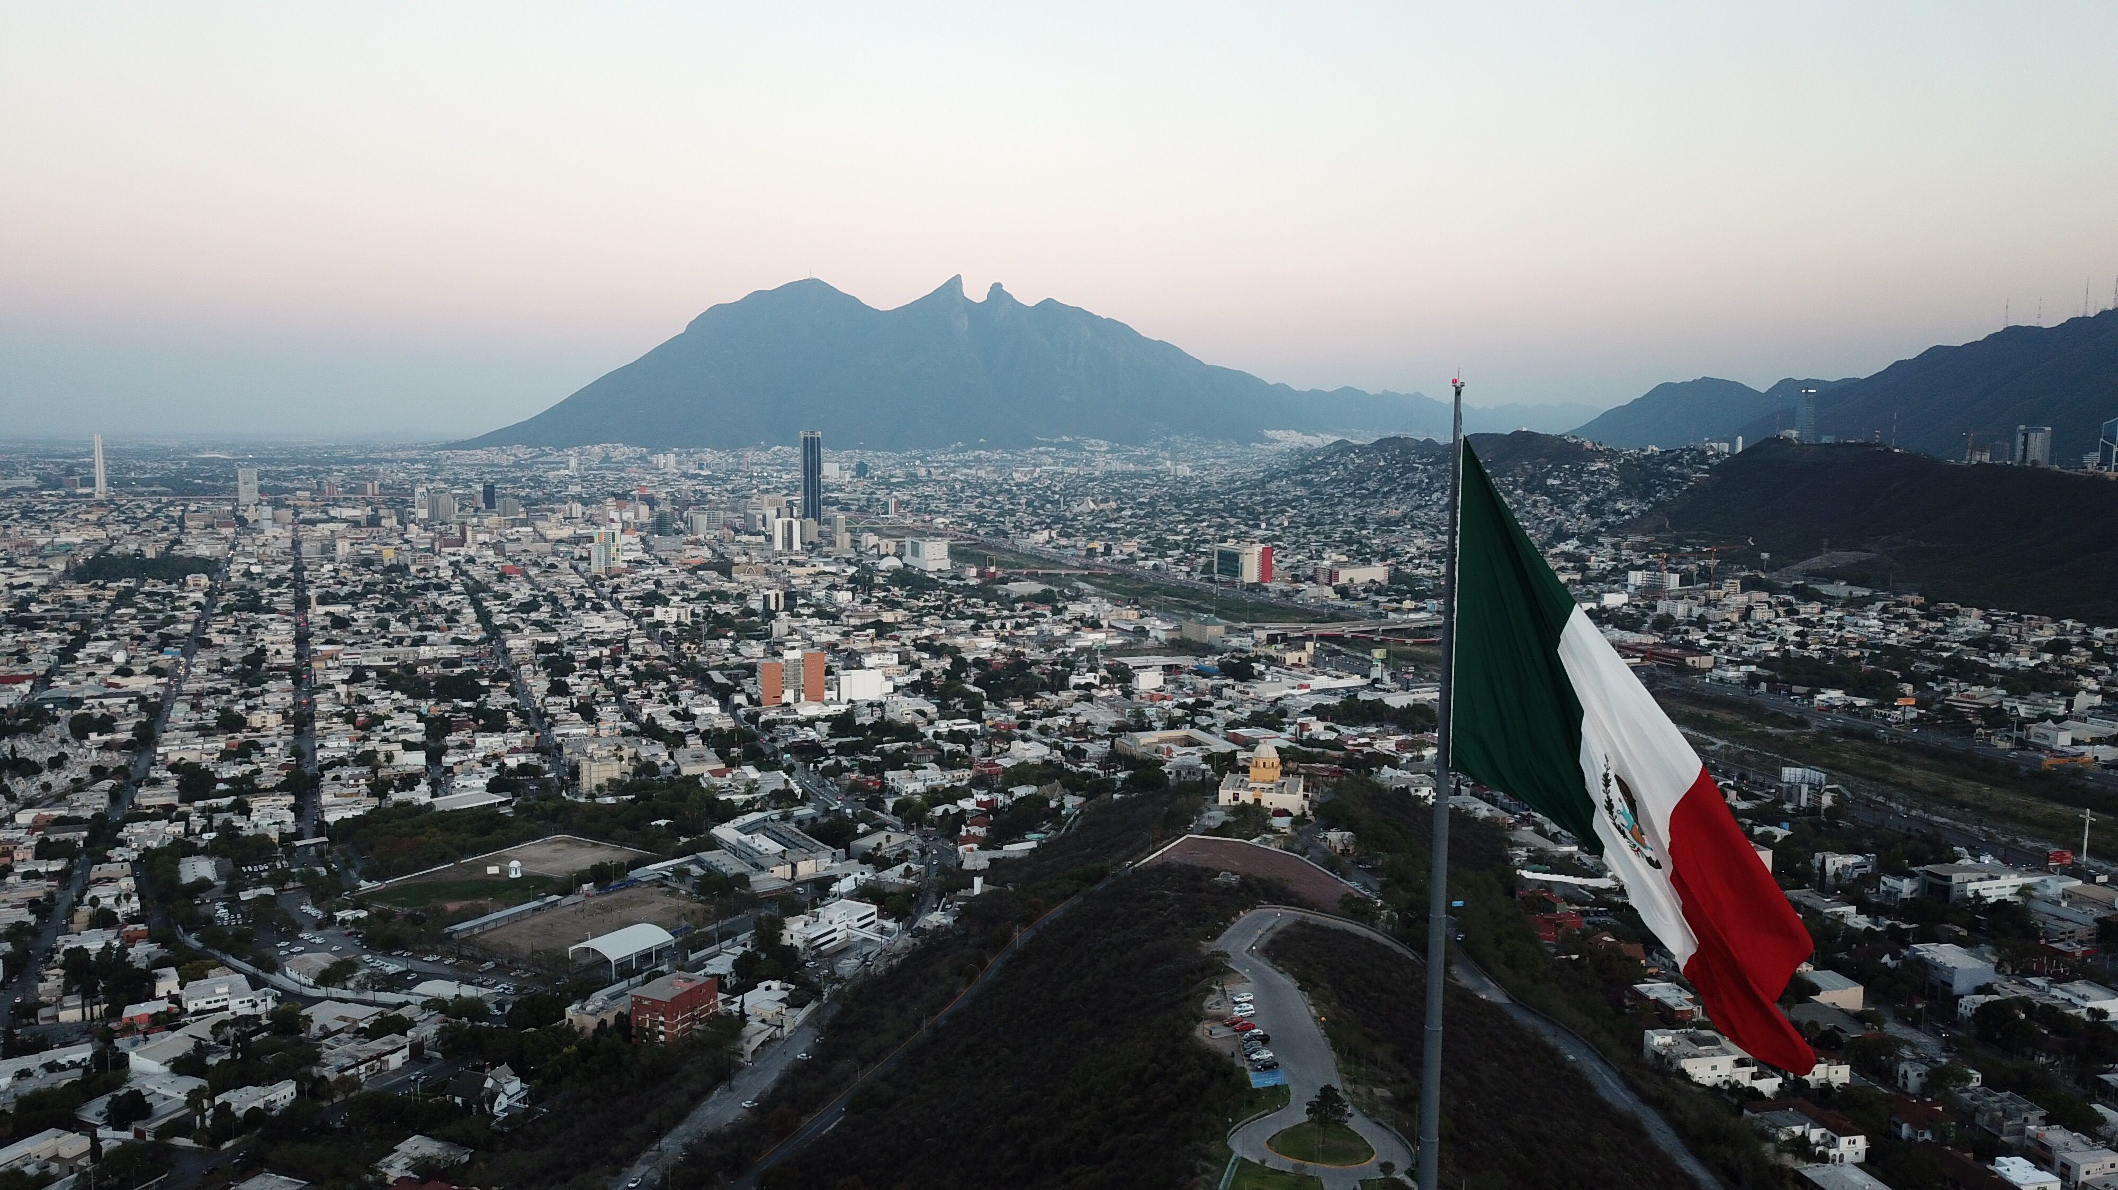

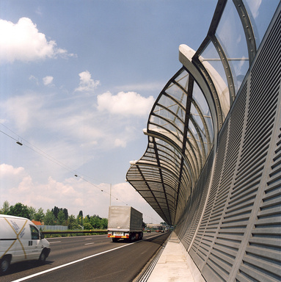
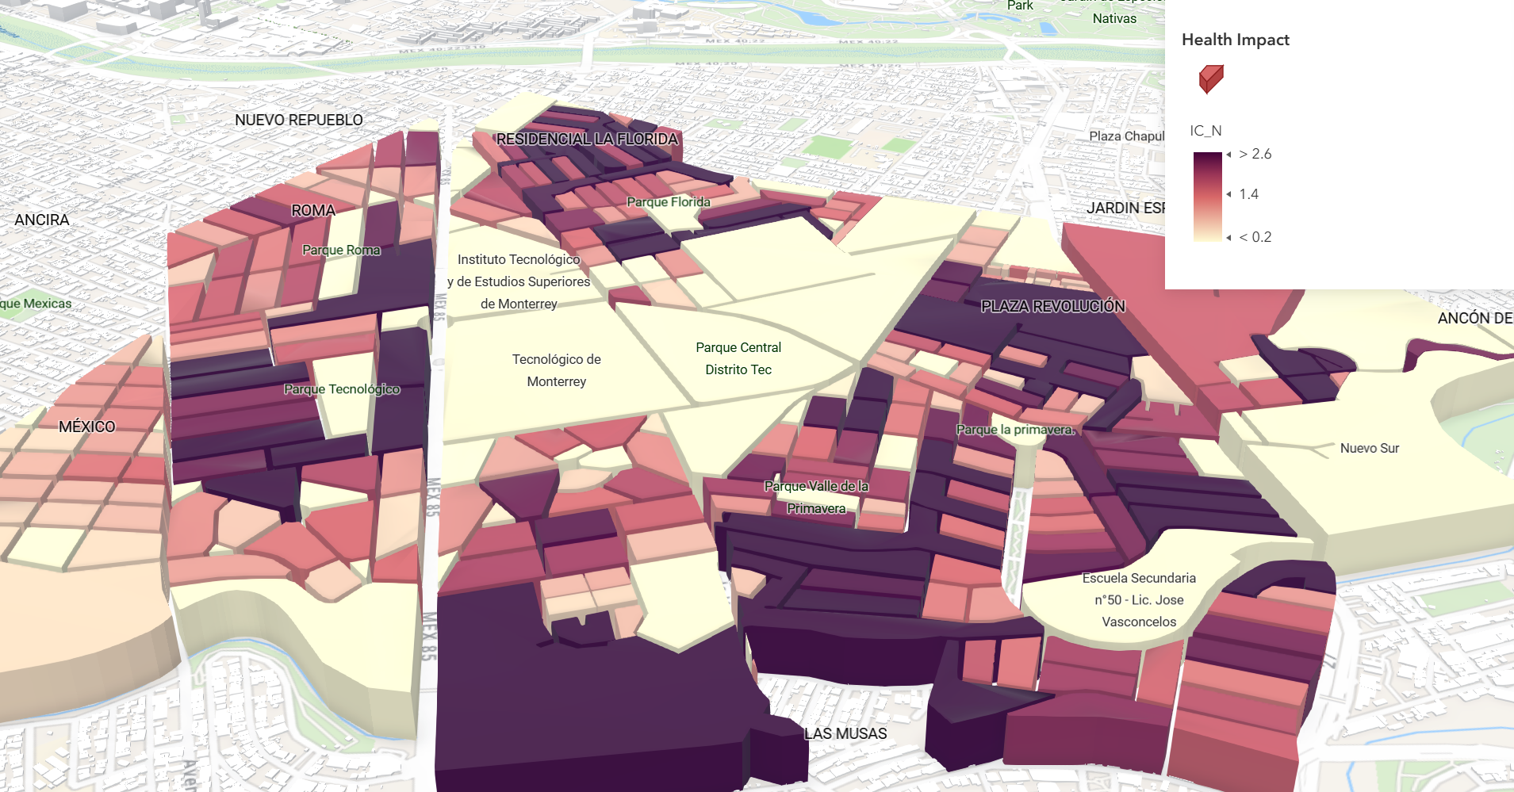
Background l Exploration l Methodology l Simulation l Future Work
Urban Digital Twins as the future for urban planning
Urban Digital Twins are virtual replicas of cities that integrate data from multiple sources as Layers of Information to test and foresee urban plans digitally.
Limitations
Health impact (Air quality).
Energy consumption.
Pollution dispersion.
Takes too much time to pre-process.
Lacks guidelines for state-of-the-art solvers as SOD2D.
Impact
Barriers to reduce
the pollution
Public health
strategies

Slide 5
Background l Exploration l Methodology l Simulation l Future Work
OBJECTIVE
To automatize and generalize pre-processing for urban flow simulations in SOD2D.

Slide 6
outline
BACKGROUND
Expansion for Digital Twins
EXPLORATION
City4CFD
Open source datasets
METHODOLOGY
City4CFD
ANSA scripting
SIMULATION
CEDVAL case
Monterrey case
Terrassa case
FUTURE WORK
FLIC

Slide 7
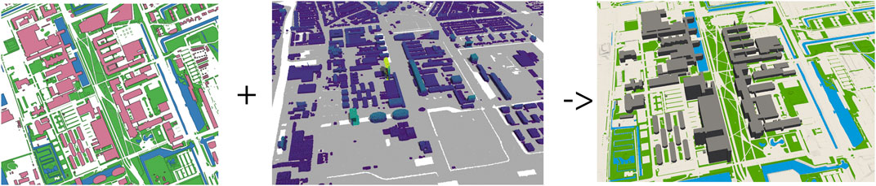
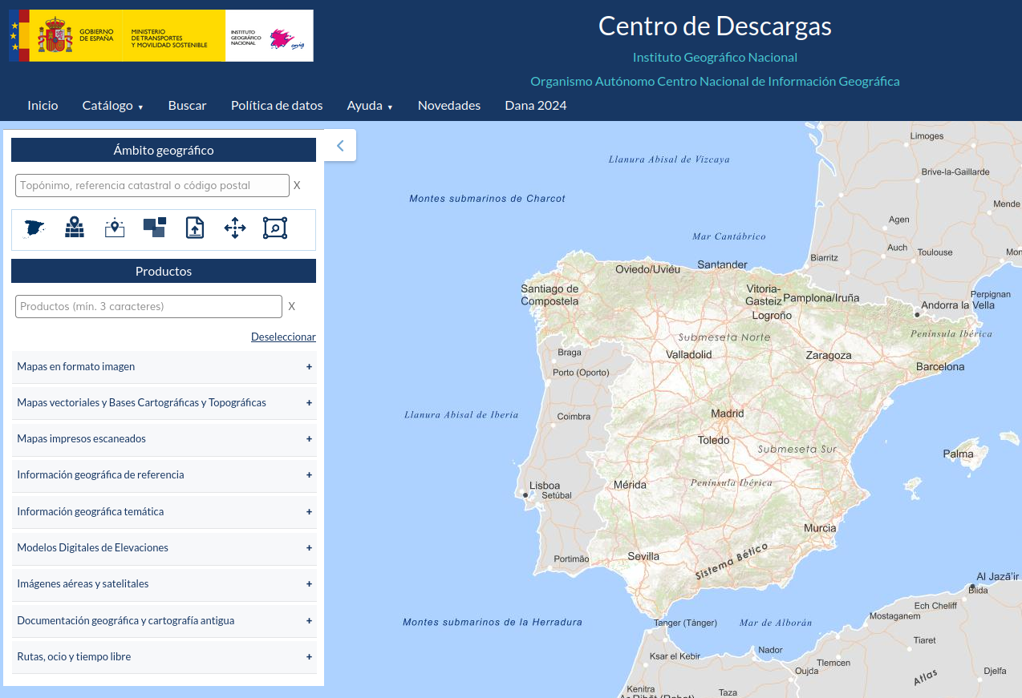
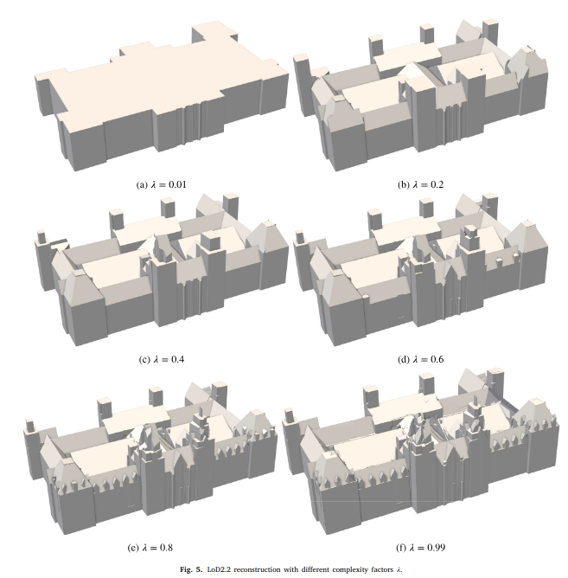




Background l Exploration l Methodology l Simulation l Future Work
City4CFD & Public Datasets
City4CFD (TUDELF)
Public Datasets
Open source
Easy integration with other programming languages
Public access
Long-term plans
Ivan Pađen, Ravi Peters, Clara García-Sánchez, and Hugo Ledoux (2024). Automatic high-detailed building reconstruction workflow for urban microscale simulations. Building and Environment, 265, 2024
LiDAR-PNOA-cob3 2022-2025 CC-BY 4.0 Comunidades autónomas y Instituto Geográfico Nacional y O.A. CNIG, D.G. de Bosques y Desertificación, FEGA, D.G. del Catastro y ENAIRE
Obra derivada de LiDAR-PNOA-cob3 2022-2025 CC-BY 4.0 scne.es

Slide 8
outline
BACKGROUND
Expansion for Digital Twins
EXPLORATION
City4CFD
Open source datasets
METHODOLOGY
City4CFD
ANSA scripting
SIMULATION
CEDVAL case
Monterrey case
Terrassa case
FUTURE WORK
FLIC

Slide 9
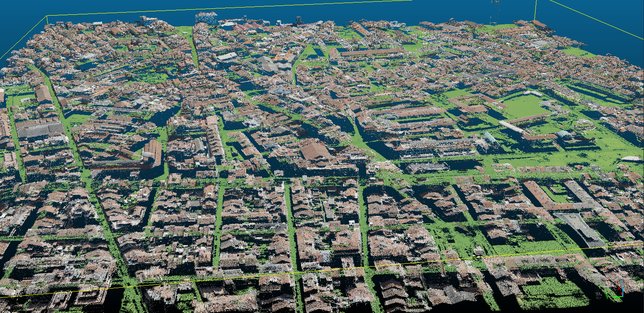
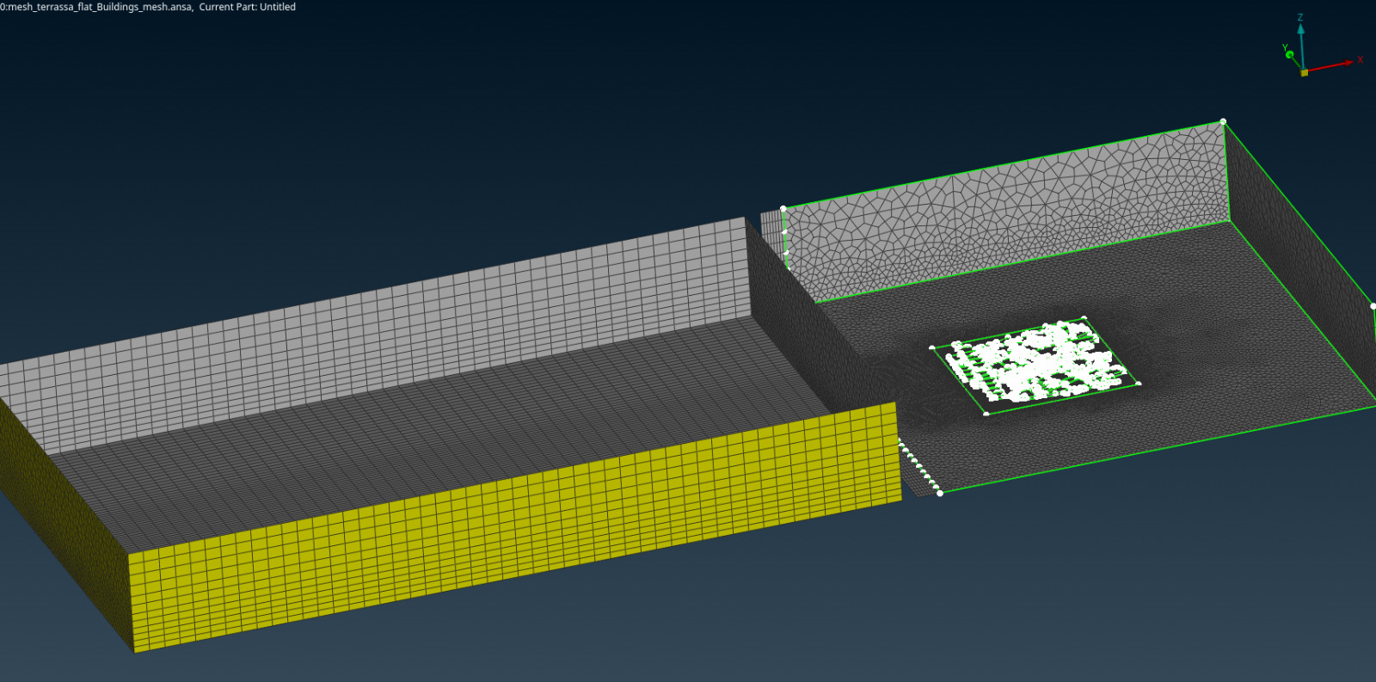
Background l Exploration l Methodology l Simulation l Future Work
City4CFD-ANSA Workflow
From LiDAR databases to CFD-ready meshes
Python scripts
City4CFD
ANSA scripts
Generic LiDAR survey points
SOD2D ready mesh (flat terrain)

Slide 10
Background l Exploration l Methodology l Simulation l Future Work
City4CFD-ANSA Workflow
Python
Input
Output
Clip zone
&
Extract polgons from OSM
LiDAR
Dataset
City4CFD
City STL
Input
Output
Domain
&
Check geometry
Manually set batch mesh
Build new inlet
Create precursor
Split to Hexa
CGNS meshfile
STL file
ANSA Scripts

Slide 11
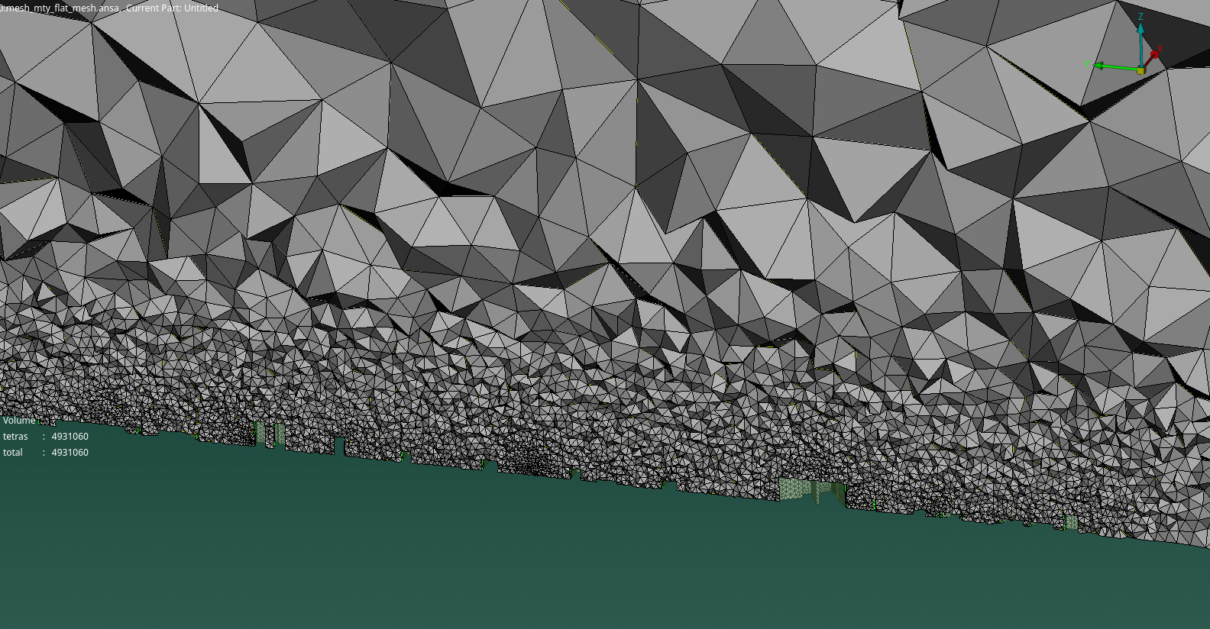
Background l Exploration l Methodology l Simulation l Future Work
CFD domain characteristics
SOD2D quality criteria.
Parametric domain and size boxes based on building height.
Flat terrain.
Minutes ready mesh.
Monterrey Volume Mesh

Slide 12
outline
BACKGROUND
Expansion for Digital Twins
EXPLORATION
City4CFD
Open source datasets
METHODOLOGY
City4CFD
ANSA scripting
SIMULATION
CEDVAL case
Monterrey case
Terrassa case
FUTURE WORK
FLIC

Slide 13
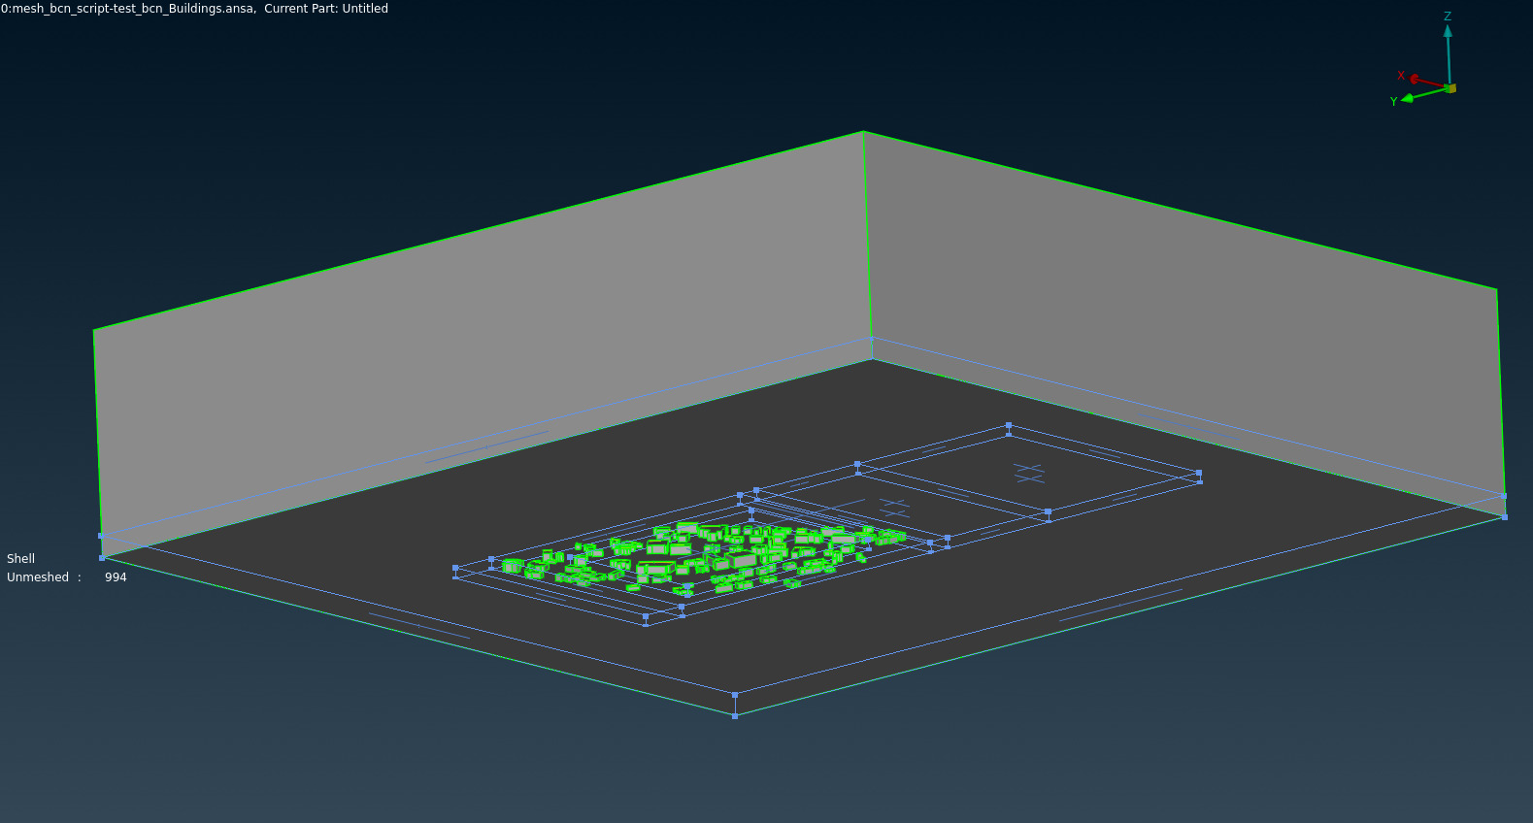
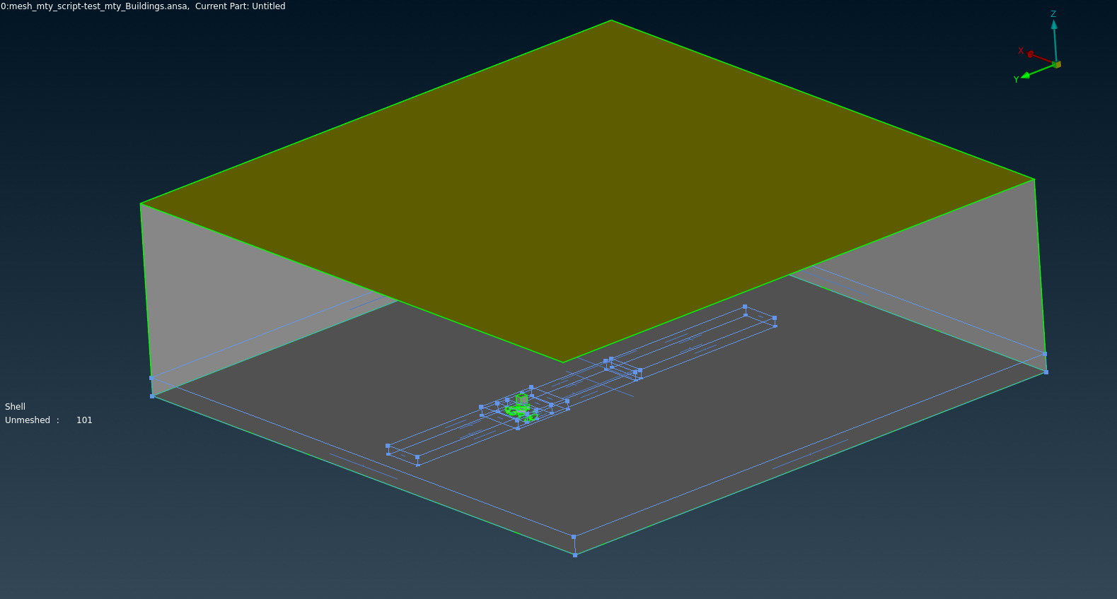
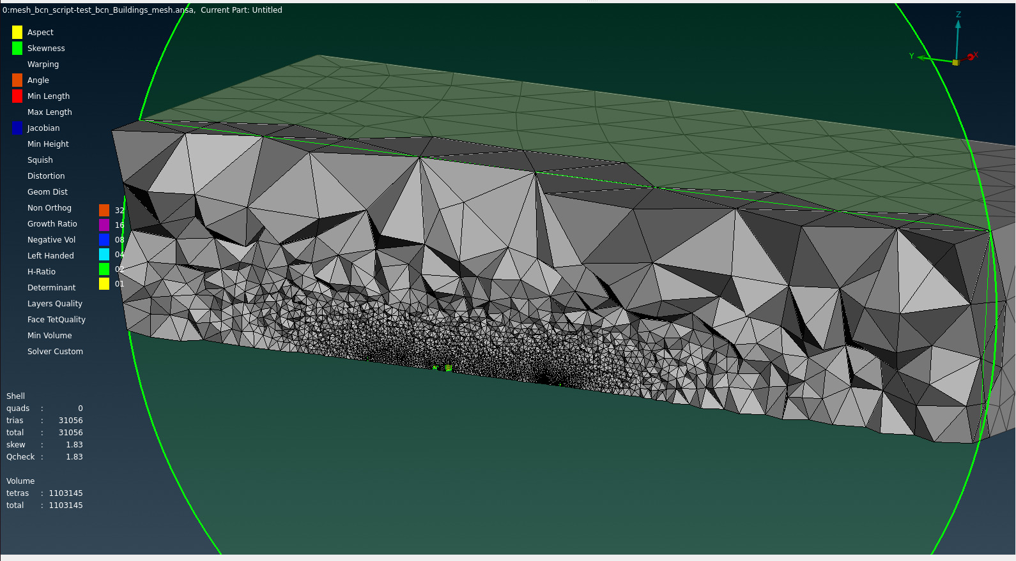
Background l Exploration l Methodology l Simulation l Future Work
Examples
Small Monterrey sample
Random BCN sample
Random BCN volume mesh sample
Terrassa sample mesh

Slide 14
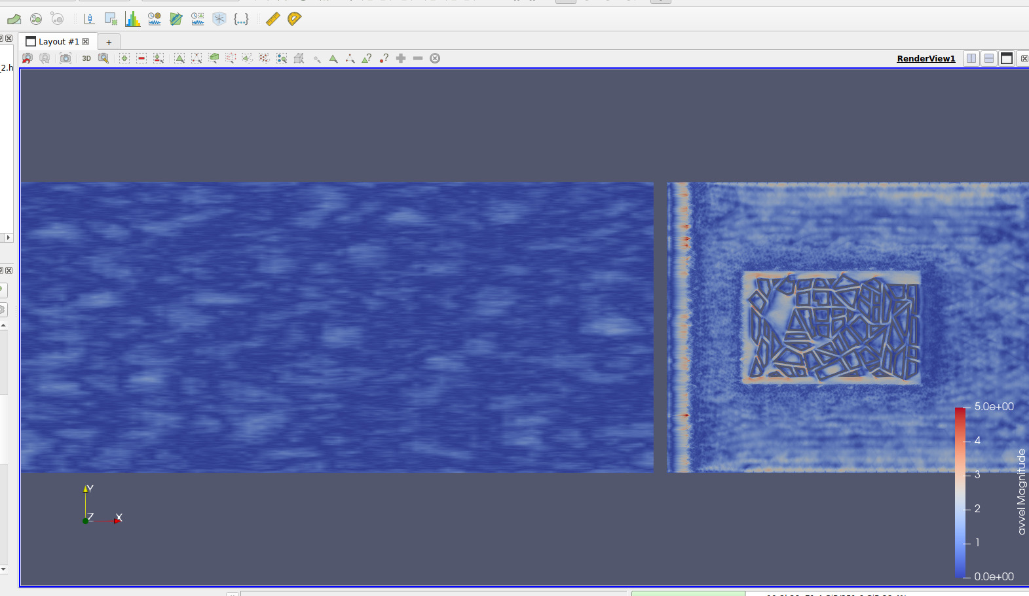
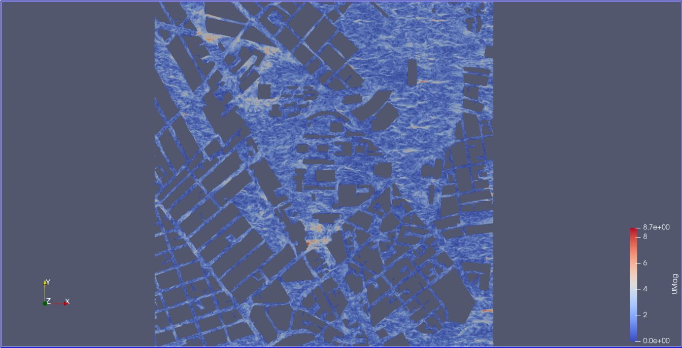
Background l Exploration l Methodology l Simulation l Future Work
Simulation results examples
Monterrey
CEDVAL

Slide 15
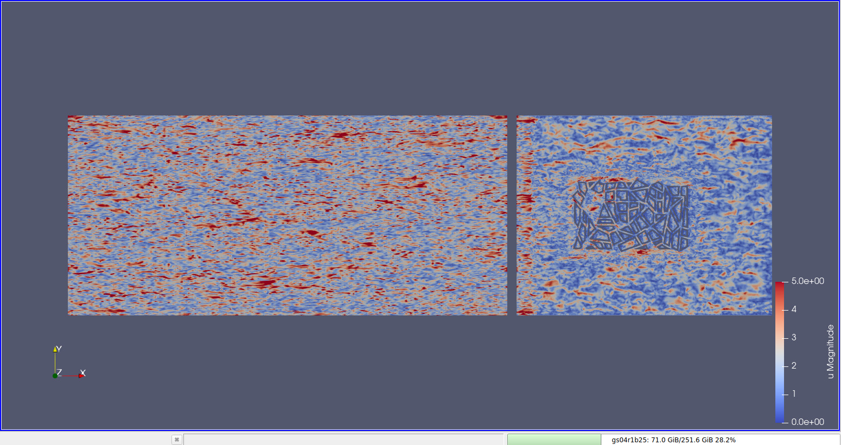
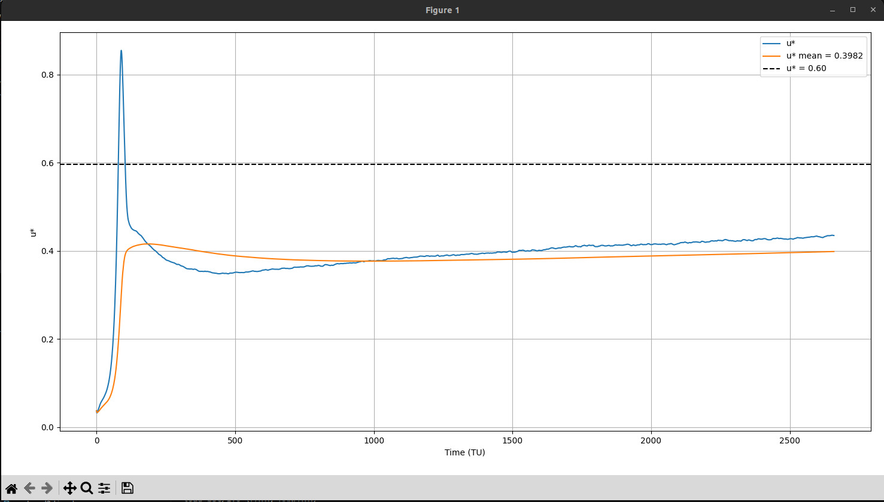
Background l Exploration l Methodology l Simulation l Future Work
CEDVAL Test Results
U* calculation
CEDVAL instant
Replica of Cedval simulation with the mesh generated by the workflow.

Slide 16
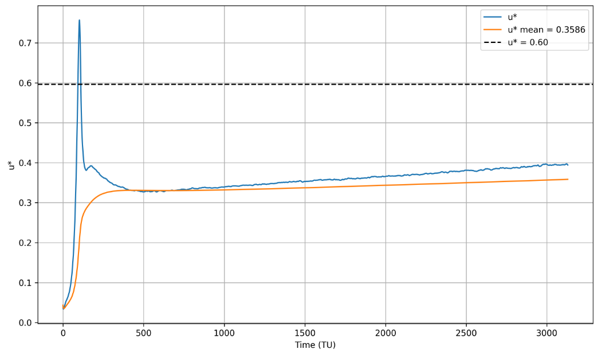
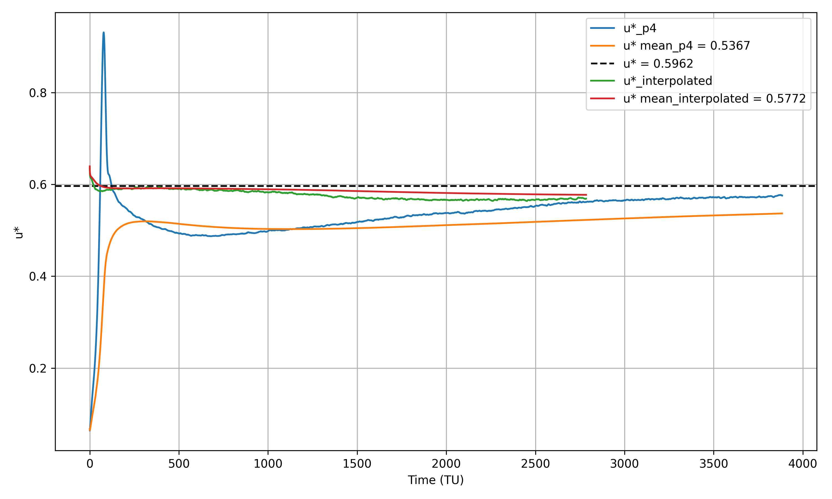
Background l Exploration l Methodology l Simulation l Future Work
Faster convergence of U* by interpolating P2 to P4
P2 (40M) interpolated to P4 (250M) vs starting from P4 (250M nodes)
Order 2 (40 million nodes) simulation for 3000 TU

Slide 17
outline
BACKGROUND
Expansion for Digital Twins
EXPLORATION
City4CFD
Open source datasets
METHODOLOGY
City4CFD
ANSA scripting
SIMULATION
CEDVAL case
Monterrey case
Terrassa case
FUTURE WORK
FLIC

Slide 18
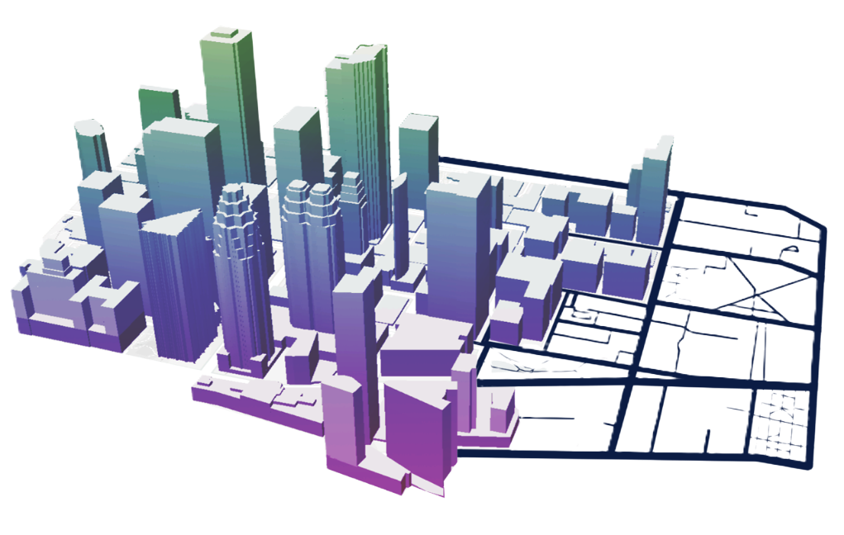
Background l Exploration l Methodology l Simulation l Future Work
FLIC — Fast modeLing for Integrated Climate
A modular toolbox for cities climate modeling and prediction
Pre-processing
Processing
Digital Twin Integration
City4CFD
STLtoGEOtool
ANSA Scripting
SOD2D
Wind Neural Network
GAVI
LAMINE
Etc...

Slide 19
THANK YOU!

Slide 20
TITLE
Autors***
¹
² TUAREG - Turbulence and Aerodynamics Research Group, Universitat Politècnica de Catalunya
³
Conference Name
Date

Slide 23
Thank you!
José Ignacio Huertas
jhuertas@tec.mx
Fabián Hernández
fabianh@tec.mx
Notes:
Hablar de bcn

Slide 24
APPENDIX

