Slide 1
MicroCode 101
March 2023
Notes:
If you don't have a micro:bit V2, you can use this URL to bring up simulator: https://microsoft.github.io/jacdac-docs/clients/javascript/devtools?jacscript=1&simulators=microbitmicrocode#http://microbit.github.io/microcode?usb=0

Slide 2
Getting Started
Copy MicroCode hex file onto micro:bit V2
get file from dialog https://aka.ms/microcode
Connect the micro:bit to MicroCode editor. Either
plug into KittenBot Arcade shield, or
connect via USB to web browser (dialog at https://aka.ms/microcode)

Slide 3

Cursor-based editing
Action | Keyboard | Shield
Move cursor | ↑, ↓, ←, → | Direction pad
Select item | Enter, Space | A button
Go back | Backspace | B button
Web browser also mouse/touch friendly
Other keyboard “shortcuts”

Slide 4

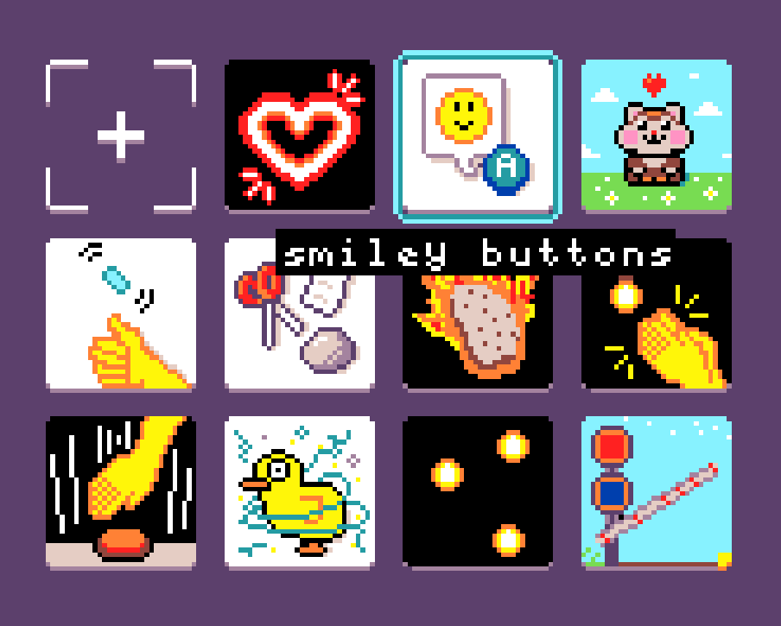
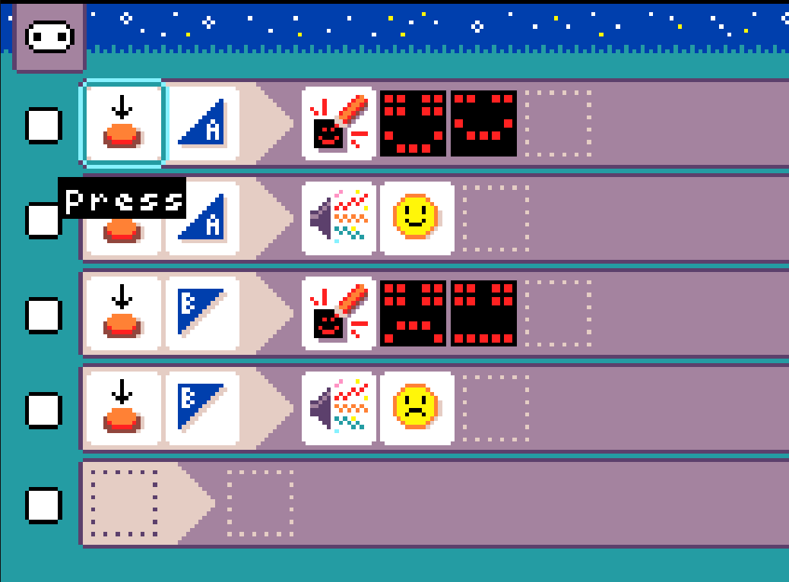
Cursor practice
Move cursor to samples and select it
Move to smiley buttons and select
Move around rules

Slide 5
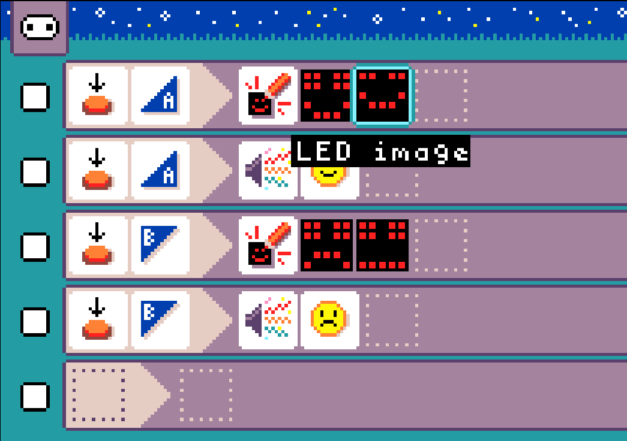
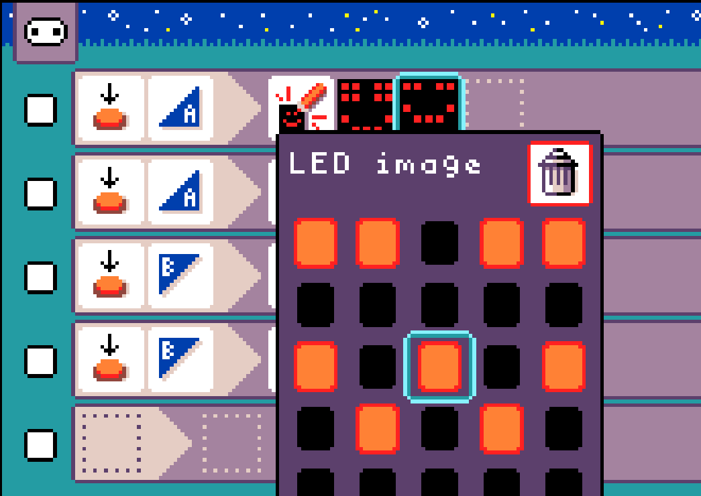
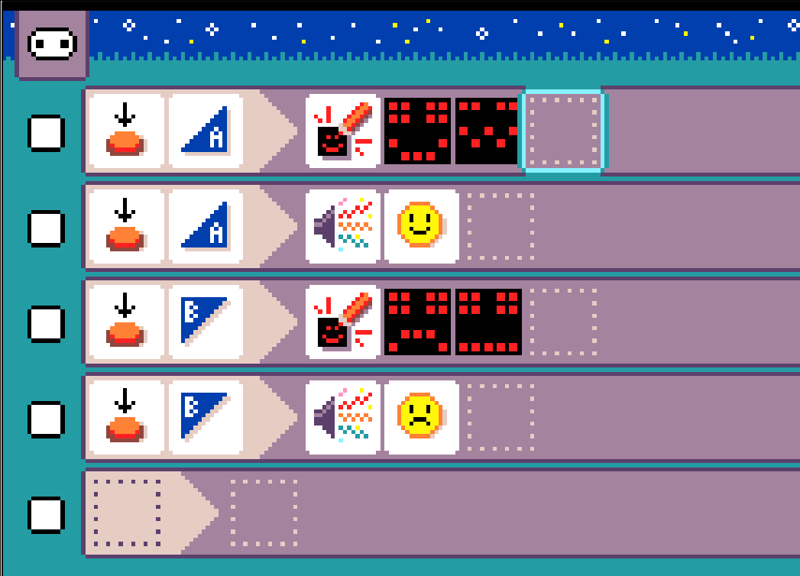
Cursor practice
Move to an LED image and select
Change the LED image
Dismiss LED image editor
Select to toggle LED

Slide 6
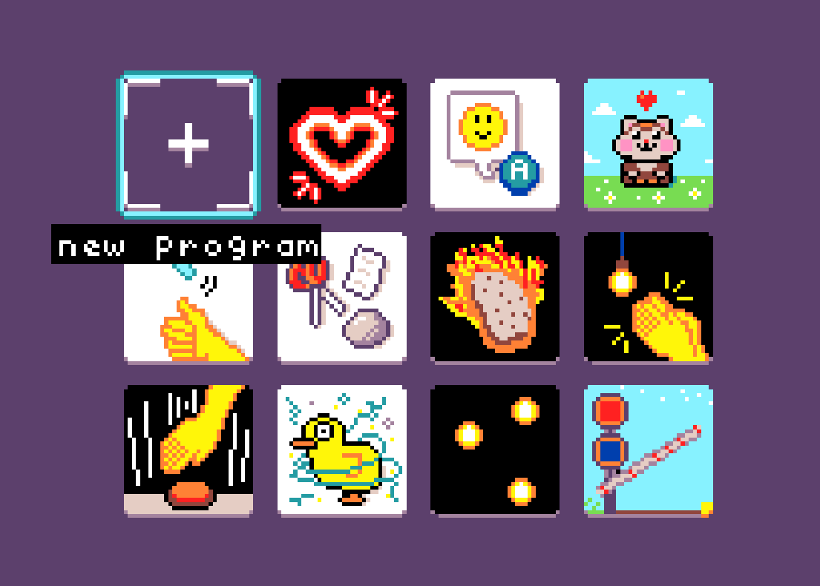
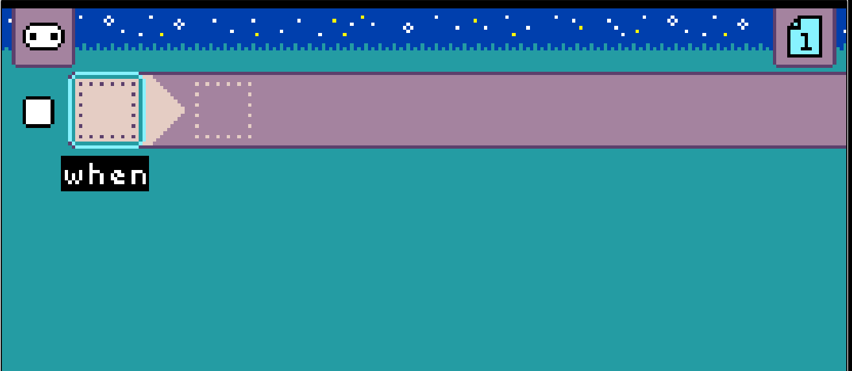
Starting from scratch

Slide 7
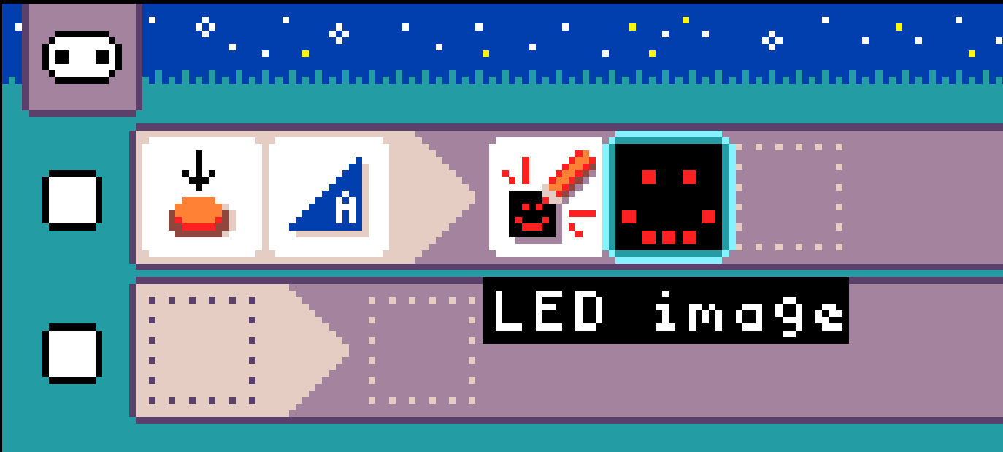
“Space Out”!
Press Space (or A button) to create your first rule…

Slide 8
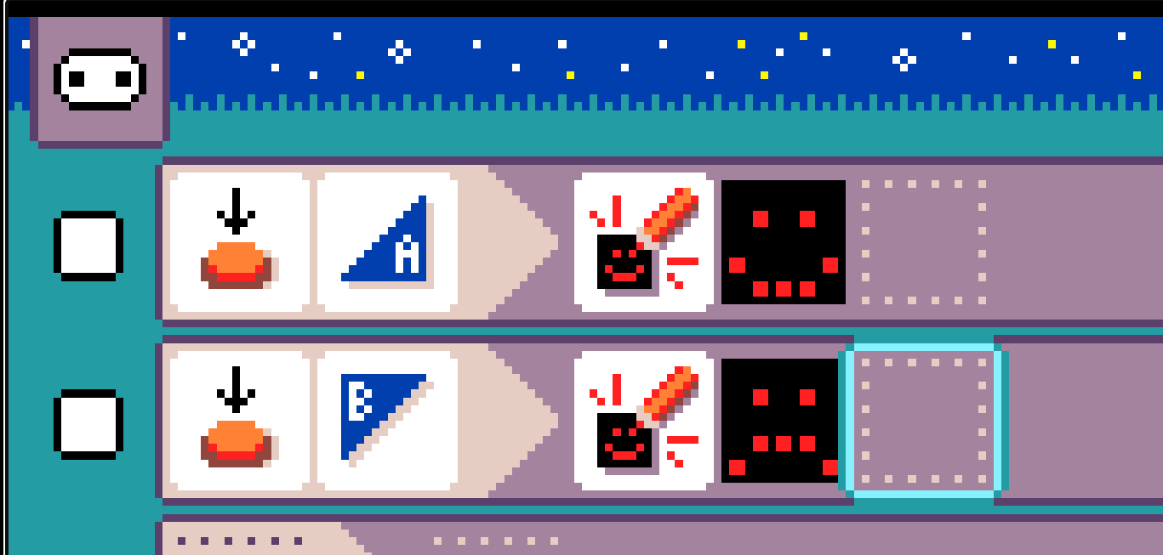
Create second rule for micro:bit B button

Slide 9
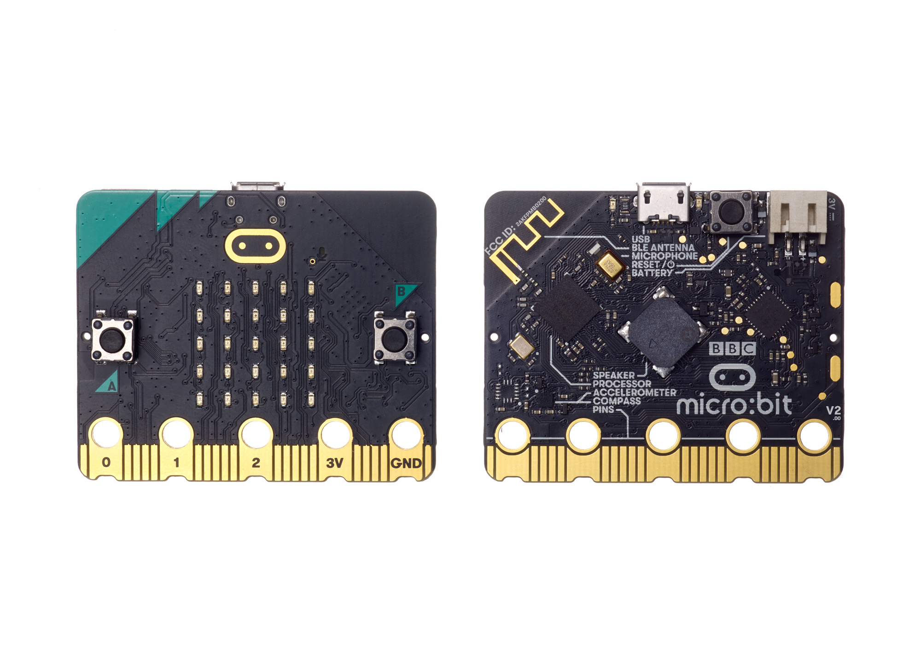
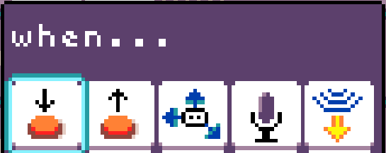
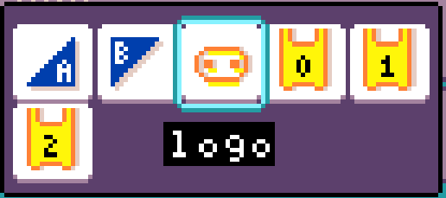
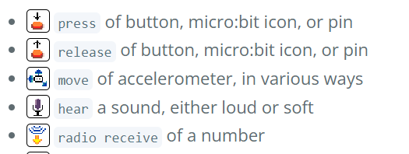
When… there is a micro:bit event …

Slide 10
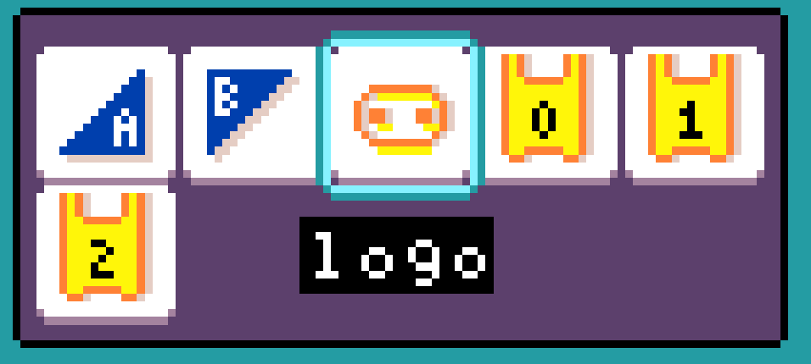
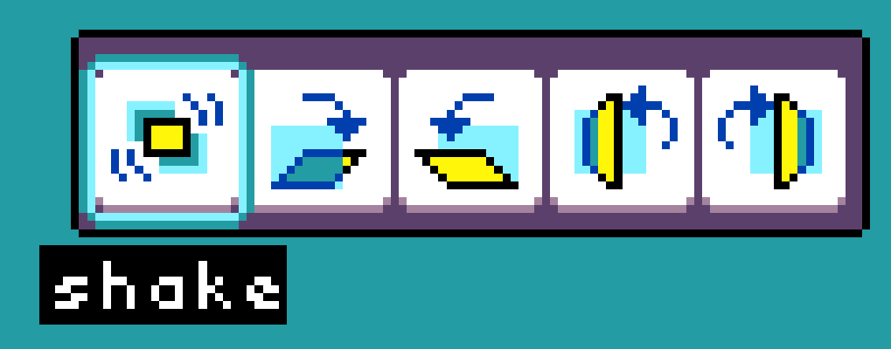
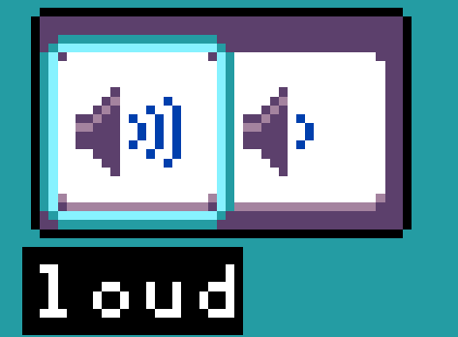

Slide 11



Sensor defaults

Slide 12
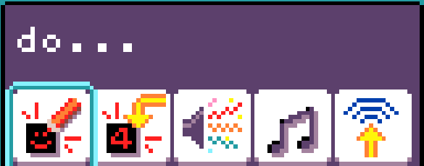
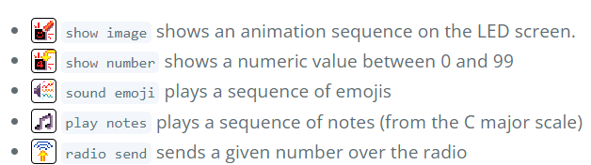
Do… perform a command/action

Slide 13
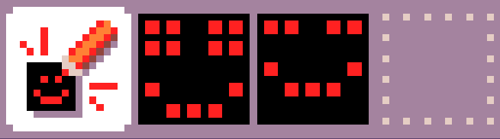
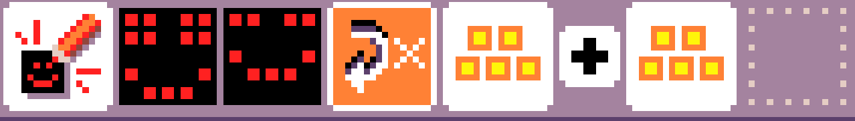
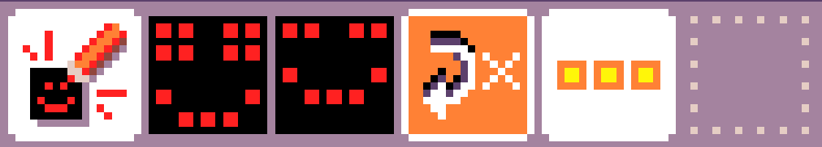

Sequencing and Repetition
Sequence of LED images yields an animation
Arrow tile to repeat
Constant # of times
Forever (if no value)
Sequencing/repeat also for
sounds
music

Slide 14
Questions
Can you program the micro:bit to make a sound at the same time as displaying a smiley face (on press of button A)?
What happens if we display both smiley and sad face on A button press (separate rules)?
Notes:
Parallel activity (different resource)
Change B button to A in second rule

Slide 15
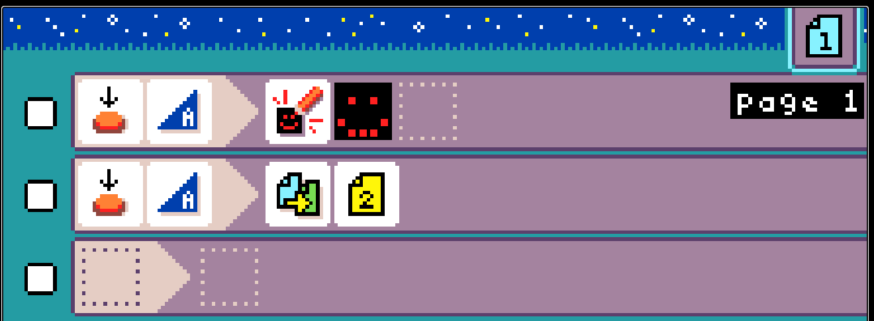
Question
Can you program the micro:bit to alternately
display smiley face on press of A button
display sad face on press of A button
Hint
Use switch page command
Notes:
Parallel activity (different resource)
Change B button to A in second rule

Slide 16

One button, two pages!

Slide 17
Navigating between Pages
Page icon (upper right)
Next page
Use down cursor to move past last rule
Previous page
Use up cursor to move up (keep going)

Slide 18
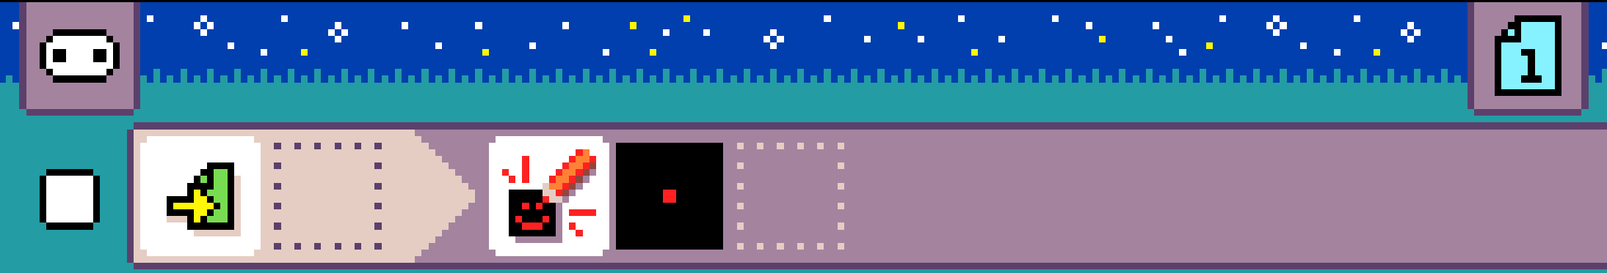
Start page event
When a page becomes active, take an action
Page 1 on program start
Page N on switch to page N

Slide 19
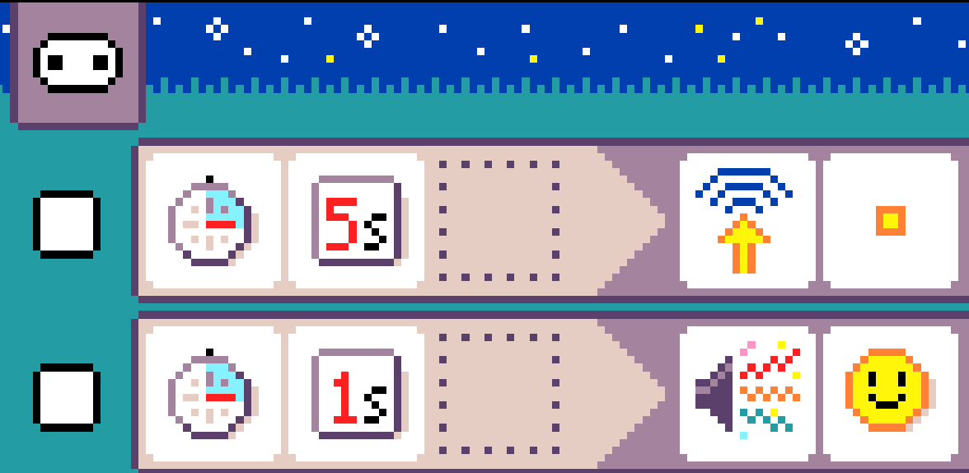
Timers
Timer per rule
Starts on page entry
Restarts after firing

Slide 20
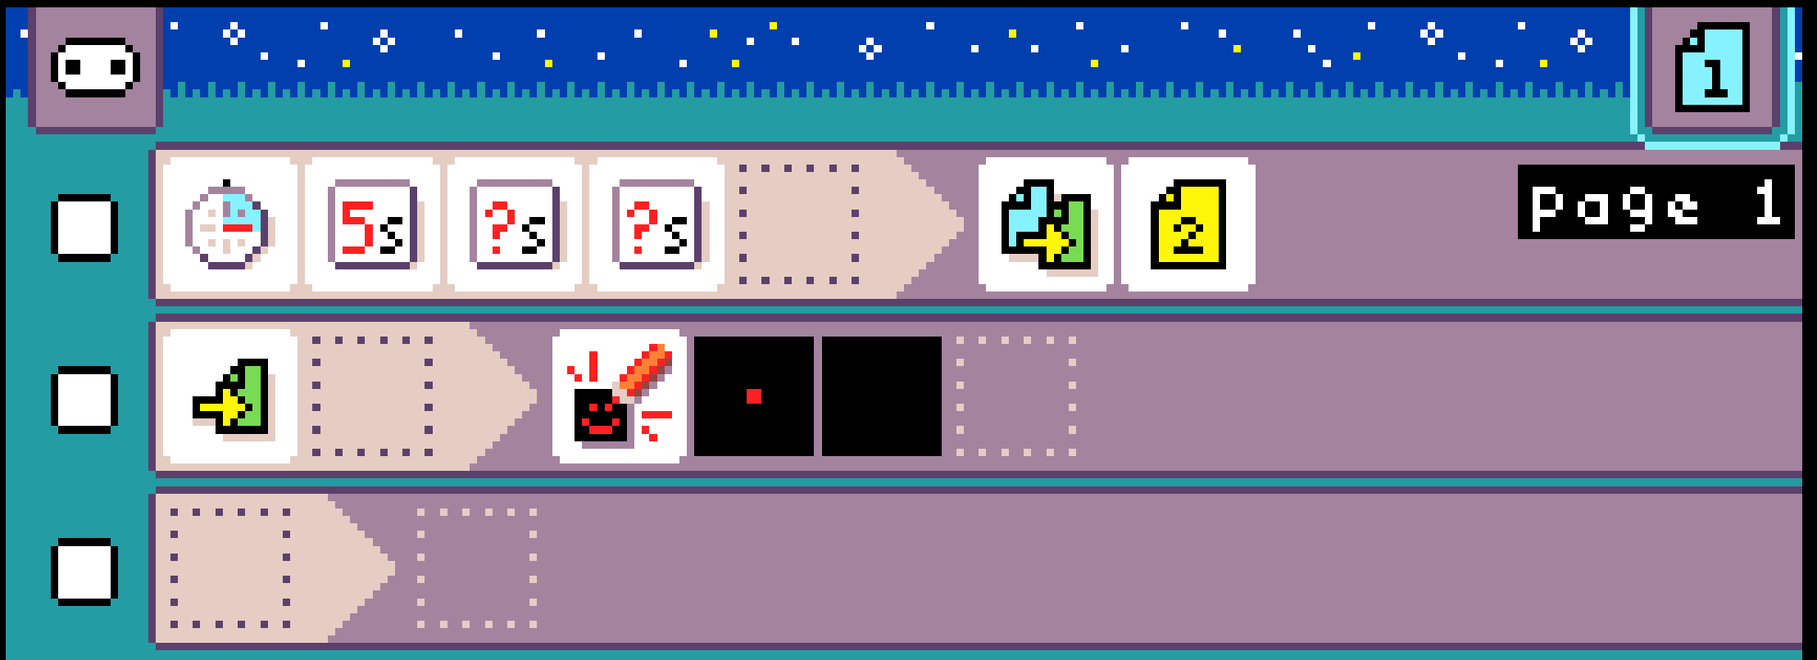
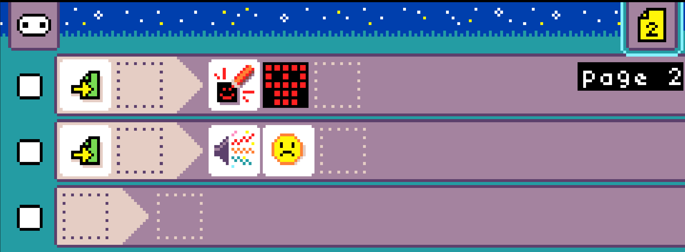

Slide 21
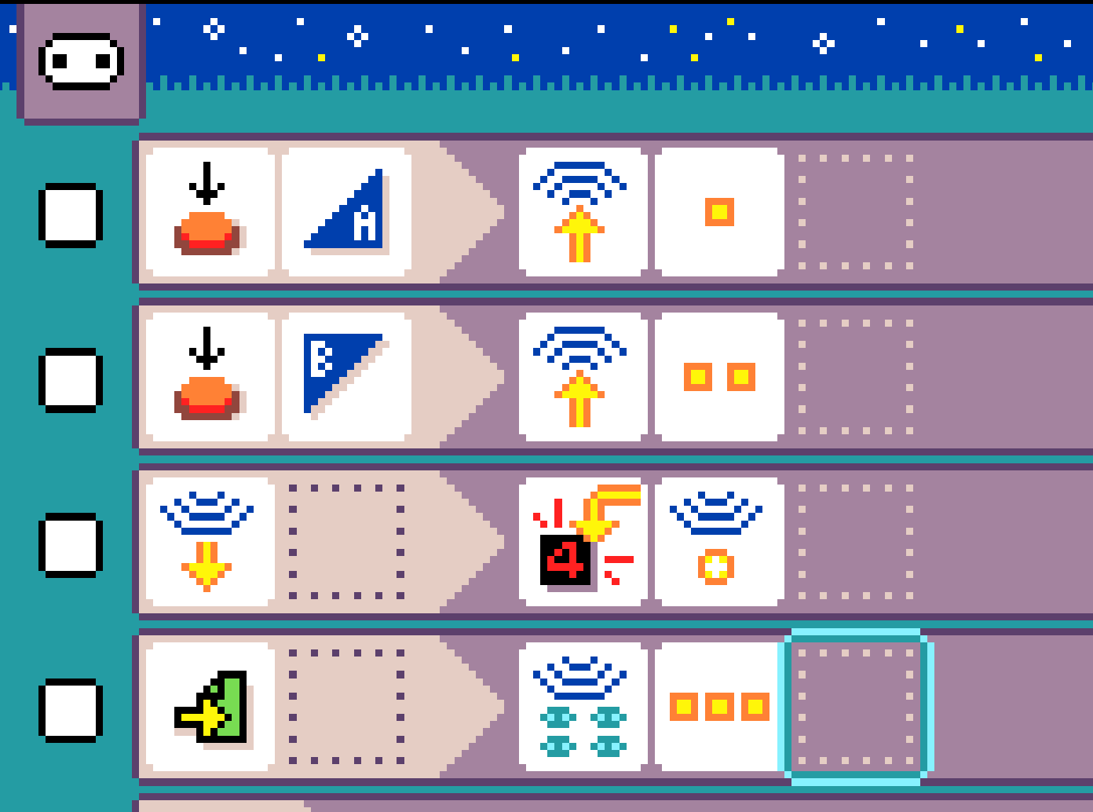
Radio
Receive message
Get message value
Send message
Set group

Slide 22
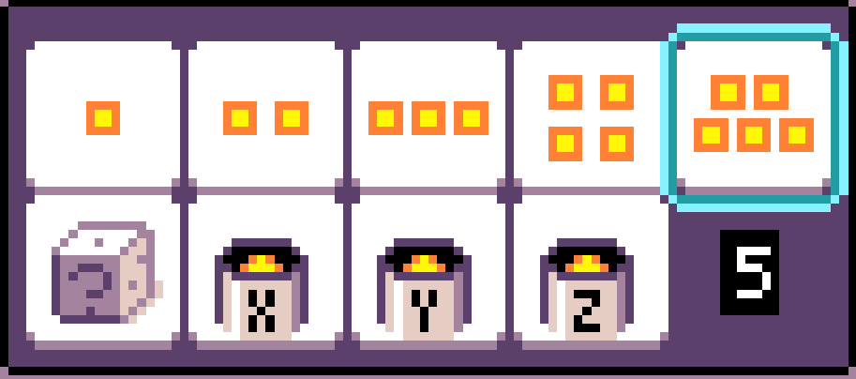
Numbers
Constants (1 – 5, 0 as default)
Dice toss
Variables

Slide 23
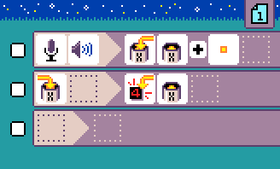
Variables
Three numeric variables: X, Y, Z
Set value (command)
Get value (expression)
On update (event)

Slide 24
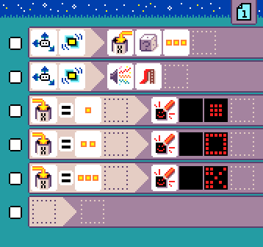
Equality conditions on numeric values

Slide 25
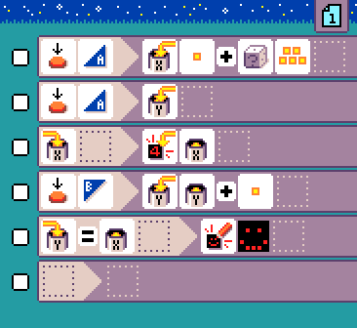
Comparing Variables’ Values

Slide 26
MicroCode: Concepts Covered
Reactive systems
Inputs
Outputs
Events
Actions
Timers
Control flow
If-Then (When-Do)
Switching context (page)
Sequencing
Iteration
Math
Variables
Addition
Equality

Slide 27
More about MicroCode
User guide
Language
Samples
FAQ

Slide 28
press of button, micro:bit icon, or pin
release of button, micro:bit icon, or pin
move of accelerometer, in various ways
hear a sound, either loud or soft
temperature change, either warmer or colder
radio receive of a number
start page only runs when the page is started (or switched to), with an optional delay
timer of a time
variable (X,Y,Z) changed to a number

Slide 29
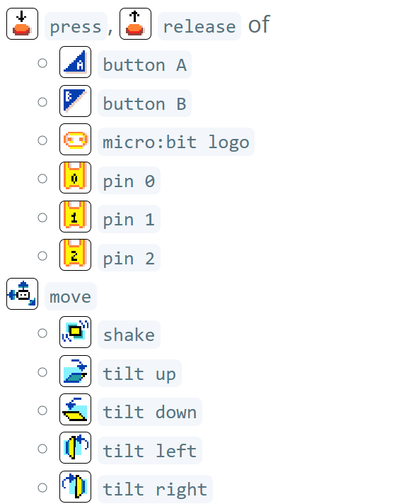
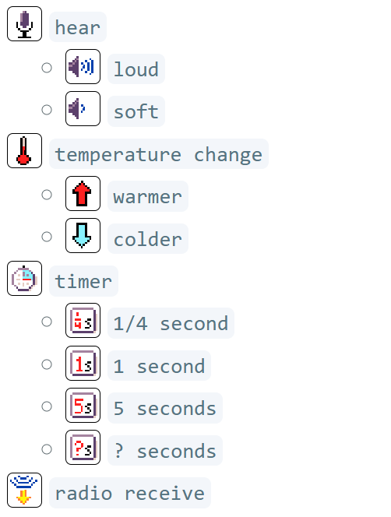
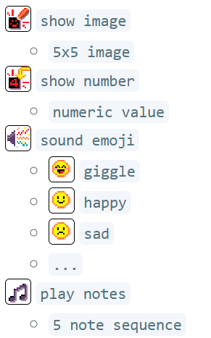
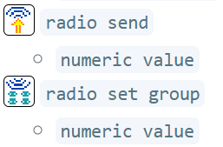
Events and Filters
Actions and Modifiers

Slide 30
Pages
Variables

