Slide 1
MicroCode: Paper Program Tiles
The following slides should be printed out
Then cut out a card for each programming tile
After introducing your students to the micro:bit hardware (input and output features)
Ask your students to make sense of the programming cards and show them an example rule
Then ask them what other sort of rules they can make

Slide 2

Example Rule

Slide 3
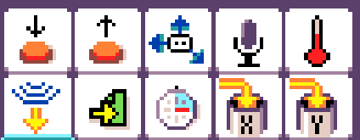
When Events

Slide 4


Press Filters

Slide 5

Move Filters

Slide 6

Microphone Filters

Slide 7

Temperature Filters

Slide 8

Timer Filters

Slide 9
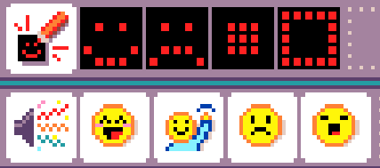
Show Image Action

Slide 10
Play Sound Action

Slide 11

Numbers

