Slide 1
Retinal Vessel Segmentation under Domain Shift
Label-Free Test-Time Adaptation for Cross-Dataset Generalisation
MSc Artificial Intelligence — Computer Vision | Final Project

Slide 2
Motivation & Problem
• Retinal vessel maps help diagnose diabetic retinopathy and glaucoma.
• Models trained on one camera/dataset degrade on another → domain shift.
• Goal: let the model adapt to each unseen image with NO labels.
• Research question:
– Can rotation-based Test-Time Adaptation (TTT) close the gap?
– And what is the right amount of the network to adapt?
2

Slide 3
Datasets — Train on One, Test on Three
• DRIVE (20 imgs) — training / source distribution.
• STARE (20 imgs) — unseen, moderate shift.
• CHASE_DB1 (28 imgs) — unseen, largest shift (darkest images).
• HRF (45 imgs) — unseen, high-resolution, bright.
• All public research datasets; model never sees the test sets in training.
3

Slide 4
Method — U-Net with Rotation Head
• U-Net encoder–decoder with skip connections segments vessels.
• Auxiliary head predicts image rotation (0/90/180/270°) — self-supervised, no labels.
• Trained jointly with augmentation: Loss = (BCE + Dice) + λ · CE(rotation), λ = 0.3.
• Best DRIVE validation Dice ≈ 0.654 (60 epochs).
4

Slide 5
Test-Time Adaptation (TTT)
• For each unlabelled test image:
– Make 4 rotated copies and predict their rotations.
– Back-propagate rotation loss → update BatchNorm params only.
– Segment with adapted weights, then restore originals.
• Memory fix: per-rotation gradient accumulation (~4× less peak RAM).
• Compared against TTA (8-view averaging) and CLAHE preprocessing.
5

Slide 6
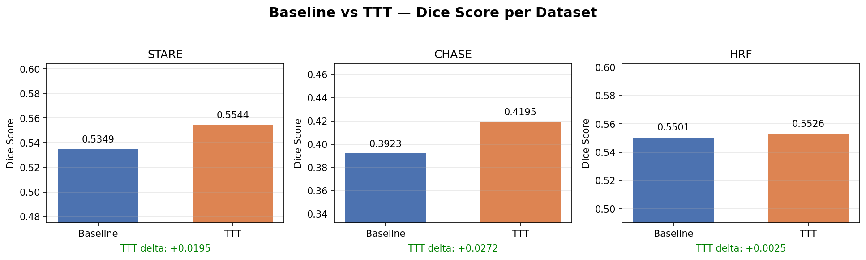
Result 1 — Baseline vs TTT
TTT improves Dice on all three datasets (STARE +0.020, CHASE +0.027, HRF +0.003).
6

Slide 7
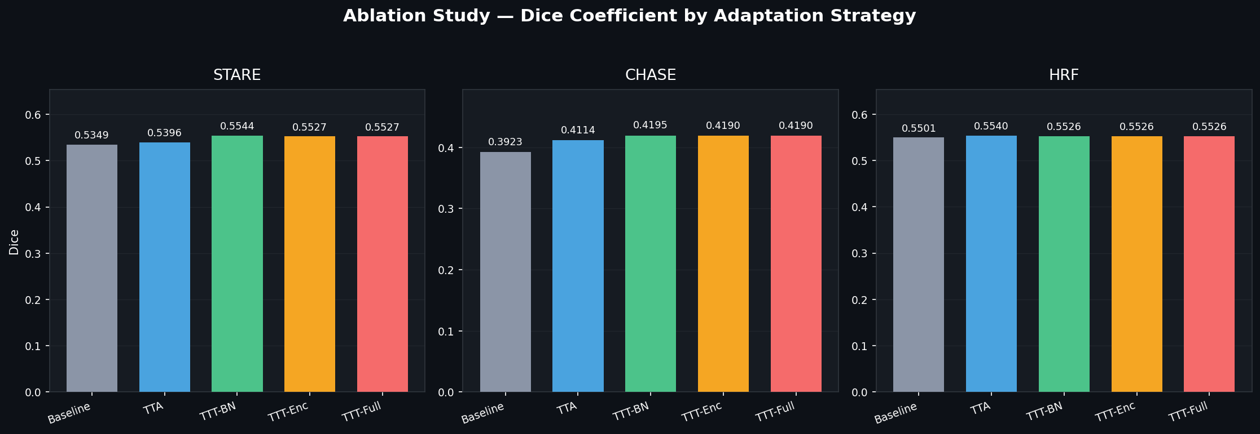
Result 2 — TTA vs TTT & Adaptation Scope
TTT-BN beats TTA on STARE & CHASE; BatchNorm-only ≥ encoder = full network.
7

Slide 8
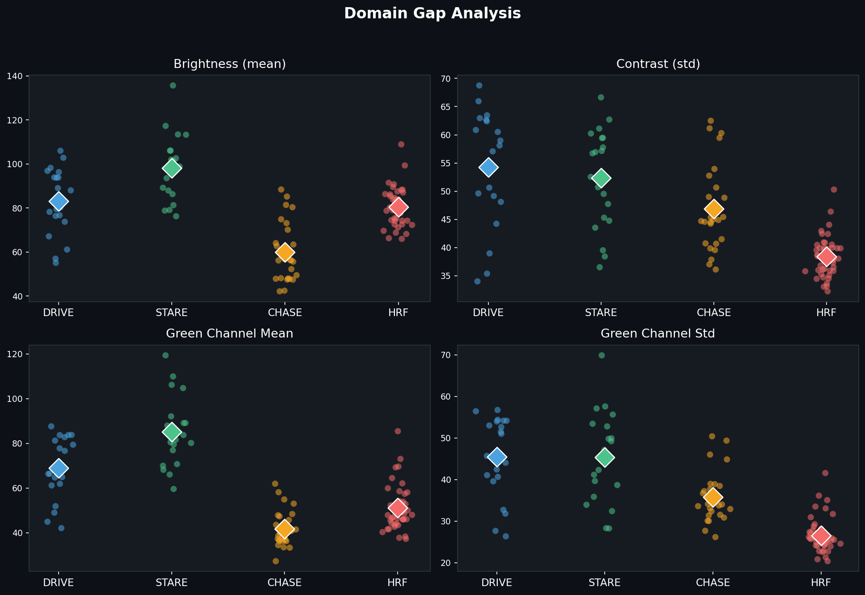
Result 3 — Domain Gap Across Datasets
CHASE is the darkest, most-shifted set — and the hardest to segment.
8

Slide 9
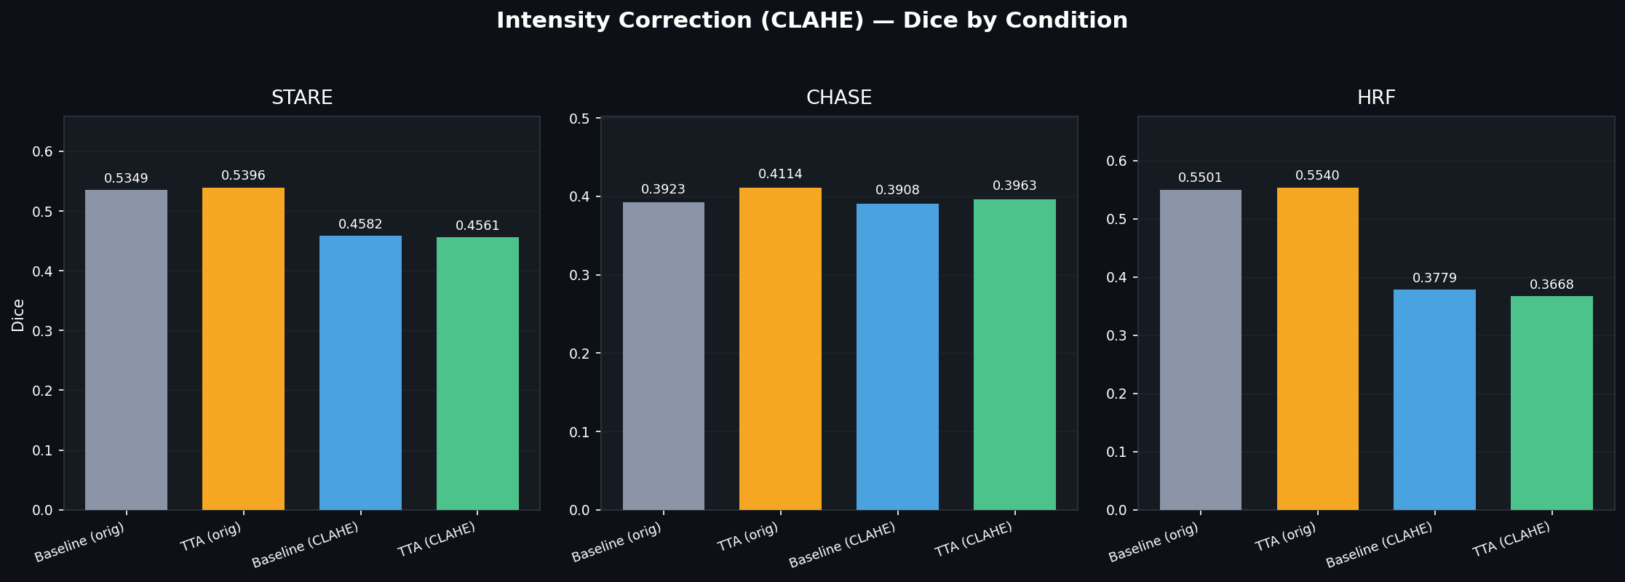
Result 4 — CLAHE Intensity Correction
CLAHE raises sensitivity but collapses specificity → lower Dice; TTT is the better lever.
9

Slide 10
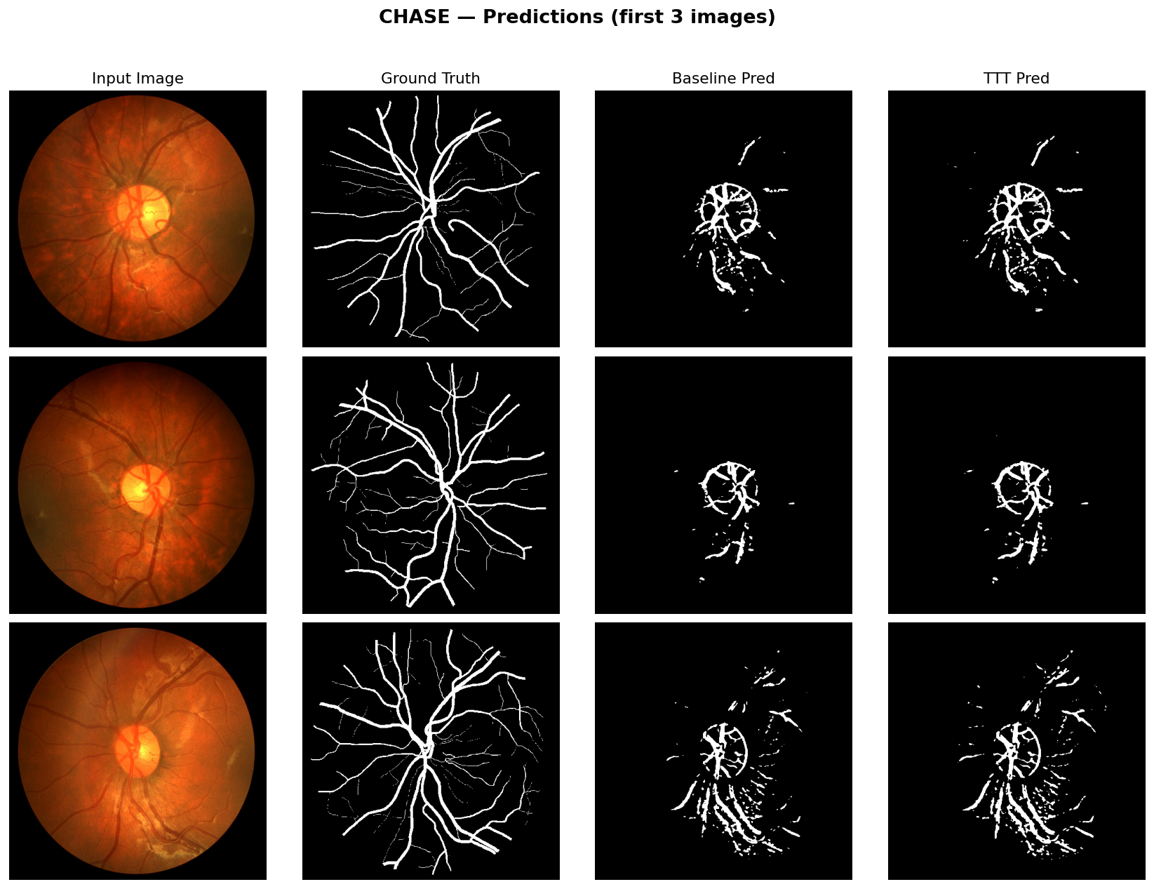
Qualitative — CHASE Predictions
On the hardest dataset, the model recovers the vessel tree and TTT adds fine branches.
10

Slide 11
Key Findings
• Rotation-based TTT improves Dice on all three unseen datasets — label-free.
• TTT-BN beats the TTA ensemble on the two largest domain shifts (STARE, CHASE).
• Adapt BatchNorm only: encoder and full-network adaptation add nothing.
• CLAHE trades specificity for sensitivity → lower Dice; adaptation is preferable.
• Takeaway:
– A lightweight BatchNorm-only adaptation is an effective, cheap robustness tool.
11

Slide 12
Limitations
• Only 20 DRIVE training images → limited absolute accuracy.
• Rotation auxiliary task is simple; richer self-supervision could help more.
• Per-image TTT adds inference-time computation.
• Small test sets — statistical significance testing would strengthen claims.
12

Slide 13
Conclusion & Future Work
• BatchNorm-only TTT is an effective, label-free route to cross-dataset robustness.
• It beats both TTA ensembling and CLAHE intensity correction.
• Future: stronger self-supervision, learned domain normalisation, multi-centre validation.
13

Slide 14
Thank You
Questions & Discussion
Retinal Vessel Segmentation under Domain Shift

