Slide 1
InfoSec 101
Introduction to Information Security
for (non-IT) Professionals
Fabian Lischka, Larry Salibra, Leonhard Weese
FCC, Hong Kong, 2015-02-26
V0.96.L from 2015-02-25
Notes:
Alphabetical order (note that order by first and order by last name coincide)

Slide 2
Content
Introduction
  Disclaimers
Suggested Best Practices
  Basics: Passwords, Phishing
  Communication: Browsing, VPN, Email, Chat
Questions

Slide 3
Introduction: What can go wrong?
Examples:
  Film journalist in Syria: Gov't confiscated laptop
  AP Twitter account hacked: Phishing
  GCHQ captured journalists' emails (BBC, NYT, …)
  Hackers used hotel Wi-Fi to steal executive's data
Can our recommendations protect you?
Attack | Opportunistic | Targeted
Hackers/Criminals | Yes | Yes, likely
Gov't/WFO (NSA,...) | Yes (but red flag?) | Well....

Slide 4
Introduction: Why should you care?
“Even if the men in suits aren't after you, there are benefits to everyday crypto”
  Jennifer Valentino DeVries, WSJ
Benefits:
  Relieved/confident sources
  Practice
  Network effect
  Red flag: Help your fellow journalists
Notes:
Avoid chilling (potential) sources
Whistleblowers prefer PGP/SecureDrop
Learn to use it – might come in handy
Snowden revelations delayed
Network effect
The more users, the more useful
Red flag: Help your fellow journalists
Make it normal instead of a red flag

Slide 5
Introduction: Disclaimer
Red flag!
Requires discipline
Weakest link property
Only introduction!
  Do not rely on this in life-and-death situations
  No protection against WFO, governments, etc.

Slide 6

Introduction: Disclaimer

Slide 7
Best Practices: Passwords
3 Attacks:
  Dictionary + trial and error
  Database breaches (LinkedIn, Gawker, …)
  “I lost my password”
3 Counter measures:
  Good passwords!
  No re-use
  No security questions
Problem: Conflict
Solution: Password Managers

Slide 8
Best Practices: Passwords
Bad passwords
  What you love
  Words related to site
  Dictionary words, patterns (`1234`, `qwerty`, `abcd`)
Tricks: all well known!
  Appending: password123, password!
  Substitutions: p@55word
  Simple composition: password123angel!
Notes:
Things you love:
Pets or significant others; Sports, sport teams, bands
Family, religion, love, sex (`696969`, `love`, `jesus`, `angel`, `lord`)
Words related to the site (eg `job`, carrer, `link` for linkedin)

Slide 9
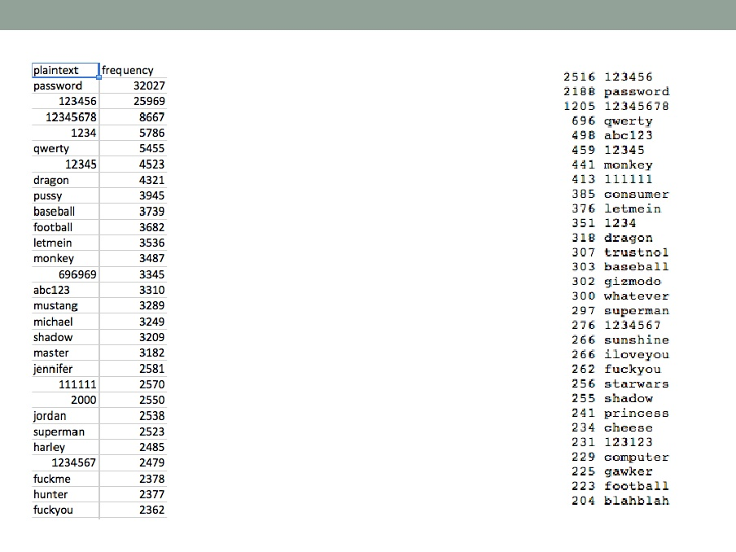
Best Practices: Passwords
LinkedIn breach (2012), Gawker breach (2010)

Slide 10
Best Practices: Passwords
Good technique (“Schneier Scheme”):
  1st letter of long passphrase
  Example: Wo hěn xǐhuān HK, IT security, and (sometimes) 9 hours sleep
  → WhxHK,ITs&(st)9hs
Good technique (“xkcd scheme”):
  4 or 5 randomly selected words
  Example: Keelhaul, cleistogamy, evince, vacuum
  → Keel3clei6evin9vacu
Notes:
Creative, weird, unique passphrase, possibly multi-language
Avoid: catch phrase, song lyrics, movie quote. Make your own!
Result should have at least 12 characters
Include numbers, small/capital letters, symbols, etc.
Note: might see different keyboard layouts on other computers

Slide 11
Best Practices: Password Managers
Purpose: Different passwords for different sites
  Master Password
Recommended:
  Apple only, simple: iCloud Keychain
  Free, open source: pwsafe, or KeePass
  Commercial, with support: 1Password, or LastPass
Disadvantages:
  Compromise
Notes:
App or browser addin, for computers, smart phones
MasterPassword: better be good (not used before). Better don't forget (use regularly, deposit in mom's safety deposit box)

Slide 12
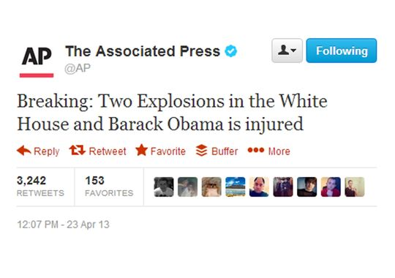
Best Practices: Avoid Phishing

Slide 13
Best Practices: Avoid Phishing, Malware
Fake email lures you to malicious website
  "log in" on fake site, or hit by drive-by exploit
  Spearphishing
Pitfalls:
  www.mybank.com → www.phishy.net
  www.mybank.com.domain.bla.phishy.net
Prevention:
  Don't click!
  Don't install!
Notes:
Phishing: Common and surprisingly effective attack
Prevention:
Be suspicious of unexpected generic emails
Don't click to "log in". Bookmark/Type it in!
Examine actual links (not displayed)
Check exact name of site, & "lock" symbol
Never provide your password to anyone
Trojan Horse
Alert: Your computer is infected!. Virus cleaner
Free flashlight app! Search bar!
Prevention:
Don't install that junk
Beware Attachments, USB, etc.
Don't install anything unless necessary, and only from a trusted source
untrusted attachments, untrusted USB sticks

Slide 14
Best Practices: Disk Encryption
Purpose: Protect data on your laptop
  Hotel, stolen, border
Forget your password, say Hasta la vista!
Available:
  Smartphones: Automatic (on latest: iOS 8, Android L)
  OS X: FileVault
  Windows: BitLocker
External drives:
  OS X: Format as encrypted disks (Disk Utility)
Notes:
Protects the content of your laptop
when it's stolen
when it's in the hand of government/border control
Problem: Without Disk Encryption, can remove harddisk from laptop, and copy everything from it (without logging in)

Slide 15
Best Practices: Browsing
You leave a massive data trail
  Search engines, social networks
  Cookies
  IP address
Recommended Tools:
  Adblock Plus
  AlwaysHTTPS
  Ghostery
  Privacy Badger
Notes:
Search engines, social networks track you
Facebook is notified whenever you visit a site that has a "Like" button
Cookies allow sites to identify you over time, across sites
IP address identifies your ISP, your location
Prevention:
Occasionally delete all cookies/history (careful: need to re-login)
Browse in Private mode ("porn mode")
Use different browsers for different tasks (private/job/project X)
Install some of the tools in the next section
Use HTTPS, as it encrypts your traffic (lock symbol)
Heed warnings about security certificates, else MITM attackers could read all your traffic (incl. Passwords)

Slide 16
Best Practices: Browsing – Search
Recommended for anonymous search:
  DuckDuckGo: Can set as default eg in Safari
  Ixquick: non-Google sources
  StartPage: Google source
Not recommended: Bing, Google, Yahoo
DuckDuckG “Bangs”: !s, !g, !v, !w

Slide 17
Best Practices: Browsing – Tor
Tor
  Routes through extra hops, encrypted
  Torbrowser (OS X, Win), OnionBrowser (iOS), Orbot (Android)
  .onion, eg 3g2upl4pq6kufc4m.onion (DuckDuckGo)
Best Practices:
  Do not divulge private information
  Don't open documents while online
Disadvantages:
  Slower
  Final hop in the clear
Notes:
Best Practices:
Do not divulge private information when using Tor
Don't log into any website (Facebook, etc.)
Don't use your real name, or google yourself
Don't open documents downloaded through Tor while online
More! See Tor documentation

Slide 18
Best Practices: VPNs
One extra hop:
  From device encrypted to VPN server "somewhere"
  From VPN server unencrypted to destination
Benefits:
  Protects from interception "nearby"
  Allows to circumvent censorship
Recommended:
  AirVPN
  ZenMate. Free. Only browser
Test: www.ipleak.net with/without

Slide 19
Short Excursion: Encryption
Encryption:
  Plain Text + key + algo = ciphertext
  Transmit/store ciphertext
  Ciphertext + key + algo = Plain Text
Disadvantage: must have same key
Solution: Asymmetric (aka Public Key)
Problems:
  Key management, MITM ("finger prints" OOB)
Notes:
Define terms in italics
Postal analogy: need SAME KEY
Alice puts the message in a box, and locks it with a padlock. She sends it over to Bob. Bob has the same key, and uses it to open the padlock and read the message. They must have gone shopping together to buy the padlock and taken a key each.

Slide 20
Short Excursion: Levels of Security
Can send message across:
  Unencrypted
  Partially
  End-to-End
Server:
Abcd
Alice
Bob
Abcd
Abcd
Server:
Abcd
Alice
Bob
Xy#!
Xy#!
Server:
Xy#!
Alice
Bob
Xy#!
Xy#!
Notes:
Unencrypted. Intercept by:
café whose Wifi you are using,
ISP
Government,
company/telecom provider.
Partial
secure against random hackers,
Secure against café
But: what happens on the server itself?
government
company could spy on it, analyse it, sell it.
end-to-end encryption
NOBODY inbetween can decrypt

Slide 21
Best Practices: Email & PGP
Standard: PGP/GPG to encrypt any text
  PGP: original (1991), GPG: open source
  Both implement OpenPGP
Command line tool, but various apps available
Recommended:
  GPG4Win: GPG for Windows
  GPGTools: GPG for OS X, with Mail integration.
  IPGMail: GPG for iOS.
For key management, consider keybase.io
Notes:
Note: Meta data is not encrypted, can be intercepted/manipulated
Sender, recipient
Subject line
Length
Time, frequency of mails

Slide 22
Best Practices: Email & PGP
Note: Meta data not encrypted
  Sender, recipient, subject, length, time, frequency of mails
  → Use generic subject ("cat pictures")
Key generation:
  4096 bits, RSA
  Expiry date, say 2 years
    Allows to retire key
    Can always extend, link to new key
  Strong passphrase
Beware of drafts stored in clear text on the mail server
Notes:
Avoid sending very similar messages with only small changes, re-using greeting and signature, etc.
- the Nazi's Enigma was broken faster because every message ended with "Heil Hitler"

Slide 23
Best Practices: Chat
Recommended (End-to-end encrypted):
  iMessage (Apple only)
  Telegram (“Secret Chat”)
  TextSecure (Android)
  Threema
MITM attack: Out-of-band key comparison
Not recommended: Anything else. SMS.
Notes:
Only partial encryption: AIM, Blackberry Messenger, Facebook Chat, IRC, Line, Telegram non-secret & groups, WhatsApp, Yahoo Messenger
Not recommended: Firechat, Google Hangout, Google Talk, ICQ, Kik, Kaoko, QQ, Snapchat, Viber, WeChat, Whisper. SMS.

Slide 24
Best Practices: Voice
Recommended:
  Signal (iOS), Redphone (Android)
    Free, encrypted calls
Not recommended:
  Normal phone calls
  Google Hangout (Voice/Video), Skype

Slide 25
Miscellaneous: Information Leaks
Your phone is a tracking device
You might reveal more than you thought
  Phone number, email can be googled
  Reverse Image Search (TinEye, Google)
  Images: EXIF
    Recommended (but complicated): ExifTool
IP address → ISP → you
Cookies
Notes:
Your phone is a tracking device
Provider knows where phone is,
smart phone knows where phone is
Reveal:
Phone number, email googled
(TinEye, Google): can reveal name etc.
Finds picture on net, eg Facebook, LinkedIn, Twitter, employer
Images contain embedded information (EXIF data)
Time, location (McAfee case)
(EXIF strippers, metadata scrubbers):
Recommended: ExifTool. Windows, OS X, UNIX
Your IP address lead to ISP, and then to you.
Cookies identify you across sites

Slide 26
Miscellaneous: Multiple Accounts
Recommended: Separate accounts on your computer
  Work
  Private
  Project XYZ
Shared folders
  move information in a controlled matter
Disadvantage:
  Have to re-enter passwords etc.
Advantage:
  Makes information leaks less likely

Slide 27
Miscellaneous: Defense in Depth
Multiple layers of protection:
  One layer broken, still secure
Examples:
  Agree on code words for sensitive entities
  Cut message in many pieces, transmit...
    … part on iMessage, part on Signal/Redphone, part on Telegram, part on Wickr, part on phone: “meet”, “Carl”, “Sunday”, “10 am”, “Wagyu Lounge”, “red shoes”
  Use TOR over a VPN

Slide 28
Best Practices: More
Not covered:
  Deleting Data
  Cloud Storage
  Whistleblowing (“SecureDrop”)
Please check
http://fabianlischka.github.io/InfoSec101

Slide 29
Finally: Advanced Steps
Highly sensitive information → much more careful, systematic, paranoid
Tools:
  OpSec
  VMs (Virtual Machines)
  Tails (The amnesic incognito live system)

Slide 30
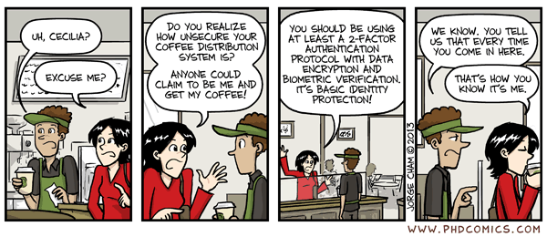
Questions?
More resources & links: http://fabianlischka.github.io/InfoSec101/

