Slide 1
InfoSec 101
Introduction to Information Security
for (non-IT) Professionals
Fabian Lischka, Larry Salibra, Leonhard Weese
FCC, Hong Kong, 2015-02-26
v0.91 from 2015-02-23
Notes:
Alphabetical order (note that order by first and order by last name coincide)

Slide 2
Content
Introduction
  What can go wrong? Why should I care? Disclaimers
Suggested Best Practices
  Basics: Passwords, Phishing, Cloud Storage
  Communication: Browsing, VPN, Email, Chat
  Miscellaneous
Questions

Slide 3
Introduction: What can go wrong?
Threats
  WFO (“Well funded organizations”) – maybe
    NSA, GCHQ, China?
  Criminals & Hackers (black hat)
    Phishing

Slide 4
Introduction: Why should you care?
You are dealing with sensitive information
  You could be a target
  Your communication could be monitored
  Your data could be manipulated/deleted
Protect:
  Sources, safety, ability to operate, reputation
Avoid:
  Accidental disclosures/information leaks
  Chilling effect on (potential) sources
    If I were whistleblower, I'd much rather contact you via PGP

Slide 5
Introduction: Why should you care?
“Even if the men in suits aren't after you, there are benefits to everyday crypto” – Jennifer Valentino DeVries, WSJ
Learn to use it – might come in handy
  Snowden revelations were delayed because Greenwald didn't have software or expertise
Network effect
  Communication tools more useful if more people use them
Red flag
  Help your fellow journalists: make security normal, a “default”, rather than a red flag

Slide 6
Introduction: Disclaimer
Using certain tools can raise red flags
Certain tools can be slow, clumsy, inconvenient
Might require expertise, discipline
Do not rely on this in life-and-death situations
  Weakest link property
  WFO will get in, if they really want to
    PGP/GPG and certain other protocols seems unbroken
    But: so many ways to get in

Slide 7

Introduction: Disclaimer

Slide 8
Best Practices: Contents
Basics: Better...
  Passwords (Protect against Phishing, Malware)
  Disk Encryption
  Cloud Storage
Communication
  Browsing, Tor
  VPNs
  Email, Chat/Voice
  Whistleblowing
Miscellaneous/Advanced

Slide 9
Best Practices: Passwords
Two basic ideas
  Avoid bad passwords, use good passwords
  Don't re-use the same password
Unfortunately, these ideas conflict
Solution: Password Managers

Slide 10
Best Practices: Passwords
Avoid bad passwords
  Things you love (but so does everyone else)
    Pets or significant others; Sports, sport teams, bands
    Family, religion, love, sex (`696969`, `love`, `jesus`, `angel`, `lord`)
  Words related to the site (eg `job`, `career`, `link` for linkedin)
  Generally, dictionary words, unless multiple unusual ones
  Patterns (`1234`, `qwerty`, `abcd`, `1qaz`)
Don't rely on simple tricks, they're all well known!
  Appending numbers, exclamation marks (`password123`): not secure
  Simple substitutions (`p@55word`): not secure
  Simple composition of common patterns (`ilovejesus123`): not secure

Slide 11
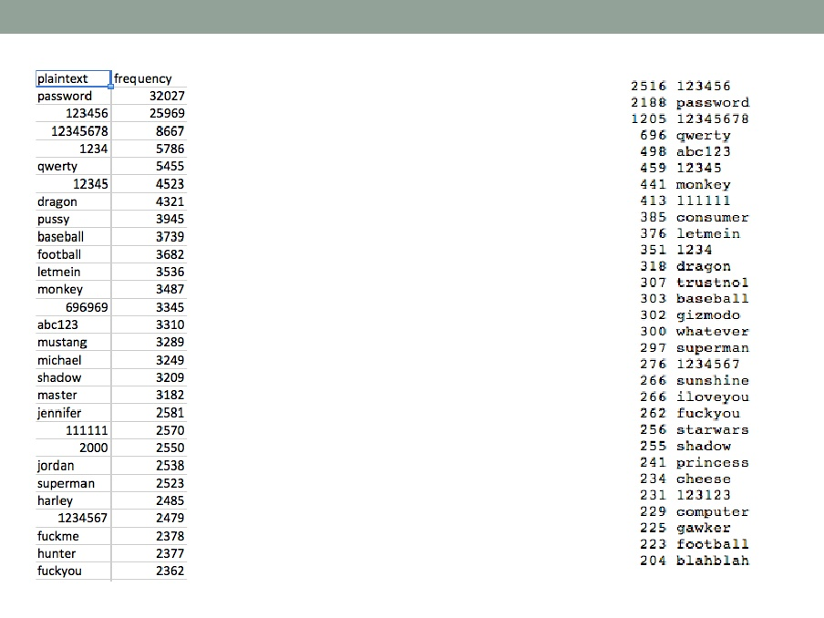
Best Practices: Passwords
LinkedIn breach (2012), Gawker breach (2010)

Slide 12
Best Practices: Passwords
Good technique (“Schneier Scheme”):
  Use 1st letter of words of a long sentence (the passphrase)
Example:
  Wo hěn xǐhuān HK, IT security, and (sometimes) 9 hours sleep
  WhxHK,ITs&(st)9hs
Best Practices:
  Creative, weird, unique passphrase, possibly multi-language
  Avoid catch phrase, song lyrics, movie quote. Make your own!
  Long phrase, resulting in at least 12 characters
  Include numbers, small/capital letters, symbols, etc.
  Note: might see different keyboard layouts on other computers

Slide 13
Best Practices: Passwords
Good technique:
  Use 4 or 5 randomly selected words from a large dictionary
  Maybe truncated at 5 or 4 characters
  Number/symbol to separate them
Example
  Keelhaul, cleistogamy, evince, vacuum
  Keel3clei6evin9vacu
Best Practices
  Random words, not some words that you like
  Sufficiently many

Slide 14

Best Practices: Passwords

Slide 15
Best Practices: Password Managers
Purpose: Use different (secure) passwords for different sites
  Password Managers generate and store these passwords securely
  Password Managers require one Master Password
    Better be good! Better don't forget it!
What: App or browser addin, available on computers, smart phones
Recommended:
  Apple only, simple: iCloud Keychain
  Free, open source: Password Safe/pwsafe, or KeePass
  Commercial solution with support: 1Password, or LastPass
Disadvantages:
  Cumbersome, particularly sync between devices
  If compromised, all your paswords are exposed
Notes:
MasterPassword: better be good (not used before). Better don't forget (use regularly, deposit in mom's safety deposit box)

Slide 16
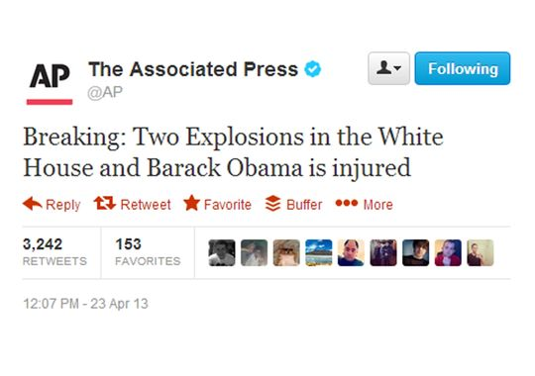
Best Practices: Avoid Phishing

Slide 17
Best Practices: Avoid Phishing
Phishing: Common and surprisingly effective attack
What is it? Fake emails (colleague, bank, etc) lures you to malicious website
  you "log in" with your real credentials on a fake site or are hit by “drive-by” exploit
Note:
  Link can have some legitimate text (http://www.mybank.com),
  but point somewhere else (http://phishingsite.xyz)
  Server (whatever is before the first slash) must be read from right to left
  (this is a bad link: www.mybank.com.domain.bla.phishingsite.xyz/login.html)
Prevention:
  Be suspicious of unexpected, somewhat generic emails
  Don't click on links in emails to "log in" somewhere. Type it in!
  Examine actual links (not what's displayed)
  Check exact name of the website, and the "lock" symbol
  Never provide your password to anyone, except the *actual* website it's for

Slide 18
Best Practices: Avoid Malware
Rule of thumb: if it's free, it's crap.
Trojan Horse
  malicious software packaged to look like something desirable, tricking the user into actively installing it
  Examples:
    spammy websites claim that your computer is infected, & offer free "virus scanner" for download. Actually, this "virus scanner" is malware
    a popular early Android app was a free flashlight app. However, it uploaded all the user's contact data, location, etc. to the provider, who sold it.
Prevention:
  Don't install arbitrary "disk cleaners", "search bars", etc.
  Don't install anything unless necessary, and only from a trusted source
  Don't open untrusted attachments
  Don't plug in untrusted USB sticks

Slide 19
Best Practices: Disk Encryption
Purpose: Protects the content of your laptop
  when it's stolen
  when it's in the hand of government/border control
What: App, or embedded in the operating system
How:
  Encrpyts your entire harddrive, and
  Decrypts what's needed on the fly
Without Disk Encryption, can just take out harddisk from your laptop, and copy everything from it, without logging in
Disadvantages: Might be ever so slightly slower on old hardware

Slide 20
Best Practices: Disk Encryption
Smartphones:
  Automatically enabled in iOS 8, and Android L
  Can be set up for earlier Android versions
Computers:
  OS X: FileVault
  Windows: ??
  Careful: TrueCrypt appears to have some issues
External Diskdrives:
  OS X: Can be formatted as encrypted disks (Disk Utility), password can be stored in Keychain
  Windows: ??

Slide 21
Best Practices: Deleting Data
Modern computer:
  Deleted Data is is just moved into the trash folder
  When the trash folder is emptied, only the "directory link" is deleted
  Actual data is still there
Prevention:
  Chose "Secure Erase"
Don't forget backups and cloud syncing!

Slide 22
Best Practices: Cloud Storage
Be aware of what is in the cloud
  iOS/OS X keep your contacts, calendars, photos in iCloud
  iCloud celebrity photo hack: most likely bad passwords & social engineering
Suggested Tools:
  Encrypted, but experimental: TorrentSync
  Careful, only partial encryption: Dropbox, Google Drive, iCloud
  Not recommended at all: 360 Cloud Disk, Baidu Cloud Disk, QQ Net Disk
Note:
  Whatever you encrypt yourself (with PGP) you can put on any cloud server; it can't be decrypted without your private key

Slide 23
Best Practices: Communication

Slide 24
Best Practices: Browsing
Search engines, social networks track you (even on other sites)
  Facebook is notified whenever you visit a site that has a "Like" button
Cookies allow sites to identify you over time, across sites
You might be uniquely identified by your browser alone (see Panopticlick)
You and your location might be determined from your IP address (see IPLeak)
Prevention:
  Occasionally delete all cookies/history (careful: need to re-login)
  Browse in Private mode ("porn mode")
  Use different browsers for different tasks (private/job/sensitive)
  Install some of the tools in the next section
Notes:
  Do not ignore warnings about security certificates. MITM ("men in the middle") attackers could read all your traffic (incl. Passwords)
  Always use HTTPS, if possible, as it encrypts your traffic (lock symbol)

Slide 25
Best Practices: Browsing – Search
Recommended Search Engines:
  DuckDuckGo: Anonymous, unlogged search.
    Can be set as default in many browsers, including Safari (OS X, iOS)
  Ixquick: Anonymous, unlogged search, using non-Google sources
  StartPage: Anonymous, unlogged search, using Google as the source
Not recommended: Bing, Google, Yahoo
DuckDuckG “Bangs”: !s, !g, !v, !w

Slide 26
Best Practices: Browsing - Addons
Recommended Tools:
  Adblock Plus: Blocks ads when browsing. Android, Chrome, Firefox, IE, Opera, Safari. Lets “acceptable ads” through by default, but can disable.
  AlwaysHTTPS: Encrypts your browsing with many websites. Firefox, Chrome, Opera.
  Ghostery: Stops trackers when browsing. Uploads anonymized tracker data by default. Firefox, Chrome, Opera, Safari.
  Privacy Badger: Stops advertisers and trackers when browsing. Firefox, Chrome.
Similar: Adblock, Adblock Edge.

Slide 27
Best Practices: Browsing – Tor
Tor routes all your traffic through a few extra hops, encrypted, so that
  the website you are visiting does not know who it's talking to, and
  interceptors near you don't know what websites you're visiting
What: stand-alone application available for most platforms, based on Firefox
Recommended: Torbrowser (OS X, Win), OnionBrowser (iOS), Orbot (Android)
Disadvantages:
  Can be rather slow
  final hop in the clear

Slide 28
Best Practices: Browsing – Tor
Best Practices:
  Do not divulge private information when using Tor
    Don't log into any website (Facebook, etc.)
    Don't use your real name, or google yourself
  Don't open documents downloaded through Tor while online
  More! See Tor documentation
“.onion” only accessible with a Tor browser
  Example: DuckDuckGo: 3g2upl4pq6kufc4m.onion

Slide 29
Best Practices: VPNs
Virtual Private Network: from your device
  encrypted all the way to a specific VPN server "somewhere"
  from VPN server unencrypted to its destination
Protects from interception "nearby"
  Internet Cafe, your ISP, local government
Allows to circumvent censorship
    When traveling in certain jurisdictions
    Might have to enable advanced options for that

Slide 30
Best Practices: VPNs
Many providers, but no free lunch
  expect to pay for good service (about USD 5/month)
Recommended:
  AirVPN. Excellent VPN, strong commitment to security & privacy. Run by activists in Italy. Three connections per account. Unix, OS X, Win, iOS, Android.
  ZenMate: Free Browser add-on. Routes only browser traffic through a VPN, not other apps (Mail, Messenger, etc.). Chrome, FireFox, Opera.
To test whether the VPN works correctly:
  Visit ipleak.net with/without VPN active
  Compare what IP address and location it reports

Slide 31
Best Practices: Email & PGP
Basic Idea:
  Encrypt your message including attachments into some blob (the ciphertext)
  Send that blob via email
Note: Meta data is not encrypted, can be intercepted/manipulated
  Sender, recipient
  Subject line
  Length
  Time and frequency of mails

Slide 32
Best Practices: Email & PGP
The standard is PGP/GPG
  PGP = "Pretty Good Privacy": original implementation (1991)
  OpenPGP: open internet standard
  GPG = "Gnu Privacy Guard": open source implementation
Purpose: PGP/GPG takes arbitrary text and encrypts it, using asymmetric encryption
What:
  Command line tool, but
  Various apps available, including utilities that integrate with existing email programs

Slide 33
Short Excursion: Encryption
Encryption uses a key, and an algorithm
Method:
  Plain Text + key + algo = ciphertext
  Send the ciphertext across (even a non-secured line)
  Ciphertext + key + algo = Plain Text
Evil Eve doesn't understand anything, if she doesn't have key
Postal analogy:
Disadvantages:
  Alice and Bob must have the same key. They must have met once before, and agreed on a key.
Notes:
Define terms in italics
Postal analogy: need SAME KEY
Alice puts the message in a box, and locks it with a padlock. She sends it over to Bob. Bob has the same key, and uses it to open the padlock and read the message. They must have gone shopping together to buy the padlock and taken a key each.

Slide 34
Short Excursion: Asymmetric Encryption
Asymmetric encryption is awesome mathemagic:
  Keys for encryption and decryption need not be the same
  Create a key pair, publish one half. Other half cannot be reconstructed!
Method:
  Plain Text + Bob's public key + algo = ciphertext
  Send the ciphertext across (even a non-secured line)
  Ciphertext + Bob's private key + algo = Plain Text
Evil Eve doesn't understand anything, if she doesn't have Bob's private key.
Problems:
  Key management, MITM (comparing "finger prints")
Notes:
AKA public-key encryption
Postal analogy:
Alice asks Bob to send over a padlock, and Bob sends over HIS padlock.
Alice puts the message in a box and locks it with Bob's padlock, and sends the box over to Bob.
Bob uses HIS key to open his padlock and read the message
Explain key management/MITM problem:
anyone can upload keys to keyservers, so you cannot trust that any key you download actually belongs to the individual listed in the key. You should therefore verify with the individual owner the full key fingerprint of their key. You should do this verification in real life or over the phone..
Ask for Bob's key, but bad server gives you Eve's key
Explain signatures?

Slide 35
Best Practices: Email & PGP
Recommended:
  GPG4Win. GPG for Windows
  GPGTools. GPG on OS X Mail.
  IPGMail: GPG for iOS.
For key management, consider keybase.io
Not recommended for sensitive information:
  Normal email

Slide 36
Best Practices: Email & GPG
Use generic subject ("cat pictures")
Key generation:
  4096 bits, RSA
  Expiry date, say 2 years
    Allows to retire key
    Can always extend, link to new key
  Strong passphrase
Beware of drafts stored in clear text on the mail server
  Either enable "encrypt drafts", or go off-line while composing sensitive emails
Notes:
Avoid sending very similar messages with only small changes, re-using greeting and signature, etc.
- the Nazi's Enigma was broken faster because every message ended with "Heil Hitler"

Slide 37
Short Excursion: Levels of Security
Can send message across:
  Unencrypted
  Partially
  End-to-End
Server:
Abcd
Alice
Bob
Abcd
Abcd
Server:
Abcd
Alice
Bob
Xy#!
Xy#!
Server:
Xy#!
Alice
Bob
Xy#!
Xy#!
Notes:
Unencrypted. Intercept by:
café whose Wifi you are using,
ISP
Government,
company/telecom provider.
Partial
secure against random hackers,
Secure against café
But: what happens on the server itself?
government
company could spy on it, analyse it, sell it.
end-to-end encryption
NOBODY inbetween can decrypt

Slide 38
Best Practices: Chat
Most apps are crap, but there are good & free alternatives!
Weaknesses:
  Meta data (with whom do you chat how often)
  MITM (man in the middle attack)
    Solution: Out-of-band key comparison
Notes:
Out-of-band key comparison: explain MITM briefly, then solution:
Compare 2 words (over voice) representing key
Compare raster-image representing key

Slide 39
Best Practices: Chat
Recommended (End-to-end encrypted):
  iMessage: Closed Source. Apple only.
  Telegram: only “Secret Chat” end-to-end. Closed source. Smartphone, Desktop
  TextSecure: Open source. Android, but iOS version on the way.
  Threema: Closed source. Not free. Smartphone.
Recommended (advanced!):
  Adium: OTR chat for OS X. A bit clunky.
  Pidgin + OTR: OTR chat for Windows.
  ChatSecure: OTR chat for iOS, Android. A bit clunky.
Only partial encryption: AIM, Blackberry Messenger, Facebook Chat, IRC, Line, Telegram non-secret & groups, WhatsApp, Yahoo Messenger
Not recommended: Firechat, Google Hangout, Google Talk, ICQ, Kik, Kaoko, QQ, Snapchat, Viber, WeChat, Whisper. SMS.

Slide 40
Best Practices: Voice
Recommended:
  Signal (iOS), Redphone (Android)
    Free, encrypted calls
Only partial encryption:
  Google Hangout (Voice/Video)
Not recommended:
  Normal phone calls
  Skype

Slide 41
Best Practices: Whistleblowing
Recommended: SecureDrop
Purpose: Confidential communication between journalist and source
What: Stand-alone software package, running on a server
How:
  Contact news organization's “SecureDrop” via Tor
  Choose a pseudonym
  Drop documents securely
  Follow up/Communicate using pseudonym
Your organization can set up an instance of the software on a server
Example: Contact The Guardian at 33y6fjyhs3phzfjj.onion

Slide 42
Best Practices: Miscellaneous

Slide 43
Miscellaneous: Information Leaks
Your phone is a tracking device
  Cell phone provider knows where it is, smart phone knows where it is
If you hand out info, you might reveal more than you thought
  Phone number, email can be googled: what to they reveal?
  Reverse Image Search (TinEye, Google)
    See whether a picture appears elsewhere on the net, eg Facebook, LinkedIn, Twitter, or your employer's website
  Images contain embedded information (EXIF data)
    Might contain the time and location the picture was taken (McAfee case)
    Tools available to remove that information (EXIF strippers, metadata scrubbers)
      Recommended (but maybe a bit complicated): ExifTool. Windows, OS X, UNIX
Your IP address can lead to your ISP, and then to you.
Cookies on your browser can identify you across sites

Slide 44
Miscellaneous: Multiple Accounts
Recommended: Separate accounts on your computer
  Work
  Private
  Project XYZ
Use shared folders to move information between them in a controlled matter
Disadvantage:
  Have to re-enter passwords etc.
Advantage:
  Makes information leaks less likely

Slide 45
Miscellaneous: Defense in Depth
Multiple layers of protection might be best
If the adversary breaks one layer, the information is still protected
Examples:
  Agree on code words for sensitive entities
  Cut message in many pieces, transmit...
    … part on iMessage, part on Signal/Redphone, part on Telegram, part on Wickr, part on phone: “let's meet”, “Sunday”, “10 am”, “Wagyu Lounge”, “red shoes”
  Use TOR over a VPN
  Etc.

Slide 46
Finally: Advanced Steps
If you have highly sensitive information, you'll need to be way more careful, systematic, paranoid.
Research:
  OpSec
  VMs (Virtual Machines)
  Tails (The amnesic incognito live system)
Remember:
  If they want to get you, they will.

Slide 47
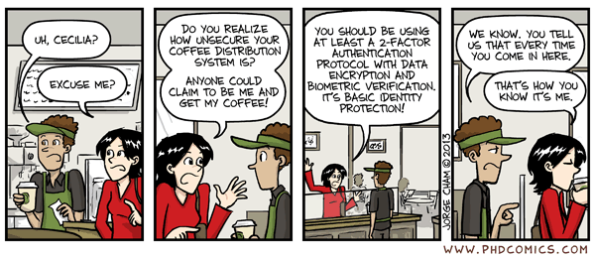
Questions?
More resources & links: http://fabianlischka.github.io/InfoSec101/

