Slide 1
Getting Started with Machine Learning & AI Session 1
AI vs. Machine Learning
Types of Machine Learning
Key Concepts of Machine Learning

Slide 2
References
Lecture Notes: https://lme.tf.fau.de/lecture-notes/lecture-notes-pr/lecture-notes-in-pattern-recognition-episode-1-introduction/
Stanford CS 229: https://www.youtube.com/watch?app=desktop&v=jGwO_UgTS7I&ab_channel=stanfordonline
Machine Learning Crash Course: https://developers.google.com/machine-learning/crash-course

Slide 3
Workshop Objectives
Understand ML & AI
Build basic ML models
Hands-on with data
Real-world & ethics
Notes:
Understand the key concepts of Machine Learning and AI, including how they differ and overlap
Learn how to build and evaluate basic machine learning models using popular tools
Gain hands-on experience working with real datasets and applying ML algorithms
Explore real-world applications and reflect on the ethical considerations involved in AI and ML systems

Slide 4
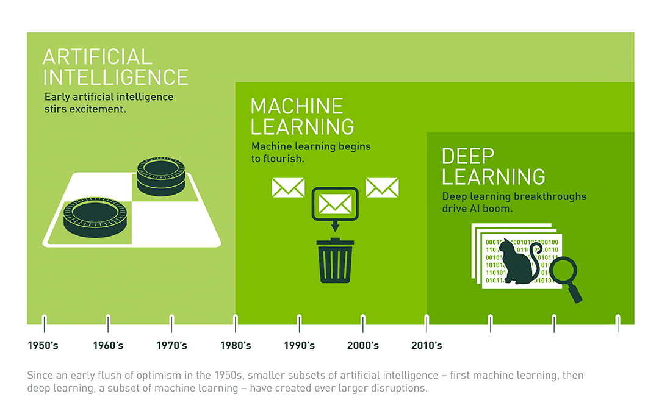
What is Artificial Intelligence?
Simulates human intelligence
Tasks: reasoning, language, perception, …
Rule-based or learned
Examples: self-driving cars, assistants, recommendations
https://shorturl.at/778QR
Notes:
Artificial Intelligence (AI) is a broad field of computer science that focuses on creating systems capable of performing tasks that typically require human intelligence.
These tasks include reasoning, problem solving, understanding language, perception (e.g., seeing and hearing), and decision-making.
AI systems can be rule-based or learn from data.
Examples include self-driving cars that perceive and navigate their environment, virtual assistants that understand speech, and recommendation systems that personalize content.

Slide 5
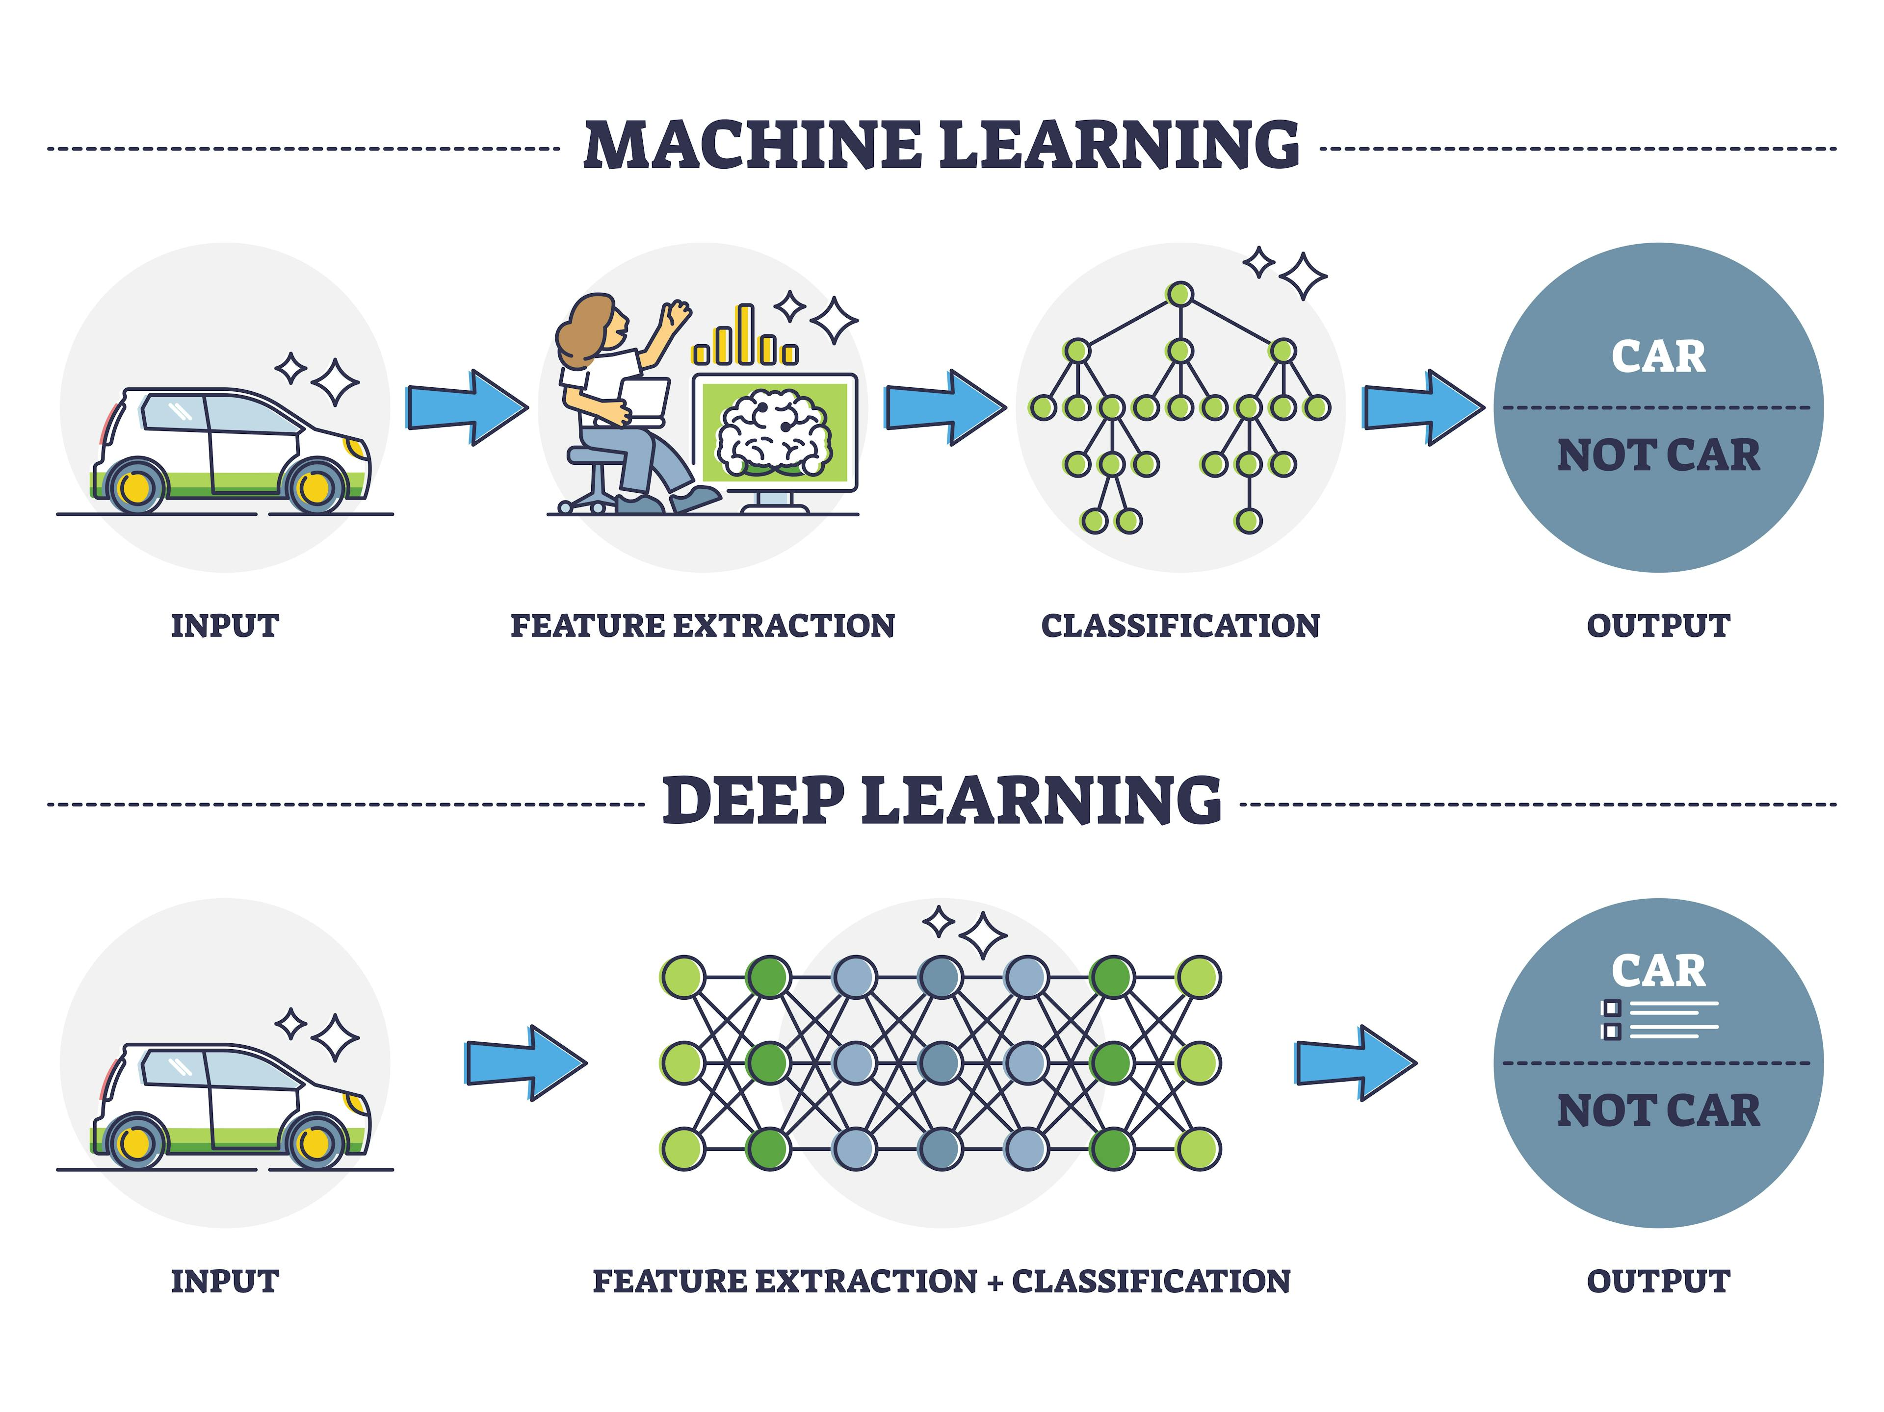
What is Machine Learning?
Subset of AI
Learns from data
Adapts over time
https://tinyurl.com/mrxb3as4
Notes:
Machine Learning (ML) is a subset of AI focused on the idea that systems can learn from data, identify patterns, and make decisions with minimal human intervention.
Instead of being explicitly programmed for every task, ML algorithms adjust and improve their performance based on the data they encounter.
For example, a spam filter learns from examples of spam and non-spam emails and adapts to new spam patterns over time.
Deep Learning is a subset of Machine Learning: DL = ML algorithms with learned. i.e., data-based, feature engineering

Slide 6
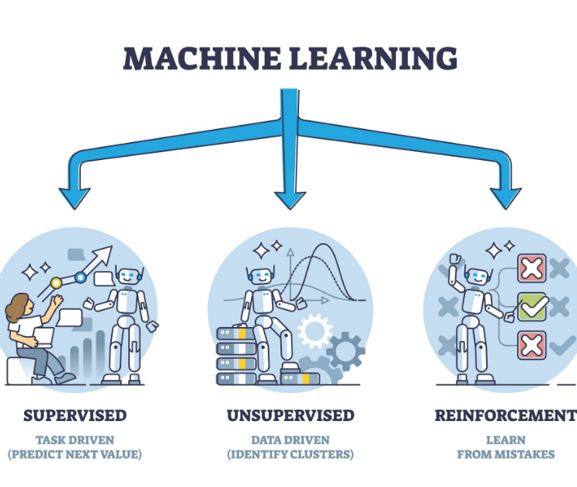
Types of Machine Learning
Supervised: labeled data → predictions
Unsupervised: discover patterns
Reinforcement: reward-based learning
Generative: synthesizing text or images
https://tinyurl.com/yuxwedf8

Slide 7
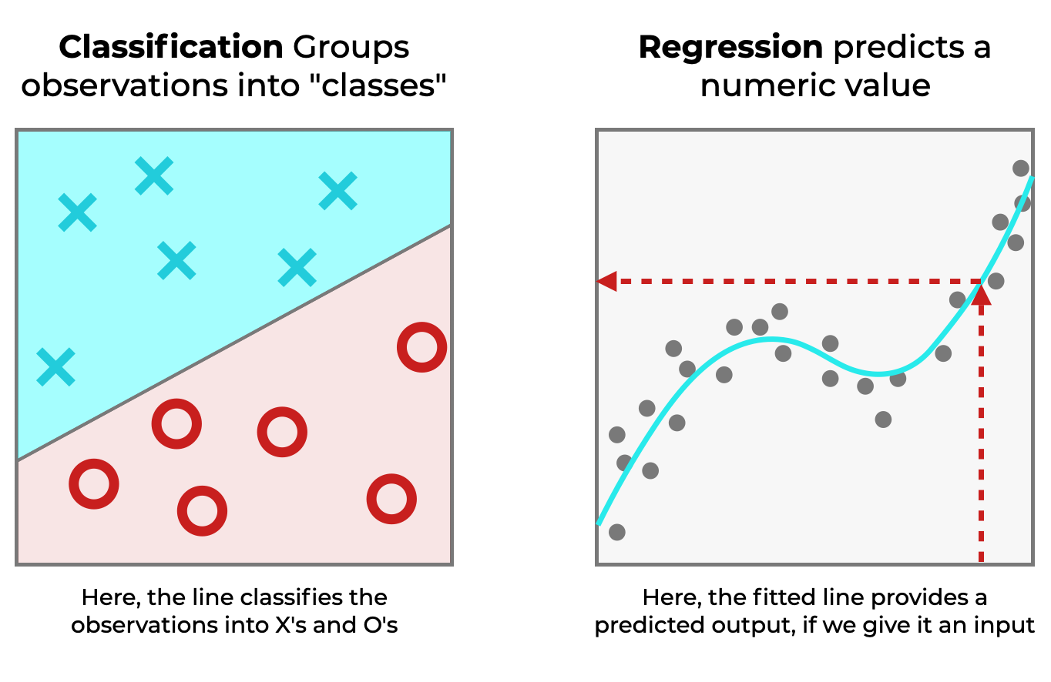
Types of Machine Learning - Supervised Learning
https://tinyurl.com/44a97br8
Notes:
Supervised learning involves training a model on a labeled dataset, where each input has a corresponding correct output (label).
The goal is for the model to learn the mapping from inputs to outputs so it can predict labels for new, unseen inputs.
Common tasks include:
Classification: Predicting a category (e.g., spam or not spam)
Regression: Predicting a continuous value (e.g., housing prices)

Slide 8
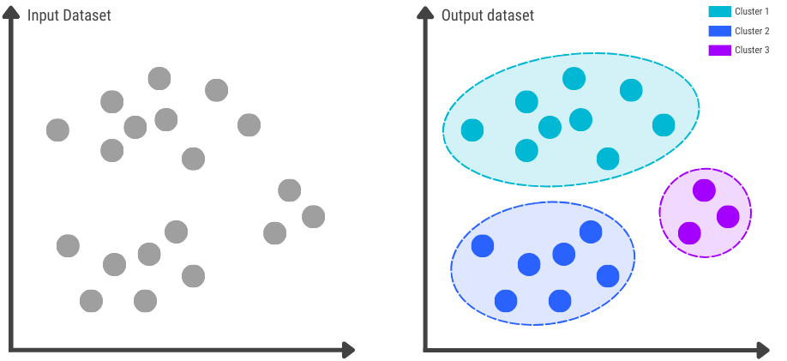
Types of Machine Learning - Unsupervised Learning
https://tinyurl.com/msrs6vn8
Notes:
In unsupervised learning, the model is given data without explicit labels and must find patterns or structures on its own.
It is often used to discover hidden groupings in data or reduce dimensionality.
Common tasks include:
Clustering: Grouping similar data points (e.g., customer segmentation)
Dimensionality Reduction: Reducing the number of features while retaining meaningful information

Slide 9
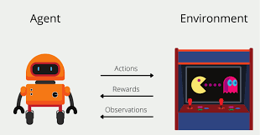
Types of Machine Learning - Reinforcement Learning
https://tinyurl.com/3kpcv774
Notes:
Reinforcement learning involves training an agent to make a sequence of decisions by rewarding desired behaviors and penalizing undesired ones.
The agent learns an optimal policy through trial and error in an interactive environment.
Examples include game-playing agents like AlphaGo and robotic systems learning to walk.

Slide 10
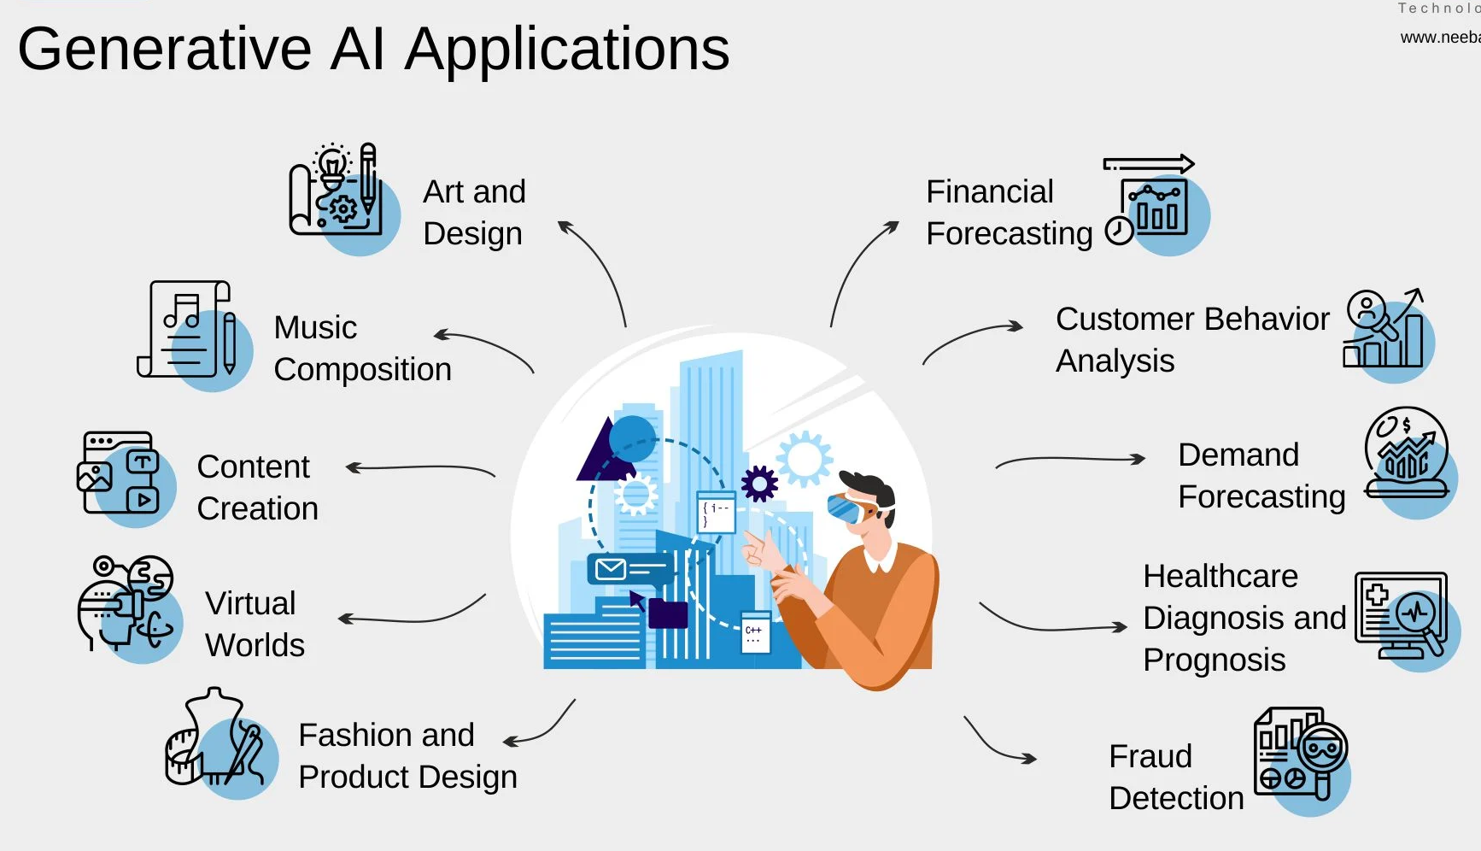
Types of Machine Learning - Generative AI
https://tinyurl.com/yc87wryt
Notes:
• Creates new content: Unlike traditional models that classify or predict, generative AI models (like GPT or DALL·E) generate text, images, code, or other data based on training examples.
• Learns patterns, not labels: Instead of learning from labeled data, generative AI often learns from raw, unlabeled data by modeling the distribution and structure of the input.
• Examples: Text generation (ChatGPT), image synthesis (Midjourney), music creation, or 3D model generation.

Slide 11
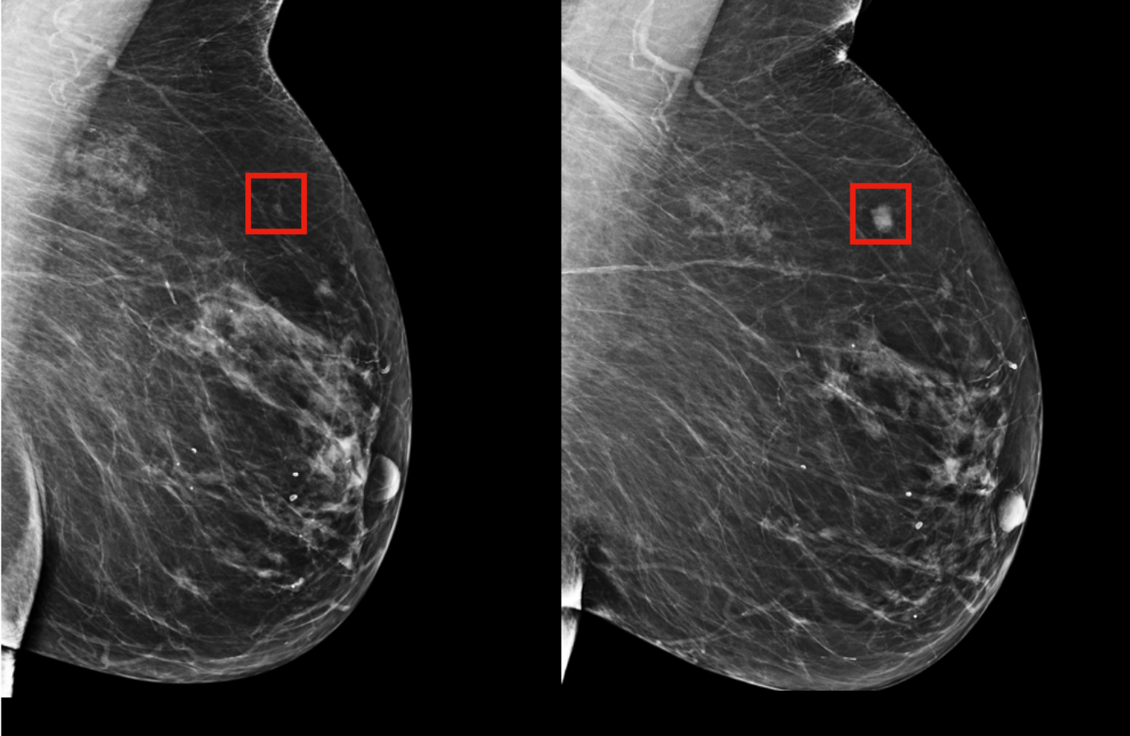
Real-World ML Applications
https://tinyurl.com/2znmpktc
Notes:
Finance: Detect fraudulent transactions, assess credit risk
Retail: Segment customers, optimize pricing and inventory
Entertainment: Generate personalized content recommendations (e.g., Netflix, Spotify)
Transportation: Autonomous vehicles, route optimization

Slide 12
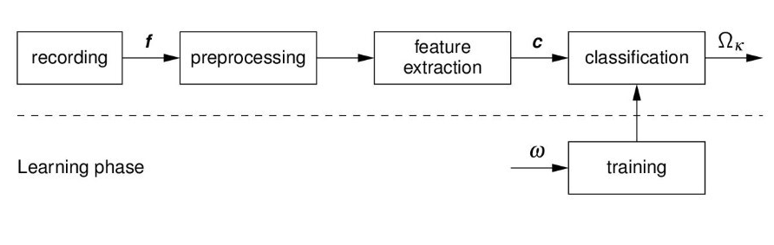
The ML Workflow
Task: Diabetes Prediction
Collect Data
Preprocess Data
Train & Validate Model
Evaluate
Deploy
https://tinyurl.com/5y8d6mph
Notes:
• Collect medical data (e.g. from the Pima Indians Diabetes Dataset).
• Features might include: age, BMI, glucose level, insulin, blood pressure, etc.
• Clean data: handle missing values, normalize features, split into train/test.
• Choose a model (e.g. random forest, or XGBoost).
• Train on labeled data (features → diabetes yes/no).
• Tune hyperparameters with cross-validation.
• Evaluate on test set using metrics like accuracy, precision, recall, AUC.
• If good enough, deploy as part of a health screening tool or app.
• Optionally monitor and retrain the model regularly with new data.

Slide 13
Key Concepts
Feature: An individual measurable property or characteristic of an observed phenomenon (e.g., age, BMI)
Label: The target output that the model is expected to predict (diabetes yes/no)
Model: The mathematical function or algorithm that maps inputs (features) to outputs (labels)
Loss Function: A mathematical function that quantifies how far the model's predictions are from the actual labels
Training: The process of adjusting the model's parameters to minimize the loss function on the training data.

Slide 14
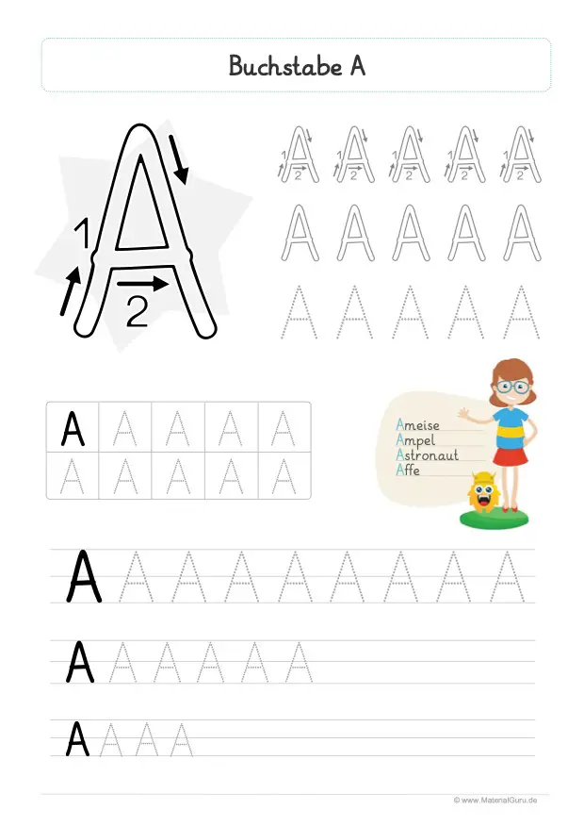
Key Concepts
Scenarios:
A child is learning to predict grades based on hours studied and sleep hours.
Kids are learning to write by tracing letters.
What are features & labels?
https://tinyurl.com/363y8rzu

Slide 15
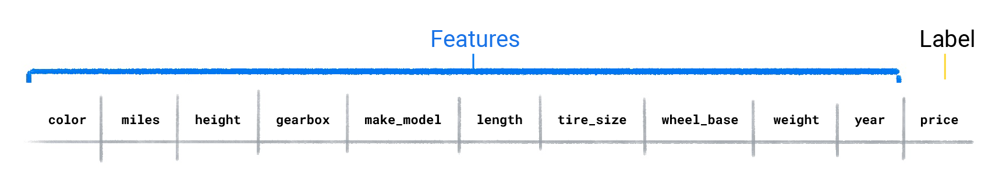
Validate your understanding
Task: Predict a value of a car
What are features?
What is the label?

Slide 16
Validate your understanding (cont.)
Which three features do you think are likely the greatest predictors for a car's price?
color, height, make_model
tire_size, wheel_base, year
make_model, year, miles
miles, gearbox, make_model

Slide 17
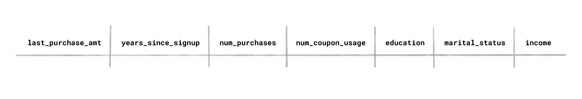
Validate your understanding (cont.)
Suppose you had a dataset of users for an online shopping website, and it contained the following columns:
If you wanted to understand the types of users that visit the site, would Do you use supervised or unsupervised learning?
Supervised learning because I'm trying to predict which class a user belongs to.
Unsupervised learning.

Slide 18
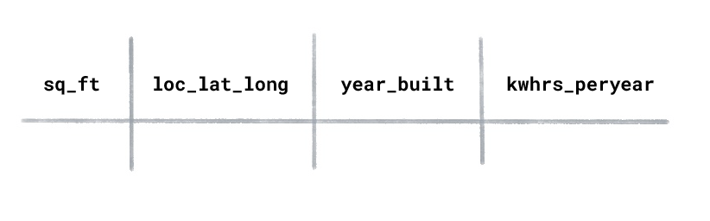
Validate your understanding (cont.)
Suppose you had an energy usage dataset for homes with the following columns:
What type of ML would you use to predict the kilowatt hours used per year for a newly constructed house?
Supervised learning
Unsupervised learning.

Slide 19
Hands-on Tools We’ll Use
Colab, scikit-learn, pandas, matplotlib, Playground, Teachable Machine

Slide 20
Getting Started with Machine Learning & AI Session 2
Linear Regression
Logistic Regression
Decision Trees & Random Forests
Feature Engineering
Model Validation & Evaluation

Slide 21
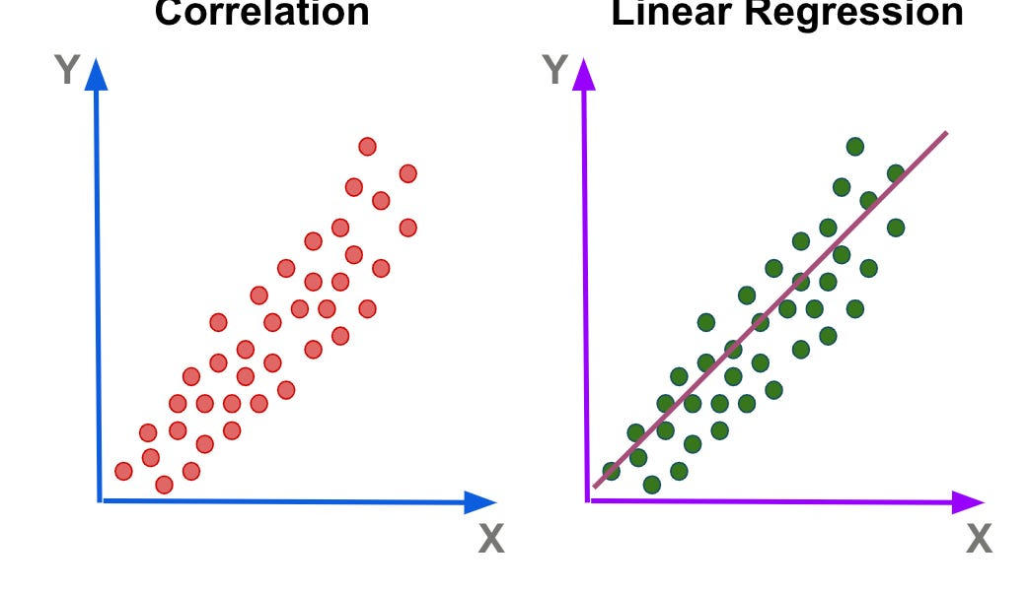

Linear Regression
Predicts continuous values
Fits a line $y=mx+b$
Minimizes MSE
Disadvantages (some):
Assumes linear relationship
Poor performance on non-linear data
Sensitive to Outliers
https://tinyurl.com/2jdf2vc5
Notes:
Relate to housing price prediction: x = sq_mts, y=price
Linear regression is used to model the relationship between a dependent variable and one or more independent variables.
For a single feature, the model learns a line (y = mx + b) that best fits the data.
The line is determined by minimizing the mean squared error, which measures the average squared difference between predicted and actual values.
Demo: Use Colab to build a simple model predicting housing prices from square footage.

Slide 22
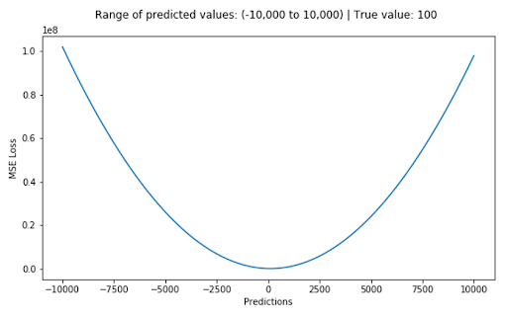
Task: Implement Linear Regression from Scratch
Implement a Linear Regressor
Scipy etc. are not allowed
Use vectorization → faster
Use the Mean-Squared Error as a loss function
https://tinyurl.com/ys4y6vb4
Notes:
Relate to housing price prediction
Linear regression is used to model the relationship between a dependent variable and one or more independent variables.
For a single feature, the model learns a line (y = mx + b) that best fits the data.
The line is determined by minimizing the mean squared error, which measures the average squared difference between predicted and actual values.
Demo: Use Colab to build a simple model predicting housing prices from square footage.

Slide 23
Logistic Regression = Classification
We will talk about
Generating probabilities
Classifying samples
Gradient descent
→ Fundamentals of Neural Networks
Notes:
Logistic regression is a classification algorithm used to predict the probability of a binary outcome (e.g., spam vs. not spam).

Slide 24
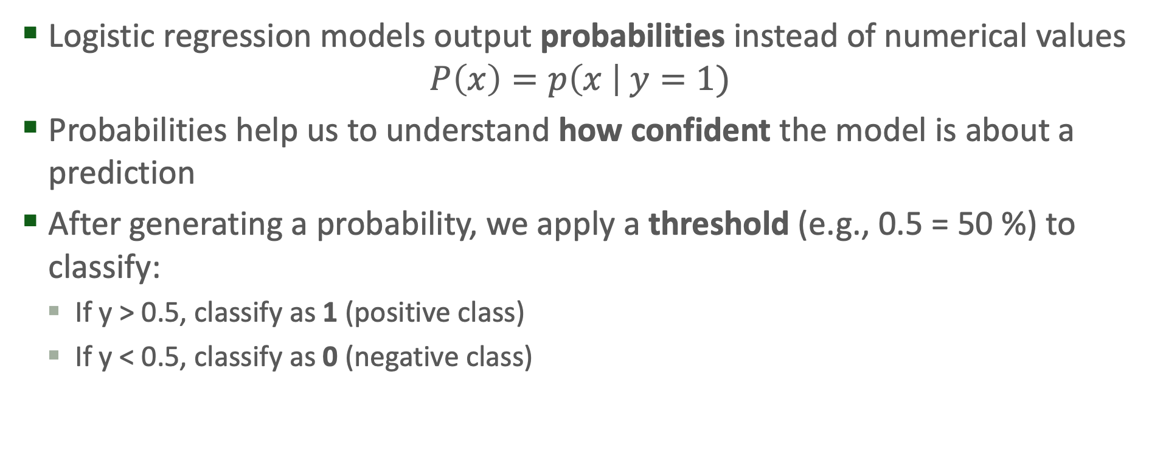
Logistic Regression (cont.)
Logistic regression models output probabilities instead of numerical values
$$P\left(x\right)=p\left(x \right| y=1)$$
Probabilities help us to understand how confident the model is about a prediction
After generating a probability, we apply a threshold (e.g., 0.5 = 50 %) to classify:
If y > 0.5, classify as 1 (positive class)
If y < 0.5, classify as 0 (negative class)
Notes:
It uses the logistic (sigmoid) function to squash outputs into a range between 0 and 1.
If the probability exceeds a threshold (commonly 0.5), the output is classified into one category.

Slide 25
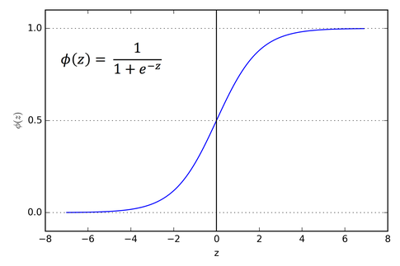
Logistic Regression (cont.)
Sigmoid function:
Notes:
It uses the logistic (sigmoid) function to squash outputs into a range between 0 and 1.
Characteristics of Sigmoid Function:
When z goes to infinity, exp(-z) gets small, so ϕ(z) goes to 1
When z goes to minus infinity, exp(z) blows up, ϕ(z) goes to 0.

Slide 26

Logistic Regression (cont.)
Linear Regression$: y=mx+b$
Logistic Regression$: y=σ\left(mx+b\right)$ → $y>0.5$ ?
Notes:
Logistic regression just extends Linear Regression with the Sigmoid Function & applies threshold

Slide 27
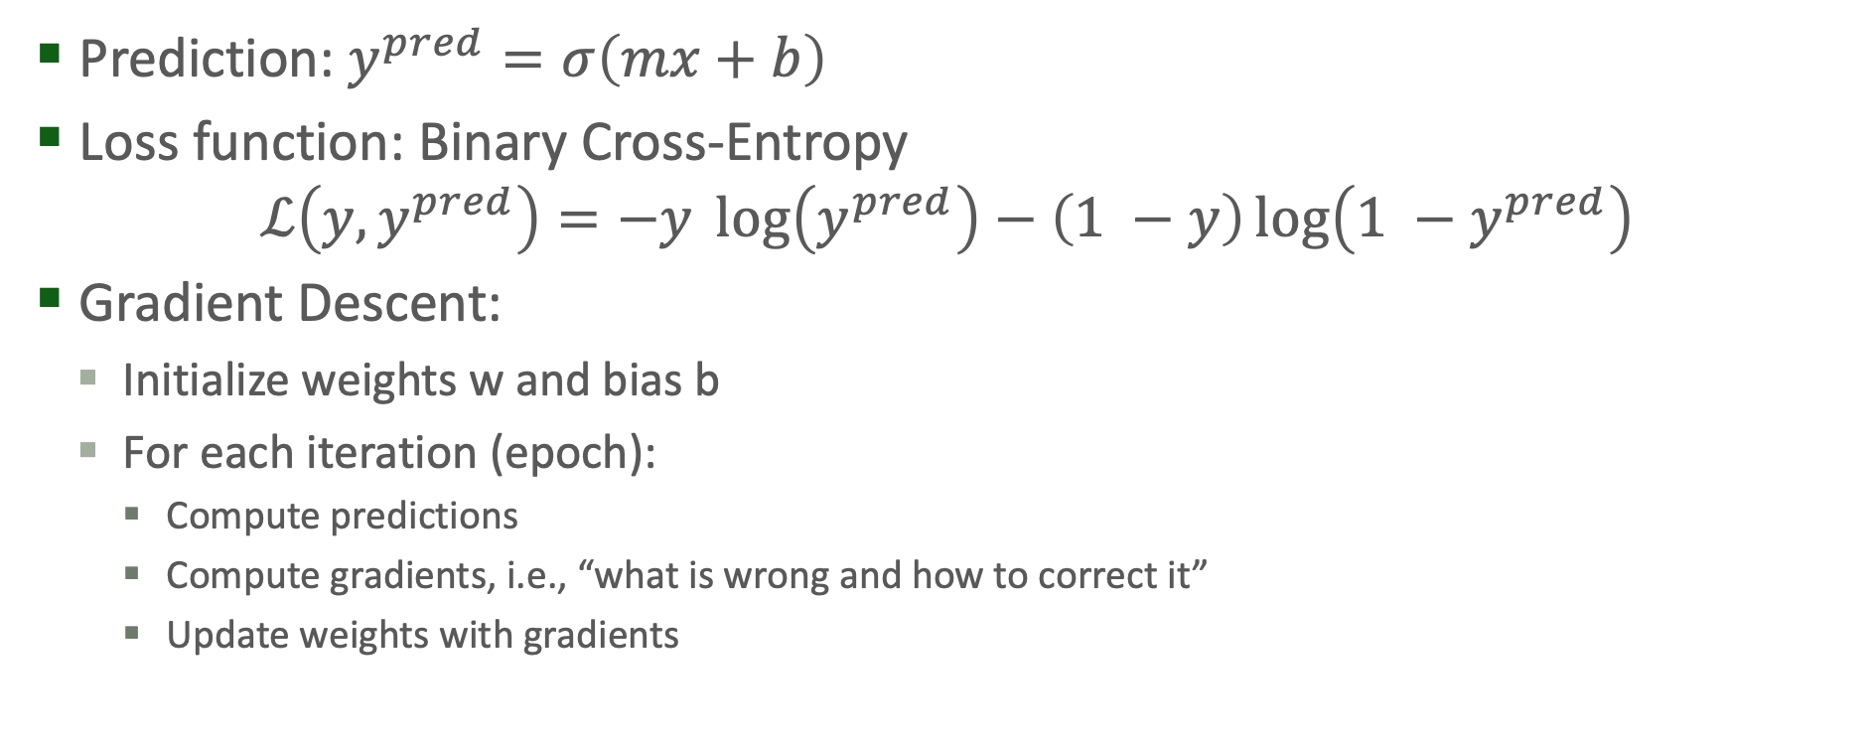
Logistic Regression (cont.)
Prediction: $y^{pred}=σ\left(mx+b\right)$
Loss function: Binary Cross-Entropy
$$ℒ\left(y, y^{pred}\right)=−y\log\left(y^{pred}\right)−\left(1 −y\right)\log\left(1 −y^{pred}\right)$$
Gradient Descent:
Initialize weights w and bias b
For each iteration (epoch):
Compute predictions
Compute gradients, i.e., “what is wrong and how to correct it”
Update weights with gradients
Notes:
Left term is 0 if y == 0
Right term is 0 if y == 1
Imagine you’re standing on a hill, blindfolded.
Your goal: reach the bottom (lowest point of the loss function).
You can feel the slope beneath your feet — that’s your gradient.

Slide 28
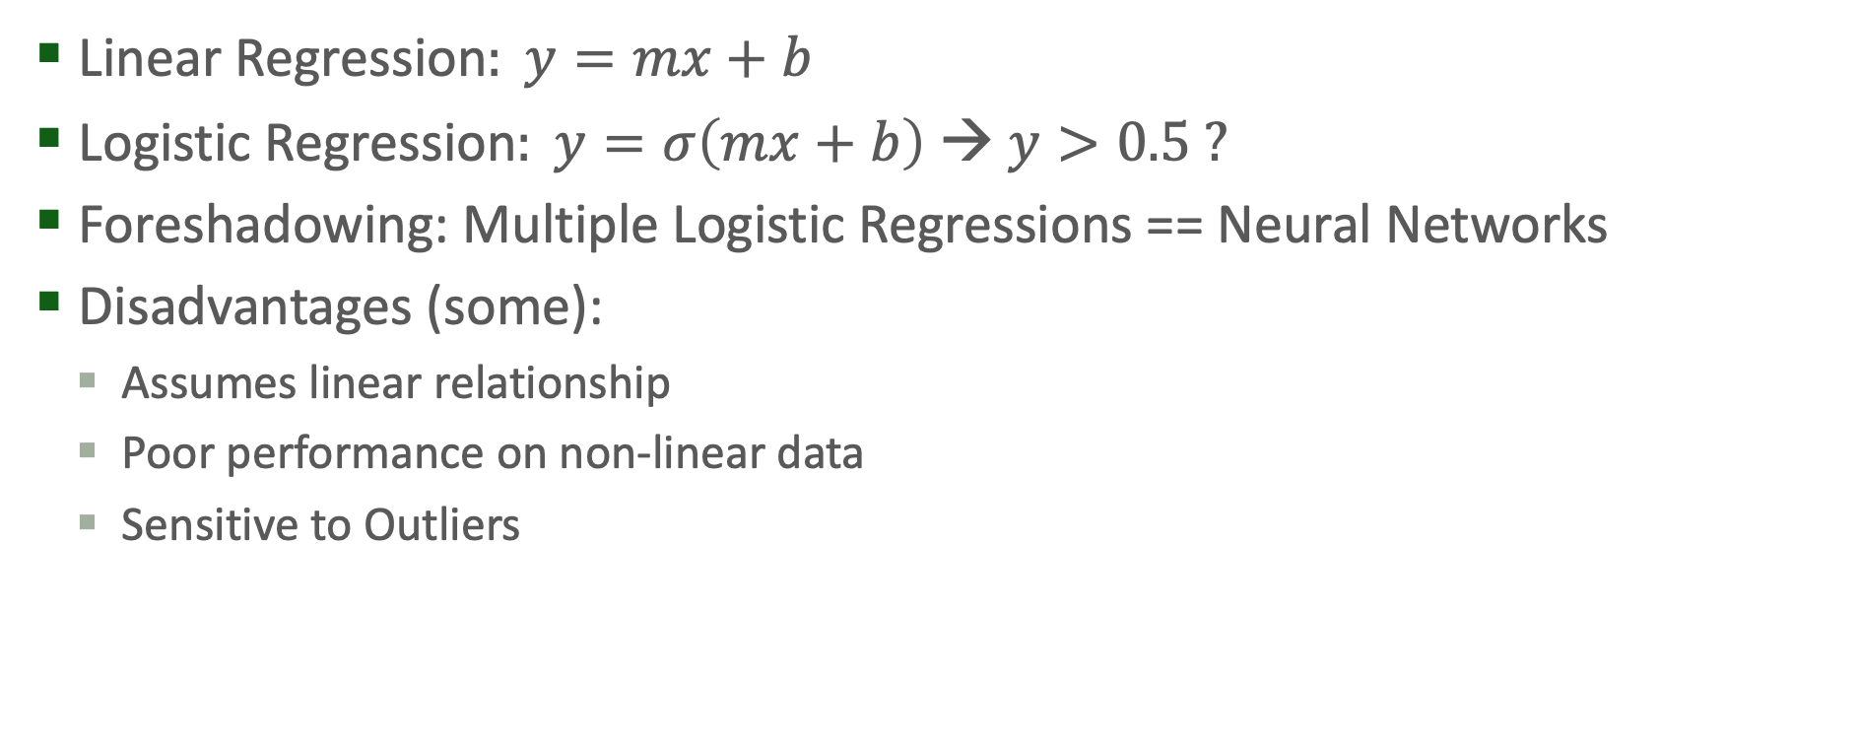
Logistic Regression (cont.)
Linear Regression$: y=mx+b$
Logistic Regression$: y=σ\left(mx+b\right)$ → $y>0.5$ ?
Foreshadowing: Multiple Logistic Regressions == Neural Networks
Disadvantages (some):
Assumes linear relationship
Poor performance on non-linear data
Sensitive to Outliers
Notes:
Logistic regression just extends Linear Regression with the Sigmoid Function & applies threshold

Slide 29
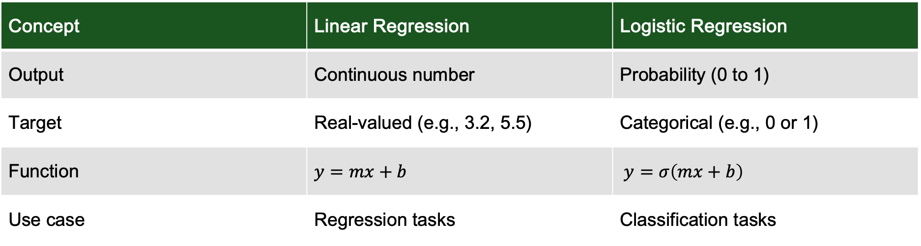
Logistic Regression (cont.)
Concept | Linear Regression | Logistic Regression
Output | Continuous number | Probability (0 to 1)
Target | Real-valued (e.g., 3.2, 5.5) | Categorical (e.g., 0 or 1)
Function | $$y=mx+b$$ | $y=σ\left(mx+b\right)$
Use case | Regression tasks | Classification tasks

Slide 30
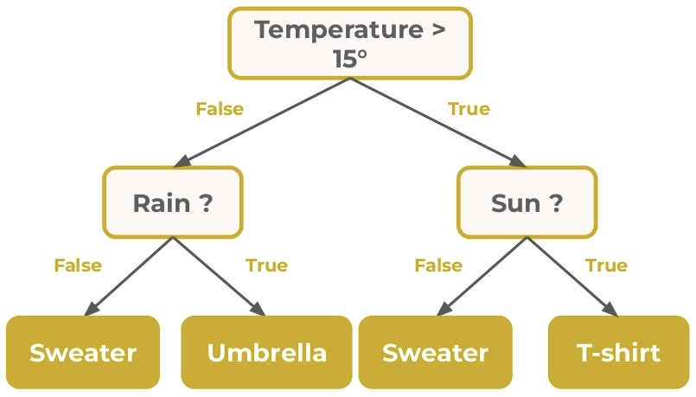
Decision Trees
Models that split data based on feature values to make decisions.
Each node in the tree represents a feature and a threshold.
Leaves represent final decisions or predictions.
Root
Subtree
Leaf
https://tinyurl.com/e7c9t4xc
Notes:
Explain that decision trees work like a flowchart where each question splits the data based on a feature — for example, "Is the income greater than $50,000?"
This continues until a decision can be made at a leaf node.
Emphasize they are easy to understand and visualize.
However, a single decision tree can overfit, especially with noisy data.

Slide 31
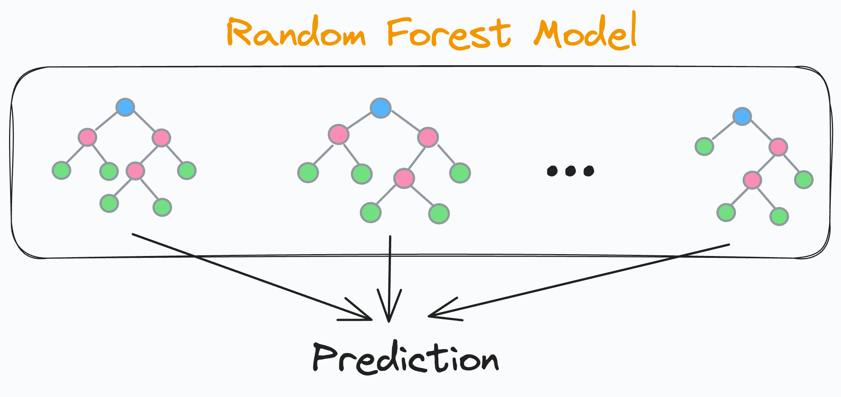
Random Forest
Ensembles of multiple decision trees trained on different parts of the data
Prediction of all trees are averaged
More robust and less prone to overfitting than a single tree
https://tinyurl.com/52vjmc2t
Notes:
That’s where Random Forests come in: by building multiple trees on different subsets of the data and averaging their results, we get a more stable and accurate prediction.
Mention that they work well out of the box and are often used in competitions and real-world applications.

Slide 32
Overfitting vs. Underfitting
Underfit: The model is too simplistic and fails to capture underlying patterns in the data.
Overfit: The model performs well on training data but poorly on new, unseen data.
How to avoid overfitting:
Use simpler models
Collect more data
Apply regularization techniques
Use cross-validation to monitor generalization
Notes:
Overfitting: Model too complex. It has learned noise or specific patterns that don't generalize.
Compare overfitting to memorizing answers instead of learning the concept — it works on familiar questions but fails on the test
Underfitting is like guessing answers because you didn’t study enough

Slide 33
Feature Engineering
Quality of features often has a bigger impact than choice of model !!!
Normalization: Scaling numerical values to a standard range (e.g., 0-1)
One-hot Encoding: Converting categorical values into binary vectors
Imputation: Filling in missing values with a strategy (mean, median, etc.)
Higher quality features → better models
Notes:
Feature engineering involves transforming raw data into features that better represent the underlying problem to the model.
Give examples from real datasets, such as converting gender into binary values or scaling income.
Explain that the model sees all features as numbers, so we need to structure data appropriately.
Point out that small changes in feature engineering can lead to significant improvements in model performance.

Slide 34
Hyperparameter Tuning
Hyperparameters are settings that control the training process (e.g., learning rate, tree depth).
They are not learned from the data and must be set manually or through search strategies.
Tuning methods include:
Grid Search: Try all combinations of predefined values
Random Search: Randomly sample combinations
Automated Tuning Tools: e.g., Optuna, AutoML
Notes:
Example: in a random forest, the number of trees is a hyperparameter.

Slide 35
Model Evaluation Techniques
Train/Test Split: Dividing data into two sets to train the model and evaluate its performance.
Cross-validation: Repeatedly train/test on different data splits to get a more reliable estimate of model performance.
Confusion Matrix: A table showing correct and incorrect predictions across all classes.

Slide 36
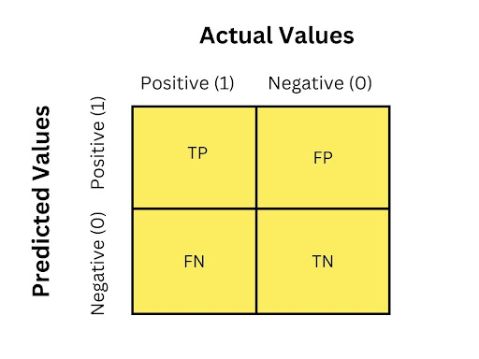
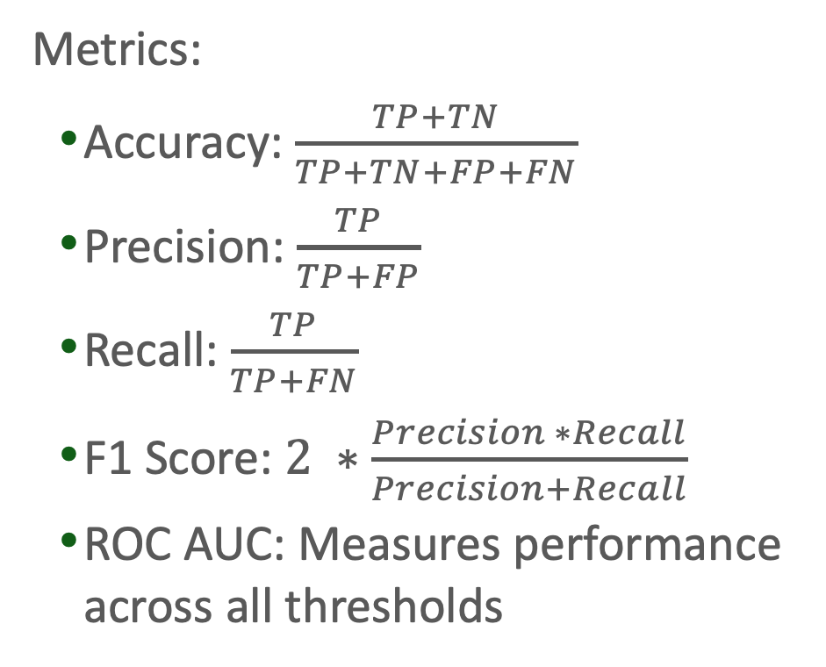
Model Evaluation Techniques
Metrics:
Accuracy: $\frac{TP+TN}{TP+TN+FP+FN}$
Precision: $\frac{TP}{TP+FP}$
Recall: $\frac{TP}{TP+FN}$
F1 Score: $2 ∗\frac{Precision ∗Recall}{Precision+Recall}$
ROC AUC: Measures performance across all thresholds
https://tinyurl.com/2srd5434
Notes:
Explain why accuracy isn't always enough — e.g., predicting rare diseases.
Accuracy: Overall correctness
Precision & Recall: Especially useful for imbalanced datasets
F1 Score: Balances precision and recall
ROC AUC: Measures performance across all thresholds

Slide 37
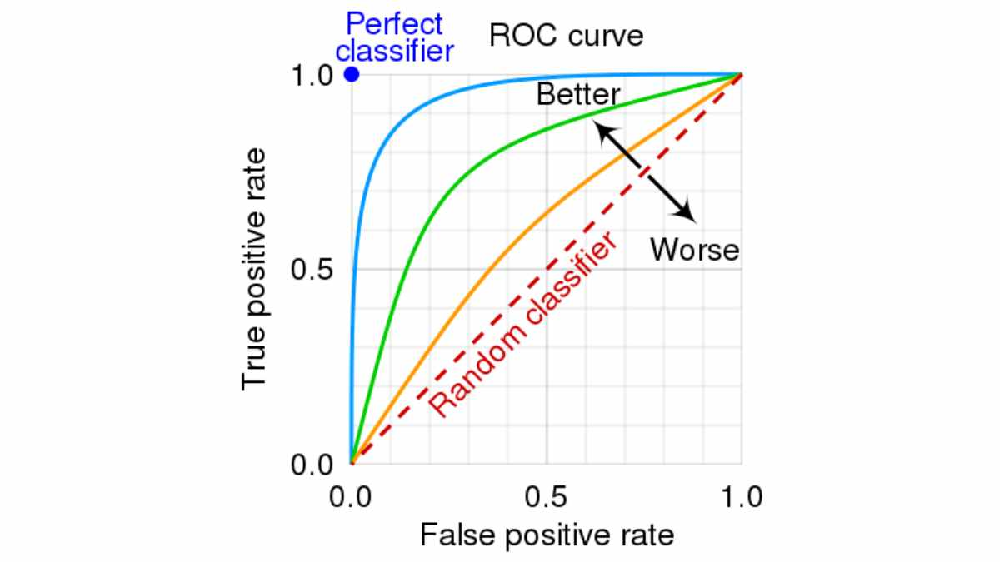
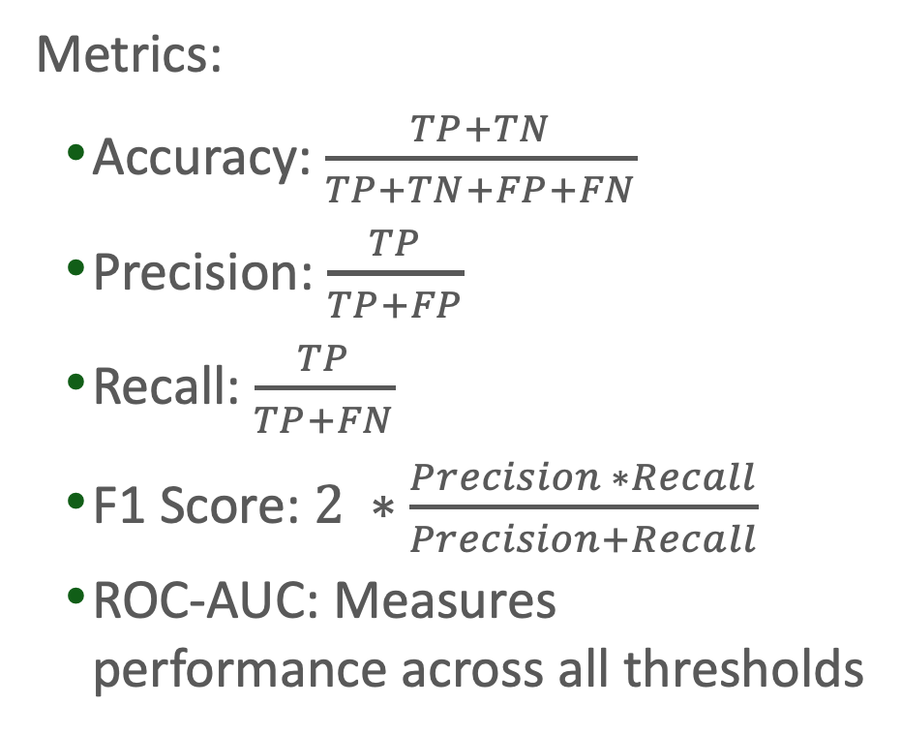
Model Evaluation Techniques (cont.)
Metrics:
Accuracy: $\frac{TP+TN}{TP+TN+FP+FN}$
Precision: $\frac{TP}{TP+FP}$
Recall: $\frac{TP}{TP+FN}$
F1 Score: $2 ∗\frac{Precision ∗Recall}{Precision+Recall}$
ROC-AUC: Measures performance across all thresholds
https://tinyurl.com/yy42bc7u
Notes:
accuracy: Overall correctness
Precision & Recall: Especially useful for imbalanced datasets
F1 Score: Balances precision and recall
ROC AUC: Measures performance across all thresholds

Slide 38
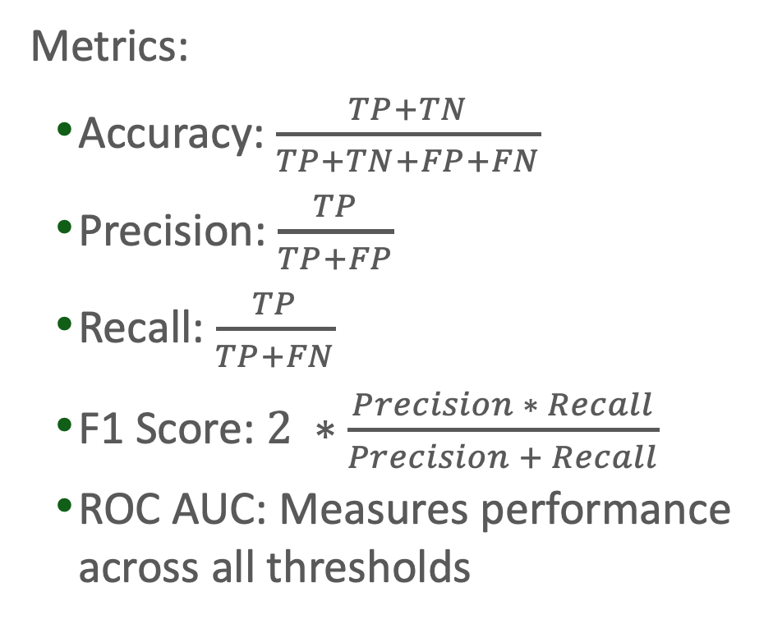
Model Evaluation Techniques - Example
Metrics:
Accuracy: $\frac{TP+TN}{TP+TN+FP+FN}$
Precision: $\frac{TP}{TP+FP}$
Recall: $\frac{TP}{TP+FN}$
F1 Score: $2 ∗\frac{Precision ∗ Recall}{Precision + Recall}$
ROC AUC: Measures performance across all thresholds
3
82
15
900
https://tinyurl.com/2srd5434
Notes:
Explain why accuracy isn't always enough — e.g., predicting rare diseases.
Accuracy: 90.3%
Precision: 3.5%
Recall: 16.68%
F1 Score: 5.79%
ROC AUC: Measures performance across all thresholds

Slide 39
Ethics in AI & ML
Bias: Models can perpetuate existing social biases if trained on biased data (e.g., gender or racial bias)
Fairness: Ensure that models do not unfairly disadvantage certain groups
Privacy: Use techniques like data anonymization, differential privacy
Responsibility: Understand the implications and risks of deploying AI systems in critical areas (health, justice, etc.)
Notes:
facial recognition systems performing poorly on people with darker skin tones
lack of diversity in training data can lead to bias
For fairness, talk about algorithmic decisions in loan approvals or hiring
Stress the importance of protecting privacy, especially when dealing with sensitive data like health records.
Who might this model hurt or leave out?

