Slide 1
SAPCAD – Kickoff Automatisiere, nachhaltige Architektur-Planung

Slide 2

Onboarding – Icebreaker Session
Who am I? (name, age)
What am I studying? (Bachelor/Master, course, year)
Skills? (Python, Java, SCRUM,…)
Interests? (software development, Machine Learning, …)
What are my expectations from this project?

Slide 3

SAPCAD - Introduction

Slide 4

Onboarding – What we offer
What you will learn
Frontend & Backend Development
Practical Experience with LLMs and AI frameworks
Agile development
European Software Project
2 students from TU Clausthal
2 students from BBU
Hybrid work mode with mandatory stays in Cluj and Goslar
Cluj: 05.04 – 12.04
Goslar: 19.05 – 25.5

Slide 5
Timeline and Grading
Phase 1 Learn about BIM, Program Synthesis and LLMs
Phase 2 Fine-tune a LLM as a BIM-copilot.
Build Backend Functionality.
 | Mar | Apr | May | Jun
Kick-Off
Phase 1 : 20% Mark
Onside Cluj (05.04. – 12.04.)
Phase 2: 50% Mark
Onside Goslar (18.05. – 24.05.)
Phase 3: 30% Mark
Phase 3 Improve the Prototype.
Implement Frontend
intermediate reports

Slide 6



What we expect
Independent organization, developing solutions
Group dynamics outperform individual results
Knowledge transfer and support within your group !!!
No competition with other groups
Group Dynamics and Reports (50 %)
Code Quality and Product (40 %)
Präsentationen (10 %)
Teamwork
Project Reports
Code
Documentation
(Intermediate)Presentations

Slide 7
“Grading”
TU Clausthal students
Just passing/failing the course
We will give you performance feedback (no mark!)
If you reach 80/100 points, you qualify for a Master’s thesis on “Building a Co-Pilot for BIM”
BBU students
x/100 points
Recommendation to Iulian

Slide 8
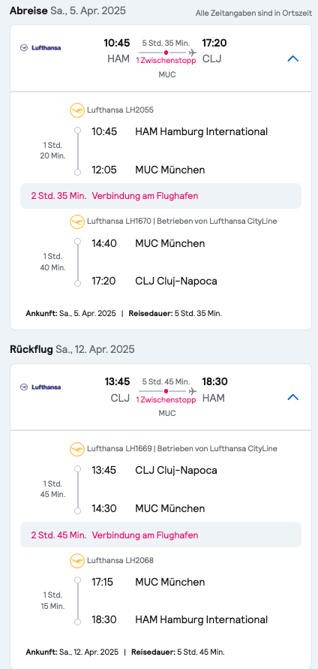
On-site stay in Cluj
Funding
Check your travel and visa requirements!!!
Work sessions & social events are mandatory for all students!
Keep in mind that you need to be at the airport > 1h before departure!

Slide 9
Questions?

Slide 10
Tools
Wiki: https://sapcad.atlassian.net/l/cp/yZFwdux1
Communication: WhatsApp (?) / Discord
Kanban Board: GitHub projects
Version control: git / GitHub
Virtual Environment: miniconda
Backend in Python
Frontend is up to you

Slide 11
Scrum Intro

Slide 12
Sprint planning
Sprint 1

Slide 13
TL-DR
Sprints:
Sprints last for 2 weeks.
At the beginning of each sprint, there is a Sprint Planning session.
At the end of each sprint, there is a Sprint Review and a Retrospective.
Roles: will change with each project month
Product Owner: responsible for User Stories and Requirement Management
Scrum Master: Facilitates Scrum ceremonies
2x Git Master: Pushes new code to version control, solves merge conflicts, etc.
Wiki Master: Oversees documentation, adds new Docs to Wiki
Task Tracking:
Every task is tracked
At the end, an artifact is created for each task
Meetings:
The Daily Standup is held independently by the team.
Mandatory attendance for all meetings.
First absence: Warning.
Second absence: Exclusion from the project.

Slide 14
Sprint Planning
Github projects

