Slide 1

AI frameworks used in sapcad
Training session

Slide 2
Study: Harnessing AutoCAD designs with machine learning for smart building optimization
International Journal of Science and Research Archive: (research article)
https://ijsra.net/sites/default/files/IJSRA-2024-2336.pdf

Slide 3

Summary The article discusses various AI frameworks used for developing and implementing artificial intelligence models. Some of the key frameworks highlighted include:
TensorFlow
PyTorch
Keras
Scikit-learn
OpenCV
Hugging Face Transformers

Slide 4

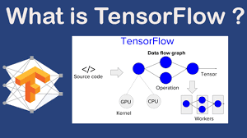
1. TensorFlow
Developed by: Google Brain Team
Description:
Key Features:
open-source framework primarily used for DL and ML
supports CPU & GPU processing
scalable for research and production-level applications
Efficient computation with data flow graphs
TensorBoard for visualization
Support for mobile and edge devices (TensorFlow Lite)
Wide adoption in industries and academia

Slide 5
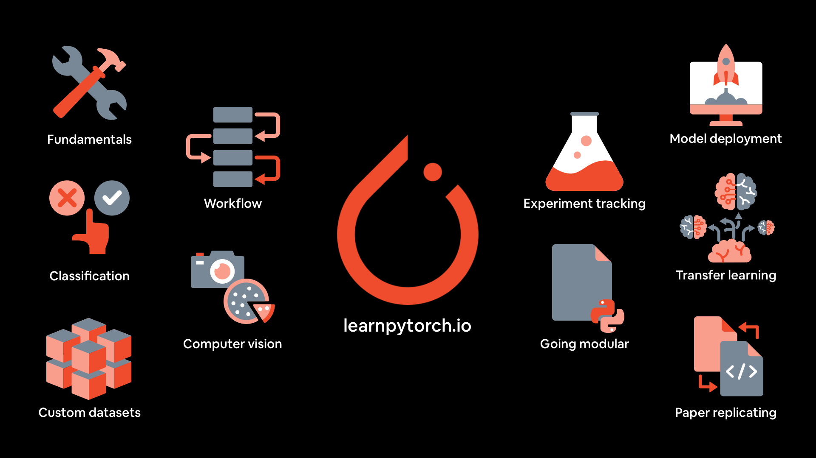
2. PyTorch
Developed by: Facebook AI Research (FAIR)
Description:
Key Features:
PyTorch is a deep learning framework
dynamic computation graph and ease of debugging
favored by researchers for flexibility and Pythonic interface
Dynamic computation graphs (debugging & experimentation)
Strong GPU acceleration for high performance
Native support for deep learning models
TorchScript for production deployment

Slide 6
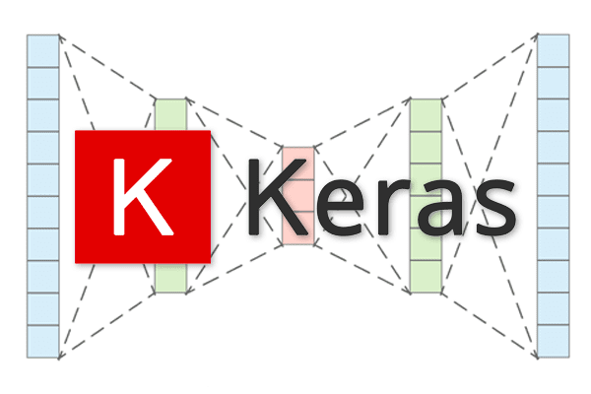
3. Keras
Developed by: François Chollet (originally), now part of TensorFlow
Description:
Key Features:
Keras is a high-level deep learning API
designed to simplify processes of building neural networks.
runs on top of TensorFlow & is user-friendly for beginners.
Simple syntax for building neural networks
Modular and easy to use
Supports multiple backends
Pre-trained models available for quick implementation

Slide 7

4. Scikit-learn
Developed by: Inria (French institute for research in computer science and automation)
Description:
Key Features:
widely used Python library for classical machine learning
provides simple and efficient tools for data mining and analysis
Wide range of ML algorithms (classification, regression, clustering)
Feature selection and preprocessing utilities
Built-in support for model evaluation and validation
Integrates well with NumPy, SciPy, and Pandas

Slide 8
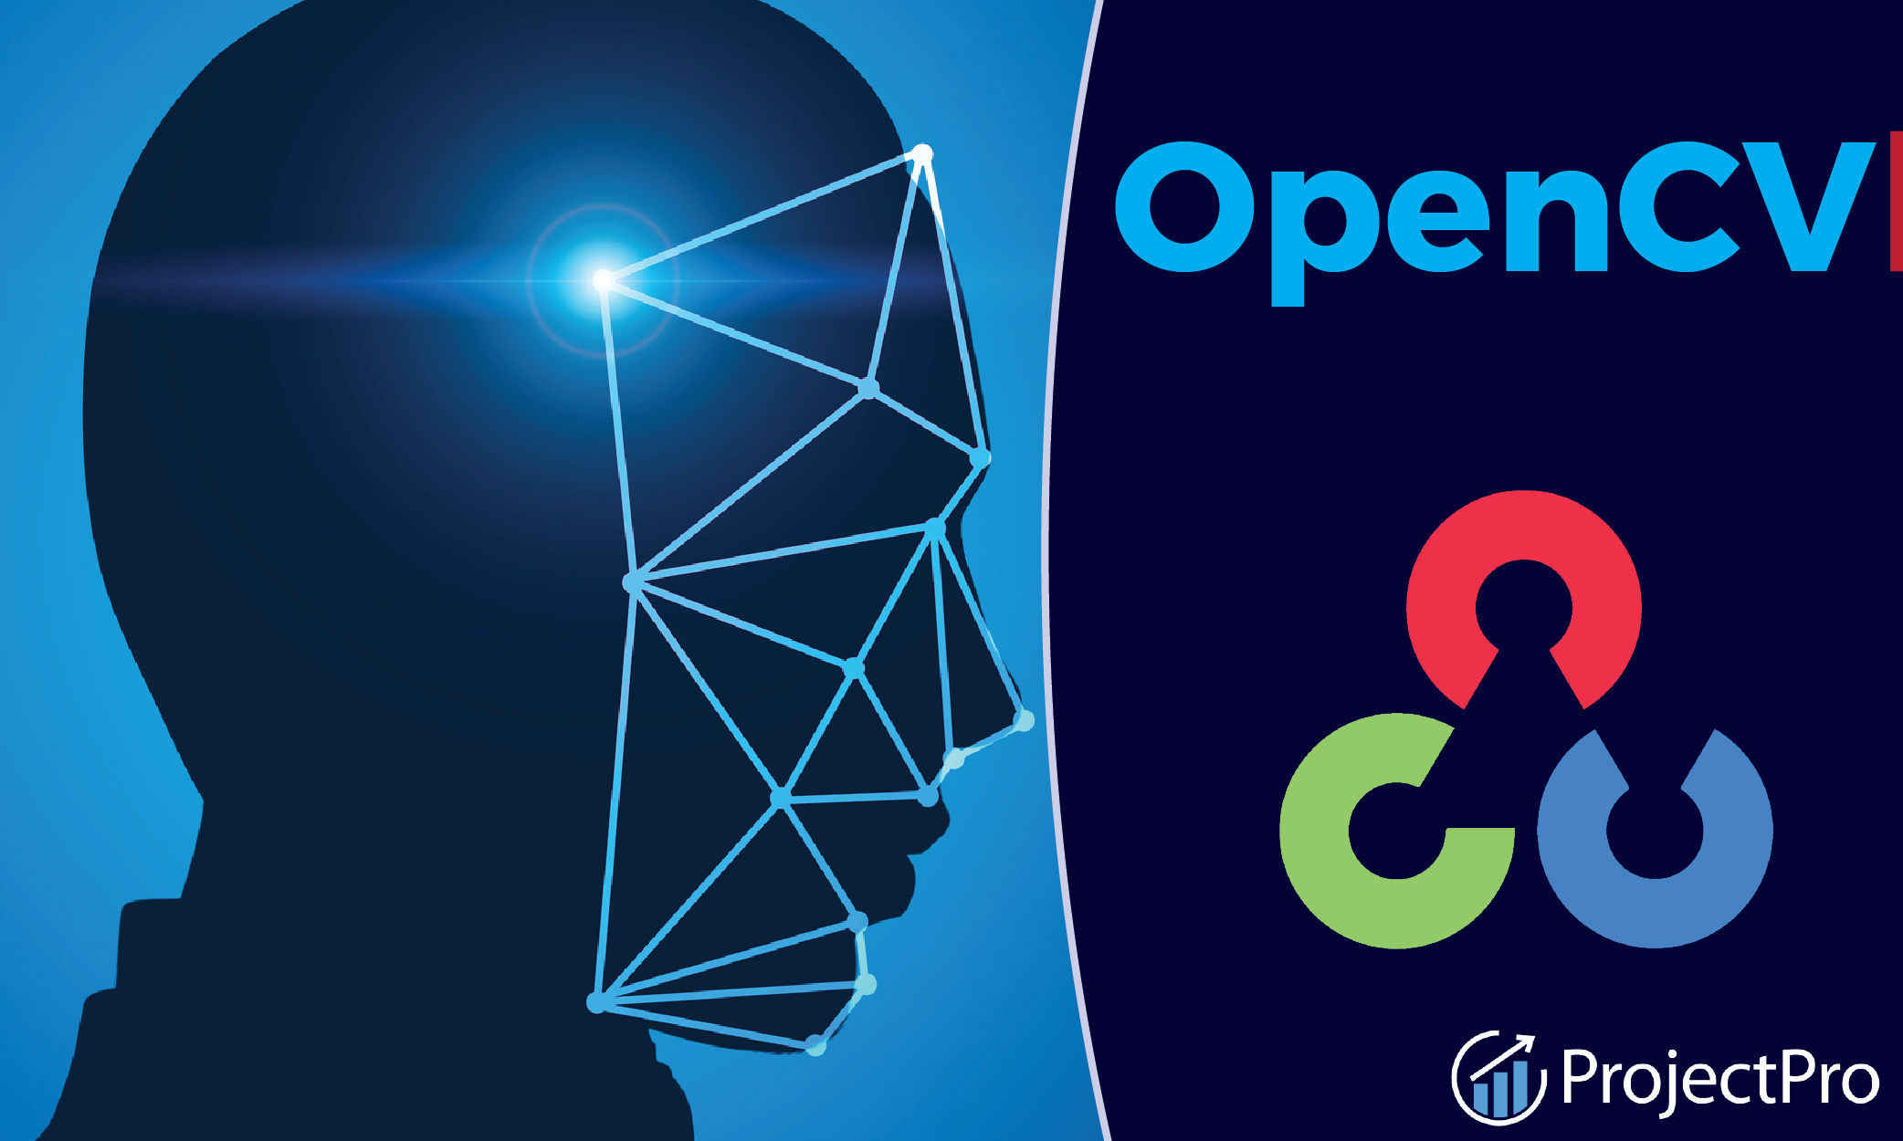
5.OpenCV (Open Source Computer Vision Library)
Developed by: Intel
Description:
Key Features:
library focused on real-time CV and image processing
widely used for object detection, face recognition, and other visual applications.
extensive collection of computer vision algorithms
supports multiple programming languages (Python, C++, Java)
runs on various hardware platforms & embedded devices
integrates well with AIframeworks (TensorFlow and PyTorch)

Slide 9
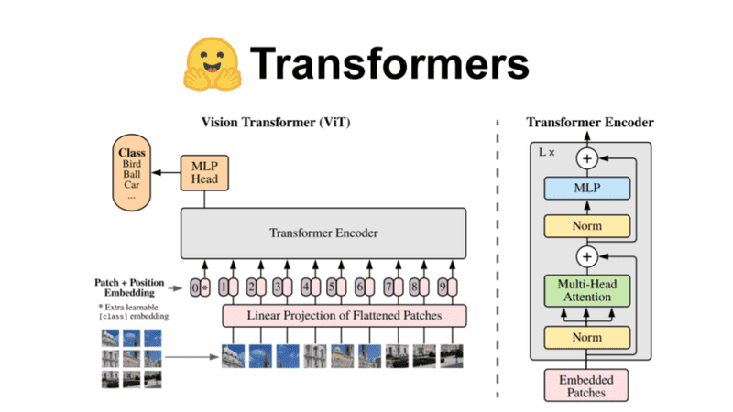
6. Hugging Face Transformers
Developed by: Hugging Face
Description:
Key Features:
transformers library is specialized in NLP (Natural Language Processing)
provides pre-trained models like BERT, GPT, and T5 for various text-based applications
Pre-trained models for NLP tasks (translation, sentiment analysis, chatbots)
Easy integration with PyTorch and TensorFlow
Supports fine-tuning on custom datasets
Active open-source community with frequent updates

Slide 10

Thank You
Zsigmond Iris-Maria
0757244580
Iris.zsigmond@stud.ubbcluj.ro

