Slide 1


Agile Project Management – SCRUM Introduction
Institute for Enterprise Systems (InES) – AI Systems Engineering Group

Slide 2
Agenda
General Scrum Introduction
Agile Development
Scrum in a Nutshell
Roles
Events
Artifacts
Our Setup for Team Projects
Learnings from Previous Projects
Team specific coordination

Slide 3
Agile development
Important factors according to agile approaches:
Communication
Running software
Collaboration with the customer
Flexibility to react to changing requirements
Minimize overhead
Each member of the team is responsible for the outcome of the project
Small team (max. 10 people)
Short release cycles (a few weeks/months)

Slide 4
Scrum in a nutshell
Lightweight project management framework for agile software development
The core element is a short and continuous product iteration (sprint)
Small teams
Self-organizing
Collaborating
Communicating
A small number of artifacts, roles, and events

Slide 5
Scrum: Roles, Events and Artifacts
Roles | Events | Artifacts
Product Owner Scrum Master Team(-member) | Sprint planning Daily Sprint review Sprint retrospective (Grooming) | Product backlog Sprint backlog Burndown report

Slide 6
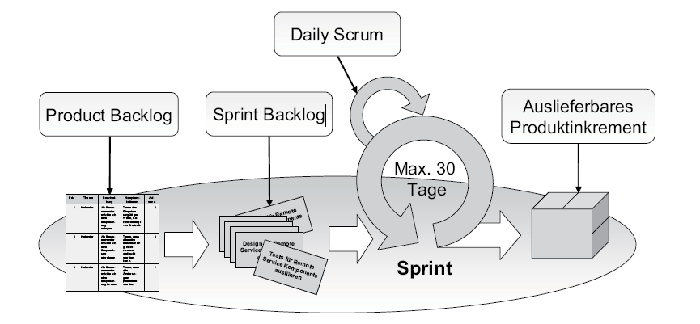
Scrum Workflow

Slide 7
Scrum: Roles
Product owner
Single point of contact for stakeholders
Responsible for requirements management
Provides user stories
provides priorities for the tasks
Responsible for release management
Sets up release dates for features
Interface between customer and team
Tracks the progress of the project

Slide 8
Scrum: Roles
Team
Up to 10 members
Interdisciplinary backgrounds
Backend, frontend, testing, design, architect
Self-organizing
Members are committed to the team
Decides on task complexities
e.g., Planning poker, discussing the tasks, …
Responsible to deliver the current sprint

Slide 9
Scrum: Roles
Scrum master
Responsible for the scrum workflow
Takes care of obstacles
e.g. missing accounts, documents, contacts
Not an Authority
Can also be a part-time member of the development team, or scrum master for multiple teams

Slide 10
Scrum: Artifacts
Product Backlog
To manage and track all the requirements of the project
Product Owner takes care of the backlog
Tasks have a
priority assigned
complexity assigned
defined output
This is not a final list of tasks
Keep tasks small and simple

Slide 11
Scrum: Artifacts
Sprint Backlog
Tasks that will be done by the team in the sprint, team commits to deliver
Tasks are from the backlog
Tasks must have the status of „ready to start“
No uncertainty
No scope changes
Workload should fit the size of the team
Update the tasks
Status/time spent

Slide 12
Scrum: Artifacts
Burndown-Report
Report across the tasks of the current sprint
„burned tasks/complexity over time“
Updated on a daily base
Compares the planned and the actual progress

Slide 13
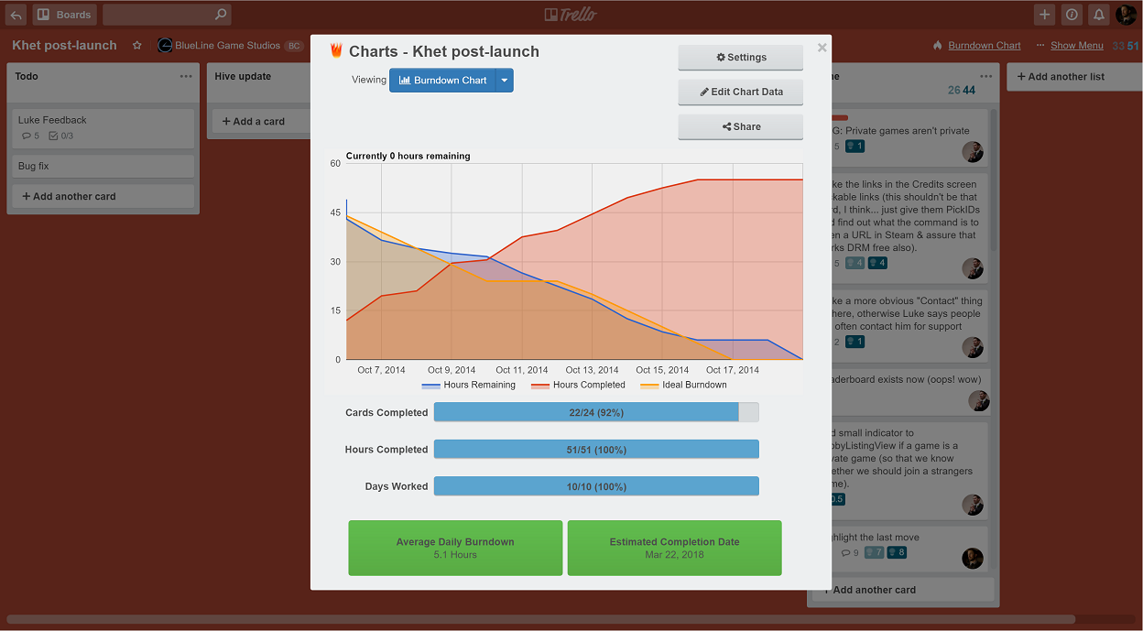
Scrum: Artifacts
https://trello.com/power-ups/569f8a70a115d18c5ea9af05/burndown-for-trello

Slide 14
Scrum: Events
Grooming (Product Owner and Team)
Clarify tasks
Define doings, outcome
Sprint planning
Filling a sprint from the backlog
Assigning responsible member and reviewer
Taking into account priorities and dependencies
Assigning task complexities

Slide 15
Excursion: Estimation of task complexity
Goal: good complexity estimation (on an arbitrary scale or in hours)
Option 1: Having reference tasks
e.g. „adding a new data provider“ has a complexity of 10
„adding a piece of information to an existing export“ has a complexity of 2
Option 2: Planning Poker (https://www.planitpoker.com)
Everybody decides on a complexity (hidden)
If there are big differences, low and high estimations argue
Revote or result has been found (e.g. median)

Slide 16
Scrum: Events
Daily
Short meeting of Team (couple of minutes per person)
Optional: Scrum master and Product Owner
Questions:
What did I do since the last daily?
What am I planning to do until the next daily?
Is there a blocker or something unexpected?

Slide 17
Scrum: Events
Sprint Review
Review of the sprint’s achievements/problems
Usually with the Scrum master, Product Owner (additional Stakeholders)
Exemplary topics:
demo of the new features
discussing tasks
planned vs. real task complexities → learnings for next sprint planning

Slide 18
Scrum: Events
Sprint Retrospective
Meeting after the „Sprint Review“ that closes the sprint
An open and honest discussion about the collaboration in the project
The good, the bad, the ugly
Leads to…
… an increase in productivity
… better sprint plannings
… better quality

Slide 19
Questions?

Slide 20
Our setup for the team projects
Roles
Usually one team member is part-time scrum master and another one part-time product owner, guided by supervisor
BUT, this depends on your project → Further information given by supervisor
Artifacts
Backlogs managed with a tool of your choice, e.g., Gitlab, Github
A board tracking the sprints and the progress
A burndown of the sprint
A board with all tasks from previous sprints to „collect“ the tasks done by each of you

Slide 21
Setup for the team projects: Main Board
User Stories | Backlog | Sprint Backlog | In Progress | In Review | Done
All user stories provided by product owner | All tasks derived from user stories left in the backlog Ordered by priority (high to low) | Overview of current sprint
 |  | All tasks not touched by the team yet | All task worked on right now One per team member | All tasks done but not reviewed yet | All reviewed and approved tasks

Slide 22
Setup for the team projects: Result Board
Member 1 (M1) | Member 2 | Member 3 | Member 4 | …
Task done by M1 | Task done by M2 | … | … | …
Other task done by M1 | … | … | … | …
… | … | … | … | …
Done tasks are only moved to this board in the review meeting, but not before
Method to transparently archive the tasks done in the project
This board also contains all the tasks of all previous sprints

Slide 23
Setup for the team projects
Events
(Almost) Daily: every day or two days (dates to be scheduled)
Direct communication channel, e.g., MS Teams, Discord
Sprint duration: 2 weeks
Sprint Planning: before the next sprint starts
Output: Sprint Backlog
Sprint Review/Retrospective: concludes current sprint
Ready to ship incrementation (of the product)
Cleared „current sprint section“ and overview of the burned issues
Grooming: upon request, maybe after a daily for easier organization

Slide 24
Setup for the team projects: Exemplary event plan
Sprint duration (colors alternating)

Slide 25
Setup for the team projects: Exemplary event plan
Sprint duration (colors alternating)
Sprint Planning

Slide 26
Setup for the team projects: Exemplary event plan
Sprint duration (colors alternating)
Sprint Planning
Daily

Slide 27
Setup for the team projects: Exemplary event plan
Sprint duration (colors alternating)
Sprint Review and Retrospective
Sprint Planning
Daily

Slide 28

Setup for the team projects: Exemplary event plan
Sprint duration (colors alternating)
Sprint Review and Retrospective
Sprint Planning
Daily
Grooming

Slide 29
Important things to share within the team and with us
Current status of the development
The prototype
Future features to be included
Distribution of efforts
Tracking of the things being done
Right now
Over the sprints
→ Carefully maintain your management tool (e.g., Trello Board)

Slide 30
Questions?

Slide 31
Learnings from Previous Projects

Slide 32
Some common pitfalls
Scrum is easy to understand, but hard to apply
Communication is key throughout the project to become a successful team
Especially in an entirely virtual environment
There might be a language barrier
If you do not understand each other, nobody else will
If something is unclear to you, ask
Test: Explain what you understood with your own words
Identify (technical) dependencies between tasks already during sprint planning
It is most likely that tasks will be assigned based on architectural elements
In theory, every member should develop features at every layer
(„Full-Stack Developer”)

Slide 33
Some common pitfalls (cont’d)
Decentralized development requires a shared code basis → Git Repository
Keep in mind integration issues at the end of your sprint
Especially before milestones (including a runnable state)

Slide 34
Some hints regarding collaboration
Use „Pair Programming“ as early as possible to solve a task
You will learn from each other (strengths and weaknesses)
Afterwards, you will also know how to define a task so that the other person truly understands it
If not, you are likely to say „yes“ although you did not fully understand everything (this is called „sugarcoating“)
Communicate everything in an open way so that everybody can read it
No written communication between sub teams except for organizational issues
You may drop a „Daily“, and instead write a message each day in the group chat
Be open and work with a high degree of discipline
The whole team is responsible for the sprint
The individual team members are not only responsible for assigned tasks

Slide 35
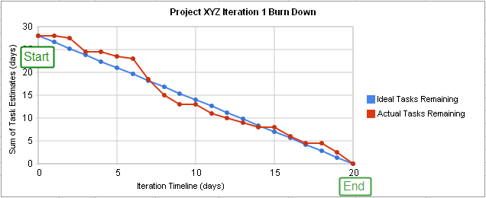
Some hints regarding Burn-Down Charts
In the ideal world where you build software for a living, the burndown chart looks like …. (Source: Wikipedia)

Slide 36
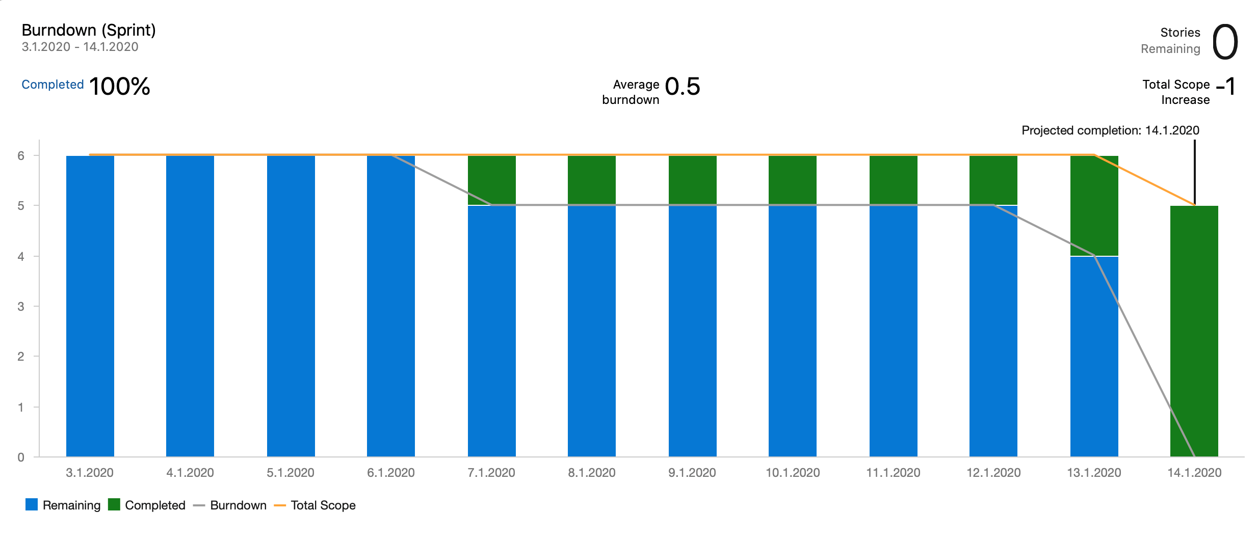
Some hints regarding Burn-Down Charts from past project

Slide 37
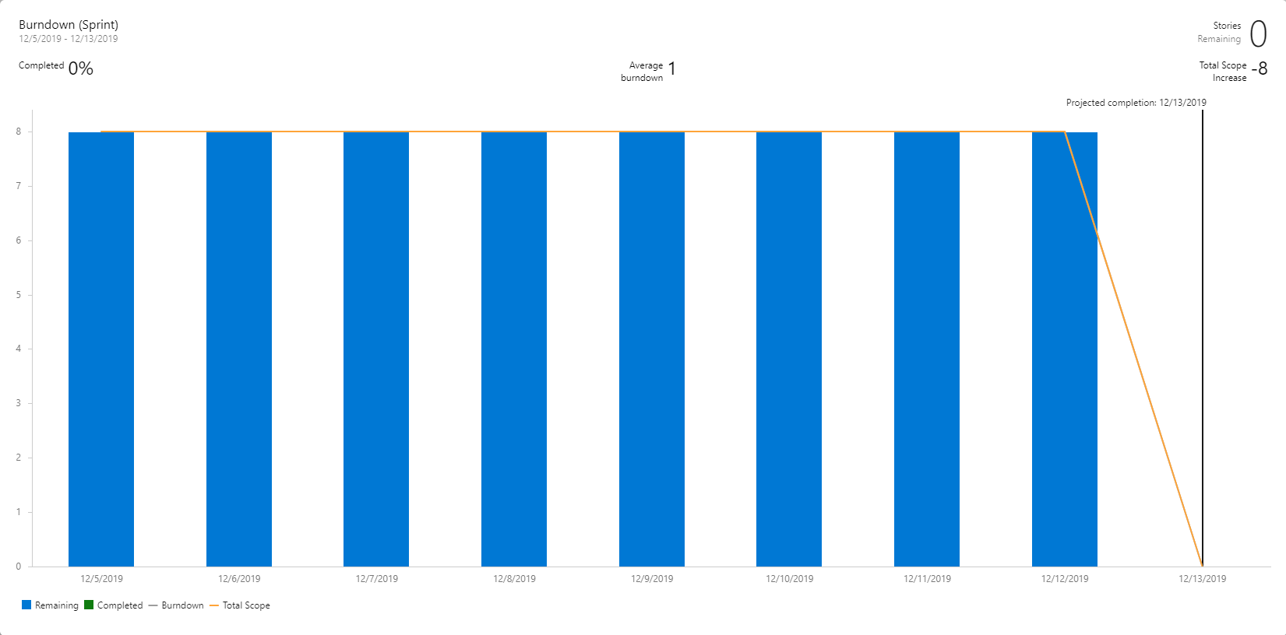
Some hints regarding Burn-Down Charts from past project

Slide 38
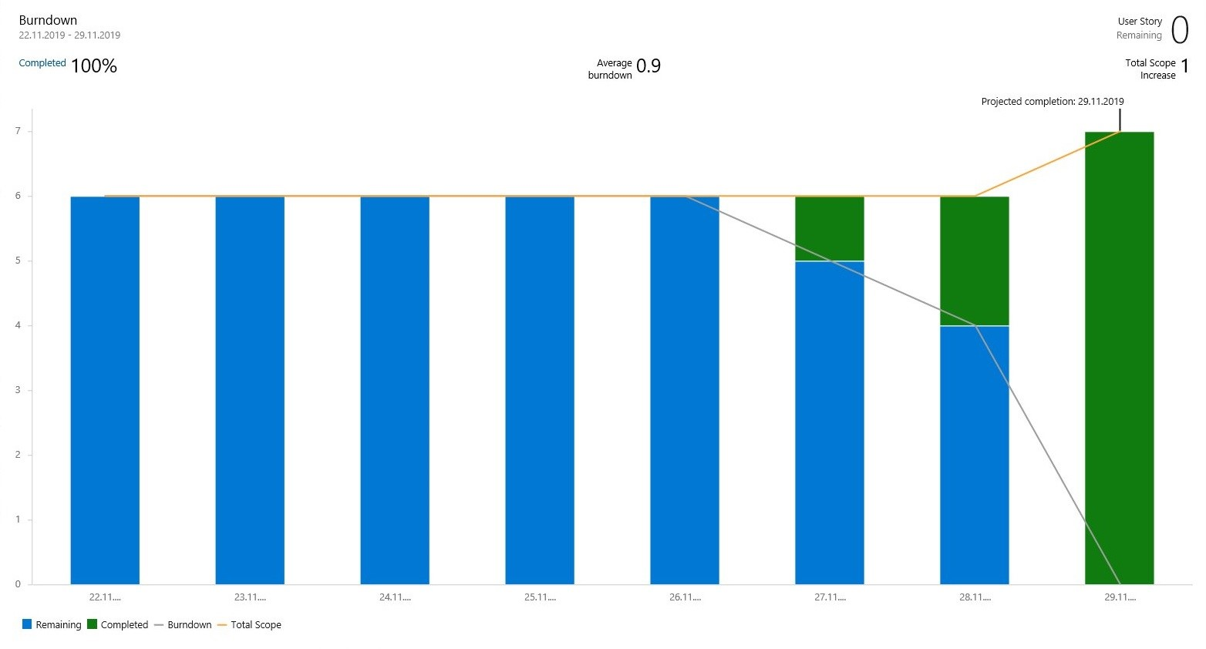
Some hints regarding Burn-Down Charts from past project

Slide 39
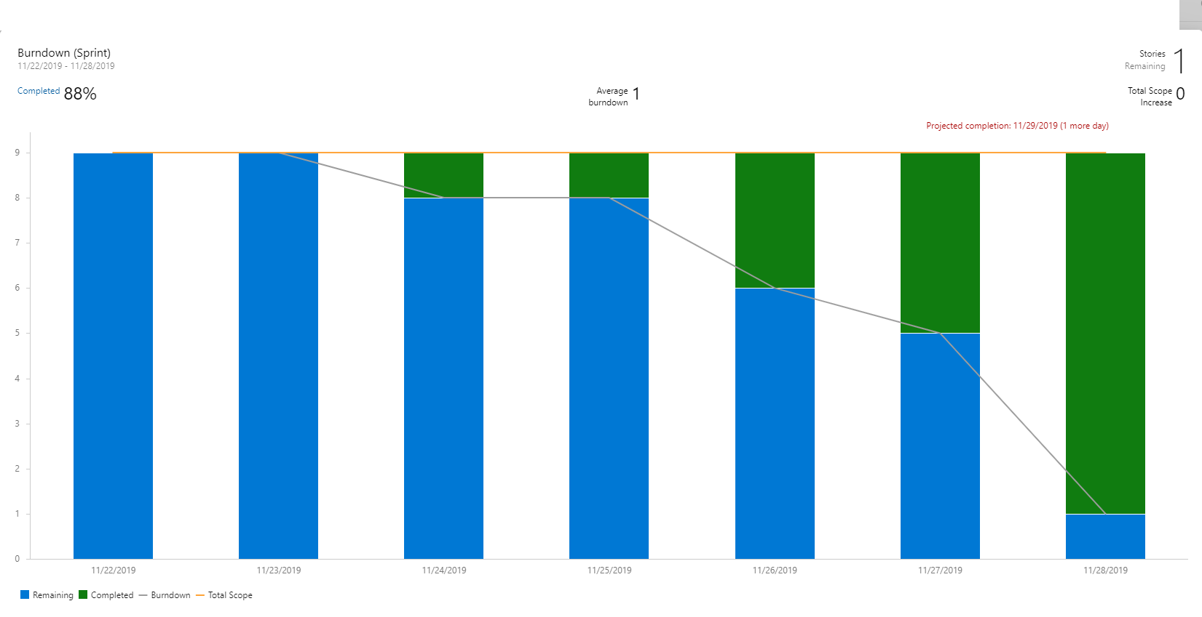
Some hints regarding Burn-Down Charts from past project

Slide 40
Questions?

Slide 41
Thanks for your attention ☺

Slide 42
Project specific coordination
Possibility to use the remaining time for clarifying project specific Scrum aspects together with your supervisor…

