Slide 1

Physics-Constrained Chip Thermal Map Prediction
CS 231N — Deep Learning for Computer Vision · Stanford Spring 2026
Fabian Molina · Ruben Carrazco
Milestone 3: Preliminary Results
May 29, 2026

Slide 2
Problem Statement & Motivation
Can a neural network replace hours of thermal simulation?
The Challenge
Core Research Question
Chip overheating degrades performance and causes failures. During chip design, engineers must evaluate thousands of layout options — each requires a full thermal simulation.
Does adding a physics constraint to the training loss help the model generalize to chip configurations it was never trained on?
The Bottleneck
HotSpot, the standard academic thermal simulator, takes minutes per design. This makes it impractical for automated layout search across large design spaces.
The physics constraint (heat equation):
k · ∇²T + Q = 0
T = temperature map, Q = power density, k = thermal conductivity
Our Goal
Train a CNN to predict a full 256x256 temperature map from two input images (floorplan + power density) in milliseconds — a 1000x speedup over simulation.
We penalize how much the prediction violates this equation during training.

Slide 3
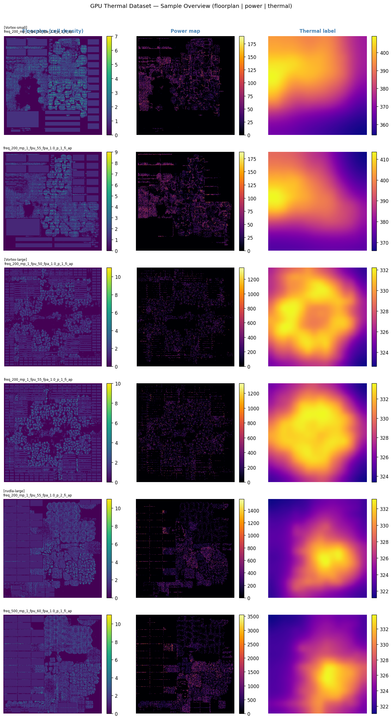
Dataset & Pipeline
CircuitNet 2.0 — public benchmark of GPU/accelerator chip designs with HotSpot thermal labels
189
3
256x256
268 / 31 / 31
chip designs
design families
pixels per map
train / val / test
Inputs (2 channels)
Floorplan — grayscale image showing where circuit components are placed on the chip Power density map — how much power each region dissipates
Target (1 channel)
HotSpot thermal map — simulated temperature at every point on the chip surface (in Kelvin)
Design families:
Vortex-small 96 designs
Vortex-large 61 designs
nvdla-large 32 designs

Slide 4
Model Architectures
Three models — progressively adding skip connections and a physics loss
PlainCNN
Baseline A
EncoderDecoder
Baseline B
U-Net + Physics
Our Model
No encoder/decoder, no skip connections
Encoder: 5 stages of downsampling (2x at each stage)
Same encoder-decoder structure as above
8 stacked conv layers with increasing dilation rates — allows wider receptive field without resolution loss
Bottleneck: compressed 16x representation + dropout
Skip connections copy encoder features to decoder at each level — spatial detail is preserved
Weakest baseline: no spatial compression or skip paths
Decoder: 4 stages of upsampling back to 256x256
Physics loss term added: penalizes predictions that violate the heat equation
Input (2ch) -> 8 layers -> Output (1ch)
No skip connections — spatial detail is lost at bottleneck
L_total = L_MSE + lambda * L_physics
64 feature channels throughout
Ablation: isolates the effect of skip connections
lambda controls strength of physics constraint

Slide 5
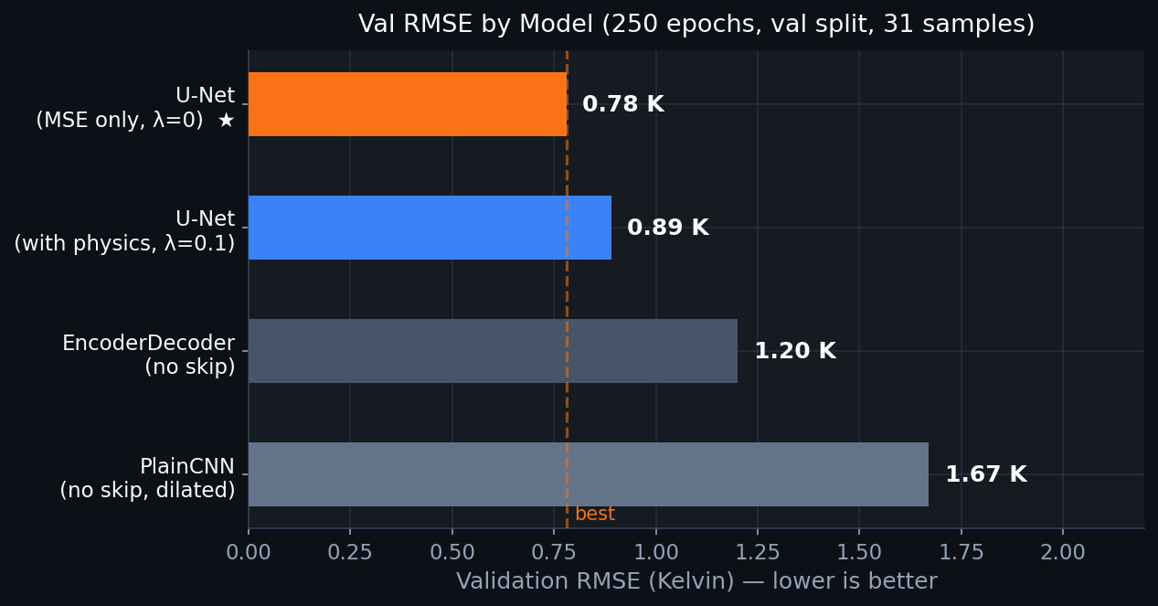
Quantitative Results
Validation split (31 samples) · 250 epochs · Adam optimizer · lower is better
Model | Val MSE | RMSE (K) | % above best
U-Net (lambda=0) *BEST* | 0.01691 | 0.78 K | —
U-Net (lambda=0.1) | 0.02196 | 0.89 K | +14%
EncoderDecoder | 0.03972 | 1.20 K | +54%
PlainCNN | 0.07693 | 1.67 K | +114%
Adding skip connections (EncoderDecoder -> U-Net) reduces RMSE by 35% (1.20 -> 0.78 K). Physics loss raises in-distribution RMSE slightly — expected, it is a regularizer.

Slide 6
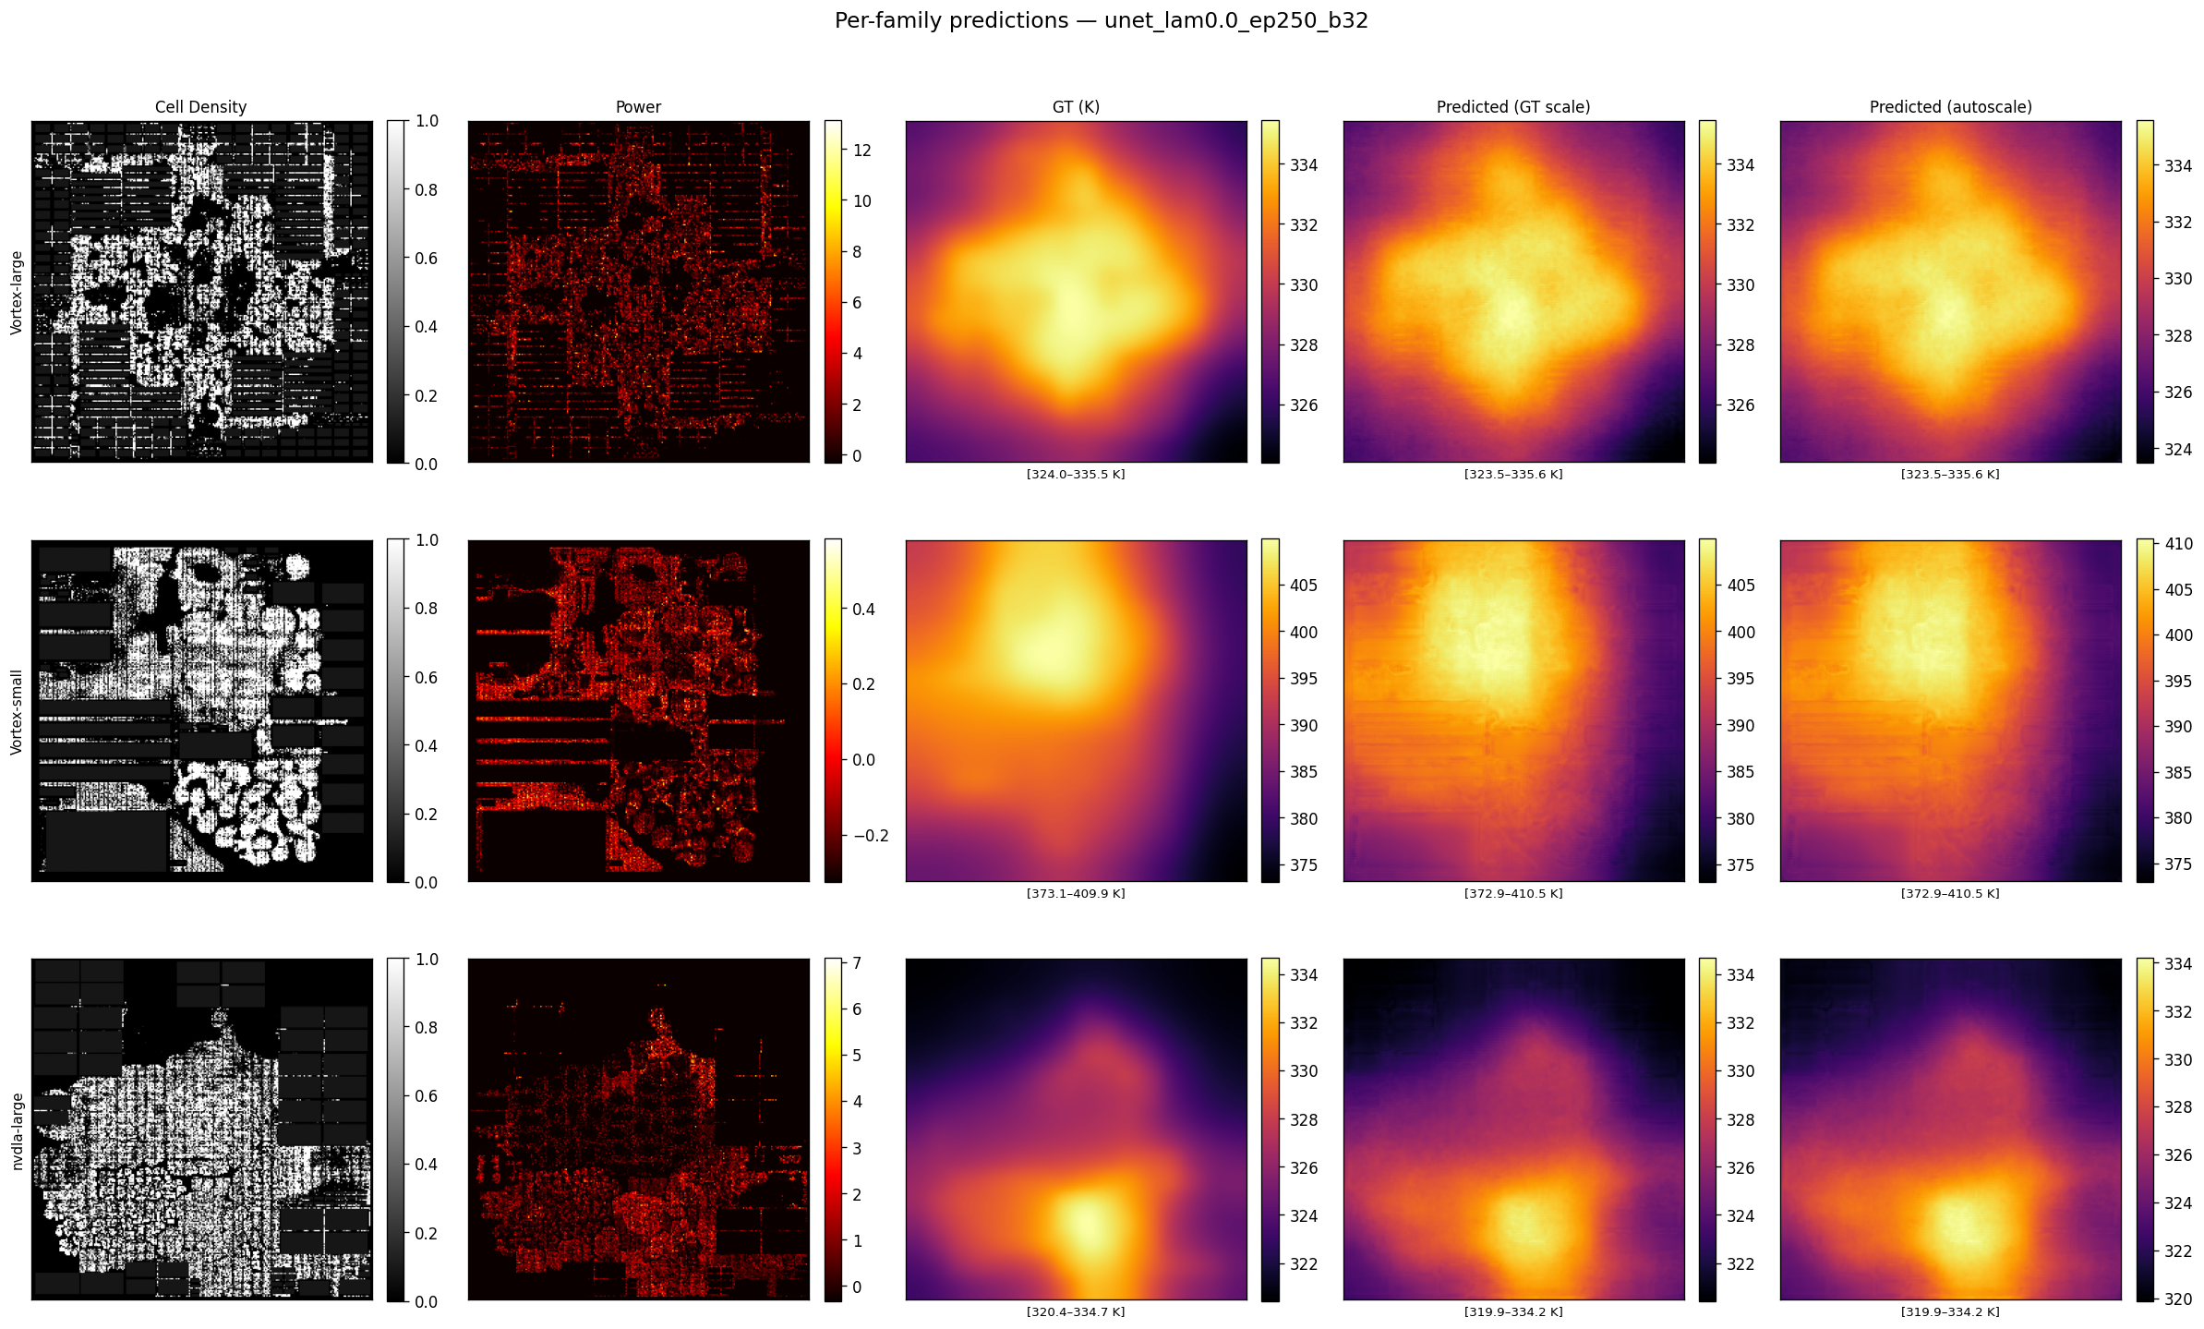
Predictions vs. Ground Truth
Best model: U-Net (MSE only, no physics loss) — evaluated on three unseen chip families
Columns: Floorplan (input) | Power density (input) | Ground truth temperature | Predicted (GT scale) | Predicted (auto scale)

Slide 7
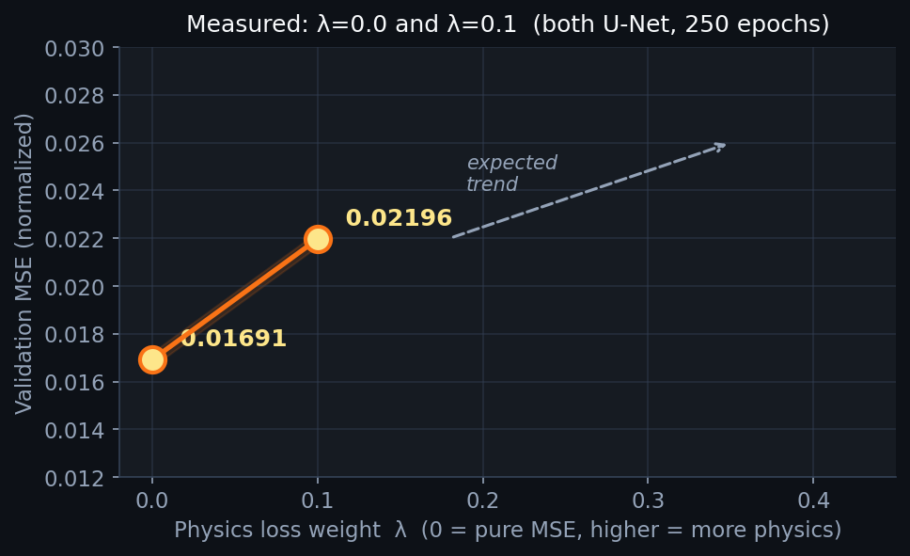
Effect of Physics Regularization
lambda controls how strongly the training penalizes violations of the heat equation
Training Loss
L = L_MSE + lambda * L_physics
L_physics measures how much the prediction violates the steady-state heat equation:
L_physics = || k * lap(T_pred) + Q ||^2
lap = discrete Laplacian (measures spatial curvature) k = thermal conductivity Q = power density input
Expected: physics loss trades accuracy for regularity
Open question: does it help on unseen chip configs?
Adding physics regularization (lambda=0.1) increases val MSE by ~30% compared to lambda=0. This is expected — the model is constrained to be physically plausible, not just MSE-optimal.
We hypothesize that physics-constrained models (lambda > 0) will degrade less when tested on chip thicknesses outside the training set. This out-of-distribution test is Milestone 4.

Slide 8
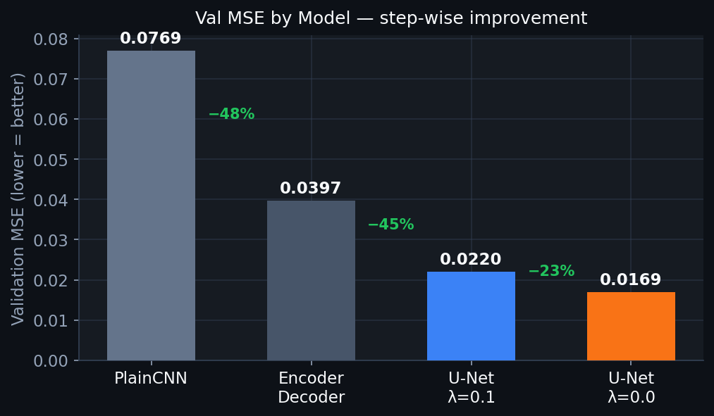
Analysis & Insights
What the architecture sweep tells us
Skip connections are the single biggest driver
57% MSE reduction
U-Net vs. EncoderDecoder have identical depth, channel counts, and training setup. The only difference is skip connections. Result: 57% reduction in val MSE (0.040 -> 0.017). Spatial detail lost in the bottleneck cannot be recovered by the decoder alone.
More layers is not the answer
Connectivity > Depth
PlainCNN uses 8 convolutional layers (more than EncoderDecoder's encoder+decoder combined) yet performs 2x worse. In pixel-to-pixel prediction tasks, how you route spatial information matters more than raw depth.
Physics loss trains stably — in-distribution cost is small
Stable across lambda values
Increasing lambda from 0 to 0.1 raises val MSE by ~30% (not catastrophic). Training did not diverge. The physics gradients are well-behaved. The out-of-distribution benefit remains to be measured.

Slide 9
Limitations
What we do not yet know
Small validation set
Labels approximate real silicon temperatures
Only 31 validation samples. RMSE estimates have high variance. The held-out test split (31 samples) has not been evaluated yet — all reported numbers are validation-only.
Ground truth comes from HotSpot, a block-level RC thermal model, not full 3D finite-element simulation. Prediction accuracy is bounded by how accurate HotSpot itself is.
No out-of-distribution test yet
Only one architecture family tested
The core claim — that physics-constrained models generalize better to unseen chip thicknesses — has not been tested. This is the goal of Milestone 4.
All three models share the same U-Net backbone style. We have not compared against attention-based models or graph neural networks, which are out of scope for this milestone.
Physics weight lambda not optimized
We measured lambda=0 and lambda=0.1. Two additional values (lambda=0.01, 1.0) were trained but results are still pending. The optimal lambda for out-of-distribution performance is unknown.

Slide 10
Next Steps
From preliminary val results to paper-quality evaluation
01
Test Set Evaluation
READY
02
Prediction Visualization
READY
Evaluate the best U-Net checkpoint on the 31-sample held-out test split (never seen during training). Report RMSE, SSIM (structural similarity), and hotspot location accuracy (IoU of top-5% hottest pixels).
Generate side-by-side comparison panels: U-Net lambda=0 vs U-Net lambda=0.1. Do physics constraints produce sharper or more accurate hotspot boundaries?
03
Out-of-Distribution Test (core claim)
IN PROGRESS
04
Complete Lambda Sweep
PENDING
Re-run HotSpot simulation at new chip thicknesses outside the training range. Evaluate all checkpoints on these unseen configs. This is the central experiment of the paper.
Collect validation metrics for lambda=0.01 and lambda=1.0 to complete the regularization curve. Understand the in-distribution vs. out-of-distribution trade-off across all four lambda values.

