Slide 1

UPI ARM Sprint Demo
DEMO 4
gwest@redhat.com
Nov 7, 2019

Slide 2
Changes
In setup-manifests
Remove the dns zones
Preserve order of settings in json
Cleanup formatting of cloud provider json settings
Fix creation date time to be null in proper format.
Delete machinesets in gw/openshift
Update resource group name in gw/openshift
In setup-variables – Automatically set the RHCOS image destination
Added Standard_D2s_v3, Standard_D4s_v3, Standard_D8s_v3 as available vm types in template.

Slide 3
Fixed Ingress Bug
Explored various ingress strategies with edge team
Changed Ingress to host-network to be compatibile with Azure Load Balancer.
Implemented in setup-host-network.sh
Long term node-port may be a better alternative, but currently it appears to require more exploration.

Slide 4
Fixed Image/Registry Bug
The OpenShift Image Registry was failing.
This was due to trying to use the wrong resource group.
Did a cleanup of gw/openshift manifests
Added update of gw/openshift/99_cloud-creds-secret.yaml to make sure correct resource group is used.

Slide 5
Bug Fixes
Allow as little as 2 compute nodes (Limited by Ingress Operator)
Fixed Standard_DSx (DS3) storage type
Added a abort of ARM Deployment failed (BZ Reported a failed on bootstrap, when the reality the deployment Failed)
Added missing install-config.yaml.example

Slide 6
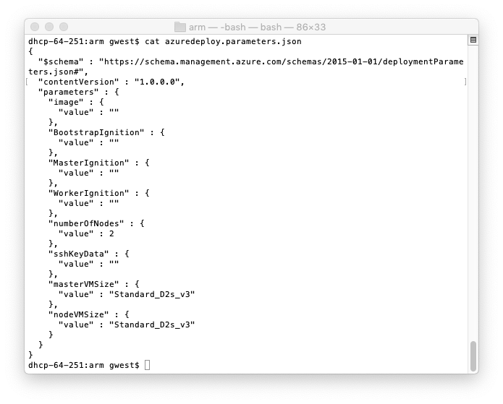
New Tiny Deploy Tested
2 Compute Nodes
Standard_D2s_v3 vm

Slide 7
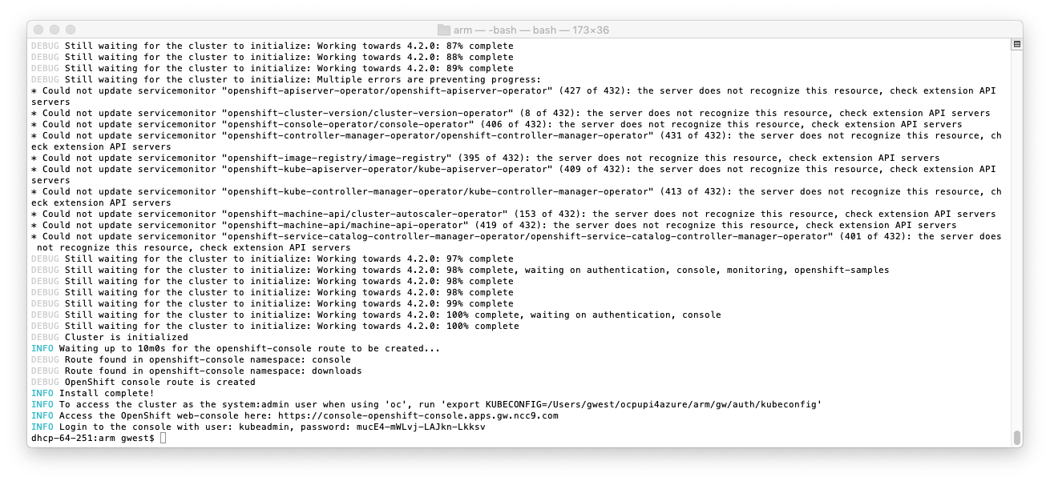
Tiny Deploy - Succes

Slide 8
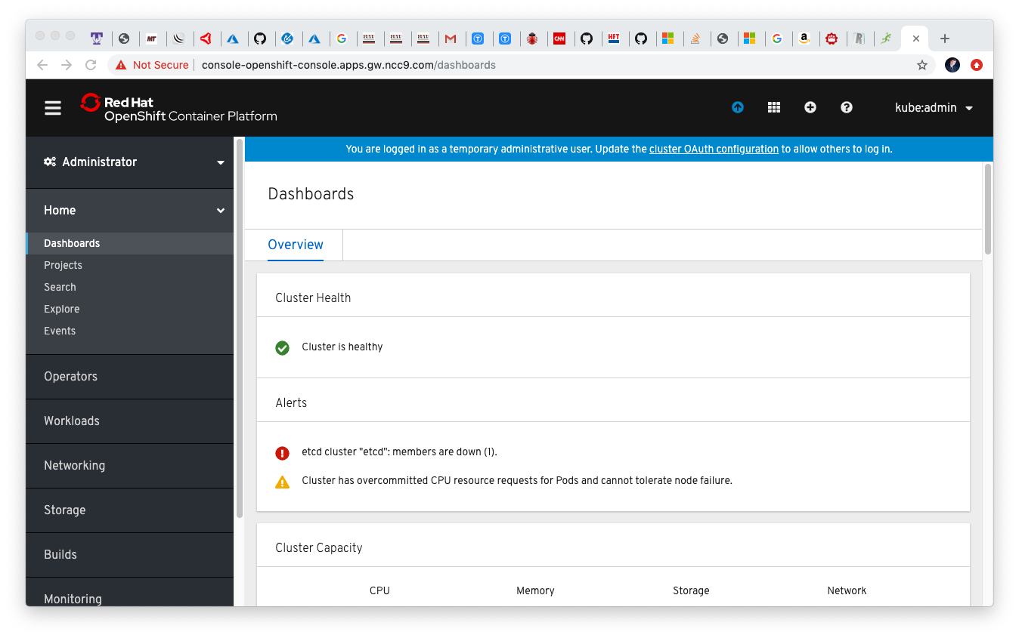
Tiny Deploy - Max Out Utilization

Slide 9
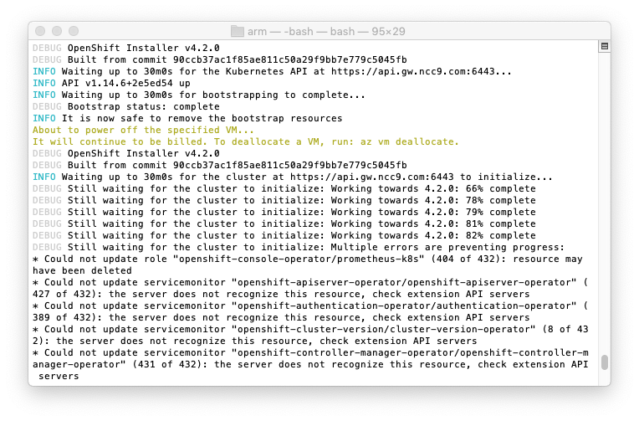

Slide 10
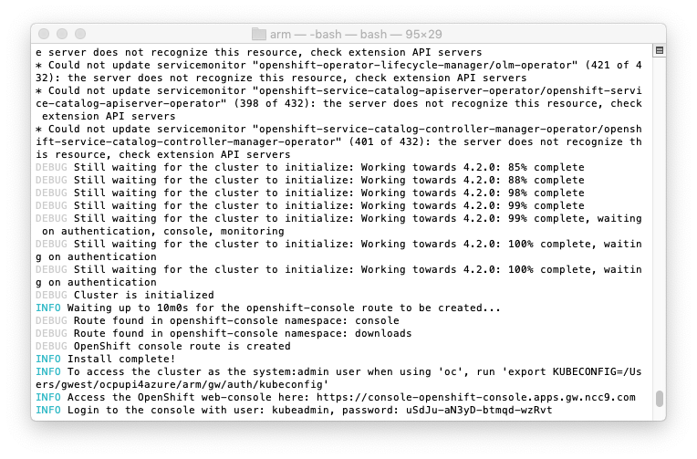

Slide 11
Current Status
Completed
Ingress Bug – Working
Identity and Access – Working
Registry – Working
Automated changes for resource group name - Working
WIP
Stress test installation – 5 Successful deploymets so far)
Identify Flakeys
Look at PR comments and work to resolve
Merge enhance sanity PR
Work on Bug Reports

Slide 12
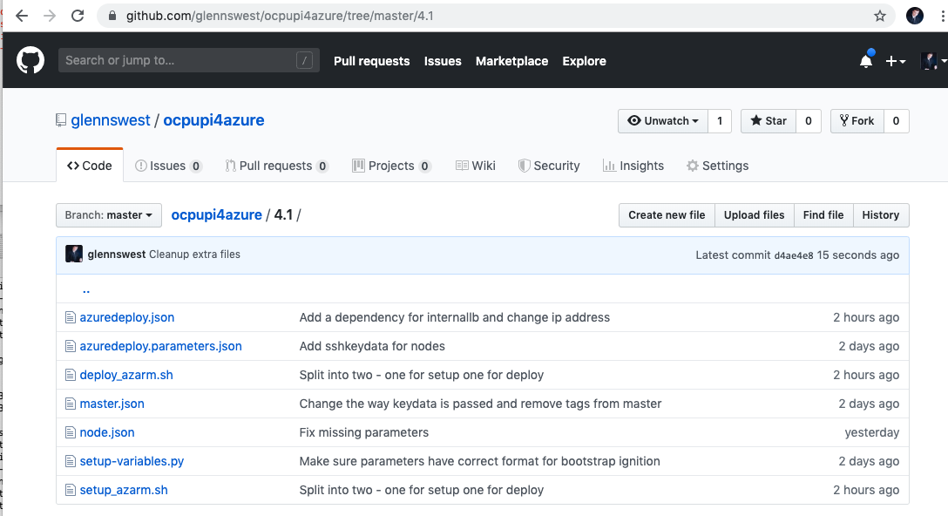
Where’s it at:
https://github.com/glennswest/ocpupi4azure/tree/master/arm

