Slide 1

UPI ARM Sprint Demo
DEMO 3
gwest@redhat.com
Oct 25, 2019

Slide 2
WIP
Delete the Bootstrap Ignition after successful bootstrap
Fix wildcard app load balacer - size 2
Add azure cloud provider - size 3 – In Progresss – Pending Blocker
Dns local or automation - size 2
Work to support ci of azure arm upi - need help from someone who does ci
Cleanup of scripts

Slide 3
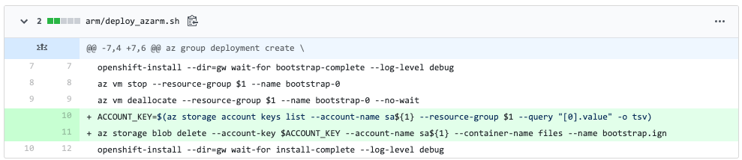
Cleanup bootstrap.ign after ignition

Slide 4
Changes to App/InfraLB
Removed Wildcard Zone Parameter
Removed references to Wildcard zone parameter
Changed interface name to resourceGroup()App ie gswx1app
Changed setup script to precreate the public IP for the InfraLB
Added name of app loadbalancer to parameters for node creation
In node template added the ip into the app loadbalancer

Slide 5
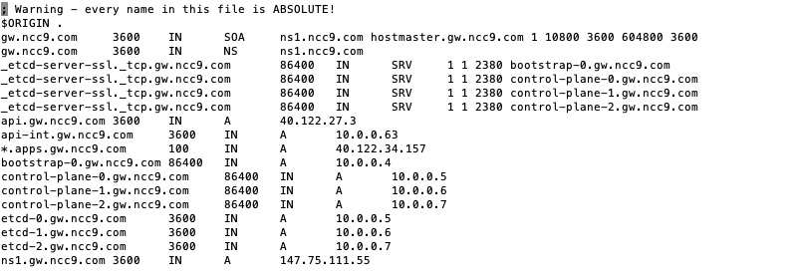
Wildcard IP For Apps

Slide 6
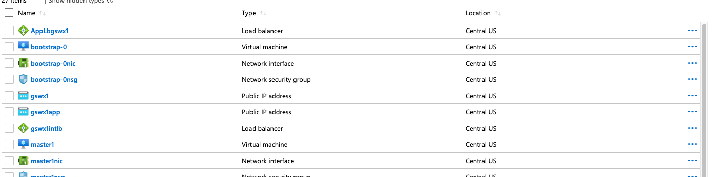
AppLoad Balancer

Slide 7
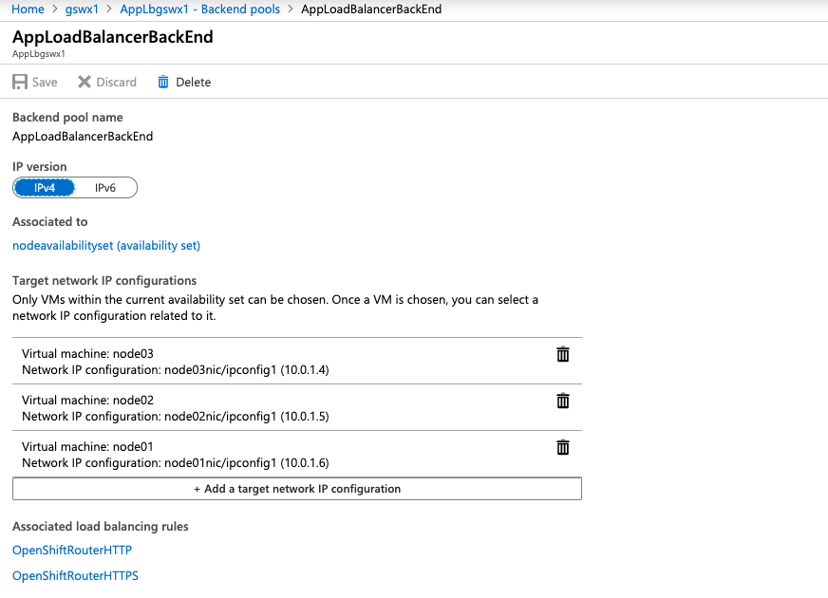
App Load Balancer Hosts

Slide 8
Minor Enhancements
Updated readme.md to point to overview
Make region a environment variable
Change default region to Central US
Change to use rhcos.vhd internally after copy of image
Switch to use ga 4.2 rhcos image

Slide 9
Cloud Provider
Switch to use user-assigned identity
Change the version for vm api version to 2018-06-01
Add in to azsetup the creation of the userid
Added in login in to service principle via osServicePrinciple.json

Slide 10
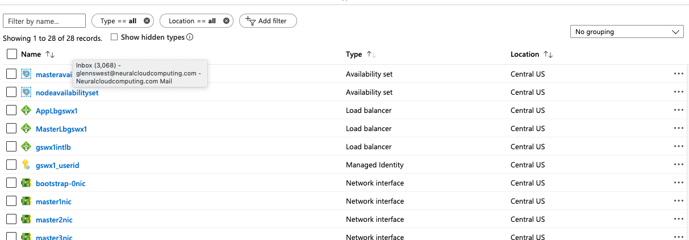
Identity Created

Slide 11
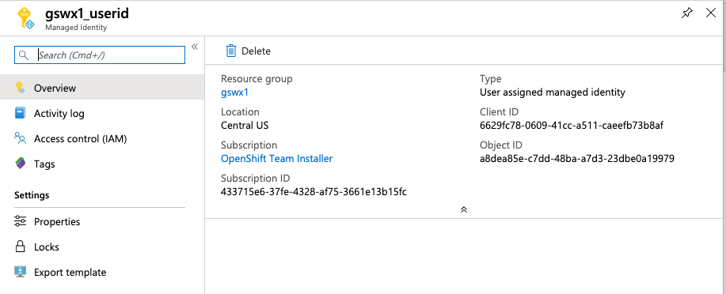
Identity Detail

Slide 12
Demo
4.2 GA Code
Azure Cloud Provider WIP
Identity Created
Service Principle Used
Manfests manually changed – Resource Group/identity releated
Fixed Mentioned above

Slide 13
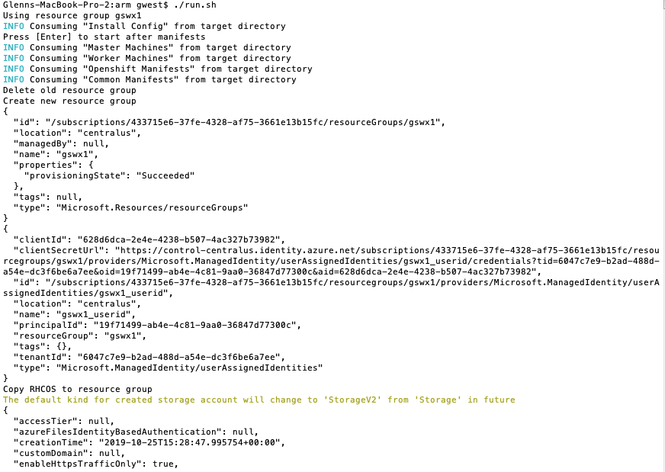

Slide 14
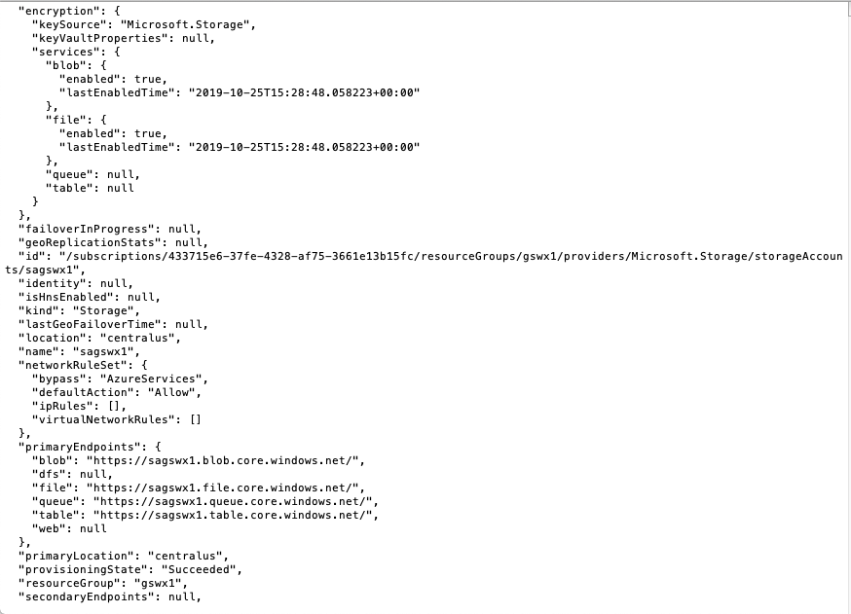

Slide 15
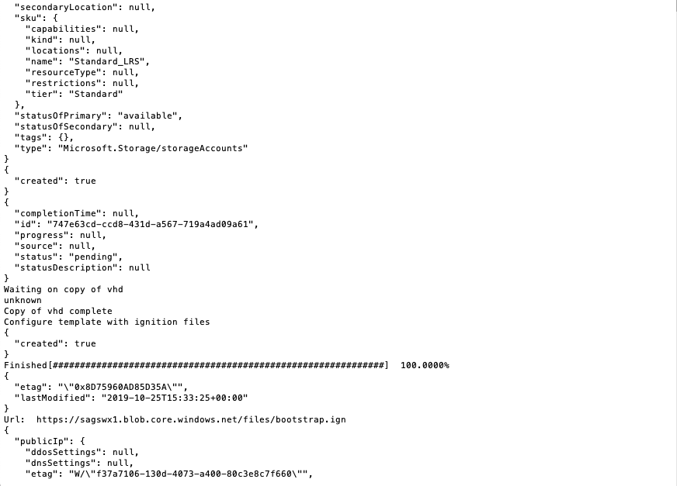

Slide 16
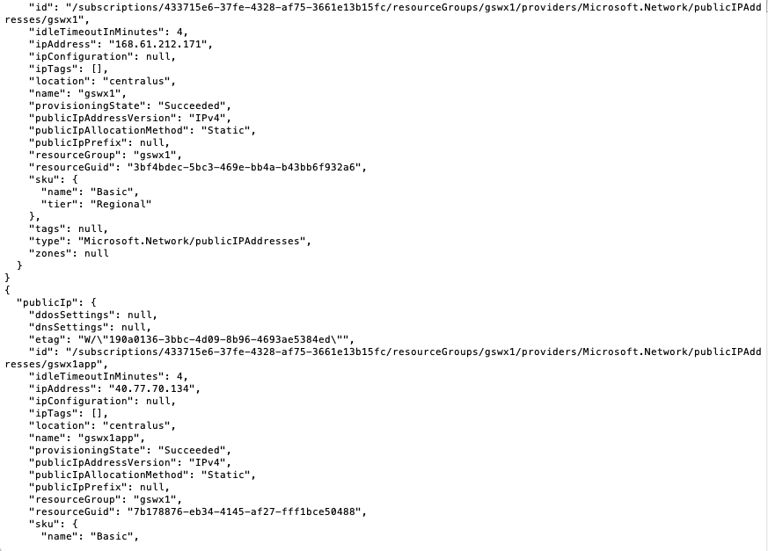

Slide 17
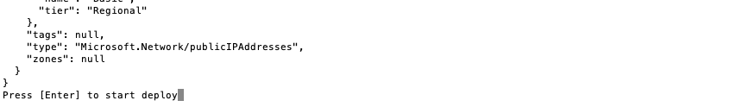
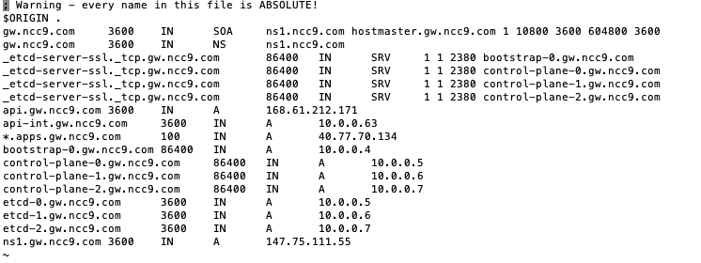

Slide 18
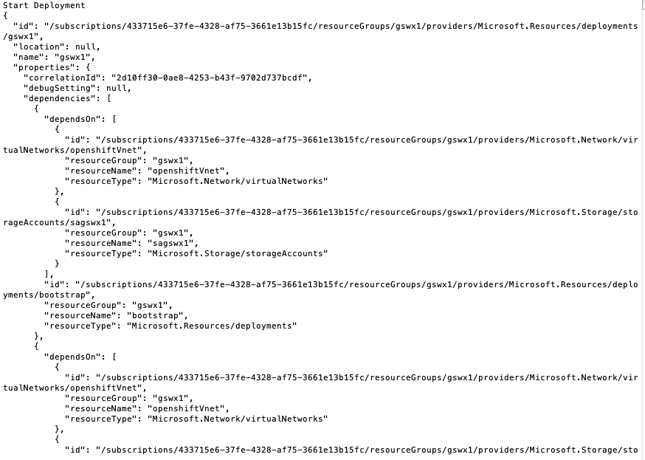

Slide 19
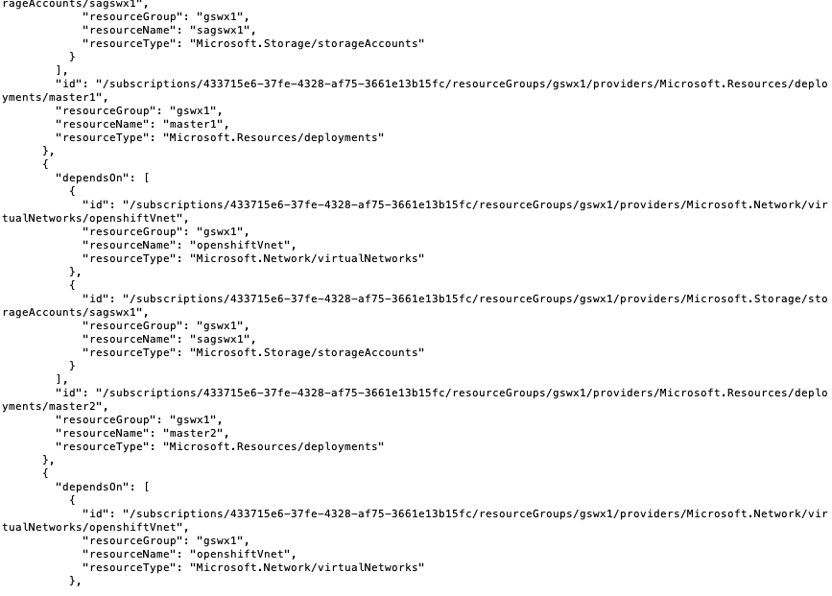

Slide 20
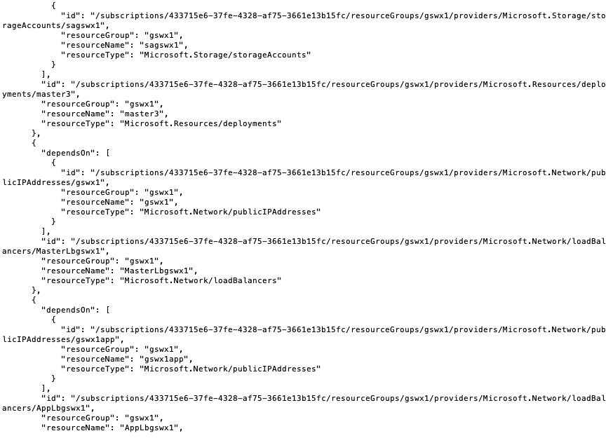

Slide 21
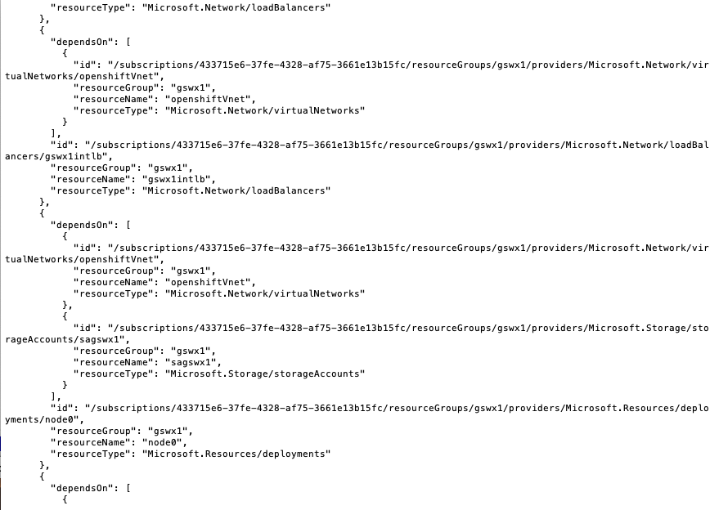

Slide 22
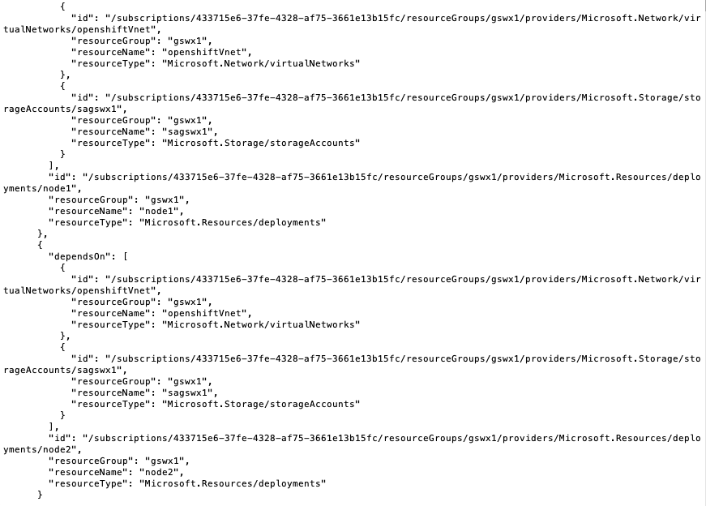

Slide 23
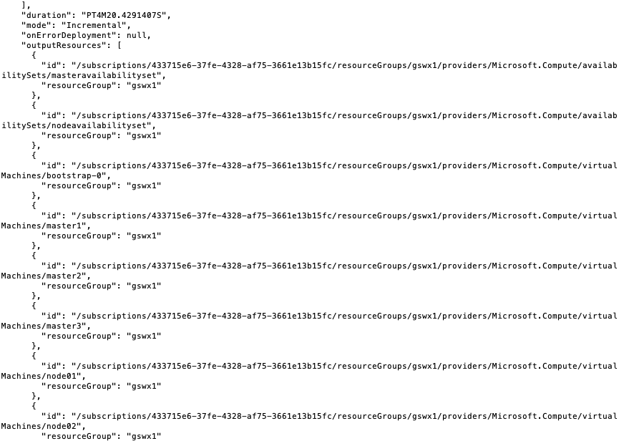

Slide 24
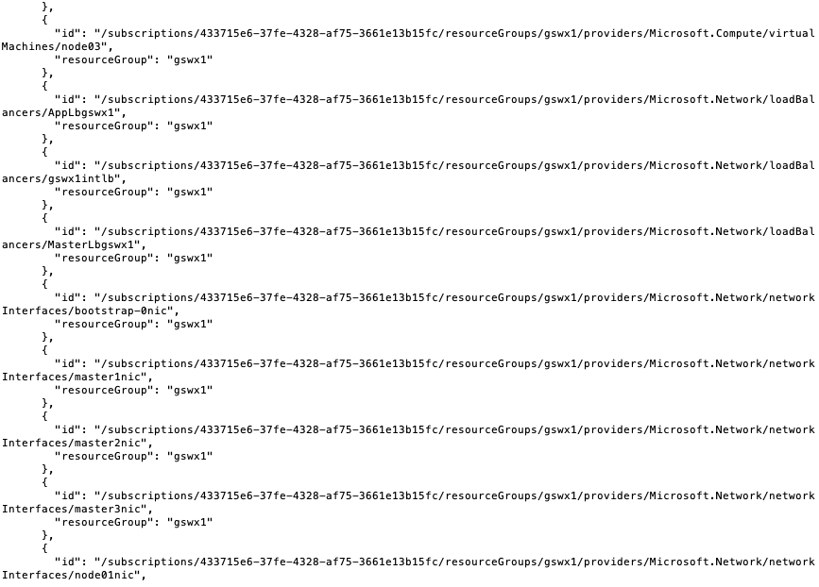

Slide 25
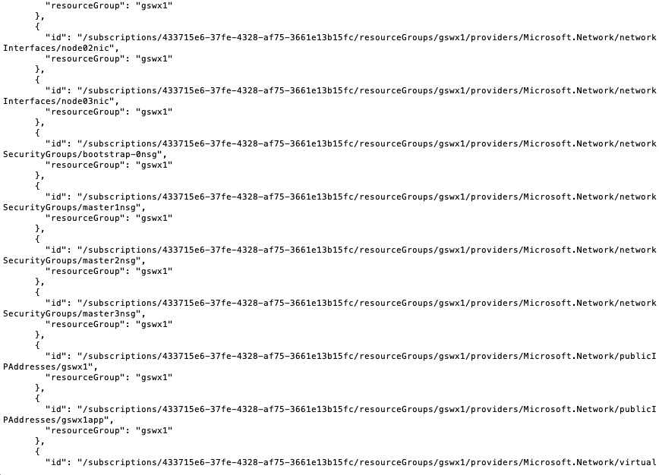

Slide 26
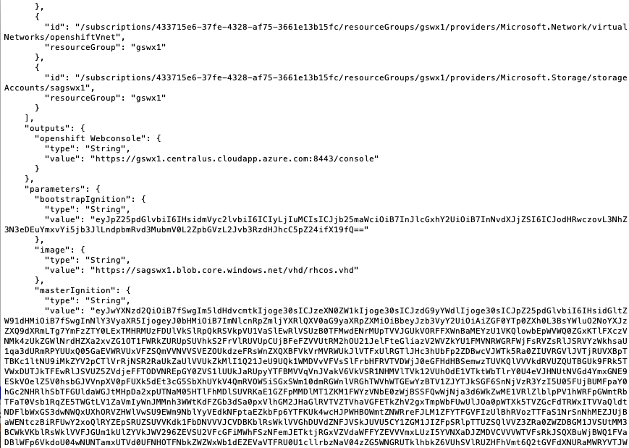

Slide 27
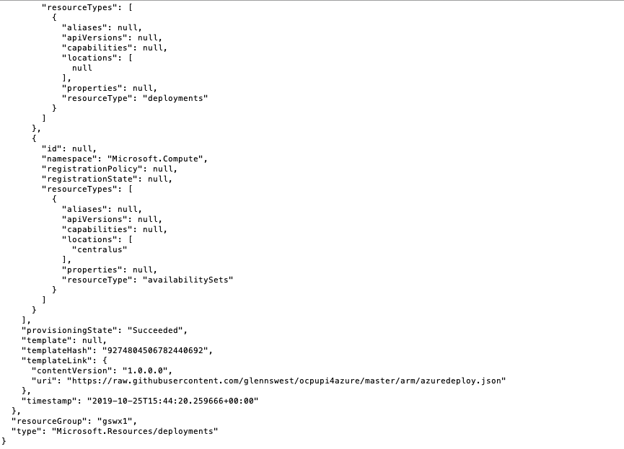

Slide 28
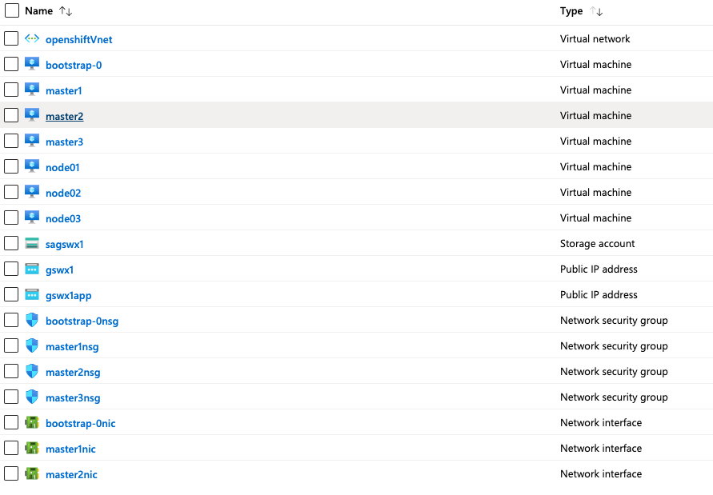

Slide 29
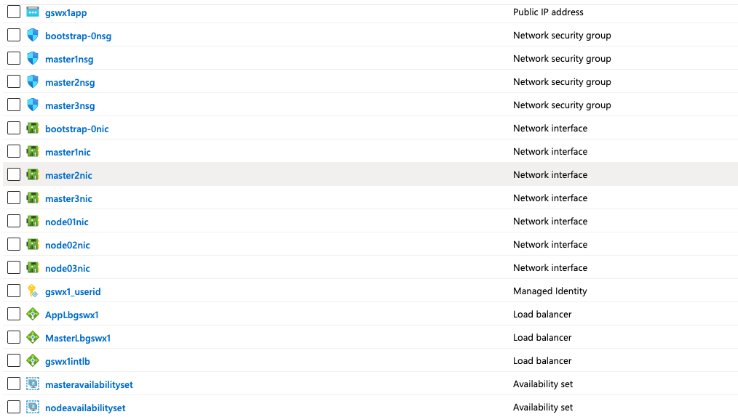

Slide 30
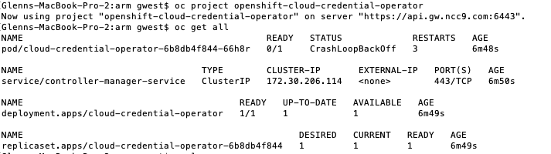
Cloud Credential crashed a few times

Slide 31
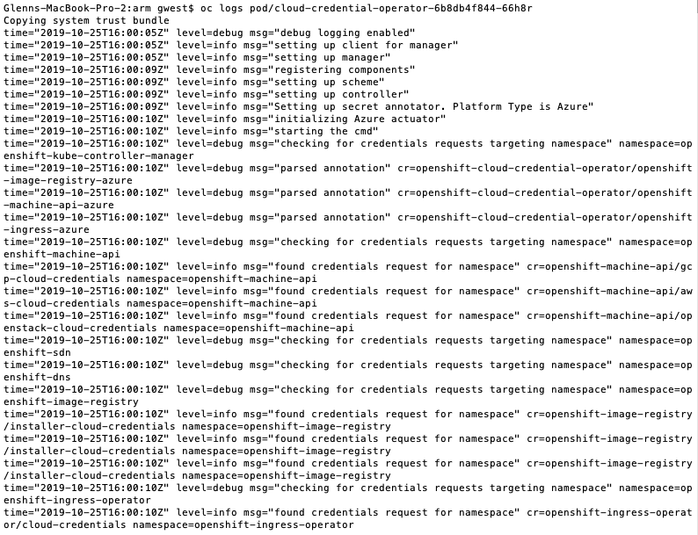

Slide 32
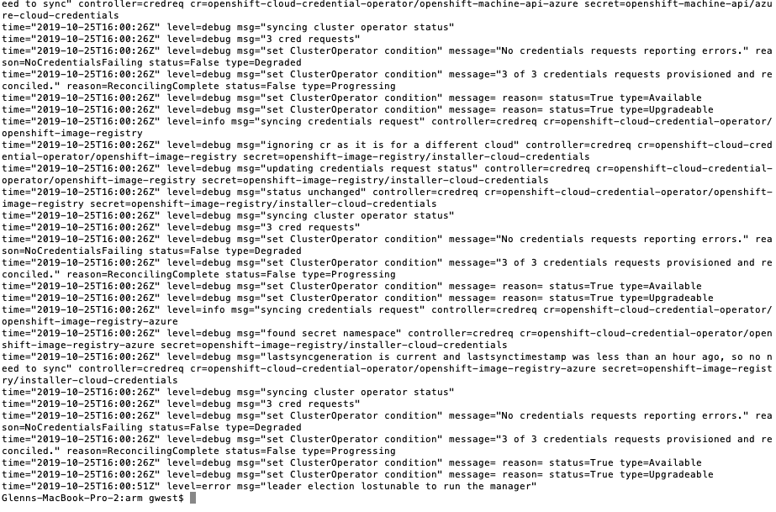

Slide 33
Current Status
Completed
Initial Overview Presentation Created – Will keep it updated
Initial Proof of concept on setup of cloud provider testing in progress
New Cards
Move to 4.3
Automate the manifests changes for identity, and resource group name

Slide 34
Resolved Issues
Resolved Issues
Cluster not booting due to manifests missing
Qouta issues resolved.
Blockers

Slide 35
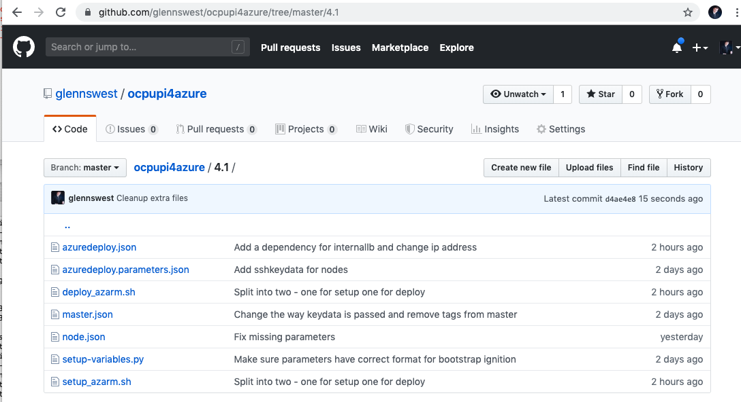
Where’s it at:
https://github.com/glennswest/ocpupi4azure/tree/master/4.1

