Slide 1

UPI ARM Sprint Demo
DEMO 2
gwest@redhat.com
Oct 11, 2019

Slide 2
WIP
Reconfigure internal load balancer to handle node boots - size 2
Fix wildcard app load balacer - size 2
Chance scripts to parametrise resource group name - size 1
Change to use 4.2 nightlies - size 2
Add azure cloud provider - size 3
Dns local or automation - size 2
Add bastion for debug - size 1
Work to support ci of azure arm upi - need help from someone who does ci
Cleanup of scripts

Slide 3
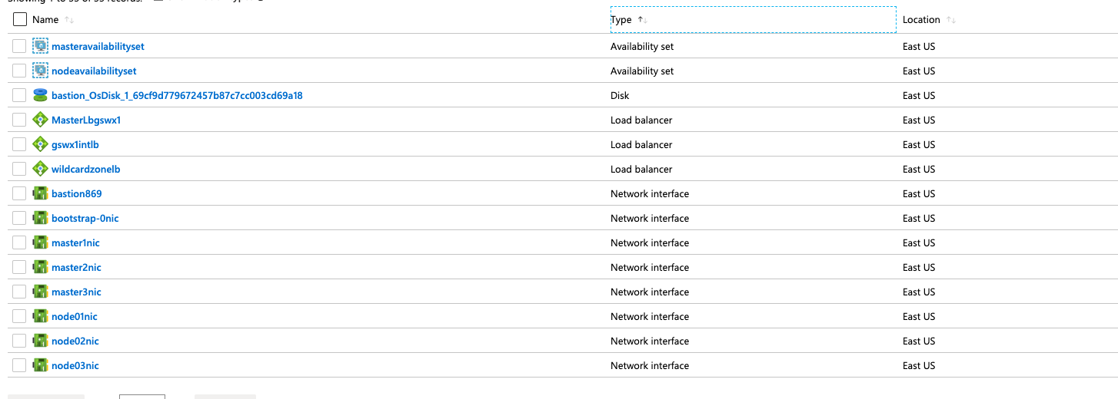
Internal Load Balancer – Created

Slide 4
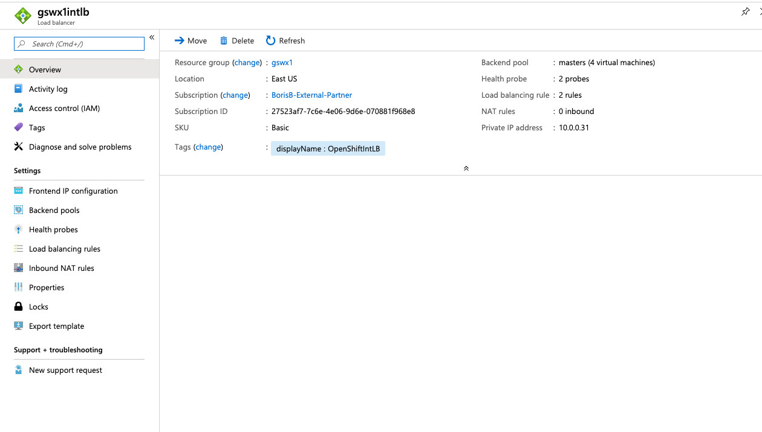
Internal Load Balancer - Working

Slide 5
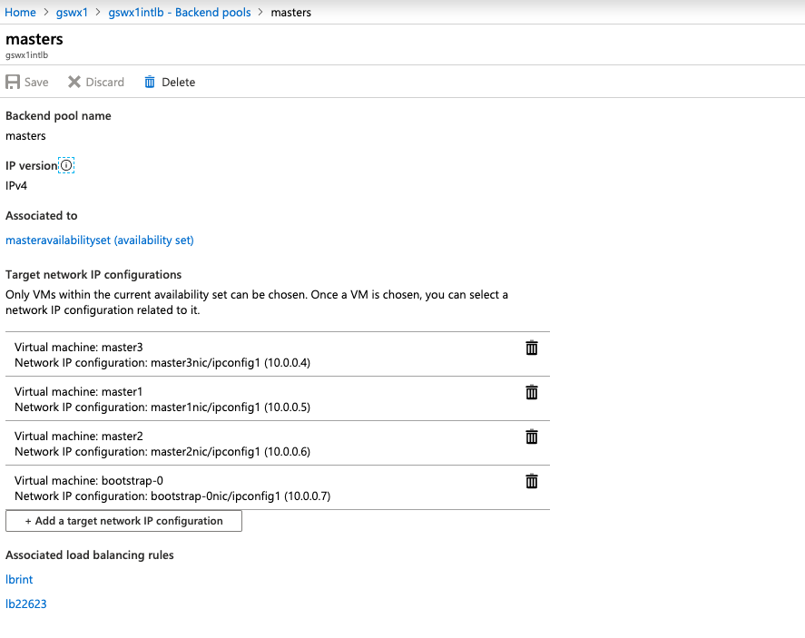
Internal Load Balancer – Backend Pool

Slide 6
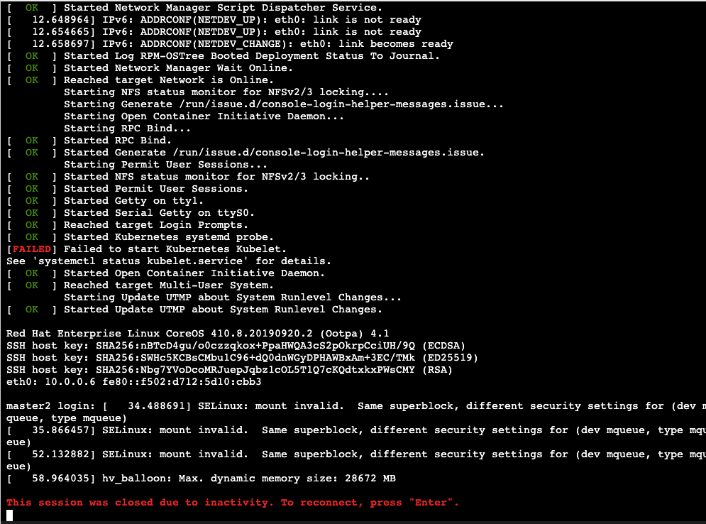
Kubelet Issue – 4.1 Flake?

Slide 7
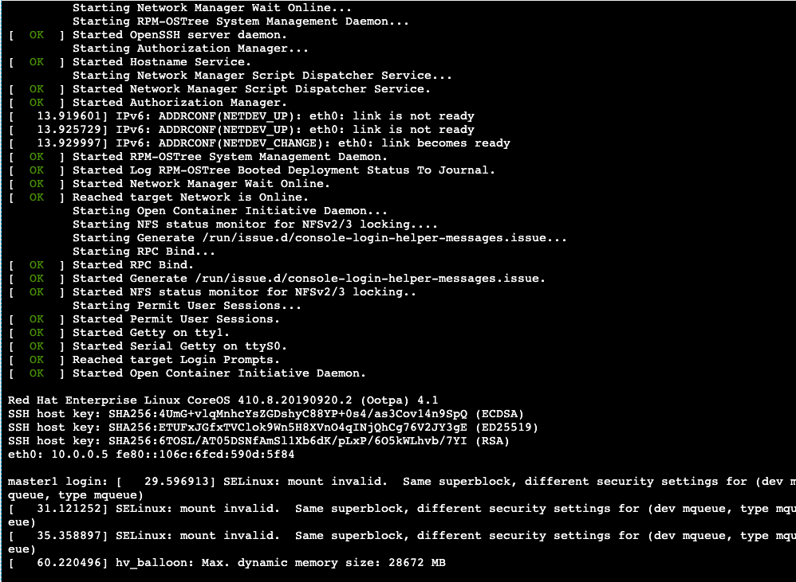
Other masters seem ok

Slide 8
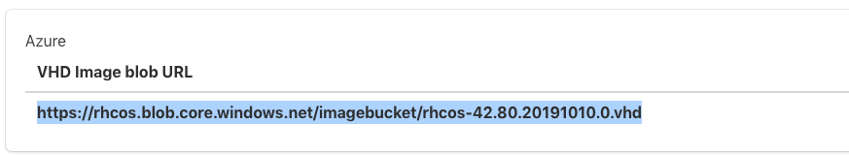
Azure VHD
Currently Azure (VHD) VM Images are just stored in a storage account
Every time you run the ARM template due to this we must “copy” the image into the resource group used by the ARM template
Note that a normal “RHEL” Image has a different mechanism, that effectively includes distribution of images to all av zones, and speeds up the vm spin up. (10-20 minutes of extra time for storage account)

Slide 9

Card – Parametertised scripts
Scripts have been changed to support giving the resource group on command line

Slide 10

Card – Move to 4.2
Changed Folder structure to be version independent
Added nightly build “Internal” script to pull installer
Changed rhcos version and storage account source
Change scripts to reflect above

Slide 11
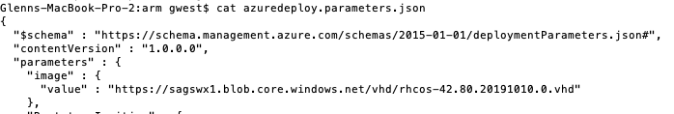
Change version of OpenShift for ARM UPI
Change the RHCOS Image name in azuredeploy.parameters.json
Change image variable in set_azarm.sh

Slide 12
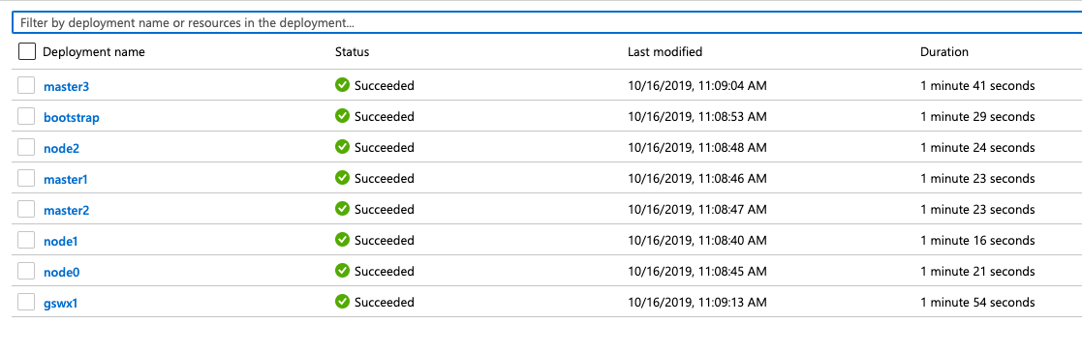
First 4.2 Nightly Deployment Success

Slide 13
Current Status
Working:
Internal Load Balancer is Fixed and Working
Not Done/Not Working:
Ssh not working to masters/nodes

Slide 14
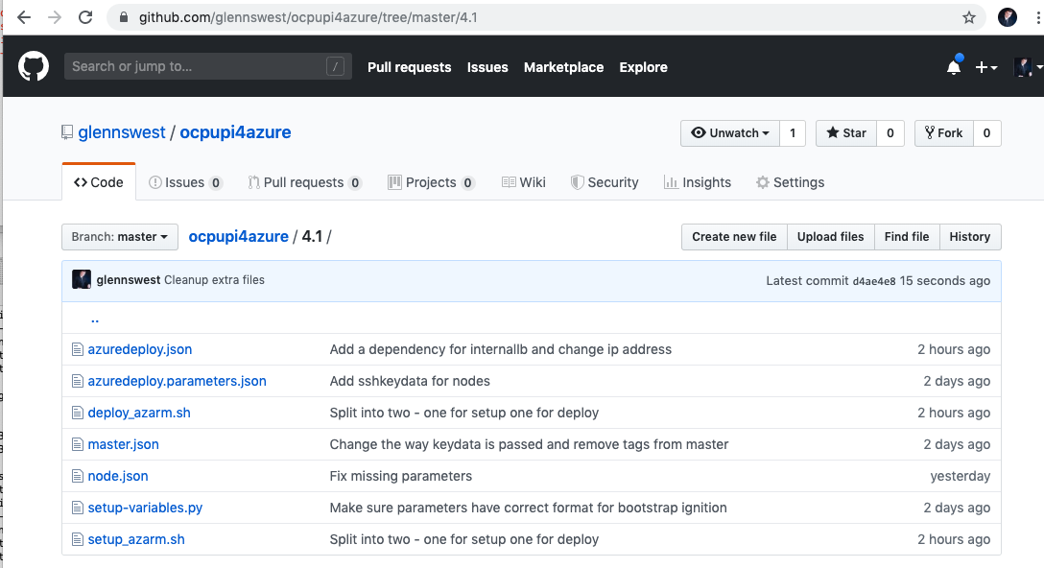
Where’s it at:
https://github.com/glennswest/ocpupi4azure/tree/master/4.1

